Slide 1

Sustainable Finance- Lecture 12
Lesson Title: Final Project & Presentation
Instructor: Dr. Mary Githinji

Slide 2

Overview of the Course
Introduction to the concept of Sustainable Finance
ESG Considerations When Making Financial Decisions
Strategies for Sustainable Investment
Green Bonds and Climate Finance
Climate Risk Assessment
Regulatory Frameworks in Sustainable Finance
Agri-Green Financing and Technology
Sustainable Banking & Lending
Role of Development Finance Institutions
Case Studies in Sustainable Finance
Ethical & Social Dimensions of Finance

Slide 3
Learning Outcomes
By the end of this final project, students will be able to:
Apply ESG risk assessment frameworks.
Critically assess and align financial strategies with selected SDGs.
Develop a financially sound and innovative sustainable finance solution.
Conduct a policy critique, identifying regulatory or institutional gaps and proposing improvements.
Communicate sustainable finance ideas effectively.
Collaborate effectively in teams, demonstrating project planning, shared responsibilities, and clear articulation of roles during the presentation.

Slide 4
WEEK 1: Introduction to the Concept of Sustainable Finance
Sustainable Finance aligns financial systems with long-term environmental, social, and economic goals.
It includes integrating sustainability considerations into investment, financing, and risk management decisions.
Key themes: climate change, social inclusion, resource efficiency.
Anchored in global efforts like the Paris Agreement and SDGs.

Slide 5
WEEK 2: ESG Considerations When Making Financial Decisions
ESG = Environmental, Social, and Governance factors.
ESG integration supports risk mitigation and long-term value creation.
Examples:
  E: Emissions, biodiversity, energy efficiency
  S: Labor practices, human rights, community impact
  G: Board diversity, transparency, ethics
Tools: ESG ratings, sustainability indices, materiality maps.

Slide 6
WEEK 3: Strategies for Sustainable Investment
Strategies include:
  Negative Screening (exclusion of harmful sectors)
  Positive Screening (investing in ESG leaders)
  ESG Integration, Impact Investing, Thematic Investing
Growing popularity of SRI (Socially Responsible Investment) and ESG ETFs.
Requires balancing financial return and positive impact.

Slide 7
WEEK 4: Green Bonds and Climate Finance
Green Bonds: Fixed-income instruments used to finance green projects.
Key sectors: Renewable energy, energy efficiency, clean transport.
Climate finance supports both mitigation and adaptation efforts.
Standards: Green Bond Principles (GBP), Climate Bonds Standard (CBS).
Role of sovereigns, MDBs, and corporates in issuing bonds.

Slide 8
WEEK 5: Climate Risk Assessment
Climate risks = Physical risks (e.g., floods, droughts) + Transition risks (e.g., carbon taxes, stranded assets).
Assessment tools: TCFD framework, scenario analysis, stress testing.
Financial institutions must disclose climate-related financial risks.
Integrating climate risk into valuation and asset pricing is now essential

Slide 9
WEEK 6: Regulatory Frameworks in Sustainable Finance
Rise of taxonomy regulations (e.g., EU Taxonomy).
Disclosure mandates: TCFD, SFDR, CSRD.
Central banks adopting green prudential regulations.
National and international policies shape investor behavior and capital flow.

Slide 10
WEEK 7: Agri-Green Financing and Technology
Focuses on sustainable agriculture and climate-smart practices.
Tools: Green credit, blended finance, crop insurance, carbon markets.
Digital technologies: Remote sensing, IoT, AI in precision farming.
Aligns food security with environmental conservation goals.

Slide 11
WEEK 8: Sustainable Banking & Lending
Involves integrating ESG in credit analysis, loan structuring, and portfolio management.
Products: Green loans, Sustainability-linked loans (SLLs).
Principles: Equator Principles, PRB (Principles for Responsible Banking).
Banks must manage ESG-related credit and reputational risks

Slide 12
WEEK 9: Role of Development Finance Institutions (DFIs)
DFIs provide long-term financing in underserved markets.
Catalysts for private investment in sustainable infrastructure.
Promote blended finance, technical assistance, and capacity building.
Examples: IFC, AfDB, DEG, FMO.

Slide 13
WEEK 10: Case Studies in Sustainable Finance
Real-world examples showcase practical application:
  Kenya’s green bond for affordable housing.
  IFC's green equity investments.
  Sustainability-linked loans in agribusiness.
Emphasize lessons on innovation, impact measurement, and risk-sharing.

Slide 14
WEEK 11: Ethical & Social Dimensions of Finance
Finance must be grounded in ethics, fairness, and social justice.
Address issues of financial inclusion, gender equity, and access.
Avoid harm through responsible lending, anti-corruption, and stakeholder engagement.
Shift from profit-only to purpose-driven finance.

Slide 15
WEEK 12: Final Recap and Reflection
Sustainable finance is essential for long-term economic stability and planetary health.
Professionals must balance returns, risks, and responsibility.
The field is evolving, requiring continuous learning and innovation.
Your role: Apply these insights to promote finance that serves people and planet.

Slide 16
Final Project & Presentation Guidelines
Project Title: Applying Sustainable Finance: ESG Risk, Policy Critique, and Market Innovation

Slide 17
Objective
To synthesize knowledge from the course by applying sustainable finance tools to a real or conceptual problem. Students will assess ESG risks, align strategies with SDGs, and offer financially sound and innovative solutions.

Slide 18
Project Components
Part A – Real-World Analysis
Each group selects an existing financial product, institution, or policy and:
Analyzes ESG risks and opportunities
Evaluates SDG alignment (at least 3 goals)
Reviews financial performance or market relevance
Provides a policy critique or improvement proposal

Slide 19
Part B – Strategic or Conceptual Design
Each group develops a new sustainable finance proposal, such as:
Green or Agri-finance lending model
ESG-based investment vehicle
Sustainable finance regulation or institutional strategy

Slide 20
Project Themes
Climate-Smart Agriculture Finance in East Africa
ESG Assessment of a Listed Green Bond
Designing a Microfinance Product with ESG Screening
Sustainable Lending Reform in Kenyan Banks
SDG-Aligned Pension Fund Strategy
Blended Finance for Renewable Energy Access

Slide 21
Must Include:
ESG metrics
Financial logic (risk-return profile, viability)
SDG alignment
Stakeholder identification
Implementation plan

Slide 22
Presentation Format
Duration: 15 minutes presentation + 5 minutes Q&A
Style: Creative academic-style
Tools Encouraged: PowerPoint, visual dashboards, graphs
Submission:
  Slide deck (PowerPoint or PDF)
  2-page Executive Summary (Word or PDF)

Slide 23
Timeline & Deliverables
Week | Task
Week 10 | Form groups and submit the project topic for approval
Week 11 | Submit a 1-page progress update
Week 12 | Final presentation + submission of materials

Slide 24
Grading Rubric (20%)
Criteria | Weight
ESG Risk Analysis & SDG Alignment | 25%
Financial and Strategic Soundness | 25%
Policy Insight and Critique | 20%
Innovation & Creativity | 10%
Presentation Quality (structure, visuals, clarity) | 10%
Collaboration & Q&A Handling | 10%

Slide 25
Conclusion
Ethical finance redefines value and purpose.
Requires integration of ESG, CSR, inclusive finance, and strong governance.
Future finance must serve people and the planet.

Slide 26
Reflection Questions
How has your view of finance changed?
What role will you play in building a more sustainable economy?

Slide 27

Sustainable Finance
A worthy cause/ or not?

Slide 28
Questions and Discussions?

Slide 29
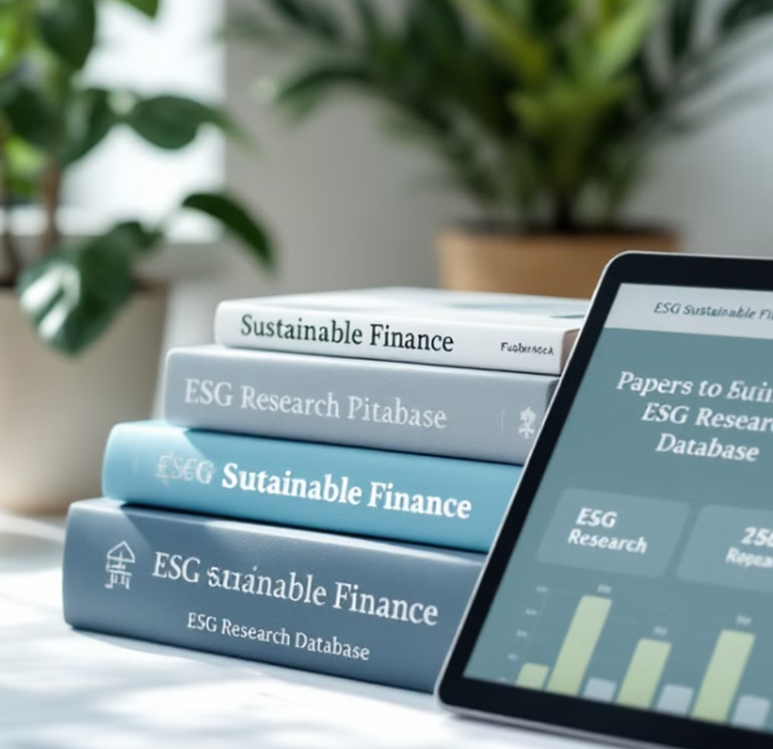
Suggested Readings & Resources
Jeucken, M. (2001)Sustainable finance and banking: The financial sector and the future of the planet.Routledge.
Vargas, C. (2021)Sustainable finance fundamentals.Springer.
Meo, M. S., & Staniewski, M. W. (2022) Green bonds and sustainable finance: The evolution of portfolio management in conventional markets.Palgrave Macmillan.
Grigg, N. S. (2021) Infrastructure finance: The business of infrastructure for a sustainable future.Wiley.

Slide 30
Thank you

