Slide 1
THE ENTREPRENEURIAL MIND
Concept of Entrepreneurship
Week 1
Lecturer:
Fidela Reyes Balajadia
Associate Professor 2
University of the Assumption, Philippines

Slide 2
Lecture Learning Objectives:
At the end of the lecture, you will be able to:
1. Define entrepreneurship in the context of small and medium scale industries.
2. Discuss theories that explain how countries grow economically.
3. Discuss the relationship between entrepreneurship and economic growth in the community.
4. Explain the socio-economic benefits from entrepreneurship.
5. Identify entrepreneurial competencies.
6. Assess the personal entrepreneurial characteristics of successful entrepreneurs vis-à-vis PECs.

Slide 3
What is Entrepreneurship?
Entrepreneurship as the process of creating something new with value by devoting the necessary time and effort, assuming the accompanying financial, psychic, and social risks and receiving the resulting rewards of monetary and personal satisfaction and independence. Actually, this is an old concept with a new flavor. Countries have developed through time , one term for producer, seller, and service provider, all lumped into one - - - “merchants”.

Slide 4
01
02
03
04
Creation of something of value
Devotion of necessary time and effort
Assumption of necessary risks
Getting rewards
Four Basic Aspects of Being an Entrepreneur:

Slide 5
Who is an Entrepreneur?
An entrepreneur is a person who starts and or operates a business. An entrepreneur is creative and innovative. He is a person who starts something new. An entrepreneur maybe male or female, young or old, professional, college graduate or school dropout, comes from A, B, C, D or E economic group. He is an owner-manager and willing to take risks. Usually, he is someone not willing to work for others. Instead, he wants others to work for him. Usually, his kind of business is also single proprietorship because he does everything from production to selling.

Slide 6
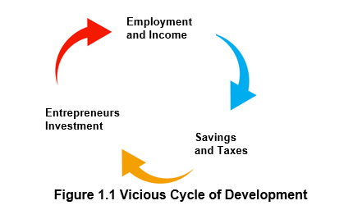
Banastao & Frias, 2022

Slide 7
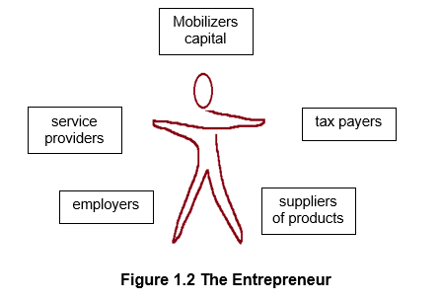
Banastao & Frias, 2022

Slide 8
Role of Entrepreneurship in Economic Growth
The government has three strategies to help MSMEs. They are:
1. Provide credit, technology, and marketing support to new enterprises from P24 billion in 2004 to P309.98 billion in 2010.
2. Tap overseas Filipino workers to invest their earnings in MSMEs.
3. Promote greater involvement of local government units (LGUs) in promoting small business activities by providing them with information on business opportunities, available
sources of funds, and the latest product design.

Slide 9
Role of Entrepreneurship in Economic Growth
In November 2002, RA 9178 was signed into law. RA 9178 or the Barangay Micro Business Enterprise (BMBEs) Act of 2002 provides five incentives and benefits are:
1. Exempt BMBEs from income taxes and encourage LGUs to exempt or reduce local taxes imposed on BMBEs.
2. Exempt BMBEs from coverage of the minimum wage law.
3. Improves credit delivery to BMBEs.
4. Provide for technology transfer, production and management training and marketing assistance to BMBEs.
5. Provides trade and investment promotion to BMBEs.

Slide 10
Entrepreneurship in Small and Medium Industries
Small and medium scale businesses are important in the country because of the following reasons:
1. They help provide the supply of products to customers.
2. They help provide personal service.
3. Small and medium-scale businesses serve as a means of earning money for an unemployed individual.

Slide 11
Entrepreneurship in Small and Medium Industries
4. The small and medium-scale businesses also provide employment for other people.
5. Small and medium scale entrepreneurs also pay taxes to the government, and such payment allows the government to provide services to the people. Some of these services are education, sanitation, peace and order, electricity, health, and others.

Slide 12
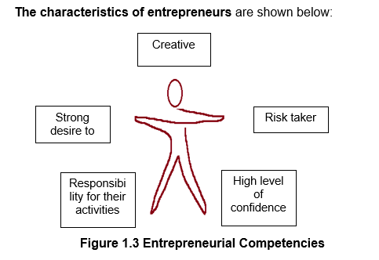
Banastao & Frias, 2022
Strong desire
To succeed

Slide 13
The rewards of entrepreneurship are:
01
02
03
Money or material return or profit
Freedom
Psychological rewards

Slide 14
Problems of Entrepreneurship:
1. Entrepreneurship demands hard work.
2. Entrepreneurship demands long working hours.
3. Entrepreneurship may
cause emotional stress.

Slide 15
Real Life Situations Where Entrepreneurial Competencies Are Applied
Here are seven entrepreneurs who, in their own ways, have demonstrated the applications of entrepreneurial competencies:
1. The Entrepreneurial Machinist
He started as an apprentice in a machine shop at age sixteen. By age twenty, he was producing tools and dies for large manufacturing companies. Then he concentrated on the production of umbrella parts and moved on to produce fly and mosquito nets when the
demand for umbrella parts had gone down because
of cheap imports.

Slide 16
Real Life Situations Where Entrepreneurial Competencies Are Applied
2. The Entrepreneurial CPAs
A group of certified public accountants have been operating a CPA review school for the last twenty-five years. They are book authors, practitioners, college professors, CPA reviewers.

Slide 17
Real Life Situations Where Entrepreneurial Competencies Are Applied
3. The Entrepreneurial Doctors
A group of doctors, most of them with their own specialization, invested money in, and for some actively run, a medical diagnostic laboratory catering to corporate and walk-in patients.

Slide 18
Real Life Situations Where Entrepreneurial Competencies Are Applied
4. The Entrepreneurial Lady
She started her business printing materials and examination booklets for the next-door university. In time, her mimeographing business grew to a bookstore with a student canteen. After a few more years, she became a book publisher. She was able to set up big business schools in four campuses in Metro Manila, all run by her children. Meanwhile, she continues manning the original site, the bookstore/student canteen and today still writes her cash vouchers and bank checks longhand.

Slide 19
Real Life Situations Where Entrepreneurial Competencies Are Applied
5. The Entrepreneurial Dermatologist
She has several cosmetic products patented in her name. To date her company continuously research for new products that are best suited for the Filipino skin. Her practice as dermatologist has been her priority even as she was attending to her cosmetic business where she heads the research and development department.

Slide 20
Real Life Situations Where Entrepreneurial Competencies Are Applied
6. The Entrepreneurial MBA (Master in Business Administration)
He was a young college professor in an exclusive girls’ school. That was soon after he graduated from one of the best MBA schools in Metro Manila. He put up a specialty restaurant which was an instant success. His classmates, convinced of his track record of making things happen, were encouraged to make cash investments in his ventures.

Slide 21
Real Life Situations Where Entrepreneurial Competencies Are Applied
7. The Entrepreneurial FrameMaker
He started a small shop laminating diplomas and certificates. Eventually, customers realized the disadvantages of lamination – that the document becomes yellowish after a while and laminated documents are blurred when photocopied. The customers opted to framing certificates. Moreover, framed cross stitch work became a fad, thus, our entrepreneur shifted business from wood lamination to the making of frames. His wife helps in doing cross stitch designs that they frame and sell. He also made arrangements with some schools to frame certificates of recognition/appreciation given to students or guests in seminars, hence his business is doing good.

Slide 22

10 Personal Entrepreneurial Characteristics (PECs) that lead to success. These are grouped into what are called the Achievement Cluster, the Planning Cluster, and the Power Cluster.
Achievement Cluster
This pertains to the desire of the individual to fulfill or to realize something. This desire is strong to an entrepreneur who will not stop at any obstacle but take such obstacles as challenges. Hence, the following characteristics are dominant in
him.

Slide 23
10 Personal Entrepreneurial Characteristics (PECs) that lead to success. These are grouped into what are called the Achievement Cluster, the Planning Cluster, and the Power Cluster.
Planning Cluster
An entrepreneur is clear on what he wants to achieve. He plans his every move because he knows that eliminated resources will be used. To make sure that the resources (money, materials, machinery, etc.) are efficiently used, he makes his move tentatively on paper, hence, the plan. A plan is a blueprint of the project that he wants to establish.

Slide 24
10 Personal Entrepreneurial Characteristics (PECs) that lead to success. These are grouped into what are called the Achievement Cluster, the Planning Cluster, and the Power Cluster.
Power Cluster
Power does not mean bossing around. This means the power to lead; to convince people of your ideas; the power to make people believe in you; or the power to persuade others, especially those with negative perceptions.

Slide 25
Achievement Cluster
2. Persistent
a. Take repeated or different actions to overcome obstacles.
b. Makes sacrifices or expends extraordinary effort to complete a task.
c. Sticks to own judgment in the face of opposition or disappointments
1. Opportunity Seeker
a. Perceives and acts on new business opportunities.
b. Seizes unusual opportunities to obtain financing, equipment, land, work, space, or assistance.

Slide 26
Achievement Cluster
3. Committed
a. Accepts full responsibility for problems encountered.
b. Helps own employees to get the job done.
c. Seeks to satisfy the customers.
4. Risk-taker
a. Takes moderate risks.
b. Prefers situations involving moderate risks.

Slide 27
Achievement Cluster
5. Values Efficiency and Quality Oriented
a. Always strives to raise standards and aims for excellence.
b. Strives to do things better, faster, and at a lower cost.

Slide 28
Planning Cluster
7. Information- seeker
a. Personally seek information on clients, suppliers, and competitors.
b. Seeks experts to render business or technical advice.
c. Uses contacts or information networks to obtain information.
6. Goal-seeker
a. Sets clear and specific short-term objectives.
b. Sets clear and long-term goals.

Slide 29
Planning Cluster
8. Systematic in Planning and Monitoring
a. Develops logical, step-by-step plans to reach goals.
b. Look into alternatives.
c. Monitors progress and switches to alternative strategies when necessary to achieve goals.

Slide 30


Power Cluster
10. Possess Strong Self-confidence
a. Believe in self.
b. Expresses confidence in own ability to complete a difficult task or to meet a challenge.
9. Be persuasive and Good in Networking
a. Uses deliberate strategies to influence or persuade others.
b. Uses business and personal contacts to accomplish objectives.

Slide 31
Other Factors to Consider
Personal Interest
Government Support/Assistance Programs
Knowledge/Talents
Training/Work Experience
01
02
03
04

Slide 32
Other Factors to Consider
Rate of Growth of Business
Other Considerations
05
06

Slide 33
High need for achievement. Here lies the strong desire of an individual to pursue his dream, a dream that could be long-range or immediate. His dream keeps on flashing in his mind until he makes a move for it to be realized.
The Entrepreneurial Personality

Slide 34
2. Strong belief that they can control their destiny. William Jennings Bryan said, “Destiny is not a matter of change, it is a matter of choice; it is not a thing to be waited for, it is a thing to be achieved.” Indeed, it is!
The Entrepreneurial Personality

Slide 35
3. Risk-taker. Risk is present in every activity, but it can be lessened. Business risk can be learned or avoided by careful planning, insurance, and being alert of what is happening around. Poultry farm pest, for example, can be avoided by vaccination or selling the entire herd in case of epidemic in a nearby farm.
The Entrepreneurial Personality

Slide 36
Reference:
Entrepreneurship, Cristina B. Banastao and Solita A. Frias, Unlimited Books Library Services & Publishing Inc.
2022

Slide 37
THANKS!
PLEASE KEEP THIS SLIDE FOR ATTRIBUTION

