Slide 1

THE ENTREPRENEURIAL MIND
Entrepreneurial Activities
Week 2
Lecturer:
Fidela Reyes Balajadia
Associate Professor 2
University of the Assumption, Philippines

Slide 2
Lecture Learning Objectives:
At the end of the lecture, you will be able to:
1. Describe trading, manufacturing, and service as entrepreneurial activities.
2. Distinguish the different types of trading, manufacturing, and services.
3. Discuss specific examples of trading, manufacturing, and service activities.
4. Explain how the activities related to trading, manufacturing, and service businesses affect their success.
5. Recognize the importance of trading, manufacturing, and service in the economy.
6. Appreciate the value of creativity in manufacturing.
7. Form sound judgment in selecting the products to trade, products
to manufacture, and services to render.
8. Appreciate the value of service business.

Slide 3
Types of Businesses
01
02
03
Trading or merchandising
manufacturing
service

Slide 4
Trading or merchandising is the buying of goods and selling the same without change in for. When goods are sold in small quantities, it is called retailing. When goods are sold in big quantities or in volume, it is called wholesaling. The process of buying and selling is also called trading or merchandising. A common example of retailing is the “sari-sari store”. Most retailing is done in retail stores.

Slide 5
Manufacturing is the process of converting raw materials into finished products. The manufacturer buys the raw materials. He makes the raw materials to finished products by applying direct labor and factory overhead.
·

Slide 6
Raw Materials are what you see in the completed product.
Direct Labor is the work on raw materials as it is converted into finished product. Direct labor is the work of the carpenter on the wood to convert wood to furniture. Direct labor is the work of the sewer when leather is made into handbags.
Factory overheads are the resources needed or costs that need to be paid for in making products other than raw materials and direct labor.

Slide 7
Service business is doing work for others. Examples of service businesses are beauty parlors, spas, barber shops, laundry shops, and repair shops. Medical, dental, accounting, legal and other services of professionals are also examples of service businesses.

Slide 8
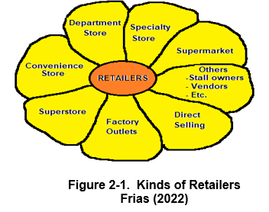

Slide 9
1. Department Store carries a wide variety of product lines usually clothing, shoes, bags, beauty products, home furnishings, and household goods.
2. Supermarkets sell a variety of food and household products.
3. Specialty Stores carry a variety of models for one kind or limited product line.
4. Convenience Stores are stores that carry high turnover goods, twenty-four hours a day and seven days a week.

Slide 10
5. Superstores which are larger than supermarkets and department stores have emerged.
6. Factory Outlets of different manufacturers are grouped together in one factory outlet mall. The outlets are located in places far from the cities. When the customer goes to the factory-outlet mall, he will have varied choices.
7. Direct Selling is one-on-one selling. One seller approaches a buyer. Many times, the buyers are friends or relatives of the seller.

Slide 11
Different Types of Trading Business
The different types of trading business are store trading and non-store trading.
Store trading is classified as to:
A. Amount of service
1. Self-service
2. Limited service
3. Full service

Slide 12
Different Types of Trading Business
B. Product line
1. Specialty store
2. Department store
3. Supermarket
4. Convenience store
5. Superstore
6. Combination store
7. Hypermarket
8. Service business

Slide 13
Different Types of Trading Business
C. Retail prices
1. Discount store
2. Off-price retailer
3. Factory outlet
4. Independent off-price retailer
5. Warehouse club
6. Catalogue showroom

Slide 14
Different Types of Trading Business
D. Control outlets
1. Chain store
2. Retailer cooperative
3. Franchise
4. Merchandising conglomerate

Slide 15
Different Types of Trading Business
E. Type of store cluster
1. Central business district
2. Shopping center

Slide 16
Different Types of Trading Business
Non-store retailing include:
A. Direct marketing
1. Door-to-door retailing
2. Automatic vending
B. Direct – mail marketing
C. Catalogue marketing
D. Telemarketing
E. Television marketing
F. Electronic marketing

Slide 17

Effects of Trading in Business
Trading cannot be avoided. Wherever you go, even in rich countries, people buy in retail. In retail business turnover of goods is fast, thus, money inflow is also fast. Imagine products on the shelves that have been standing there for about a week. Such products are occupying space and if your establishment is air-conditioned, you are, in effect, spending for the cooling of such products. Compare these with those products that stood only for a couple of hours on the shelves and then will need replenishment. It means shelf cost is very limited and your cash drawer has plenty of cash.

Slide 18
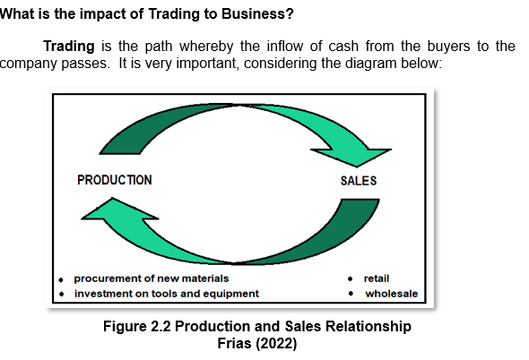

Slide 19
In a nutshell, the following are the benefits of retailing:
1. Retailing allows the fast movement of products. Product price is discounted if the buyer will buy several or in combination with other products to encourage customers to buy.
2. It encourages people to buy more by giving preferential benefits to customers.
3. Enhances buyer-owner relationship. This is because some sellers are very friendly and thus encourage people to buy from them every time, they need the product.

Slide 20
4. Low budget families would be able to buy products in small quantities.
5. Retailing is the answer for small buyers whose need is only for a couple of days for a small family.
6. Retailing is a business strategy. In grocery stores, slow moving products are packed with a toy to make the product saleable. Another strategy is the offering of credit cards to be able to move/sell goods or services.

Slide 21
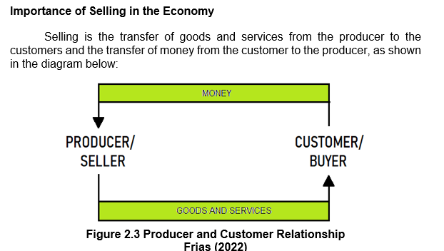
—Someone Famous

Slide 22
When an entrepreneur decides to go into business, he has to consider several factors. Some of these are:
1. Capital – How much capital is available for tools, equipment, machines, raw materials, payment for wages, overhead and other expenses.
2. Production space – How big/small is the space? Where is it? Is it owned or leased? If leased, how much is the rent? What are the terms for leasing the property?
3. Storage for materials and finished goods – Is there a space for storing materials and finished goods?

Slide 23
4. Labor costs and labor supply – Is there a ready supply of qualified workers? What is the prevailing wage rate in the area?
5. Factory overhead – How much, more or less, would be the factory overhead given the cost of utilities like water and electricity and other costs?
6. Cost of manufacturing – If the cost of manufacturing would be higher than that of the competition, then perhaps manufacturing is not the right venture.

Slide 24
7. Technology – To produce a product, technology should be available.
8. Availability of raw materials – this is vital. No product will be produced without the materials.
9. Competition – As mentioned, if the producer will produce at a higher cost compared to his competitors, selling price will be high, causing a difficulty in moving the products.

Slide 25

However, in spite of the high financial and complex operational requirements of a manufacturing enterprise, many entrepreneurs venture into it because of the following reasons:
1. the desire to earn more.
2. low manufacturing cost.
3. well-planned sales.

Slide 26

What is Manufacturing?
Manufacturing is the process of converting raw materials into finished products. The manufacturers buy the raw materials. He makes the raw materials into finished products by applying direct labor and factory overhead.

Slide 27
There are many kinds of manufacturers in the country. Some of these are:
Ø manufacturers of shoes/footwear specially in Liliw and Marikina
Ø canned goods manufacturers
Ø manufacturers of soap and toiletries
Ø manufacturers of food products
Ø manufacturers of garments or RTWs
Ø manufacturers of school and office supplies
Ø manufacturers of glasswares, silverwares and china wares or kitchenwares
The above is a list of general classifications. For example, canned goods can be subdivided into:
Ø sardines
Ø canned fruits
Ø beverage – juices, soft drinks, etc.

Slide 28
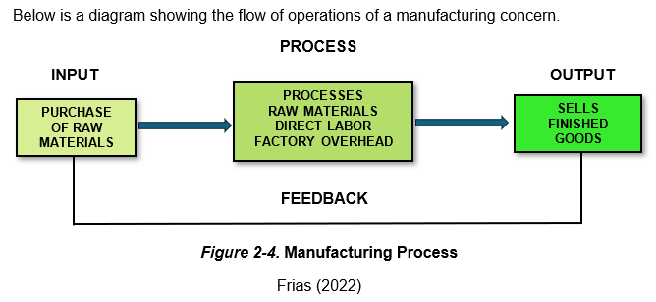
rribly hot

Slide 29

Role of Manufacturing in Economic Development
Aside from selling, manufacturing is the other dimension in economic development. No product will be sold without producing it. In the process of producing the products, exchange also takes place. Raw materials will have to be purchased and labor will have to be paid plus all other expenses

Slide 30
Generally, manufacturing entails the following costs:
Manufacturing cost or production cost is the sum of the cost of direct materials, direct labor, and factory overhead. During the accounting period, that part of the manufacturing cost which represents work completed is transferred to the Finished Goods Inventory, whereas incomplete work remains in Work in Process.

Slide 31
The elements of manufacturing cost are:
Direct Labor
Direct Materials
Factory Overhead

Slide 32
On the opposite side of the direct costs are the indirect costs, namely:
Indirect Labor
Indirect Materials
Other Indirect Expenses

Slide 33
Importance of Manufacturers
Manufacturers of products are important because of the following reasons:
1. considering the expenses and receipts of manufacturers, they contribute to the movement of the economy;
2. manufacturers provide the supply of products needed by the people like canned milk or powdered milk, clothes, bags, etc.
3. manufacturers provide employment and income to the households.
4. they pay taxes to the government which are used by the government to finance its projects and pay for salaries of government employees.

Slide 34
Creativity in Manufacturing
The availability and the production of new products in the market can be attributed to manufacturing. Since manufacturing is the process of transforming raw materials into finished products, it allows for the creative talents of an individual/manufacturer to manifest. Many kinds of products in different designs owe its production to the creativity of manufacturers.
Manufacturers need to be creative to meet the ever-changing demand of the customers.

Slide 35
How Can An Individual Be Creative?
Creativity is developed by being observant
Creativity is developed by imagination
Creativity is developed because of external conditions

Slide 36
Why Should Manufacturers Be Creative?
Manufacturers need to be creative because of the following reasons:
To be competitive. Manufacturers need to be creative to be competitive . If you do not introduce products that are different and affordable, sooner or later, you are going to be out of business.
To meet the needs of customers. Customers are very choosy and fickle minded. They do not buy the same product for long. They want to try new things. Hence, manufacturers need to be creative.

Slide 37
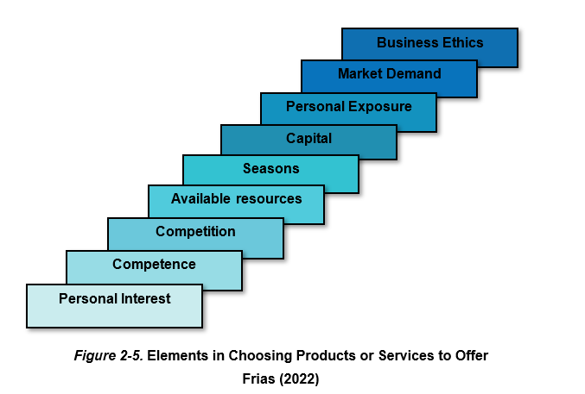

Slide 38

What is a service business?
Service business is doing work for others. It is a kind of business that sells services. The service offered could be the service of a single individual, like the one who fixed your leaking faucet, to the sophisticated services of hotels and banks.
Concepts can now be sold! Your idea as to how a product should be marketed commands a price. Your artistic talent as to how a garden should look has also a tag price.

Slide 39
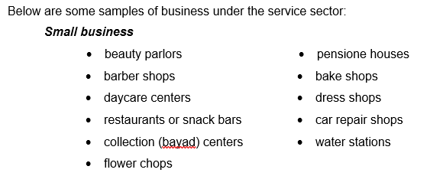
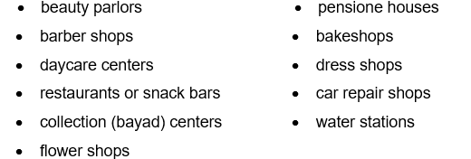

Slide 40
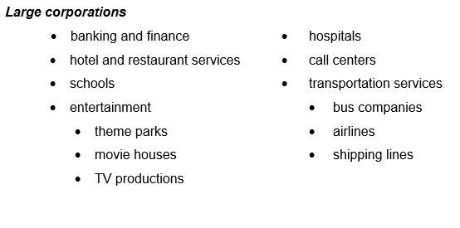

Slide 41
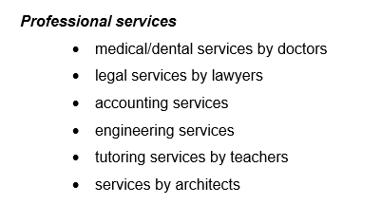

Slide 42
Benefits of Services Business
The easiest way towards becoming an entrepreneur is to render personal service to customers. Plumbers, for example, do home repairs and as the magnitude of the work becomes great, they hire people to work them as helpers. As these helpers learn the task, they too enter into an agreement to work on plumbing projects, hence, knowledge and skills multiply, and more people become self-employed.
Observe the street food vendors selling noodles, goto, boiled eggs, banana que and other street foods. As sales increase, more are encouraged to do the same business. Thus, they mushroom on the streets. Eventually, others put up a more presentable place for people to eat their snacks, which, looking beyond, means more people are hired and are provided with employment and income.

Slide 43
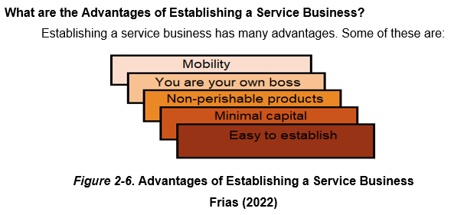

Slide 44
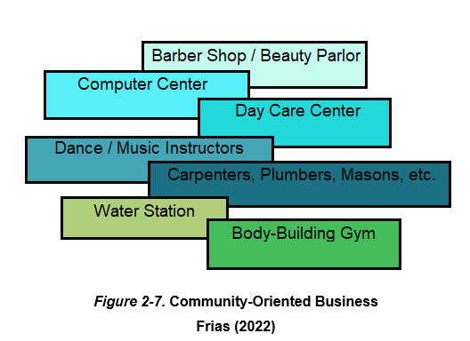

Slide 45
Importance of Service in the Economy
As explained in the previous topic, the economy moves through the process of exchange, while manufacturers exchange products for money, service business exchange service for money. Both sectors are helping the economy move through the exchange of goods and services. If we stop one and depend on the other only, the economy will weaken because without employment, income will fall. Considering the multiplier effect, this will result to the vicious cycle poverty which is the people of the vicious cycle of prosperity, to wit:

Slide 46
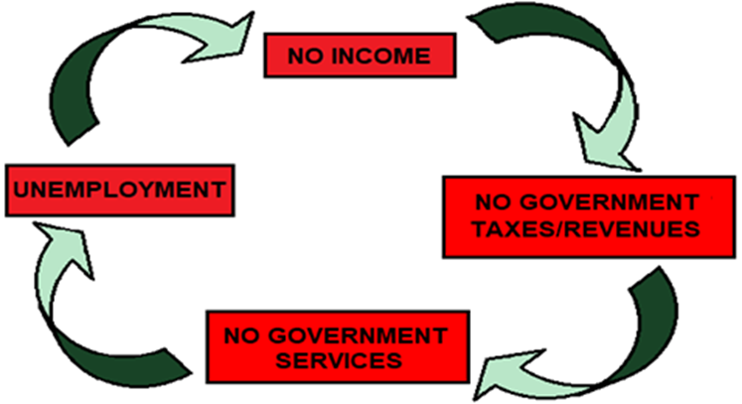
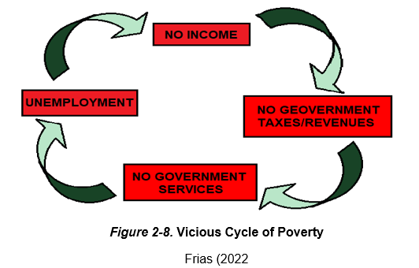

Slide 47
Services are important because of the following basic reasons:
It allows people to travel and communicate with each other
01
02
03
04
It helps move the economy
It makes life not only pleasant but also comfortable
It makes products available

Slide 48
Service – Manner of Delivery
Service may be delivered by people or by machines. They are consumed by the customer as they are produced by the server. A doctor treats a patient, a teacher teaches a student, a lawyer counsels a client. A viewer sees a movie, a passenger rides a taxi, a caller uses the telephone line. Some services are delivered by machines.

Slide 49
Services – Types of Organization
Services may be provided by profit or nonprofit organizations (NPO). There are schools that are nonprofit organizations and there are also those that are for profit. There are hospitals that are organized for profit and there are also those that are NPO’s. Most television stations are for profit, and there are also those that are non-profit. Most loan grantors are for profit but there are also those that are non-profit. Even individual service providers allot time for free services. Some doctors provide free medical service in their parish churches on specific days in a week, lawyers provide free legal assistance, teachers teach for free to prisoners at the national penitentiary, retired business executive serve like “big brothers” to small businesses.

Slide 50
Services – Sponsoring Organizations
There are many organizations providing services to the public. Aside from the providers mentioned in the preceding section, some organizations are formed mainly to sponsor or serve other organizations or to serve their members

Slide 51
Reference:
Entrepreneurship, Cristina B. Banastao and Solita A. Frias, Unlimited Books Library Services & Publishing Inc.
2022

Slide 52

Thanks!
Please keep this slide for attribution

