Slide 1

THE ENTREPRENEURIAL MIND
Business Planning
Week 4
Lecturer:
Fidela Reyes Balajadia
Associate Professor 2
University of the Assumption, Philippines

Slide 2




Lecture Learning Objectives:
At the end of the lecture, you will be able to:
Discuss the importance of a business plan
Enumerate the components of a business plan
Conduct environmental scanning
Design a production plan
Determine the financial needs of the proposed business plan
Analyze the feasibility of the proposed business plan
Write a business plan

Slide 3
Planning the Business to Establish
Planning is the defining of goals for future organizational performance and deciding on the tasks and resources needed to attain them.

Slide 4

1.) Product Planning
2.) Process Planning
Involves determining:
How the product meets customers’ needs,
How long it takes for the product to make and market, and
The total cost to the customer
Deals with determining the specific technologies and procedures required to produce a product or service.

Slide 5
f. Supplies
g. Location of company’s other facilities
h. Peace and order condition
i. Government laws, rules and regulations
j. Environmental regulation
k. Host community
l. Competitive advantage
3.) Facility location planning
Deals with the identification of the place where the manufacturing process will be situated.
Proximity or nearness to customers
Business climate
Total costs
Transportation facilities
Quality of labor

Slide 6
4.) Facility layout planning
Objective or purpose of the system in terms of output and flexibility
Product and service demand
Number and volume of operations
d. Space availability
Involves the placement of departments, workstations, machines, inventory storage, within the factory.

Slide 7
5.) Job planning or
job design
d. Working time
e. Reason for hiring
f. Performance
measurement
g. Motivation
h. Training
Is the function of specifying work activities of an individual or group in an organizational setting.
Tasks to be done
Qualification of worker
Physical location

Slide 8
Ways of Promoting Sales
Marketing, the activity involved in moving products from the manufacturers to the customers is divided into 4 P’s, namely: promotion, product, price and place.
Promotion in its broad definition means telling the target market about the product.
Personal selling involves direct communication between sellers and potential buyers.
Mass selling is communicating with a large group of buyers at the same time.

Slide 9
Ways of Promoting Sales
The communication with large groups of buyers may be done through advertising or through publicity.
Advertising is paid form of presenting the product while publicity is not paid for.
Sales promotion in its narrow definition, refers to activities that stimulate interests, trial or purchase by final customers.
The objectives of promotion are (1) to inform, (2) to persuade and (3) to remind.

Slide 10

Here are the different means of advertising,
publicity and sales promotion:
Advertising
Publicity
Sales Promotion
Magazines
Newspapers
Radio
TV
Signs
Direct mail
Press conference
Talk shows
Human interest
Write-ups
Articles in trade magazines
Coupons
Contests
Trade shows
Sporting news
Samples
Catalogues
Flyers

Slide 11
Creative Pricing
Notice how creative entrepreneurs increase sales in the pricing of their products. Look around and you will be amazed to hear and see the way products are priced.
At the entrance of a Metro Manila residential subdivision, the ambulant vendor of the vegetables has only one price. Everything sells at ten pesos (₱10); a pack of garlic, a pack of onions, a bunch of string beans, a slice of squash, a piece of ampalaya, a pack of tomatoes, among others. The customer shells out ₱10, ₱20, ₱30 for her purchase, no bargaining, then heads for home.
The prices at multiples of ₱10 are generally higher than when buying is done in the wet market or in the supermarket. The business has been going on for a long time. Very likely,
both seller and buyer are happy with the set-up.

Slide 12
Creative Pricing
B. A colorful banner in front of a bakery announces
₱10 for 12 pieces of any ₱2 bread
₱2 x 12 is ₱24 but if the buyer buys a dozen, he gets a ₱4 discount.
C. In the ground floor of a Makati Building, this seller of home-made snack food: macaroons, brownies, puto, cuchinta, pastillas and the like, packed in styro plates inside transparent plastic bags, sells her product at 3 for ₱100. Very seldom would the buyer ask the price of 1 pack nor buy one pack only.
Often, the buyer gives ₱100 and selects an assortment of 3 packages. The seller does not stay long in one building. She moves from one building to the next. Usually, she comes back only after several weeks.

Slide 13
Creative Pricing
D. A restaurant where customers eat and would spend ₱100 to ₱150 per seating had this poster that says,
“Merienda, eat all you can at ₱75 from 2:00 PM to 5:00 PM.”
Many customers come at 2:00 PM to avail of the special price.
E. An ophthalmologist charge consultation fee of ₱600 (by appointment only) in a popular hospital, ₱400 (first-come, first-served) in his clinic across the hospital, and ₱200 in a health card clinic not far away. The quality of his consultation does not go up or down in relation to the fees charged.

Slide 14



Consumer’s Evaluation of the Purchase Process
Buying decisions are influenced by availability of income. Since many consumers do not have enough income to buy everything they want, they want to make sure that they make the “best buy” out of available money.

Slide 15



The factors that guide consumers in the purchase process are:
Price
2. Product
Quality
3. Convenience
4. Impact of
Promotion

Slide 16
Consumer’s Evaluation of the Purchase Process
“Value for money” is a valuable guide to the consumer in making a purchase. However, a customer may be willing to buy the product because it is available here and now even when it is priced higher than one available tomorrow and from a distant place. Product efficiency is another major consideration.

Slide 17
Physiological needs are:
Food
Drink
Rest
Sex
Safety needs are concerned with protection and physical well-being like:
Health food
Medicine
Exercise
Social needs are concerned with an individual interaction with others like:
Love
Friendship
Status
Esteem
Personal needs are concerned with the need for personal satisfaction, unrelated to what others think or do like:
Self-esteem 4. Freedom
Accomplishment 5. Relaxation
Fun
The physiological, safety, social and personal needs of consumers are:

Slide 18
Consumer’s Evaluation of the Purchase Process
Moreover, consumers’ buying is also largely influenced by attitudes and psychology. Buying is also affected by relations with other people like family, social class, culture and other groups.

Slide 19

Good Location and Workplace
Listed in the section for facility of location planning are the criteria for selecting a site for a business.
Home-Based Business
For varied reasons, the business may be home-based. We see lot of cottage industries that are home based. Some entrepreneurs leave their corporate employment to be close to their young children. They put up their home-based businesses with plans of moving to other work site as their businesses grow.

Slide 20
Meeting Financial Requirements
The financial requirements of the business will depend upon the nature of the business and the nature of the product. A direct door-to-door selling activity, for example,may require a very small capital for the sales agent/trader.

Slide 21
Meeting Financial Requirements
The trader buys the product from the supplier/producer of goods on cash or credit basis, sells them also on cash or credit basis. The credit terms are short so the cash comes in fast and also is paid out to the supplier within short periods.

Slide 22
Meeting Financial Requirements
Will last for a long period of time
This is the cash requirement in the first few months from the formation of business.
1. Fixed Capital
2. Working capital
For land, building, rental deposits, improvements, machinery, equipment, furniture and tools.
For day-to-day operations until cash comes in from regular business.
It is the amount paid to lawyers & accountants in the writing contracts/agreements and fees paid to government offices to register the business.
3. Organization costs/expenses
4. Contingencies or
unforeseen costs
This may be estimated amount for reserve for contingencies or unforeseen events.
This is the cost of putting up the legal business entity.

Slide 23
The Sources of Cash
Cash may come from any of the following:
The personal money of the entrepreneur
Loans from relatives and friends
Loans from banks and other lending institutions
Investors
Government assistance programs
Non-government Organizations (NGO)

Slide 24
Rules for Sound Financing
An entrepreneur should be guided by sound financing rules such as:
Know the cash requirements
Know the best terms
Know how and when to pay
Owner’s investments should be more than the borrowings
If borrowings are needed for fixed assets or working capital
  Finance fixed assets from long-term borrowings
  Finance working capital from short-term borrowings

Slide 25
Project Feasibility Study
A feasibility study is an activity designed to find out what is feasible, achievable, attainable, practicable or workable. In the graduate schools of business, project feasibility studies are among the standard course requirements, while in many colleges of business, project feasibility studies are among the requirements for graduation.

Slide 26
Product feasibility studies are needed by:
Management
2. Investors
4. Government
Agencies
3. Lenders

Slide 27
Project Feasibility Study
Management need feasibility studies when they have to decide on new products or when they have excess funds to invest.
Investors, like top management in number 1, would want to put in money where the rate of return is high. Such rates of return may not be limited to financial rate of return. They may also emphasize environment and social outreach.

Slide 28
Project Feasibility Study
3. Lenders need to know if the borrowers are capable of paying the loans that will be granted to them.
4. Government agencies need to know the details of government projects before funds are released.

Slide 29
The Executive Summary presents the highlights of the study that are shown in detail in the different sections. The executive summary presents the conclusions arrived at on the feasibility of the project. This part is very important.
Executives are too busy and usually do not have the time to read a lengthy report. But, they would like to pick-up the “gist” of the study and make a quick decision whether the feasibility study is worth considering.
The project background and history discusses the proponents of the project or the owner of the project. This section states the name of the business. It states the form of the organization, whether sole proprietorship, partnership or corporation.
Parts of
the
Feasibility
Study

Slide 30
3. The industry study involves the analysis of threat of new entrants and substitutes and bargaining power of buyers and suppliers as shown in the figure below. The study will determine the intensity of competition within the industry. The industry study will guide you if it is still advisable to go into a business like Jollibee or like the neighbourhood sari-sari store.
Parts of
the
Feasibility
Study
Threat of New Entrants
Bargaining Power of Buyers
Bargaining Power of Suppliers
Business Project
Threat of Substitutes
(Banastao & Frias, 2022)

Slide 31
4. The market study consists of market description, demand, supply, statistical analysis of demand and supply, general marketing practices, proposed marketing programs, projected sales and system design. This part of the study focuses on the four P’s of marketing, namely, the product, place, promotion and price. The product is described; it’s manner of distribution and promotion; and finally, the computation of price.
Parts of
the
Feasibility
Study

Slide 32
Parts of
the
Feasibility
Study
5. The management study consists of personnel requirement, management policies, timetable (Gantt Chart), and system design. It shows the organization chart of the proposed business. It provides job analysis, job description, job specification and job classification.

Slide 33

Human Resource Management
Personnel requirement
Job analysis
Job specification
Job description
Job classification
Management Study
Organizational
Chart
Management
Policies
BUSINESS
PROJECT
Salaries and Wages
Gantt
Chart
Benefits
System
Design
Supervision
And
Administration
(Banastao & Frias, 2022)

Slide 34
6. The technical study consists of the identification of the product, the process of acquiring, processing and bringing the product to the point of sale. The study covers materials, technology, physical facilities, manpower requirements, costs and system design.
7. The Financial study consists of projected balance sheet, projected income statement, projected cash flow over a period of time, usually five years. The study shows computations using financial analytical tools like ratios and trends and the interpretations of the computations arrived at. The study tests the financial health of business, The tests are for (a) liquidity, (b) capital adequacy,
(c) profitability and (d) break-even point.
8. The socio-economic study shows the impact of the project on the personnel, on the community, on the environment, on the government and other beneficiaries.
Parts of
the
Feasibility
Study

Slide 35
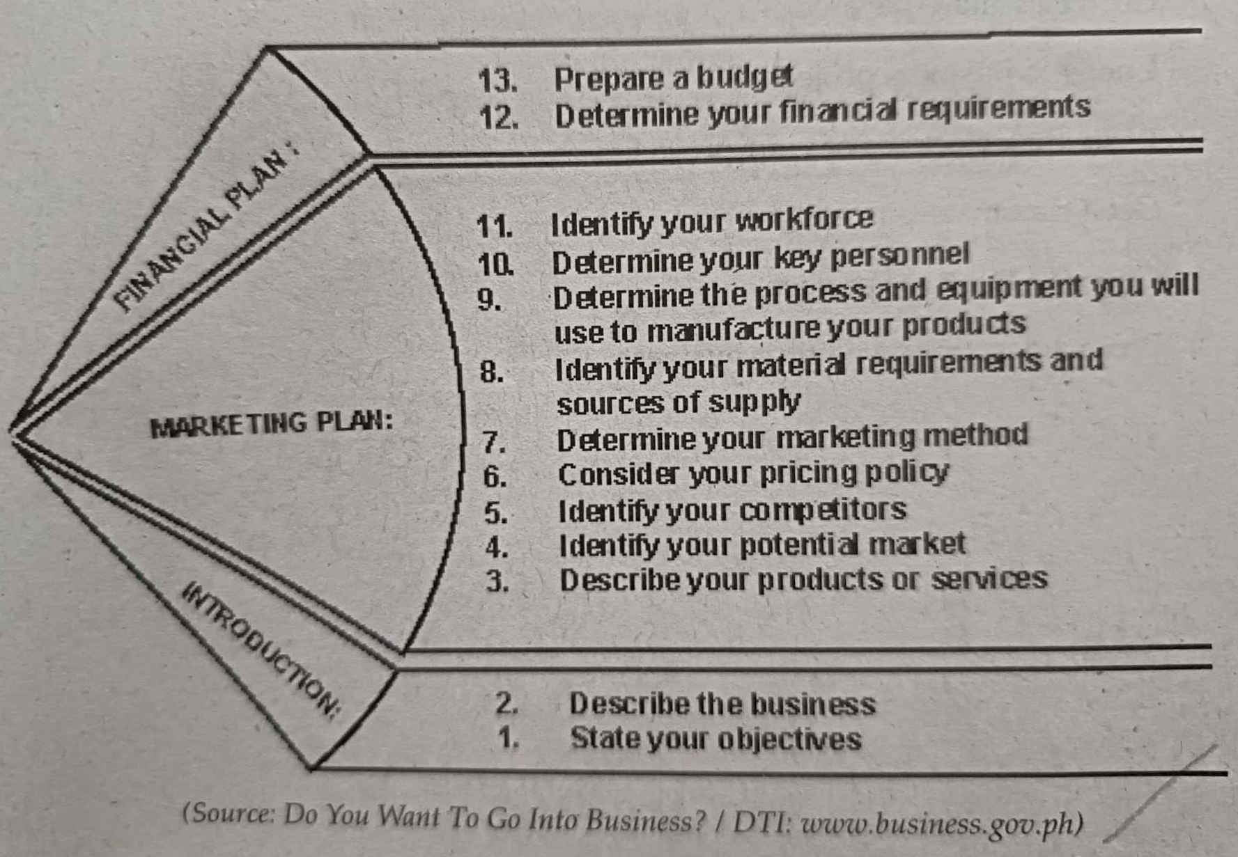
Guidelines in Writings a Business Plan

Slide 36

Writing the Business Plan
In partnerships or corporations, the plan is submitted to higher officers for approval. In a proprietorship, however, a written plan serves as the reference of the owner in running his business.
The actualizing stage begins with the registration of the business with the government agencies that regulate businesses. Non registration of business renders it illegal and subject to closure.

Slide 37
Writing the Business Plan
In the words of a successful entrepreneur, the business plan is the single most important document at the start-up stage. A business plan is a written document describing all relevant internal and external elements and strategies for starting a new venture or a new product or a business expansion. It provides a guide and structure to management.

Slide 38
The business plan will detail the following:
Product to be made or traded or service to be rendered
Marketing - when, where, to whom the product or service is to be sold
Management - organization, employees’ and officers’ position and job assignments
Finance - financial needs & where the money will come from and paid to
Operations - how the product will be produced or how the service will be rendered or how the merchandise is to be acquired.

Slide 39
Writing the Business Plan
A written business plan is like a game plan that is both for the current and future years. It is also called a road map. It may start as a preliminary plan and evolve to a final plan. The business plan is prepared by the entrepreneur who may consult with accountants, lawyers, engineers and marketers. They are called consultants. They may be private consultants or government consultants.

Slide 40
Writing the Business Plan
Lenders, investors, employers, government, suppliers and customers, all benefit from a business plan. The lender determines the amount of money to lend based on the plan; the investor analyzes it for investment opportunities; employers use it as guide for operations; customers determine what products to buy from the business; and suppliers determine what products to sell to the business through the plan. The government set policies guided partly by the plans of business. At the time this lecture is being written, a marketing company was charged with pyramiding. It submitted to SEC a business plan showing that the questioned activity is not in their plans.

Slide 41
Process Flow of Starting a Small Enterprise
Self-assessment
Entrepreneur
Analyze Environmental Factors
Start of Operations
PLANNING STAGE
ACTUALIZING STAGE
Determine your product/service decide the form of business
Hiring/Training of Personnel
Write a business plan
Business Registration
(Banastao & Frias, 2022)

Slide 42
The Business plan may be simple or complex depending upon the product or service. The entrepreneur doing the “road map” gets to:
See the product and service in detail
Do self-assessment
See obstacles
Assess cash and other resource requirements.

Slide 43
Plans…
Also tell the entrepreneur to “go for it” or “abandon it”. It points out the present, the future and the road that connects the two. It is a selling document; a document for selling ideas to investors. It is a tool that hopes to create interest in the project. The business plan should communicate clearly and effectively the features that are important to the user, who is the reader of the document. It is better to do a feasibility study before doing a business plan.

Slide 44
Usually, a business plan has the following parts:
Executive Summary - highlights briefly and convincingly the different sections in the business plan. It supports the conclusion that the business is profitable and that it is worth pursuing.
Description of the Venture - provides a complete picture or description of the products, services and their unique features.
Operating Plan - gives the detail of how products are to be manufactured. The merchandising plan for a trading business shows in detail how the products are to be acquired.

Slide 45
Usually, a business plan has the following parts:
Marketing plan - Describes market conditions and strategy related to how products and services will be priced, distributed and promoted.
Organizational Plan - describes the form of ownership and lines of authority and responsibilities of the people in the organization.
Financial Plan - projects financial data that show profitability, liquidity and stability.
Appendices or Annexes - back-up materials that support the text of the business plan. They are mentioned in the text as references.

Slide 46
After the business plan has started…
Operations are compared with the plan. The entrepreneur should find out if actual operation is on schedule or in accordance with planned time. The monitoring should be done within a period shorter than a year; better monthly or even a shorter period. With the availability and speed of computers, frequent measure of progress may not pose a problem. The entrepreneur should not hesitate to modify, change or update the plan whenever necessary. Environmental development after the plan has been implemented may call for its updating.

Slide 47
At this point, it is important to repeat that goals should be SMART.
Meaning they should be…
Specific, Measurable, Attainable, Realistic and Time-bound

Slide 48
Contents of a Business Plan
Cover Page
Name and address of business
Name(s) and address(es) of the owners
Contact persons
Date prepared
Statement of confidentiality of report
II. Executive Summary - One to four pages overview of total
business plan highlighting significant point arousing interest
on the part of the reader
III. Product - Description of products or services and their unique
features

Slide 49
IV. Marketing Plan - Who the customers are, competition,
marketing strategy, competitive edge, pricing
V. Organizational Plan - States the form of business organization,
Identifies management team, investors, their background,
their duties and responsibilities. States the plan for employees
recruitment and training.
VI. Operating Plan - Explains the process of acquiring and
processing products. Identifies equipment, physical plant,
machinery, materials.
VII. Financial Plan - Specifies financial needs and sources of
financing and shows for a three- to five-year period pro forma
income statement, cash flow projections, pro forma balance sheet
and break-even analysis.
VIII. Appendix - Shows supplementary materials.
*continuation

Slide 50
Desirable Business Practices
After the planning stage, the entrepreneur moves to the next stage, that is actualizing the plan. He sets the plan to work. He obtains money. He registers the business with the government offices. He moves to the business location, does the layout, acquires equipment, products and materials and hires employees.

Slide 51
Now the entrepreneur is ready to start his business. He does the following:
Computes costs, determines selling prices, adds mark-ups, subtracts markdowns. These steps are guided by desired profit margin and prices that the customers are willing to pay and afford to pay;
Prepare price tags
Makes promotional or advertising materials like brochures, posters, ads for TV, radio, magazines and newspapers.
Review purchase orders from customers.
Fill-up orders of customers by packaging products for delivery.

Slide 52
Now the entrepreneur is ready to start his business. He does the following:
6. Prepares delivery receipts, sales invoices for the products to be delivered and issues official receipts for payments from the customers.
7. Practices courtesy and efficiency in serving customers.
8. Gets ready to answer and properly handle complaints of customers.

Slide 53



End of Lecture
Thank you!

Slide 54




This presentation template is free for everyone to use thanks to the following:
SlidesCarnival for the presentation template
Pexels for the photos
THANKS!

Slide 55







Reference:
Entrepreneurship, Cristina B. Banastao and Solita A. Frias, Unlimited Books Library Services & Publishing Inc.
2022

