Slide 1
THE ENTREPRENEURIAL MIND
Management
Week 5
Lecturer:
Fidela Reyes Balajadia
Associate Professor 2
University of the Assumption, Philippines

Slide 2

Lecture Learning Objectives:
At the end of the lecture, you will be able to:
Define management and understand its functions
Realize the value of management skills and management’s role in attaining business goals
Read organizational structures
Compare leaders with managers
Trace the evolution of management thoughts
Learn from the contribution of management thinkers to the field of management

Slide 3


Functions of Management
  Management is the attainment of organizational goals in an effective and efficient manner through planning, organizing, leading, and controlling organizational resources.
  Organization is an entity that is goal-directed and deliberately structured.
  Effectiveness is the degree to which the organization achieves a stated goal.
  Efficiency is the use of minimal resources to produce a desired volume of output.

Slide 4
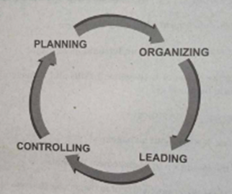
Four Management Functions
  Planning is the defining of goals for future organizational performance and deciding on the tasks and resource needed to attain them.
  Organizing is assigning tasks, grouping tasks into departments and allocating departments.
  Leading is the use of influence to motivate employees to achieve the organization's goals.
  Controlling is the monitoring of employees' activities, keeping the organization on track toward its goals, and making corrections as needed.
Banastao (2022)

Slide 5
Planning
  Planning is the defining of goals for future organizational performance and deciding on the tasks and resources needed to attain them. Goals are what the organization wants to achieve.
  A vision is a dream. It is what the organization wants to achieve. Mission is what the business is doing. It is the reason for existence.

Slide 6
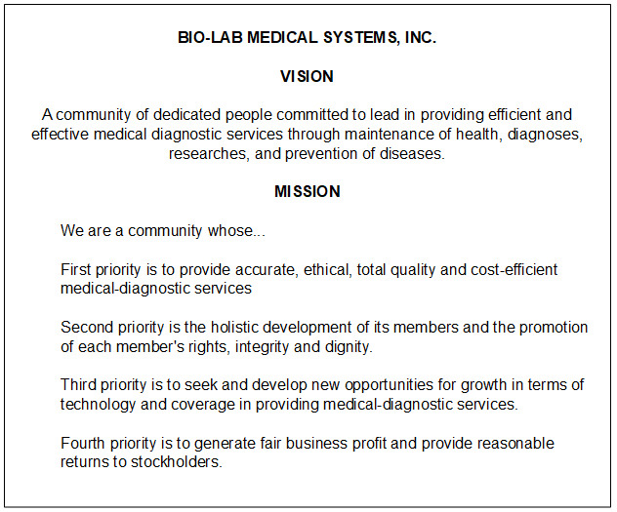
Planning
  Here is the Vision/Mission of Bio-Lab Medical Systems, Inc., a medical- diagnostic clinic.

Slide 7



Guidelines for Setting Goals
S
Specific
  To be specific, goals should be expressed in quantitative terms.
M
Measurable
  The target is exact as seen
Achievable
A
  Given increasing population, a stable economy, peace and other situation and other environmental factors
R
Realistic
  Again, based on environmental factors
T
Time-based
  The example of a goal is bound by time

Slide 8
The Purpose of Planning
The uses of planning are:
1. establishes coordinated effort - gives direction, helps the organization towards its objectives or goals;
2. helps the organization to look ahead, to anticipate or expect changes, to address or provide solutions to problems that may arise from changes or uncertainties;
3. reduces duplications, overlapping and wasteful activities;
4. sets standards for control.
5. serves as reference -- planners refer to previous
plans for guidance.

Slide 9
The Planning Types and Models are:
1. Management by Objectives (MBO) is a method whereby managers and employees define goals for every department, project and person and use them to monitor subsequent performance. The four major activities for MBO to be successful are:
a. Setting goals
b. Developing actions plans
c. Reviewing progress
d. Appraising overall performance

Slide 10
The Planning Types and Models are:
2. Single Use Plans are plans that are developed to achieve a set of goals that are unlikely to be repeated in the future.
3. Standing Plans are ongoing plans used to provide guidance for tasks performed repeatedly within the organization.
4. Contingency Plans are plans that define company responses
to specific situations, such as emergencies and setbacks.

Slide 11
Organizing
Knowledge of the following terminology is important to understand organizing -the second function of management.
1. Organizing is the development of organizational resources to achieve strategic goals.
2. Organizational Structure is the framework in which the
organization defines how tasks are divided,
resources are developed, and departments are coordinated.

Slide 12
Organizing
3. Organizational Chart is the visual representation of an organization's structure.
4. Work Specification is the degree to which organizational tasks are subdivided into individual jobs also called division of labor.
5. Chain of Command is an unbroken line of authority
that links all individuals.

Slide 13
Organizing
6. Authority is the formal and legitimate right of a manager to make decisions issue orders and allocate resources to achieve organizationally desired outcomes.
7. Responsibility is the employees' duty to perform the assigned task of activity.

Slide 14
Organizing
8. Accountability is the duty of people with authority and responsibility to report and justify task outcomes to those above them in the chain of command.
9. Delegation is the process managers use to transfer authority and responsibility to positions below them in the hierarchy.

Slide 15
How to Delegate:
a. Delegate the whole task.
b. Select the right person
C. Ensure that authority equals responsibility
d. Give thorough instructions
e. Maintain feedback
f. Evaluate and reward performance

Slide 16
Organizing
10. Line Authority is a form of authority in which individuals in management positions have the formal power to direct and control immediate subordinates.
11. Staff Authority is a form of authority granted to staff specialists in their areas of expertise.
12. Span of Management or Span of Control is the number of
employees who report to a supervisor.

Slide 17
Departmentalization
  is the basis on which individuals are grouped into departments and departments into total organizations.

Slide 18
Departmentalization
1. Functional Structure is an organizational structure in which positions are grouped into departments based on skills, expertise and resource use.
2. Divisional Structure is an organization structure in which departments are grouped based on similar organizational outputs.
3. Cross-functional Team is a group of employees assigned
to a functional department that meets as a team to resolve
mutual problems.

Slide 19
Departmentalization
4. Permanent Team is a group of participants from several functions who are permanently assigned to solve ongoing problems of common interest.
5. Network Structure is an organization structure that disaggregates major functions into separate companies that are broken by a small headquarters organization.

Slide 20
Departmentalization
6. Tall Structure is a management structure characterized by an overall narrow span of management and a relatively large number of hierarchical levels.
7. Flat Structure is a management structure characterized by an overall broad span of control and relatively few hierarchical levels.
8. Centralization is the location of decision authority near
top organizational levels.

Slide 21
Departmentalization
9. Decentralization is the location of decision authority near lower organizational levels.
10. Formalization is the written document used to direct and control employees.

Slide 22
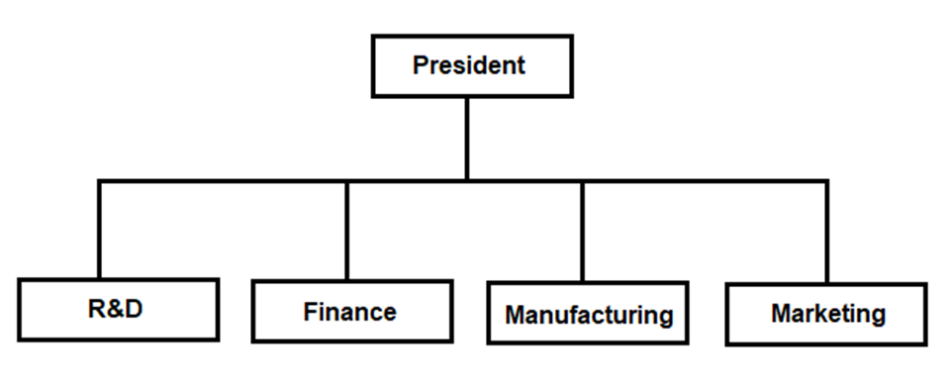
Functional versus Divisional Structures
(Illustrations of Organizational Charts)
a. Functional Structure
Banastao (2022)

Slide 23
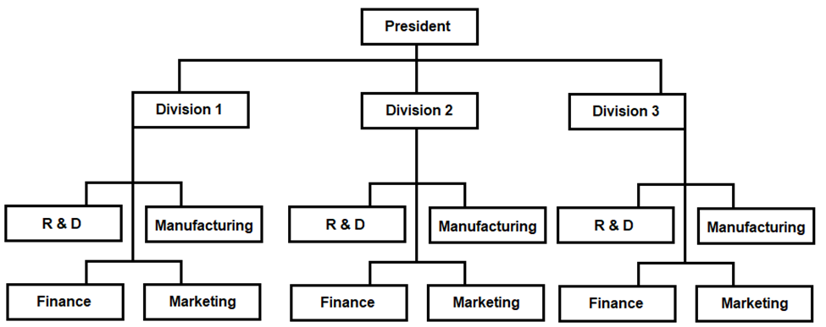
Functional versus Divisional Structures
b. Division Structure
Banastao (2022)

Slide 24
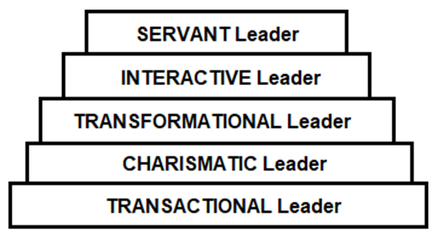
Leading
Leadership
is the use of influence to motivate employees to achieve organizational goals.
is the quality that inspires and motivates people beyond their normal levels of performance.
Leaders come in different types, such as:
Banastao (2022)

Slide 25
1. Transactional Leader - is one who classifies subordinates' role and task requirements, initiates structure, provides rewards and displays consideration for subordinates.
2. Charismatic Leader - is a leader who has the ability to motivate subordinates to transcend their expected performance.
3. Transformational Leader - is a leader distinguished by a special ability to bring about innovation and change.

Slide 26
4. Interactive Leader - is a leader who is concerned with consensus building, is open and inclusive, and encourages participation.
5. Servant Leader - is a leader who works to fulfill subordinates' needs and goals as well as to achieve the organization's larger mission.

Slide 27
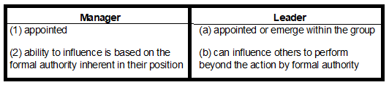
Comparison of Manager and Leader

Slide 28
Six Traits that Differentiate Leaders from Nonleaders
1. Drive. Leaders exhibit a high effort level. They have a relatively high desire for achievement, they're ambitious, they have a lot of energy, they are tirelessly persistent in their activities, and they show initiative.
2. Desire to Lead. Leaders have a strong desire to influence and lead others. They demonstrate the willingness to take responsibility.

Slide 29
Six Traits that Differentiate Leaders from Nonleaders
3. Honesty and Integrity. Leaders build trusting relationships between themselves and followers by being truthful or non deceitful and by showing high consistency between word and deed.
4. Self-confidence. Followers look to leaders for an absence of self-doubt. Leaders, therefore, need to show self-confidence in order to convince followers of the rightness of goals and decisions.

Slide 30
Six Traits that Differentiate Leaders from Nonleaders
5. Intelligence. Leaders need to be intelligent enough to gather, synthesize, and interpret large amounts of information; and to be able to create visions, solve problems and make correct decisions.
6. Job-relevant Knowledge. Effective leaders have a high degree of knowledge about the company, industry, and technical matters. In-depth knowledge allows leaders to make well-informed decisions and to understand the implications of those decisions.
(SOURCE: Shelly A. Kirkpatrick and Edwin A. Locke, "Leadership: Do Traits Really Matter?"
Academy of Management Executive, May 1991, pp. 48-60)

Slide 31
Motivation
Motivation is defined as the arousal, direction and persistence of behaviour. This definition was introduced by psychologists and management thinkers who also came up with theories in motivation. Some of these theories are:
1. Content theory is a group of theories that emphasize the needs that motivate people.

Slide 32
Motivation
2. Hierarchy of needs theory is a content theory that proposes that people are motivated by five categories of needs-physiological, safety, belongingness, esteem and self-actualization that exist in a hierarchical order.

Slide 33
Motivation
3. ERG Theory is a modification of needs hierarchy theory that proposes three categories of needs: existence, relatedness and growth.
• Existence needs. These are the needs for physical well-being.
• Relatedness needs. These pertain to the need for satisfactory relationships with others.
• Growth needs. These focus on the development of human potential and the desire for personal growth and increased competence.

Slide 34
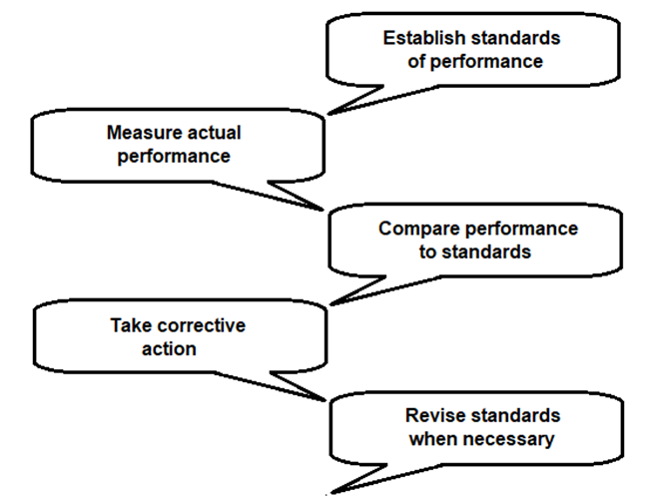
Control
Organizational control is the systematic process through which managers regulate organizational activities to make them consistent with expectations established in plans, targets, and standards of performance.
Control entails the following process:
Banastao (2022)

Slide 35
The Types of Control are:
1. Feed Forward Control or Preliminary or Preventive Quality Control is one that focuses on human, material and financial resources flowing into the organization.
2. Concurrent Control consists of monitoring ongoing employee activities to ensure their consistency with established standards.

Slide 36
The Types of Control are:
3. Feedback Control or Output Control focuses on the organization's output.
4. Bureaucratic Control is the use of rules, policies, hierarchy of authority, reward systems and other formal devices to influence employee behavior and assess performance.

Slide 37
Qualities of Effective Control Systems
The control systems:
1. are linked to strategy
2. are accepted by members
3. are accurate
4. are flexible
5. are timely
6. point out exceptions
7. within reasonable costs
8. provide corrective measures

Slide 38
Qualities of Effective Control Systems
To be effective, the control system should be linked to strategy.
For example, the strategy is attaining goals through motivated human resources.
Thus, a reward system is put in place (as seen in the Control Process diagram). The reward system is also accepted by employees. Hence, their willingness to punch in and out their DTR's. Entries in the DTR are accurate.

Slide 39




The Importance of Control
  1. to ensure that activities are done according to plans
  2. to ensure that goals are attained.
  3. to assist managers in delegation of authority - controls will motivate managers to delegate

Slide 40
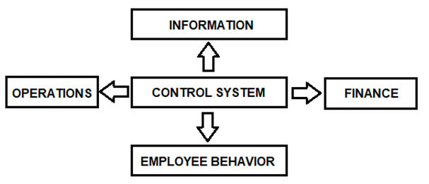
Areas of Control
Control is applied in the following areas:
Banastao (2022)

Slide 41
Areas of Control
1. Information - the managers need the right information at the right time and in the right place. Information should be accurate, complete, available when needed and not voluminous or not excessive.
2. Finance - the company sets budgets or standards, collects data on actual operation, compares budget with actual, uses analytical financial tools like ratios and trends.

Slide 42
Areas of Control
3. Operations the company monitors activities to ensure they are on schedule, within allowable costs, according to quality standards and that equipment are properly monitored.
4. Employees Behavior - the company sets criteria for hiring employees, designs job specifications, orients and supervises, trains, mentors, sets rewards systems and develops organizational culture.

Slide 43
The Traditional Bureaucratic Control are:
1. Rules and Regulations
a. standard operating procedures (SOPs)
b. policies that prescribe correct employee behavior
2. Management control systems
a. budgeting
b. financial report
c. reward system
d. operations management
e. management by objective (MBO)

Slide 44
The Traditional Bureaucratic Control are:
3. Hierarchy of authority
a. central authority
b. supervision
4. Total Quality Control (TQM)
5. Formalized selection and training
6. Information Technology

Slide 45
Evolution of Management
These approaches attempt to explain the real issues facing managers and provide them with tools to solve future problems. Some authors call them management theories. Theory is a coherent group of assumptions that explains the relationship between two or more observable facts and to provide a sound basis for predicting future events.

Slide 46
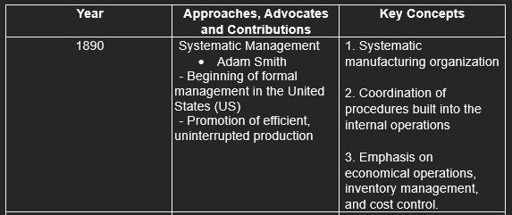
A. Classical Approaches
provide the foundation for management and organization as they exist today

Slide 47
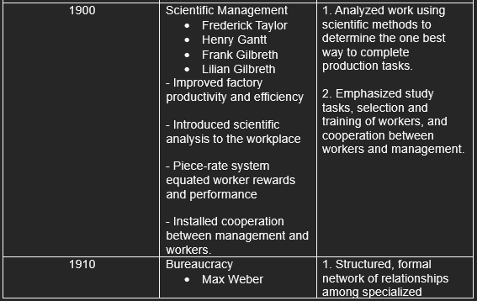
A. Classical Approaches
Continuation

Slide 48
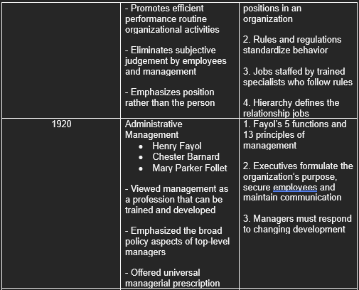
A. Classical Approaches
Continuation

Slide 49
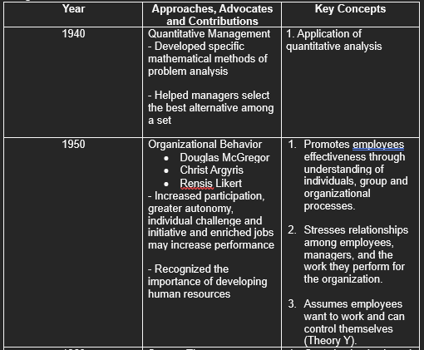
B. Contemporary Approaches
- represent the cornerstones of modern management thoughts.

Slide 50
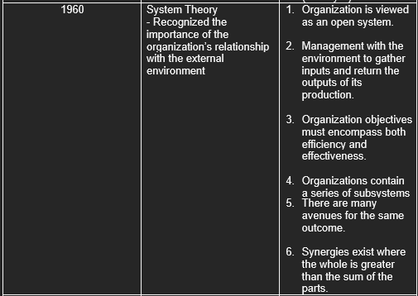
B. Contemporary Approaches
Continuation

Slide 51
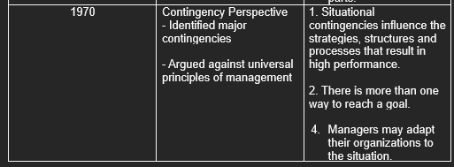
B. Contemporary Approaches
Continuation

Slide 52
Management Theorists
  Contributions of Key Advocates of Management Theories
  Over the years, many management advocates or writers of management theories have contributed concepts, theories and principles that enriched the field of management as a science.

Slide 53
Management Theorists
Barnard, Chester. Mr. Barnard observed that people in the organization come together to achieve goals that they cannot achieve alone and that organizations can operate efficiently and survive the difficult times if goals are kept in balance with the needs of the individuals working for such goals.
Deming, Edwards. He introduced the concept of total quality management (TQM) which means quality is the concern of everybody in the organization from the directors down to the rank and file. He also came up with the 14 points of quality, which are:
1. Create constancy of purpose for improvement of product/service
2. Adopt a new philosophy
3. Cease dependence on mass inspection

Slide 54
Management Theorists
4. End the practice of awarding business on price tag alone
5. Constantly and forever improve the system of production and service
6. Institute modern methods of training on the job
7. Institute leadership
8. Drive out fear
9. Break down barriers between staff areas
10. Eliminate slogans, exhortations and targets for the workforce
11. Eliminate numerical quotas
12. Remove barriers to pride of workmanship
13. Institute a vigorous program of education and training
14. Take action to accomplish the transformation.

Slide 55
Management Theorists
Drucker, Peter. He is a modern management thinker who introduced the concept of efficiency and effectiveness.
Fayol, Henri. He was a French industrialist who believed that management can be viewed from the top level and covers the whole organization. He introduced the fourteen principles of management. These are:
1. Division of Work
2. Authority
3. Discipline
4. Unity of Command
5. Unity of Direction
6. Subordination of individual interest to common good
7. Remuneration

Slide 56
Management Theorists
8. Centralization & Decentralization
9. Hierarchy
10. Order
11. Equity
12. Stability of the Staff
13. Initiative
14. Esprit de Corps
Follet, Mary. She defined management as "the art of getting things done through people". She believes in the power that people can accomplish if their diverse talents are combined.

Slide 57
Management Theorists
Gantt, Henry. Mr. Gantt was an industrial engineer, who introduced the "bonus" system as conceived by Frederick Taylor. Worker's performance was posted on colored charts - black if his performance was within standards and red if he fell below the expectations.
Gilbreth, Frank and Lilian. They concluded in their "time and motion study", that motion and fatigue are intertwined. Therefore, if motion is reduced, fatigue is also reduced.

Slide 58
Management Theorists
Mayo, Elton and his associates. They concluded in their study, called the "Hawthorne Effect", that the workers perform well if they are treated well; that man is a social being and therefore respond more to work-group relationships than to management pressures.
McGregor, Douglas. He introduced theory X and theory Y about the manager's perception of the behavior of workers.

Slide 59
Management Theorists
Munsterberg, Hugo. He introduced the use of psychology in organizations emphasizing on the behavior of people in the workplace. He is known as the father of applied psychology.
Murphy, Edwards Jr. Murphy's Law states that: (1) nothing is as simple as it seems; (2) everything takes longer than it should; (3) if anything can go wrong, it will; and (4) if there are two or more ways of doing something and one of them can lead to catastrophe, then someone will do it.

Slide 60
Management Theorists
Ouchi, William. He studied how Japanese business organizations are managed hoping to find solutions to some of the problems of American business. His study resulted in his introduction of Theory Z.
Pareto, Vilfredo. Mr. Pareto was a mathematician who introduced the 80/20 principle or theory of distribution.

Slide 61
Management Theorists
Parkinson, Northcote Cyril. Parkinson's Law suggests that organizational growth is based on two premises, such as (1) the desire of managers to have more subordinates as a measure of success, and (2) the personnel of an organization perform work for another.
Peter, Lawrence. According to him, managers tend to be promoted to their level of incompetence.
Peters, Thomas J. Considering rapid changes in the environment, Mr. Peters introduced the concept of dynamic engagement.

Slide 62
Management Theorists
Taylor, Frederick. Having introduced the use of science in management, Mr. Taylor was named the father of scientific management. He believed that there is one best way of performing tasks and selecting workers. He also introduced the differential rate system and cost analysis. Specially, Mr. Taylor introduced the following principles:
1. The development of scientific approach in work activity.
2. Efficient selection and training of employees.
3. Cooperation and harmonious relationship between management and labor.
4. Division of work between managers and workers.

Slide 63
Management Theorists
Waterman, Robert. He together with his partner, Tom Peters introduced the MBWA technique or Management by Walking Around.
Weber, Max. According to Mr. Weber, organizations operate on a formal and hierarchical structure that defines lines of authority.

Slide 64
Theories in Organizational Behavior
  The three major theories of organizational behaviour are Theory X, Theory Y and Theory Z.

Slide 65
A. Theory X
The assumptions of Theory X are:
1. The average human being has an inherent dislike of work and will avoid it if he can;
2. Because of this human characteristic of dislike of work, most people must be coerced, controlled, directed or threatened with punishment to get them to put forth adequate effort toward the achievement of organizational objectives;
3. The average human being prefers to be directed, wishes to avoid responsibility, has relatively little ambition and wants security above all.

Slide 66
B. Theory Y
The assumptions of Theory Y are as follows. They are opposite those of Theory X:
1. The expenditure of physical and mental effort in work is as natural as play or rest;
2. External control and the threat of punishment are not the only of bringing about effort toward organizational objectives; means
3. Commitment of objectives is a result of the rewards associated with, their achievement;

Slide 67
B. Theory Y
4. The average human being learns, under proper conditions not only to accept but to seek responsibility;
5. The capacity to exercise a relatively high degree of imagination, ingenuity, and creativity in the solution of organizational problems is widely, not narrowly, distributed in the population;
6. Under conditions of modern industrial life, the intellectual potentialities of the average human being are only partially utilized.

Slide 68
C. Theory Z
Theory Z is the Japanese Theory of Management. It features the creation of an industrial team and a stable, cohesive work environment where employees feel affiliated, independent, while sticking to the proper quality and control of the needs of the organization. The Theory involves:
1. Lifetime employment; 5. Less formal control systems;
2. Non Specialized careers; 6. Consensus decision-making;
3. Individual responsibilities; 7. Slower rates of promotion.
4. Concern for the total person;

Slide 69
Managing the Human Resources
  Workers work toward the fulfillment of business goals. They are the backbone of the enterprise. Hence, hiring the right workers is vital.

Slide 70
Sources of Manpower
  Potential employees can be sourced through:

Slide 71
Sources of Manpower
• Job Fair. Schools, industry organizations, the government, or private institutions sponsor job fairs with the objective of helping job seekers and employers meet each other. Employers joining a job fair should know exactly what qualifications or traits of an applicant they are looking for and for what positions. Employers are guided by a job descriptions and job specifications.
• Employment Agencies. Employment agencies have mushroomed over the years. This is a kind of service that helps entrepreneurs or employers locate a job seeker for local or overseas employment.

Slide 72
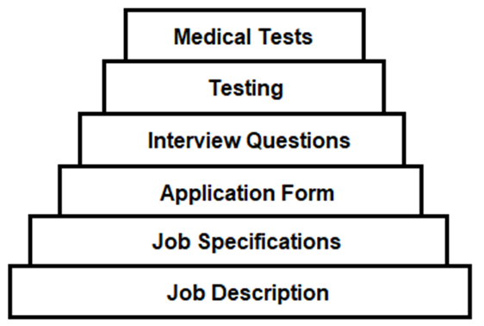
Sources of Manpower
• Internet. Posting in the internet a need for an employer is no longer uncommon these days given the computer technology. For this reason, international sourcing is no longer improbable.
• Through Friends. Friends usually recommend people they know with the aim of helping them find jobs, and normally friends help each other.
Banastao (2022)

Slide 73
Recruitment and Hiring
  Employers do not look at the physical appearance only and hire the person. They would like to know a lot of information about the applicant, hence the many tools used in the process of recruitment and hiring. Some of these tools are:

Slide 74
Recruitment and Hiring
• Job Description. This pertains to the list of functions that the worker is expected to perform. It includes the position title, the supervisor to whom he shall report, salary range and other information about the job.
• Job Specification. This refers to the qualifications, traits and skills needed to perform the job. Physical attributes, like height, may also be included.
• Application Form. This form asks about some personal details about the applicant, his educational qualifications, traits, skills, experience, training, former employers (if previously employed) and other information
which the employer feels are important.

Slide 75
Recruitment and Hiring
• Interview Questions. A list of interview questions is prepared prior to the interview. Sometimes these questions are already answered in the application form, but it is asked just the same, for verification purposes.
• Testing. This can be either a written test or a performance test depending on the position applied for. A performance test is an actual test.

Slide 76
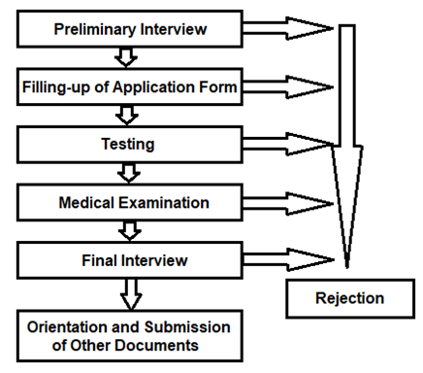
Recruitment and Hiring Process
Recruitment means trying to attract applicants to apply for a position in a company. This is done through advertisements in newspapers, radio/TV, the internet or through friends.
Banastao (2022)

Slide 77
Employee Categories
  Employees are categorized as follows:

Slide 78
Employee Categories
• Casual/Temporary. As temporary employees, their stay should not reach six months. Otherwise, the entrepreneur will be forced to give them a regular status as provided by law. Many entrepreneurs terminate the services of casual workers after five months and rehires them if their performance is satisfactory.
• Probationary. Employees on probation are those intended for permanent position. The length of time involved is again not more than six (6) months.

Slide 79
Employee Categories
• Contractual. Employees work in an organization based on a contract. The contract can be a year or more and the entrepreneur is not expected to hire
the contractor for regular employment. The service of the contractual worker expires at the termination of the contract.
• Permanent or Regular Employee. Regular employees enjoy all the benefits mandated by law plus the benefits on the generosity of the employer. The stay in the business is also unlimited.

Slide 80
Training
In spite of their background, employees still need to be trained. The first training that they receive upon joining the company is the orientation.
Training could be in the form of meetings, keeping employees informed about changes in the company, like new policy, new rules, salary increase, new benefits or even a change in their uniform, will motivate them. It will give them the feeling that they belong.
Employees may also be sent to attend seminars or conferences outside the company or trainors may be asked to conduct a seminar
for the employees.

Slide 81
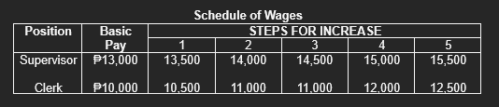
Wage and Salary
Wage is the price for services rendered. It is a determinant whether the applicant will accept the job offer or not or whether the entrepreneur will accept the applicant or not, especially if his asking price is too much. In all cases, the minimum wage law is the basis for remuneration.

Slide 82
Employee Benefits
Benefits are classified as monetary and non-monetary. The former refers to bonuses, 13th month pay, allowances and SSS employer's contributions, while the latter comes in the form of free uniform, free accommodation, free food, free medical/dental assistance, free use of company facilities like the library and others.

Slide 83
Reward System
Part of managing human resources is motivation and to motivate the personnel to give their best job performance, a reward system is organized. This is made known to everybody so that everybody is a candidate for the reward.
Discipline
On the other side of the reward system is discipline. Erring employees are disciplined for non-compliance of rules and regulations and violation of policies.

Slide 84
Disciplinary actions are progressive in nature, like:
1
1st offense -
verbal warning
2
2nd offense -
another verbal warning
3
3rd offense -
written warning
4
4th offense -
suspension
5
termination from service
5th offense -

Slide 85
Labor Unions
A labor union is an organization of workers, ideally, to work as partners of the business owners or managers in operating the business. In practice, however, this is not the case. The general feeling is animosity. Workers believe management is taking advantage of them and is depriving them in terms of wages and benefits.

Slide 86

End of Lecture
  Thanks!

Slide 87



CREDITS
  This presentation template is free for everyone to use thanks to the following:
  SlidesCarnival for the presentation template
  Pexels for the photos
HAPPY DESIGNING

Slide 88







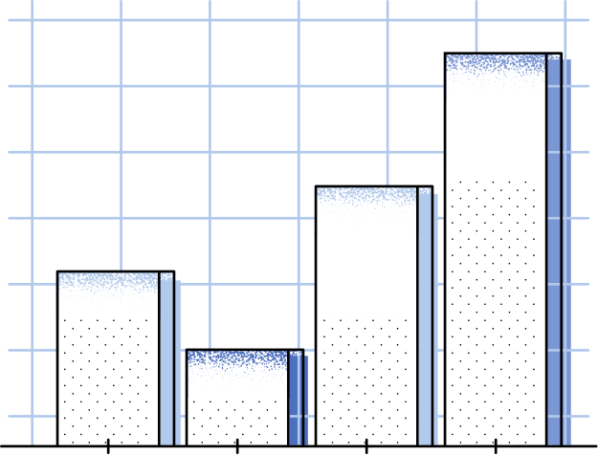







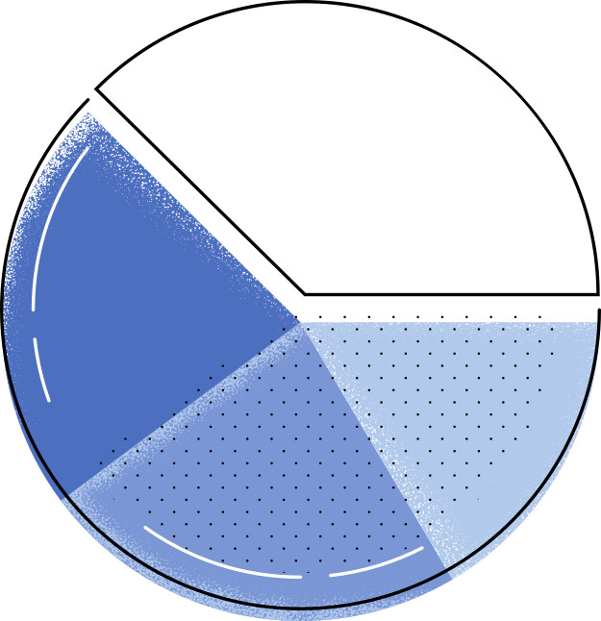

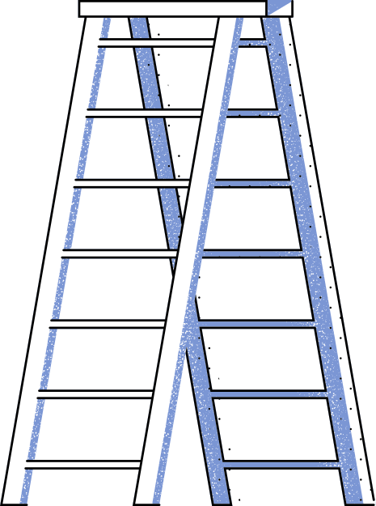
Reference:
Entrepreneurship, Solita A. Frias and Cristina B. Banastao , Unlimited Books Library Services & Publishing Inc.
2022

