Slide 1

ENTREPRENEUR & MANAGEMENT RESEARCH
Research Presentation Preparation
Present By
Dr. Tumpal P. Situmorang, ST.,MM

Slide 2
REVIEW OF MEETING 13
ACADEMIC WRITING AND REPORTING
01
Good research must be written clearly to be understood
e.g., a strong model loses impact when reported unclearly
02
Reporting is part of research integrity
e.g., unclear methods reduce credibility
03
Structure and logic make research readable
e.g., IMRAD structure helps readers follow arguments

Slide 3

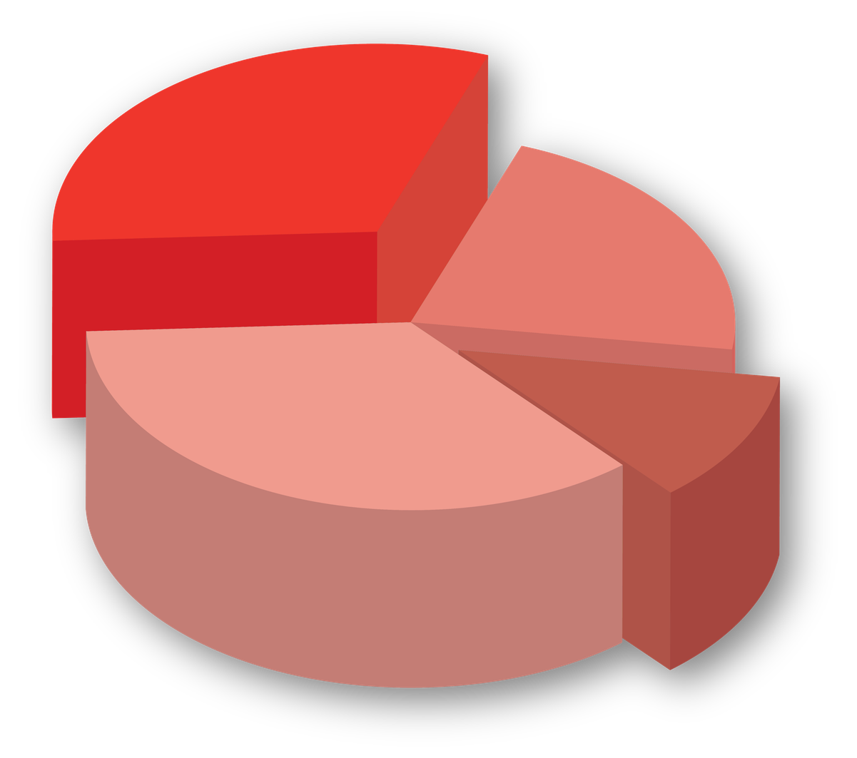

INTRODUCTION
Why Research Presentation Matters
A presentation translates research into accessible knowledge
e.g., complex models must be explained simply to audiences
Presentation is a form of academic persuasion
e.g., presenters must help the audience see why the research matters
Presentation skills influence how research is perceived
e.g., unclear delivery reduces perceived quality
Good presentations focus on clarity, not completeness
e.g., not all tables need to be shown

Slide 4





source: https://share.google/9G3p0RqsItCAaxx7R
WHAT IS A GOOD RESEARCH PRESENTATION?
source: https://share.google/sSeYiLLWMBTeMohRx
From Data to Story
A presentation is not a paper read aloud
e.g., slides should not contain full paragraphs
A good presentation tells a coherent research story
e.g., problem → method → finding → implication
source: https://share.google/p3YCOOV6Ek2f0yYhG
source: https://share.google/ow7Xoi9hi2kL06adH

Slide 5
source: https://share.google/9G3p0RqsItCAaxx7R
WHAT IS A GOOD RESEARCH PRESENTATION?
source: https://share.google/sSeYiLLWMBTeMohRx
From Data to Story
Clarity is more important than technical detail
e.g., explain model logic instead of formulas
source: https://share.google/p3YCOOV6Ek2f0yYhG
source: https://share.google/ow7Xoi9hi2kL06adH

Slide 6

STRUCTURE OF A RESEARCH PRESENTATION
A LOGICAL FLOW FOR AUDIENCE UNDERSTANDING
01
The introduction defines the problem
e.g., why this research is needed now
02
The literature provides context
e.g., what is already known and what gap remains

Slide 7
STRUCTURE OF A RESEARCH PRESENTATION
A LOGICAL FLOW FOR AUDIENCE UNDERSTANDING
03
The method explains how the study was conducted
e.g., sample, data collection, and analysis strategy
04
The results show the key findings
e.g., the most important effects, themes, or patterns
05
The discussion explains meaning and implication
e.g., what the findings contribute to theory and practice

Slide 8




DESIGNING EFFECTIVE SLIDES
VISUAL COMMUNICATION MATTERS
01
Slides should support, not replace the speaker
e.g., minimal text, clear visuals

Slide 9
DESIGNING EFFECTIVE SLIDES
VISUAL COMMUNICATION MATTERS
02
Use visuals to simplify complexity
e.g., diagrams instead of long explanations

Slide 10
DESIGNING EFFECTIVE SLIDES
VISUAL COMMUNICATION MATTERS
03
Avoid overcrowded slides
e.g., too many tables reduce clarity

Slide 11



PRESENTING QUANTITATIVE RESEARCH
MAKING NUMBERS UNDERSTANDABLE
Focus on key relationships, not all statistics
e.g., show the main path rather than the full output table

Slide 12
PRESENTING QUANTITATIVE RESEARCH
MAKING NUMBERS UNDERSTANDABLE
Explain meaning, not just numbers
e.g., translate coefficients into substantive interpretation

Slide 13
PRESENTING QUANTITATIVE RESEARCH
MAKING NUMBERS UNDERSTANDABLE
Use simple visuals for models
e.g., arrows, effect signs, or concise path diagrams

Slide 14

PRESENTING QUALITATIVE RESEARCH
Source: Canva
FROM NARRATIVE TO INSIGHT
01
Highlight themes, not transcripts
e.g., show the thematic structure rather than long interview text

Slide 15
PRESENTING QUALITATIVE RESEARCH
Source: Canva
FROM NARRATIVE TO INSIGHT
02
Use quotes selectively
e.g., one powerful quotation can support a theme better than many weak excerpts

Slide 16
PRESENTING QUALITATIVE RESEARCH
Source: Canva
FROM NARRATIVE TO INSIGHT
03
Explain patterns and meaning
e.g., show how participant accounts reveal process, tension, or identity work

Slide 17

TIME MANAGEMENT IN PRESENTATION
LESS IS MORE
01
Time constraints require prioritization
.g., a 10-minute presentation cannot contain every detail of a 30-page paper
source: https://share.google/OgNp52sR38PNBB0Ev

Slide 18
TIME MANAGEMENT IN PRESENTATION
LESS IS MORE
02
Focus on core contribution
e.g., identify the one message the audience must remember
source: https://share.google/OgNp52sR38PNBB0Ev

Slide 19
TIME MANAGEMENT IN PRESENTATION
LESS IS MORE
03
Avoid overloading slides
e.g., fewer slides with stronger messages are better than many slides with weak focus
source: https://share.google/OgNp52sR38PNBB0Ev

Slide 20
HANDLING QUESTIONS AND DISCUSSION
ENGAGING WITH THE AUDIENCE
01
Questions are part of academic dialogue
e.g., feedback helps refine the research argument)
source: https://share.google/OgNp52sR38PNBB0Ev

Slide 21
HANDLING QUESTIONS AND DISCUSSION
ENGAGING WITH THE AUDIENCE
02
Answer clearly and honestly
e.g., respond to the question asked rather than avoiding it
source: https://share.google/OgNp52sR38PNBB0Ev

Slide 22
HANDLING QUESTIONS AND DISCUSSION
ENGAGING WITH THE AUDIENCE
03
Admit limitations when necessary
e.g., acknowledge what the study cannot claim
source: https://share.google/OgNp52sR38PNBB0Ev

Slide 23
COMMON MISTAKES IN RESEARCH PRESENTATION
Source: Canva
WHY STRONG RESEARCH CAN BE COMMUNICATED WEAKLY
01
Too much text on slides
e.g., paragraphs make audiences read instead of listen

Slide 24
COMMON MISTAKES IN RESEARCH PRESENTATION
Source: Canva
WHY STRONG RESEARCH CAN BE COMMUNICATED WEAKLY
02
Reading instead of explaining
e.g., presenters lose authority when they simply read bullet points

Slide 25
COMMON MISTAKES IN RESEARCH PRESENTATION
Source: Canva
WHY STRONG RESEARCH CAN BE COMMUNICATED WEAKLY
03
Lack of clear structure
e.g., audiences cannot follow the argument when sections are disconnected

Slide 26
COMMON MISTAKES IN RESEARCH PRESENTATION
Source: Canva
WHY STRONG RESEARCH CAN BE COMMUNICATED WEAKLY
04
Overloading with technical details
e.g., excessive statistics or methodological jargon can obscure the contribution

Slide 27



CONCLUSION
Research Presentation as Academic Communication
01
Research presentation is a skill of communication and persuasion
e.g., presenters must make the audience understand and trust the argument
02
Clarity and structure determine effectiveness
e.g., a clear flow helps audiences follow complex research

Slide 28
CONCLUSION
Research Presentation as Academic Communication
03
Good presentation highlights contribution, not complexity
e.g., the audience should remember the insight, not the amount of output

Slide 29

KEY TAKEAWAYS
Structure guides audience understanding
e.g., problem → gap → method → findings → contribution
Presentation is about clarity, not completeness
e.g., select the essential message rather than show everything
Good presenters explain, not read
e.g., slides provide cues while the presenter delivers the argument
Visuals enhance communication when they simplify meaning
e.g., models, diagrams, and thematic maps help audiences see patterns

Slide 30


CLOSING REMARKS
Good researchers do not only produce findings; they communicate why the findings matter
e.g., a final showcase tests both research quality and communication quality
source: https://share.google/jVUio3THQSjccu9nA
Presentation is where research becomes visible to an audience
e.g., ideas, data, and implications meet public academic judgment

Slide 31
CLOSING REMARKS
The next step is the Final Research Showcase
e.g., students integrate problem, method, findings, and contribution into a defensible presentation
source: https://share.google/jVUio3THQSjccu9nA

Slide 32

See you in Meeting 15, with the topic:
Final Research Showcase

Slide 33
REFERENCE
Research Methods for Business Students, Mark N. K. Saunders, Philip Lewis, Adrian Thornhill, Pearson Education Limited, 2023, 888 pages.
Research Design: Qualitative, Quantitative, and Mixed Methods Approaches, John W. Creswell, J. David Creswell, SAGE Publications, 2018, 304 pages.
Research Methods For Business: A Skill Building Approach, Roger Bougie, Uma Sekaran, John Wiley & Sons, 2020, 432 pages.
Business Research Methods, Emma Bell, Alan Bryman, Bill Harley, Oxford University Press, 2022, 647 pages.
Presenting Your Research: Conferences, Symposiums, Poster Presentations and Beyond, Lucinda Becker, SAGE Publications Ltd, 2014, 160 pages.
The Craft of Scientific Presentations: Critical Steps to Succeed and Critical Errors to Avoid, Michael Alley, Springer New York, 2013, 241 pages.
One Truth and One Standard for Its Telling: Reporting on and About Scientific Business Research, Jean-Etienne Joullié, Anthony M. Gould, Journal of Business Research, Elsevier, 2023, Article 113565.
The Research Transparency Index, Herman Aguinis, Zhuyi Angelina Li, Maw Der Foo, The Leadership Quarterly, Elsevier, 2024, Article 101809.
Transparency of Reporting Practices in Quantitative Field Studies: The Transparency Sweet Spot for Article Citations, Matthias Weiss, Lakshmi B. Nair, Bareerah H. Hoorani, Michael Gibbert, Martin Hoegl, Journal of Informetrics, Elsevier, 2023, Article 101396.
Multilevel Qualitative Research: Insights from Practice, Tine Köhler, European Management Journal, Elsevier, 2024, 503–514.
Does XBRL Adoption Increase Financial Information Transparency in Digital Disclosure Environment? Insights from Emerging Markets, Manaf Al-Okaily, Hani Alkayed, Aws Al-Okaily, International Journal of Information Management Data Insights, Elsevier, 2024, Article 100228.

Slide 34
THANK YOU

