Slide 1

Module 1_Introduction
Introduction to Hospitality
and Tourism Business
Communication
Building the skills that define exceptional service
Course: Hospitality and Tourism Business Communication
Prof. Alia Amor D. Uy, MBA

Slide 2

Why Communication Matters
Guest Experience How you communicate shapes how guests remember their stay
Team Coordination Clear communication keeps departments running smoothly
Brand Reputation Every interaction reflects the organization's image

Slide 3
Learning Outcomes
01 02 03
Define Identify Differentiate
Meaning and importance of Components of the communication Hospitality communication vs. general
communication in hospitality process communication
04 05
Analyze Demonstrate
Communication's role in customer satisfaction Professional communication standards in tourism workplaces

Slide 4
Hospitality and Tourism Business Communication
) Workplace Communication
Customer service & staff interactions
Communication Process
Components and flow of messages
Professional Standards
Etiquette, tone, and conduct
Intercultural Communication
Adapting to diverse guests

Slide 5
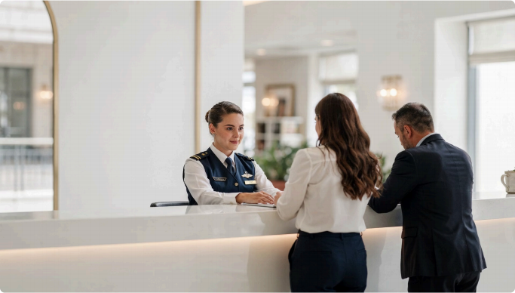
Communication
&
Professionalism
Clear & Respectful Use appropriate language in every situation
Active Listening Understand before responding
Positive Attitude Guests remember how you made them feel

Slide 6

A Multicultural Industry
Cultural Sensitivity Respect different customs and expectations
Empathy Understand guests beyond language
Adaptability Adjust communication style for every guest

Slide 7
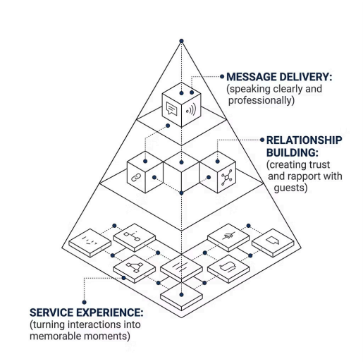
Communication Is More Than Words
The Bigger Picture
Effective communication in hospitality means:
Delivering messages with clarity
Building genuine relationships
Creating meaningful service experiences
The way we communicate is the service itself.

Slide 8
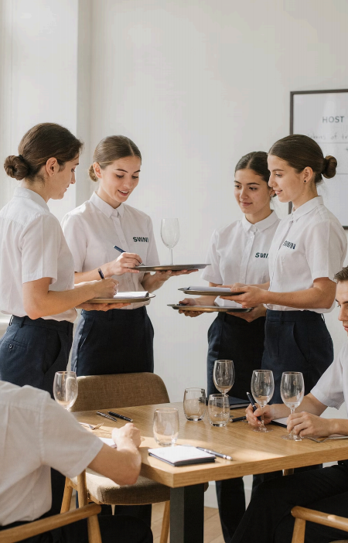
Your Foundation Starts Here
Communication
drives everything in
tourism.
Customer Satisfaction
Workplace Coordination
Service Quality
Professionalism

