Slide 1
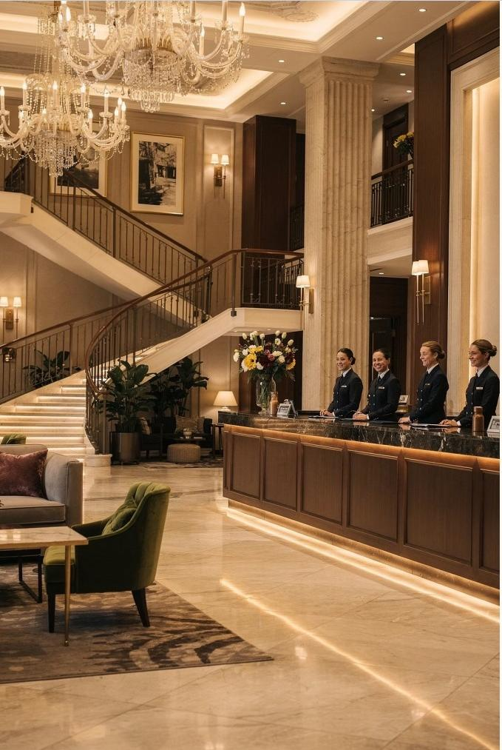
Module 1
Introduction to Hospitality and Tourism Business
Communication
Course:Hospitality and Tourism Business Communication How communication shapes the guest experience
Prof. Alia Amor D. Uy, MBA

Slide 2
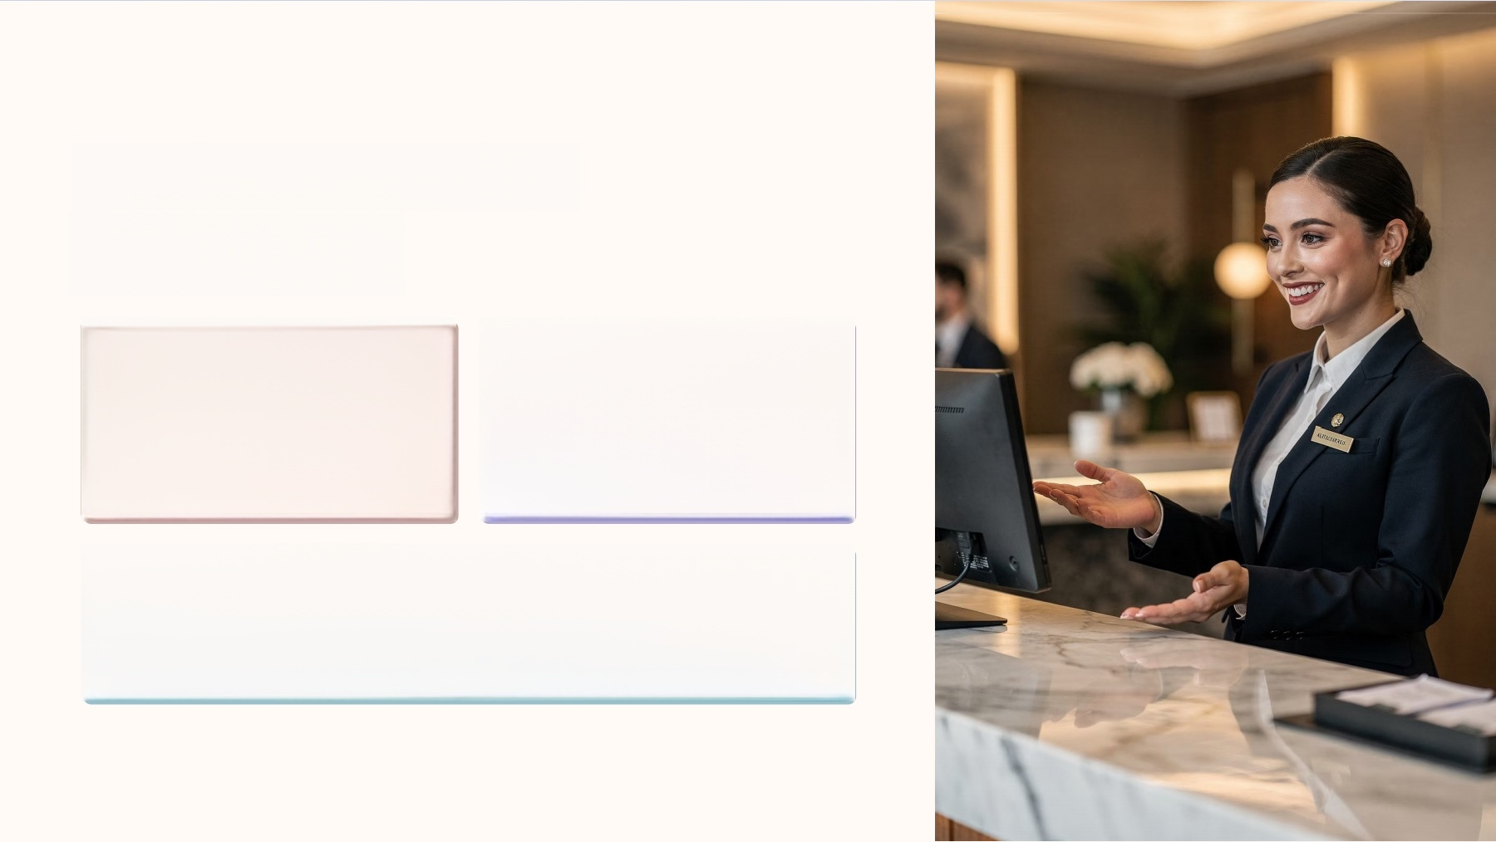


Communication Is
Everywhere
Hotels
Welcoming guests
Travel Agencies
Explaining tour
packages
IO Restaurants
Assisting customers

Slide 3

Tourism
Organizations
Communicate Too
Every message and interaction shapes the customer
experience

Slide 4

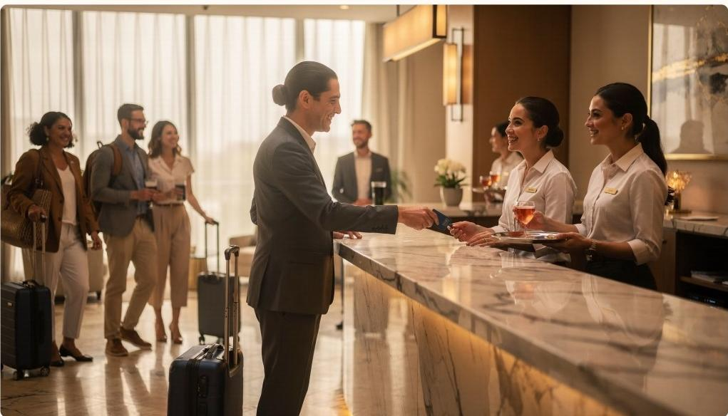
Communication
Affects Service
Quality
Customer Satisfaction
Workplace
Professionalism
Service Quality

Slide 5
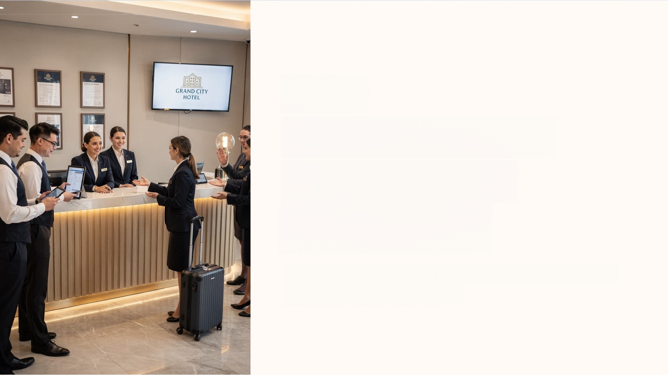
Your
Communication
Skills=Guest
Experiences
As future tourism professionals,how you communicate shapes every guest's journey.

Slide 6
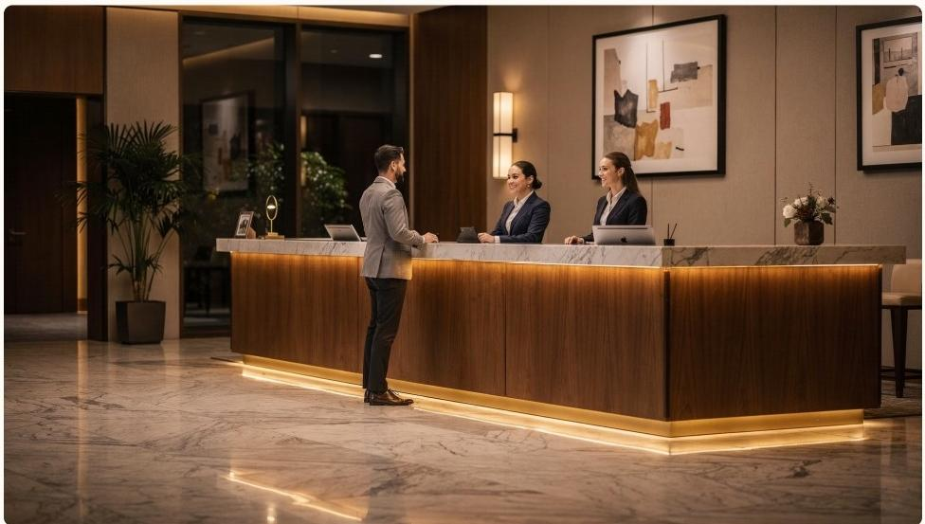
Every
Interaction
Reflects Your
Organization
Hospitality &tourism are highly dependent on communication.
□ Each interaction reflects your organization's image, reputation,and service
quality.

Slide 7
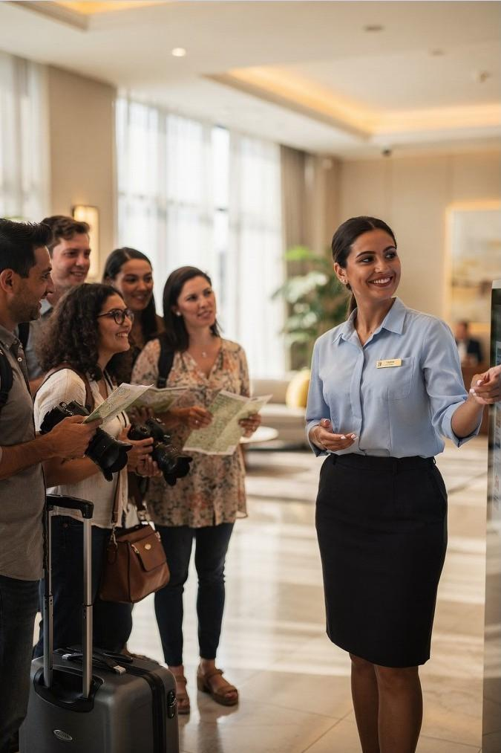


Communication Is More
Than Speaking
Understand Needs
00
Respond Professionally
Handle Multicultural Situations

Slide 8
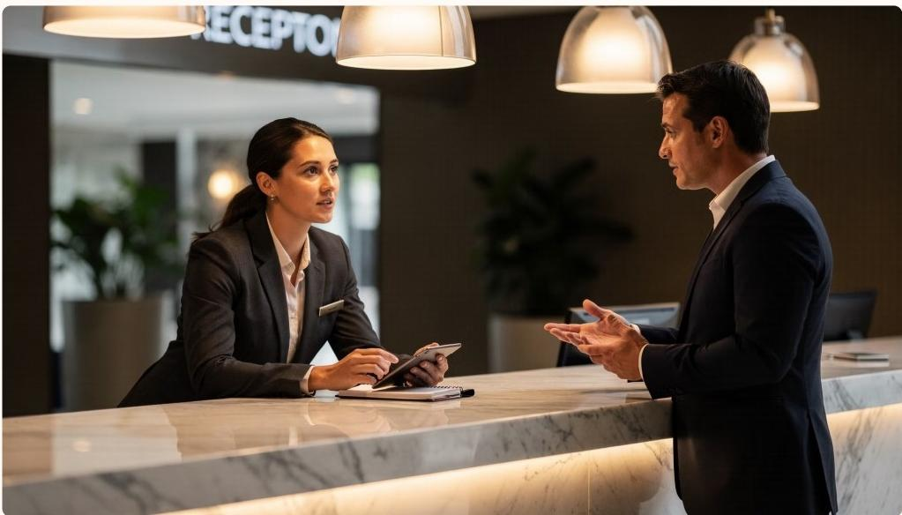
Conflict
Resolution8
Professionalism
Communication includes:
· Resolving conflicts calmly
·Maintaining professionalism
·Both oral and written interactions

Slide 9
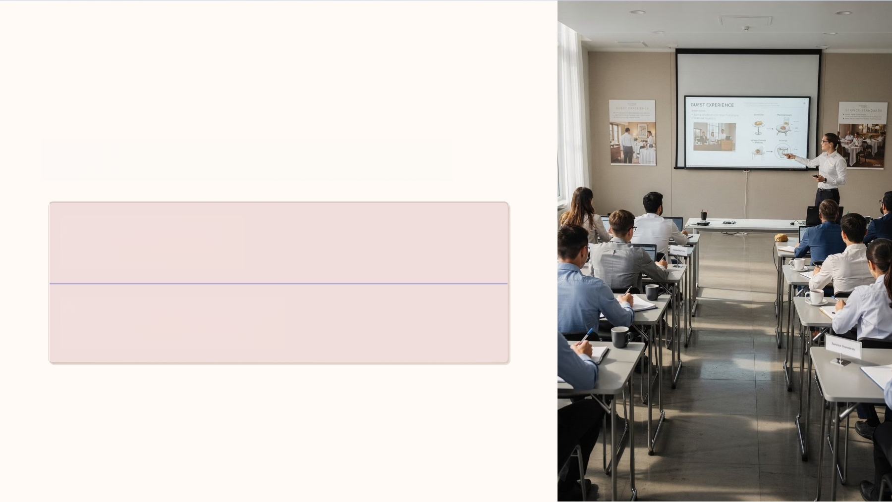
What This Course Covers
Foundational Skills
Core communication basics
Advanced Competencies
Professional-level communication

Slide 10
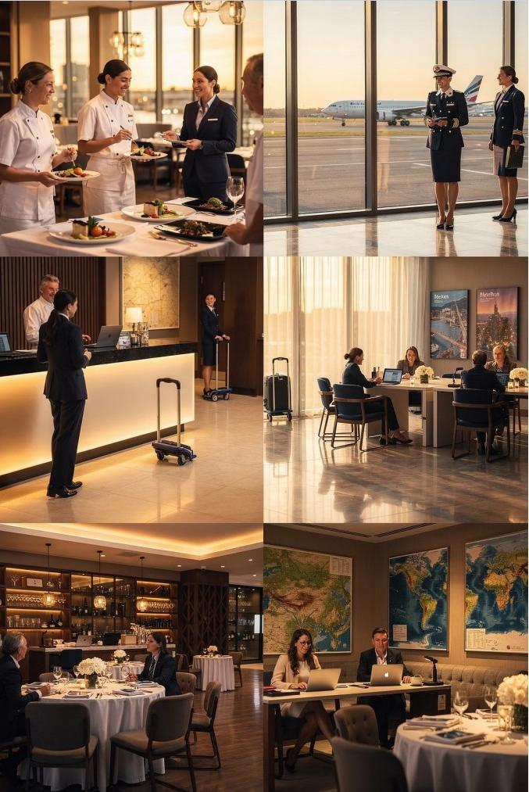


Where You'll Use These Skills
Hotels
小
Airlines
Restaurants
Travel Agencies
0
Events

Slide 11

What Is Communication?
The process of exchanging information,ideas,feelings,and messages between
individuals or groups.

Slide 12
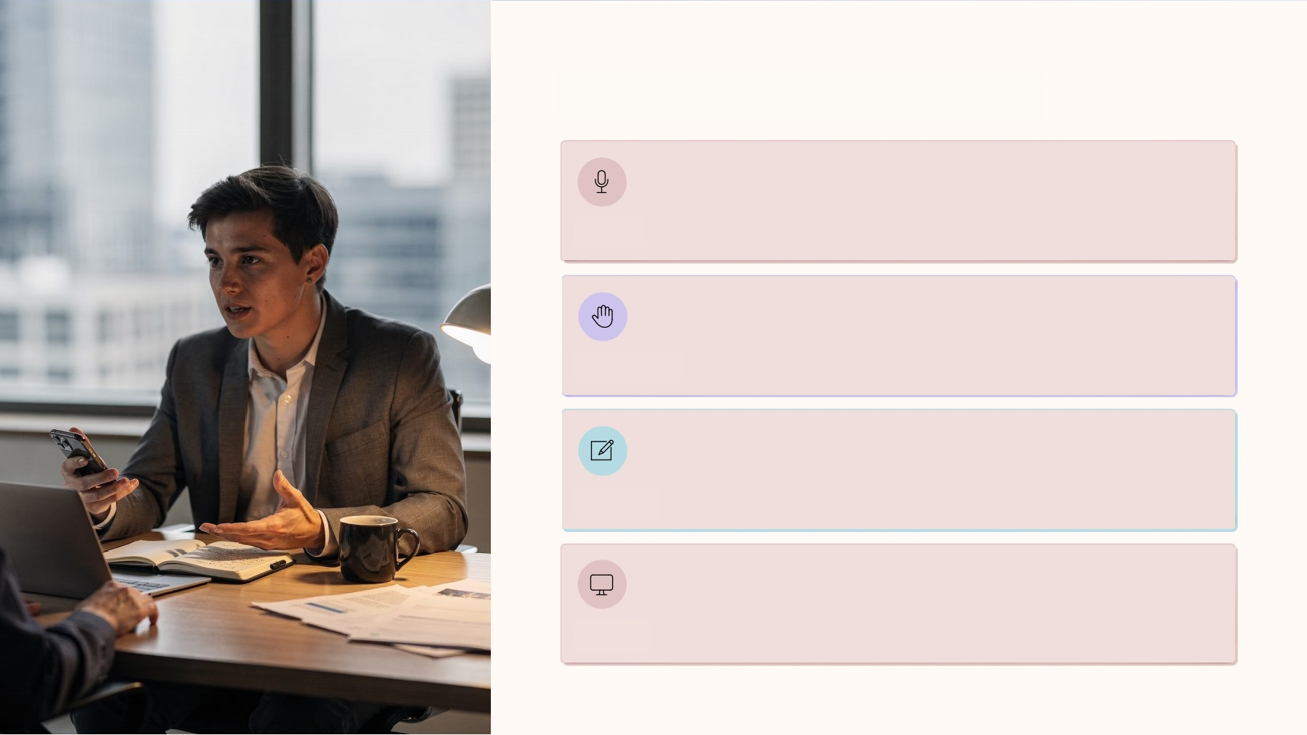
Forms of Communication
Verbal
Nonverbal
Written
Digital

Slide 13
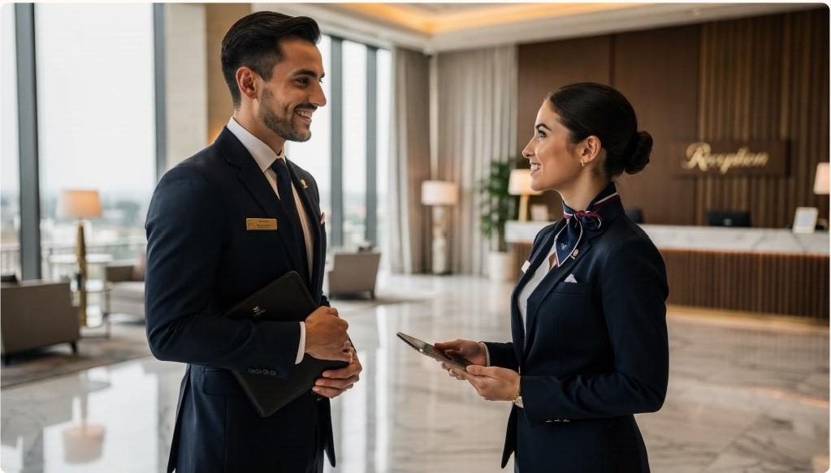
Verbal
Communication
Spoken words used in:
· Conversations &greetings
· Discussions
·Spoken instructions

Slide 14





Nonverbal Communication
Facial Expressions
Gestures
Body Language
Tone of Voice

Slide 15

Effective
Communication
Communication is effective when the receiver correctly understands the intended message of the sender.
Sender Send Message Receiver Understand

Slide 16
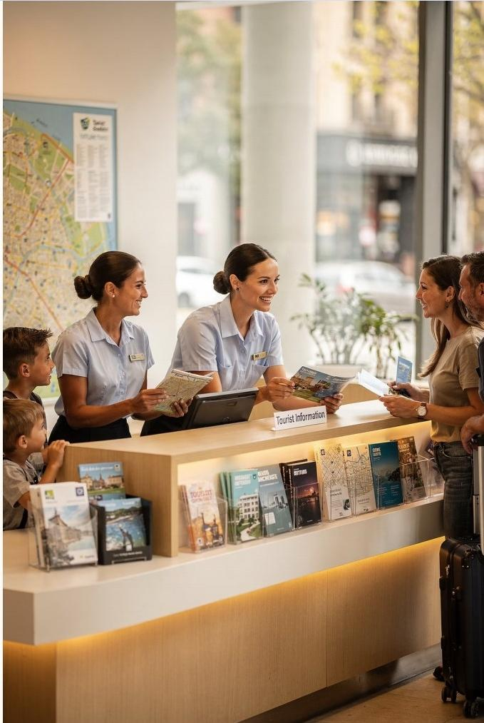
Why Communication
Matters in Tourism
Communication serves several key purposes in hospitality and tourism.

Slide 17
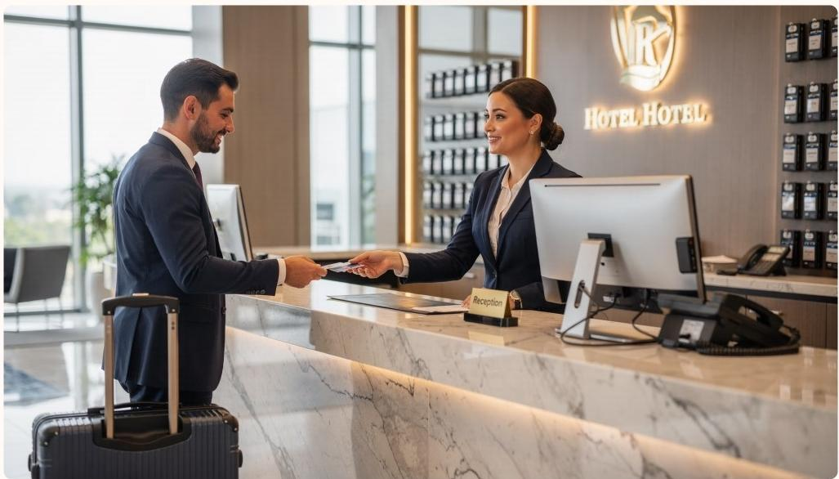
Providing
Information
Inform Guests
Assist Inquiries
Manage Reservations

Slide 18
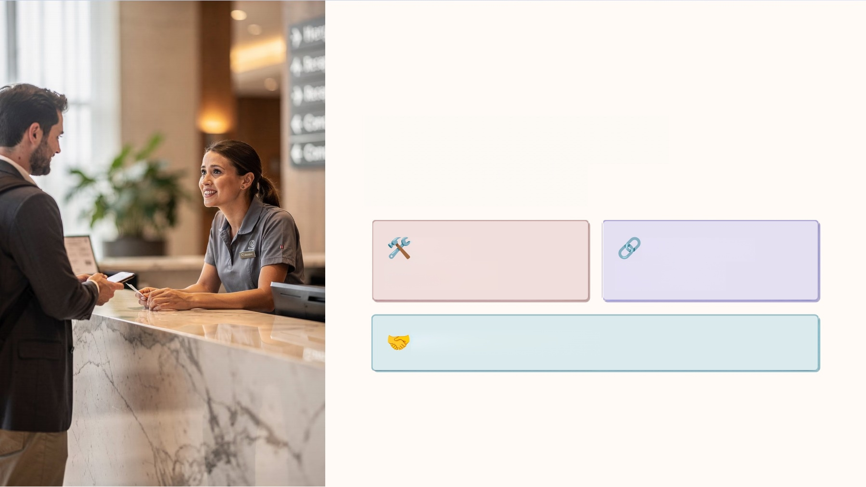
Solving Building
Relationships
Solve
Complaints
Coordinate
Operations
Build Relationships

Slide 19



Promoting
Tourism
Services
Communication is essential for
marketing and promoting
tourism products and services.
③ From social media
campaigns to travel
brochures 一
communication drives
tourism.

Slide 20
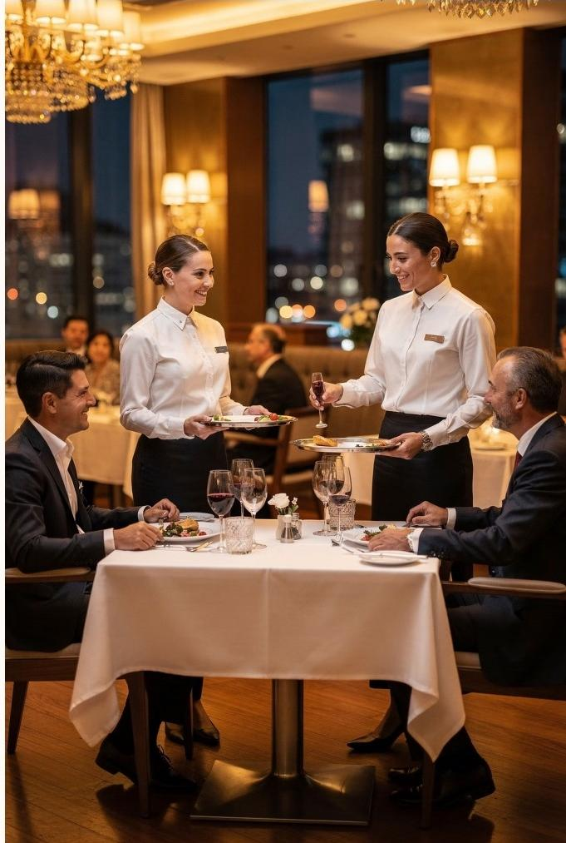

Service-Oriented
Industry
In hospitality and tourism, communication directly
affects every guest experience.
Great Communication
=Happy Guests
Happy Guests
=Successful Business

Slide 21
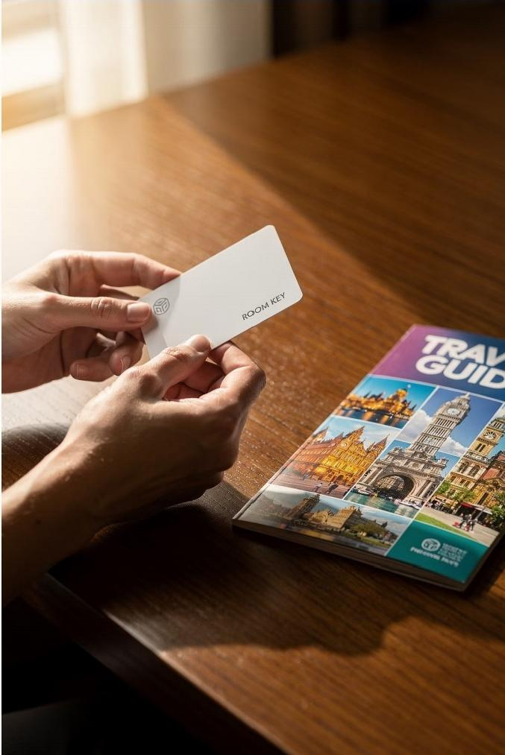
Intangible Tourism Services
Unlike physical products,tourism services cannot be seen or touched before purchase.
③ You can inspect a shoe-but not a hotel stay.

Slide 22

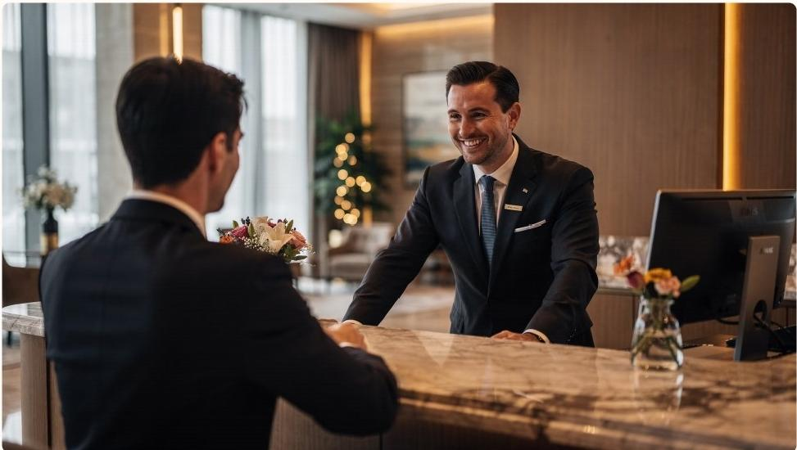
How Guests
Evaluate Service
Interactions
Responsiveness
Empathy
Professionalism

Slide 23
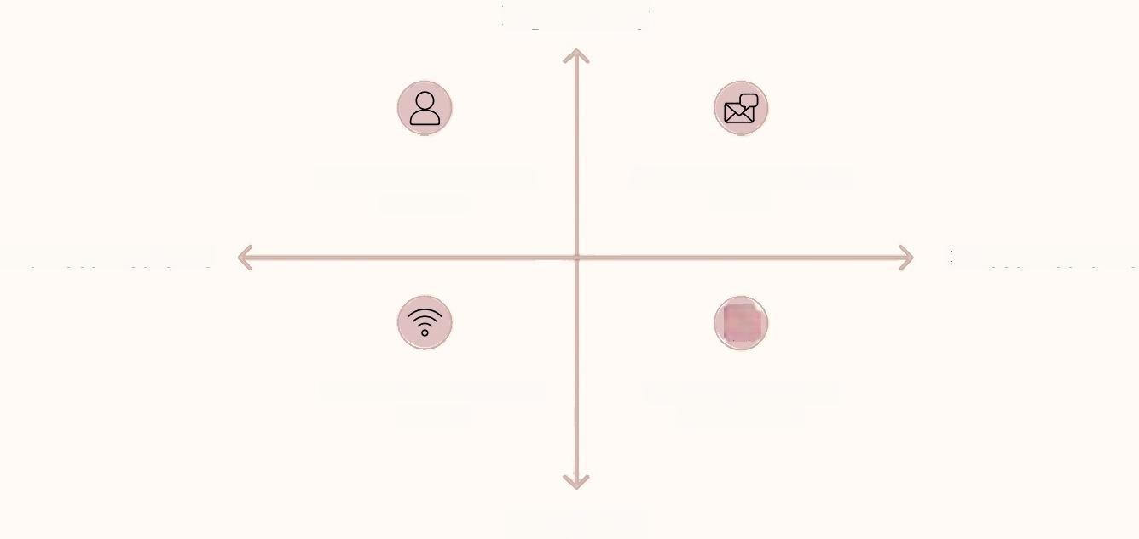
The Communication Process
High Clarity
Sender-Originates the message
Indirect Mediums
Channel-Medium used to send
Message-Content and intent
只
Direct Mediums
Receiver-Interprets the message
Low Clarity
Every interaction in hospitality follows this cycle.

Slide 24
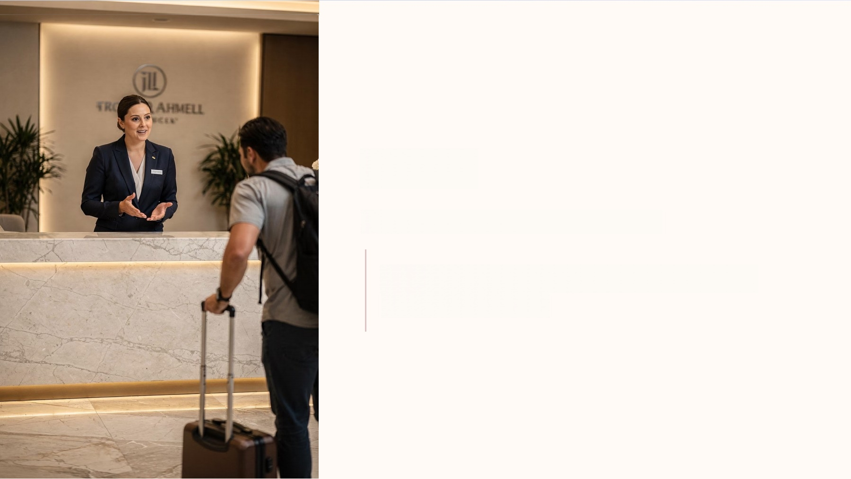
Sender
The person who initiates the message.
Example:A receptionist informing a guest about check-in procedures.

Slide 25
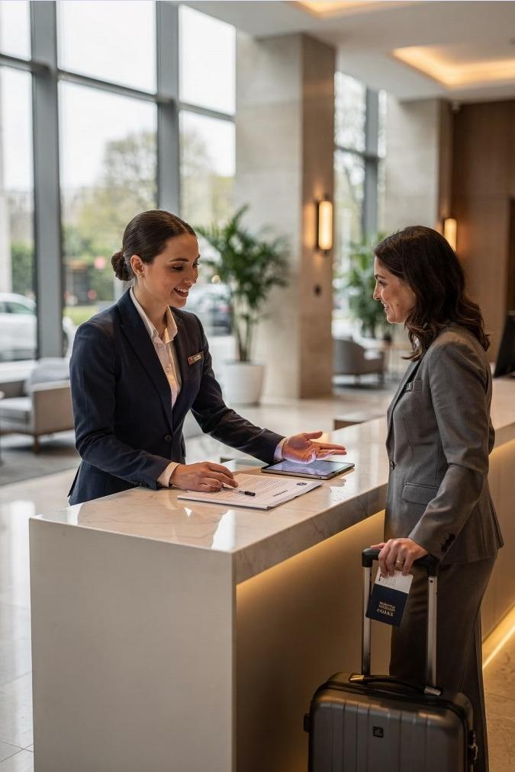
Message
"Your room is on the 5th floor. Breakfast is served
6:00 AM-10:00 AM."
The message is the information being communicated- it must be clear and accurate.

Slide 26
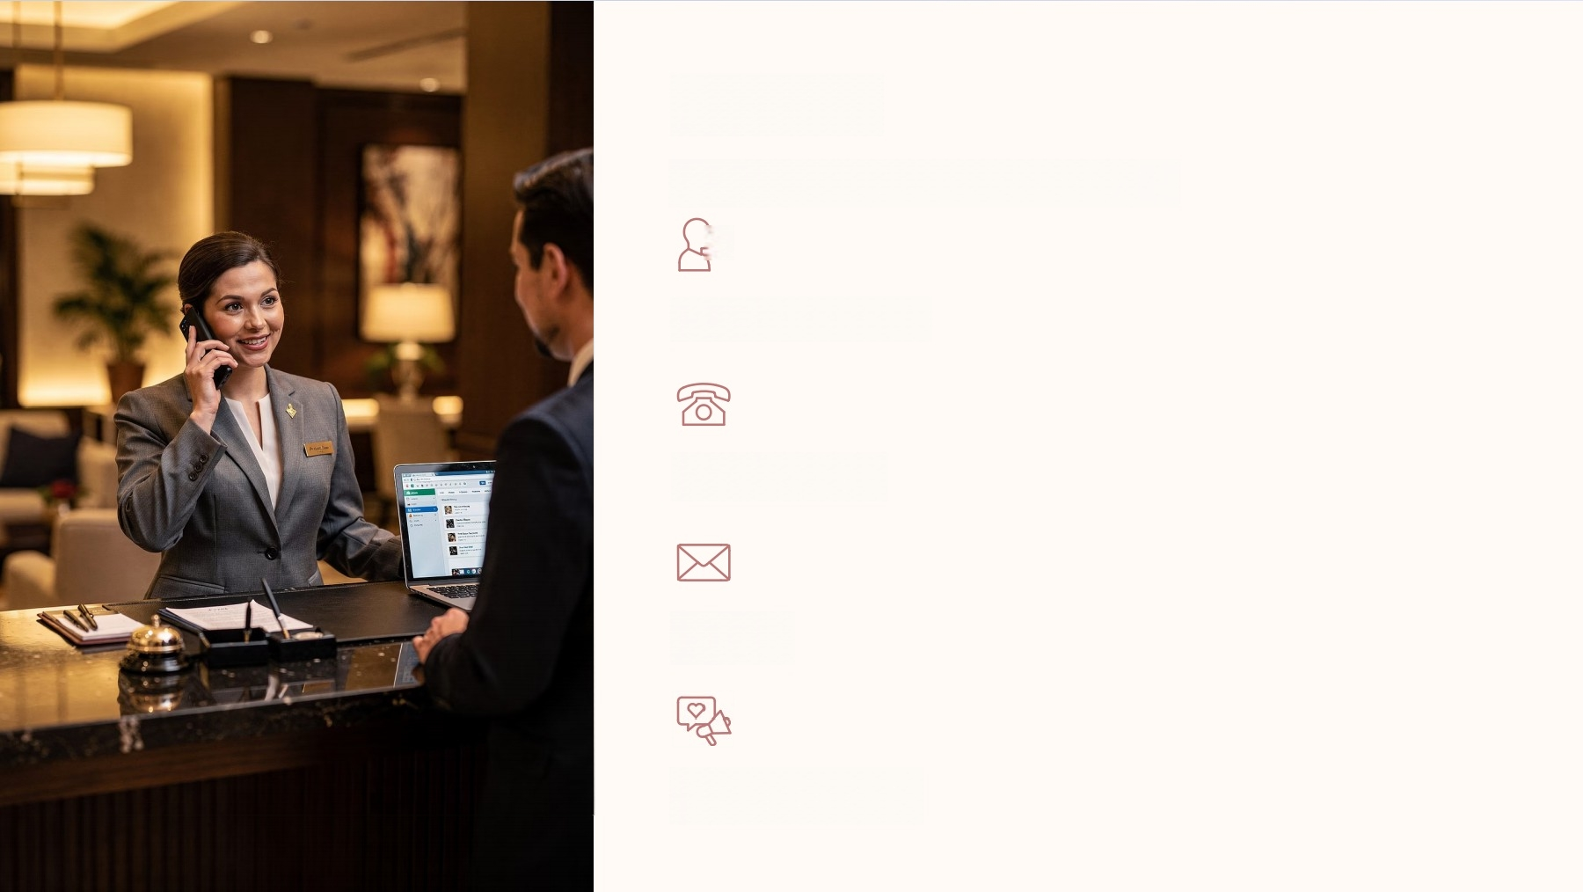
Channel
The medium used to deliver the message.
)
Face-to-Face
Phone Call
Email
Social Media

Slide 27
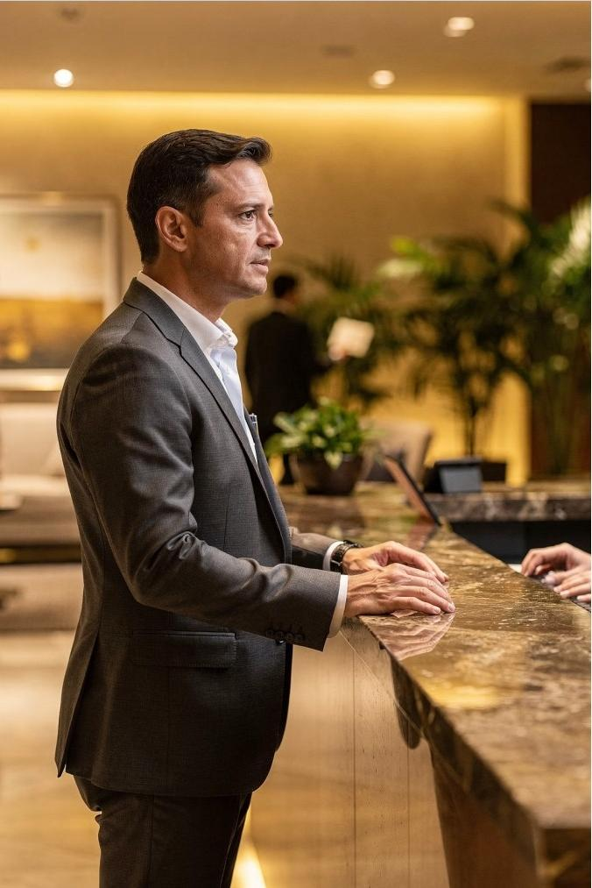
Receiver Feedback
The receiver interprets the message.
"Thank you.What time is the swimming pool open?"
This response is feedback-the receiver's reply.

Slide 28
Noise
Anything that interferes with communication.
Language Differences
Loud Environments
Poor Internet
Misunderstandings
Emotional Stress

Slide 29

Communication=Guest
Satisfaction
Clear,professional communication leads to positive
guest experiences.

Slide 30

Workplace Coordination
FRONT OFFICE
HOUSEKEEPING
COMMUNICATION
MANAGEMENT
TRANSPORTATION
FOOD
SERVICE

Slide 31
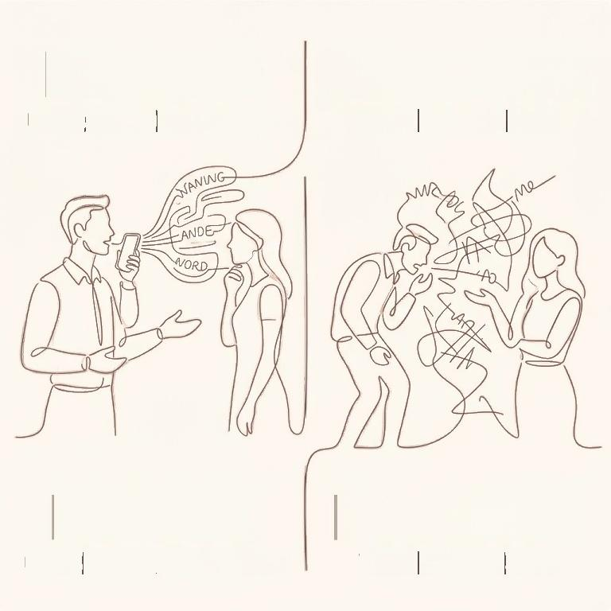
EFFECTIVE
CLEAR|TIMELY |PROFESSIONAL
EFFECTIVE
CLEAR|TIMELY |PROFESSIONAL
INEFFECTIVE
VAGUE |DELAYED|RUDE
Service Quality
Communication directly influences service delivery.
A Even small communication failures can
hurt the guest experience.
INEFFECTIVE
VAGUE |DELAYED |RUDE

Slide 32
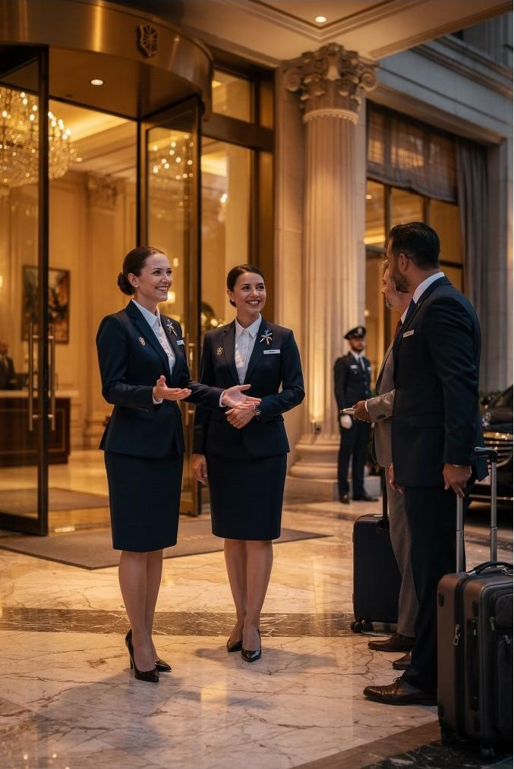
Brand Image
Employees represent the organization.
How you communicate =how guests see the brand.

Slide 33
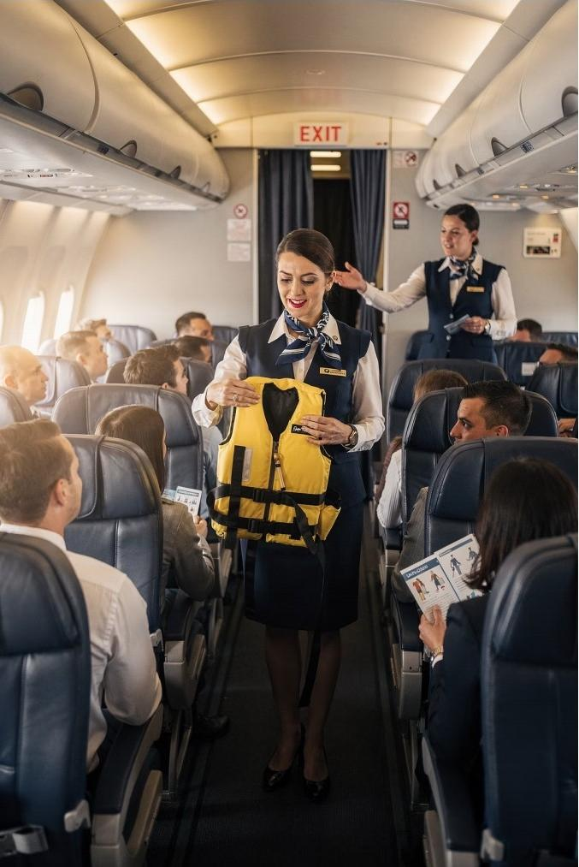

Safety and Security
Clear communication is critical during:
Emergencies
Evacuations
Safety Briefings
Crisis Situations

Slide 34

4 Features of Hospitality Communication
1
Customer-Oriented
Guest needs come first
3
Intercultural
Across cultures &languages
2
Professional
Courtesy &respect always
4
Service-Focused
Fast-paced,dynamic settings

Slide 35
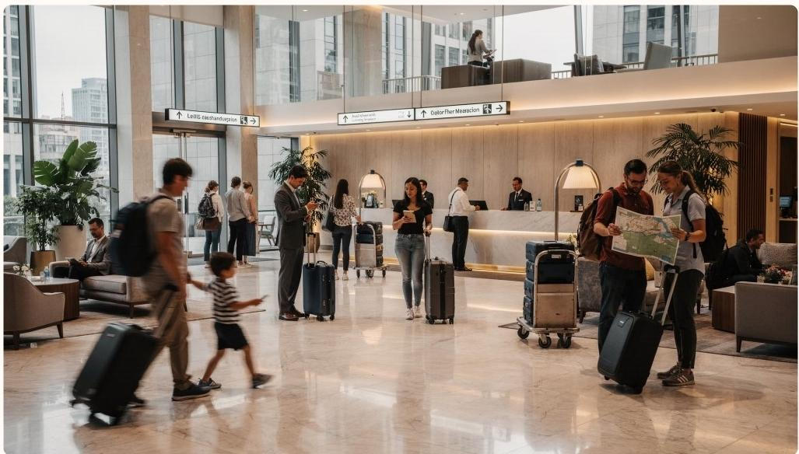
Intercultural8
Dynamic
Tourism brings people from all
cultures and languages
together.
Employees must adapt to fast- paced,changing environments.

Slide 36
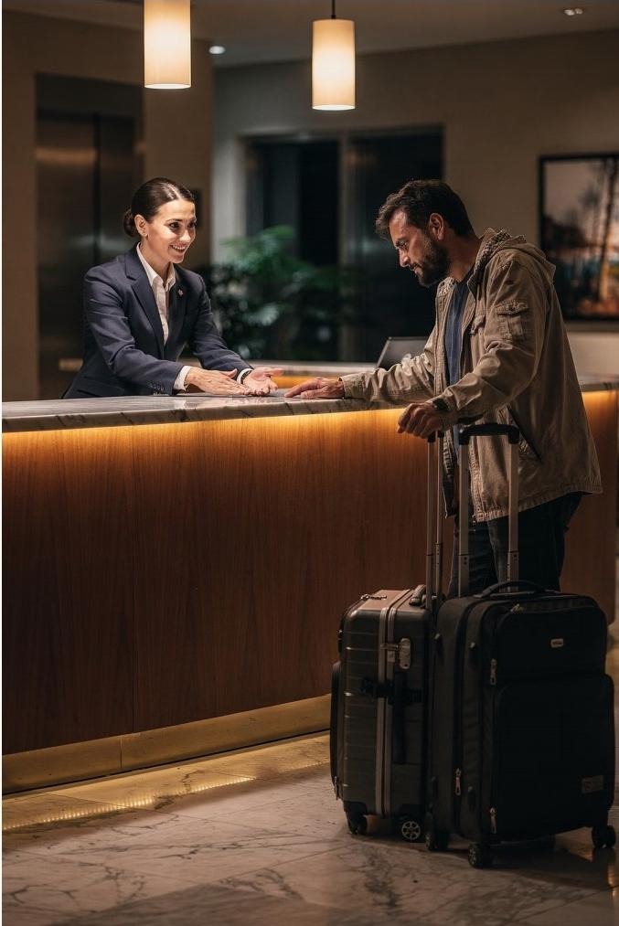
Real-World Scenario
A tourist arrives after a delayed flight —tired and
frustrated.

Slide 37
"Good evening,Ma'am.Welcome to our hotel.I understand you had a long journey.
Let me assist you with your check-in quickly so you can rest comfortably."
—Hotel Receptionist

Slide 38




This Statement Demonstrates
Empathy
Professionalism
Positive Attitude
Customer-Oriented

Slide 39

Communication is
Everything
In hospitality and tourism,how you communicate defines
the guest experience.

