Slide 1
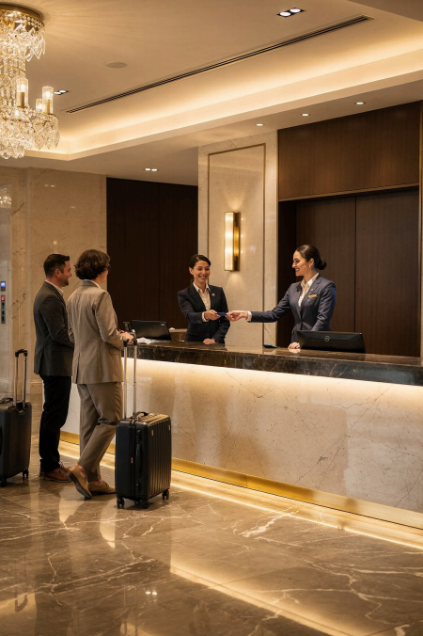
Module 2
Professional
Communication
in Hospitality and Tourism
Course: Hospitality and Tourism Business Communication
How we speak shapes every guest experience.
Prod. Alia Amor D. Uy, MBA

Slide 2
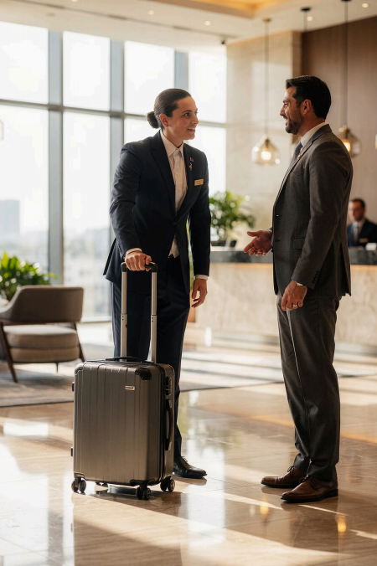
Communication and
Customer Experience
d Guest Satisfaction Happy guests return
, Workplace
Relations
Better teamwork
⭐ Service Quality
Higher standards

Slide 3
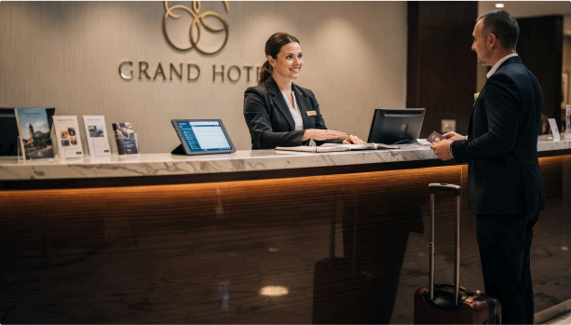
KEY STANDARD
What Guests
Expect
Confidence
Speak with assurance
Clarity
Easy to understand
Courtesy
Always polite
A calm, respectful employee can
turn a complaint into loyalty.

Slide 4



Verbal Communication
Using spoken words to deliver
messages
Speaking
Delivering information clearly
Listening
Understanding guest needs
Informing
Sharing accurate details
The most common form of communication in hospitality.

Slide 5
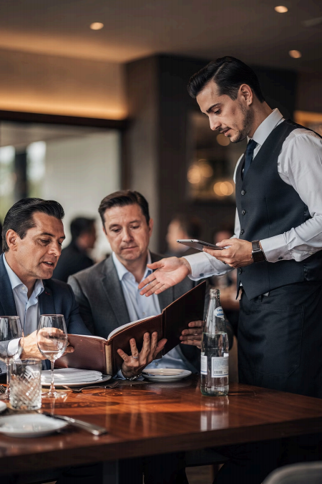




Why Verbal Skills Matter
Guest Satisfaction
Workplace Coordination
Build Trust
Service Quality

Slide 6
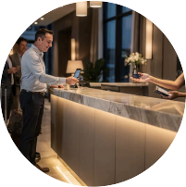

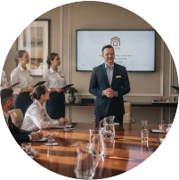
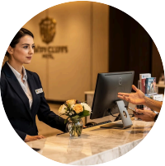
When Do We Use Verbal Communication?
Welcoming Guests
Tourism Information
Workplace Meetings
Handling Concerns

Slide 7
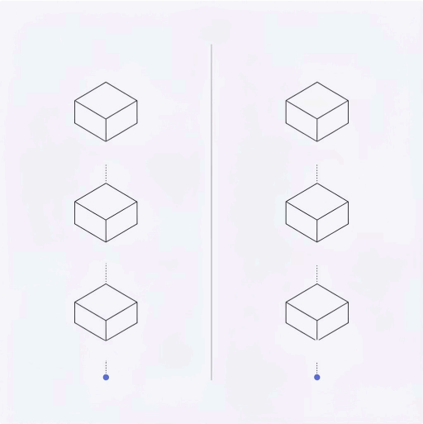

Clear Communication Understanding Satisfaction Efficiency | Unclear Communication Confusion Misunderstanding Dissatisfaction
Messages must be easy to understand — complete, accurate, and direct.
Unclear messages cause confusion,
delays, and unhappy guests.

Slide 8
Clarity in Action
❌ Poor
"Maybe the room isn't ready yet. "
Vague · Confusing · Unprofessional
✅ Better
"Your room will be ready in approximately 15 minutes. "
Clear · Specific · Professional
One small change — a completely different guest experience.

Slide 9
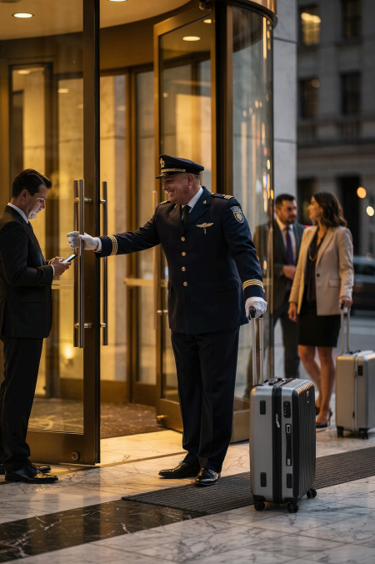
Courtesy in
Communication
Always communicate with kindness, patience, and professionalism.
Be Kind
Be Patient
Be Professional

Slide 10



Courteous Expressions to Use
"Good morning."
"May I assist you?"
"Thank you."
"You're welcome."
"Excuse me."
Small words. Big impact. Guests feel valued and welcome.

Slide 11
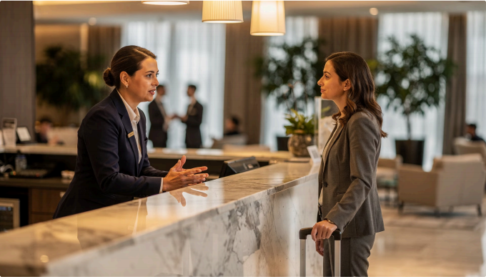
Tone of Voice
It's not just what you say — it's how you say it.
Pitch
Friendliness
Emotion
Attitude

Slide 12
Tone Changes Everything
"Please wait for a moment."
⑩ Warm & Calm Tone
Guest feels respected and at ease
● Impatient Tone
Guest feels dismissed — even with the same words
Same words. Different tone. Completely different experience.

Slide 13
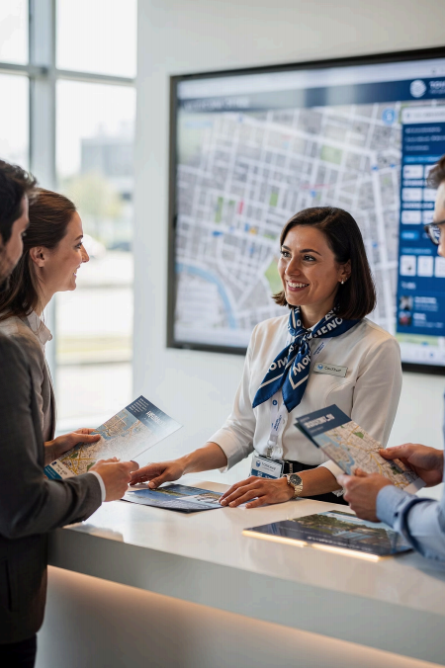
Confidence Builds Trust
Confident employees …
Speak clearly and
directly
Answer without
hesitation
Reflect
professionalism
Guests trust employees who …
Sound knowledgeable
Project calm assurance
Demonstrate
competence

Slide 14



Benefits of Strong Verbal Communication
Happier Guests
Higher satisfaction scores
Better Teamwork
Fewer errors, smoother operations
Customer Loyalty
Guests come back
Positive Image
Strong organizational reputation

Slide 15
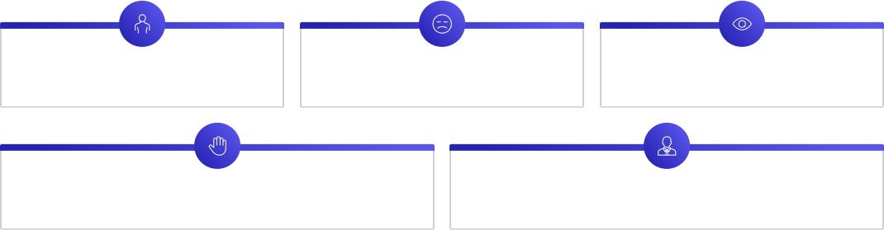
Nonverbal Communication
Messages without words
Posture Facial Expressions Eye Contact
Gestures Appearance
Guests read your body — even before you speak.

Slide 16
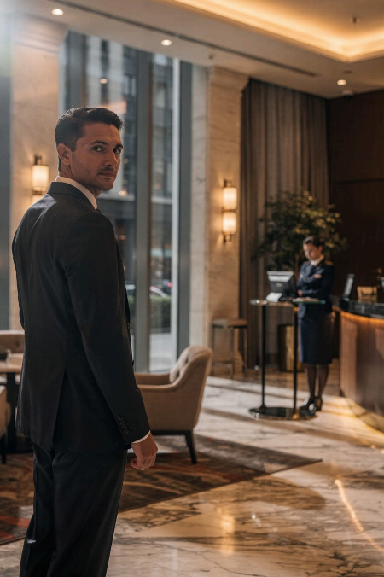
First Impressions Start Before You Speak
Guests observe your behavior, appearance, and body language before any words are exchanged.
◉ Customer Perceptions
Formed instantly, nonverbally
✨ Guest Experience
Shaped by how you look and move

Slide 17
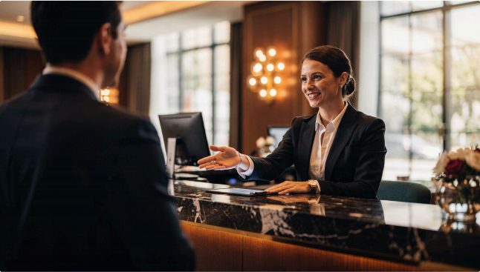
Facial Expressions
Your face tells a story
A smile creates warmth. A frown creates distance.
d Positive Welcoming, open, friendly
z Negative Poor impressions, lower satisfaction

Slide 18
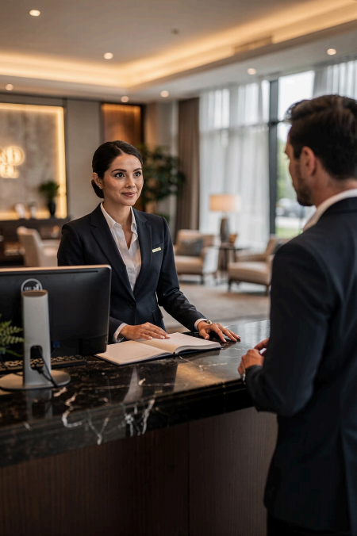
Eye Contact Matters
✅ Good Eye Contact
Shows attentiveness, confidence, and respect — guests feel heard
❌ Avoiding Eye Contact
Appears distracted, nervous, or uninterested

Slide 19
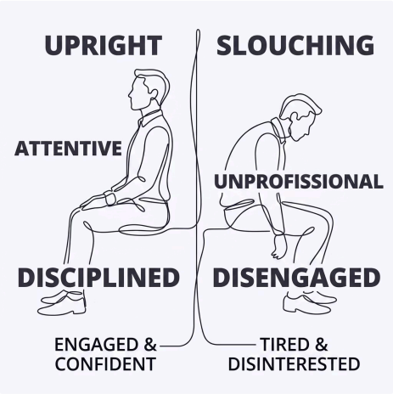
Posture: Stand Tall, Stand Professional
What posture communicates
Professionalism
Confidence
Attentiveness
Poor posture sends the opposite message — instantly.

Slide 20
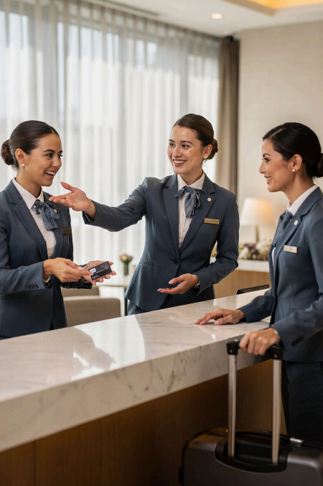
Gestures & Appearance
, Gestures
Hand movements and actions that support your words
o Appearance
Grooming · Hygiene ·
Uniform · Presentation
a Reflects
Discipline, service quality, and organization

Slide 21
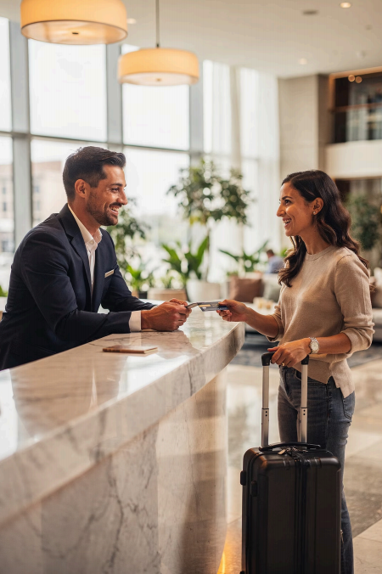



Why Nonverbal
Communication Matters
Welcoming Environment
Guests feel comfortable and valued
Stronger Professionalism
Supports everything you say verbally
Positive Relationships
Builds trust and guest loyalty

Slide 22
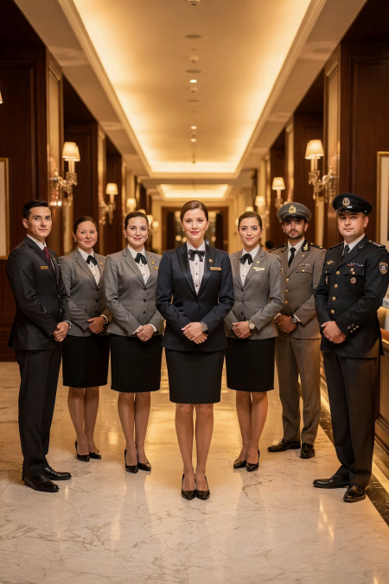
What Is Professionalism?
Behaving appropriately, respectfully, and responsibly in the workplace
Guest Satisfaction Workplace
Relationships
Organizational Reputation

Slide 23
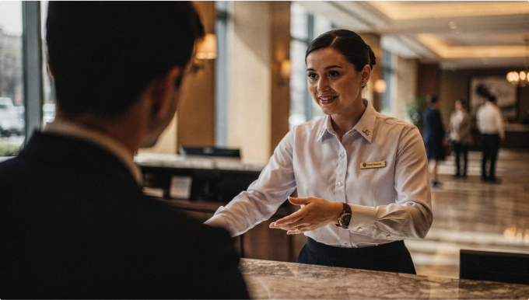
What Professional Employees Do
In both verbal and
nonverbal communication:
Speak politely
Show respect
Dress appropriately
Handle situations calmly

Slide 24
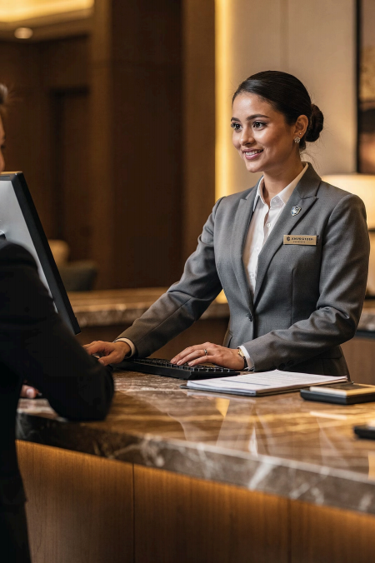



Traits of a Professional
Employee
Respectful & Courteous
Reliable & Ethical
Calm Under Pressure
Customer-Focused

Slide 25
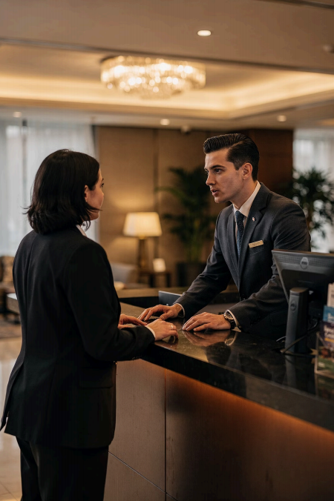
Respectful & Courteous Communication
, Listen Carefully Give guests your full attention
P Use Polite Language Value their concerns and opinions
d Be Friendly Considerate, warm, and genuine

Slide 26
Reliability & Calm Under Pressure
Reliable Employees
Dependable and trustworthy
Provide accurate information
Complete tasks responsibly
Calm Under Pressure
Hospitality is fast-paced and stressful. Stay calm, patient, and composed — even during complaints or emergencies.

Slide 27
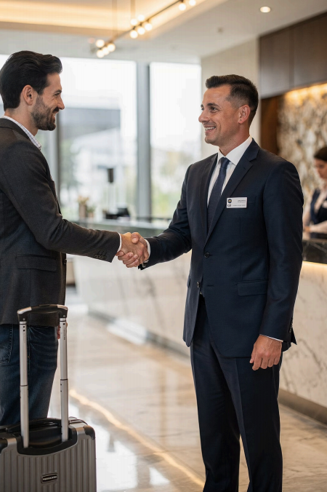
Ethical Communication
Communicate honestly, respectfully, and responsibly — always.
, Build Guest Trust
昌 Maintain
Professionalism
× Protect Reputation

Slide 28
Unprofessional vs. Professional Response
❌ Unprofessional
"It's not my fault. The kitchen is busy."
Blames others · No empathy · No solution
✅ Professional
"I sincerely apologize for the delay, Sir. I will follow up immediately."
Courtesy · Responsibility · Empathy

Slide 29
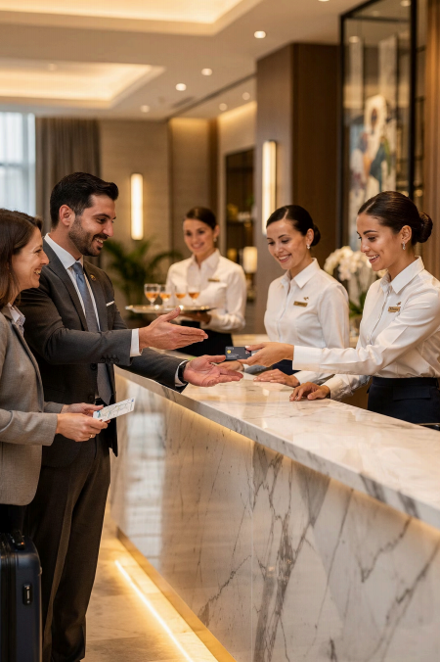

Summary: Professional Communication
P Verbal
Polite, clear, respectful language
像 Nonverbal
Body language, posture, eye contact
a Professionalism
Appearance, attitude, ethics
❤ Guest Impact
Trust, satisfaction, loyalty
Professional communication is the foundation of excellent hospitality service.

