Slide 1
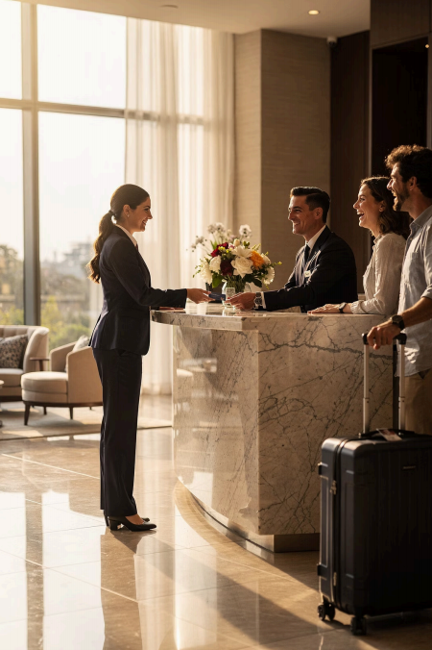
Module 3_Introduction
Oral Communication
in Hospitality &
Tourism
How we speak shapes every guest experience
COURSE: HOSPITALITY AND TOURISM BUSINESS COMMUNICATION
Prof. Alia Amor D. Uy, MBA

Slide 2
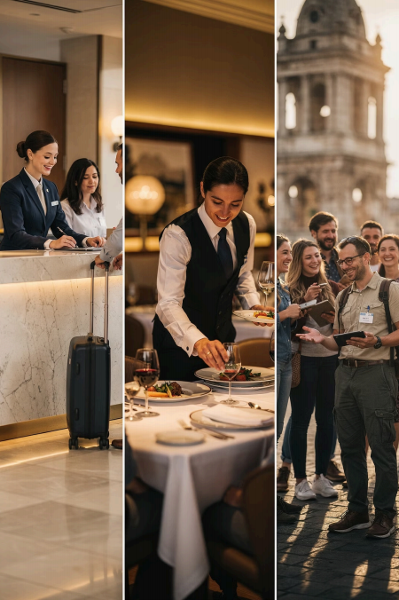




Where We Communicate Every Day
Welcoming Guests
Answering Questions
Handling Concerns
Conducting Tours
Every interaction is a chance to create a positive experience

Slide 3
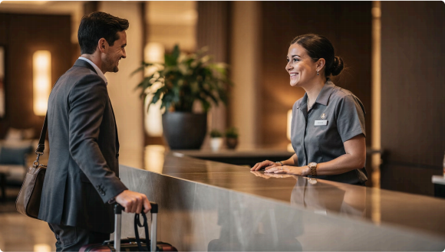
Communication
Shapes the Guest
Experience
Guest Satisfaction A warm tone builds loyalty
Teamwork Clear talk reduces mistakes
Professionalism Respect earns trust

Slide 4
Learning Outcomes
01 | 02 | 03
Demonstrate | Apply | Practice
Effective oral communication | Active listening during guest | Proper telephone etiquette
techniques | interactions
04 | 05
Respond | Evaluate
Professionally to customer inquiries | Real-world oral communication scenarios

Slide 5
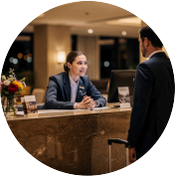


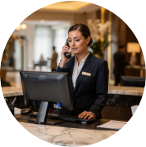
Lesson Overview
Oral Communication
Speaking clearly and professionally
Active Listening
Hearing and understanding fully
Customer Interaction
Building positive relationships
Telephone Etiquette
Polite and effective phone skills

Slide 6
1 | Clearly
Professionalism
Starts with How You Speak
Hospitality teams serve guests from all
cultures and backgrounds
2 | Politely
3 | Respectfully
Your words, tone, and attitude are
your most powerful tools on the job.
4 | Professionally

Slide 7
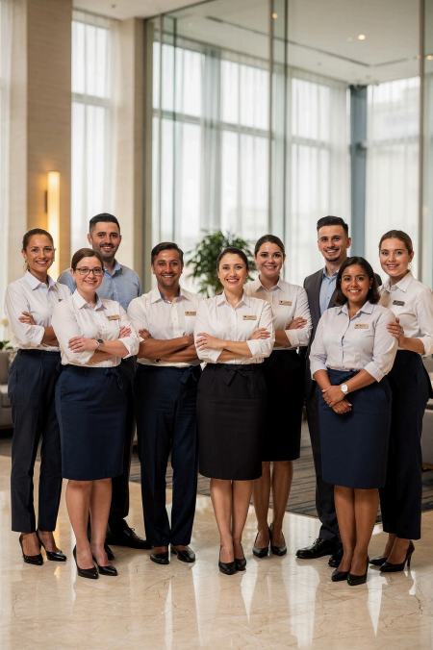

Communication =
More Than Words
Listen Carefully
Respond Professionally
Create Positive Experiences
1
2
3

