Slide 1
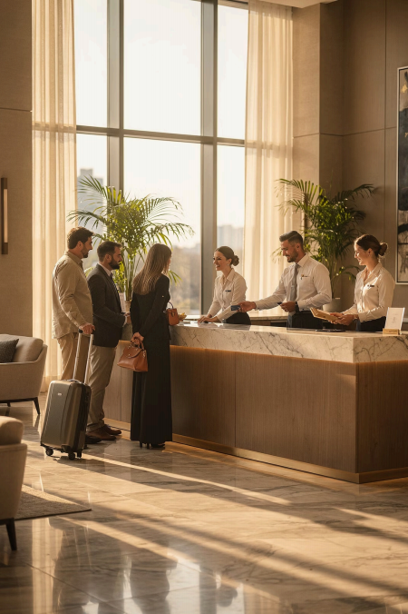
Module 3
Oral Communication
in Tourism &
Hospitality
Course: Hospitality and Tourism Business Communication
Prof. Alia Amor D. Uy, MBA

Slide 2
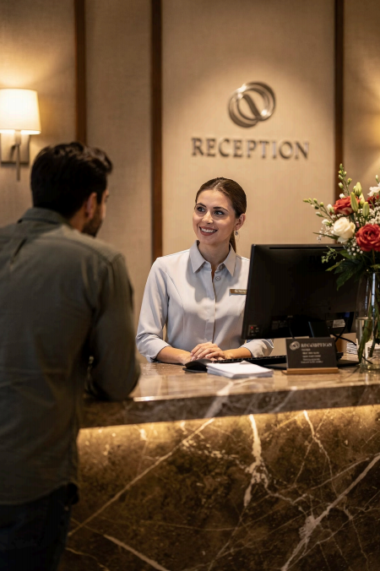
Oral Communication in
Tourism and Hospitality
» Front Desk Assisting & welcoming guests
T Tours Guiding & informing tourists
⚠ Complaints Resolving issues calmly
Speaking well = better service, happier guests.

Slide 3
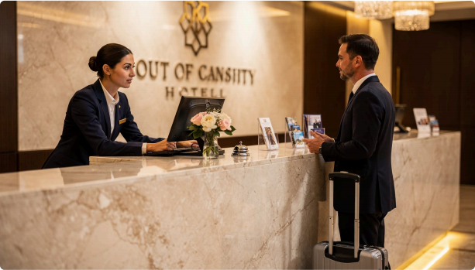
What Is Oral
Communication?
Exchanging information through spoken words.
Ask questions
Clarify information
Get instant feedback
Unlike writing, spoken words allow immediate responses.

Slide 4
Where Do We Use It?
Assisting Guests
Answering questions & requests
Conducting Tours
Sharing info & ensuring safety
Giving Instructions
Explaining procedures & schedules
Handling Complaints
Staying calm & professional

Slide 5
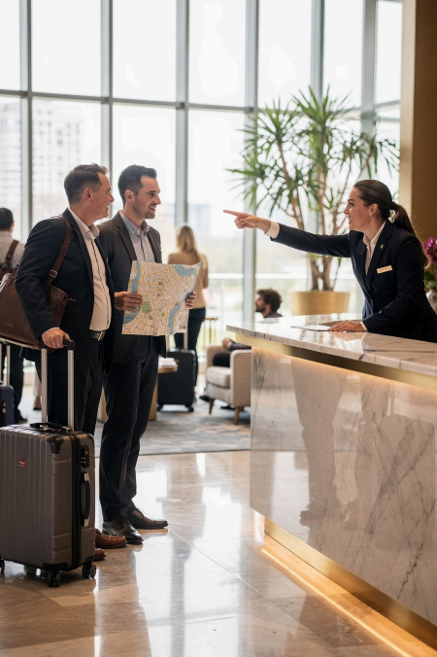
Assisting Guests
Answer questions
Give recommendations
Explain services
Respond to concerns
Polite & clear communication makes guests feel
comfortable and valued.

Slide 6

Giving
Instructions
Employees must explain clearly to avoid misunderstandings.
· Hotel procedures
Safety reminders
Transportation schedules
· Event guidelines
Clear instructions =
smooth operations.

Slide 7
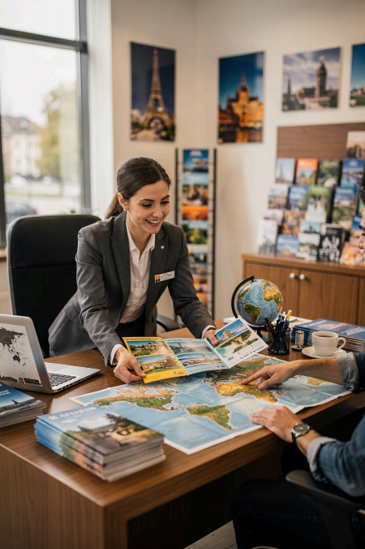
Providing Information
嗲 Hotel Amenities
Þ Restaurant Hours
T Tourist Attractions
, Transportation
Always be accurate and easy to understand.

Slide 8
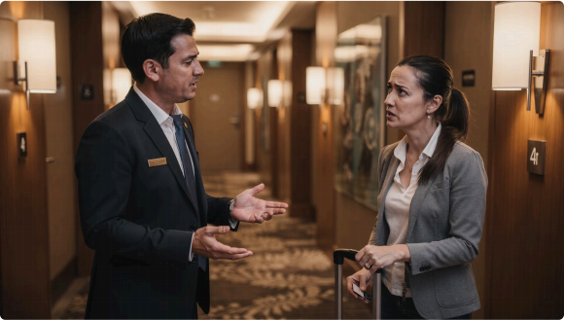
Handling
Complaints
How you speak matters as much as what you say.
● Stay Calm Never raise your voice
, Be Respectful Show empathy always
d Stay Professional Focus on solutions

Slide 9
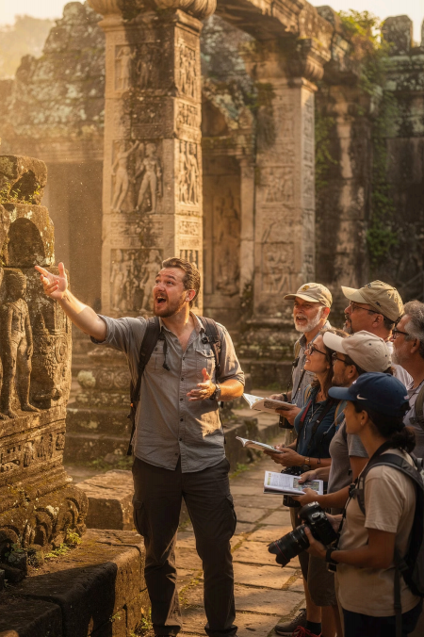




Conducting Tours
1
Explain history & culture
Share travel instructions
Entertain tourists
Ensure group safety
2
3
4

Slide 10
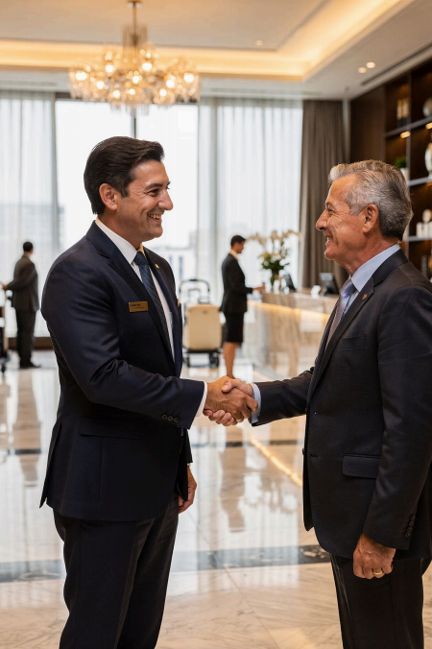



Building Customer
Relationships
Build Trust
Boost Satisfaction
Earn Loyalty
Friendly greetings + respectful conversations = guests who come back.

Slide 11
Active Listening
Speaking is only half of communication — listening is the other half.
 | 1 |  | 2
Focus |  | Understand
Concentrate fully |  | Grasp the meaning
 | 3 |  | 4
Respond
Reply appropriately
Remember
Retain key details

Slide 12
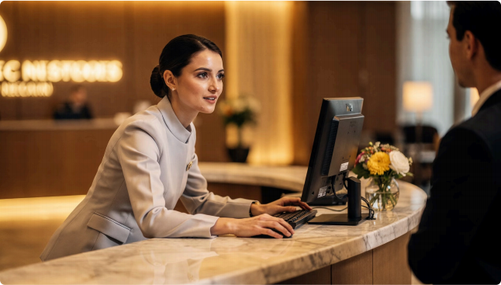


Why Active
Listening Matters
Employees who listen well can
better understand:
Guest needs & preferences Concerns & expectations
Result: Personalized
service that guests remember.

Slide 13
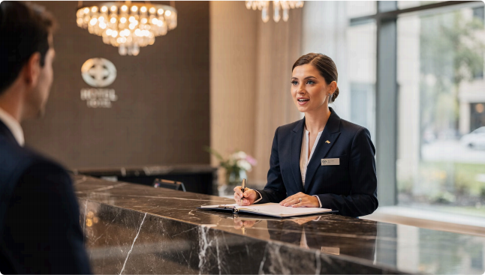
Paying Attention
Focus completely. No
distractions.
✅ DO Face the speaker, maintain eye contact
❌ DON'T Check phone, look away, multitask

Slide 14
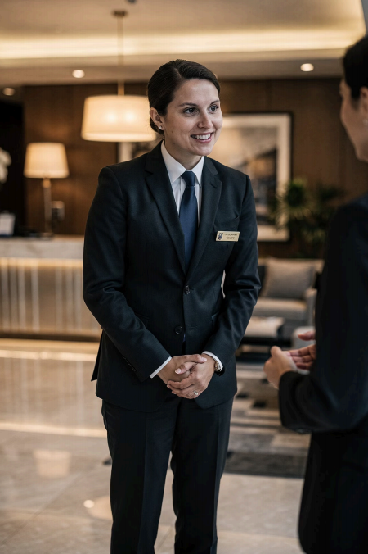
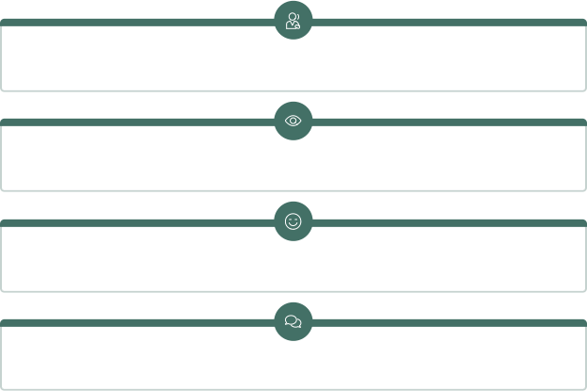
Showing Interest
Use verbal and nonverbal cues to show you care.
Nodding
Eye Contact
Smiling
"I understand"
These cues help guests feel heard and valued.

Slide 15
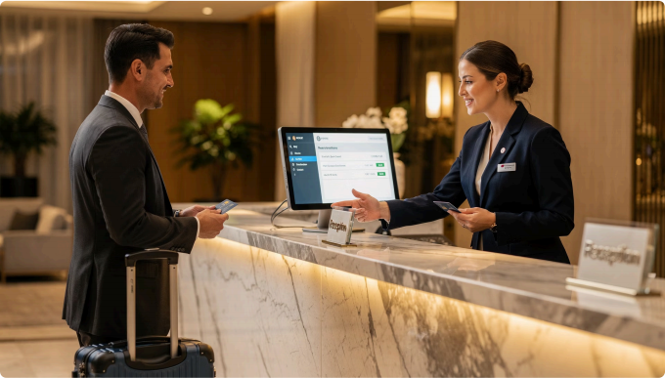
Clarifying
Information
Ask questions to confirm —
avoid misunderstandings.
Reservations
Dietary restrictions
Special requests
Transportation schedules
"May I confirm if you prefer a non-smoking room?"

Slide 16
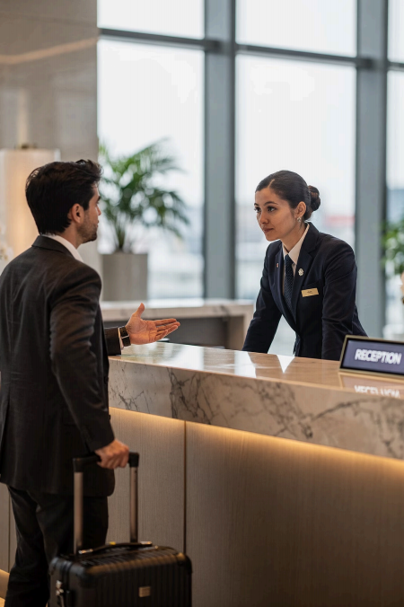
Responding Appropriately
Empathy Understand the guest's feelings
Professionalism Stay composed and respectful
Willingness Always offer to help

Slide 17
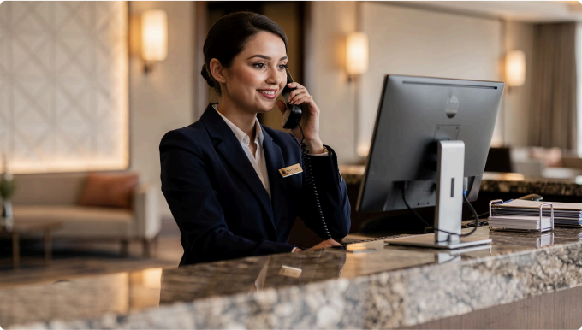
Telephone Communication Still Matters
Guests call to:
· Ask questions
Make reservations
Confirm schedules
Request assistance
Used in hotels, airlines,
restaurants, travel agencies & tourism offices

Slide 18
Telephone Etiquette
Professional behavior on the phone shapes how guests see your organization.
Positive Impressions
First words set the tone
Better Guest Experience
Guests feel heard and valued
Organizational Image
Reflects the whole company

Slide 19
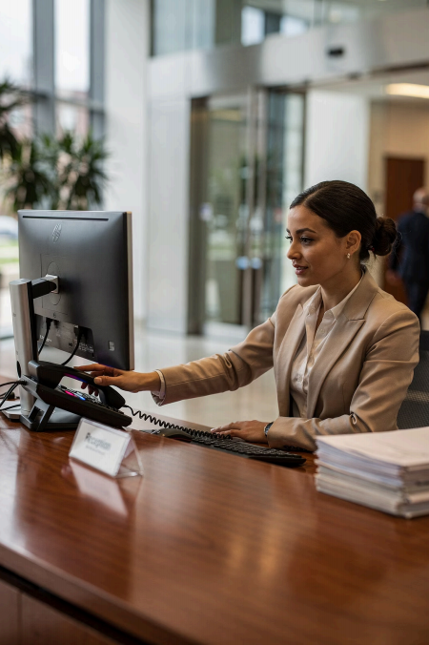
Answer Calls Promptly
乡 Quick Response Shows respect for the guest's time | d Positive Impression Delayed calls = guest frustration
✅ Preparedness Always be ready to assist

Slide 20

Introduce
Yourself
Professionally
"Good morning. Thank you for calling ABC Hotel. This is Anna speaking. How may I assist you?"
Professional
Polite
Welcoming

Slide 21
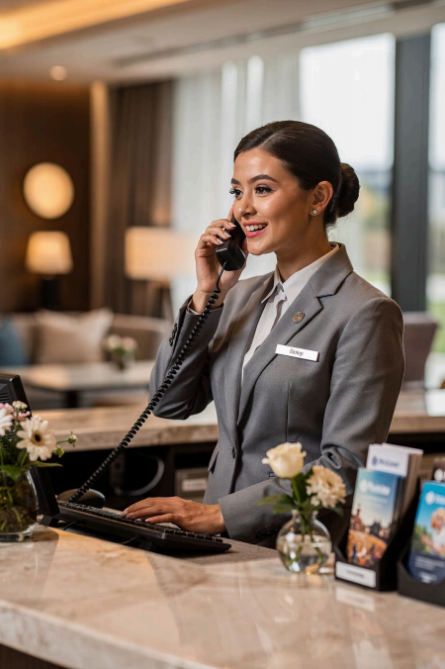



Speak Clearly & Politely
Guests cannot see your body language — your tone of voice is everything.
Speak Clearly
Stay Calm
Be Polite

Slide 22
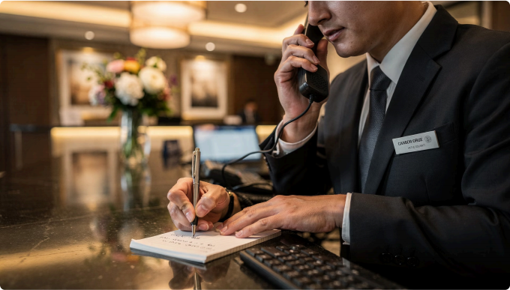
Listen Carefully
& Take Accurate Messages
During calls, record:
Caller's name
Phone number
Schedule or date
Specific requests
Accurate notes prevent
service errors and build trust.

Slide 23
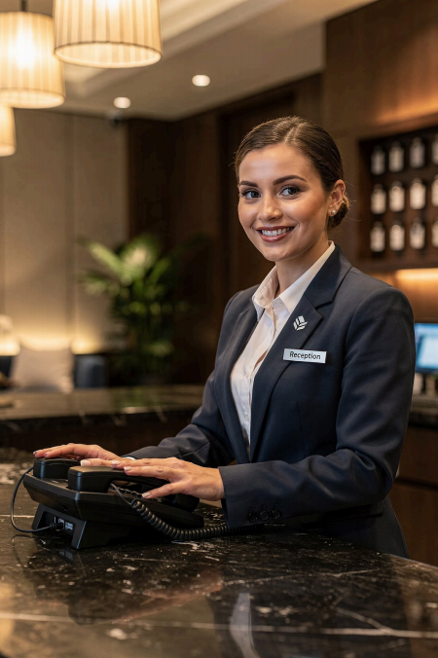
End Calls Professionally
"Thank you for calling ABC Hotel. Have a wonderful day!"
Thank the caller
Offer further help
Close on a positive note

Slide 24
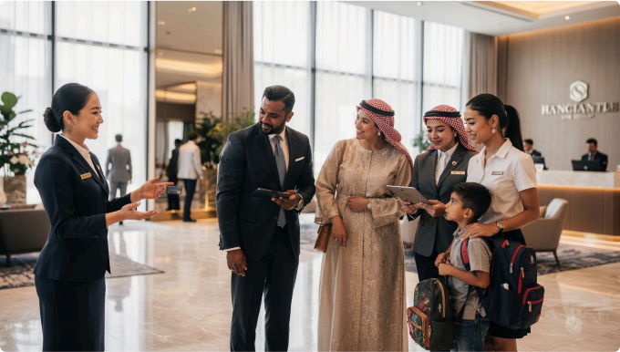
Customer Interaction Skills
Why it matters:
Guest Satisfaction Happy guests return and recommend
Stronger Reputation Positive word-of-mouth grows business

Slide 25
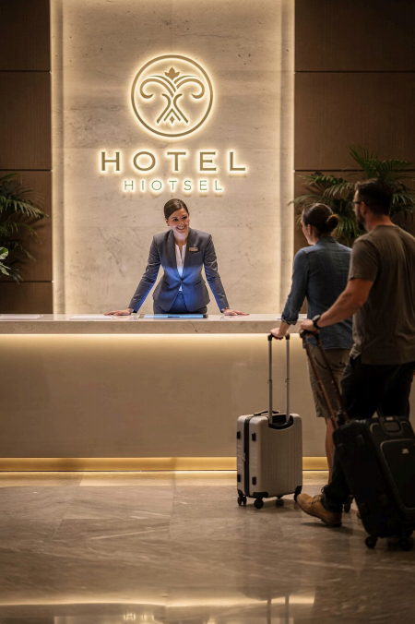
Greeting Guests
First impressions matter most.
Polite Words "Good afternoon, Sir." |  | Friendly Tone Warm and welcoming voice
Body Language Eye contact and a smile

Slide 26
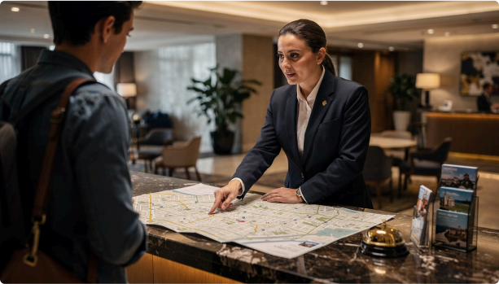
Asking Questions
& Giving
Directions
Questions help you
understand:
· Room preferences
Dietary restrictions
Transportation needs
Good directions are:
Simple and clear
Use landmarks
Easy to follow

Slide 27
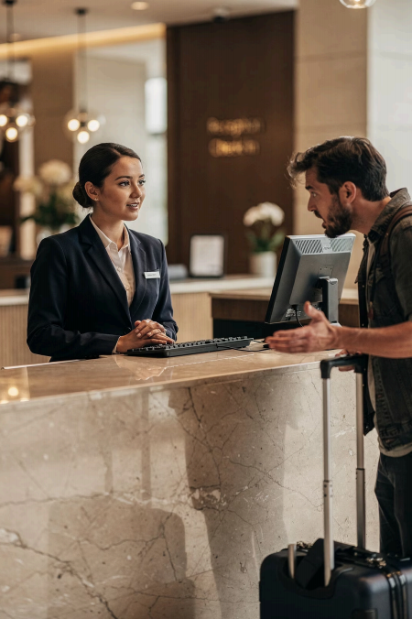


Managing Difficult
Conversations
Stay Calm Never argue or interrupt | Be Respectful Treat all guests with dignity
Find Solutions Focus on fixing the problem

Slide 28

The Complete Communication Journey
Create Listen Respond Build Trust
Experience
Every interaction is an opportunity to leave a lasting positive impression.

Slide 29
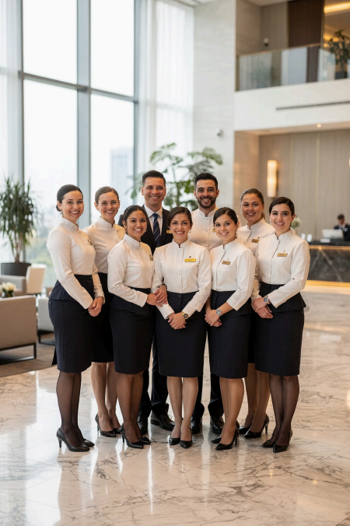
Key Takeaways
1 Speak clearly
Tone and clarity build confidence
2 Listen actively
Understand before responding
3 Respond professionally
Empathy + respect = great service
4 Communicate respectfully
Every guest deserves to feel valued

