Slide 1
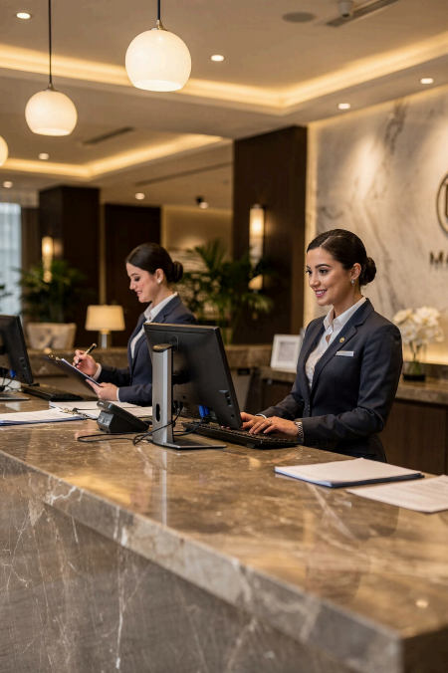
Module 4_Introduction
Written Business
Communication
Course: Hospitality and Tourism Business Communication
Prof. Alia Amor D. Uy, MBA

Slide 2
Why Does Written Communication
Matter?
Creates Records
Written messages can be saved and reviewed later
Builds Trust
Professional writing reflects credibility
Connects Everyone
Guests, staff, suppliers, partners

Slide 3
Learning Outcomes
01
02
Identify
Different forms of written business communication
03
Prepare
Professional emails and memoranda
04
Apply
Correct formatting in letters and reports
Evaluate & Practice
Clarity, professionalism, and customer-oriented writing

Slide 4
Lesson Overview
Emails
s Memoranda
✉ Business
Letters
r Reports
, Customer Writing

Slide 5

Professionalism in
Writing
❌ Unprofessional
· Unclear & disorganized
· Causes confusion
· Damages reputation
✅ Professional
Clear & concise
Organized
Builds credibility

Slide 6

Written Communication & Customer Service
When do we write to
guests?
Confirming reservations
Responding to inquiries
Handling concerns
Sharing updates
Good writing makes guests feel respected and valued

Slide 7
Key Takeaway
Write clearly, professionally, and
respectfully.
Accurate Info
Maintain Records
Better Service
Stay Professional

