Slide 1
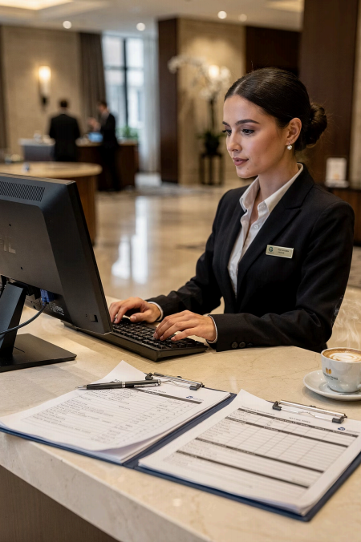
Module 4
Written Business
Communication
Course: Hospitality and Tourism Business Communication
Prof. Alia Amor D. Uy, MBA

Slide 2
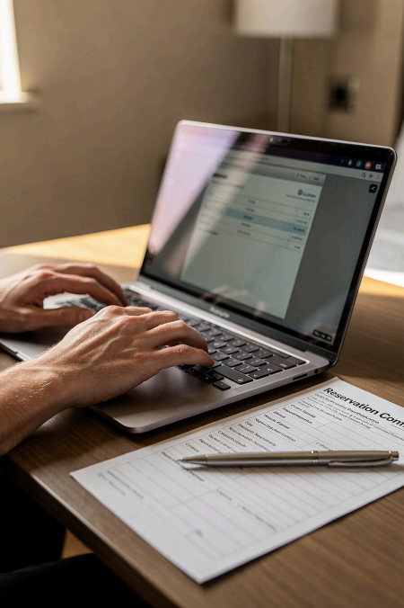
Written Communication
Matters
Exchange Info
Share details across teams & guests
Keep Records
Permanent, reviewable
messages
Stay Professional
Clear, accurate, organized

Slide 3
Where Is It Used?
Reservations Customer Inquiries
Confirmations & bookings
Complaints
Professional issue resolution
Responding to guest questions
Reports
Internal documentation & records

Slide 4
✅ Professional Writing
Clear and organized
Builds credibility
Positive impression
❌ Poor Writing
Creates confusion
· Upsets customers
· Damages reputation
Every message reflects the organization — write with care.

Slide 5
Forms of Written Communication
1
Emails Fast, direct communication
2
Memoranda Internal staff notices
3
Business Letters Formal external correspondence
4
Reports Documented findings & updates
Each form has a specific purpose depending on the situation.

Slide 6
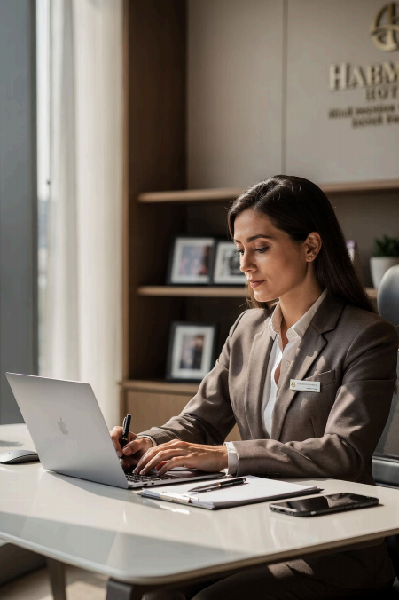
Business Emails
Confirm reservations
Respond to guest inquiries Coordinate & update staff
Emails create formal impressions — always write professionally.

Slide 7
Subject Lines Matter
✅ GOOD
"Reservation Confirmation for June 15, 2026"
Clear, specific, and professional
❌ POOR
"Hello" | "Important"
Too vague — looks unprofessional
A strong subject line tells the reader the purpose before they open the email.

Slide 8
Professional Greetings
Always open with a respectful greeting:
"Dear Mr. Santos,"
"Good afternoon, Ma'am,"
"Dear Valued Guest,"
Respectful greetings set a positive, professional tone from the very first line.

Slide 9



Keep It Concise
Readers need to quickly understand: · The email's purpose
Key information
Required actions
Direct
Organized
Brief
Avoid long explanations and repetition.

Slide 10
Professional Tone
✅ Use
Respectful language
Polite expressions
Formal vocabulary
❌ Avoid
Slang & abbreviations
Emotional language
Rude expressions
The tone of your message shapes how guests and colleagues perceive you and your organization.

Slide 11



Always Proofread
₁ Grammar & Spelling
₂ Punctuation
₃ Formatting
₄ Information Accuracy
Errors reduce credibility and create misunderstandings.

Slide 12
Sample Professional Email
From | reservations@abchotel.com
To | angelareyes@gmail.com
Subject | Reservation Confirmation for July 20–22, 2026
Dear Ms. Reyes: Thankyou for choosing ABC Hotel. We are pleased to confirm your reservation.
Check-in: July 20, 2026 | Check-out: July 22, 2026 | Room: Deluxe Queen
We look forward to welcoming you.
Best regards, Elyse D. Uy – Reservations Officer
Notice the clear subject, respectful greeting, organized details, and professional closing.

Slide 13
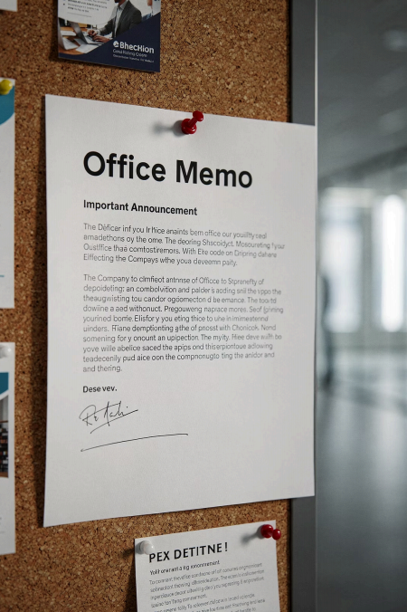
What Is a
Memorandum?
A memo is a formal message used inside an organization.
Schedule Changes
Policy Reminders
Staff Instructions
Memos are for internal use only — not for guests or outside parties.

Slide 14
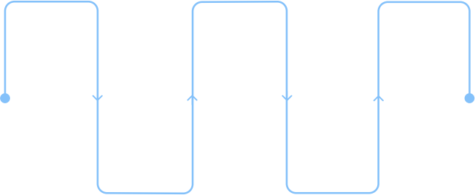
Parts of a Memorandum
Why Each Part Matters
To / From — identifies sender & recipient
Date — creates an official record
· Subject — states the purpose clearly
Body — delivers the message
TO
Recipient of the memo
DATE
Official
record of
time
Message
Body
Main
content and
details
SUBJECT
Purpose
stated
clearly
FROM
Sender of
the memo
Following the format keeps communication clear and professional.

Slide 15
Sample Memorandum
To | Front Office Staff
From | Maria Cruz, Front Office Manager
Date | June 10, 2026
Subject | Updated Staff Meeting Schedule
Please be informed that the staff meeting scheduled for Friday will be moved to 2:00 PM atthe conference room. Thankyou.
Short, clear, and professional — this is what a well-written memo looks like.

Slide 16
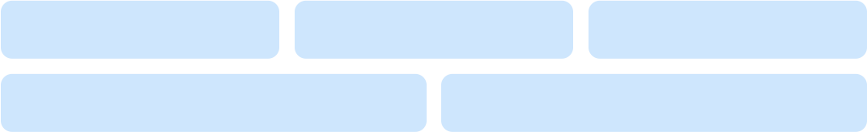
Business Letters
Formal written communication used for external correspondence — representing your organization's professionalism.
Customers Suppliers Government
Partners Travel Agencies

Slide 17
What Makes a Good Business
Letter?
Every effective business letter shares five key qualities.
Clear
Easy to understand at a glance
Concise
No unnecessary words
Professional
Formal tone and language
Organized
Logical structure and flow
/ Accurate
Correct facts and details

Slide 18

Parts of a Business Letter
Thin k of it like a recipe
—follow the order every time for a perfect result.
Sender Date Address | Receiver Address | Salutation | Body
Each part has a specific
purpose and must appear in the correct order.

Slide 19
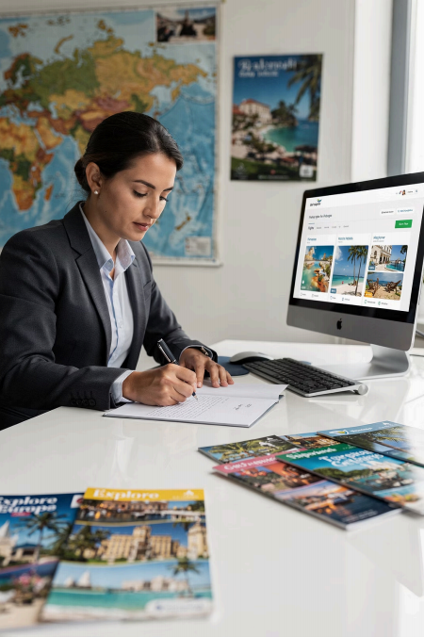
Inquiry Letters
Used to request information about services, reservations, pricing, or tour packages.
✅ State the request clearly
✅ Explain the purpose
✅ Keep it professional

Slide 20
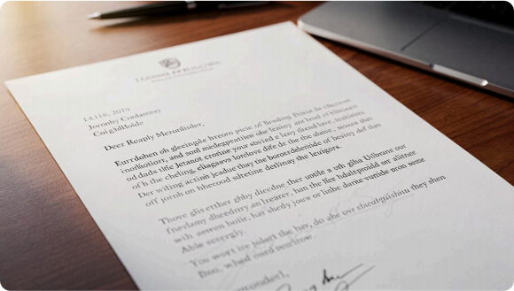
Sample: Inquiry Letter
June 15, 2026
Dear Sir/Ma'am,
We would like to inquire about group accommodation rates for 30 guests (Aug 10–12, 2026).
· Room availability
· Conference facilities
· Meal package options
Respectfully,
Elle D. Uy
Operations Manager

Slide 21

Complaint Letters
Express dissatisfaction about a service — but always remain respectful and professional.
Delayed Services
Reservation Problems
Billing Concerns
Poor Service

Slide 22
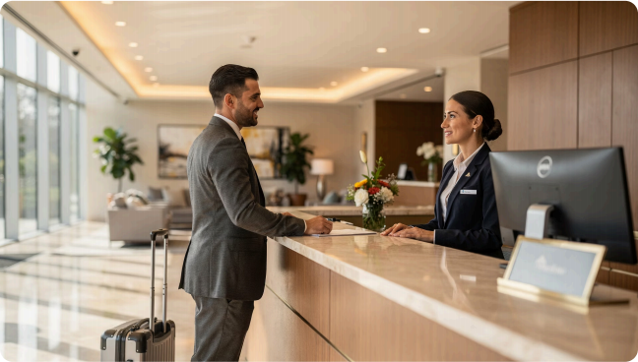
Sample: Complaint Letter
A complaint letter is NOT a rant — it is a polite,
professional request for improvement.
Date: June 20, 2026
To: Customer Service Dept., ABC Hotel
"I would like to express my concern
regarding the delay in room preparation during my stay. I respectfully request
that this matter be reviewed."
— Anna Cruz

Slide 23
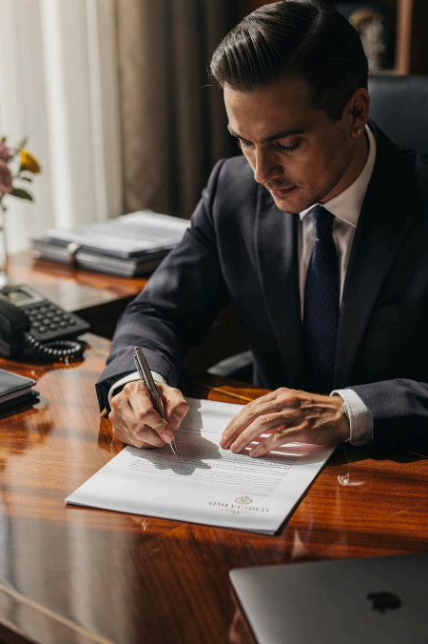
Response Letters
A professional reply to complaints, inquiries, or requests.
Acknowledge
Recognize the concern raised
Apologize
When appropriate, say sorry
Resolve
Explain the solution clearly

Slide 24
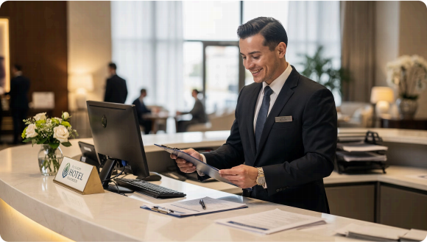
Sample: Response Letter
JUNE 22, 2026
Dear Ms. Reyes,
"We sincerely apologize for the
delay during your check-in. The
matter has been discussed with the concerned department. We value your feedback."
Respectfully, Maria Cruz — Front Office Manager
Always end on a positive note — thank the guest for their
understanding.

Slide 25
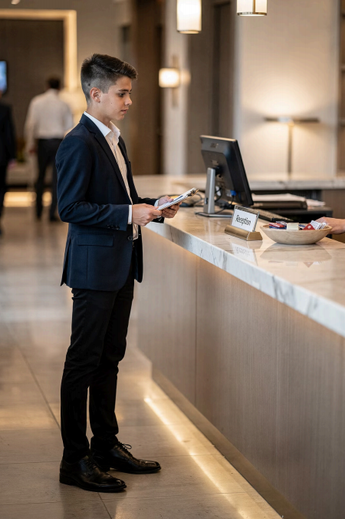
Application Letters
Your first impression as a job or internship applicant.
01
Introduce yourself 02
State the position 03
Highlight your qualifications 04
Close professionally

Slide 26
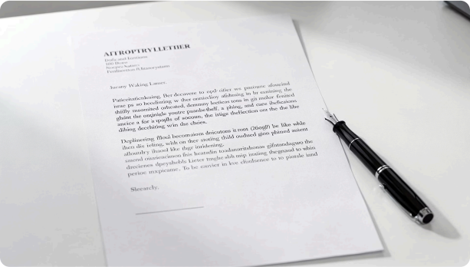
Sample: Application Letter
GRAND HORIZON HOTEL, MAKATI
June 25, 2026
Dear Sir/Ma'am,
"I am writing to express my interest in a Hospitality Internship position. My
communication skills and
professionalism will allow me to contribute positively."
— Juan Dela Cruz
This is your chance to shine — make every word count!

Slide 27





Report Writing
Formal documents that support management decisions.
Incident Reports
Sales Reports
Financial Reports
Guest Feedback

Slide 28
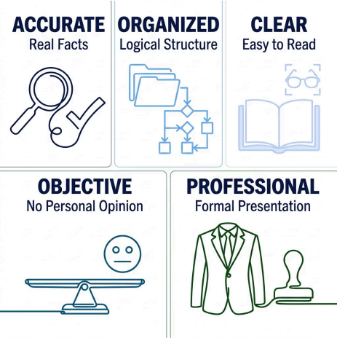
What Makes an Effective Report?
The Golden Rule
Stick to the facts. A good report presents information — not opinions.
Think of a report like a news article: who, what, when, where, how — no personal feelings.

Slide 29
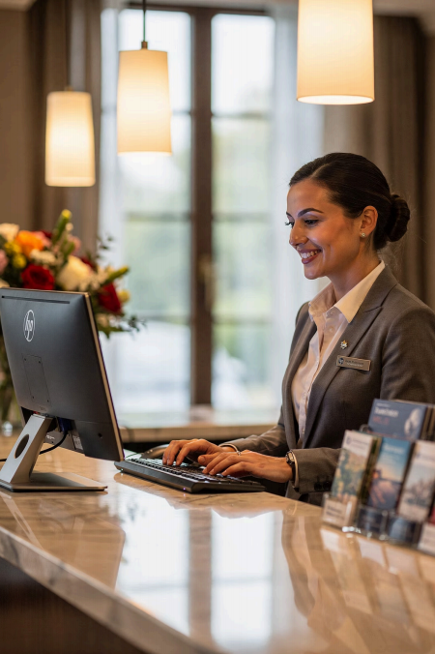
Customer-Oriented Writing
In hospitality, every word matters to the guest experience.
Use polite language
Provide helpful information
Respond respectfully
Address concerns clearly

Slide 30
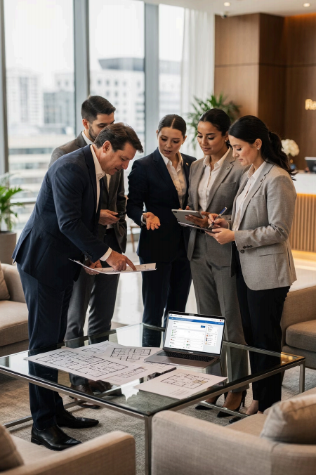
Key Takeaways
Professional writing is a core skill in hospitality and tourism.
图 Emails
Fast, digital communication
s Memoranda
Internal coordination
✉ Business Letters
External correspondence
r Reports
Data-driven decisions
Master these formats — and you'll communicate with confidence in any hospitality workplace.

