Slide 1

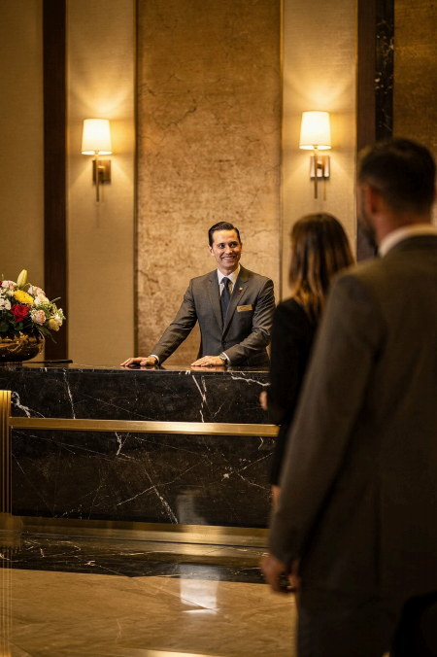
Module 5_Introduction
Customer Service
Communication Skills
Course: Hospitality & Tourism Business Communication
Satisfaction |  |  | Reputation
Every word shapes the |  |  | How you speak reflects
guest experience |  |  | your organization
Service Communication IS the service
Prof. Alia Amor D. UY, MBA

Slide 2
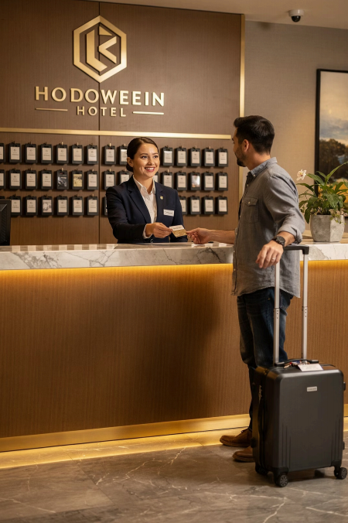
Why Communication Matters
Guests talk to employees constantly 4 and every moment counts.
Asking for Help
Directions, requests, information
Making Reservations
Bookings, scheduling, planning
Raising Concerns
Complaints, feedback, issues
How you respond shapes perceptions of quality, professionalism, and
care.

Slide 3

WHY IT MATTERS
Good
Communication
Builds Trust
Encourages repeat visits
Earns positive reviews Strengthens reputation
Guests remember how you made them feel 4 respected, valued, and heard.

Slide 4


Learning Outcomes
By the end of today, you will be able to:
Explain The role of communication in customer service |  | Demonstrate Customer-oriented communication skills |  |  |  | Apply Empathy and professionalism with guests
Analyze Real hospitality service situations |  |  |  | Recommend Strategies to improve guest satisfaction
1
2
3
4
5

Slide 5
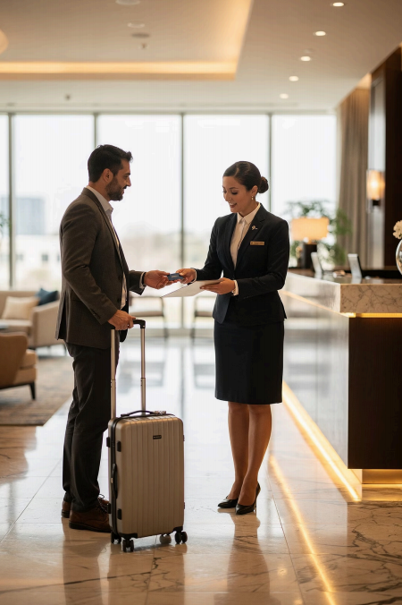
More Than Just Completing Tasks
Create experiences,
not just service.
Professional Communication | Respectful Interactions
Service-Oriented Attitude
Guests remember how employees spoke to them 4 especially in important moments.

Slide 6

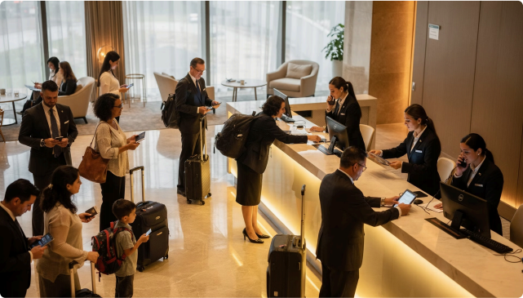
REAL-WORLD SITUATIONS
Stay Calm. Stay Professional.
Hospitality environments can be:
Good communication helps you handle complaints, delays, and high-pressure moments with confidence.
乡 Fast-Paced
m Stressful
§ Unpredictable

Slide 7
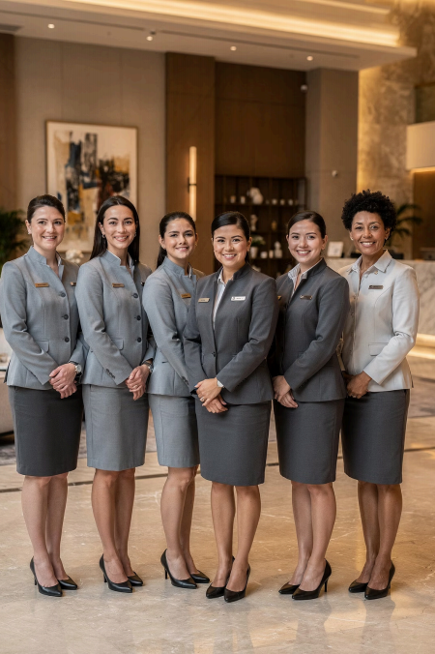
Your Communication = Your
Career
Speak well. Serve better.
Build Relationships
Guests return when they feel valued
Boost Satisfaction
Great communication = great reviews
Stand Out Professionally
Communication skills open doors

