Slide 1

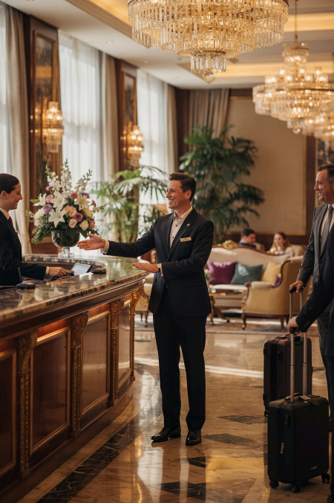
Module 5
Customer Service
Communication Skills
Course: Hospitality & Tourism Business Communication Service is people. How we communicate is the product.
Prof. Alia Amor D. Uy, MBA

Slide 2
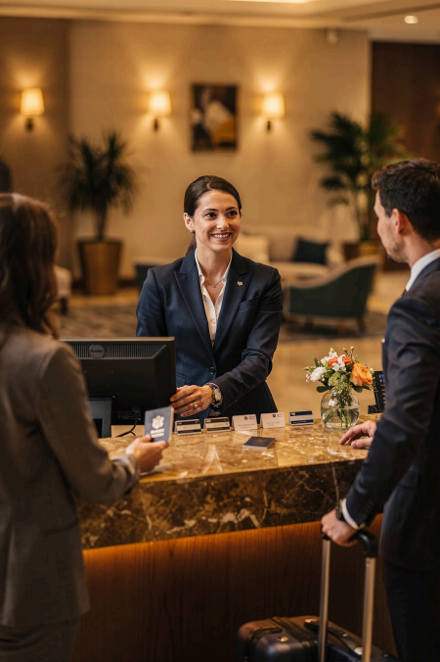
Communication Matters
In hospitality and tourism, you are the experience.
» Hotels
/ Airlines
Þ Restaurants
n Travel Agencies
Guests judge you by how you communicate 4 not just what you offer.

Slide 3
How Do We Communicate with
Guests?
Face-to-Face
Direct guest interactions
Phone
Reservations & inquiries
。
Complaints
Service recovery
Email & Written
Formal correspondence

Slide 4
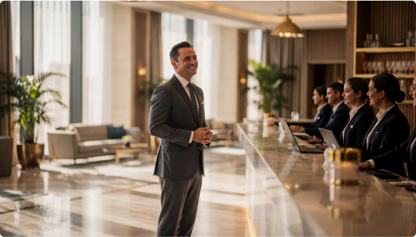
Communication
Shapes Everything
Guest Satisfaction
Customer Loyalty
Organizational Reputation
Business Success
One conversation can change a
guest's entire experience.

Slide 5
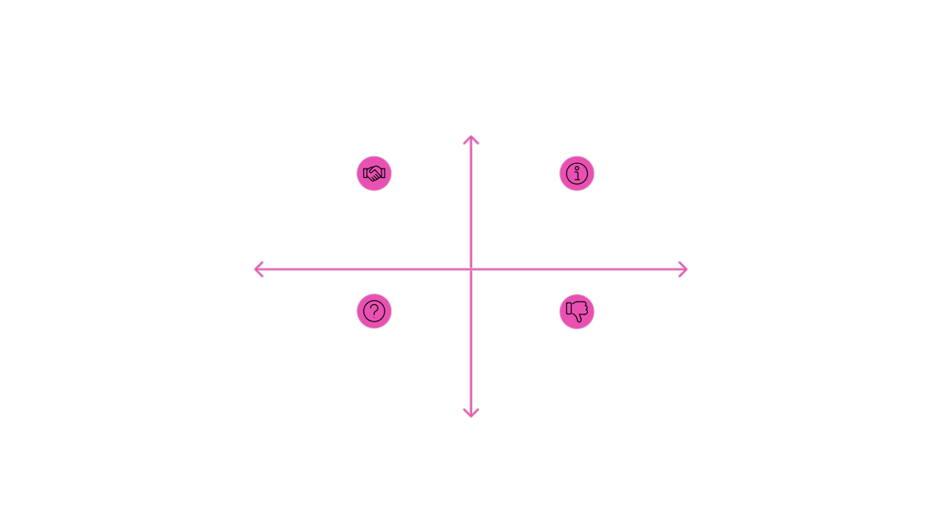
What Good Communication Does
Positive Experience
Welcoming Staff - Guests feel
respected
Poor
Communication
Confused Guests -
Misunderstandings
arise
Clear Guidance -
Expectations set
positively
Clear
Communication
Complaints &
Reviews - Negative
feedback
Negative Experience
Your words directly create 4 or destroy 4 a positive guest experience.

Slide 6
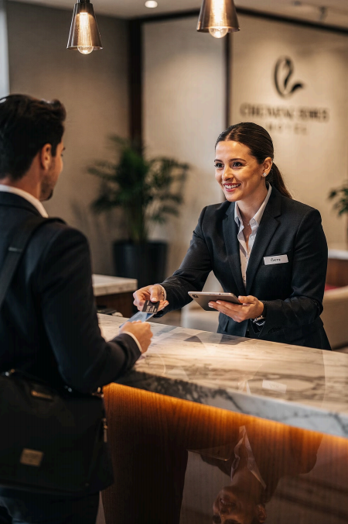
Real Example: Hotel Check-In
A polite, clear check-in makes guests feel safe and confident about their stay.
, Listen carefully
T Show empathy
⑥ Respond appropriately

Slide 7





5 Elements of Excellent Service
Communication
Courtesy
Empathy
Responsiveness
Patience
Personalization
Practice these consistently — every interaction, every day.

Slide 8
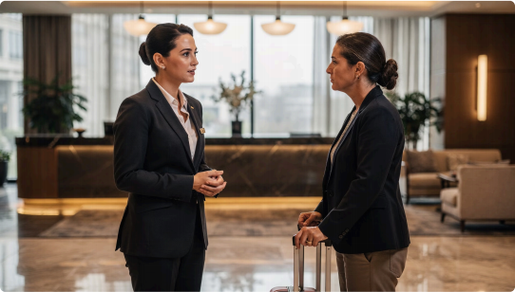
ELEMENT 1
Courtesy
Especially important when handling …
Guest Requests
Complaints
Service Delays
Stay respectful, calm, and professional _ always.

Slide 9


What Does a Courteous Employee Look Like?
Uses respectful language Stays calm under pressure
Acknowledges guest concerns
Never sounds irritated or impatient
Even when a guest follows up repeatedly 4 stay polite. d

Slide 10
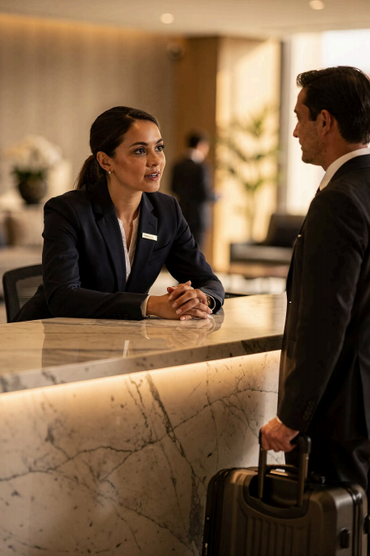
Courtesy in Action
"Thank you for your patience, Ma'am. We are currently preparing your room and will assist you as quickly as possible."
Reduces Frustration | Prevents Conflict
Builds Trust

Slide 11
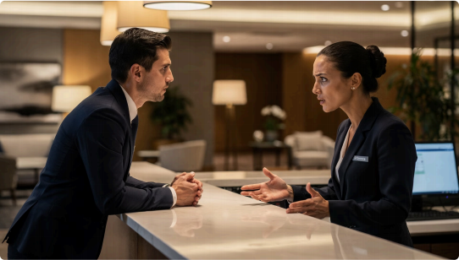
ELEMENT 2
Empathy
Guests may be feeling …
⑩ Stressed
x Disappointed
疊 Frustrated
Empathy is most critical during service
recovery.

Slide 12
When Do Guests Get Frustrated?
Flight Delays
Cancelled Tours
Overbooked Rooms
Lost Reservations
In these moments, how you respond matters most.

Slide 13
Empathy: Right vs. Wrong
o Unprofessional
"That reservation is not showing. You probably entered the wrong
information."
³ Blames the guest. Creates conflict.
' What Empathy Looks Like
Recognize emotions
Acknowledge the concern
Avoid blame & defensiveness
Show genuine willingness to help

Slide 14
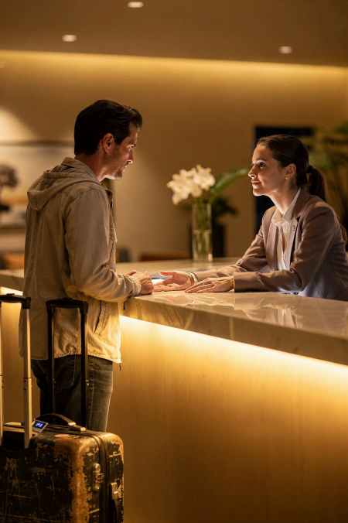
Empathy in Action
"I sincerely apologize for the inconvenience, Sir. I understand how stressful this may be after your travel. Please allow me a moment to review your reservation."
Calms the Guest
Builds Trust
Protects Reputation

Slide 15
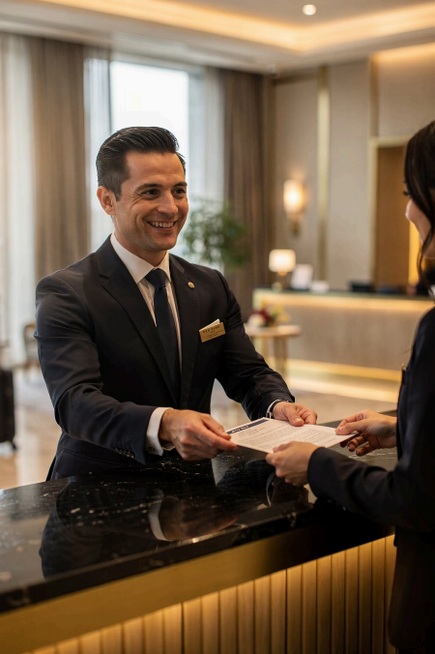
Responsiveness
ELEMENT 3
Reply fast. Act faster.
Guests expect prompt, efficient responses to every request 4 no waiting, no excuses.

Slide 16
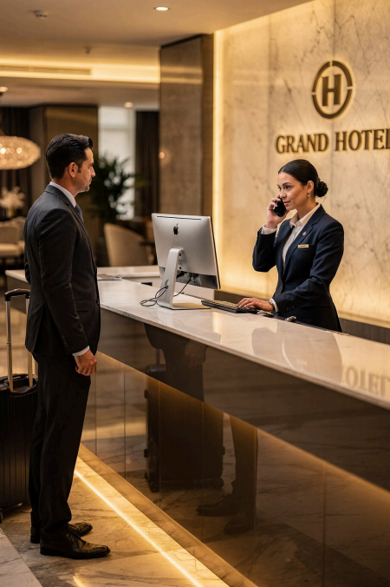
Why Responsiveness Matters
o Slow Response Frustration · Dissatisfaction · Bad impressions
' Quick Response Trust · Professionalism · Loyalty
Fast communication = higher satisfaction + stronger trust

Slide 17
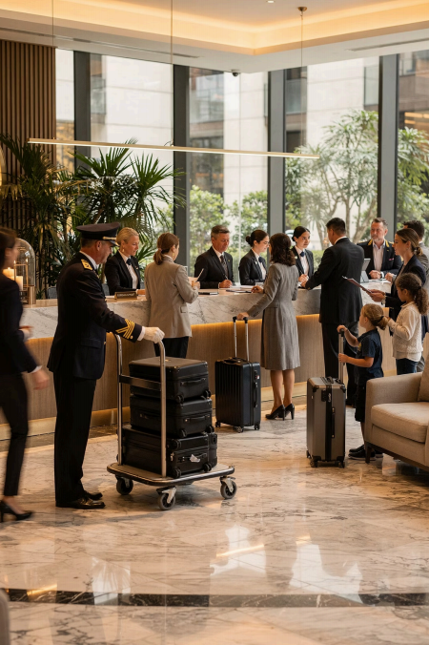
Patience
ELEMENT 4
Stay calm. Always.
Hospitality is fast-paced and unpredictable. Patience keeps service quality high no matter what.

Slide 18
High-Pressure Situations
Long Queues
Booking Delays
Reservations go wrong
Miscommunication
Departments out of sync
Peak seasons bring crowds
Travel Disruptions
Guests arrive stressed
Through it all _ remain calm, professional, and solution-focused

Slide 19
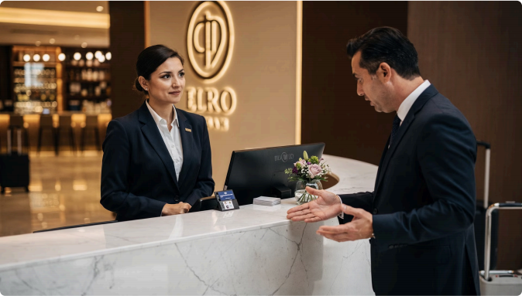
Patience in
Practice
"I sincerely apologize for the delay. We will update you
immediately once your room is ready."
Listen without interrupting
Stay composed during complaints
Focus on solutions, not blame

Slide 20
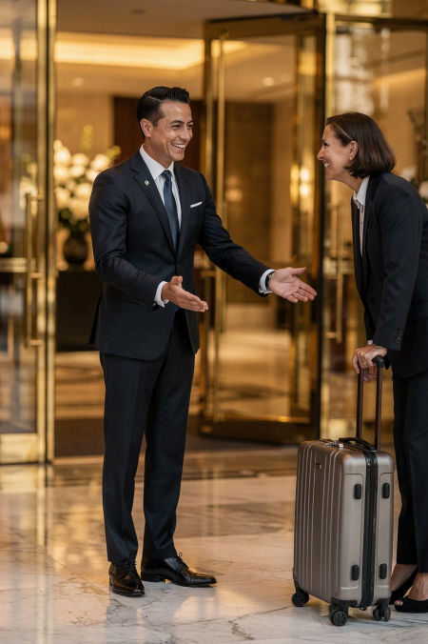
Personalization
ELEMENT 5
Make every guest feel special.
Adjusting service to individual preferences and needs makes guests feel truly valued.

Slide 21
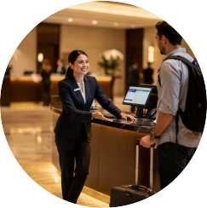
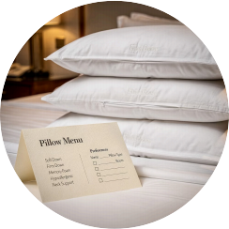
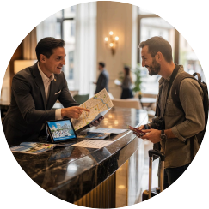
Personalized Guest Experiences
Greet by Name
Returning guests love recognition
Remember Preferences
Room type, dietary needs,
amenities
Custom
Recommendations
Tailor suggestions to each guest

Slide 22
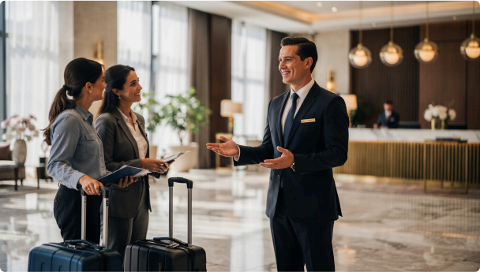
Guest Relations
Maintaining positive, professional relationships throughout every
guest interaction.
Communicate
Be Attentive
Solve Problems
Show Care

Slide 23




Building Strong Guest Relations
Welcomed Warm greetings every time
Assisted Prompt help with all needs
Comfortable At ease throughout their stay
Respected Treated with dignity always

Slide 24
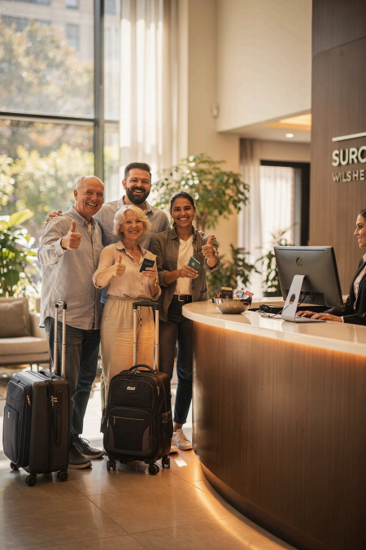




Customer Satisfaction
Satisfaction = when guest expectations are met or exceeded.
Service Quality
Employee Behavior
Communication
Problem-Solving

Slide 25
Communication = Business Impact
' Positive Communication Repeat visits · Word-of-mouth referrals 5-star reviews Long-term loyalty
o Poor Communication Complaints · Negative reviews Lost customers · Damaged reputation

Slide 26
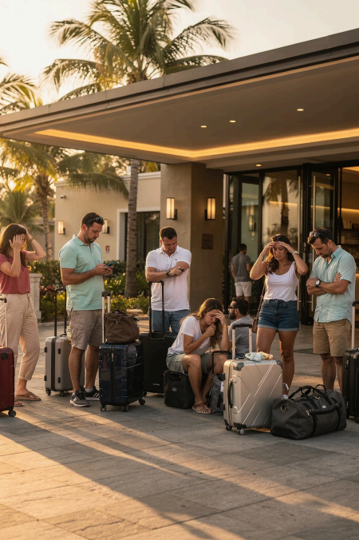
Real Scenario
CASE STUDY
A tour group arrives at a resort 4 only to find their
transportation is delayed due to a scheduling problem. Their island tour is at risk.
How should staff respond? ③

Slide 27
Unprofessional vs. Professional
o Unprofessional
"That problem came from the transportation provider, not from us."
Passes blame. Offers nothing. Damages trust.
' Professional
"We sincerely apologize. We are coordinating with the provider and arranging an alternative to minimize delays."
Takes ownership. Offers solutions. Builds trust.

Slide 28

Communicating During Service Disruptions
Guests expect:
Clear, honest
communication
Immediate action
Reassurance and calm
A real solution
Acknowledge | Apologize | Offer Solution | Follow Up

Slide 29

Strategies for Better Guest Satisfaction
Active Listening
Hear guests fully before responding
Clear Communication
Simple, direct, professional language
Quick Response
Never keep guests waiting
Positive Attitude
Warmth and professionalism always
Follow-Up
Check that issues were resolved

Slide 30





Conclusion
CUSTOMER SERVICE COMMUNICATION
Courtesy
Empathy
Communication shapes:
Guest experiences
Customer satisfaction
Organizational reputation
Responsiveness
Patience
As future hospitality professionals, your words and
actions create memorable experiences.
Personalization

