Slide 1


Module 6_Introduction
Intercultural
Communication in Tourism
Course: Hospitality and Tourism Business Communication
Understanding Culture in Global Hospitality
Prof. Alia Amor D. Uy, MBA

Slide 2

Tourism is a Global
Industry
n Millions Travel Daily Leisure, business, education, culture
» One Workplace Many nationalities 4 same day
P Many Backgrounds Languages, customs, beliefs

Slide 3


Cultural Awareness
Even with the same
language, culture shapes how we communicate.
Gestures & Eye
Contact
Meaning varies by culture
Tone & Personal Space
Different cultural expectations
Misunderstandings
Can affect guest experience

Slide 4

Learning Outcomes
By the end of this lesson, you will be able to:
1 Define | 2 Explain | 3 Identify
Intercultural | Why cultural awareness | Barriers to communication
communication | matters
4 Demonstrate Analyze
Culturally sensitive behavior Multicultural communication practices
5

Slide 5
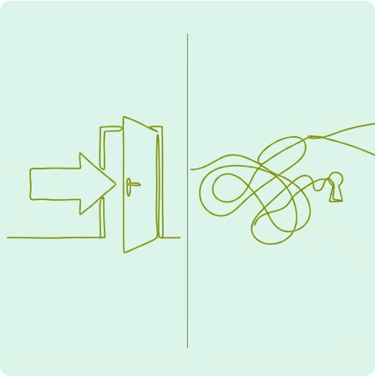
Communication Beyond Language
Direct Communication Messages are clear and explicit. Minimal reliance on context. | Indirect Communication Messages are subtle and implicit. High reliance on context.
Speaking English fluently is not enough 4
culture shapes every conversation.
Different cultures expect different things from:
. Greetings and politeness
Punctuality and service style
Direct vs. indirect responses

Slide 6
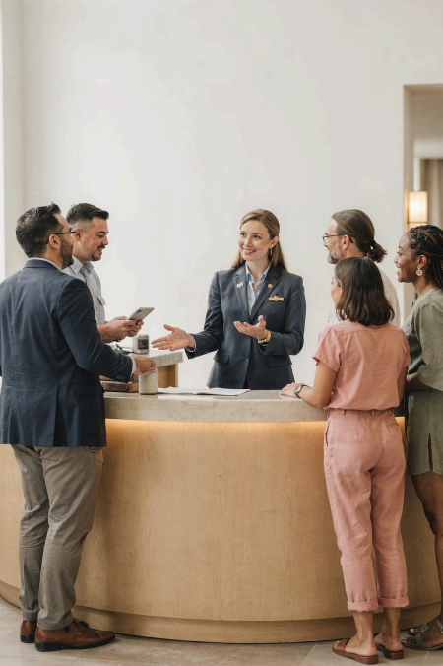
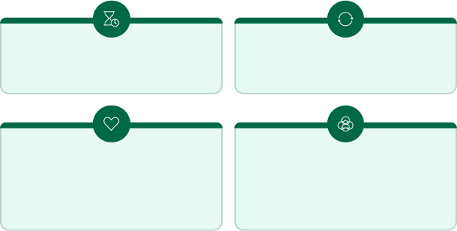
Adapting to Cultural Differences
Patience Adaptability
Cultural
Sensitivity
Respect for Diversity

Slide 7
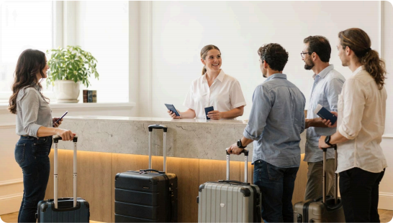
The Role of Hospitality Professionals
You Are the First Impression
Employees represent the organization the moment a guest arrives.
How you communicate shapes:
Guest comfort
Guest satisfaction
Overall impression of your
organization
Cross-cultural communication =
a valuable career skill

Slide 8

What We Will Explore Today
Intercultural Barriers
Common
misunderstandings
and obstacles
Culture &
Communication
How cultural norms shape interactions
Practical Strategies
Effective
approaches for
multicultural
settings
Intercultural communication is about understanding how culture shapes behavior, expectations, and relationships 4 not just language.

