Slide 1

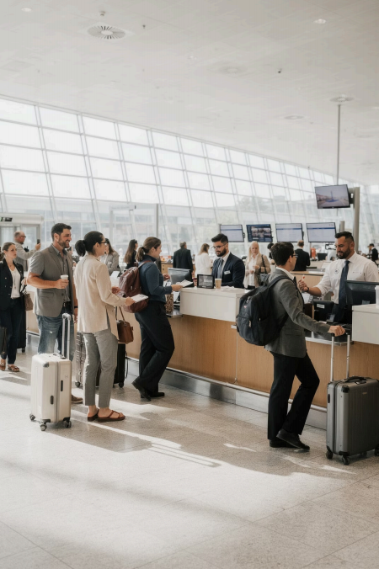
Module 6
Intercultural
Communication in Tourism
How we connect across cultures in hospitality
COURSE: HOSPITALITY AND TOURISM BUSINESS COMMUNICATION
Prof. Alia Amor D. Uy, MBA

Slide 2
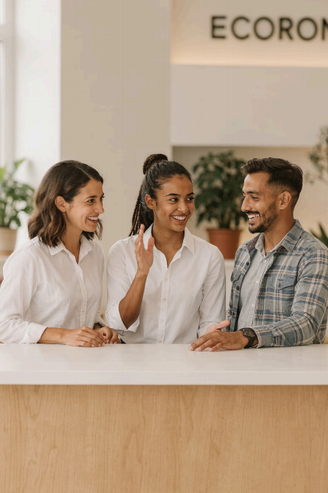
Communication Beyond Language
P Not Just Words Tone, gestures, and cultural respect matter too
n Diverse Guests Different languages, traditions, and expectations every day
, Your Future Multicultural skills are essential for hospitality careers

Slide 3
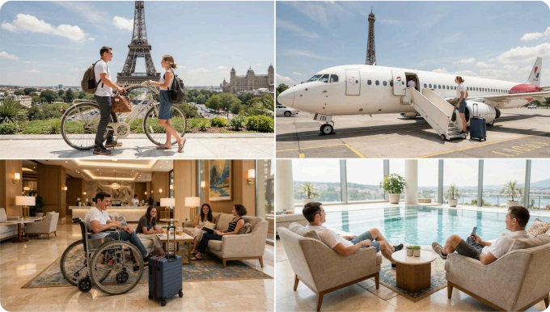
Tourism Is a Global Industry
One hotel. Many cultures. Same day.
A Seoul hotel may welcome
guests from Japan, the USA, France, and the Middle East 4 all before noon.
Millions travel globally every
single day for leisure, business, and culture.

Slide 4
What Is Intercultural Communication?
Exchanging Messages
Sharing ideas and
emotions across cultural
boundaries
Different Backgrounds
Different languages,
values, customs, and beliefs
Culture Shapes
Behavior
How we speak, gesture,
and respond is culturally influenced
Think of culture as invisible rules that guide how people communicate.

Slide 5
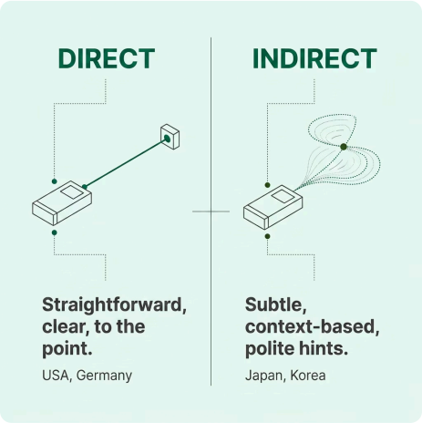
Culture Shapes Communication
Same message. Different meaning.
Some cultures say exactly what they mean. Others
hint, imply, and read between the lines.
In hospitality, recognizing this difference prevents
misunderstandings.

Slide 6
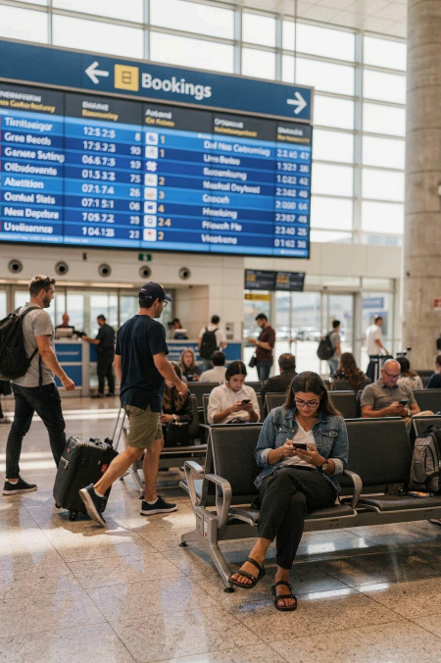
Globalization Changed Everything
/ Faster Travel Modern transport connects the world overnight
Online Booking Anyone, anywhere can book a hotel instantly
» Global Guests Hotels now serve dozens of nationalities daily

Slide 7
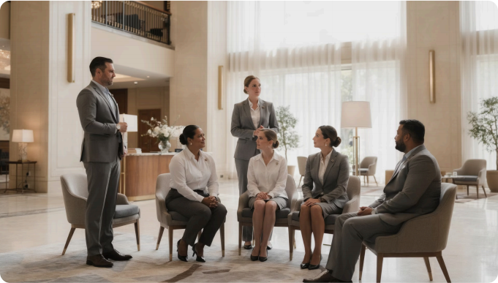
Multicultural Workplaces
Staff from many
countries. Guests from
even more.
International hotels hire
multicultural teams and serve
global guests 4 at the same time.
Communication
adaptability is a must- have professional skill.

Slide 8
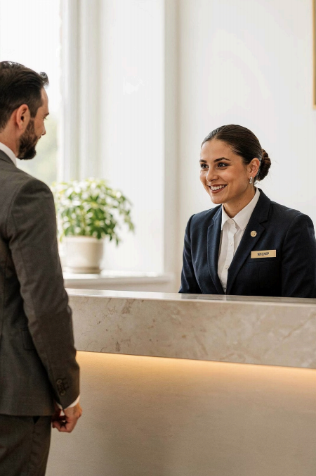



Cultural Awareness
See Differences Notice cultural variation without judgment
Respect Others Treat every guest's culture with dignity
Deliver Better Service Guests remember how you made them feel

Slide 9
Guest Satisfaction
d
Happy guests return
Culturally sensitive service creates loyalty and
positive reviews
What guests really want:
To feel welcomed and respected
Employees who understand their culture
Comfortable, stress-free service
Respect = Satisfaction = Loyalty

Slide 10

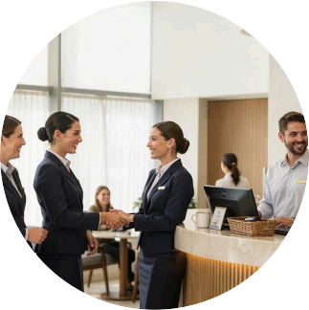
Adapting to Guest Preferences
Privacy First
Some guests prefer quiet, minimal contact, and formal tone
Social & Friendly
Others enjoy casual, warm, and interactive service
Adapting to each guest's style creates more memorable experiences.

Slide 11
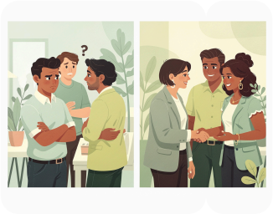
Preventing Misunderstandings
Misunderstandings
often come from:
Different meanings of
gestures
Tone of voice misread across cultures
Facial expressions
interpreted differently
Body language that varies
by culture
Without
Cultural
Awareness
Confusion,
conflict,
negative
experience
With
Cultural
Awareness
Clarity, respect, positive
experience
Cultural knowledge turns potential conflict into connection.

Slide 12
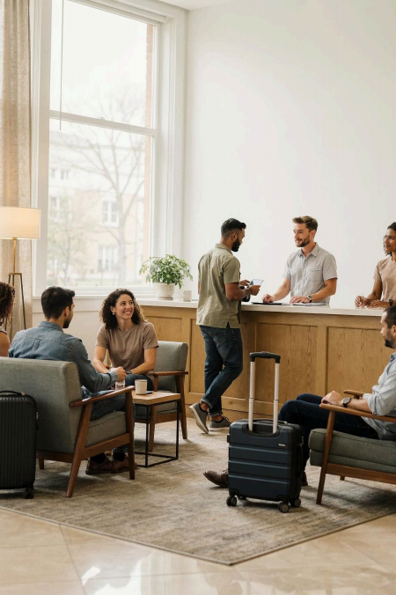
Promoting Inclusivity
Every Guest Belongs All nationalities, religions, and backgrounds deserve equal respect
Inclusive Language Fair and professional treatment regardless of cultural origin
Welcoming Environment Guests should always feel valued from the moment they arrive

Slide 13
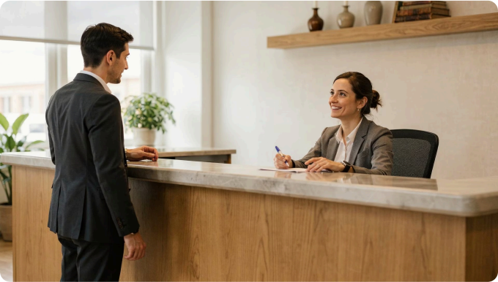
Language Challenges
Not everyone speaks English fluently.
Guests may struggle with
vocabulary, pronunciation, or understanding.
Speak clearly and slowly
Avoid jargon or slang
Confirm understanding gently

Slide 14
Simple Communication Wins
01 | 02
Use Simple Words | Listen Actively
Avoid slang, idioms, and complex vocabulary | Pay attention, nod, and show you understand
03 | 04
Confirm Understanding | Use Visuals When Needed
Repeat back key information to avoid confusion | Maps, signs, and gestures bridge language gaps
Simple + Clear = Comfortable Guest Experience

Slide 15

Nonverbal
Communication
Gestures and body language mean different things in
different cultures.
H Gestures Same gesture, different meaning
d Expressions Facial cues vary by culture
, Body Language Posture and movement matter

Slide 16

Eye Contact Across Cultures
' Some Cultures
Direct eye contact =
confidence & respect
¦ Other Cultures
Prolonged eye contact =
confrontational or rude
Observe guest reactions __ and adjust accordingly.

Slide 17
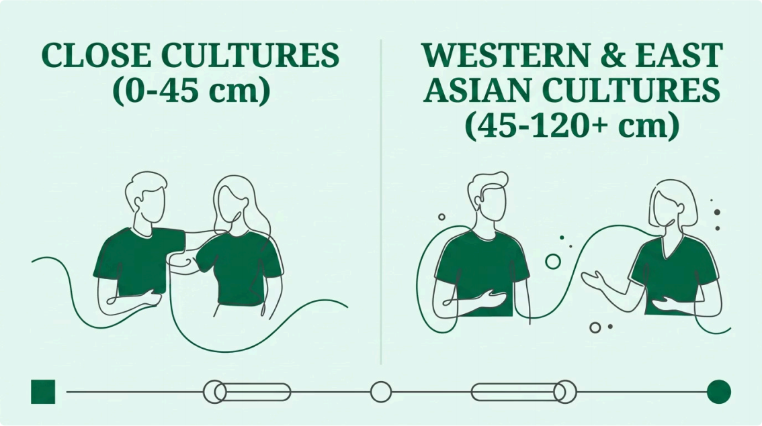
Personal Space
Different cultures prefer different physical distances during conversation.
Respecting personal boundaries makes guests feel safe and comfortable.

Slide 18
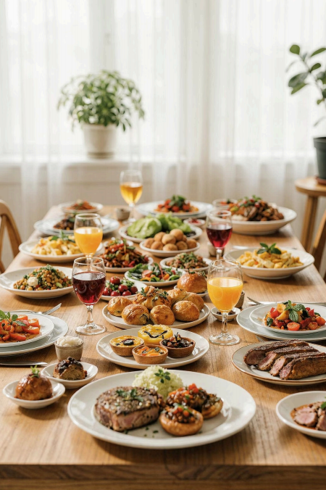
Dining Customs
Food Preferences
Vary widely by culture
Dietary Restrictions
Religious & ethical needs
Table Manners
Etiquette differs globally

Slide 19
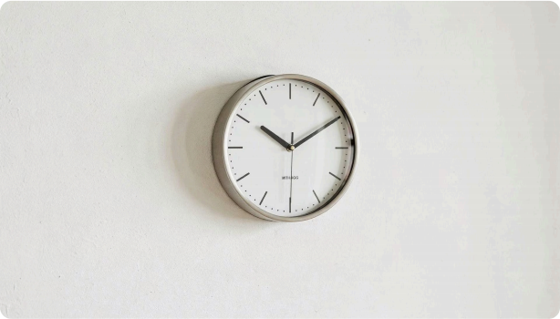
Time Orientation
ó Punctuality-First Strict schedules, exact timing e.g. Germany, Japan, Korea
ë Flexible Time Approximate timing, relationship- first e.g. Latin America, Middle East
Communicate wait times clearly to
all guests.

Slide 20
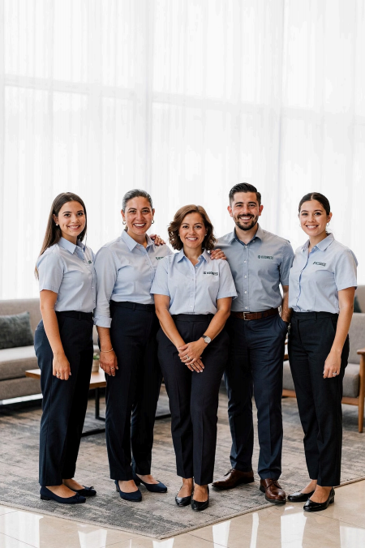
Multicultural Workplace
Many hospitality teams include staff from many different
countries.
Cultural differences affect teamwork & coordination
Managers must build inclusive, respectful environments

Slide 21
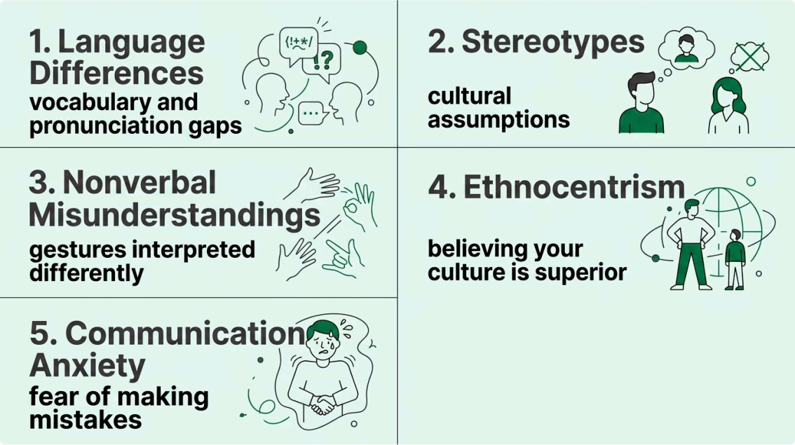
Barriers to Intercultural Communication
These barriers cause misunderstandings, conflict, and discomfort.

Slide 22
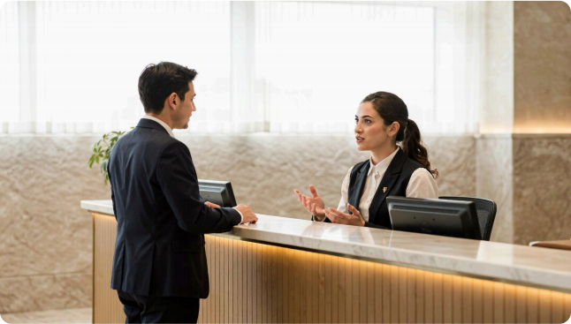
Language
Barriers
Pronunciation, vocabulary, and
fluency differences cause
communication gaps.
P Speak Slowly
' Use Simple Words
« Confirm Understanding

Slide 23
Stereotypes & Biases
o Stereotyping
Assuming all guests from one country behave the same
way
' Individualized Service
Treat every guest as a unique individual 4 with fairness
and open-mindedness
Every guest deserves respect regardless of nationality, religion, or ethnicity.

Slide 24
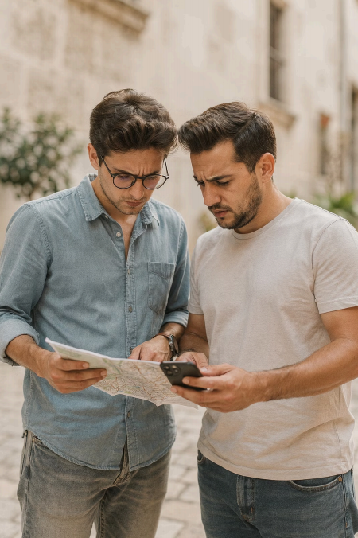
Nonverbal
Misunderstandings
The same gesture can mean completely different things
across cultures.
Don't Assume Not all guests interpret body language the same way
Stay Aware Noticing differences reduces confusion and improves service

Slide 25

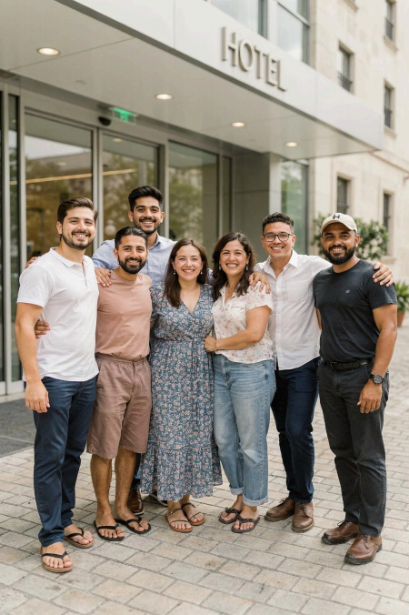
Ethnocentrism
Believing your own culture is superior to others
leads to disrespectful service.
Hospitality professionals must stay open-minded and
treat all cultures as equally valid.

Slide 26
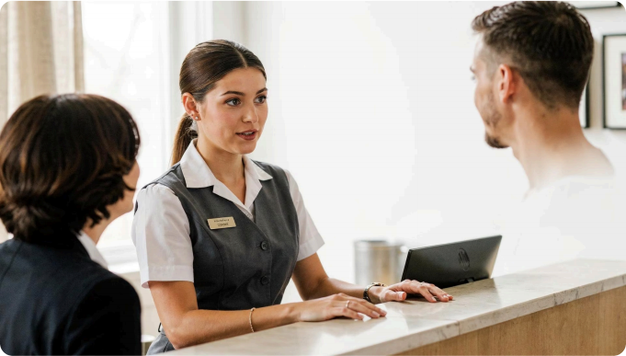
Communicatio
n Anxiety
Interacting with unfamiliar
cultures can feel nerve-
wracking.
1 Build cultural
knowledge
2 Practice real
interactions
3 Confidence grows with experience

Slide 27
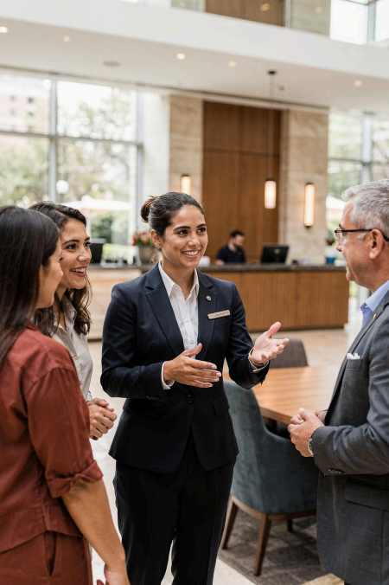




Cultural Intelligence
Understand. Adapt.
Connect.
 | Understand Learn cultural differences
 | Adapt Adjust your style
Respect Value every culture equally
 | Observe Read guest reactions

Slide 28
Effective Communication Strategies
01 | 02
Avoid Stereotypes | Use Simple Language
See each guest as an individual | Clear words, slow pace
03 | 04
Show Respect & Patience | Observe & Adapt
Never rush cultural differences | Watch guest cues and adjust

Slide 29
Case Scenario
» The Situation
An employee maintains direct eye contact
while serving an international guest.
The guest appears uncomfortable.
D The Lesson
The employee sees eye contact as
professional.
The guest's culture sees it as confrontational.
A culturally aware employee notices the
reaction and adjusts immediately.

Slide 30
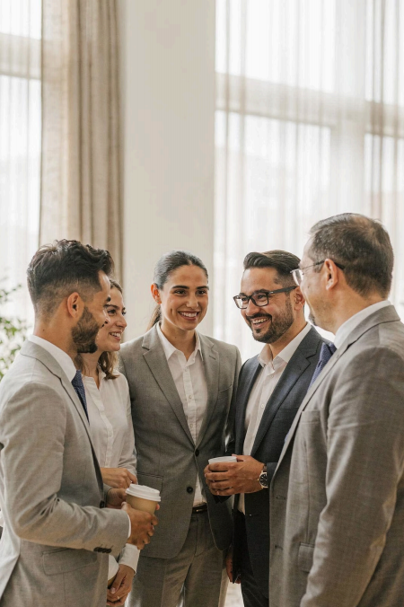
Conclusion
Intercultural communication is at the heart of great
hospitality.
Understand Differences Culture shapes communication | Adapt Your Style Observe and respond thoughtfully
Build Global Skills Become competitive worldwide

