Slide 1
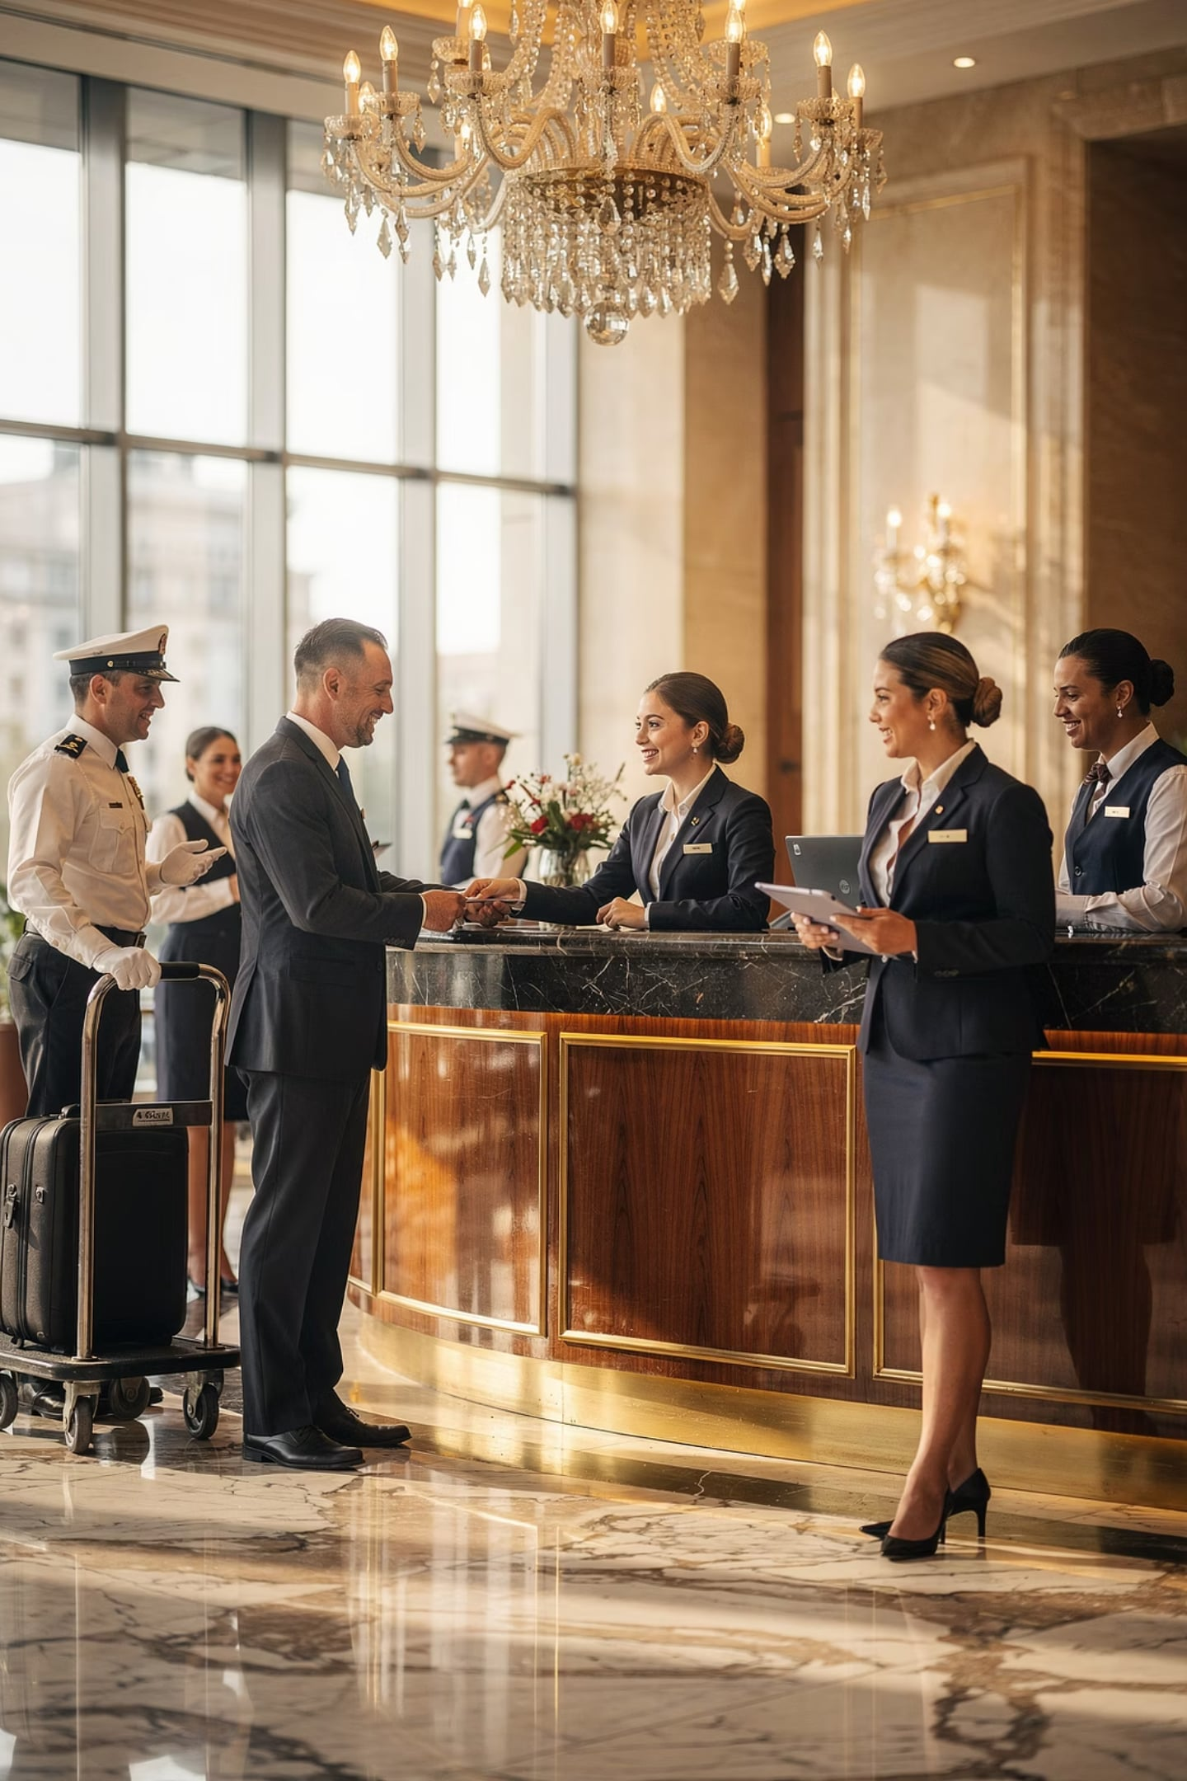
Module 7: Introduction
Workplace Communication & Team Collaboration
Course: Hospitality and Tourism Business Communication
Prof. Alia Amor D. Uy, MBA

Slide 2

What You Will Learn
By the end of this lesson, you will be able to:
Why It Matters
Service Situations
Define Communication
Communication & Teamwork
Team Collaboration
Impact on service quality and guest experience
Real examples from hospitality settings
What workplace communication means
How interaction supports team performance
Practical ways teams coordinate work
These skills are the foundation of a successful hospitality career.

Slide 3
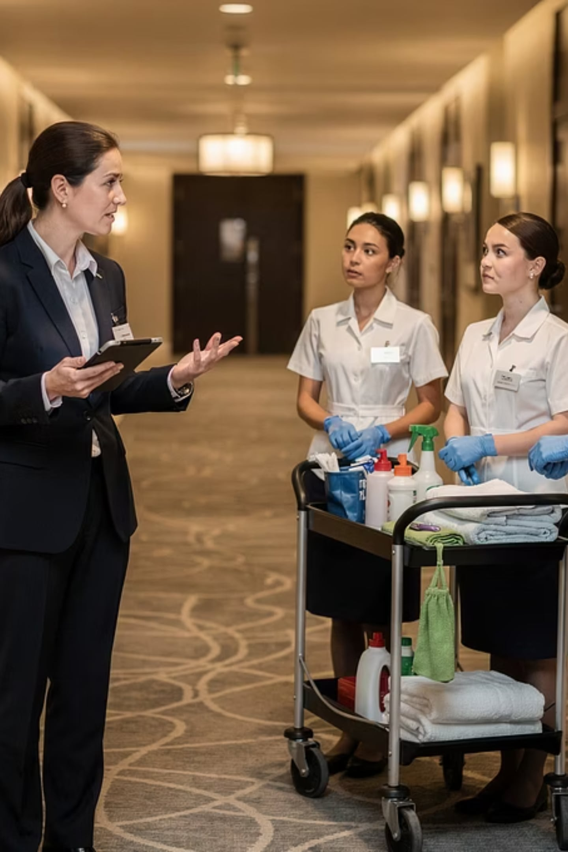




DEFINITION
What is Workplace Communication?
Sharing information so people can work together effectively.
Conversations & Meetings
Emails & Reports
Digital Platforms
💡 Example: Supervisor tells housekeeping about an early check-in → room is ready on time.

Slide 4
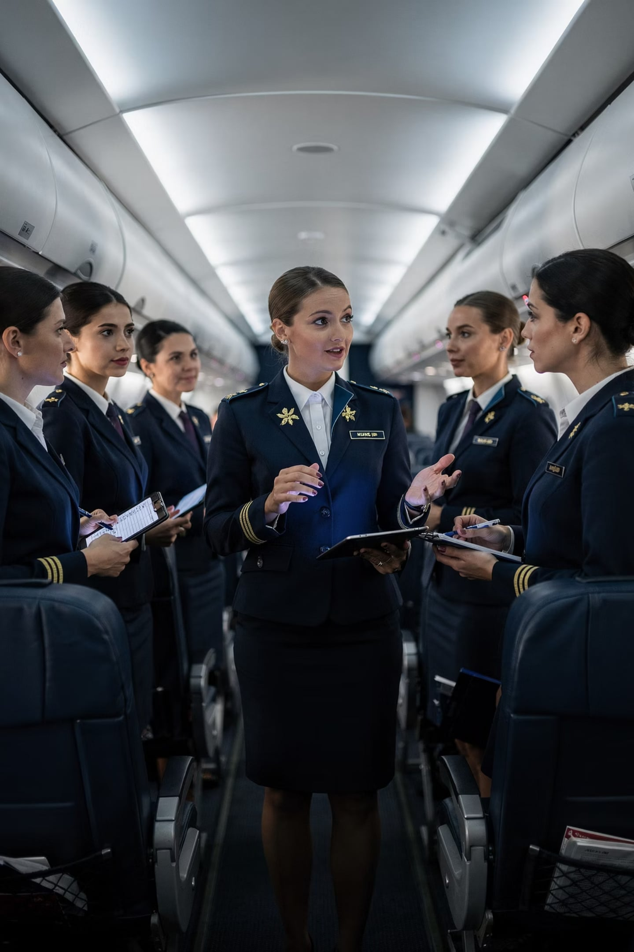

Why Communication Matters
When communication breaks down, the guest experience suffers.
✅ With Communication
Departments coordinate smoothly. Guests are happy.
❌ Without Communication
Delays. Confusion. Unhappy guests.
Real Example: A flight attendant notices that a passenger requires special meal service but forgets to inform the flight purser → the meal is not prepared or delivered during the flight, leading to passenger dissatisfaction and a decline in service quality.

Slide 5
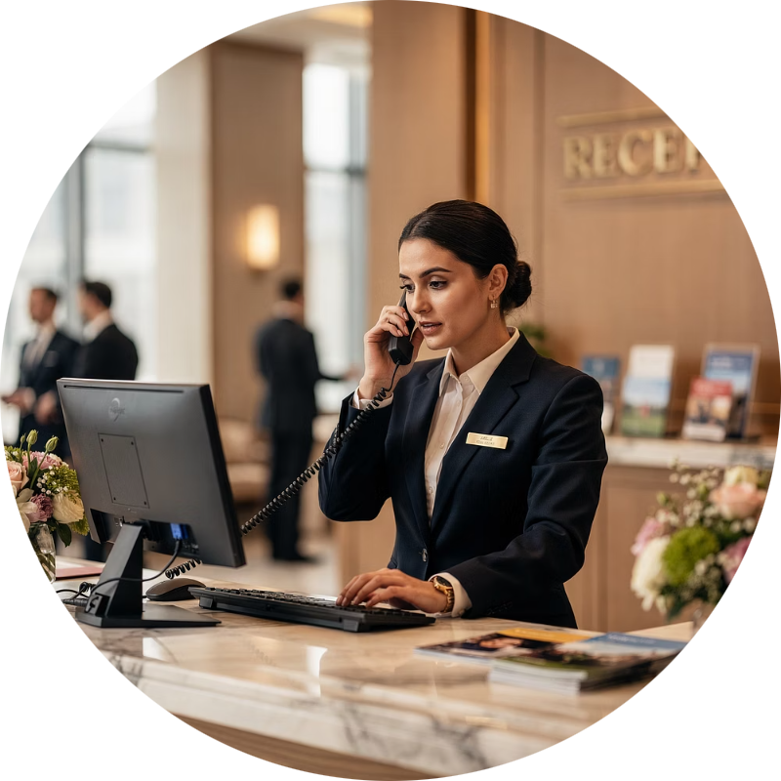
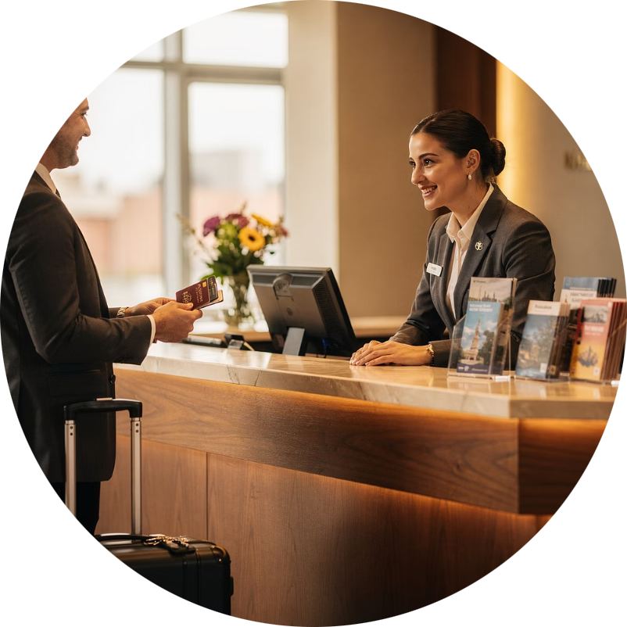
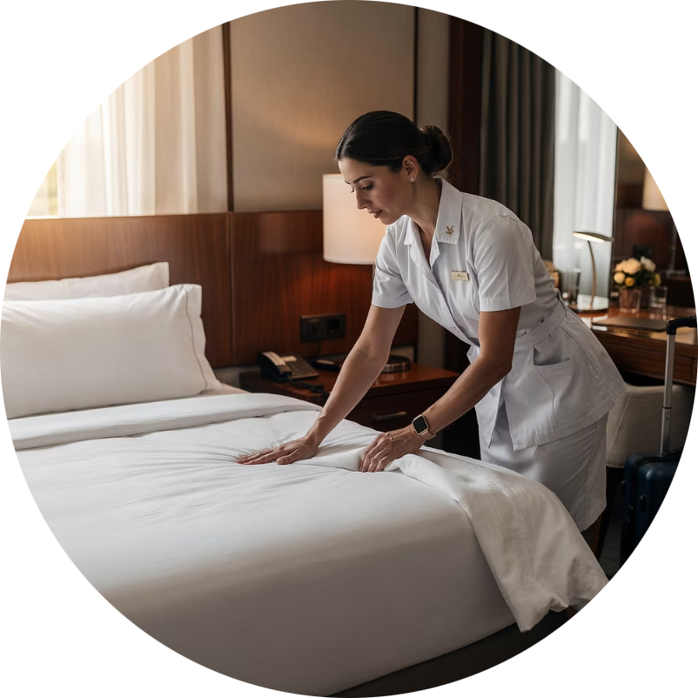
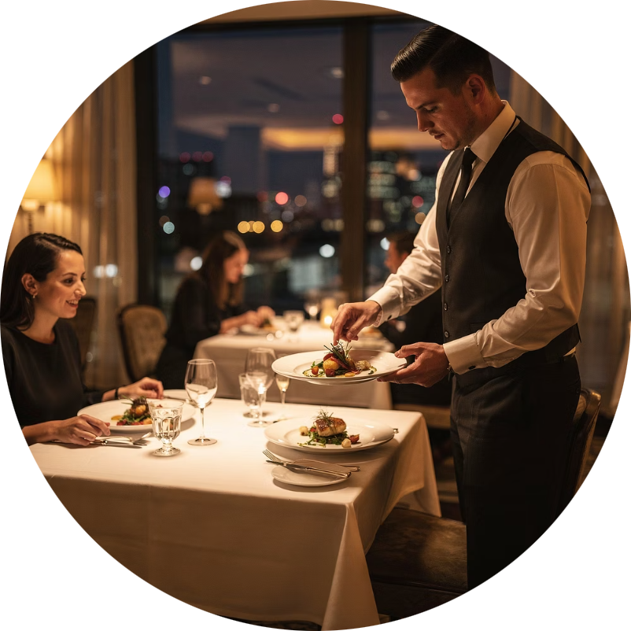
Team Collaboration
No single employee can create the full guest experience alone.
Reservation Agent
Front Desk
Housekeeping
Restaurant
Books the stay
Welcomes the guest
Prepares the room
Serves the meals
Together → One seamless guest experience

Slide 6
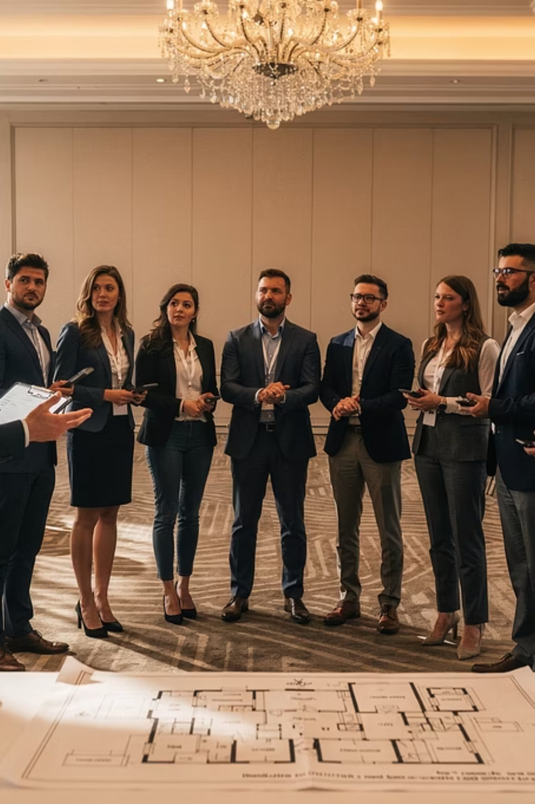


TEAMWORK
Communication = Foundation of Teamwork
Share information
Clarify responsibilities
Coordinate tasks
Solve problems together
Example: A pre-event briefing aligns catering, venue, and tech teams → the event runs perfectly.

Slide 7
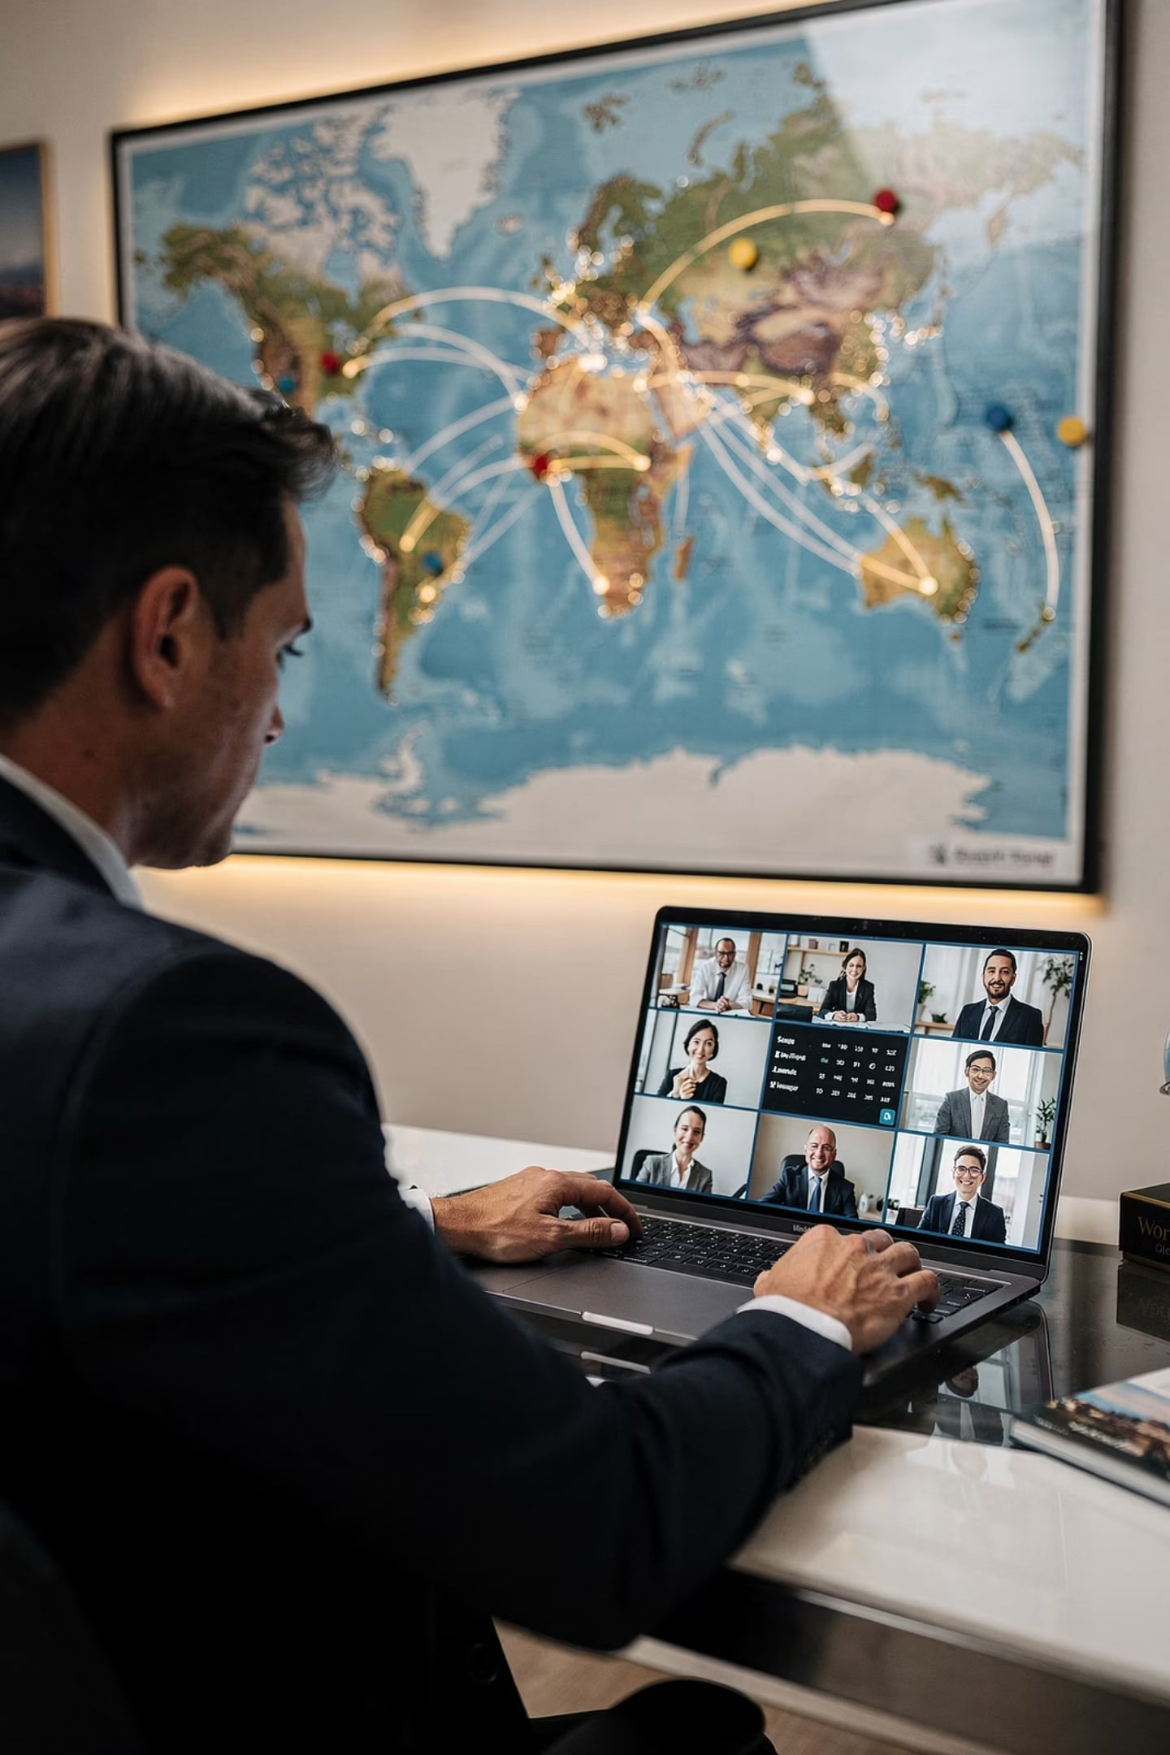




Communication in Modern Tourism
Today's tourism is global, digital, and multicultural.
International Partners
Multicultural Teams
Digital Platforms
Example: A Philippine travel agency emails an overseas hotel to book accommodations for international travelers.

Slide 8
KEY TAKEAWAYS
Remember These 🎯
1
Communication = sharing information within an organization
2
Good communication → smooth coordination → quality service
3
Teamwork = people working toward the same goal
4
Modern tourism requires digital + cross-cultural communication
💬 Reflection: Which communication skill will matter most in YOUR future tourism career — and why?

