Slide 1

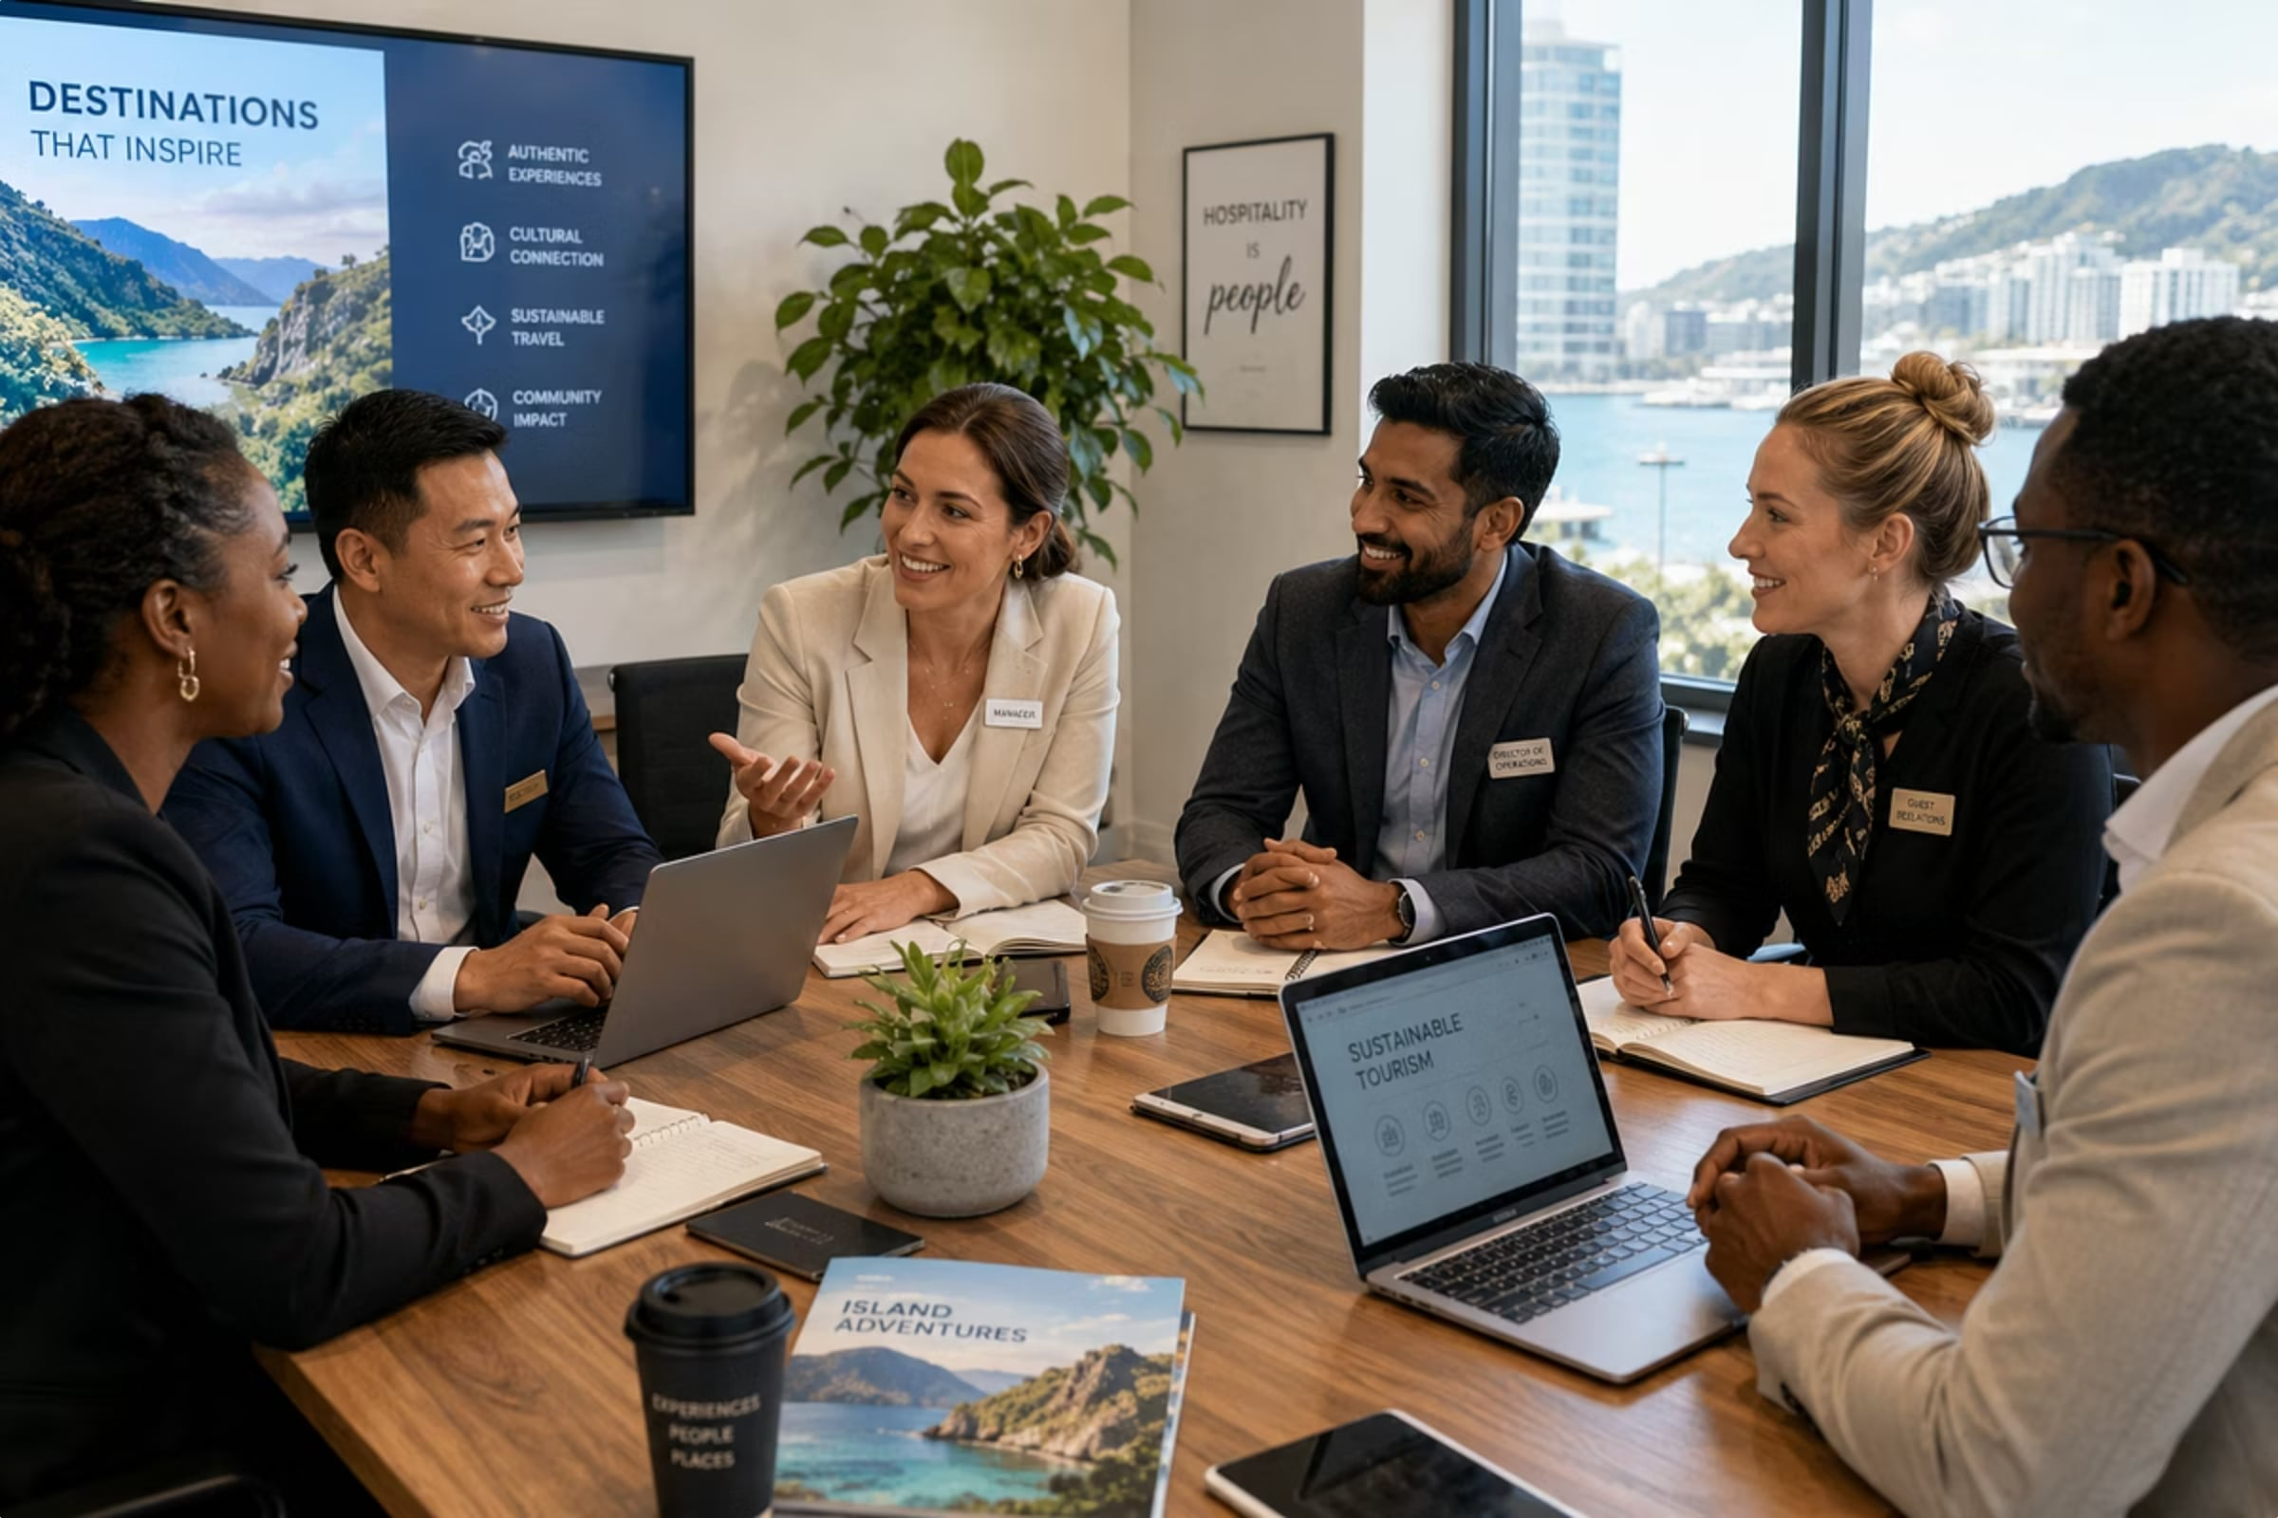
Module 7
Workplace Communication & Team Collaboration
Course: Hospitality and Tourism Business Communication
Prof. Alia Amor D. Uy, MBA

Slide 2
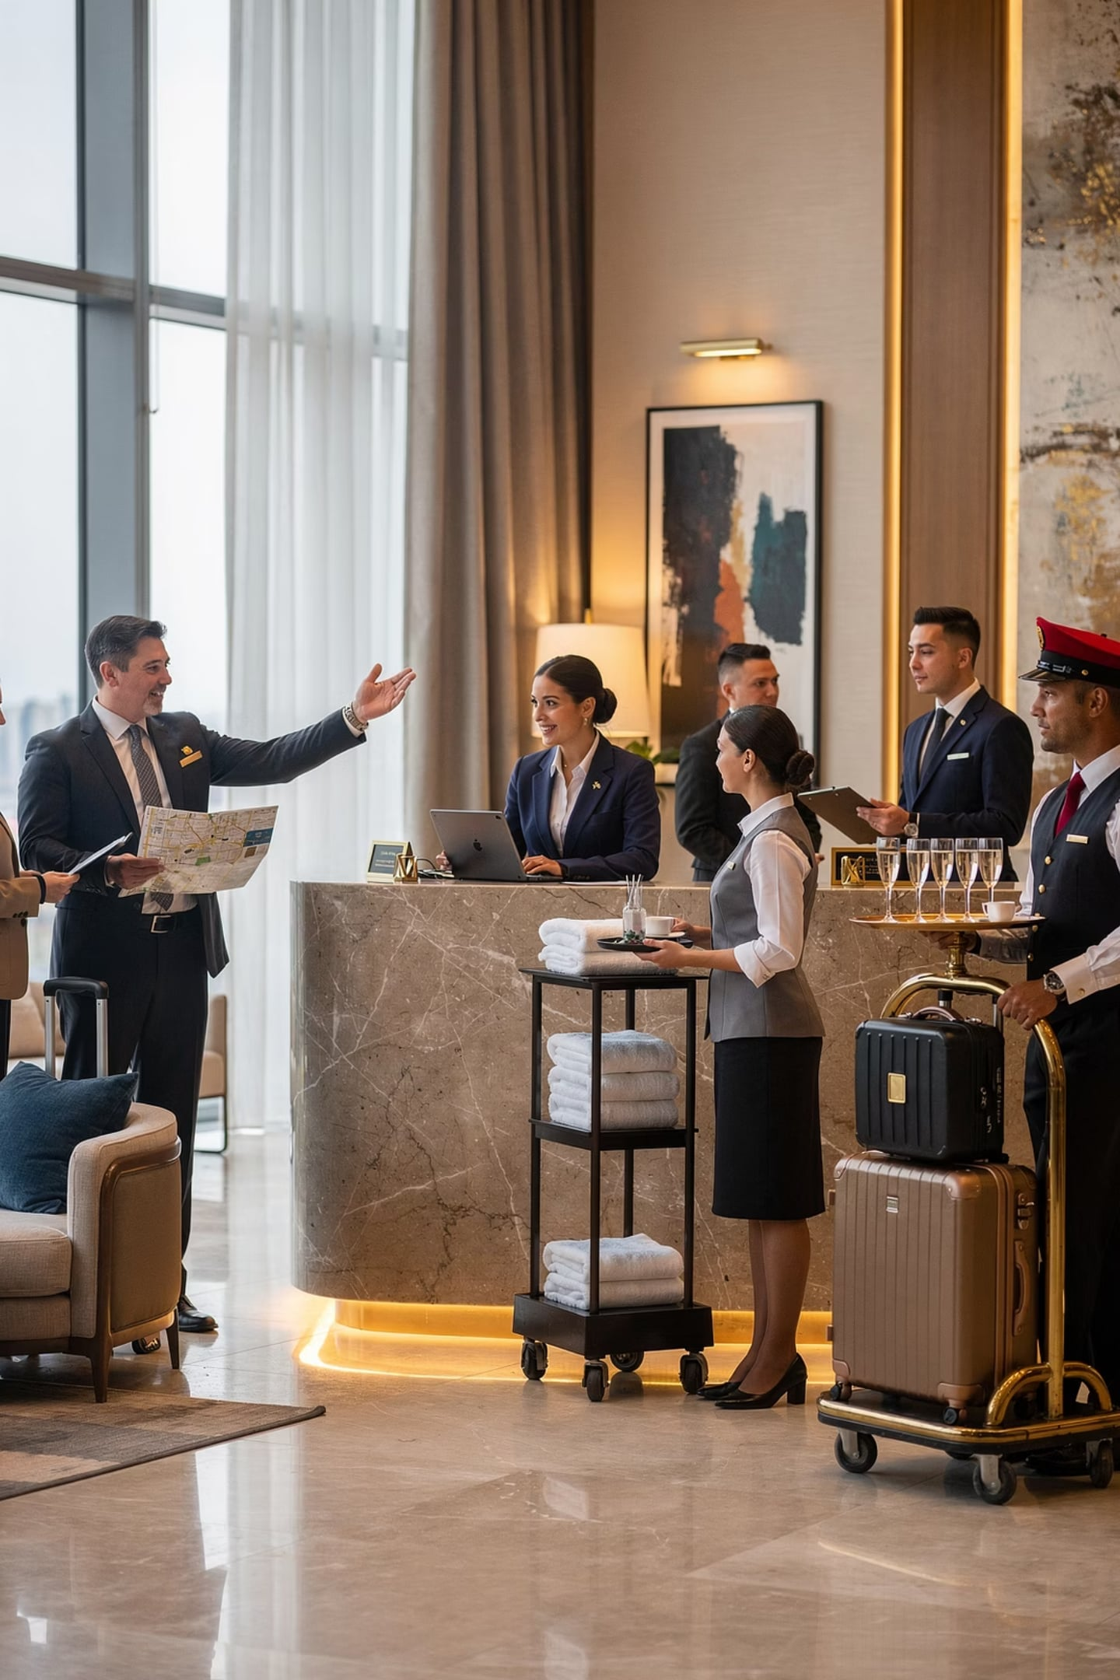
Workplace Communication & Team Collaboration
Great service is never one person's effort — it's a team working together.
🏨 Hotel Check-In
Reservations → Front Office → Housekeeping → Maintenance
🎯 Why It Matters
Coordinate tasks, solve problems, share info, deliver quality service

Slide 3
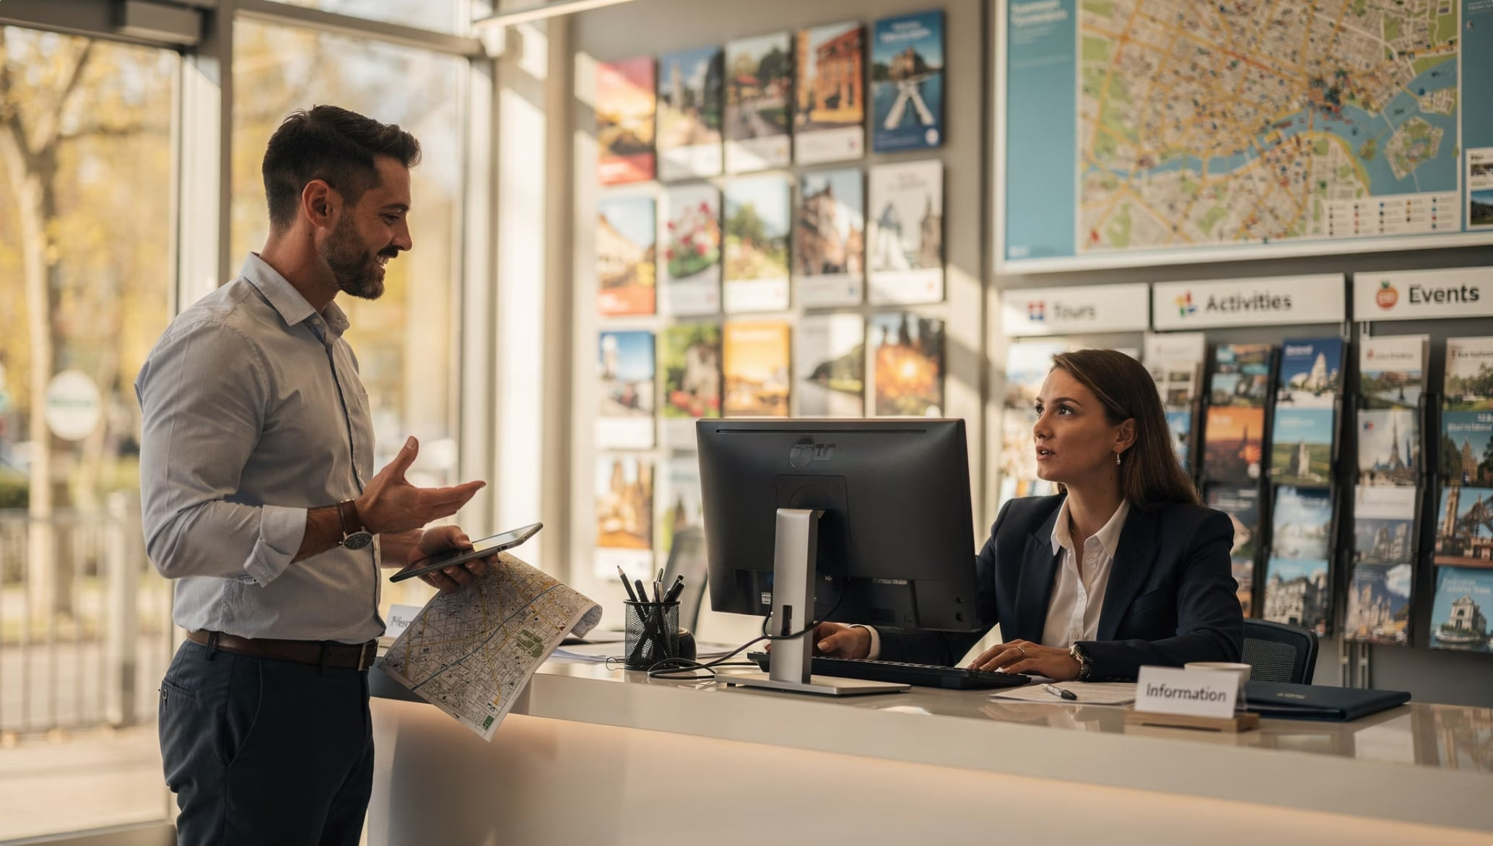


What Is Workplace Communication?
Constant exchange of:
Information & Instructions
Ideas & Feedback
Updates & Changes
Example: Tour coordinator updates guides on itinerary changes so guests get accurate info.

Slide 4
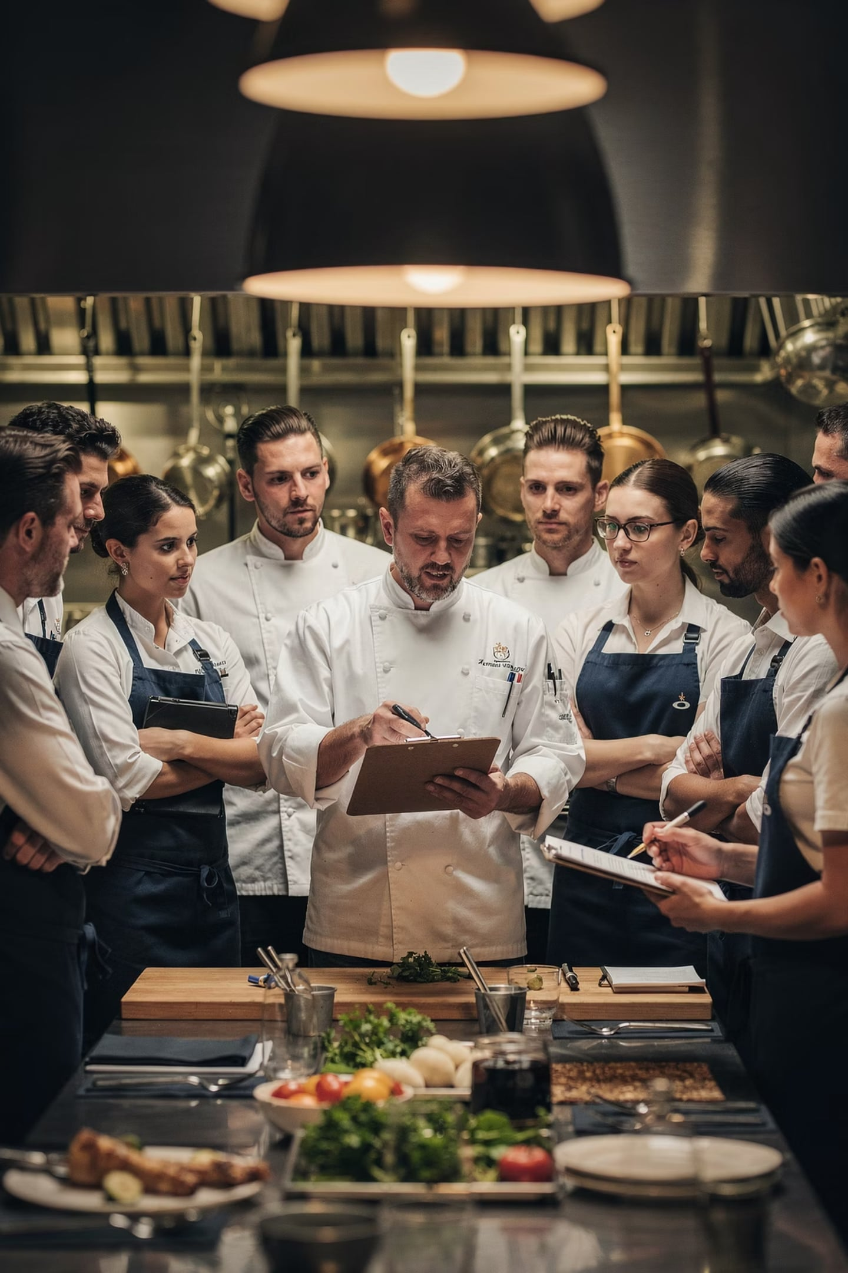



Why Communication Matters
Know What To Do
Employees understand their responsibilities
Know When
Tasks completed on time
Know How
Correct methods followed

Slide 5
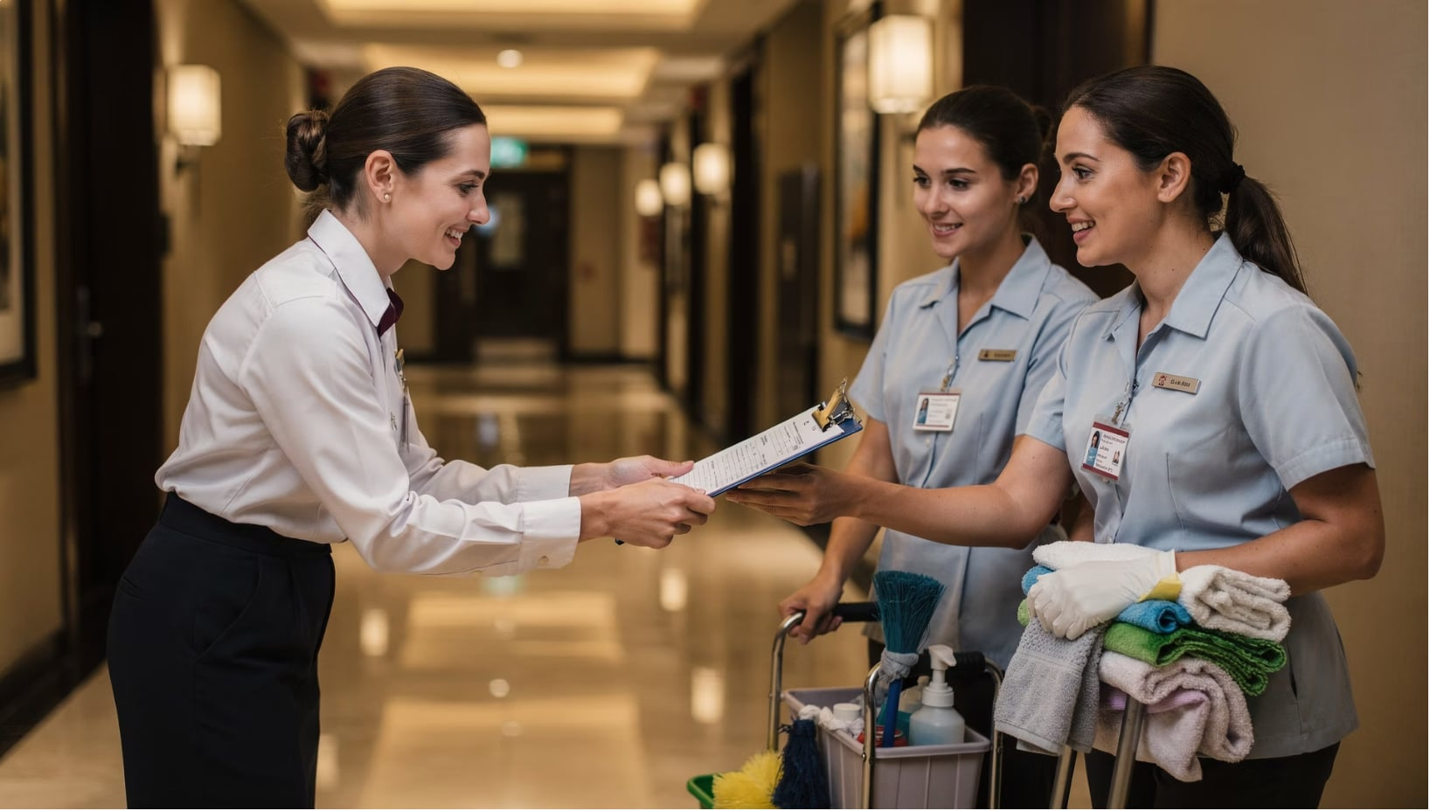

Communication in Daily Operations
Every guest service involves communication:
Before the service
1
During the service
2
After the service
3
Front office updates housekeeping on room status → rooms ready for arriving guests.

Slide 6
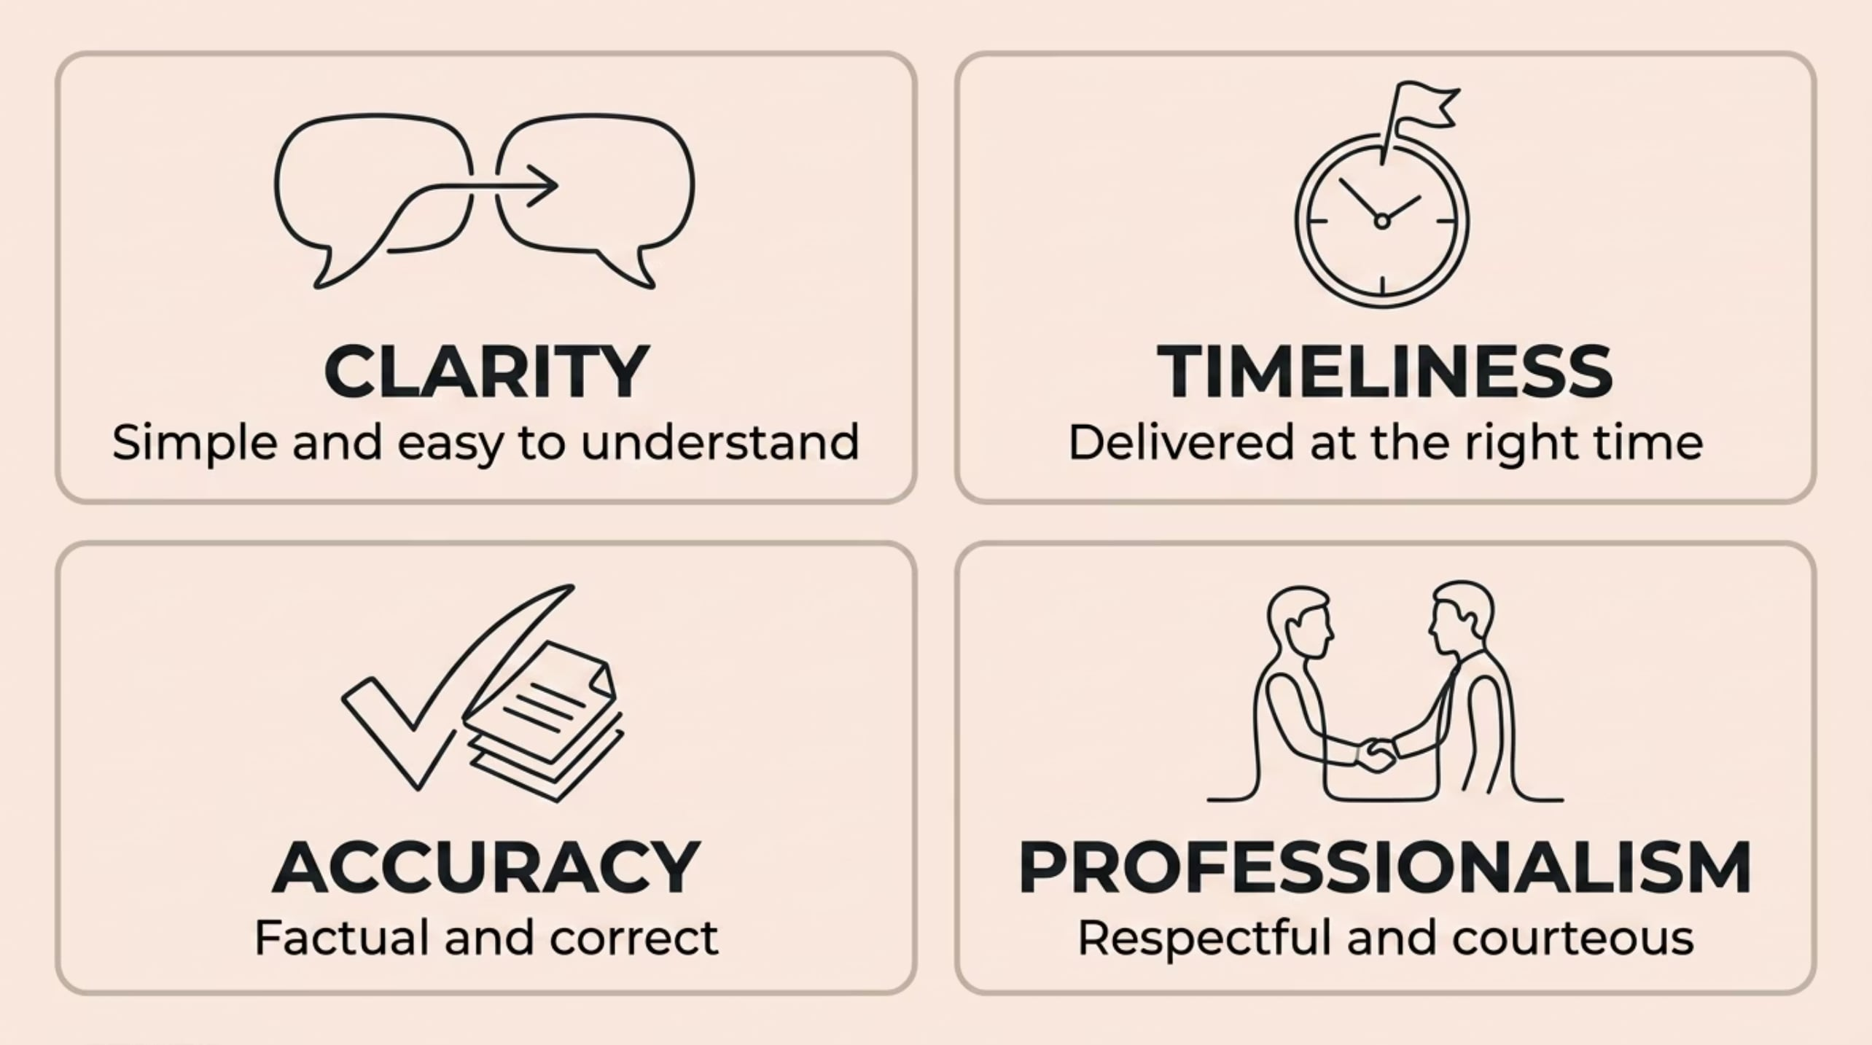
4 Characteristics of Effective Communication
Missing even one of these can lead to mistakes, delays, or poor service.

Slide 7
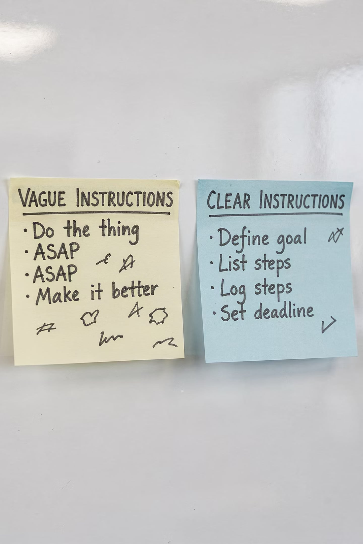
Clarity
❌ Unclear
✅ Clear
"Prepare the function room later."
"Prepare Function Room A for the corporate seminar at 2:00 PM."
Avoid vague words, incomplete info, or jargon your coworkers may not know.

Slide 8
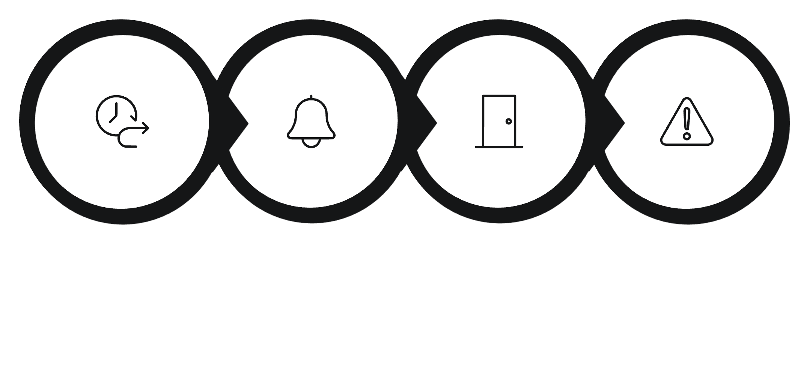


Timeliness
Late communication causes:
⚠️ Operational disruptions
Late Notice
Housekeeping Notified
Room Not Ready
Service Failure
😞 Service failures
😡 Customer dissatisfaction
Even correct information becomes useless if it arrives too late.

Slide 9
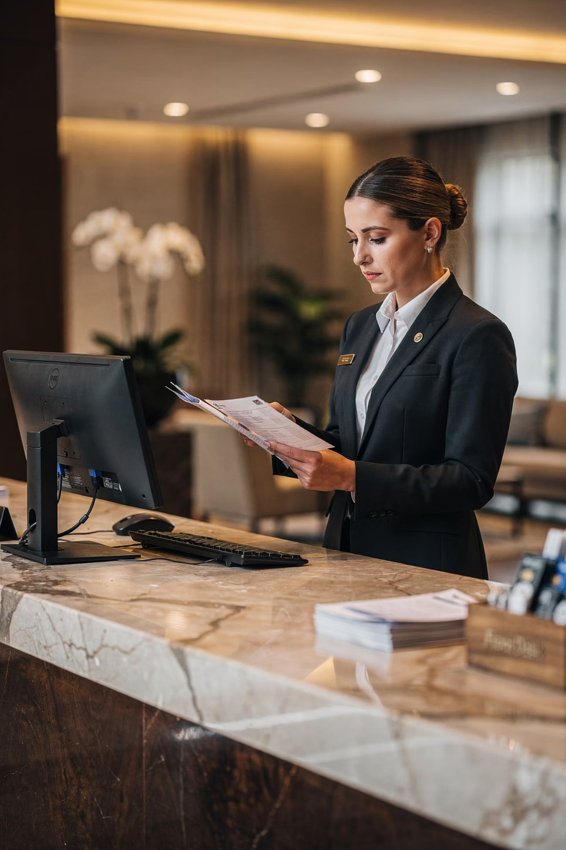

Accuracy
✅ Factual
✅ Correct
Only share verified information
No guessing — confirm before sharing
✅ Updated
Use the most current information
Wrong flight time given to tourists = missed flights + complaints.

Slide 10
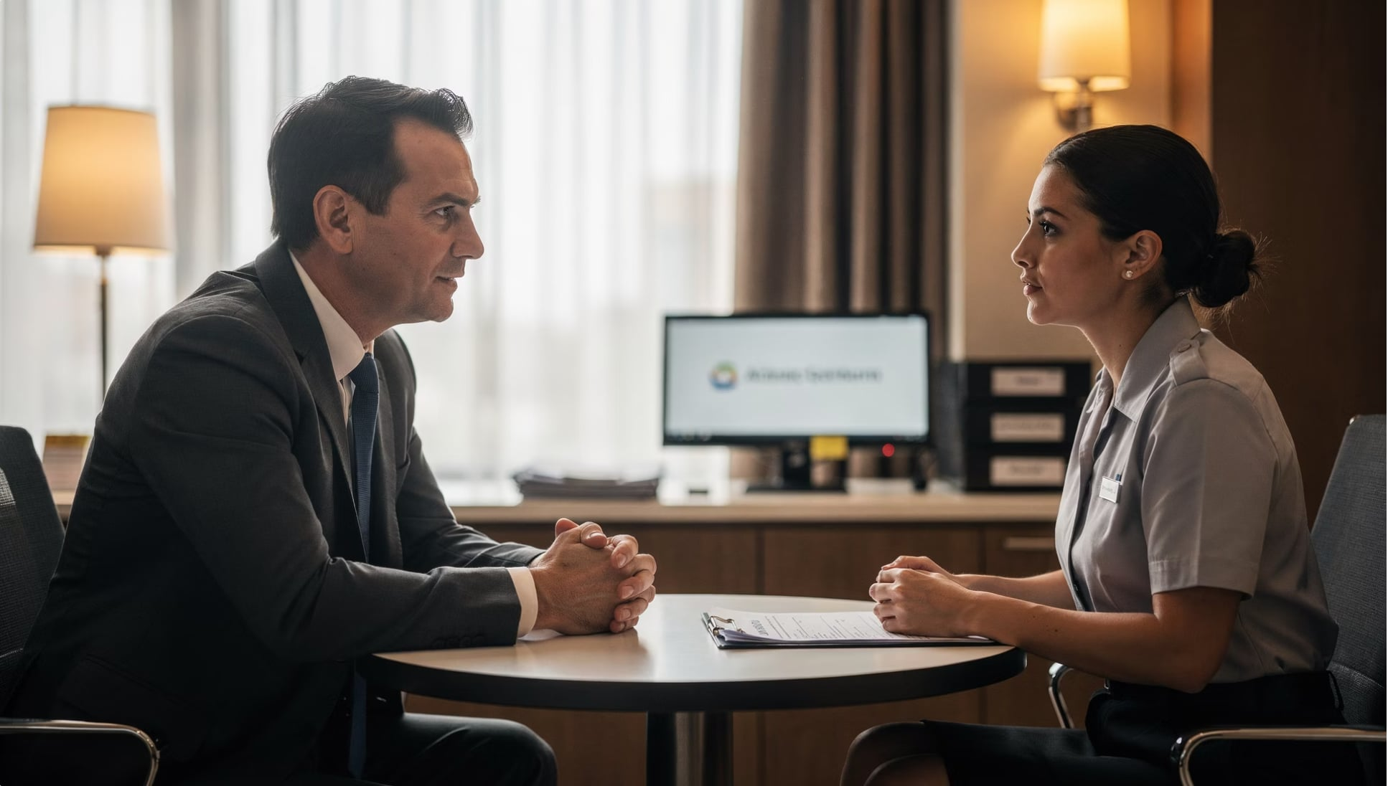


Professionalism
Communicate with respect, courtesy & responsibility
Use appropriate language
Be polite and respectful
Give constructive feedback
Correct mistakes privately, not publicly.

Slide 11
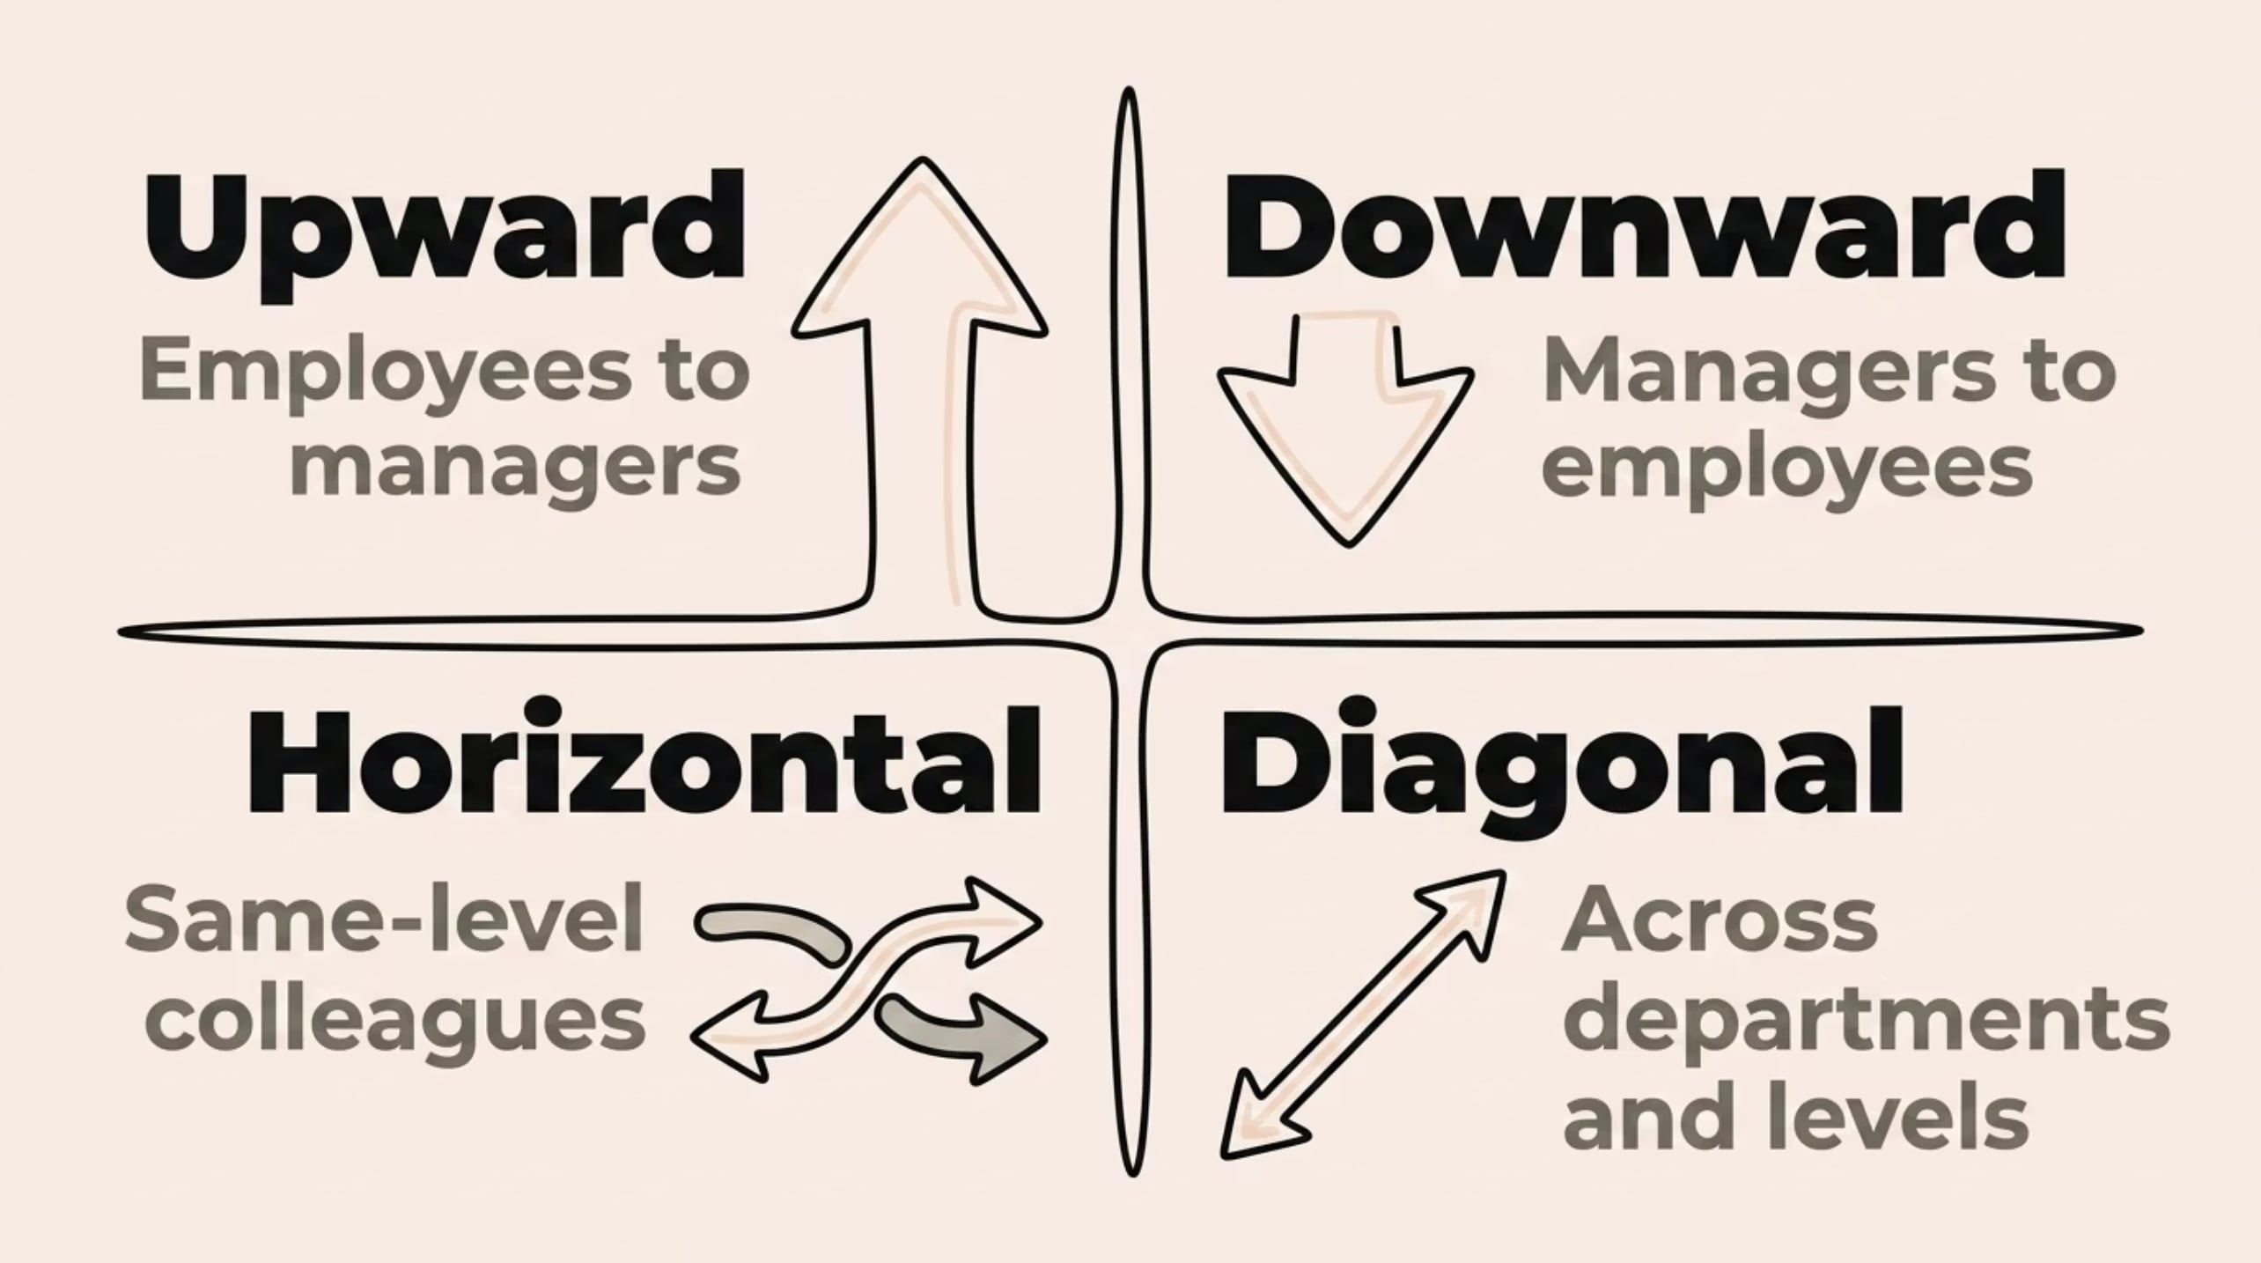
4 Types of Workplace Communication
Each type keeps information flowing in the right direction at the right time.

Slide 12
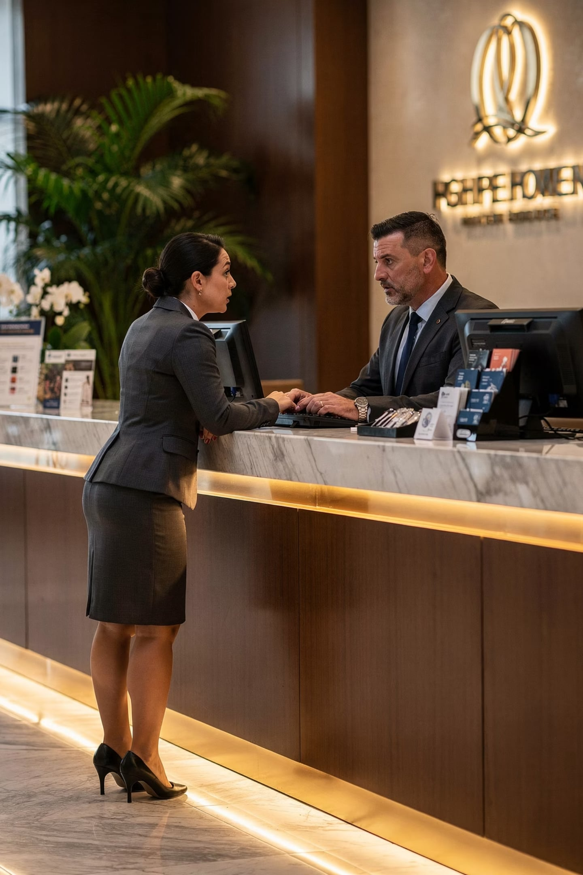


Upward Communication
Employees → Managers
What flows up?
Feedback, suggestions, reports, operational concerns
Why it matters
Helps management understand real conditions on the ground

Slide 13
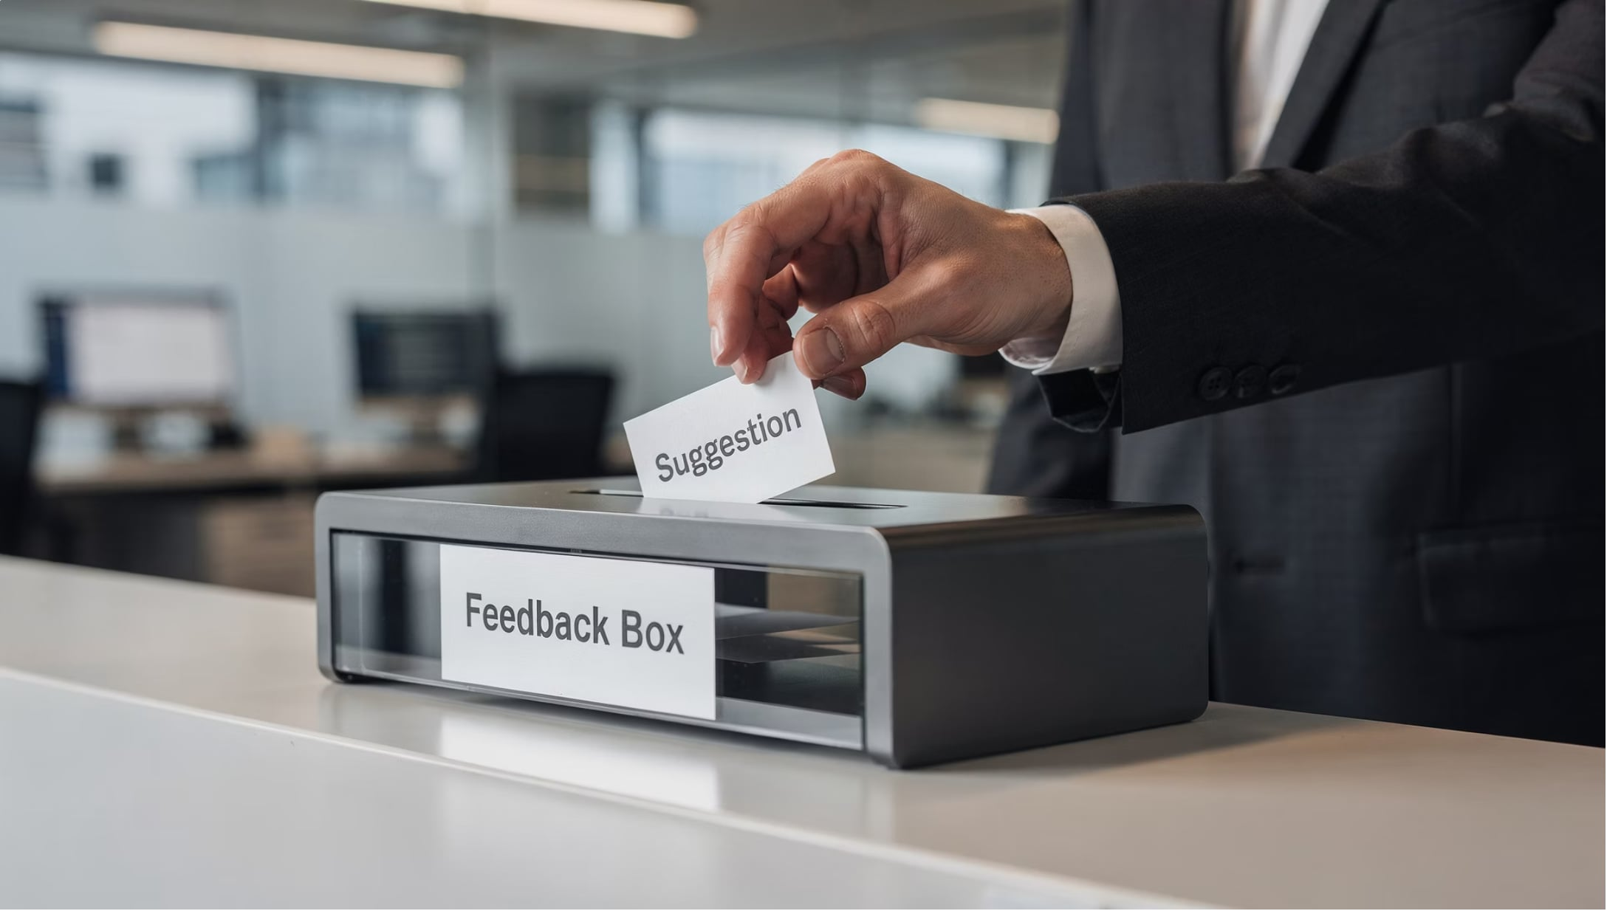
Benefits of Upward Communication
Encourages employee participation
Helps management identify problems
Supports informed decision-making
Creates space for improvement ideas

Slide 14
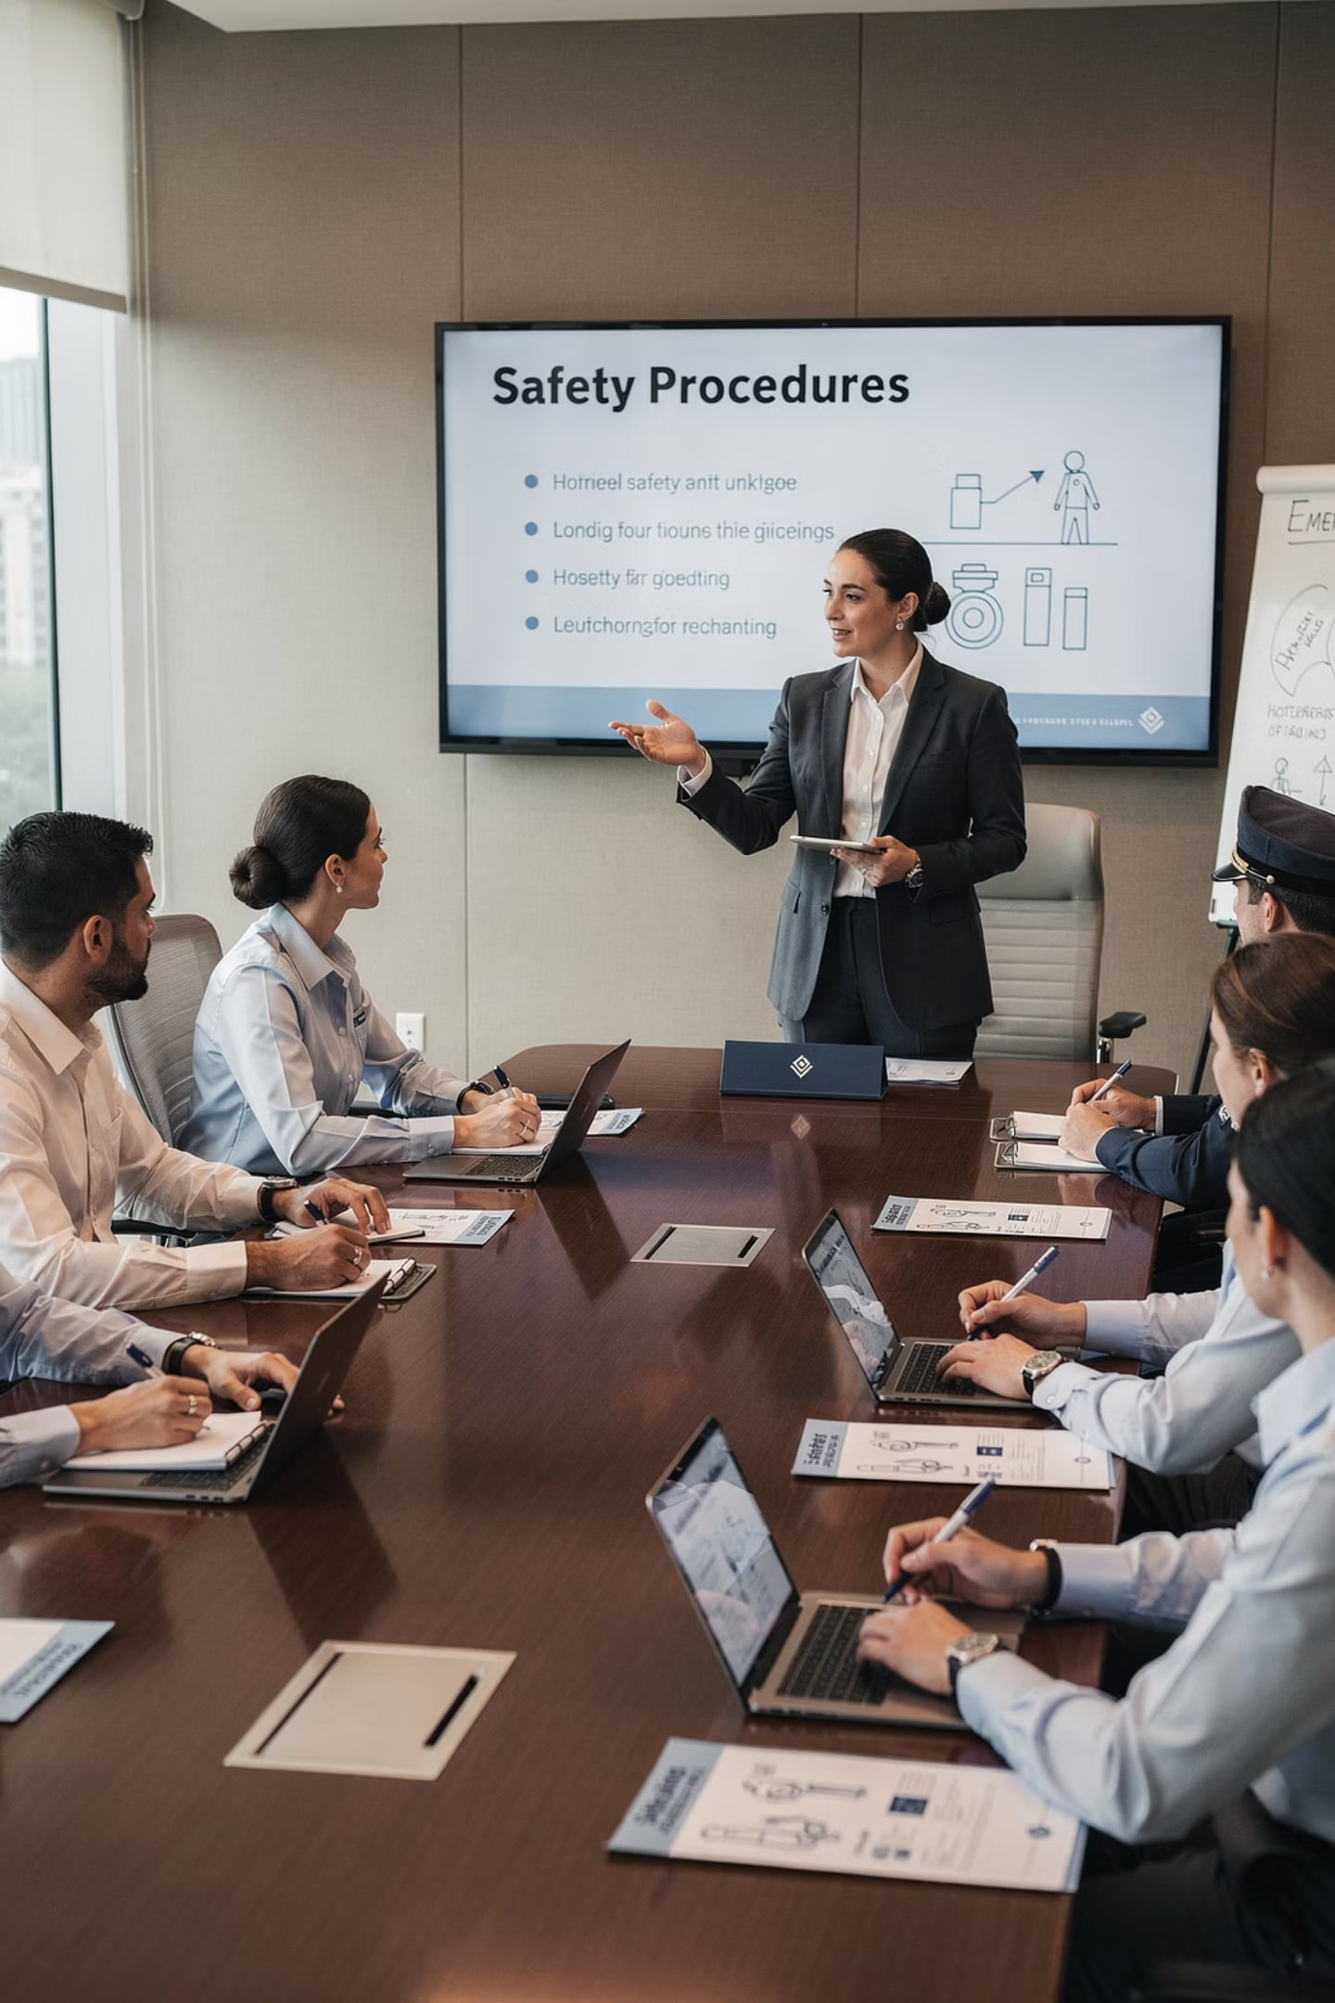
Downward Communication
Managers → Employees
📋 Policies
📢 Instructions
Rules and standards to follow
How tasks should be done
🎯 Expectations
📣 Announcements
What results are needed
New updates and changes

Slide 15
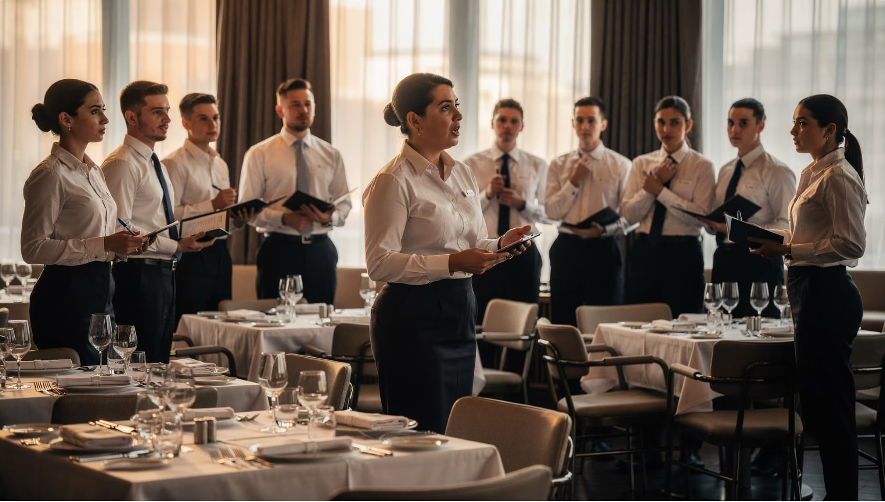

Benefits of Downward Communication
Clarifies responsibilities
Sets clear expectations
Ensures consistency
Supports service quality
Employees perform better when they know exactly what's expected.

Slide 16
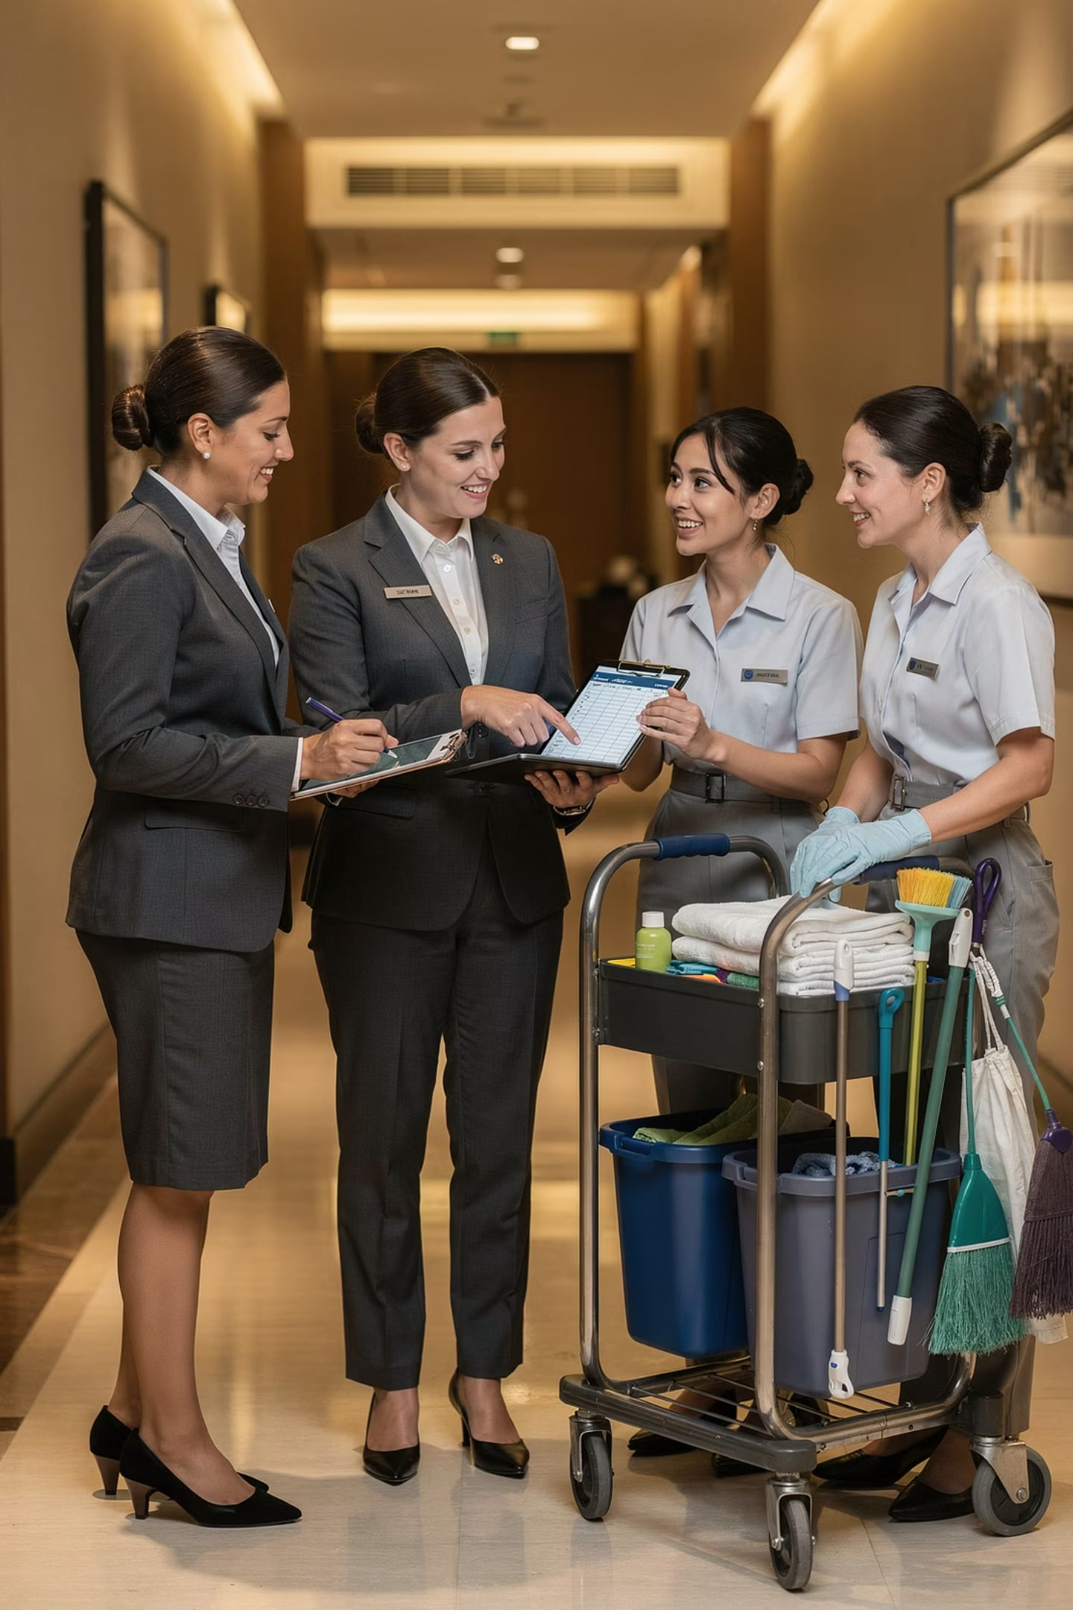


Horizontal Communication
Same Level ↔ Same Level
Teamwork & Coordination
Info Sharing & Problem-Solving
Departments work closely together
Front office ↔ Housekeeping: room availability updates

Slide 17
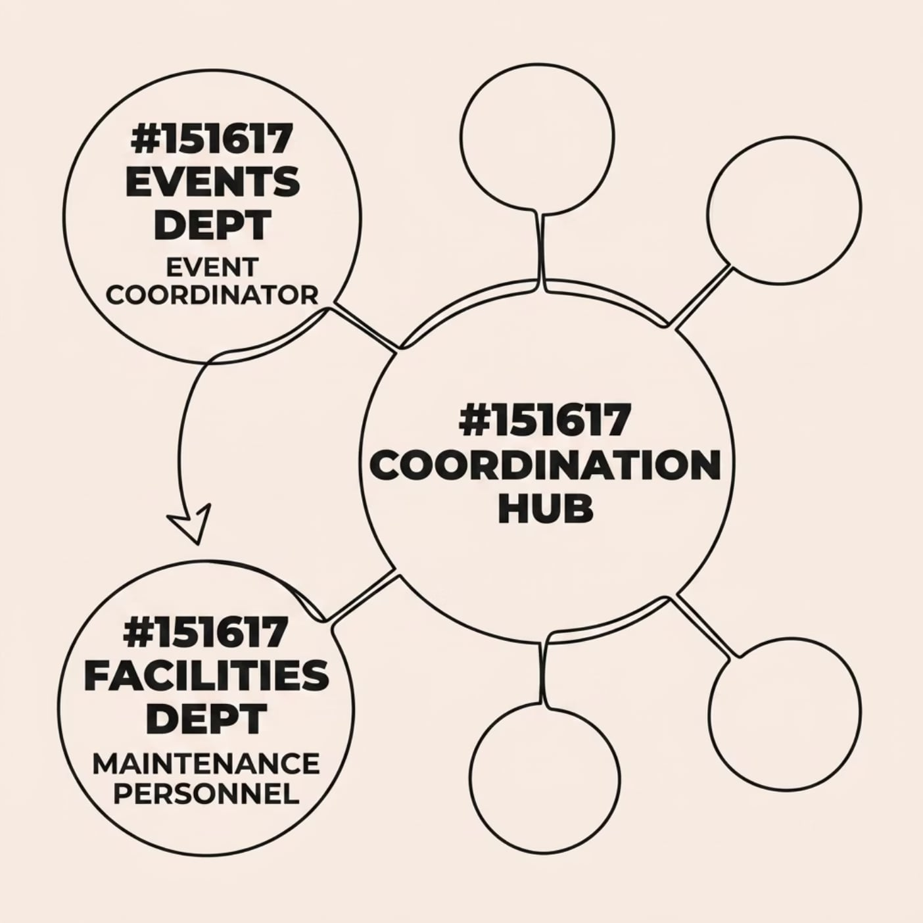


Diagonal Communication
Across departments AND levels
Speeds up information flow
Improves coordination
Reduces chain-of-command delays
Event coordinator → Maintenance: technical setup for upcoming event.

Slide 18
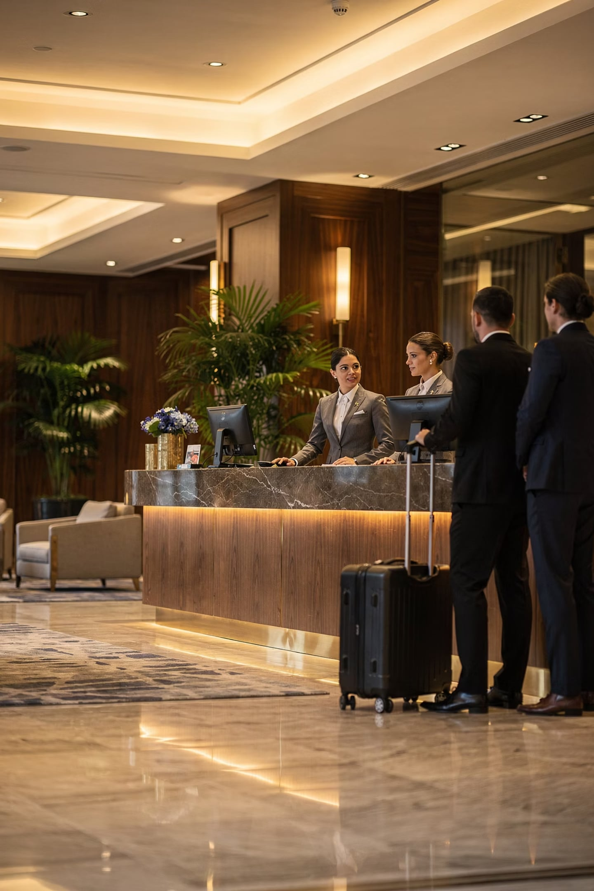
Internal Communication in Hospitality
How employees share information to keep operations running smoothly
⚙️ Efficiency
🤝 Engagement
🎯 Coordination
🏨 Culture

Slide 19
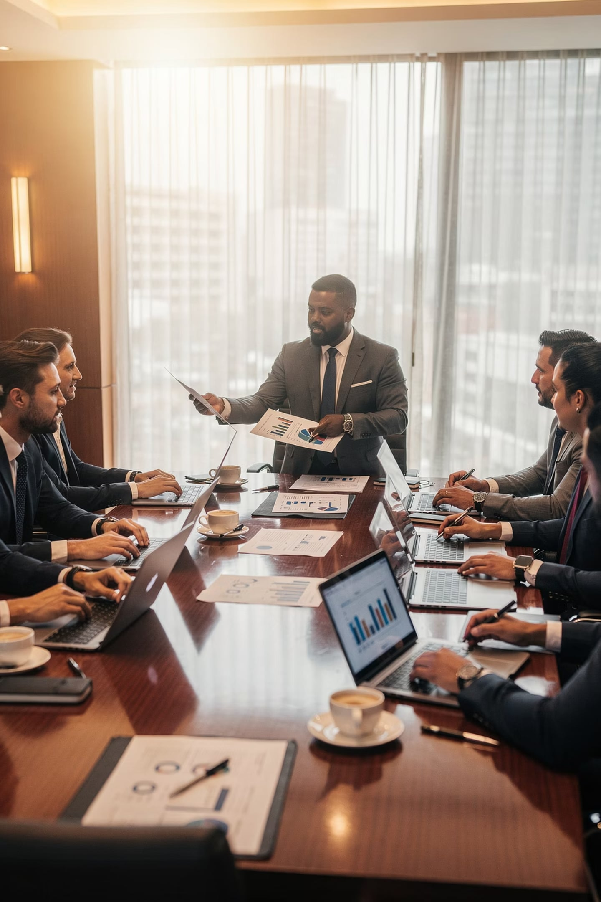



Communication Tools at Work
Digital
Emails & messaging platforms
In-Person
Meetings & briefings
Written
Memos, reports & notice boards

Slide 20
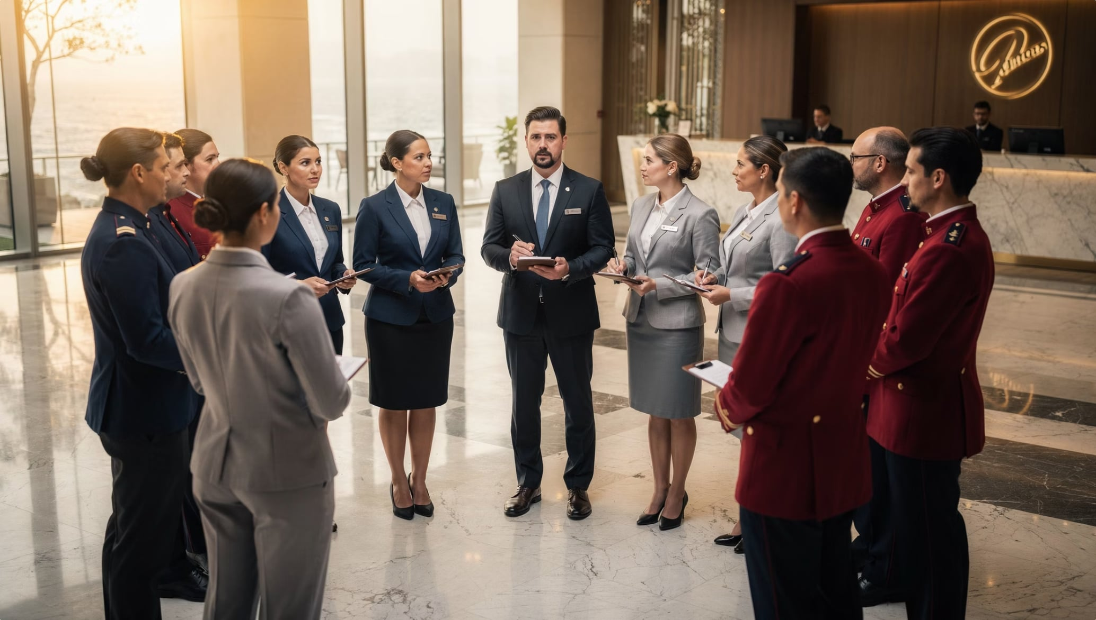
Daily Briefings
A short meeting before work begins — like a team huddle!
VIP Arrivals
Occupancy Levels
Special Events
Guest Requests

Slide 21
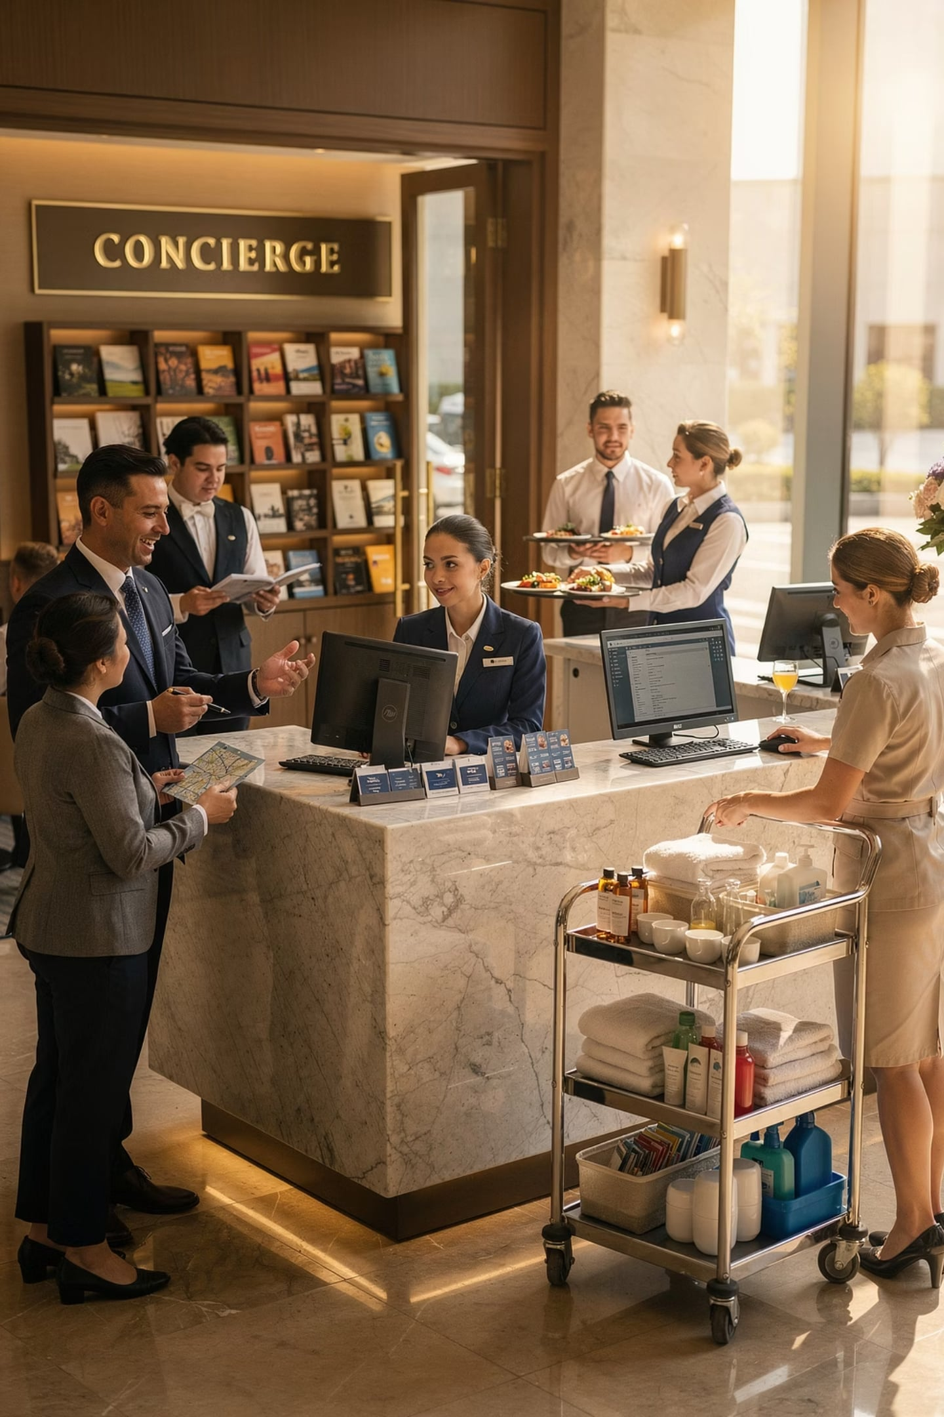

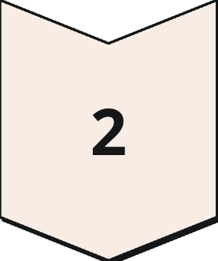
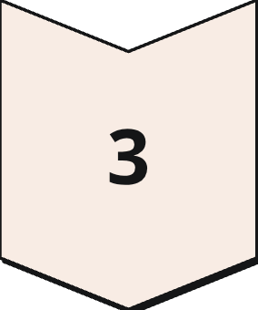
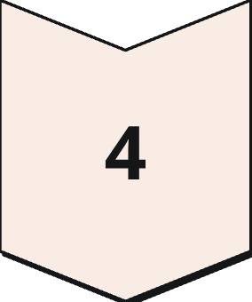
Team Collaboration
No single employee delivers the full guest experience alone.
Reservations
Front Office
Housekeeping
F&B

Slide 22
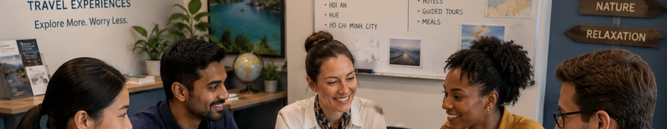
Why Collaboration Matters
Better Performance
Stronger Service
Faster Tasks
Guest Needs Met
A tour team coordinates transport, hotels, guides & attractions — together.

Slide 23
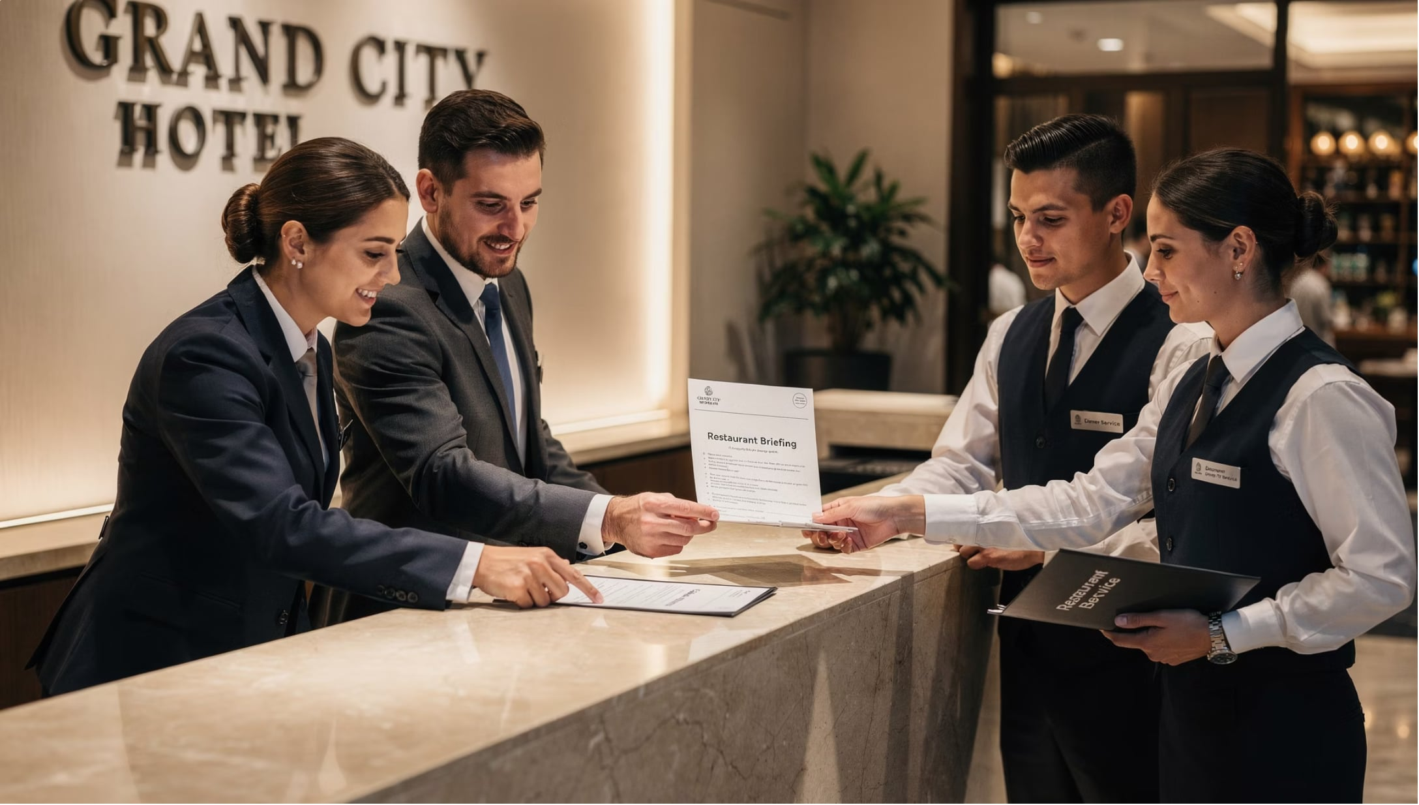

Improved Service Quality
Front office tells the restaurant about a guest's dietary needs before arrival.
✅ Accurate Information
✅ Prompt Fulfillment
✅ Consistent Standards

Slide 24
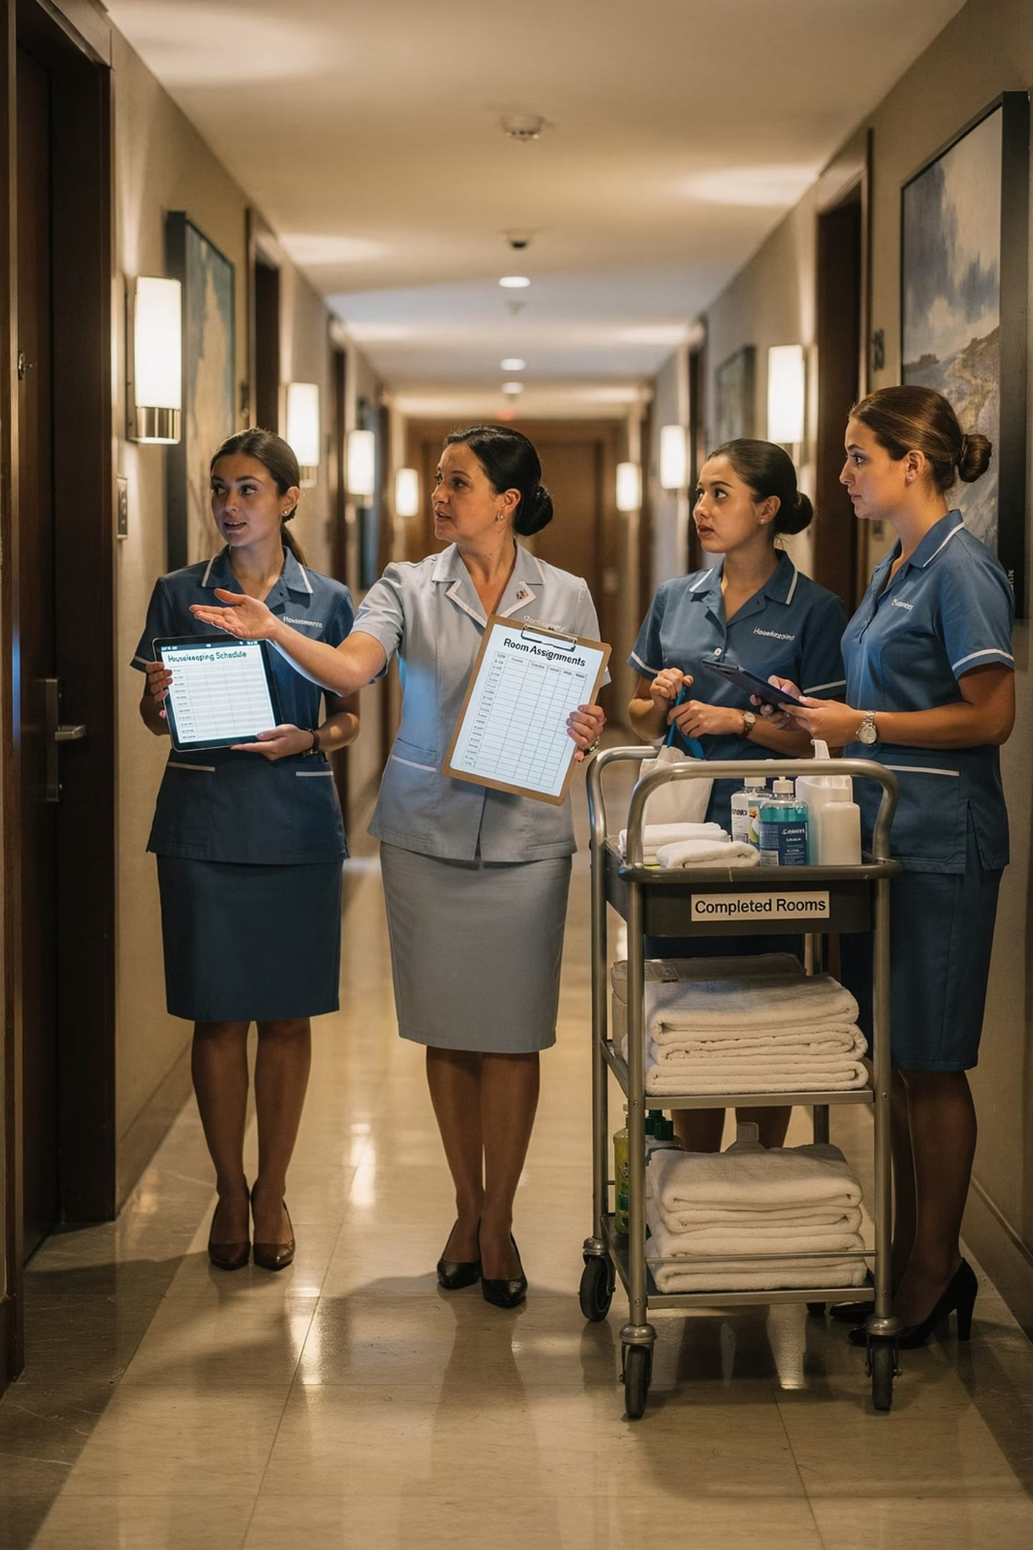
Increased Efficiency
1
Share Responsibilities
2
Support Each Other
3
Use Time Productively
Teamwork reduces wasted effort and improves workflow.

Slide 25
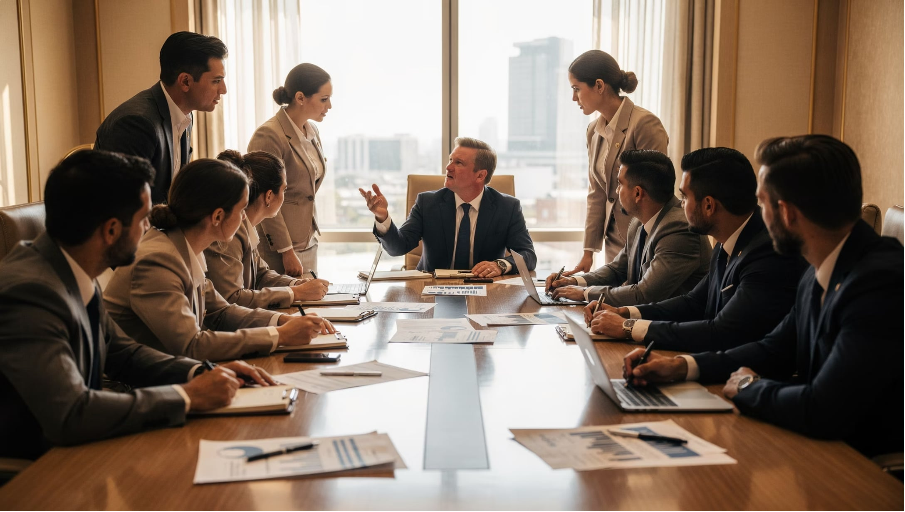
Better Problem-Solving
Different perspectives = better solutions.
All three departments needed to resolve one guest complaint.
Housekeeping
Front Office
Management

Slide 26








Positive Workplace Environment
Trust
Respect
Satisfaction
Cooperation

Slide 27
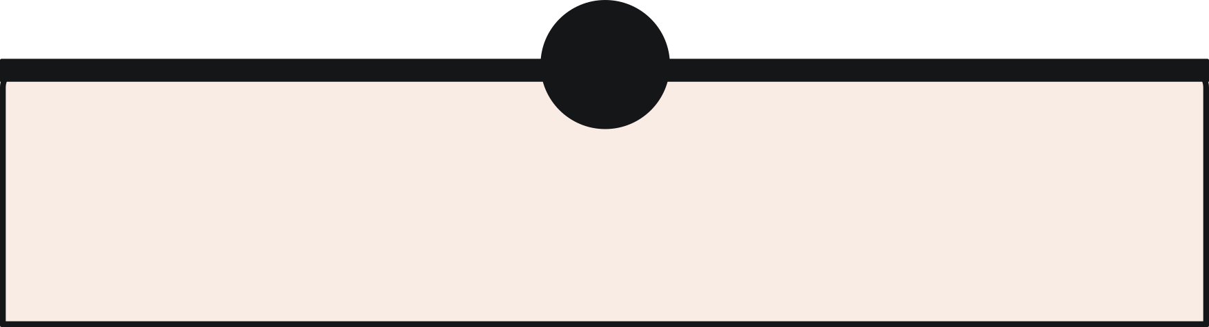




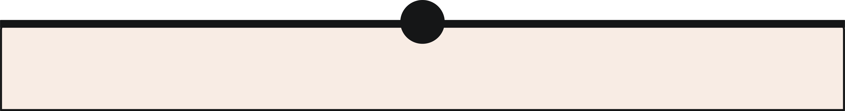

Characteristics of Effective Teams
Shared Goals
Open Communication
Trust
Accountability
Mutual Respect

Slide 28
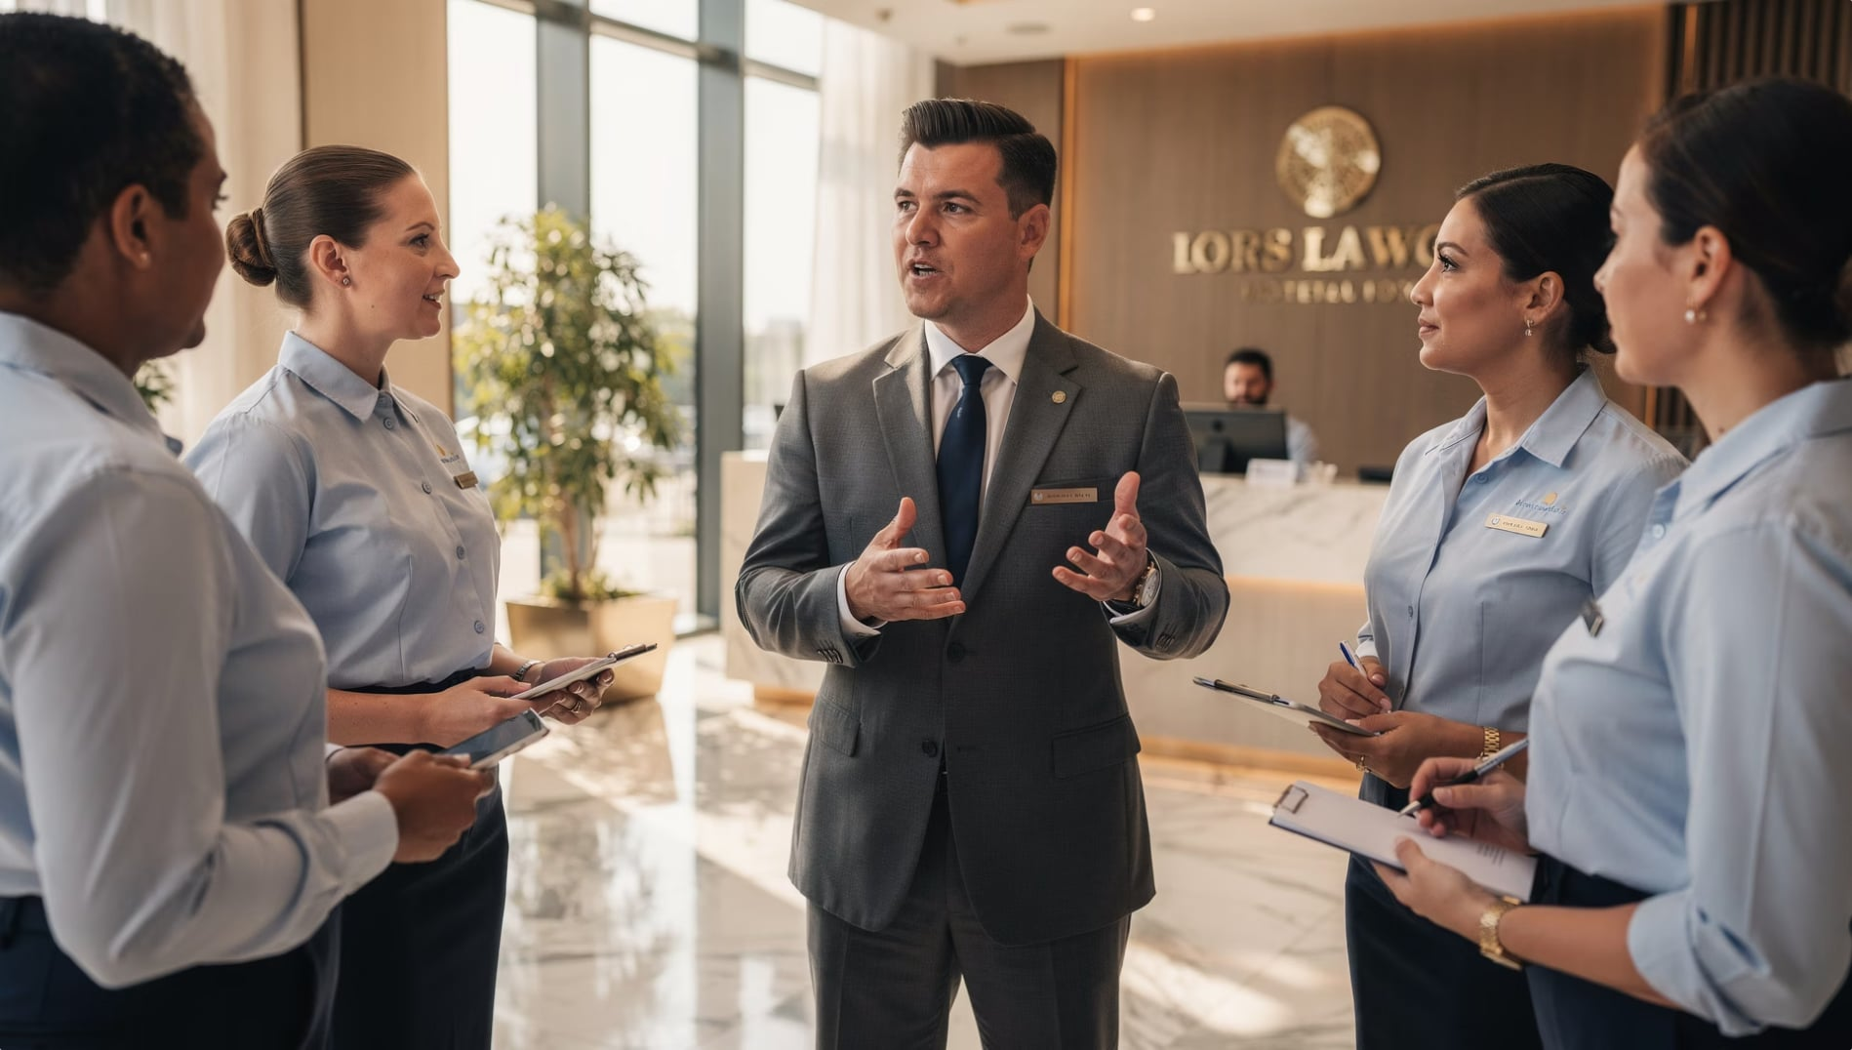

Leadership Communication
Leaders guide, motivate, and inform their teams.
Set Expectations
Share Goals
Give Feedback
Offer Encouragement

Slide 29
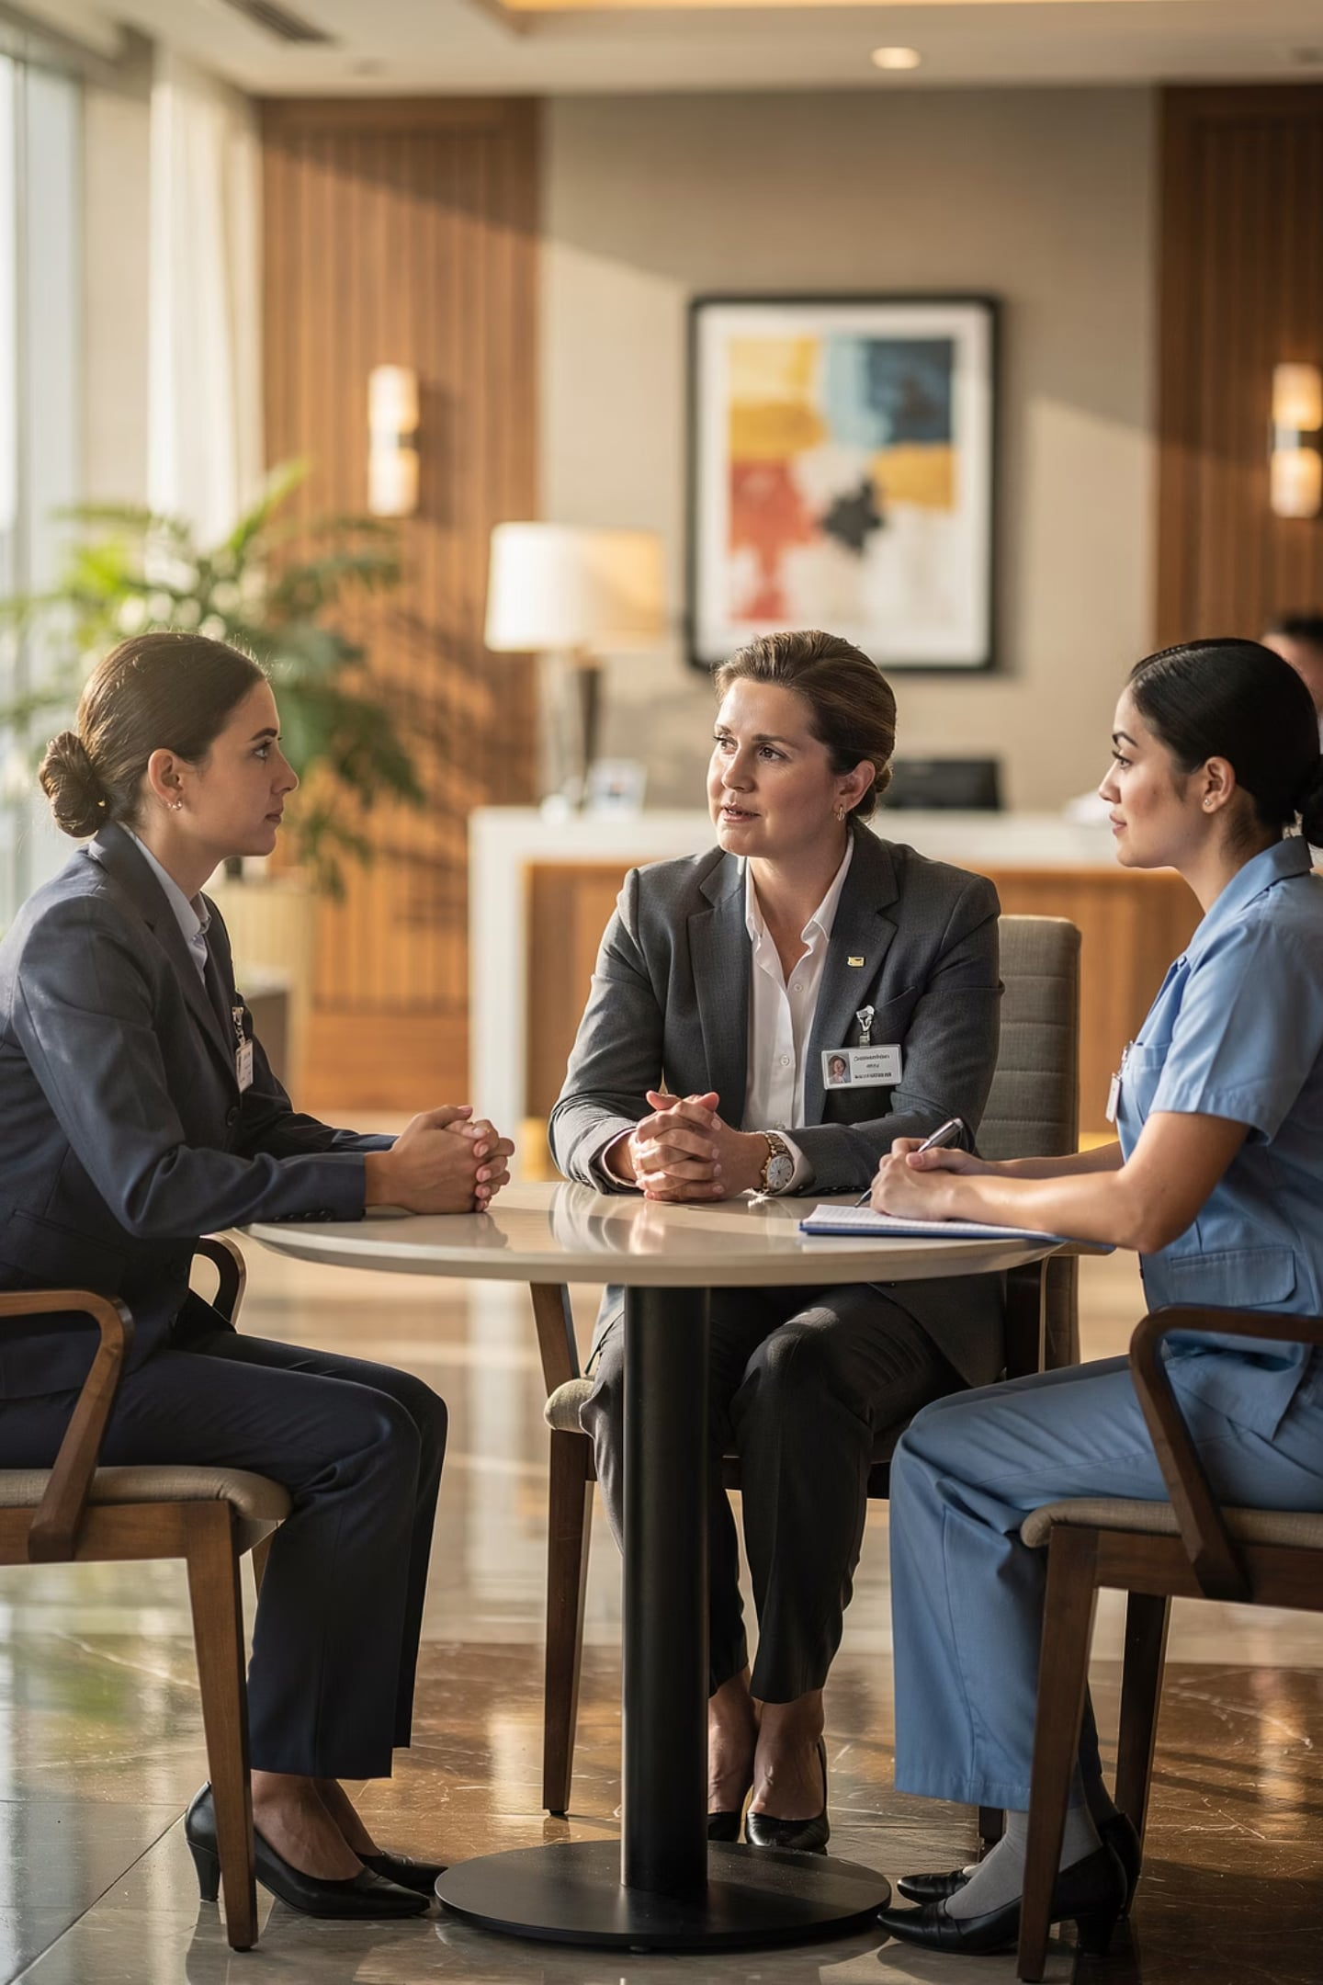



Responsibilities of Leaders
Provide Direction
Motivate Employees
Resolve Conflicts
Build Cohesion

Slide 30
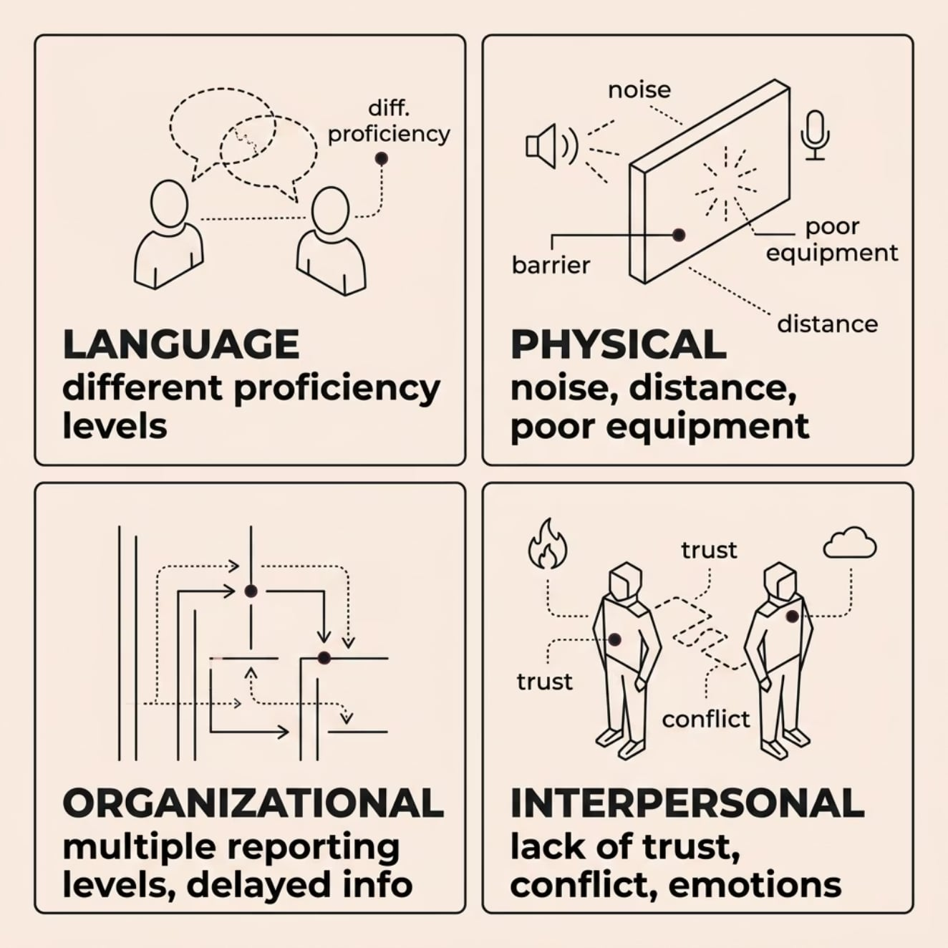
Communication Barriers
Factors that block the flow of information — causing misunderstandings and reducing teamwork.
Employees misunderstand instructions because they interpret the same message differently.
🗣️ Language
📡 Physical
🏢 Organizational
💬 Interpersonal

Slide 31
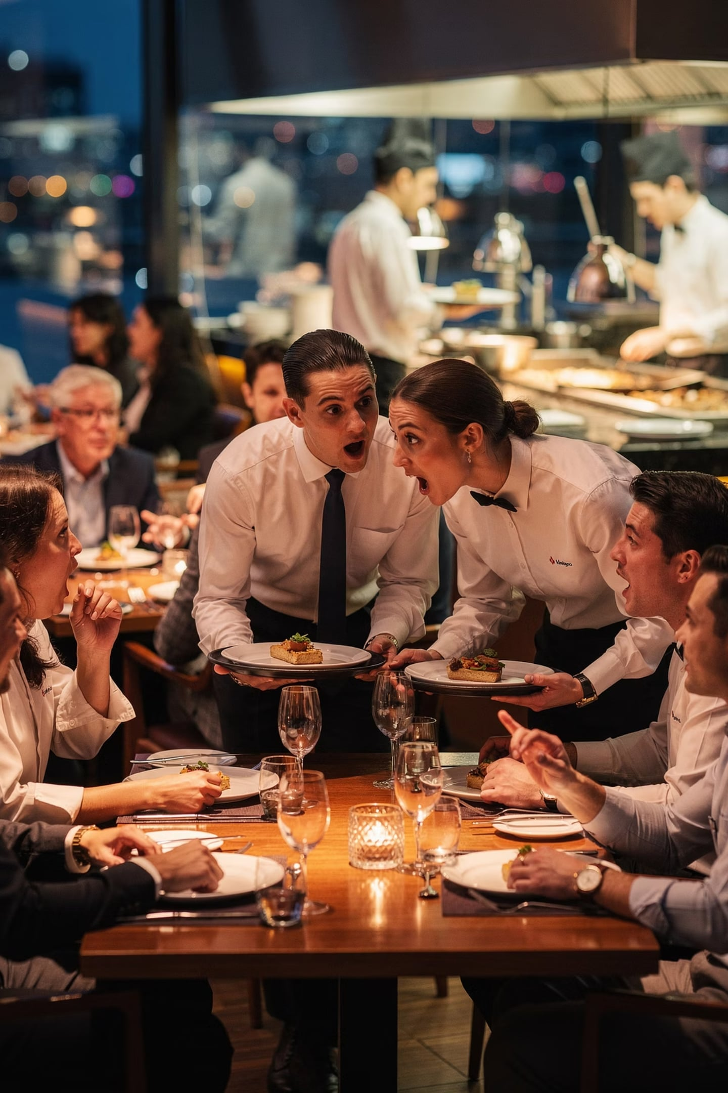
Types of Communication Barriers
Language
Differences in language proficiency
Physical
Noise, distance, poor equipment
Organizational
Too many reporting levels, delayed info
Interpersonal
Conflict, distrust, emotions

Slide 32

Best Practices & Key Takeaways
01
02
Listen Actively
Communicate Clearly
03
04
Verify Understanding
Respect All Perspectives
05
Stay Professional
💭 Which communication practice will have the greatest impact on your future career in tourism?

