Slide 1
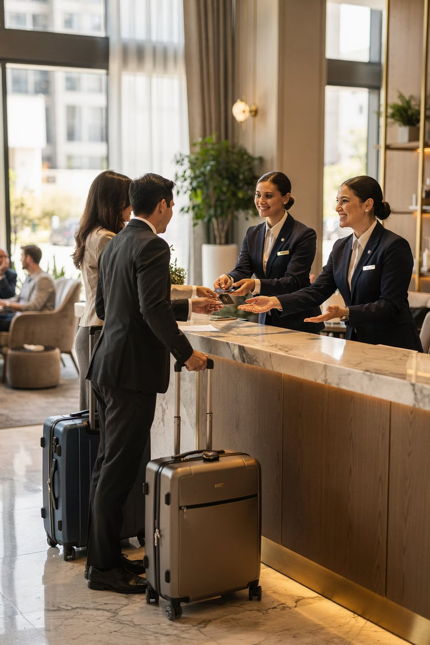
Module 8_Introduction
Conflict Resolution & Complaint Handling
Course: Hospitality and Tourism Business Communication
Prof. Alia Amor D. Uy, MBA

Slide 2



When People Disagree — It's Inevitable
In hospitality, people with different backgrounds and expectations interact constantly. Conflicts and complaints will happen.
Conflict Resolution
Identifying and resolving disagreements constructively
Complaint Handling
Receiving and resolving guest concerns to restore satisfaction
Who's Involved?
Guests, employees, supervisors, departments, suppliers

Slide 3

Learning Outcomes
Define
Conflict resolution & complaint handling
Explain
Common causes of conflicts & complaints
Discuss
Role of communication in resolving disputes
Recognize
Service recovery & professional complaint handling

Slide 4
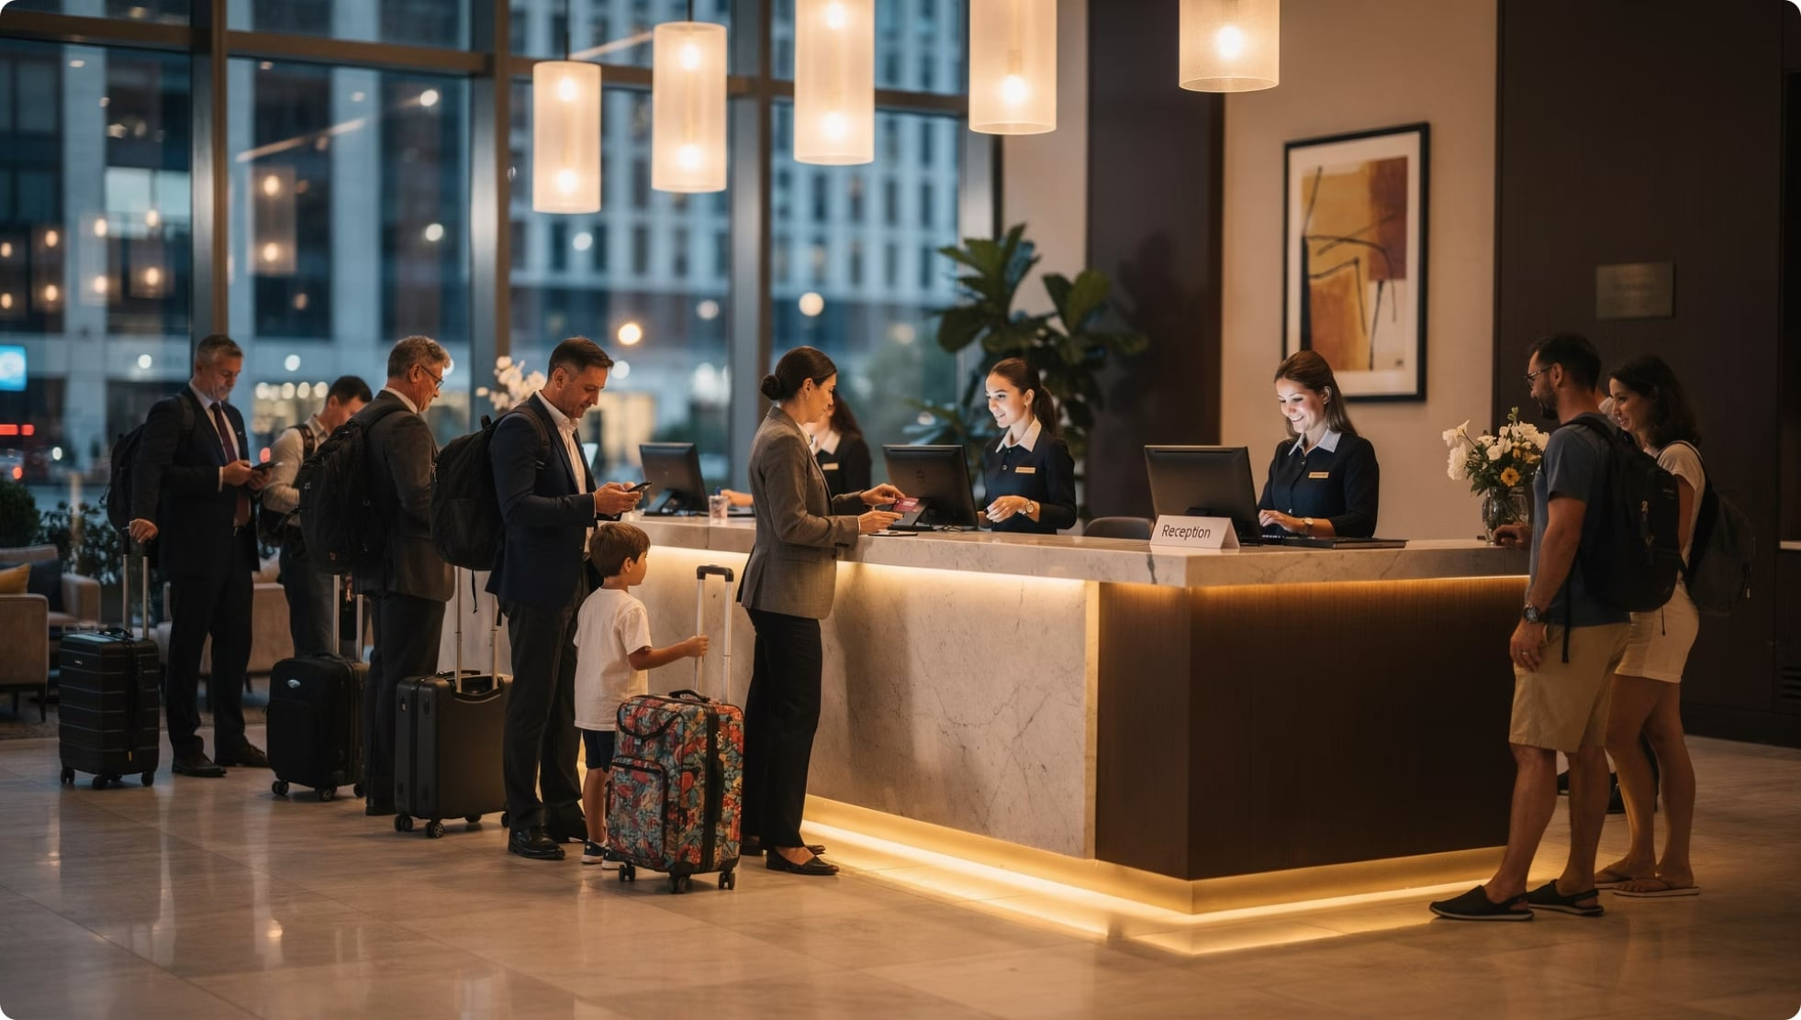
Why Do Conflicts Start? — High Expectations
Guests expect a lot
Prompt service, comfort, personalized experiences — when these fall short, dissatisfaction follows.
⏳ Long waits
📋 Booking errors
🚫 Unavailable facilities
⏰ Delayed services

Slide 5
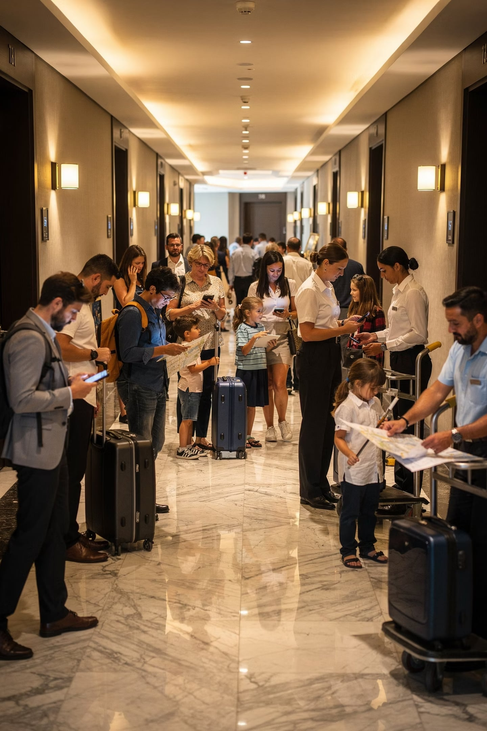
Two More Big Causes of Conflict
🌍 Multicultural Interactions
😓 Stressful Work Environments
Guests come from different nationalities, languages, and customs. Different communication styles = misunderstandings.
Peak seasons, staff shortages, heavy workloads — pressure builds and communication breaks down.
📢 Poor Communication
Unclear instructions, wrong info, missing feedback — the most common conflict trigger of all.

Slide 6





Conflict Isn't Always Bad
When managed well, conflict can actually improve your organization.
Better Communication
Problem-Solving
Stronger Teamwork
Spot Weaknesses
Organizational Learning

Slide 7
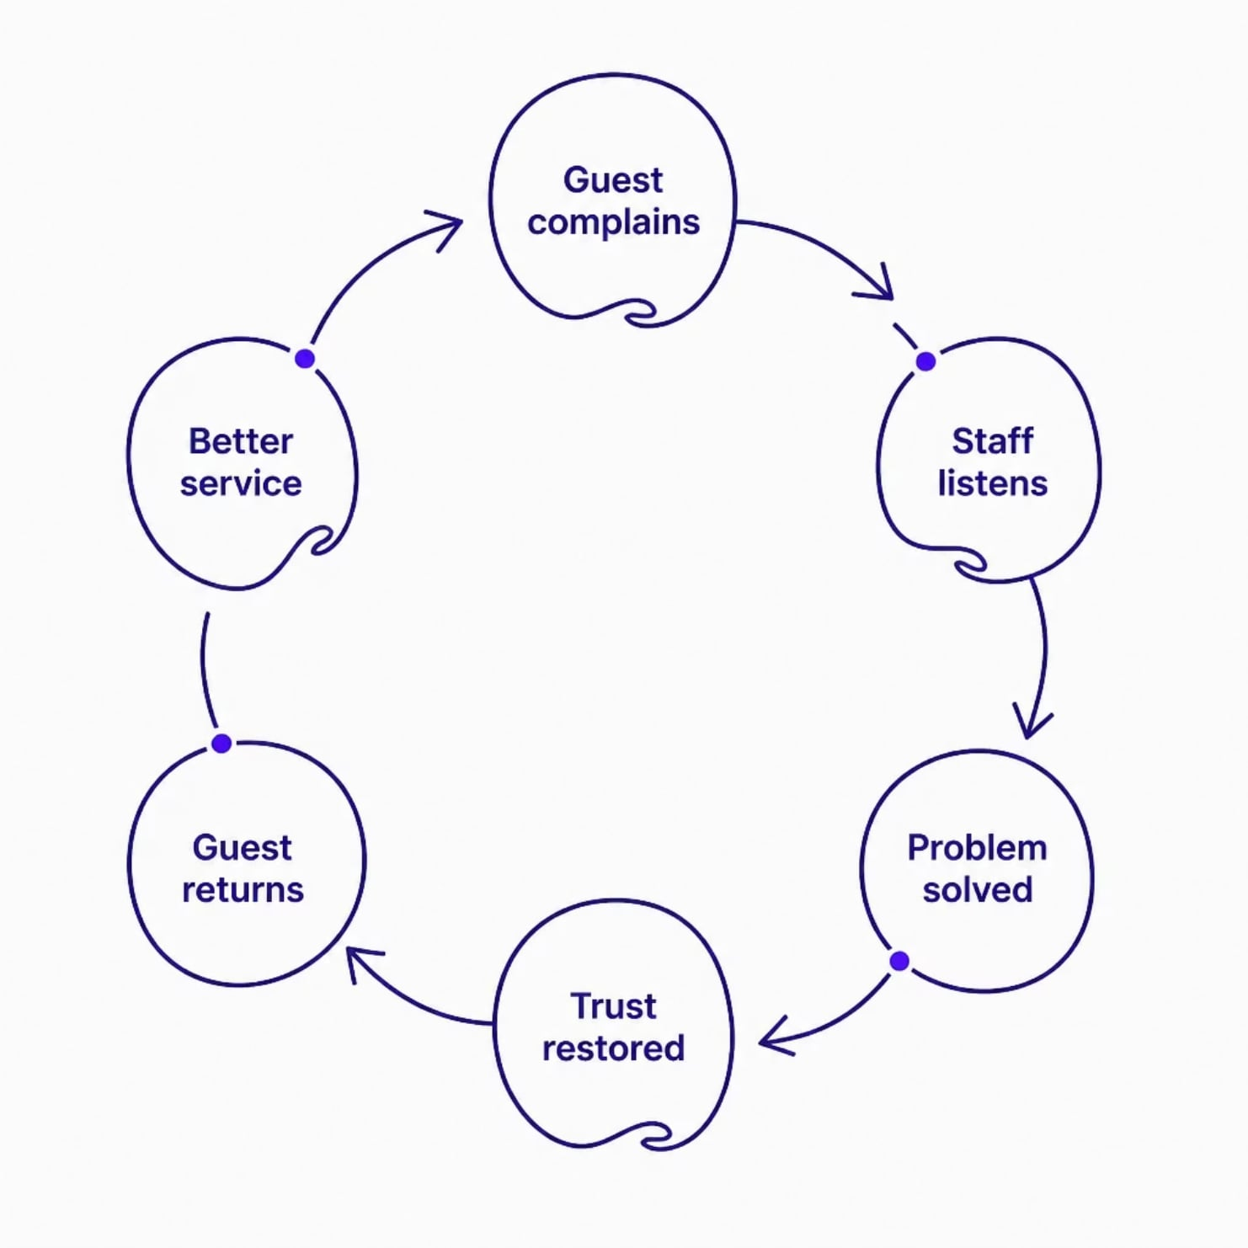


Complaints = Opportunities, Not Just Criticism
Effective complaint handling helps organizations grow and retain customers.
Recover customer trust
Increase loyalty
Prevent negative reviews
Improve reputation
A guest whose complaint is handled well may become more loyal than one who never had a problem.

Slide 8
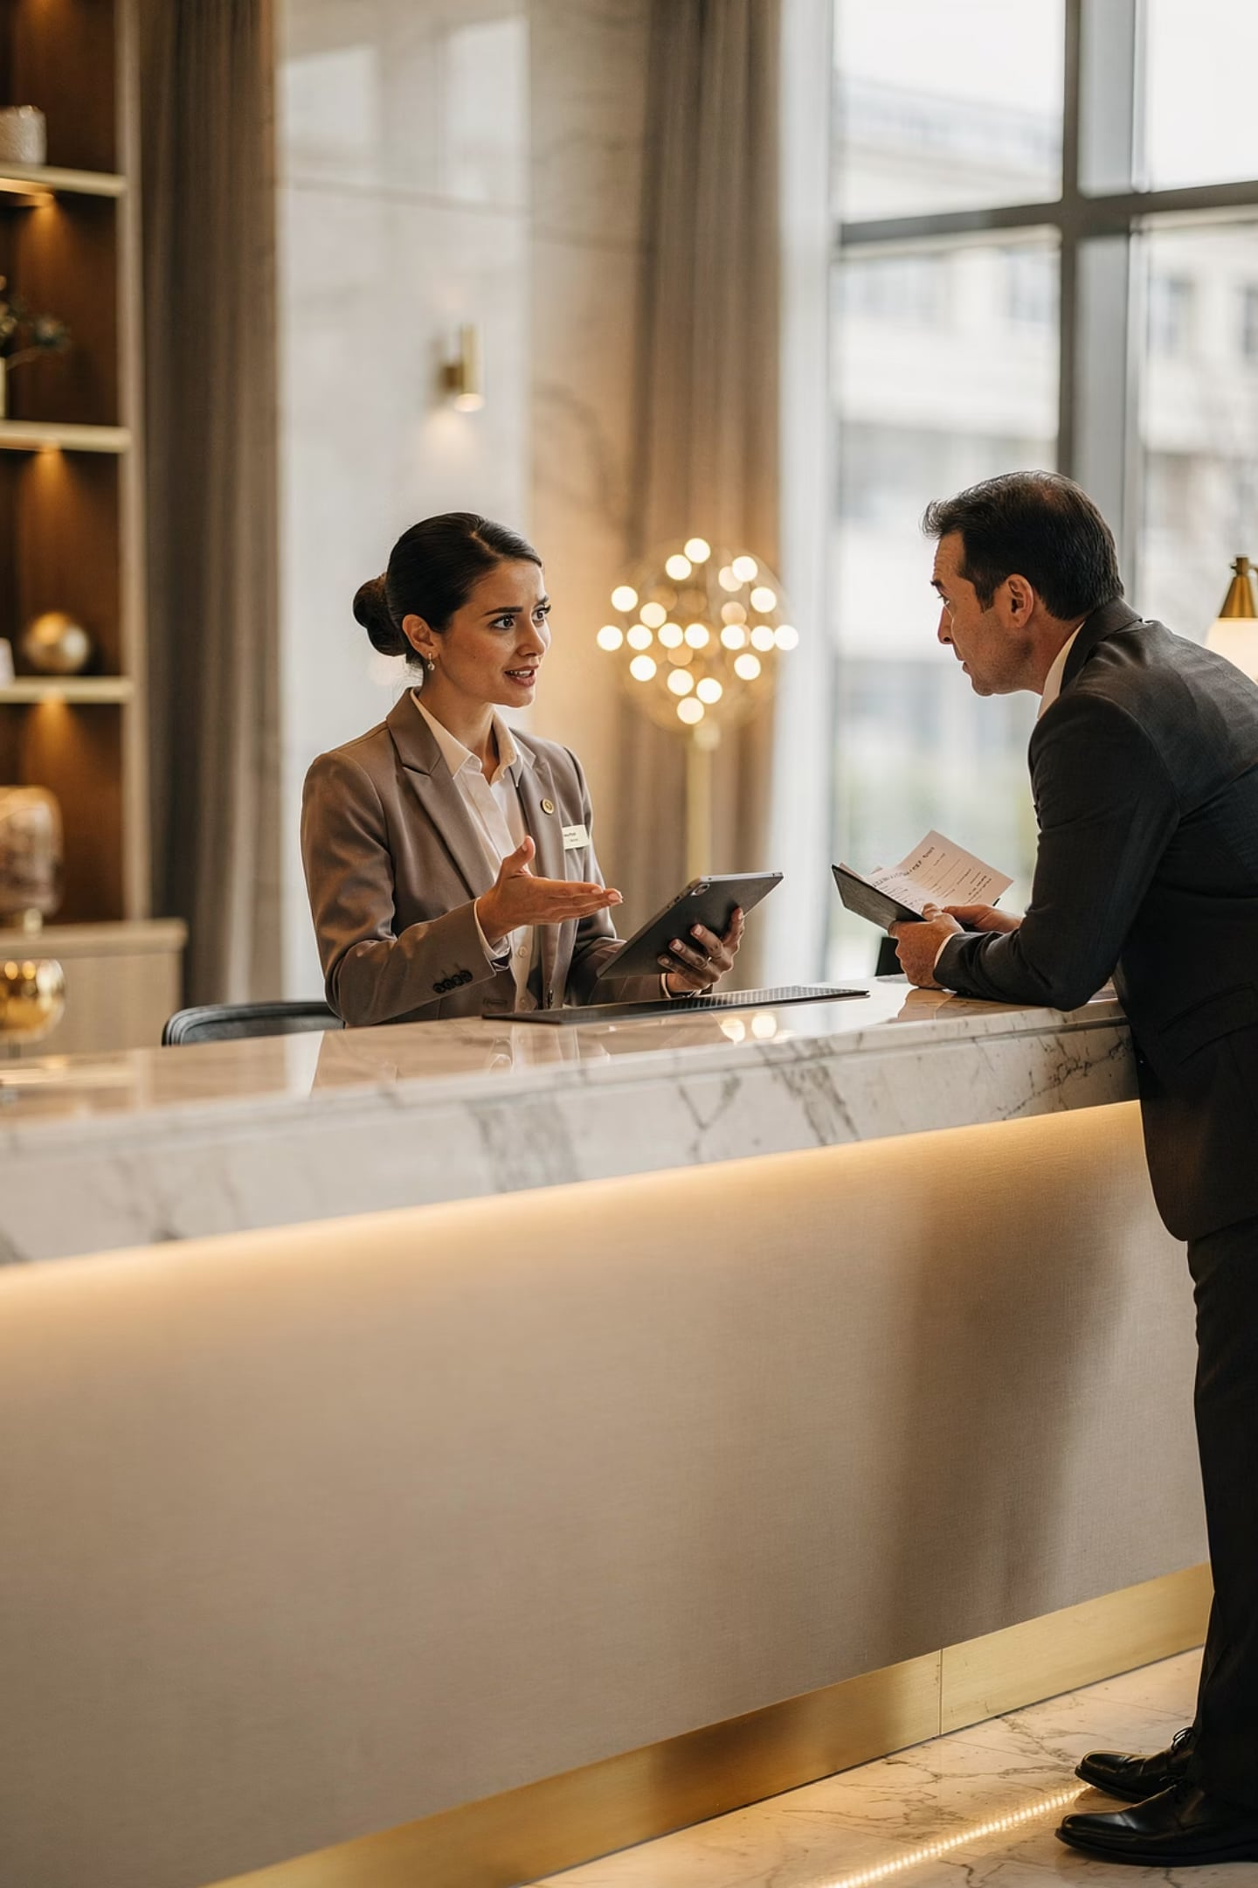
Service Recovery — Fix It & Win Them Back
Service recovery = actions taken to correct failures and restore satisfaction.
Apologize
Provide Solutions
Correct Mistakes
Compensate if Needed

Slide 9




Communication Is the Key Skill
Resolving conflicts professionally starts with how you communicate.
Active Listening
Empathy
Hear the full concern before responding
Understand the guest's feelings
Patience
Professionalism
Stay calm under pressure
Respectful language at all times

Slide 10
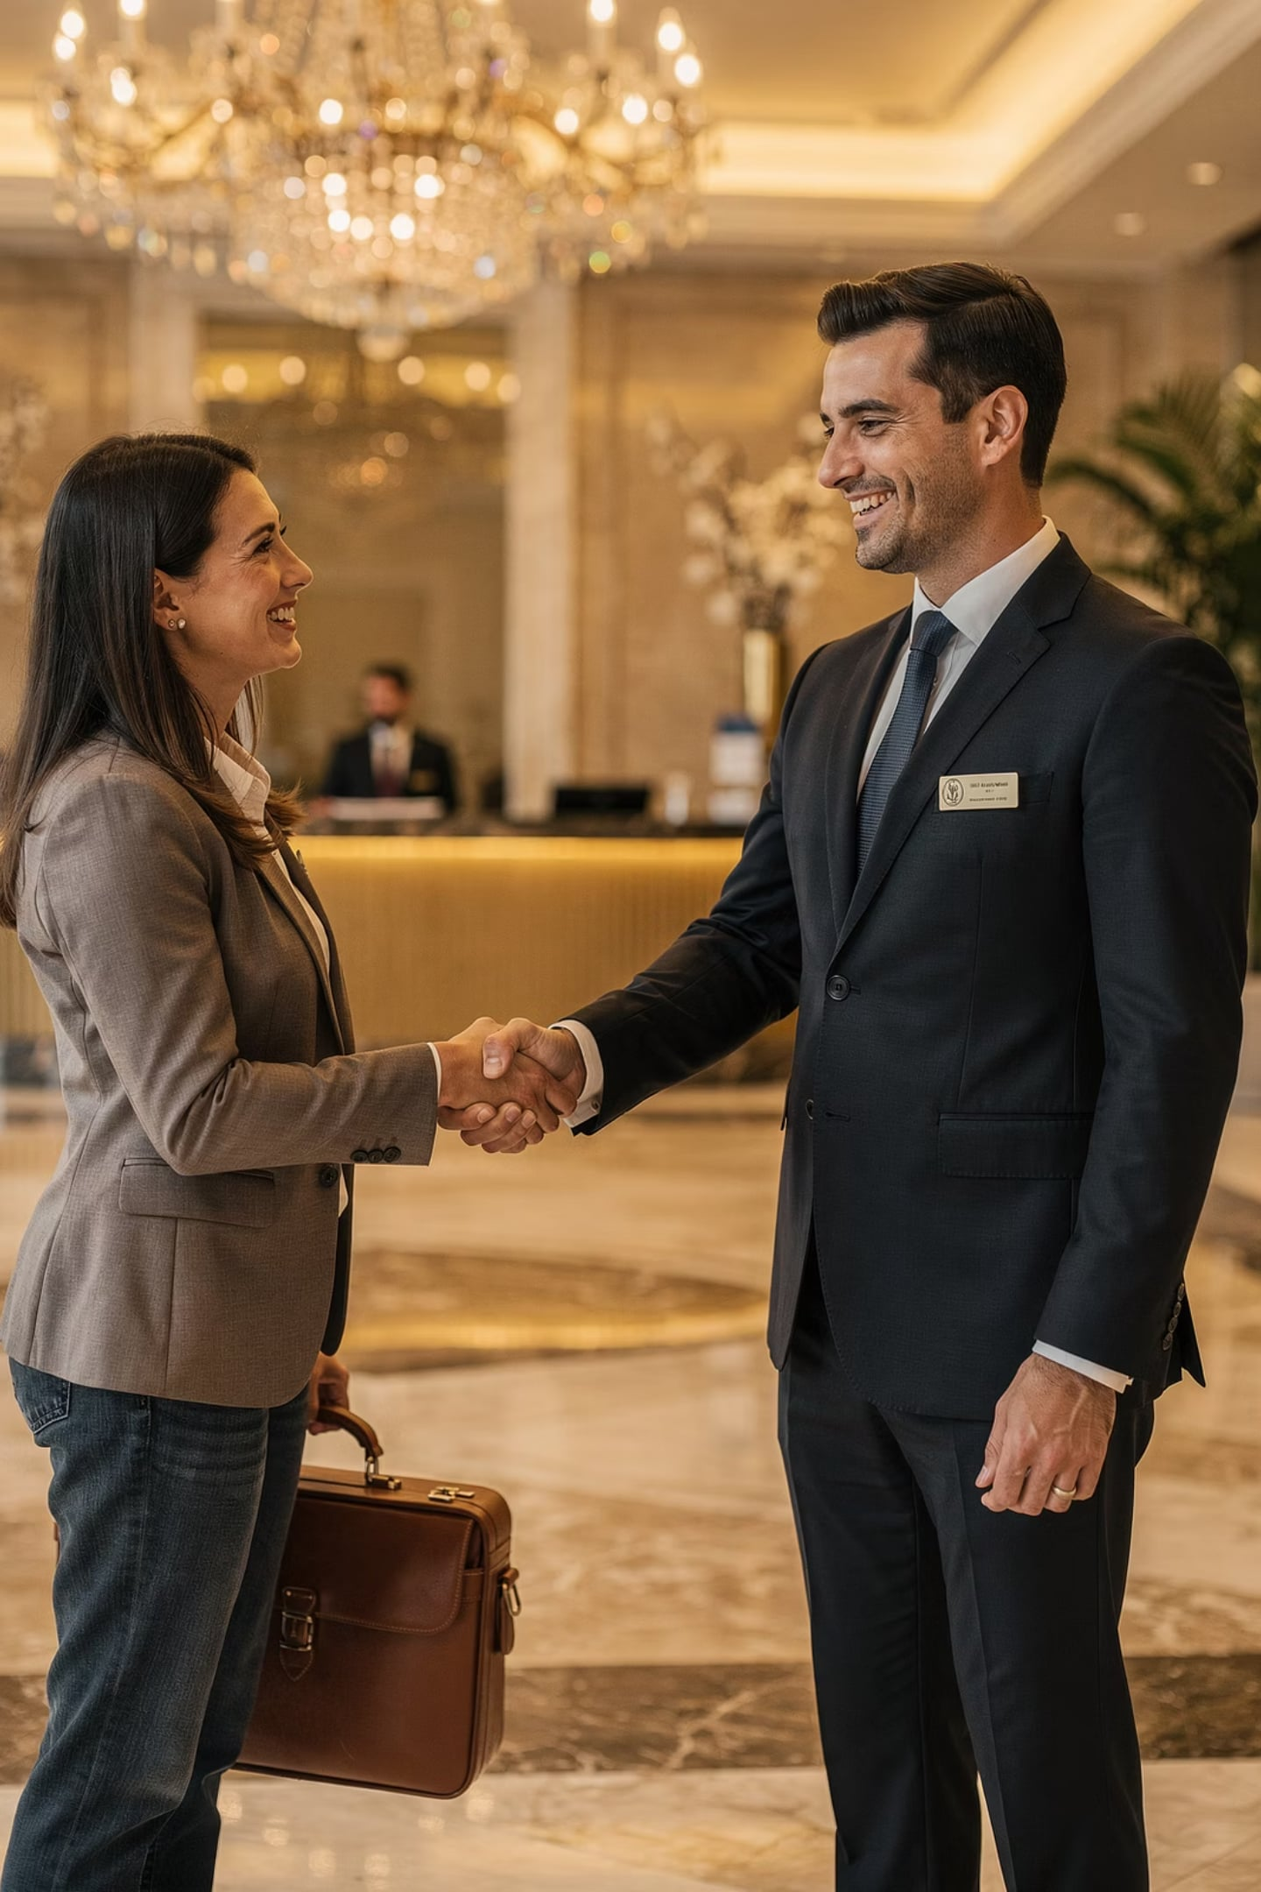

Conflict Management = A Career Skill
Employers value tourism professionals who handle conflict calmly and professionally.
🤝 Strong Relationships
🏆 Leadership Growth
With guests and colleagues
Essential for future managers
✅ Organizational Success
Better culture, better service
Empathy + Communication + Problem-Solving = The foundation of hospitality excellence.

