Slide 1
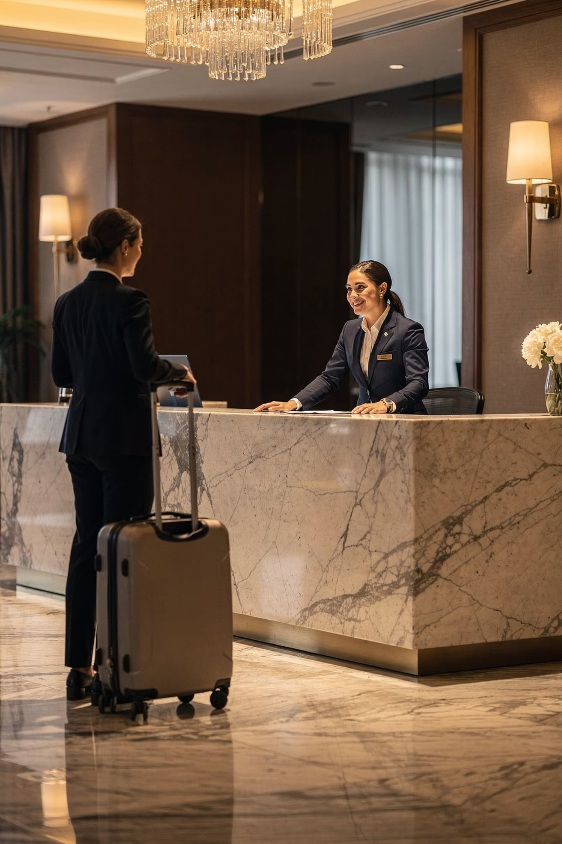
Module 8
Conflict Resolution and Complaint Handling
Course: Hospitality and Tourism Business Communication
PROF. ALIA AMOR D. UY, MBA

Slide 2


Conflict Is a Normal Part of Work
Key Idea: Conflict happens naturally whenever people work, communicate, or have different goals.
Think of it like a group project — disagreements are bound to happen when people have different ideas.

Slide 3





Who Do Hospitality Employees Interact With?
Key Idea: Hospitality staff deal with many different people every day — and more interactions means more chances for conflict.
Guests
Coworkers
Supervisors
The primary customers you serve
Teammates sharing daily tasks
Leaders who direct your work
Suppliers
Business Partners
Vendors providing goods & services
External companies you collaborate with

Slide 4
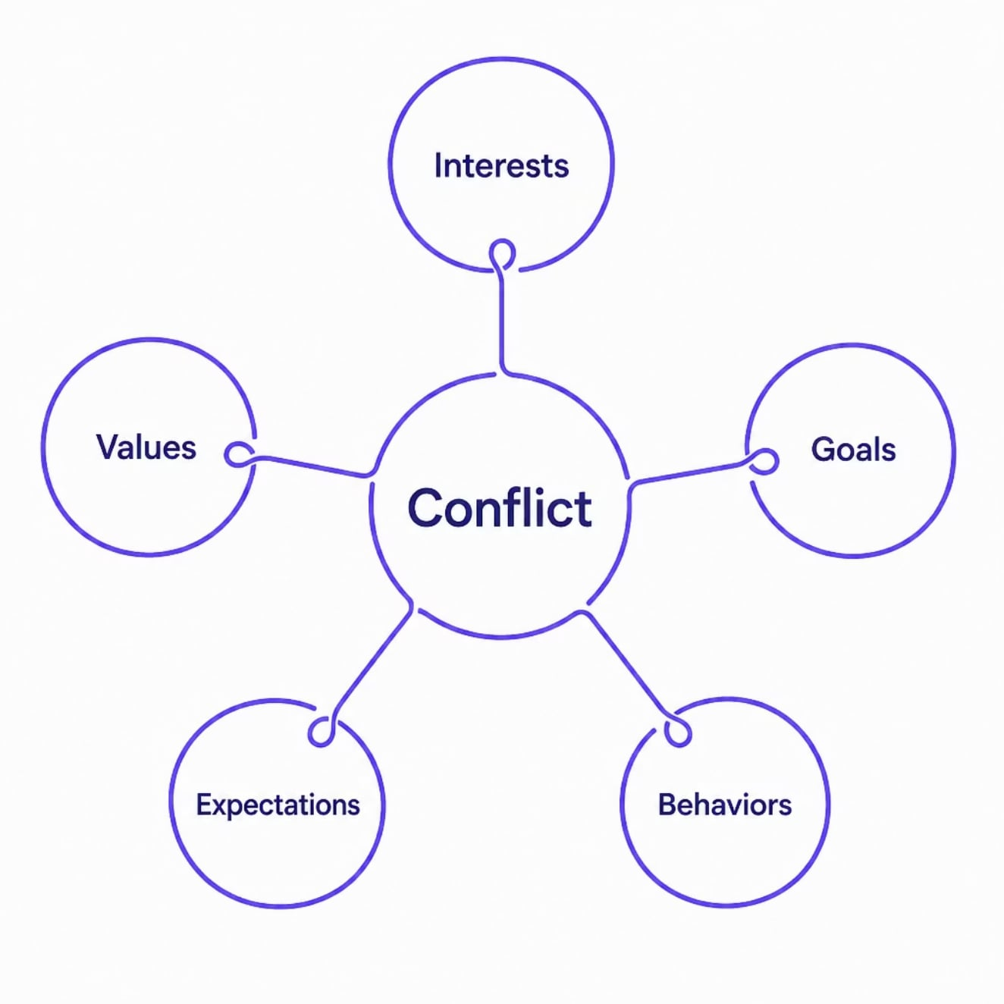

What Is Conflict?
Key Idea: Conflict occurs when two or more people see things differently — in goals, values, or expectations.
Conflict is like two people trying to go through the same door in opposite directions — both have a reason, but they're in each other's way.
Tension and disagreement arise when these differences go unaddressed.

Slide 5
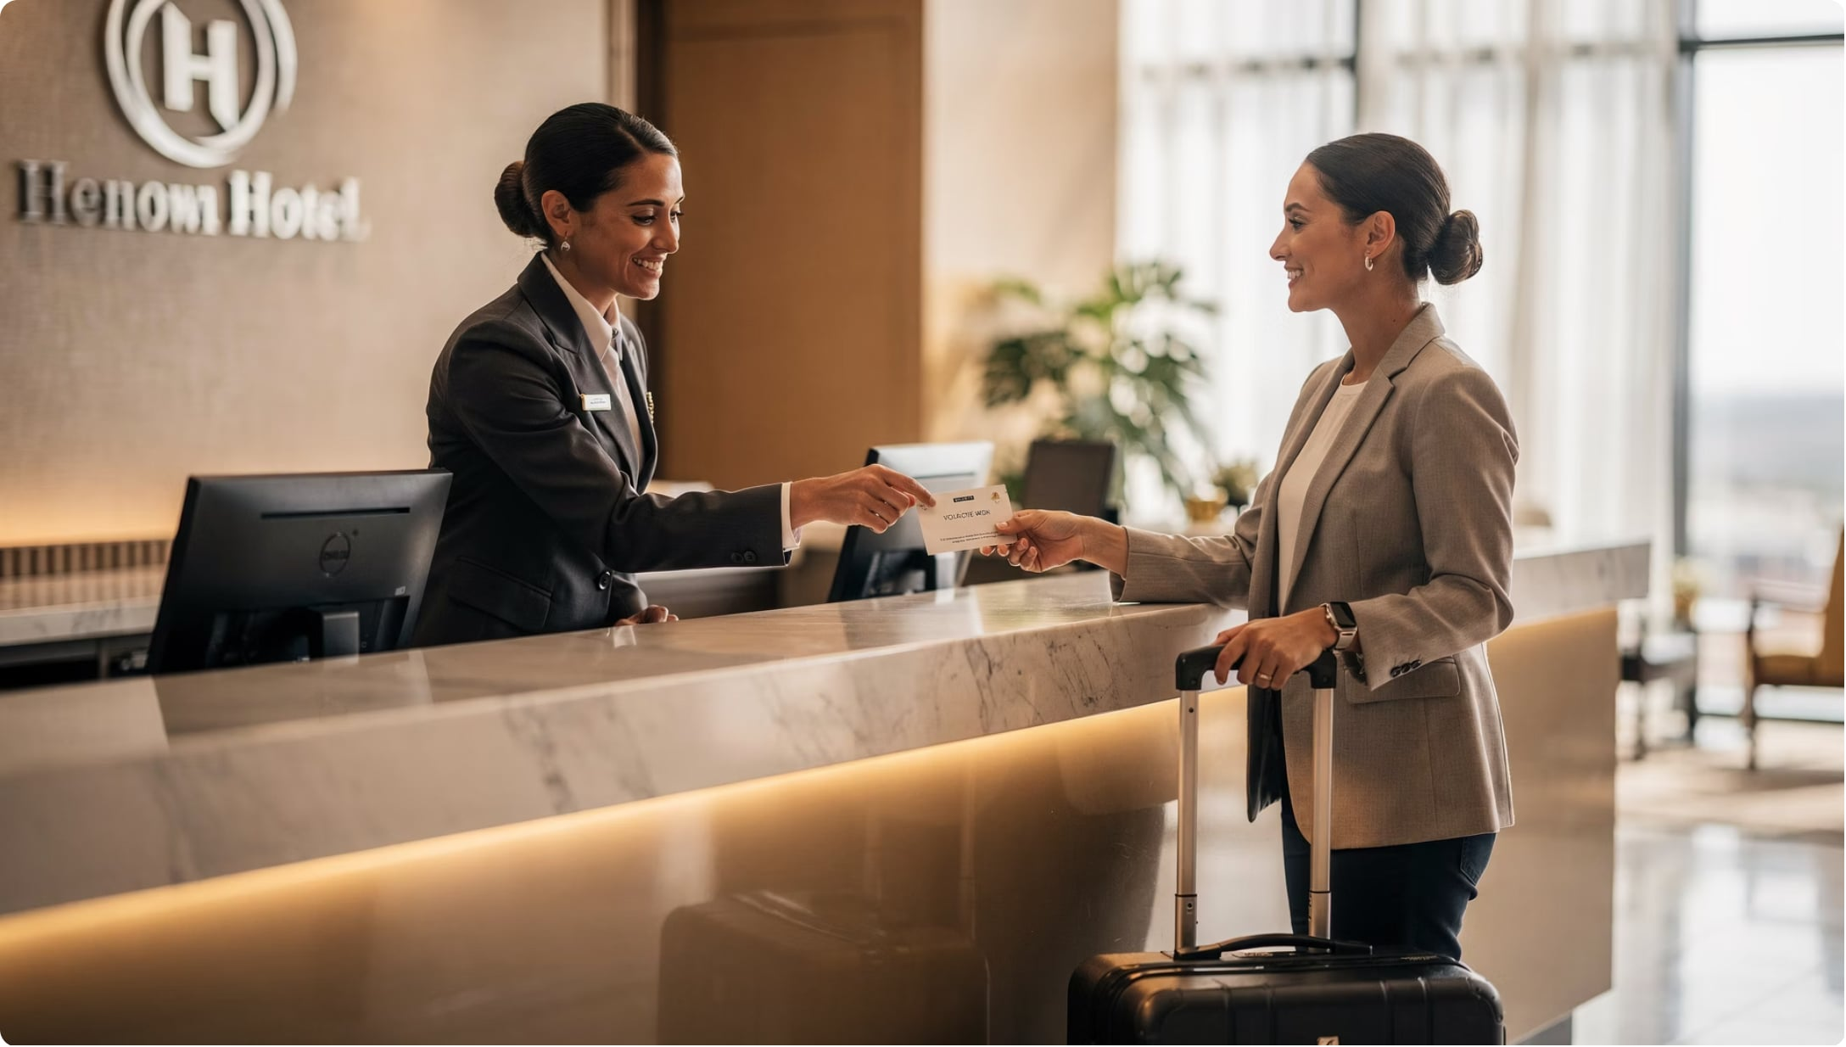

People, Not Products
Key Idea: Hospitality is a service industry — delivered by people, for people. That makes communication everything.
Unlike a factory that makes products, hospitality businesses "deliver" experiences through human interaction.
Good communication prevents conflict. Poor communication creates it.

Slide 6
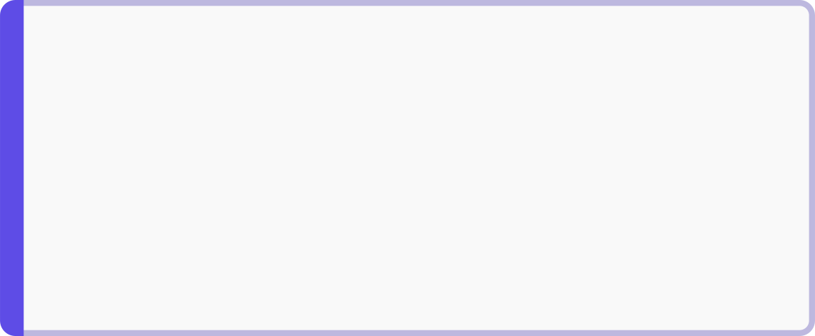
Real-World Conflict Situations
Key Idea: Conflicts in hospitality take many forms — between guests, staff, and service providers.
🏨 Hotel Check-In
👥 Staff Dispute
🚌 Tour Scheduling
Guest complains about a delayed check-in
Two employees disagree on work responsibilities
Tour guide and transport provider clash over schedule changes
🍽️ Wrong Order
📋 Performance Review
Restaurant guest upset about incorrect food
Supervisor and employee disagree on work performance

Slide 7
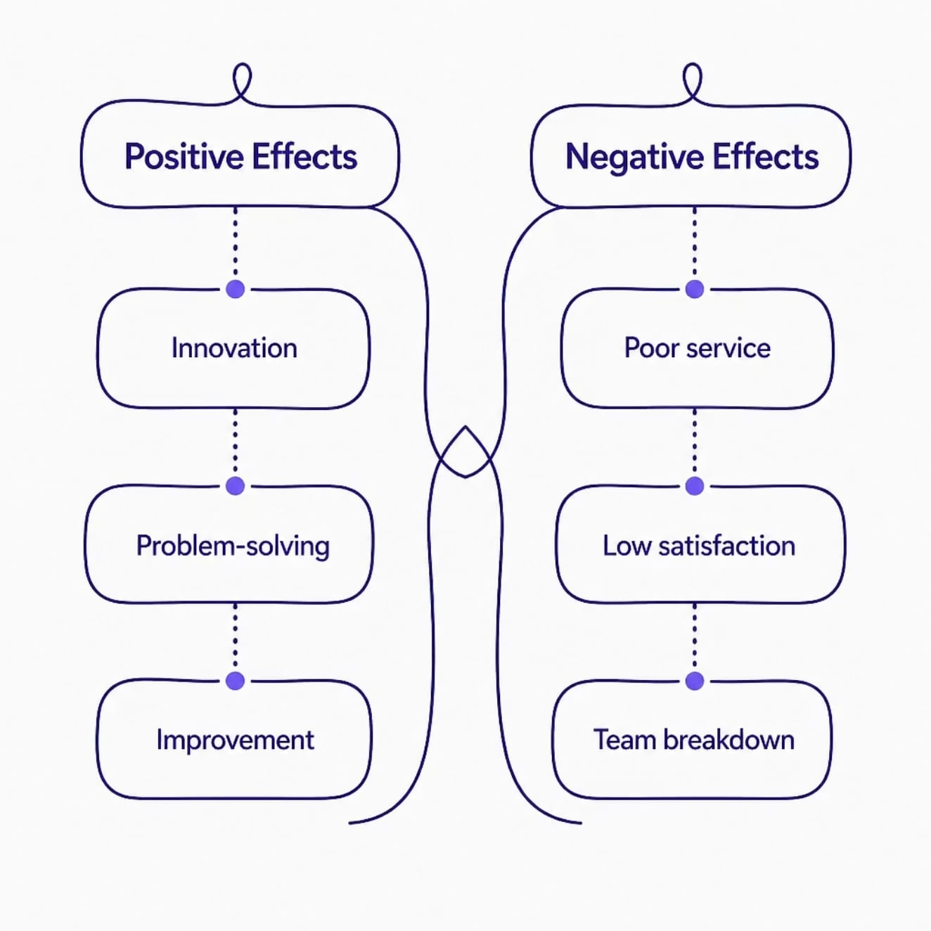


Conflict Isn't Always Bad
Key Idea: Conflict can push organizations to improve — but only if handled well.
Think of conflict like fire — it can warm a room or burn it down. The outcome depends on how you manage it.
Well-managed conflict → growth and improvement
Ignored conflict → damaged service and relationships

Slide 8
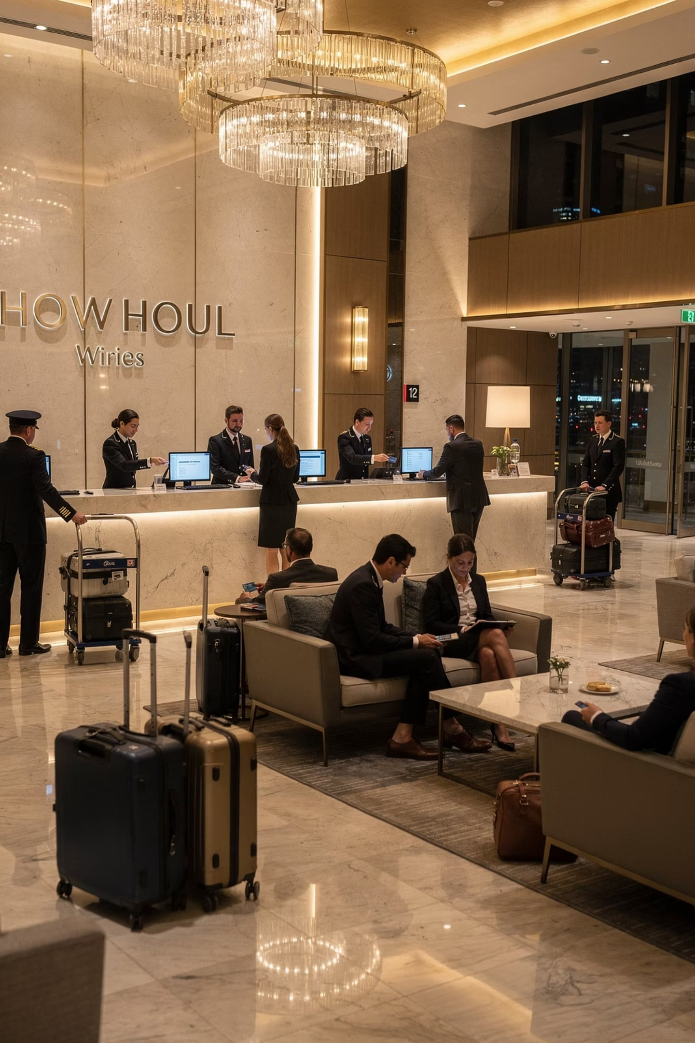
Why Conflict Happens More in Hospitality
Key Idea: The fast-paced, people-centered nature of hospitality creates ideal conditions for conflict.
High Customer Contact
Staff face guests directly throughout every service moment
Time Pressure
Strict schedules leave little room for error
Emotional Encounters
Guests carry high expectations for special occasions
Diverse Workforces
Different cultures and languages create communication gaps

Slide 9
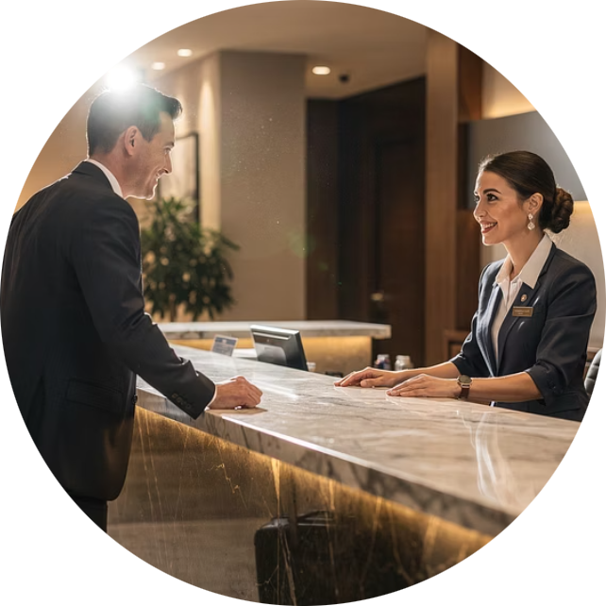
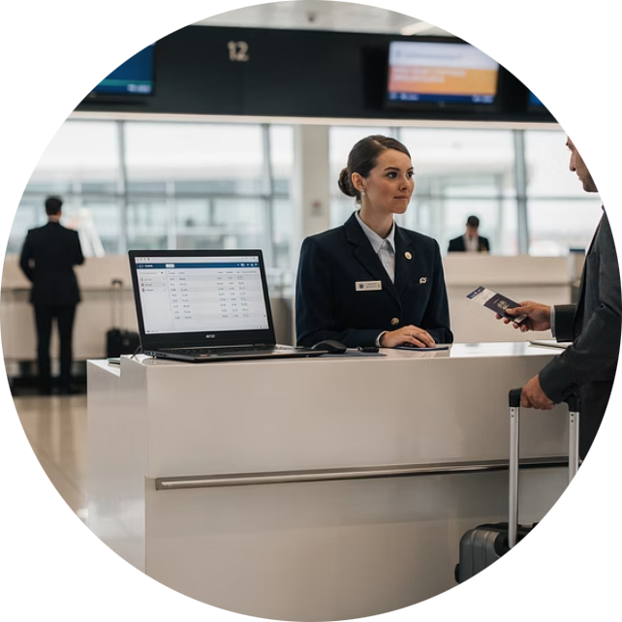
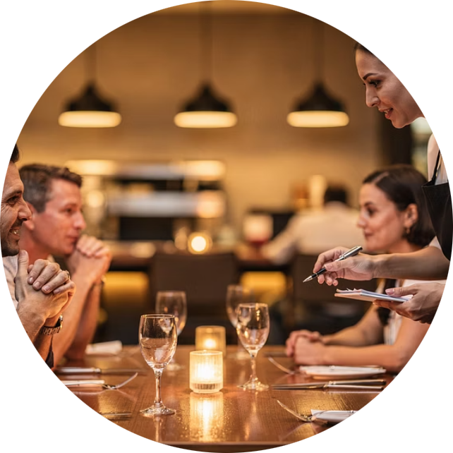

High Customer Contact
Key Idea: Hospitality employees interact face-to-face with guests at every touchpoint — so misunderstandings happen easily.
Hotel Reception
Airline Check-In
Check-in, check-out, and guest requests
Ticketing, baggage, and boarding assistance
Restaurant Service
Tour Guiding
Taking orders, serving food, handling complaints
Managing groups, schedules, and expectations

Slide 10
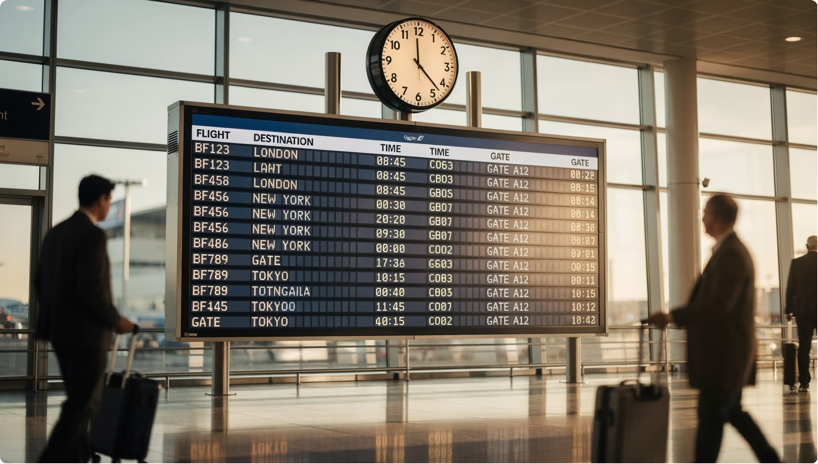
Time Pressure in Tourism
Key Idea: Tourism runs on tight schedules — and delays create stress that can spark conflict.
✈️ Flight departures
🗺️ Tour itineraries
🎉 Event schedules
🏨 Hotel check-in/check-out
When time is short, patience runs thin — for both guests and employees.

Slide 11
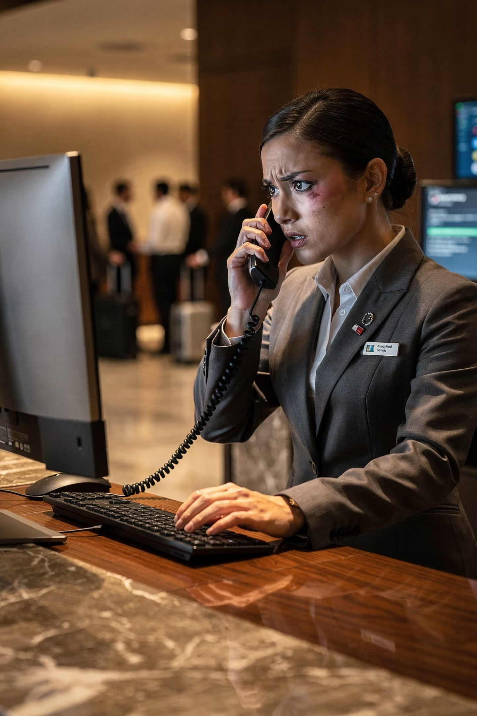
Pressure Leads to Tension
Key Idea: Employees working under time pressure are more likely to experience stress — and stressed employees are more likely to have disagreements.
It's like rushing to finish an exam — small mistakes happen when you're under pressure. The same applies at work.

Slide 12


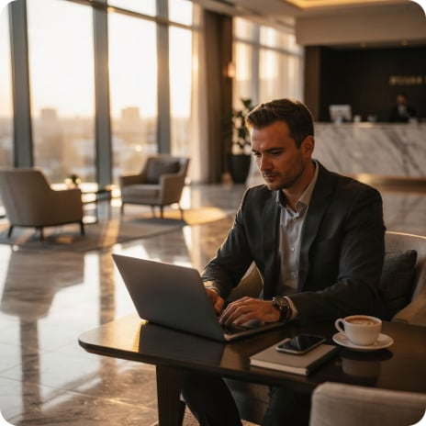
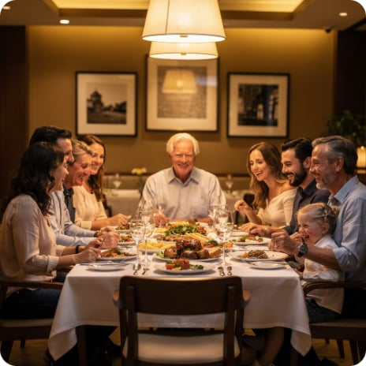
Guests Travel for Meaningful Moments
Key Idea: Guests often have high emotional stakes — making service failures feel more personal and upsetting.
Vacations
Honeymoons
Business Trips
Family Celebrations
Hard-earned time to relax and recharge
Once-in-a-lifetime romantic experiences
High-stakes travel with professional expectations
Special gatherings with great expectations

Slide 13
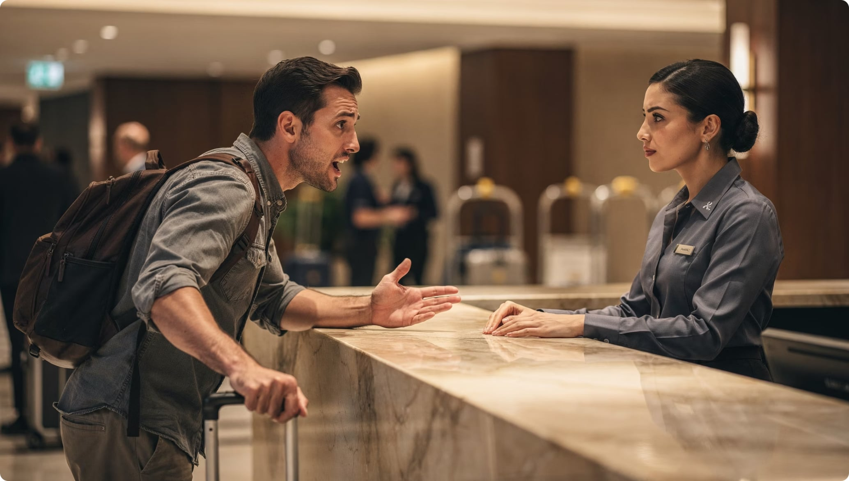

Emotions Shape Reactions
Key Idea: When guests travel for important reasons, emotions run high — and even small problems can trigger big reactions.
A delayed room might be a minor inconvenience to staff — but to a guest on their wedding night, it's a major disappointment.
Understanding the emotional context of a guest's trip helps staff respond with more empathy.

Slide 14
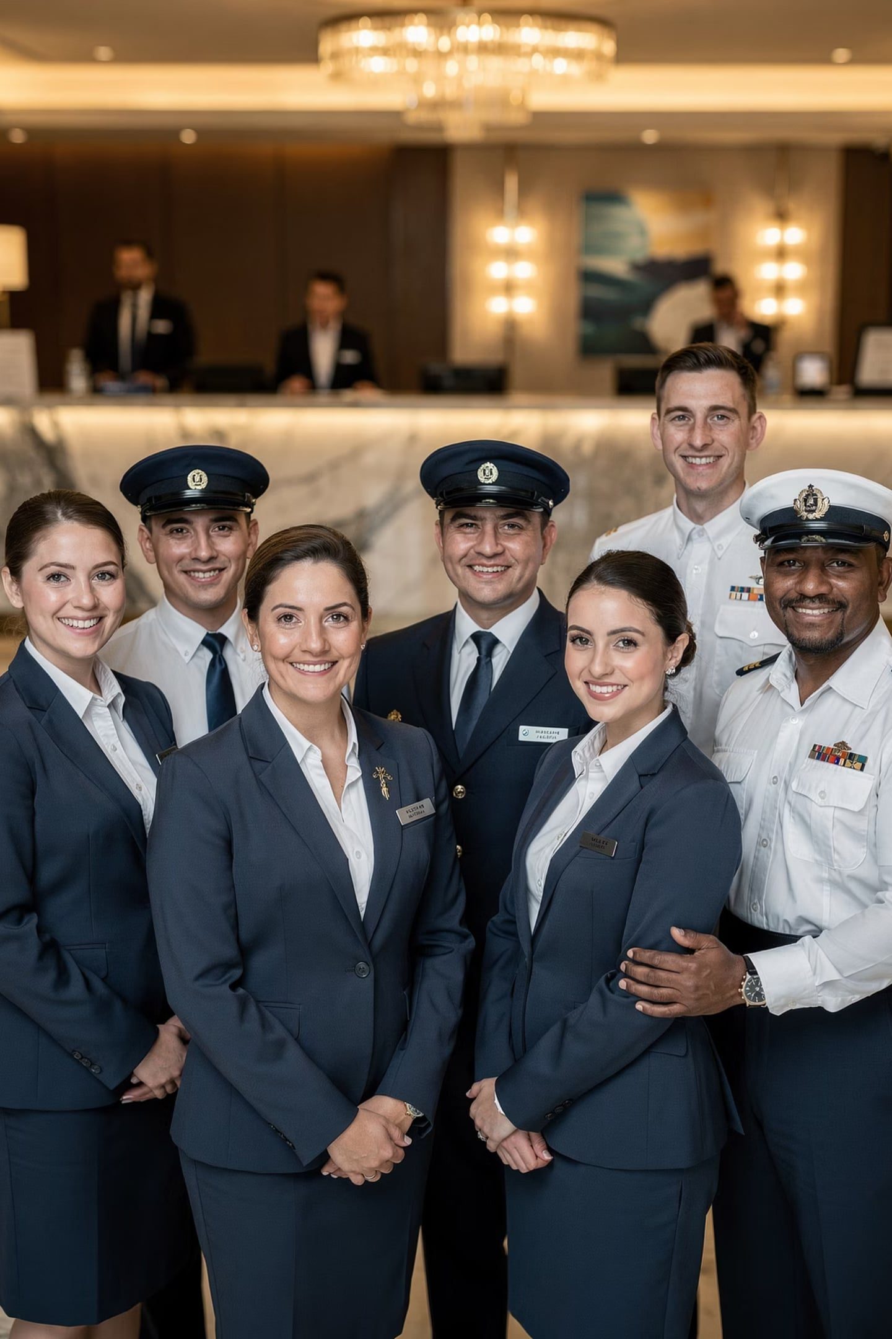
Diverse Workforces
Key Idea: Hospitality teams include people from many different backgrounds — and that diversity can sometimes cause misunderstandings.
Cultural Backgrounds
Different norms and customs
Languages
Varying levels of fluency
Education Levels
Different training and knowledge bases
Generations
Varied communication styles and expectations

Slide 15


Diversity Can Create Communication Gaps
Key Idea: When team members have different cultural or language backgrounds, simple messages can be misunderstood.
Like playing a game of "telephone" — the message that starts at one end may arrive completely changed at the other.
Awareness and patience are the first steps to bridging these gaps.

Slide 16
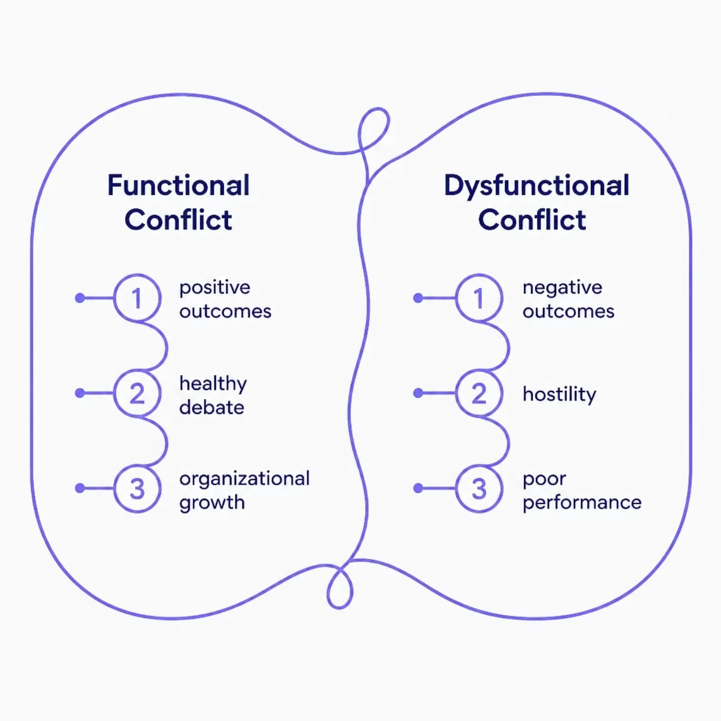
Not All Conflict Is Harmful
Key Idea: Conflict falls into two categories — one helps organizations grow, the other holds them back.
Think of functional conflict as a productive debate — people disagree, but the goal is to find a better answer together.
Dysfunctional conflict is the opposite — it's personal, destructive, and leaves everyone worse off.

Slide 17
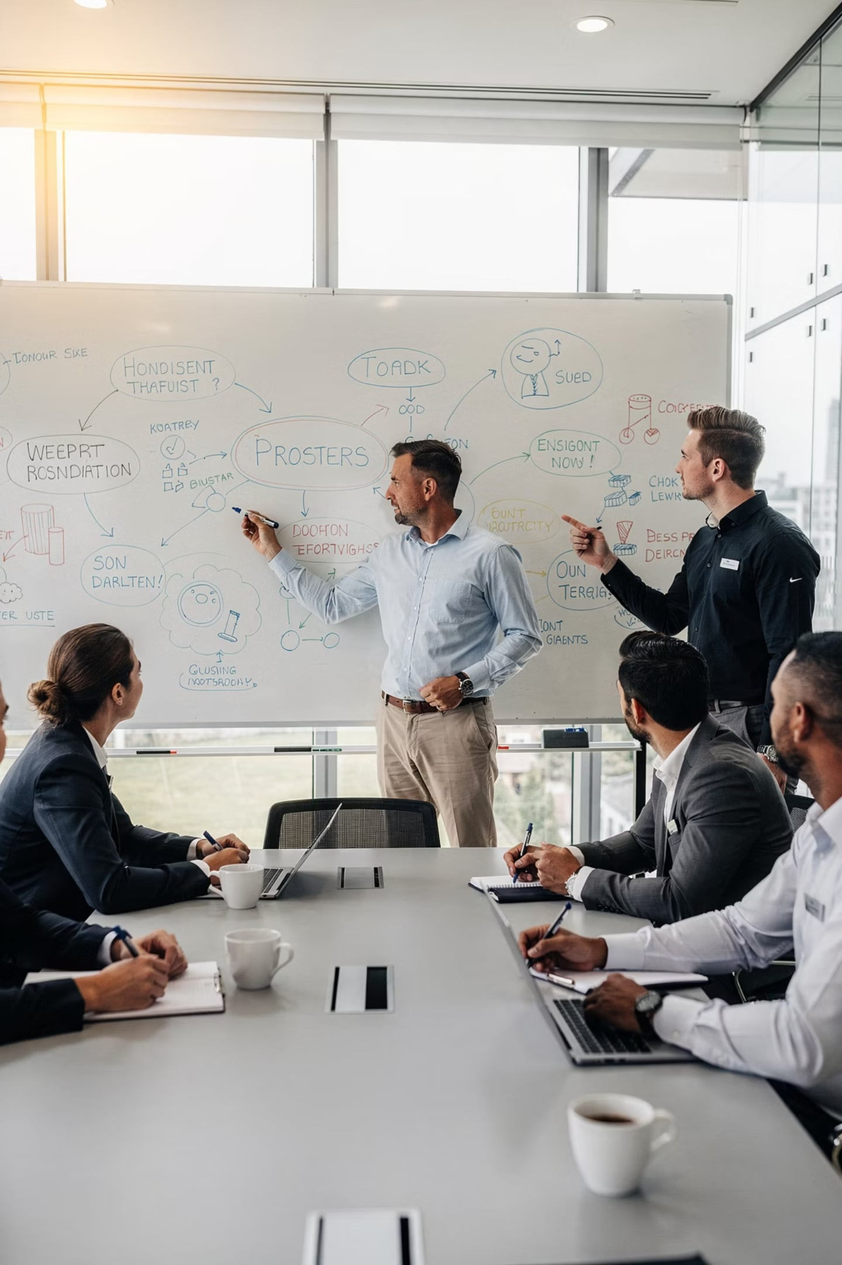
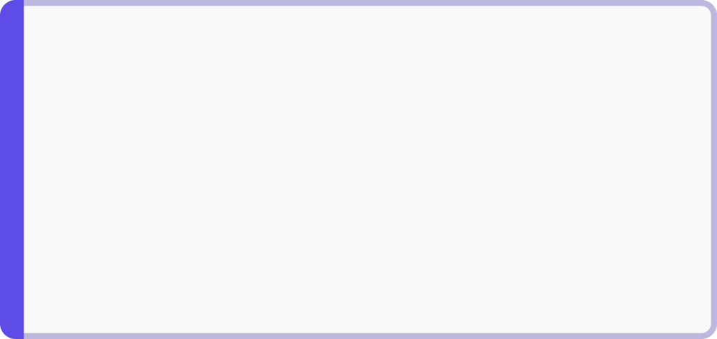
The Upside of Functional Conflict
Key Idea: When handled well, conflict can actually make an organization stronger and more innovative.
Creativity
Better Decisions
New ideas emerge from disagreement
Multiple views lead to stronger outcomes
Problem-Solving
Open Discussion
Challenges are worked through collaboratively
Honest conversations replace silence

Slide 18
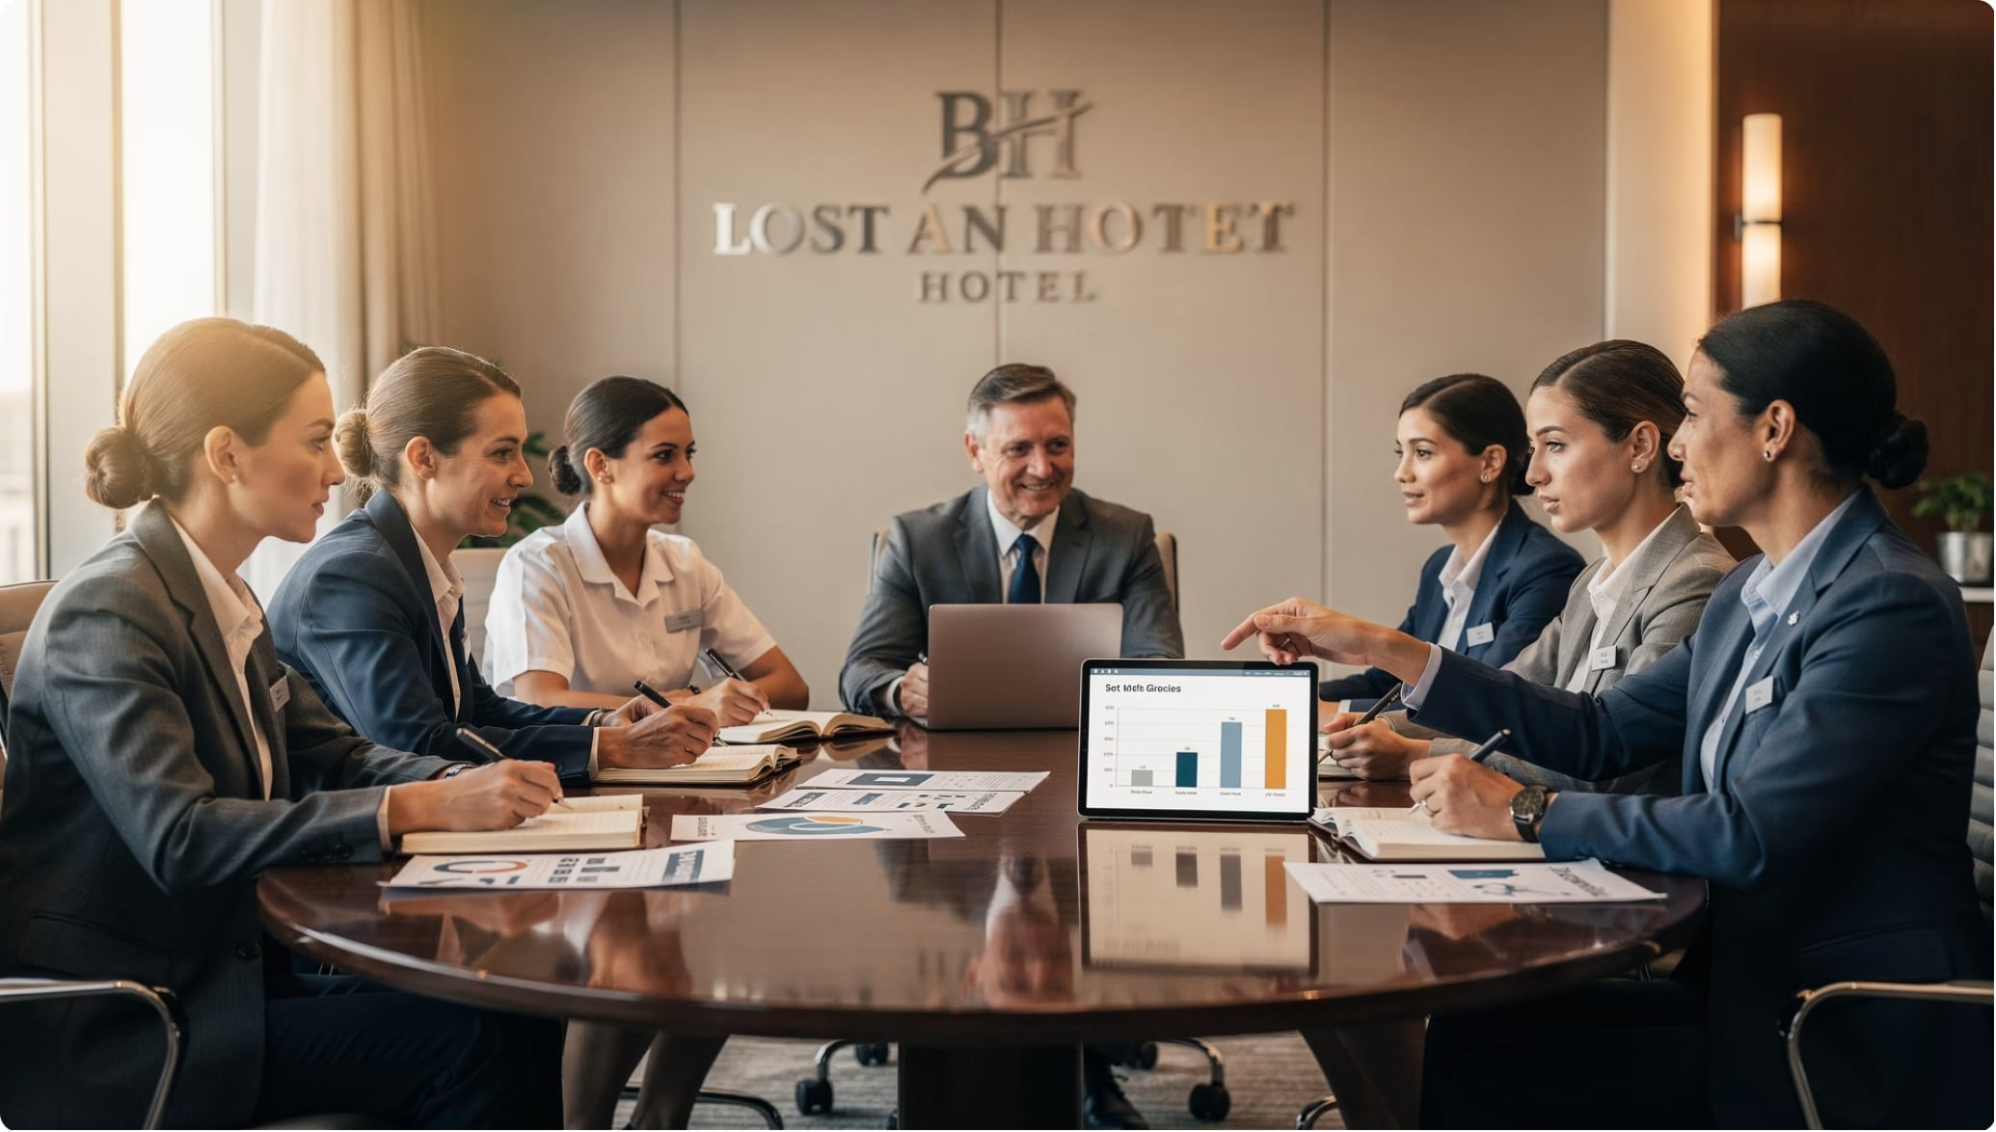

Functional Conflict in Action
Key Idea: When staff openly debate how to improve guest services, they often discover better solutions together.
"Should we change the check-in process to reduce wait times?" — a disagreement that becomes an improvement.
Productive disagreement = better guest experiences

Slide 19
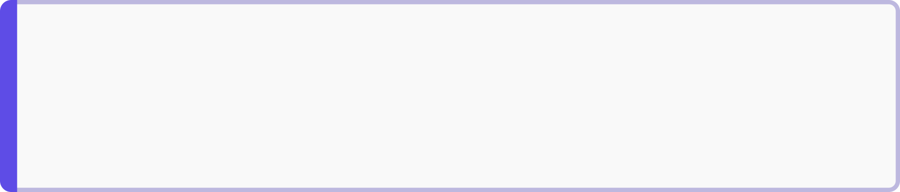
When Conflict Becomes Destructive
Key Idea: Dysfunctional conflict damages teamwork, productivity, and the guest experience.
📉 Reduced Productivity
😞 Employee Dissatisfaction
Staff focus on conflict instead of guests
Low morale and high turnover
🤝 Poor Teamwork
😡 Customer Complaints
Cooperation breaks down across departments
Internal tension spills over into guest service

Slide 20
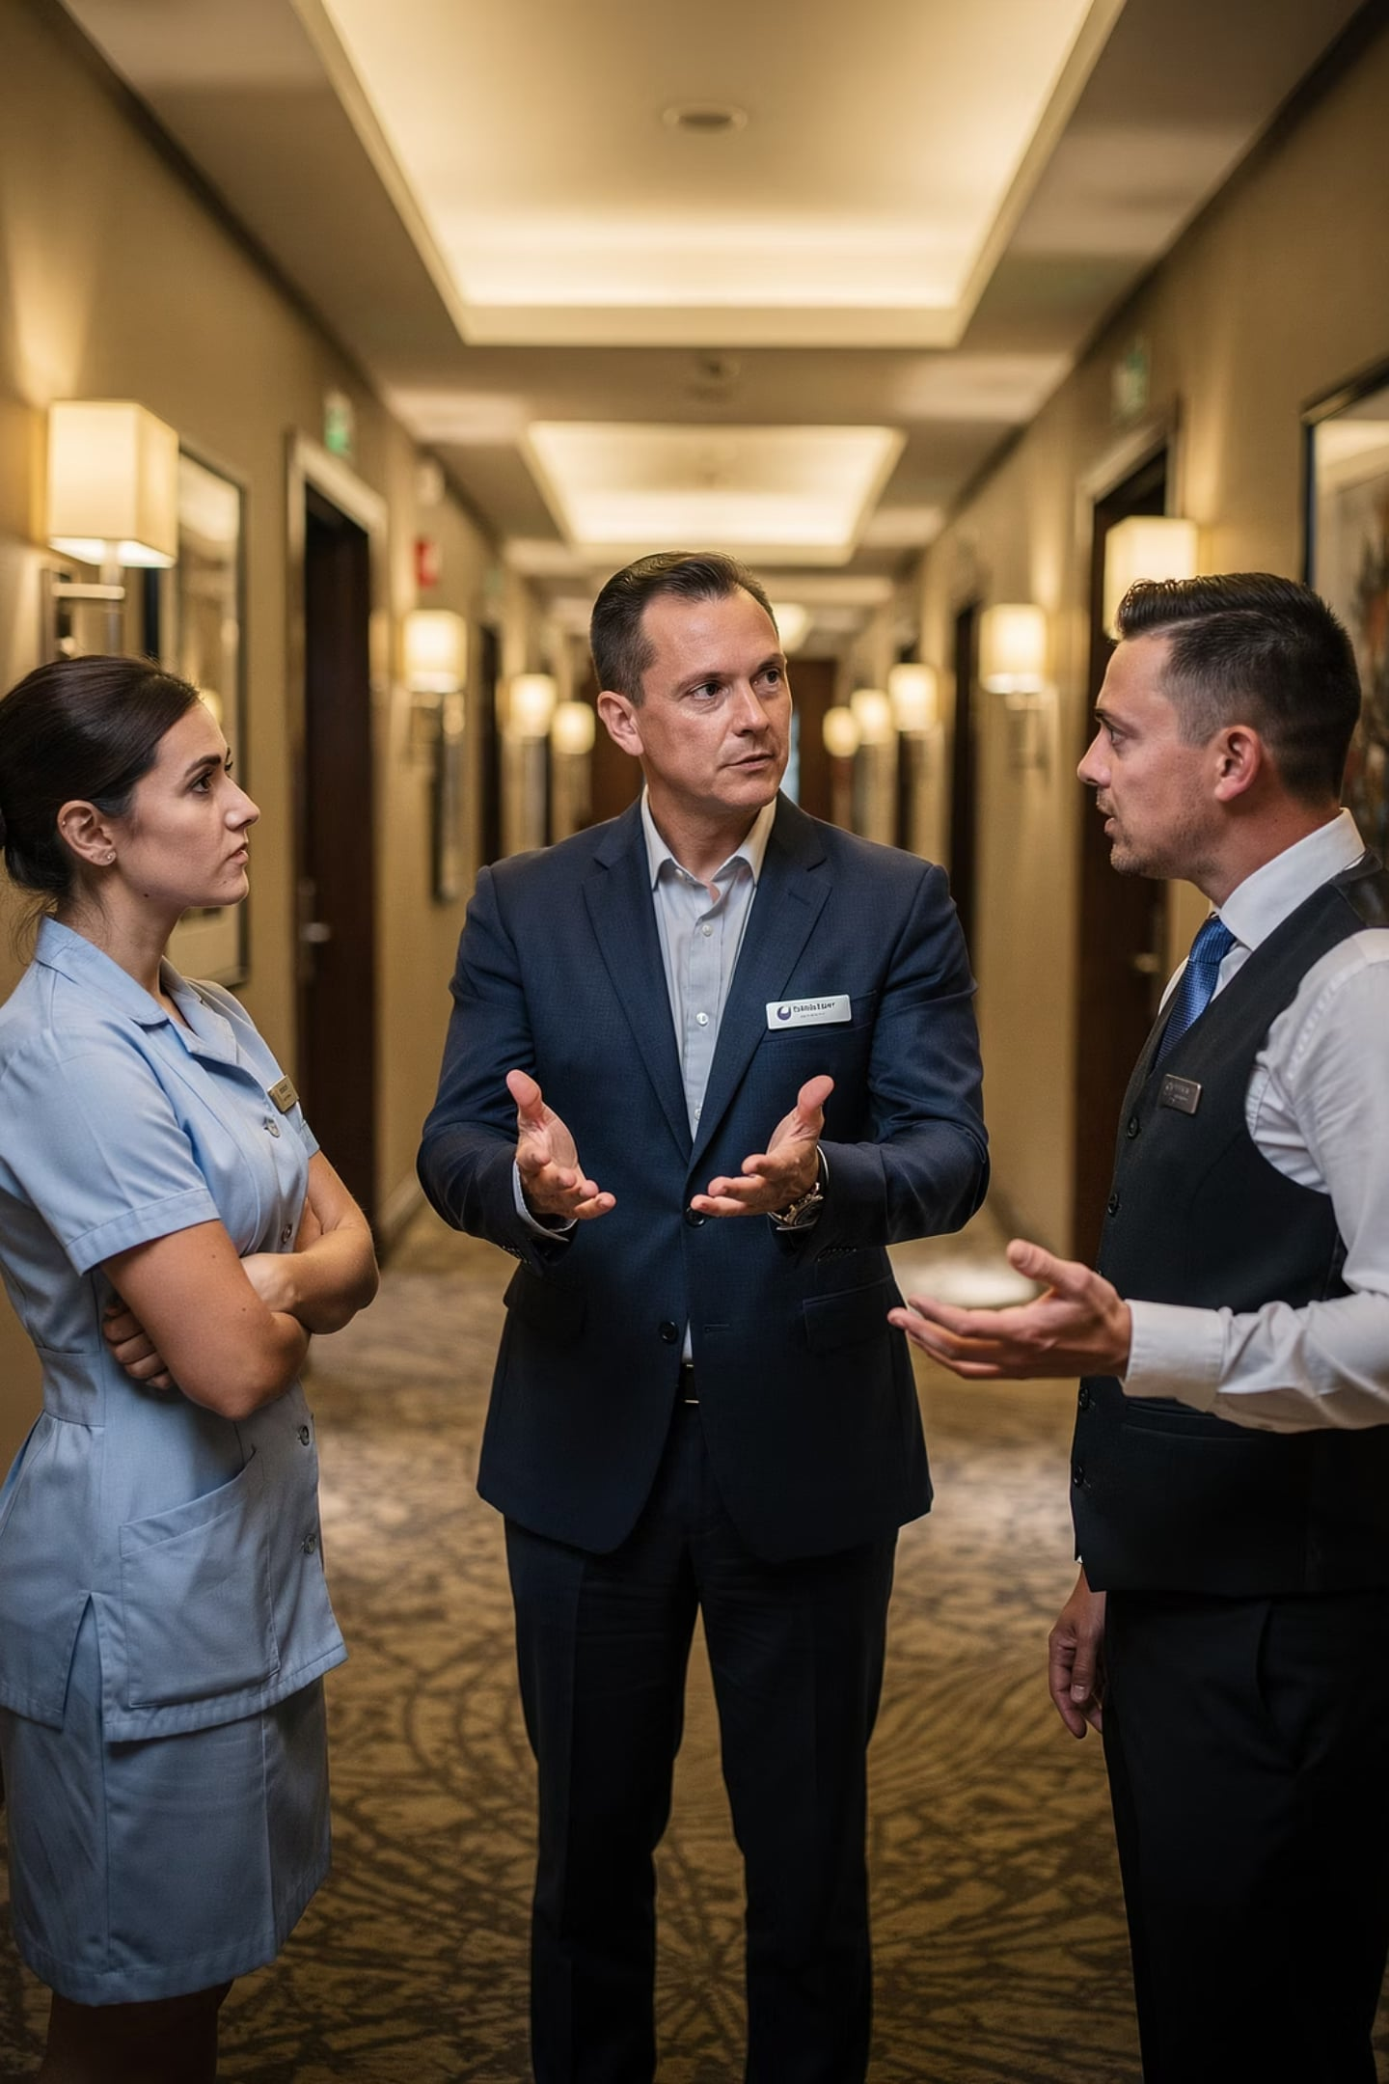
The Manager's Role: Balance Conflict Wisely
Key Idea: Great managers encourage healthy debate while stopping destructive conflict before it harms the team.
Encourage ✅
Minimize ❌
Functional conflict that drives innovation and improvement
Dysfunctional conflict that lowers morale and harms guests
Up next: How to actually resolve conflict and handle guest complaints professionally.

Slide 21
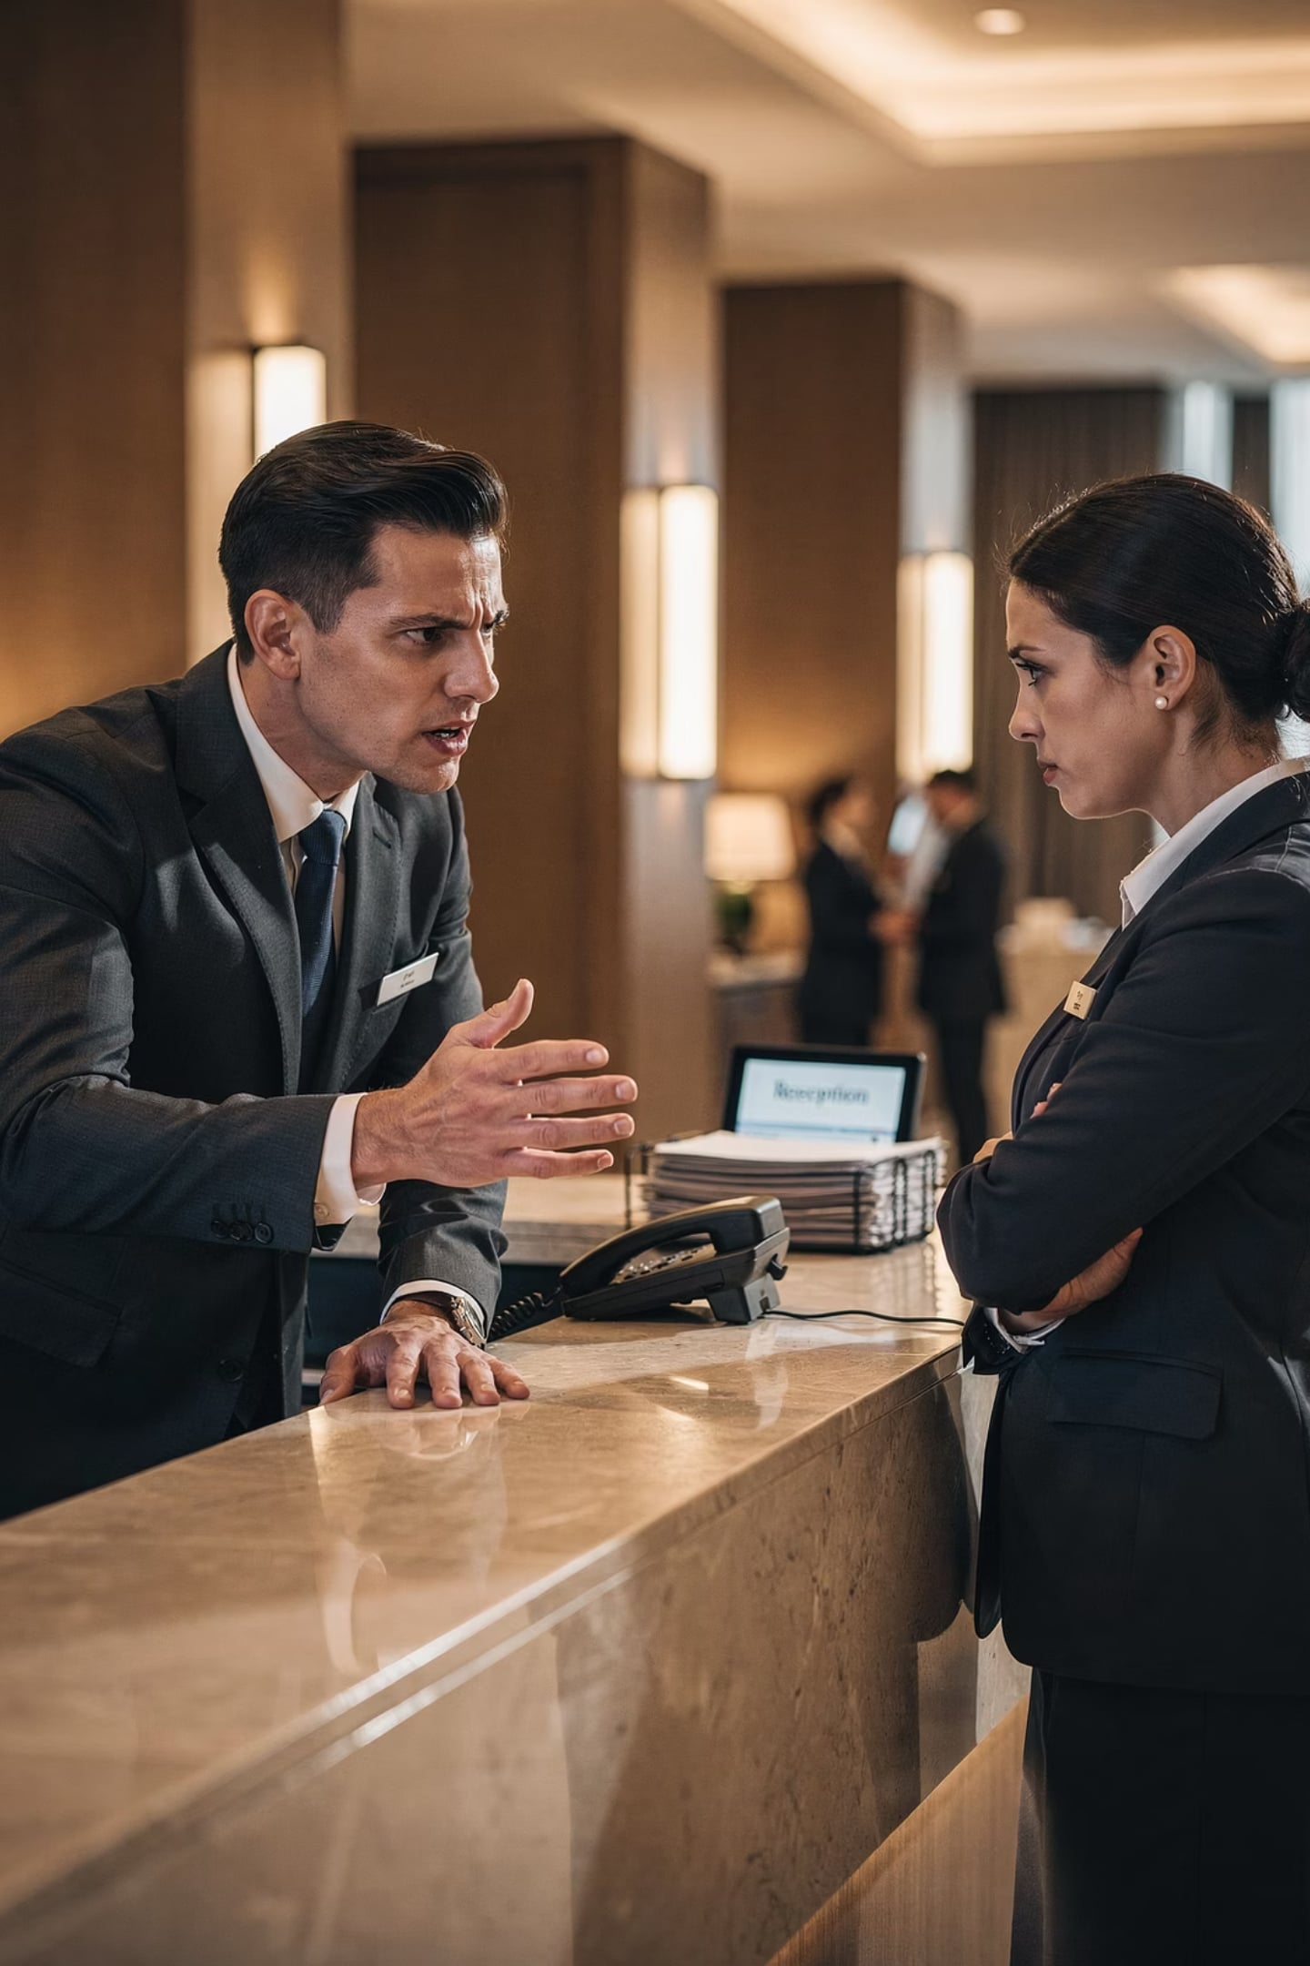
Types of Workplace Conflict
Interpersonal Conflict — the most common type, happening between two people
🧑‍🤝‍🧑 Who's Involved
⚡ Common Triggers
Individual employees
Personality clashes, miscommunication
📍 Simple Analogy
Like two friends arguing over different plans

Slide 22
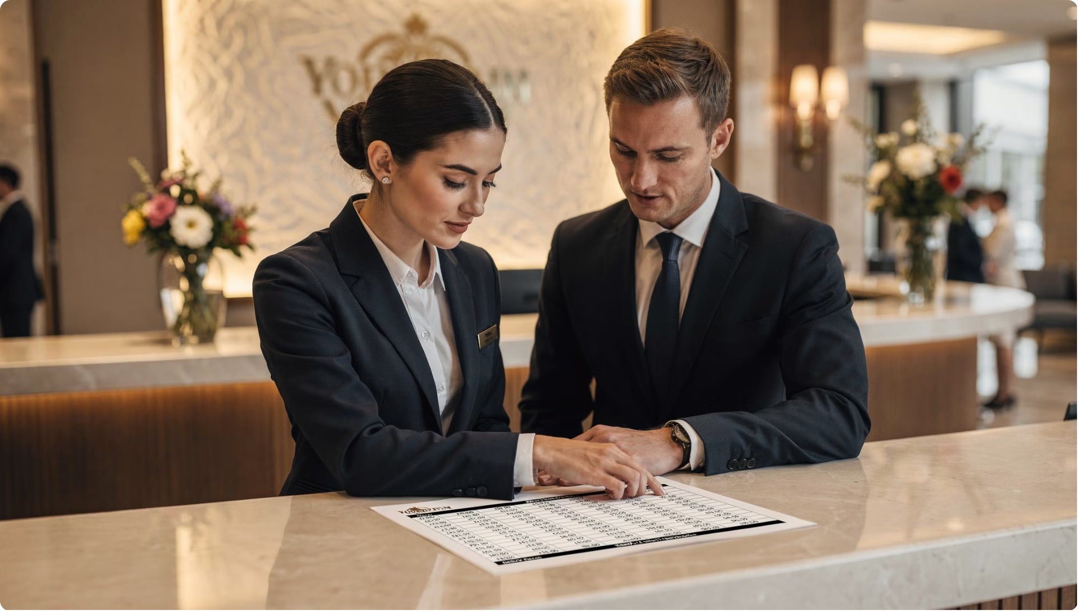
REAL EXAMPLE
Interpersonal Conflict in Action
Two front desk employees argue about shift responsibilities — who covers which hours and tasks.
This is the most relatable type of conflict. Think of group project disagreements at university!

Slide 23
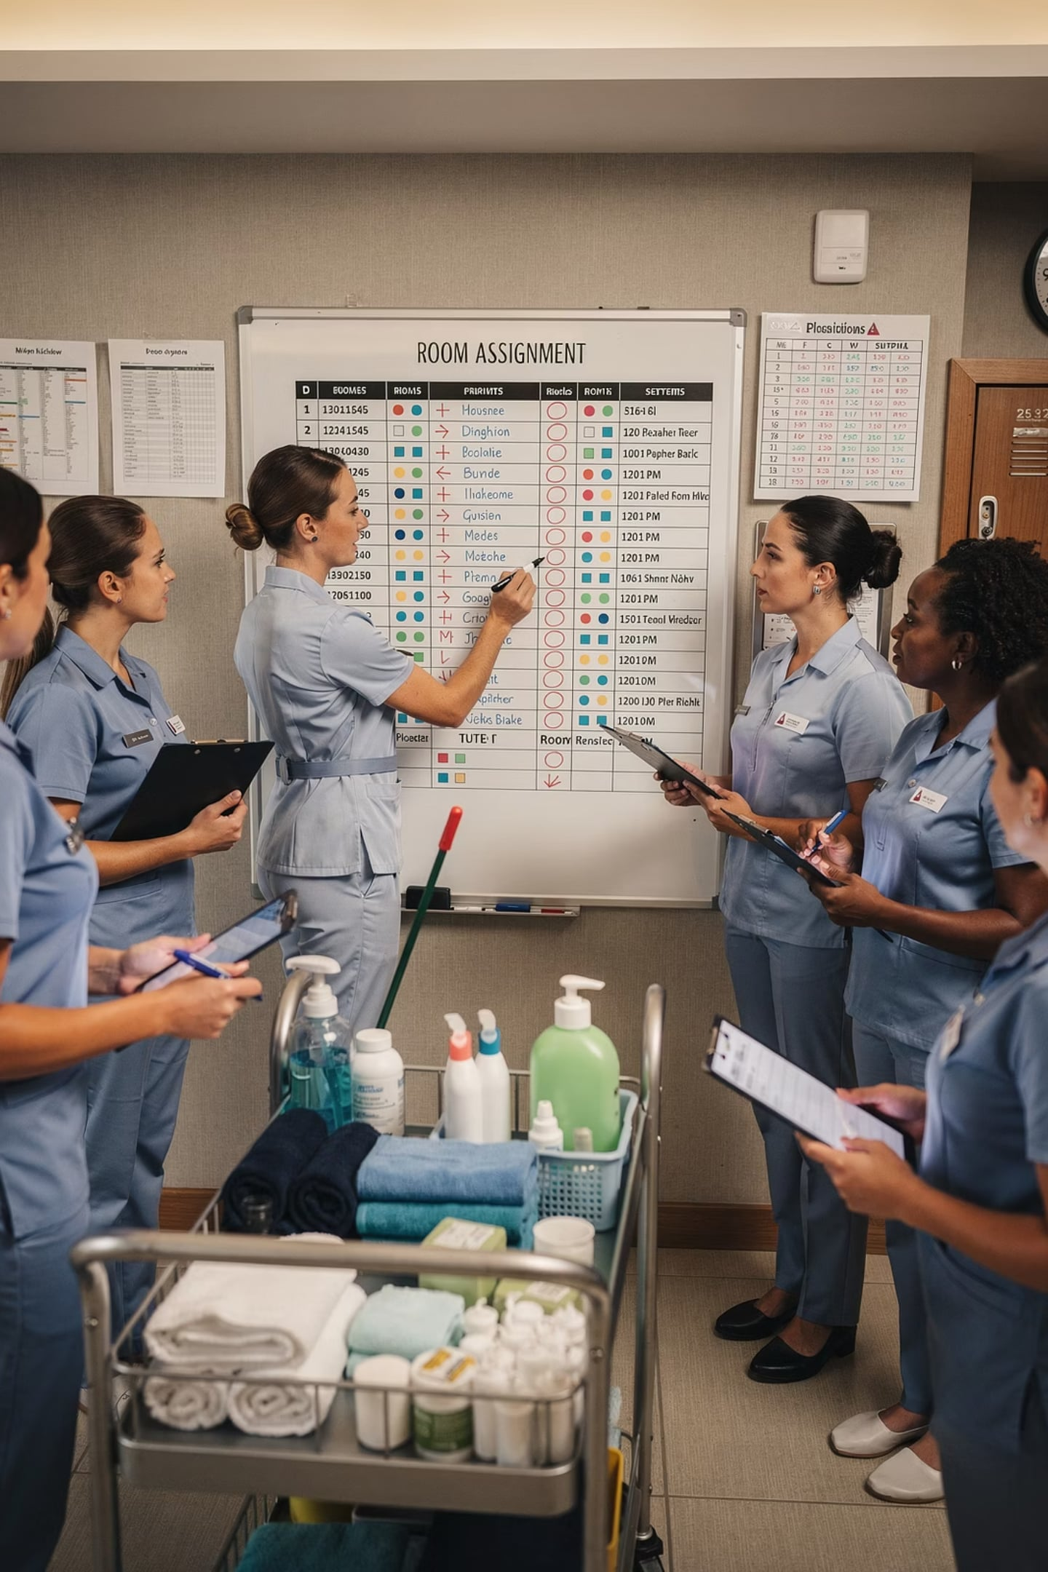
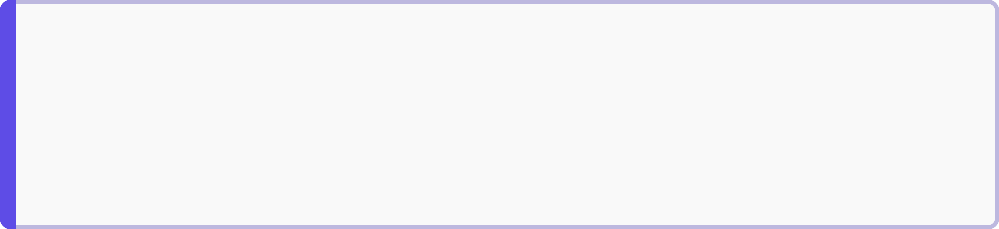
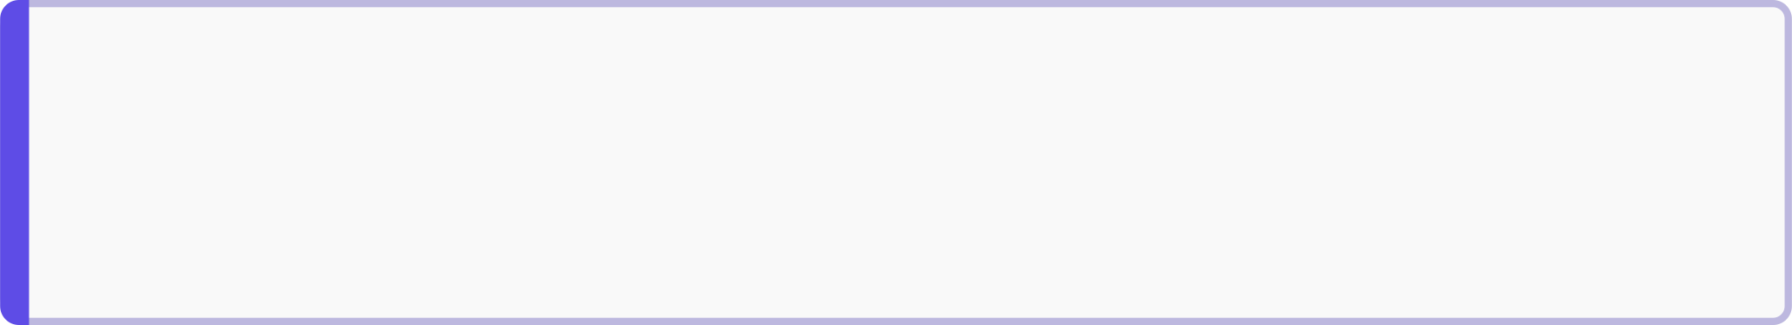
Intragroup Conflict
Conflict that happens within a single team — not between two individuals, but among group members
📌 Example
Housekeeping staff disagree about room assignments during peak season
💡 Analogy
Like teammates on a sports team arguing over positions

Slide 24

Interdepartmental Conflict
Conflict between different departments — usually caused by poor coordination
The Front Office promises guests an early check-in — but never tells Housekeeping. Rooms aren't ready. Guests are upset. Departments blame each other.
Front Office Promise
Housekeeping Uninformed
Rooms Not Ready
Interdepartmental Tension
📌 Analogy: Like one friend making plans for a group without telling anyone else.

Slide 25
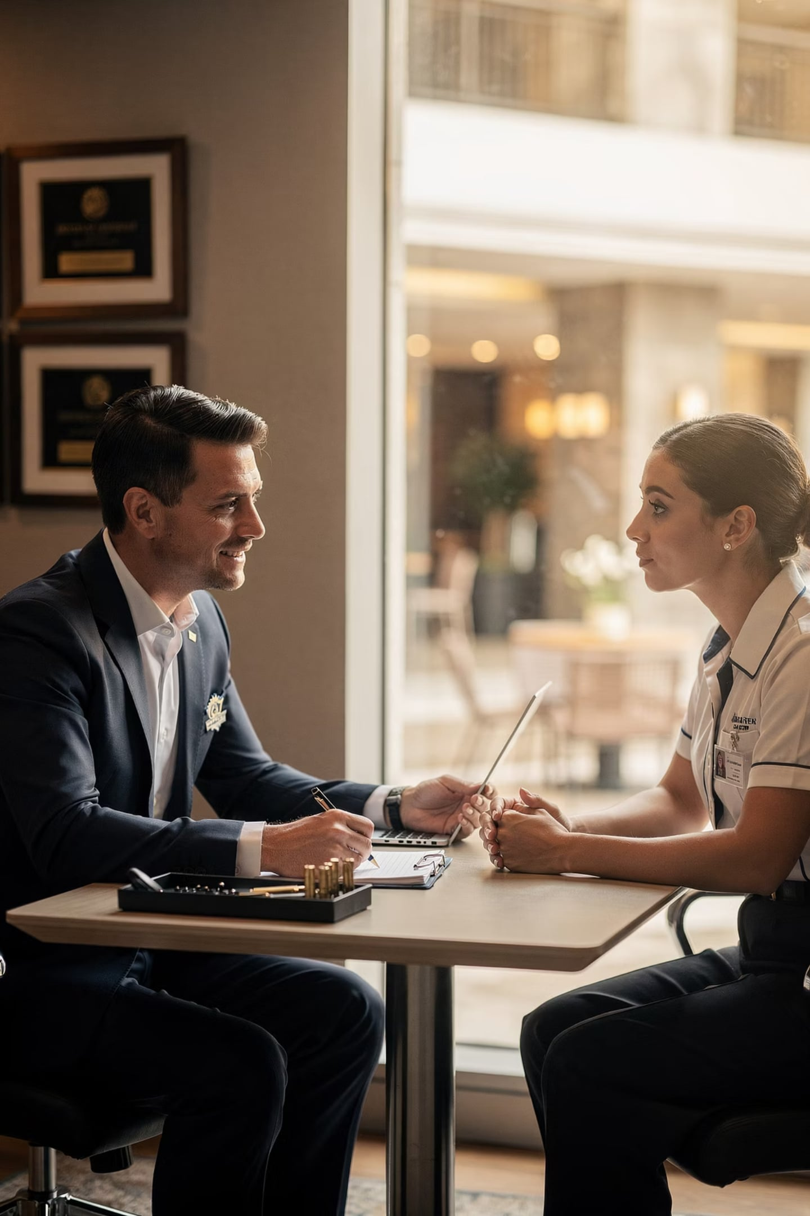
Employee–Supervisor Conflict
When managers and employees clash over expectations or leadership
Performance Reviews
Scheduling
Disagreements over ratings
Unfair or unclear shift assignments
Communication
Leadership Style
Unclear instructions or feedback
Different expectations of authority

Slide 26
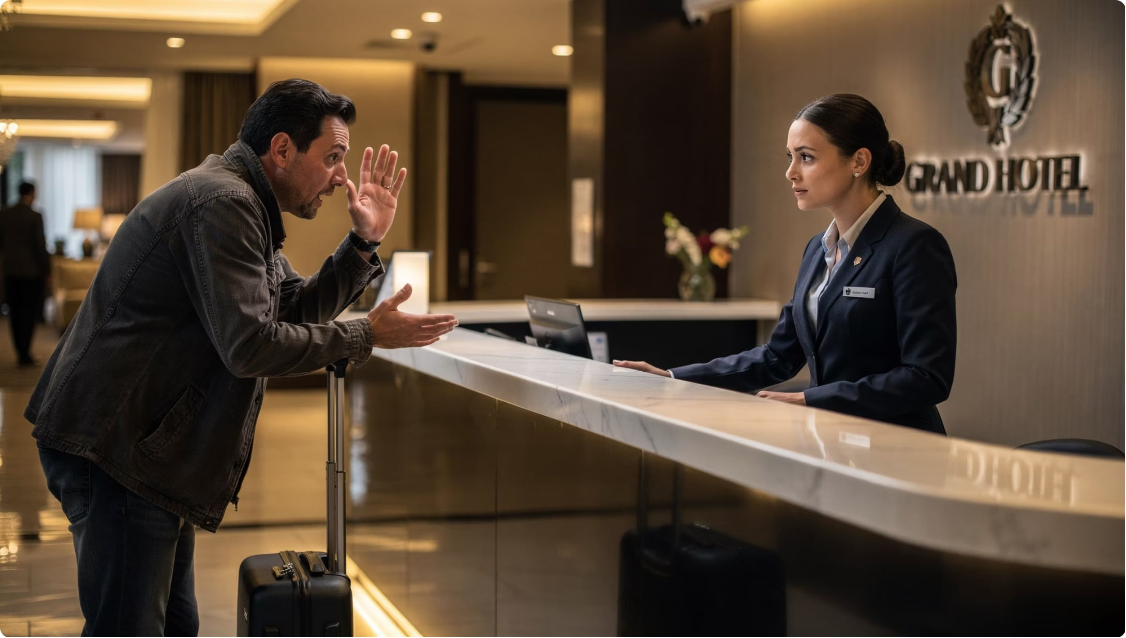
HIGH IMPACT
Customer–Service Conflict
Conflict between guests and staff — directly affects customer satisfaction
Billing disputes
Reservation problems
Service delays
Facility complaints
This type matters most — unhappy guests leave bad reviews!

Slide 27


Common Cause: Poor Communication
The #1 cause of workplace conflict — when information is missing, late, or misunderstood
Incomplete Instructions
Staff don't know what to do
Delayed Information
Updates arrive too late
Misunderstood Messages
Different interpretations of the same message
Lack of Feedback
Employees unsure if they're doing well

Slide 28
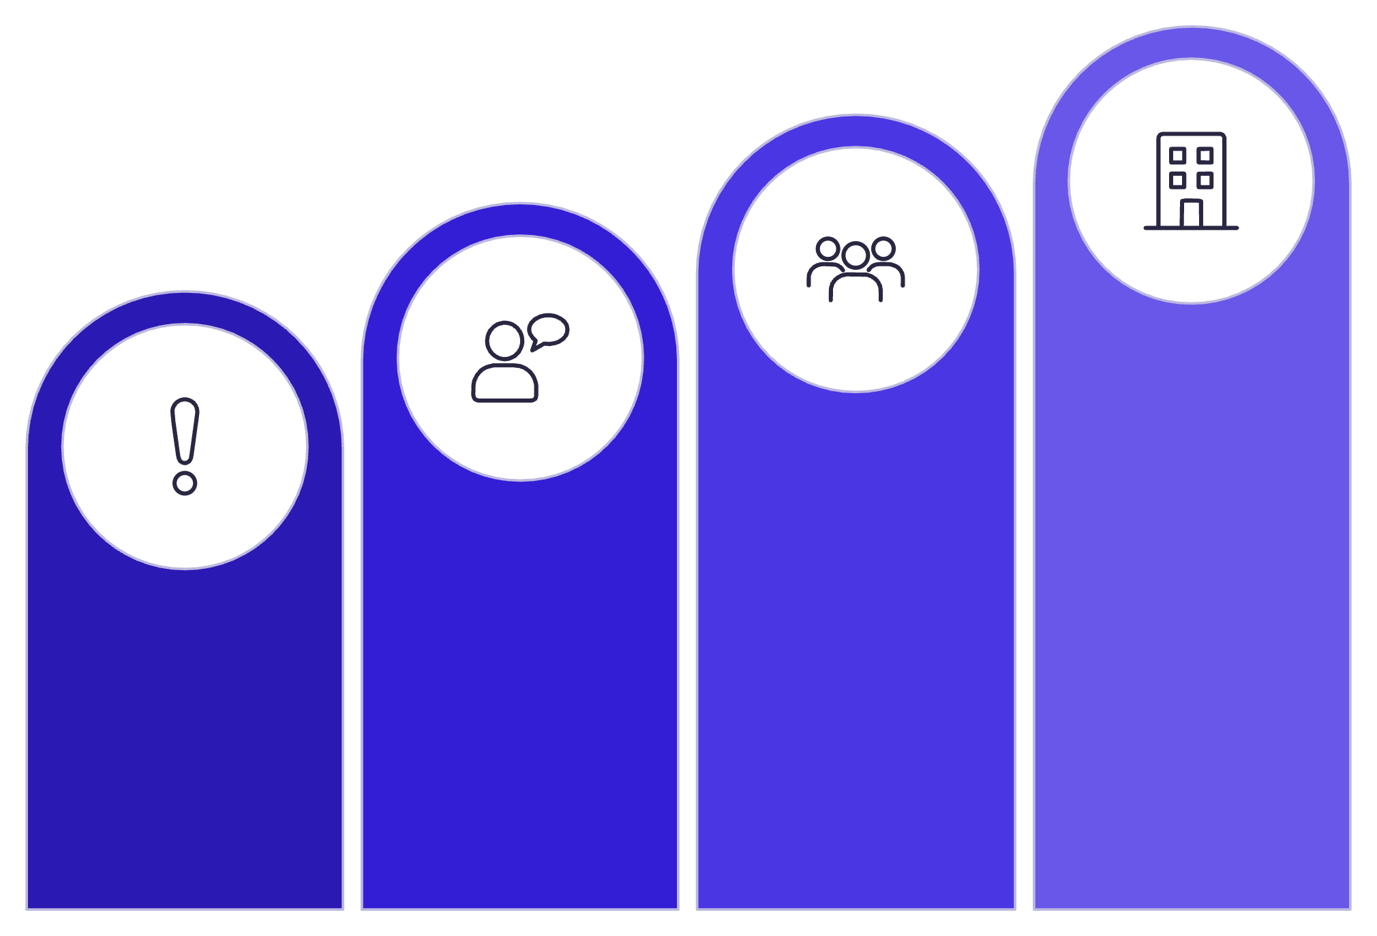
Small Errors, Big Problems
Differing Expectations
Employees and guests often expect different things from the same situation.
Organizational Issue
What seems obvious to one person may be completely unexpected to another.
Team Impact
Miscommunication
Minor Misstep
📌 Analogy: Like ordering food and expecting a large portion — but getting a small one.

Slide 29
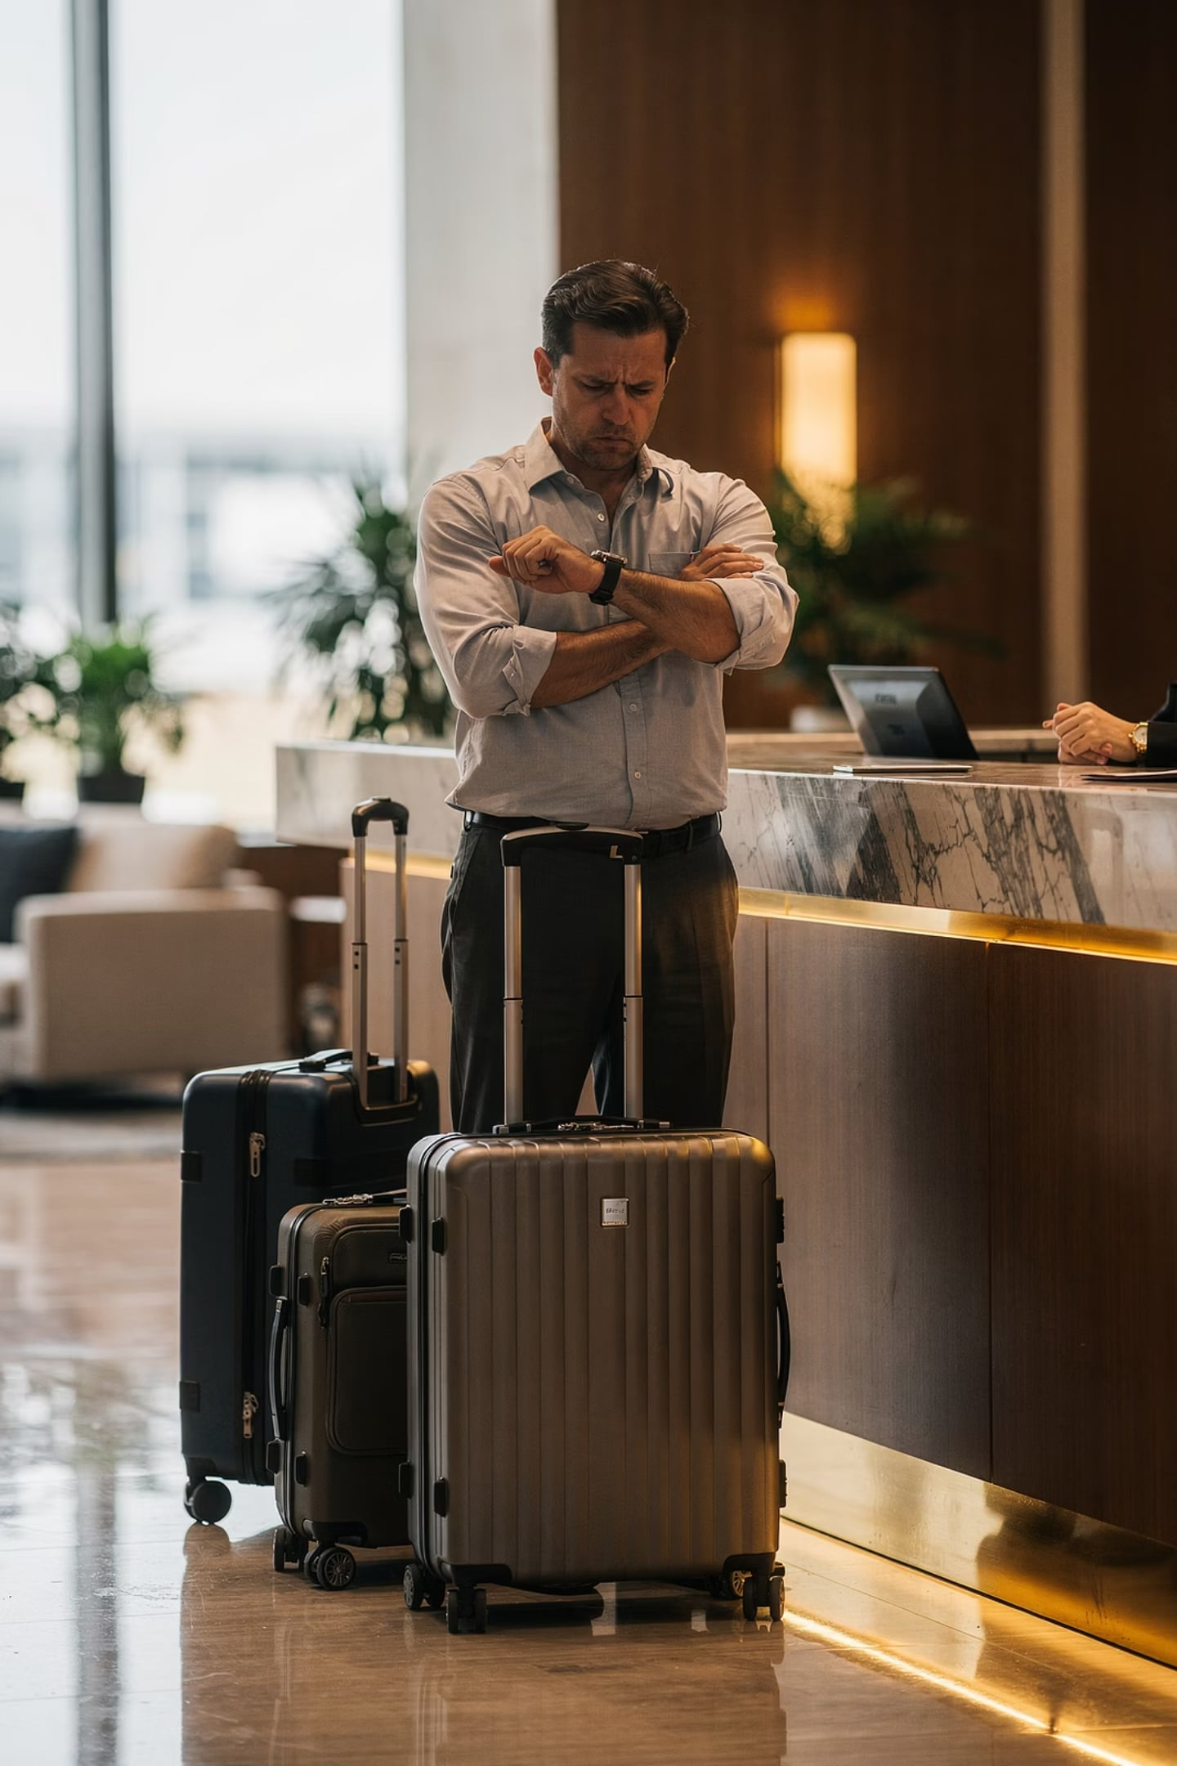
Expectations vs. Reality
😤 Guest Expects
Immediate room availability upon arrival
🏨 Hotel Policy
Check-in time is 3:00 PM — rooms need preparation
This gap between expectation and reality is a major source of guest–staff conflict.

Slide 30
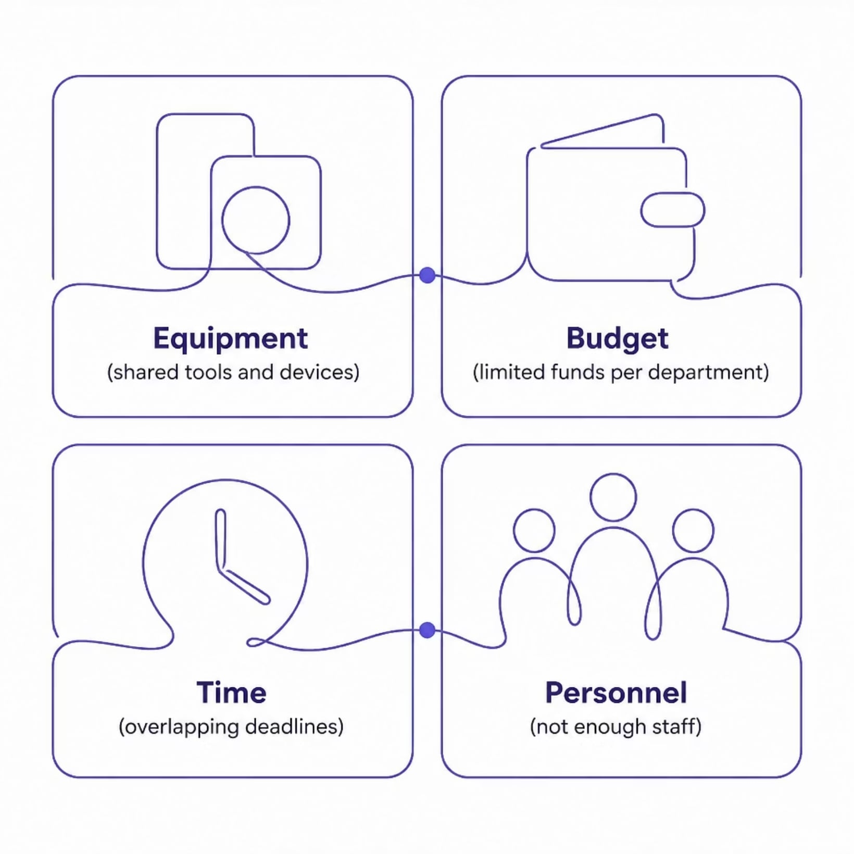
CAUSE OF CONFLICT
Resource Constraints
When resources are limited, employees compete — and tension follows.
Analogy: Like students sharing one computer in a lab — everyone needs it, but only one person can use it at a time.

Slide 31
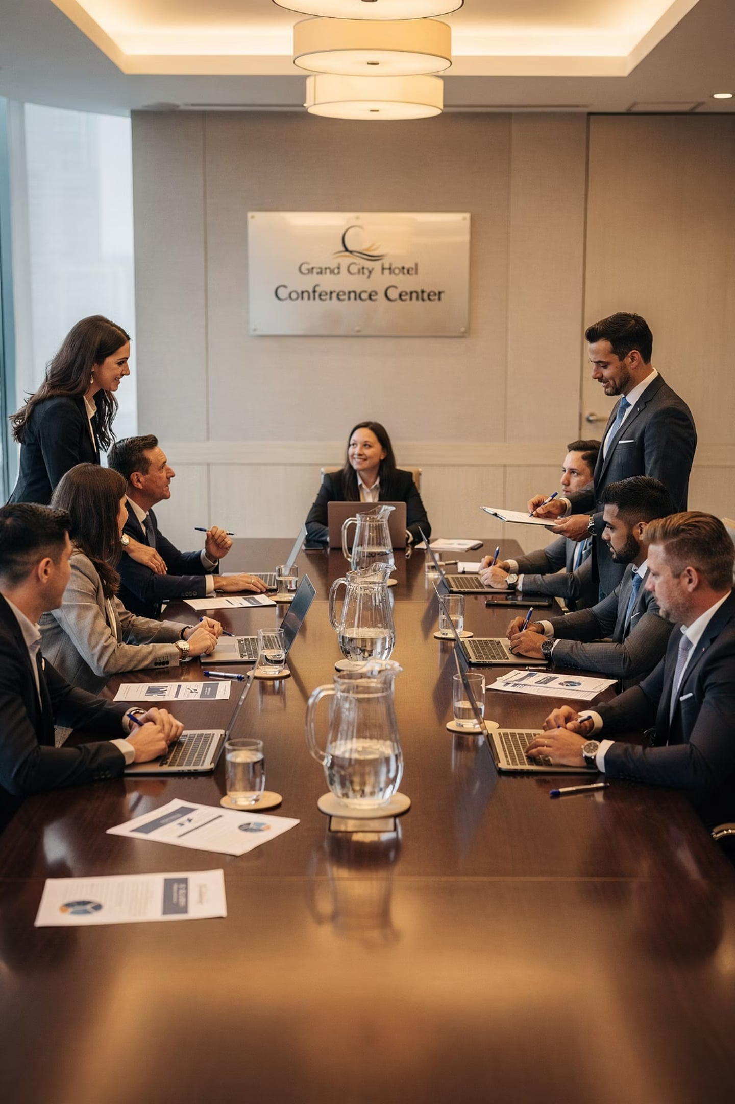
Cultural Differences
People from different cultures communicate differently — and misunderstandings can cause conflict
🗣️ Direct Communication
Say exactly what you mean — common in Western cultures
🤝 Indirect Communication
Hints and context matter more — common in East Asian cultures
Neither style is wrong — but misreading the style creates misunderstanding.

Slide 32

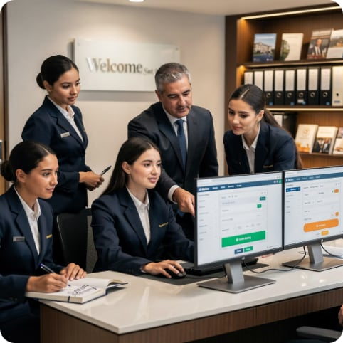
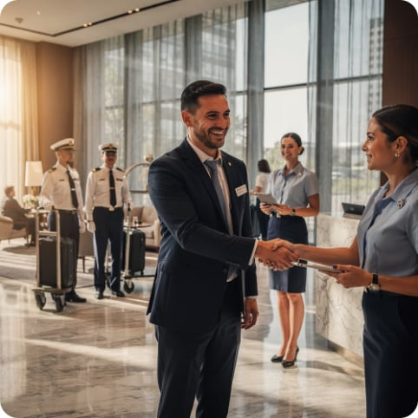
Organizational Change = Uncertainty
Policy Changes
New Technology
Leadership Shifts
New rules employees weren't part of creating
Unfamiliar systems cause stress and frustration
New managers bring different expectations
Change is necessary — but without proper communication, it breeds resistance and conflict.

Slide 33
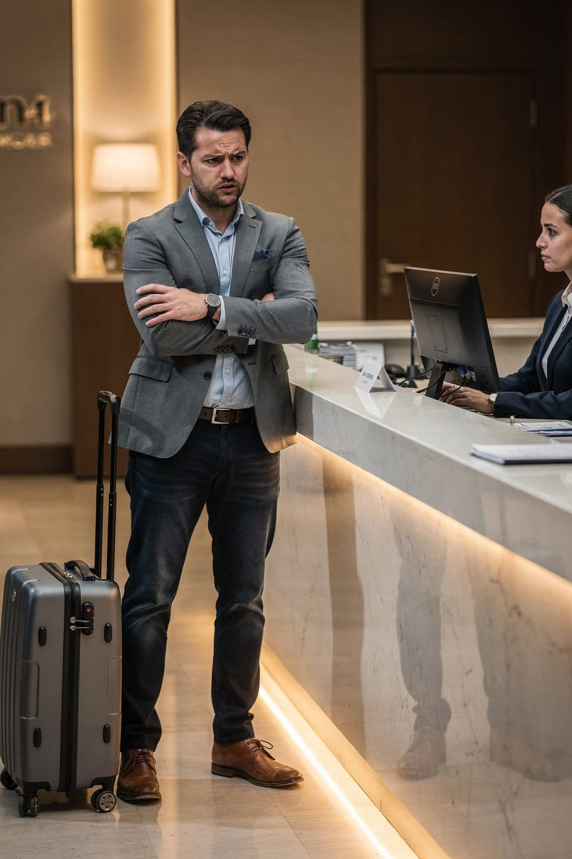

What Is a Customer Complaint?
A complaint = a guest saying "My expectations were not met."
📋 Definition
Expression of dissatisfaction about a product, service, employee behavior, or process
💡 Analogy
Like ordering a coffee and receiving the wrong drink — you expected one thing and got another

Slide 34
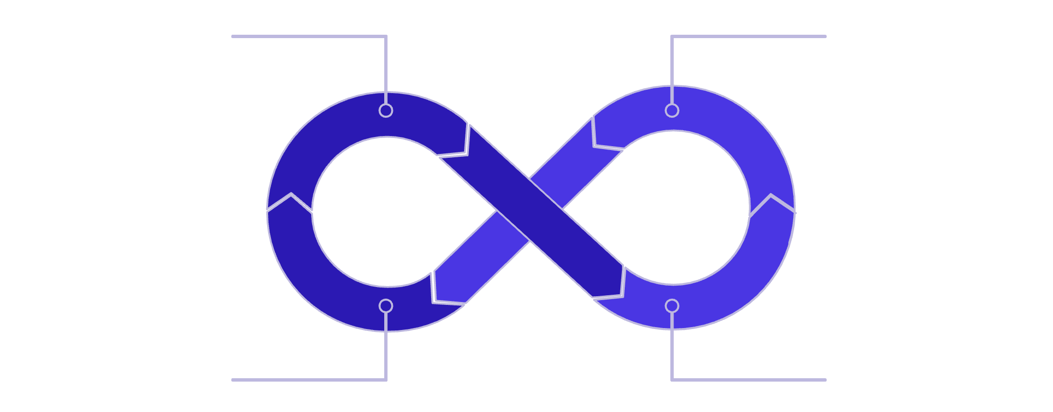
KEY MINDSET SHIFT
Complaints = Opportunities
Guest Complains
Staff Listens
Don't take it personally. A complaint is free feedback that helps you improve.
Organization Improves
Organizations that welcome complaints fix problems before they lose customers.
Guest Satisfied

Slide 35
Types of Customer Complaints
👤 Service Complaints
🍽️ Product Complaints
About employee behavior
About quality of goods
Rude staff
Slow service
Unprofessional attitude
Poor food quality
Defective amenities
Unsatisfactory items

Slide 36
🏨 Facility Complaints
💳 Pricing Complaints
📱 Technology Complaints
About physical conditions
About perceived unfair charges
Increasingly common — about digital failures
Dirty rooms
Broken equipment
Poor maintenance
Billing errors
Unexpected fees
Overcharges
Booking system errors
Website problems
App glitches
Every type of complaint is a signal — something in the guest experience needs fixing.

Slide 37
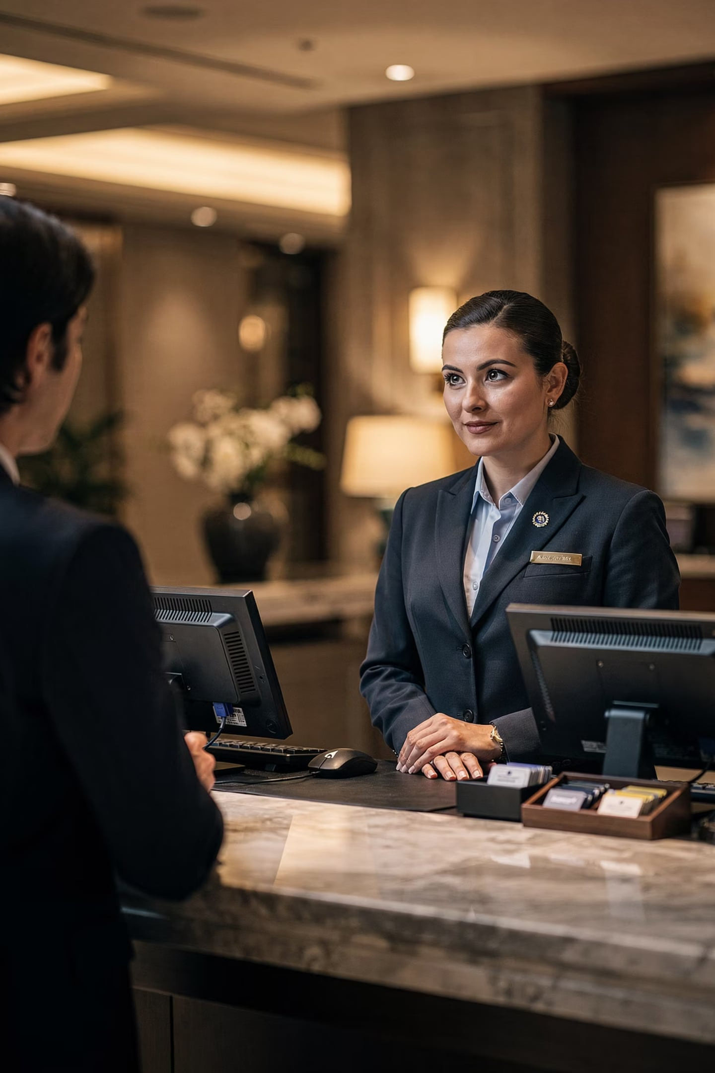
Handling Complaints: Steps 1 & 2
Receive Professionally
1
Stay calm. Don't argue, interrupt, or get defensive.
Listen Actively
2
Let the guest finish. Full attention = respect.
Analogy: Like a doctor who listens to all your symptoms before giving a diagnosis — don't jump to conclusions.

Slide 38



Handling Complaints: Steps 3, 4 & 5
Show Empathy
Investigate
Offer a Solution
"I understand your concern." — reduces guest frustration immediately
Ask: What happened? When? Who was involved? Gather facts first.
Must be fair, timely, practical, and guest-focused

Slide 39
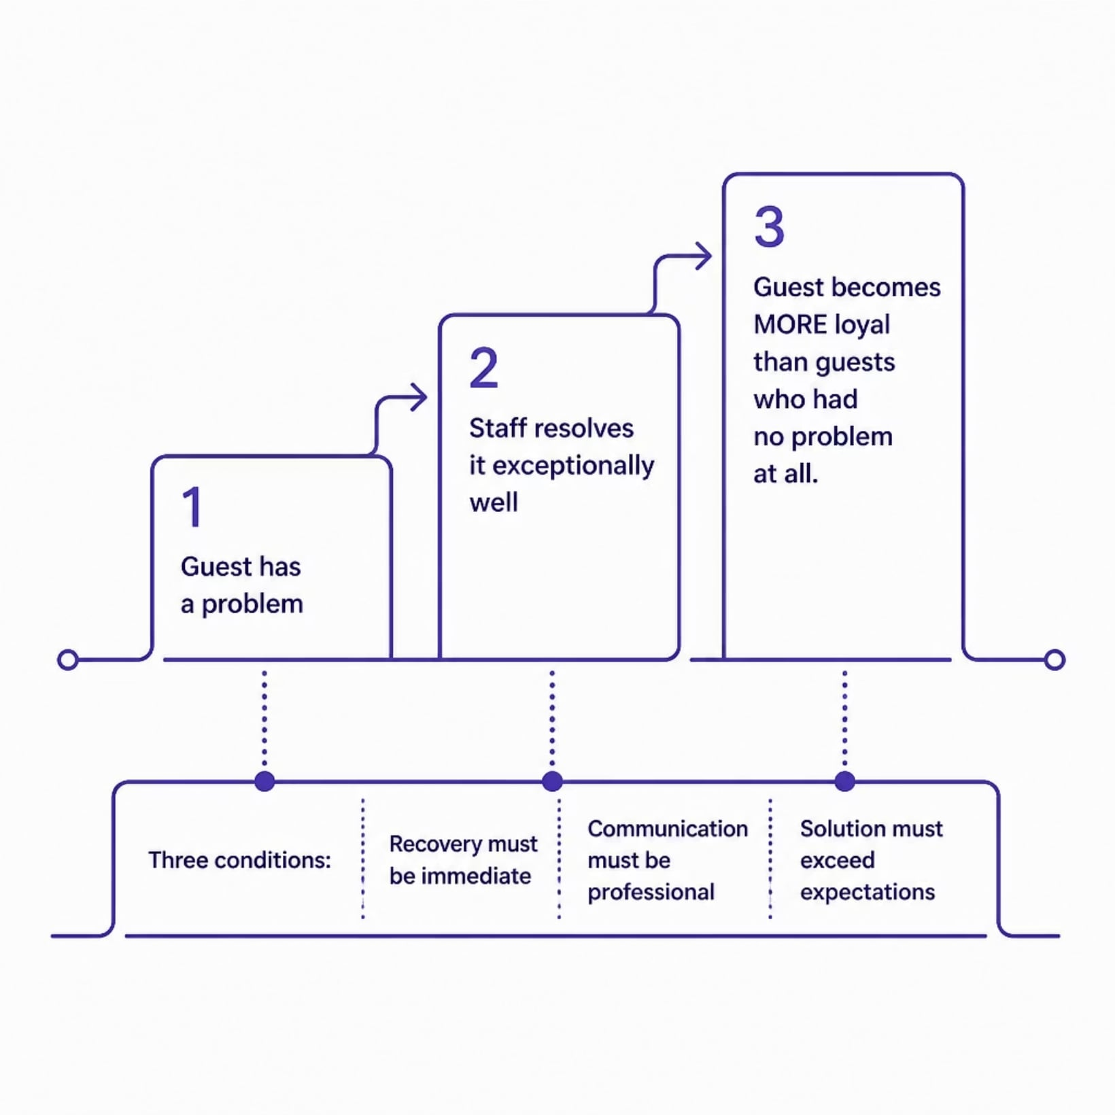
STEP 6
Follow-Up & Service Recovery
Following up shows genuine care. Recovery actions include:
Apologies
Refunds or discounts
Room upgrades
Complimentary services
The Service Recovery Paradox: A well-resolved complaint can create a MORE loyal customer than one who never complained!

Slide 40
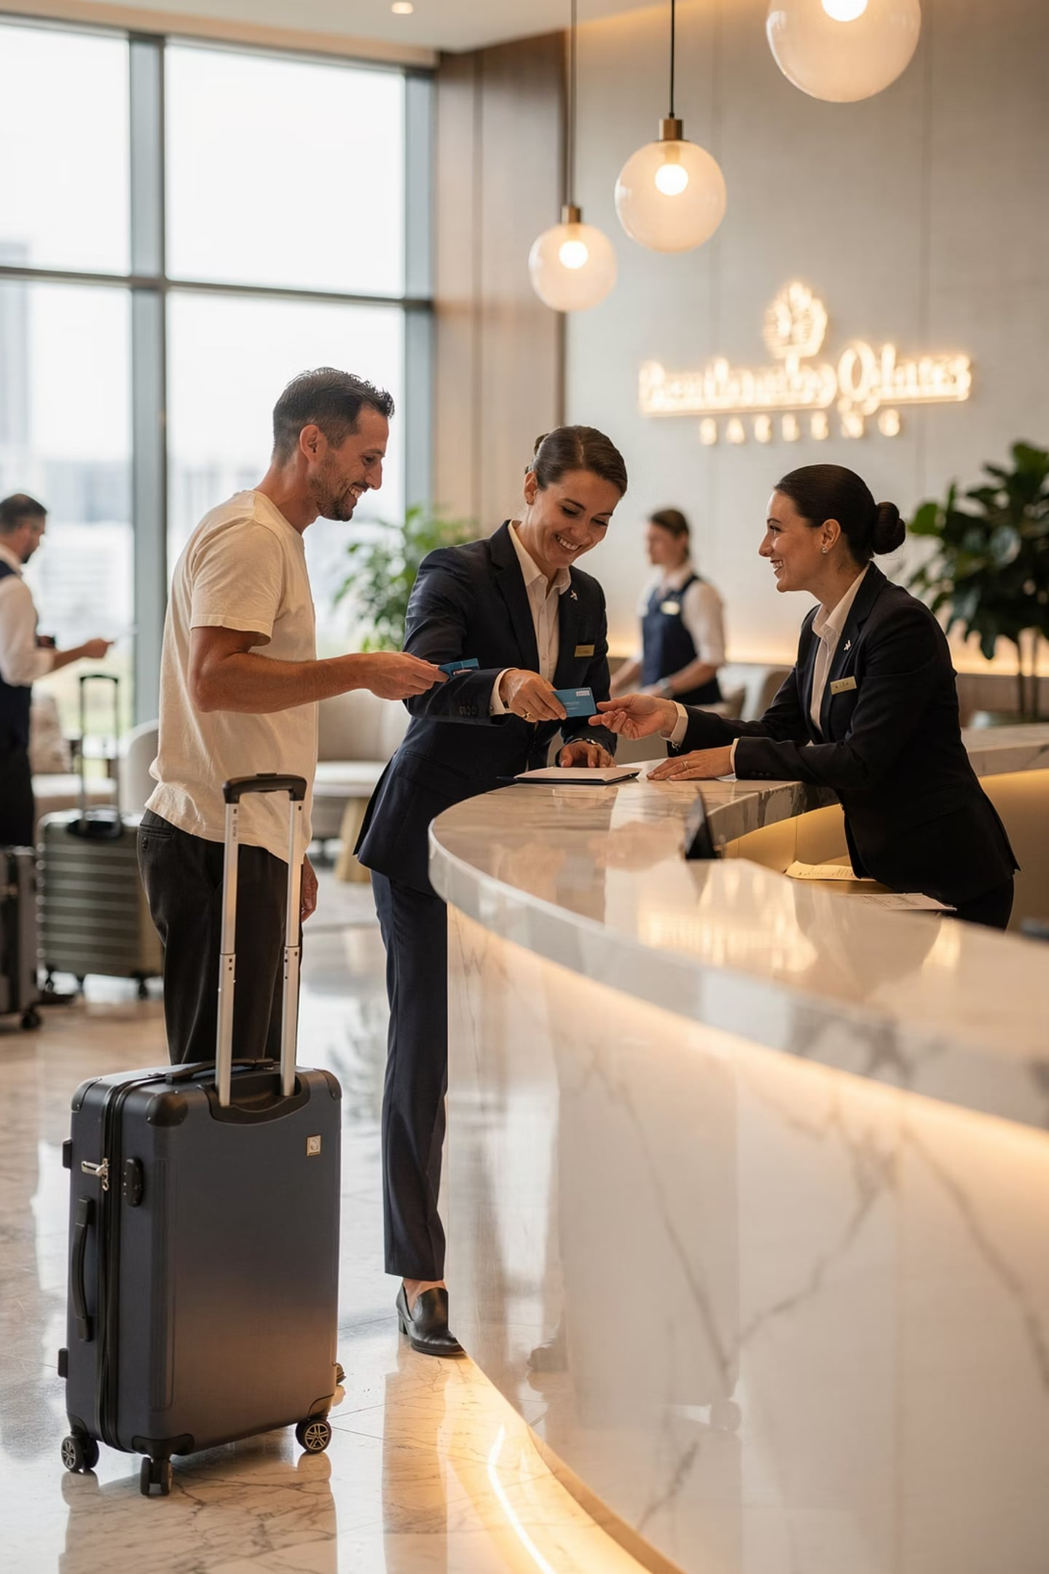
Summary: Conflict & Complaints
Both are inevitable in hospitality — but manageable with the right skills
🗣️ Communicate
Clearly, professionally, and with empathy
❤️ Show Empathy
Acknowledge feelings before offering solutions
🔍 Problem-Solve
Investigate, offer fair solutions, follow up
⭐ Build Trust
Resolved complaints strengthen long-term loyalty

