Slide 1
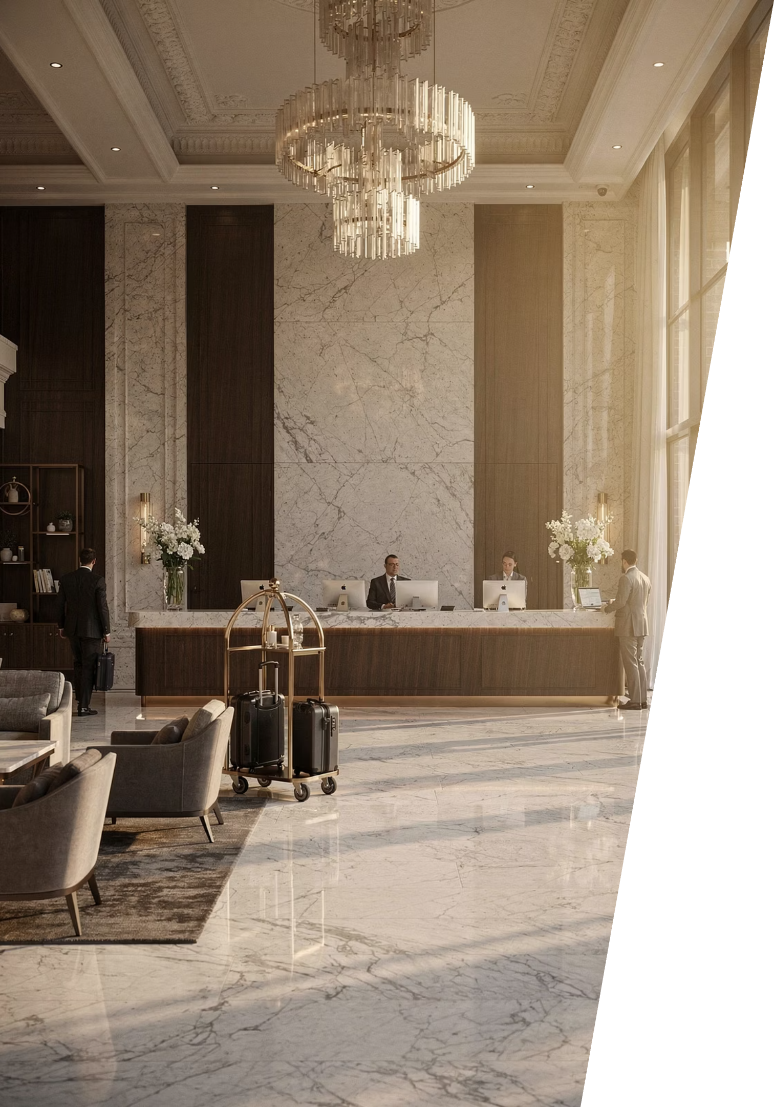
Module 9: Introduction
Communication as the Foundation of Hotel Operations
Course: Hospitality and Tourism Business Communication
Prof. Alia Amor D. Uy, MBA

Slide 2
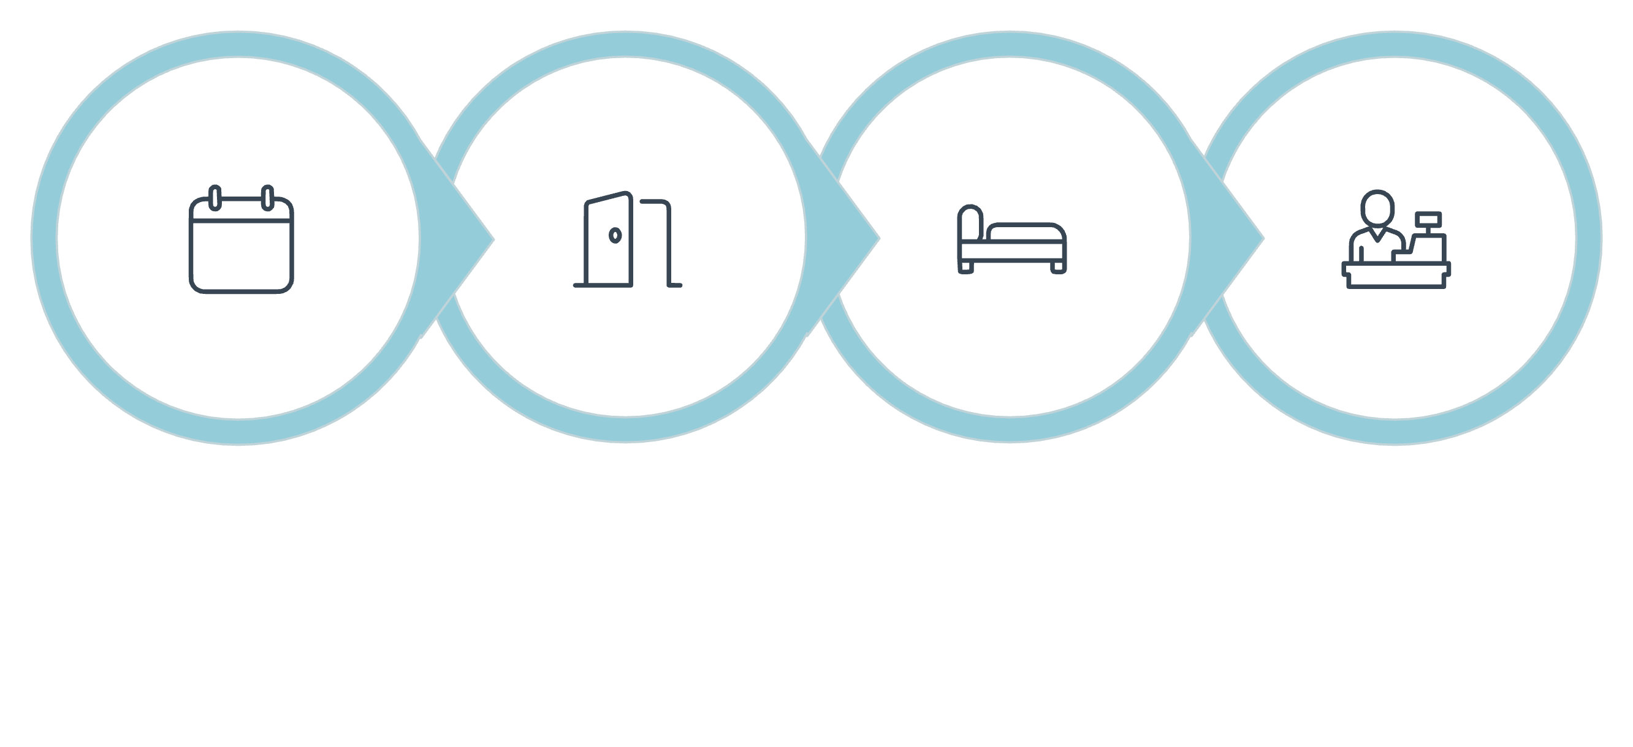
Communication Throughout the Guest Journey
Key Idea: Communication happens at every stage — from booking to checkout — to ensure smooth, satisfying experiences.
Reservation
Arrival
Stay
Departure
Effective communication ensures guest needs are understood and services are delivered accurately at every touchpoint.

Slide 3

How Communication Flows in Hotels
4 Channels
Who Communicates?
Guests
Supervisors
Coworkers
Suppliers & stakeholders
Verbal
Nonverbal
Written
Digital

Slide 4




Why Communication Matters
Key Idea: Good communication directly shapes service quality, guest satisfaction, and the hotel's reputation.
Service Quality
Guest Satisfaction
Accurate, timely information leads to consistent service delivery.
Guests feel valued when their needs are heard and met.
Operational Efficiency
Business Reputation
Departments work in sync, reducing delays and errors.
Strong communication builds trust and positive reviews.

Slide 5

Learning Outcomes
By the end of this lesson, you should be able to:
01
02
Describe
Explain
Communication responsibilities of front office staff
Why housekeeping communication matters
03
04
Discuss
Recognize
The link between communication and guest satisfaction
The role of interdepartmental communication

Slide 6

Communication in Daily Hotel Operations
Key Idea: Almost every hotel task — from taking a reservation to cleaning a room — depends on clear communication.
Reservations
Guest Arrivals
Guest Requests
Booking details shared across systems and teams
Front office coordinates with housekeeping and bell service
Staff relay needs quickly to the right department
Housekeeping
Maintenance
Room status updates shared in real time
Repair needs reported and tracked promptly

Slide 7
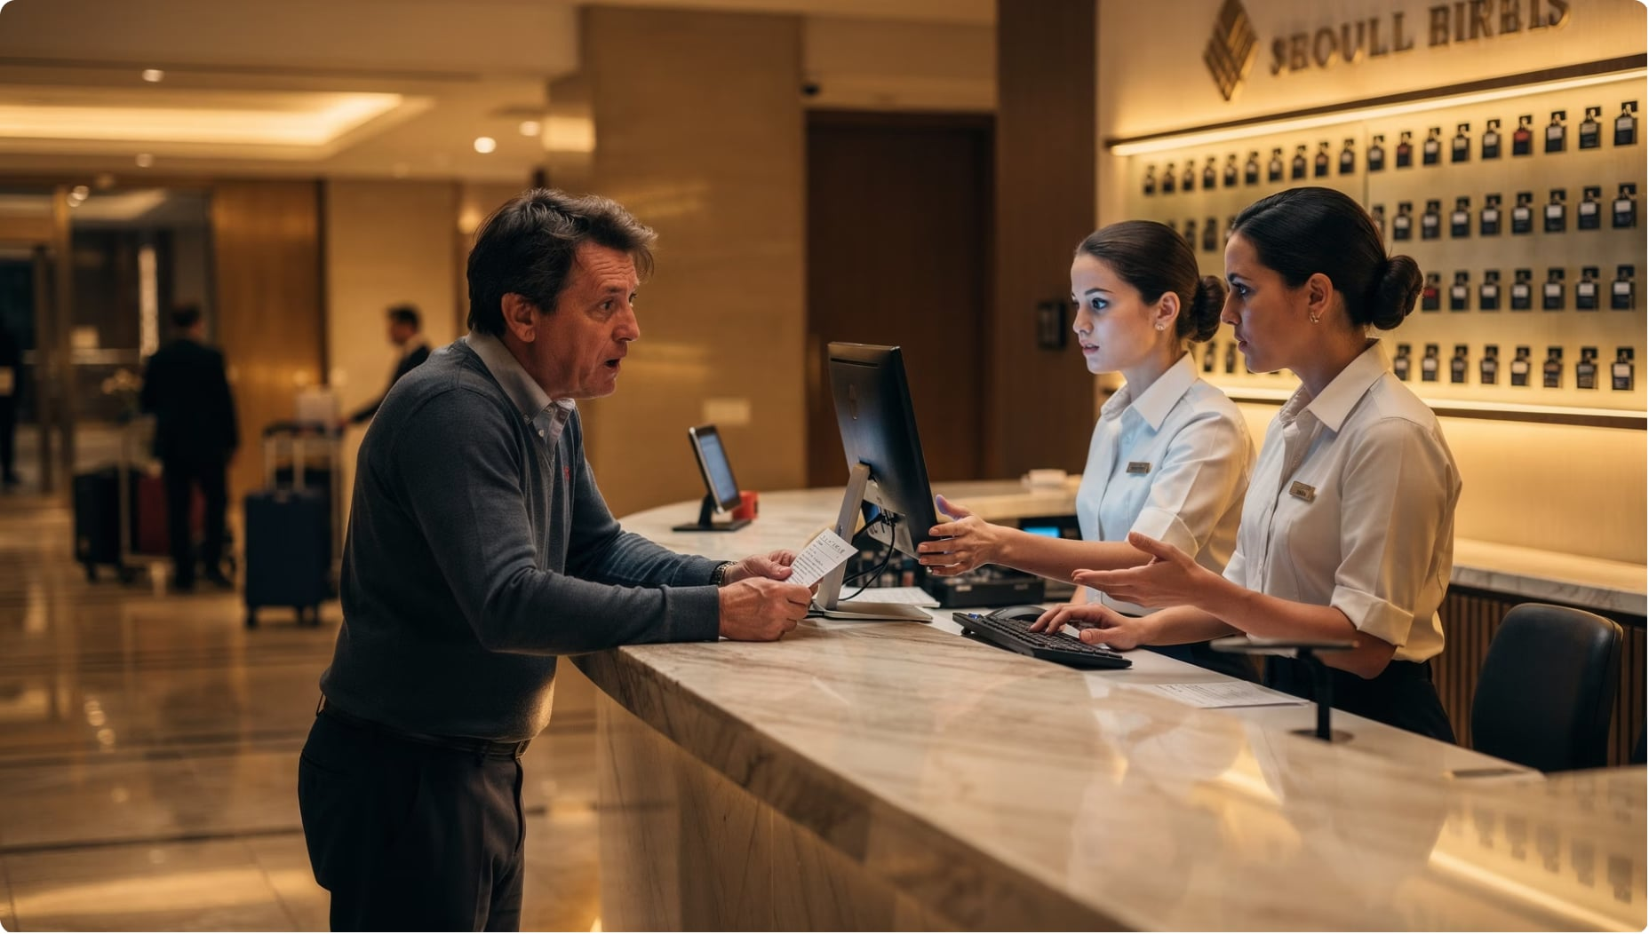

When Communication Breaks Down
Key Idea: Poor communication leads to inconsistent service, unhappy guests, and operational problems.
Without effective communication, service becomes inconsistent — resulting in guest dissatisfaction and inefficiency.
Safety information not shared
Complaints mishandled
Events poorly coordinated
Emergencies mismanaged

Slide 8
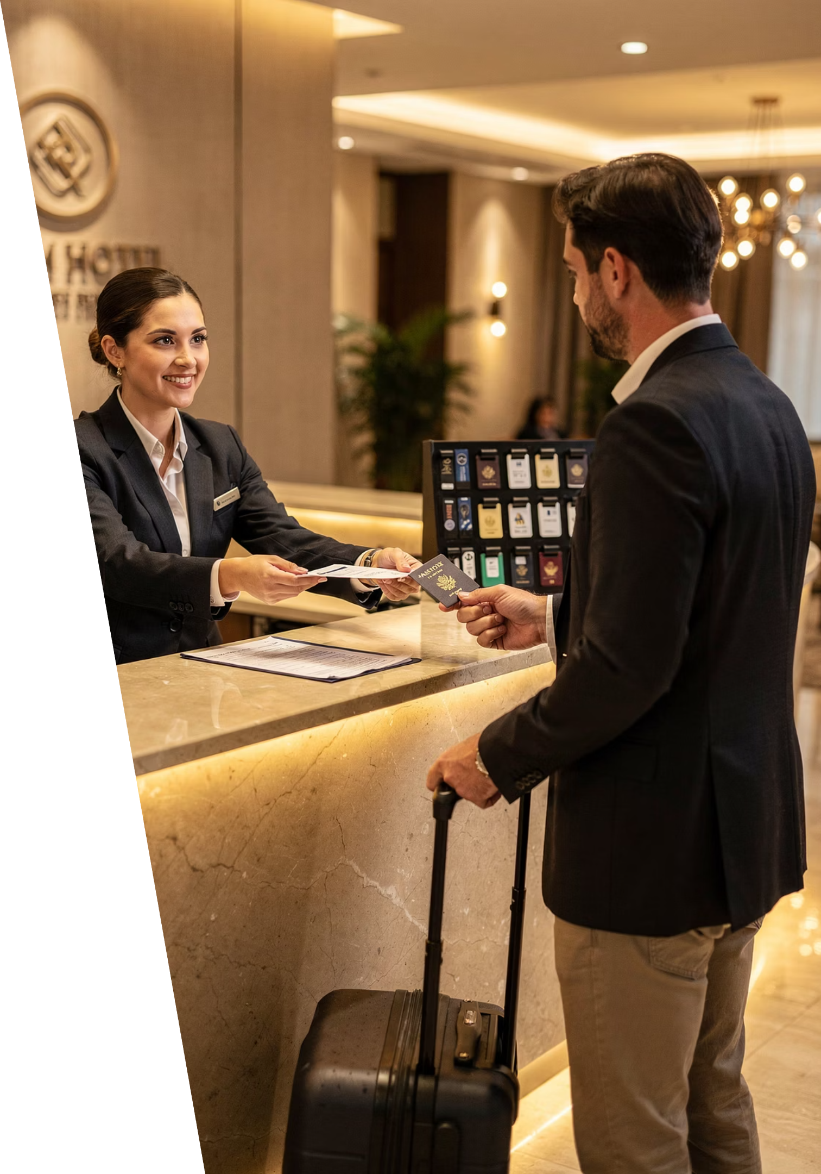
The Front Office Department
Key Idea: The front office is the communication hub of the hotel — the first and last point of contact for guests.
Reservations
Check-In
Check-Out
Guest Inquiries

Slide 9
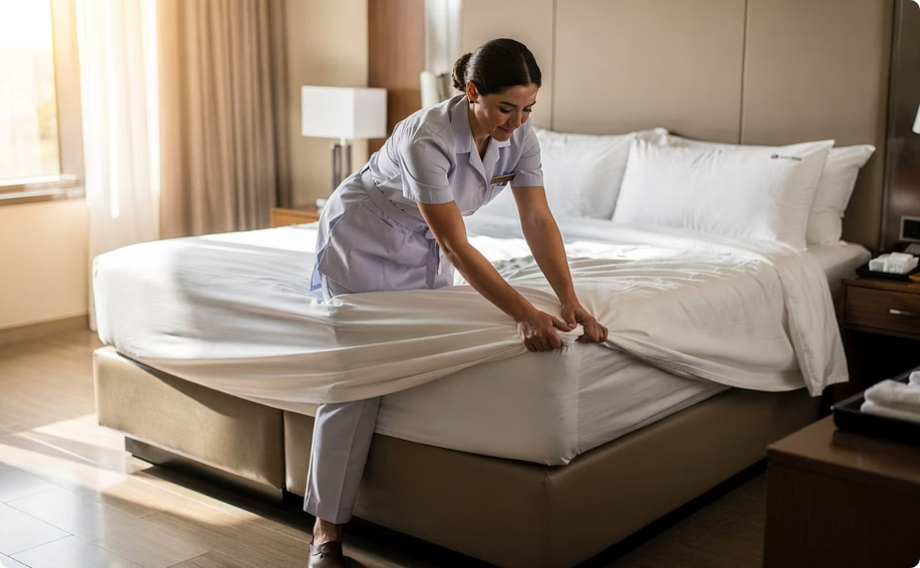
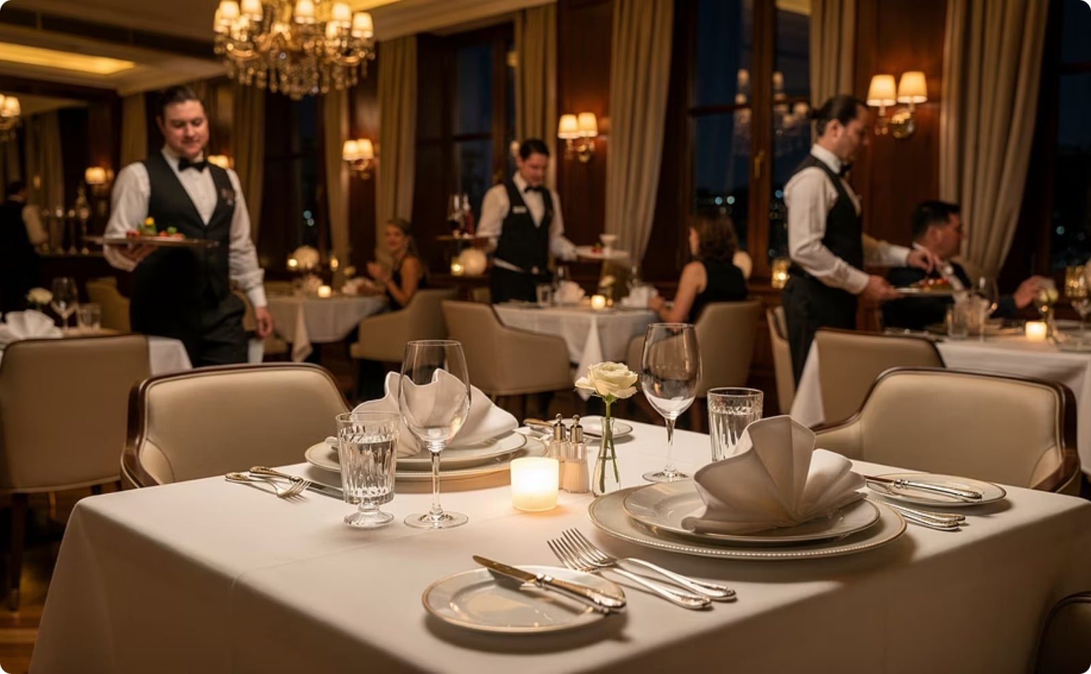
Housekeeping & Food and Beverage
Key Idea: Two essential departments that keep guests comfortable and well-served throughout their stay.
Housekeeping
Food & Beverage
Room cleanliness
Linen management
Public area upkeep
Room preparation
Restaurant operations
Banquet services
Room service
Catering

Slide 10
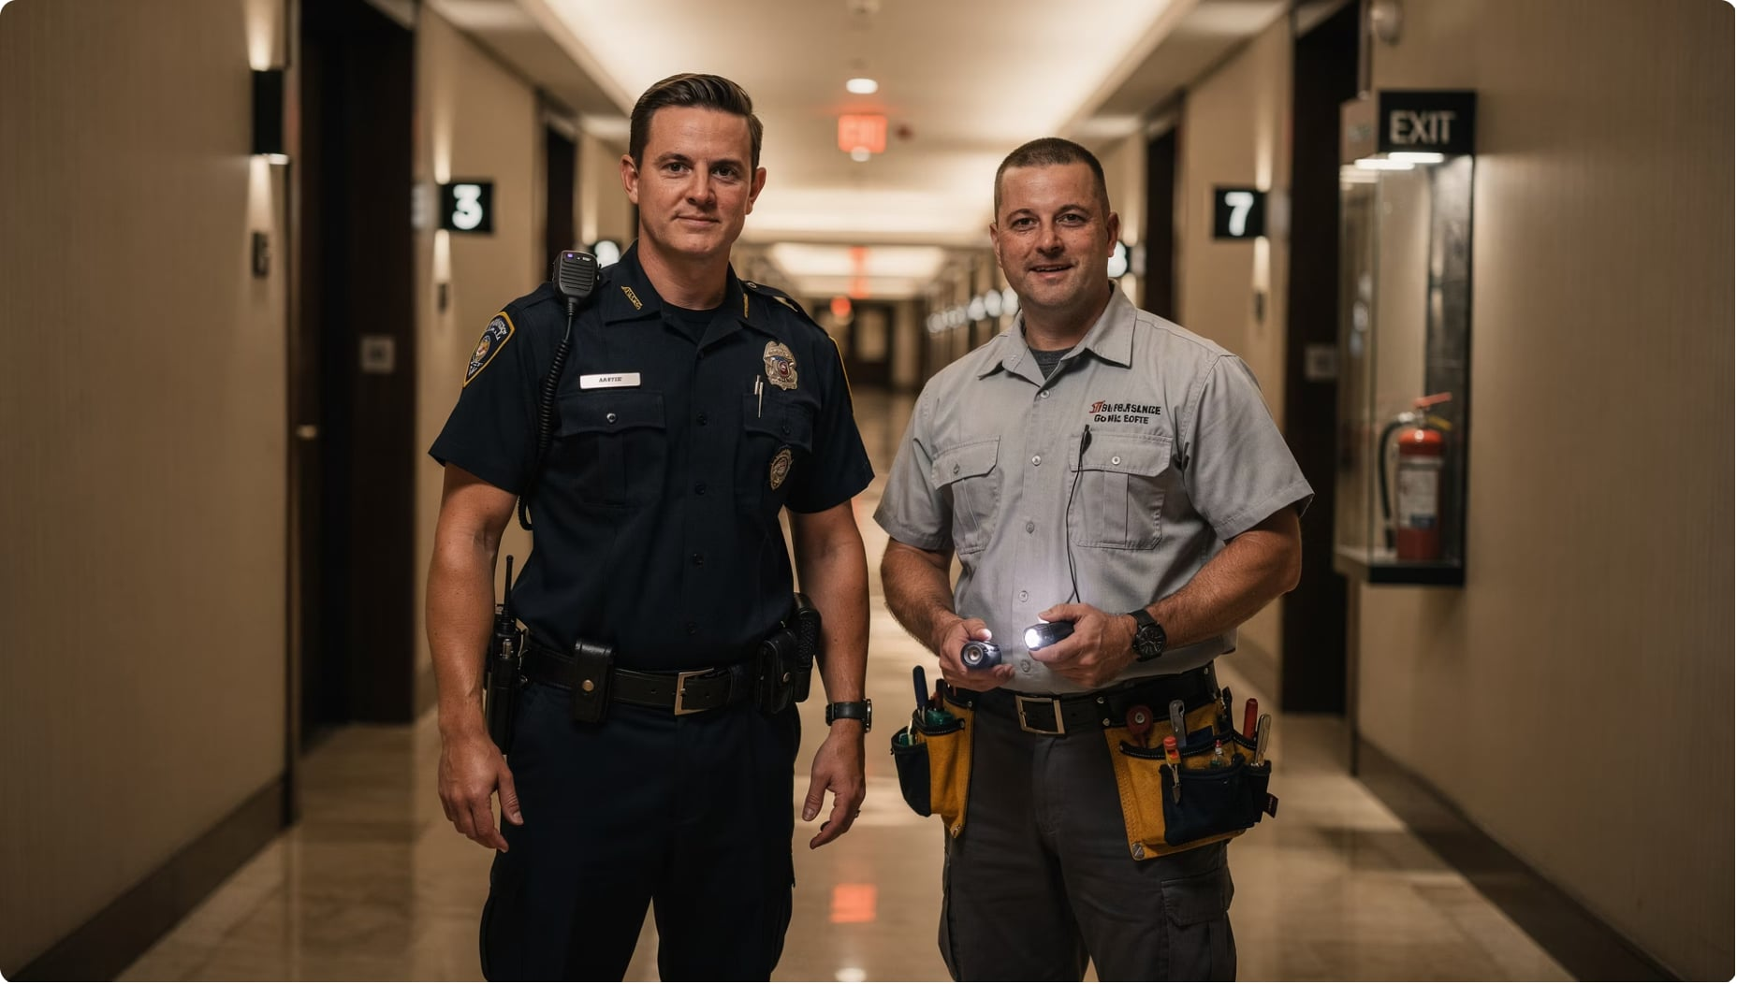

Supporting Departments Keep It All Together
Key Idea: Engineering, maintenance, and security all depend on strong interdepartmental communication to protect guests and keep the hotel running.
Engineering & Maintenance
Equipment upkeep
Facility repairs
Safety inspections
Security
Guest safety
Property protection
Emergency response
Every department must communicate to ensure seamless guest experiences.

