Slide 1

Module 10: Introduction
Communication in Travel and Tour Operations
Course: Hospitality and Tourism Business Communication
PROF. ALIA AMOR D. UY, MBA

Slide 2


What Is Communication in Travel?
Key Idea: Travel and tour operations require constant communication — more than almost any other part of tourism.
Unlike hotels, travel services involve continuous movement across multiple destinations and providers — communication never stops.

Slide 3


Why Communication Is the Foundation
Key Idea: Tourism products are intangible — customers buy experiences they haven't had yet.
Before the trip
During the trip
Tourists rely on what consultants tell them
Guides and coordinators keep everything on track

Slide 4

Communication Shapes Every Stage of Travel
Key Idea: From the first inquiry to the final review, communication affects everything.
Inquiry & Planning
Tour Execution
Post-Tour Evaluation
Reputation & Repeat
Good communication at every stage drives satisfaction, safety, efficiency, and reputation.

Slide 5
Who Do Travel Professionals Talk To?
Key Idea: Travel professionals are the center of a large communication network.
🧳 Tourists
✈️ Airlines
🏨 Hotels
🏢 Agencies
🗺️ Operators

Slide 6
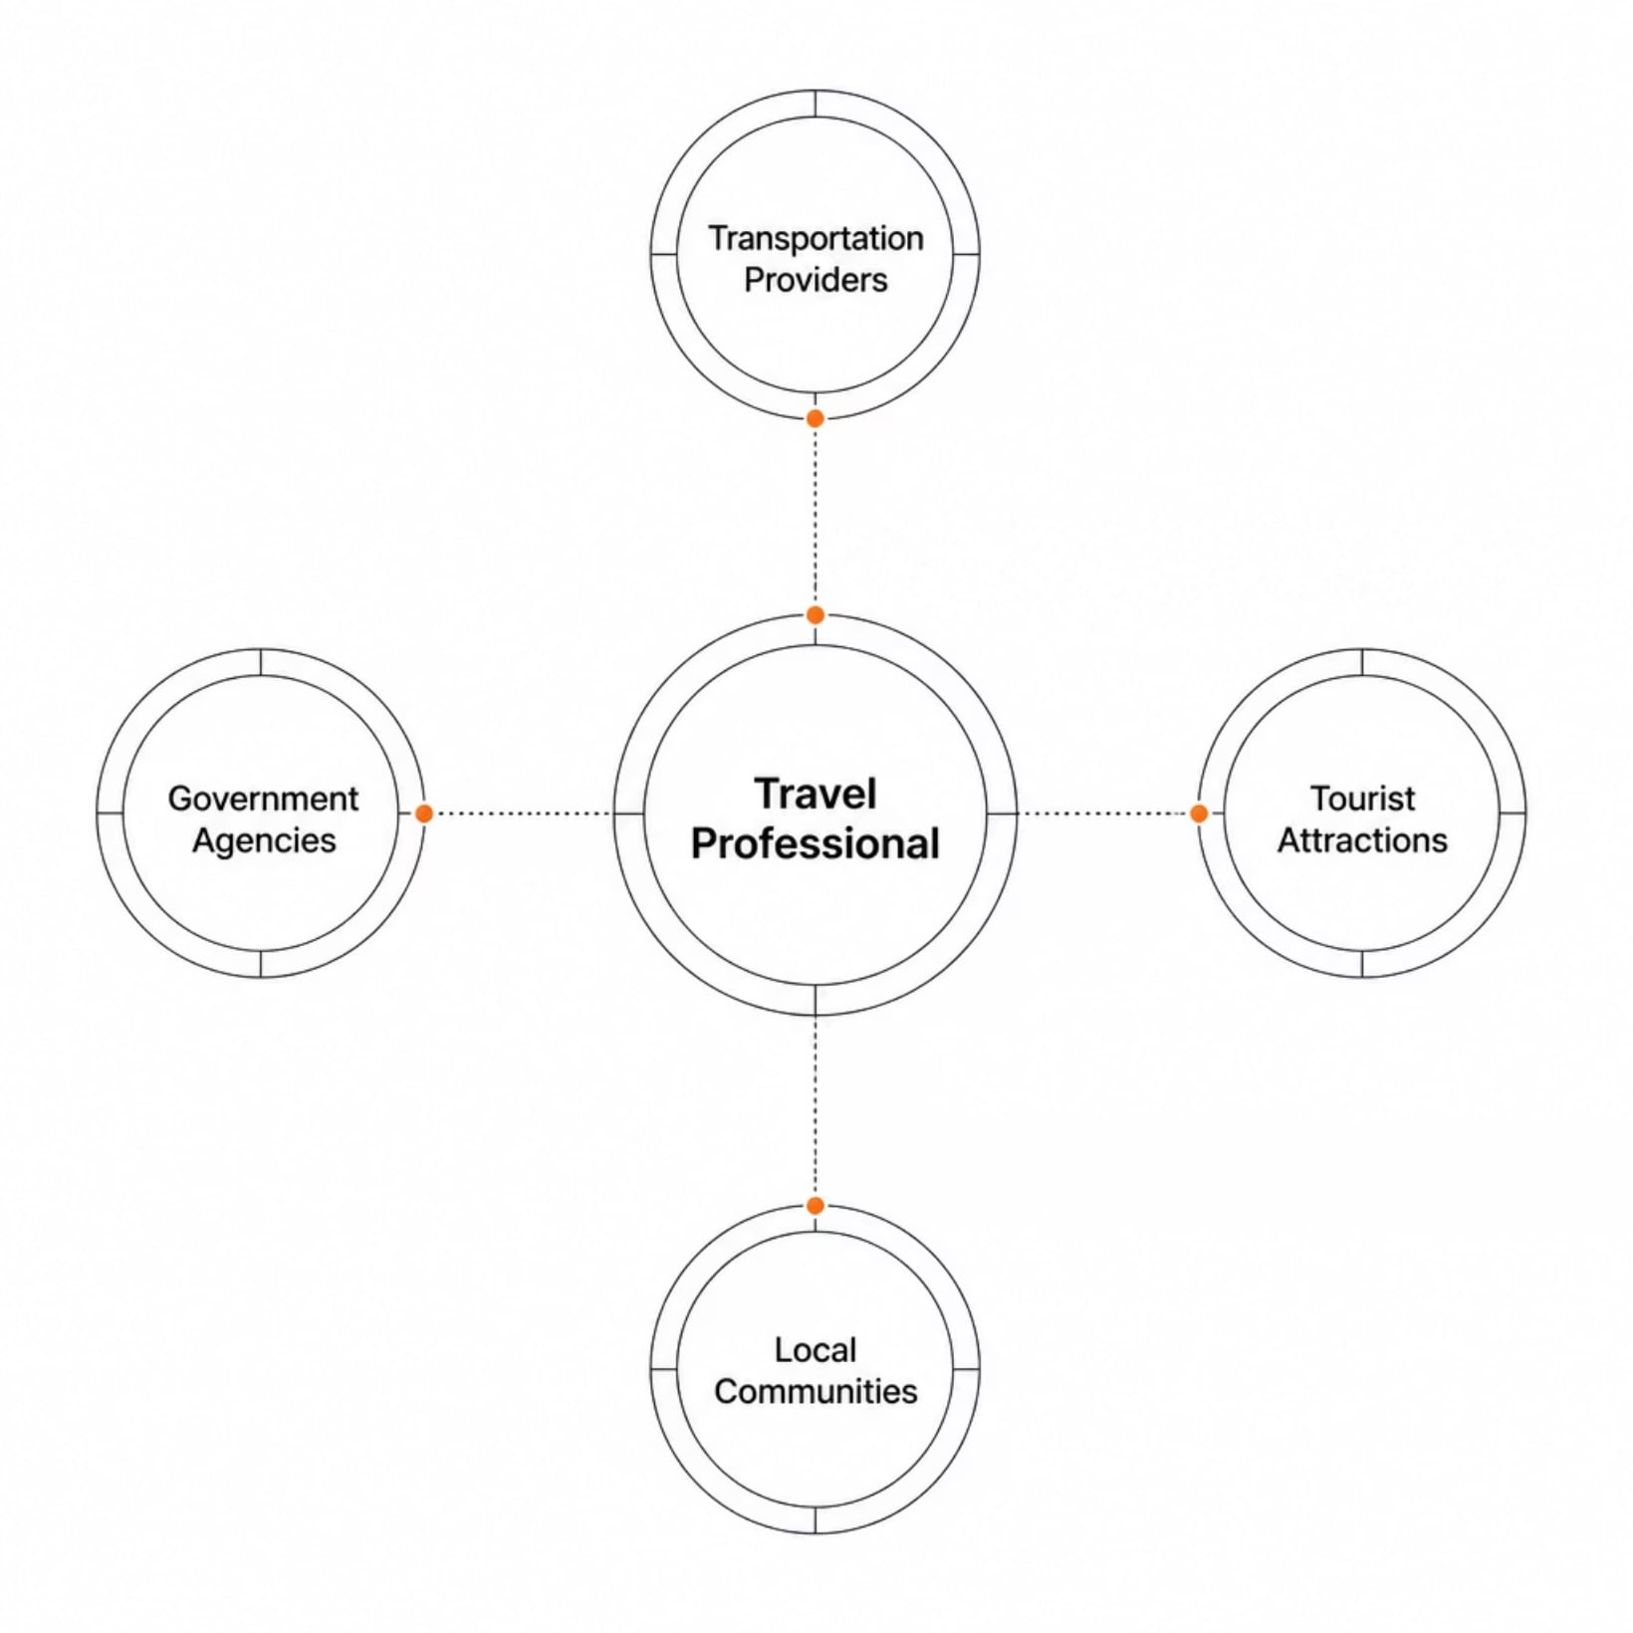
The Wider Tourism Network
Key Idea: Travel professionals must also work with partners beyond the tourist themselves.
Transportation providers
Tourist attractions
Government agencies
Local communities
Clear, professional communication is one of the most valued skills in tourism careers.

Slide 7
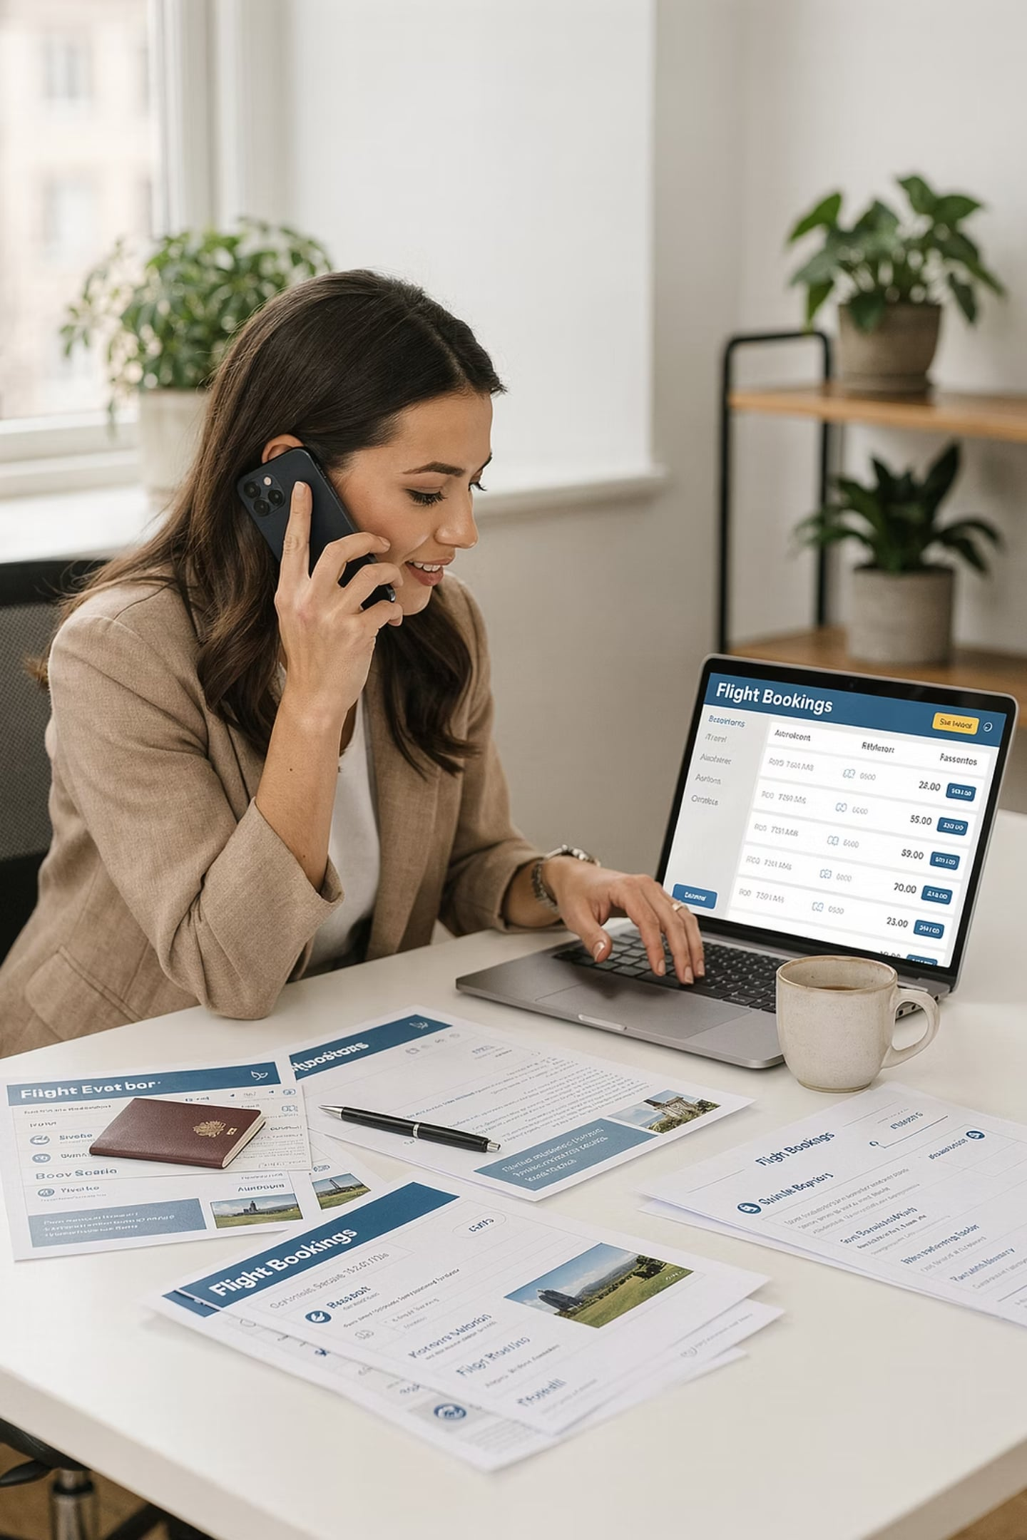



What Travel Professionals Communicate About
Key Idea: Travel services depend on constant information exchange to function.
Provide Travel Info
Share destination details, requirements, and options
Recommend Destinations
Guide clients toward the best fit for their needs
Process Reservations
Confirm bookings across flights, hotels, and tours

Slide 8
Keeping Travel Running Smoothly
Key Idea: Communication isn't just about selling trips — it's about managing them in real time.
Customers judge the quality of travel services largely by how well staff communicated — before, during, and after the journey.
Think of it like this: great communication = great travel experience.
Coordinate Transport
Manage Itineraries
Handle Concerns
Resolve Problems

Slide 9

Pre-Travel Communication
Key Idea: Communication begins long before the trip — at the planning stage.
01
Travel Inquiries
Client asks about destinations, costs, and availability
02
Package Presentations
Consultant presents suitable tour options
03
Travel Consultations
Needs and preferences are discussed in detail
04
Reservation Discussions
Bookings are confirmed and documented

Slide 10
During & After the Tour
Key Idea: Communication continues throughout the trip and even after returning home.
During Travel
Post-Travel
Tour briefings
Guide commentary
Safety instructions
Schedule updates
Customer feedback collection
Follow-up messages
Service evaluations
Relationship management
Post-travel communication builds loyalty and drives repeat business.

