Slide 1

Module 10
Communication in Travel and Tour Operations
Course: Hospitality and Tourism Business Communication
Prof. Alia Amor D. Uy, MBA

Slide 2
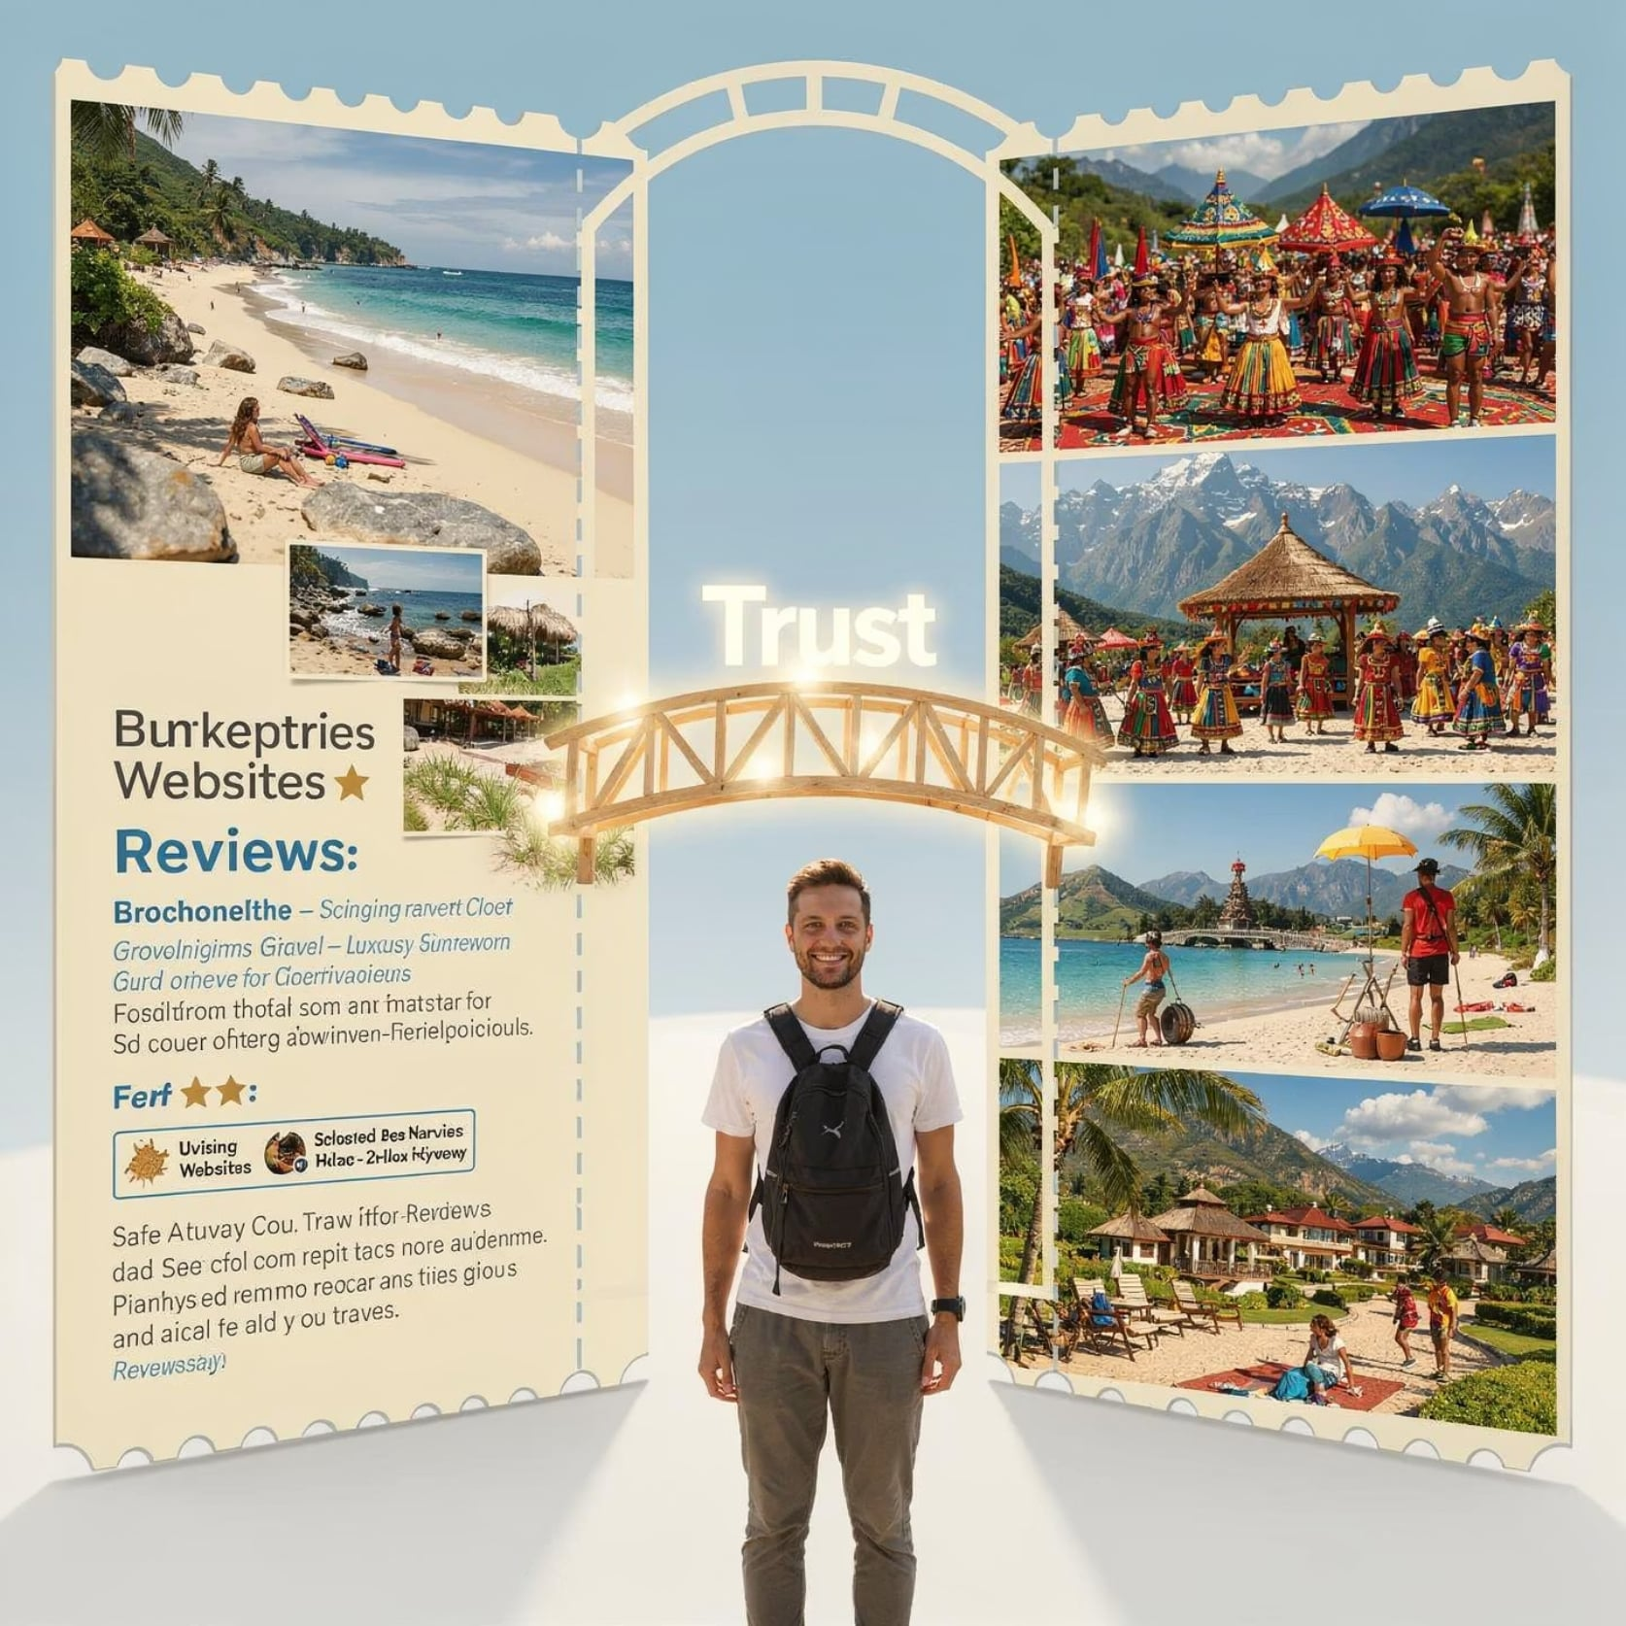

KEY IDEA
Tourism Sells Promises, Not Products
Unlike physical goods you can touch or inspect, travel experiences are bought based on information, descriptions, and trust communicated by tourism professionals.
Communication is the product before the product exists.

Slide 3
Communication Connects Everything
Think of communication as the invisible bridge linking tourists to every part of their journey.
Destinations
Accommodations
Attractions
Transport
Organizations

Slide 4
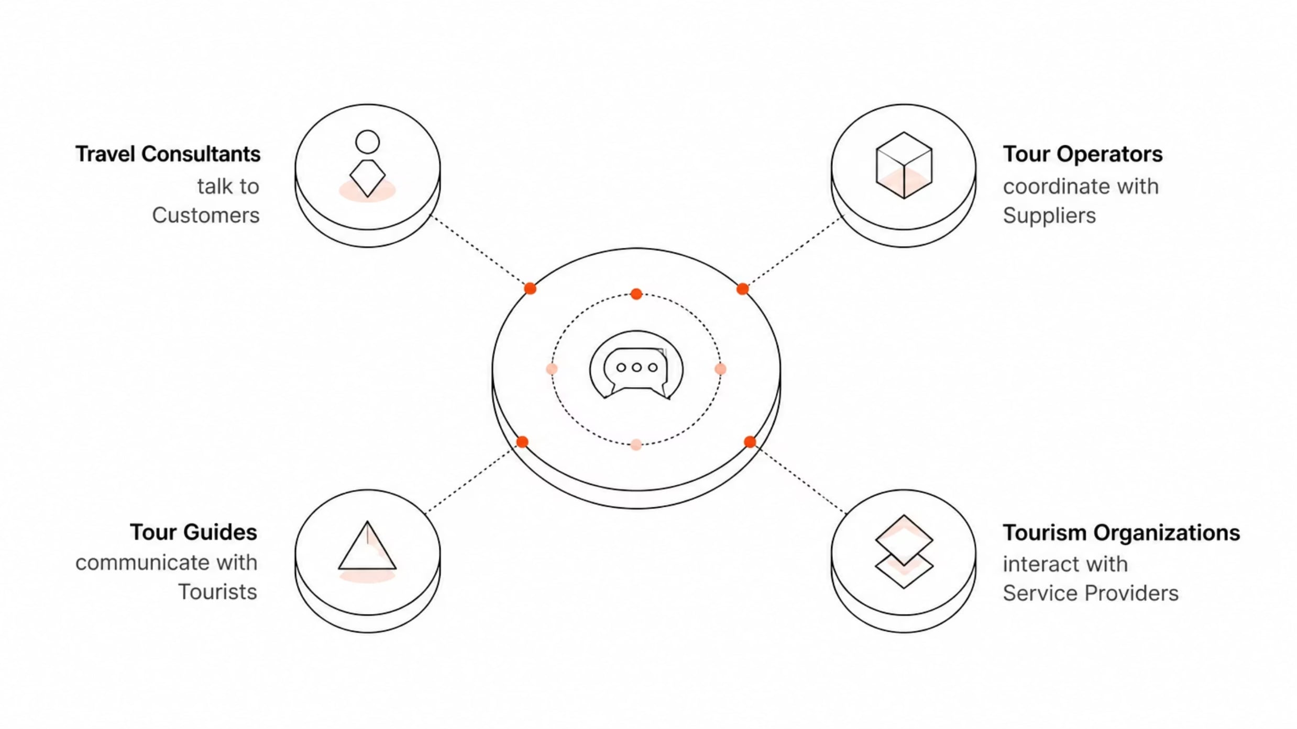
Everyone Talks to Everyone
Tourism runs on a web of constant coordination. Success depends on accurate, timely, and professional communication at every level.

Slide 5

What Happens When Communication Breaks Down?
Poor communication creates a chain reaction of failures — from small inconveniences to major financial losses.
Poor Communication
Service Failures
Missed schedules and unmet promises
Breakdown of clear instructions
Incorrect Reservations
Negative Outcomes
Wrong bookings and missed slots
Customer complaints and losses
This is why communication is ranked among the most valuable professional competencies in the tourism industry.

Slide 6

Communication Shapes Every Stage of Travel
From the first search online to the last review posted at home — communication guides the entire tourism experience.
Before Travel
Research & planning
During Planning
Booking & coordination
On the Journey
Guidance & service
After Travel
Feedback & loyalty

Slide 7

FUNCTION 1
Providing Information
Tourists can only make good decisions when they have accurate, complete information. Tourism professionals are the primary source.
Destinations & attractions
Transportation options
Accommodation details
Travel requirements & safety

Slide 8

FUNCTION 2
Coordination: Keeping All Parts in Sync
Think of tourism coordination like an orchestra — every part must be in harmony or the whole performance falls apart.
Flight Bookings
Hotel Reservations
Reserve flights and share itineraries promptly.
Confirm rooms and sync arrival details.
Ground Transportation
Tour Activities
Align pick-ups with flight and check-in times.
Coordinate schedules with transport and hotels.
Effective coordination minimizes disruptions and ensures seamless service delivery.

Slide 9





FUNCTION 3
Customer Service Starts with Communication
Assist
Answer
Guide travelers through every step of their journey
Respond clearly to questions and concerns
Solve
Manage
Resolve problems quickly and professionally
Set realistic expectations to prevent disappointment

Slide 10
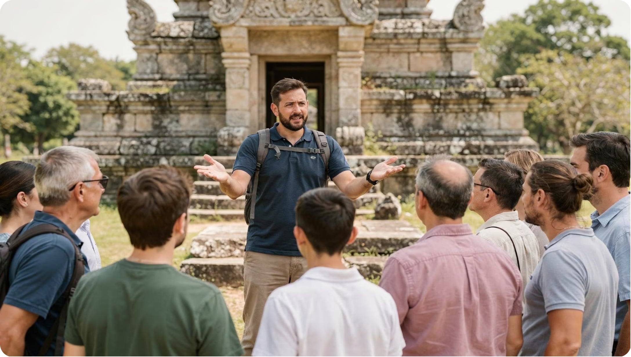
FUNCTION 4
Communication Enriches the Experience
A tour guide's words can transform a simple visit into a memorable, meaningful experience.
Interpretation
Storytelling
Education
Making meaning of places
Creating emotional connection
Building cultural understanding

Slide 11


Tourism Runs on a Communication Network
Unlike many industries that operate internally, tourism depends on multiple independent organizations working together — all coordinated through communication.
No single organization delivers the full travel experience alone.

Slide 12
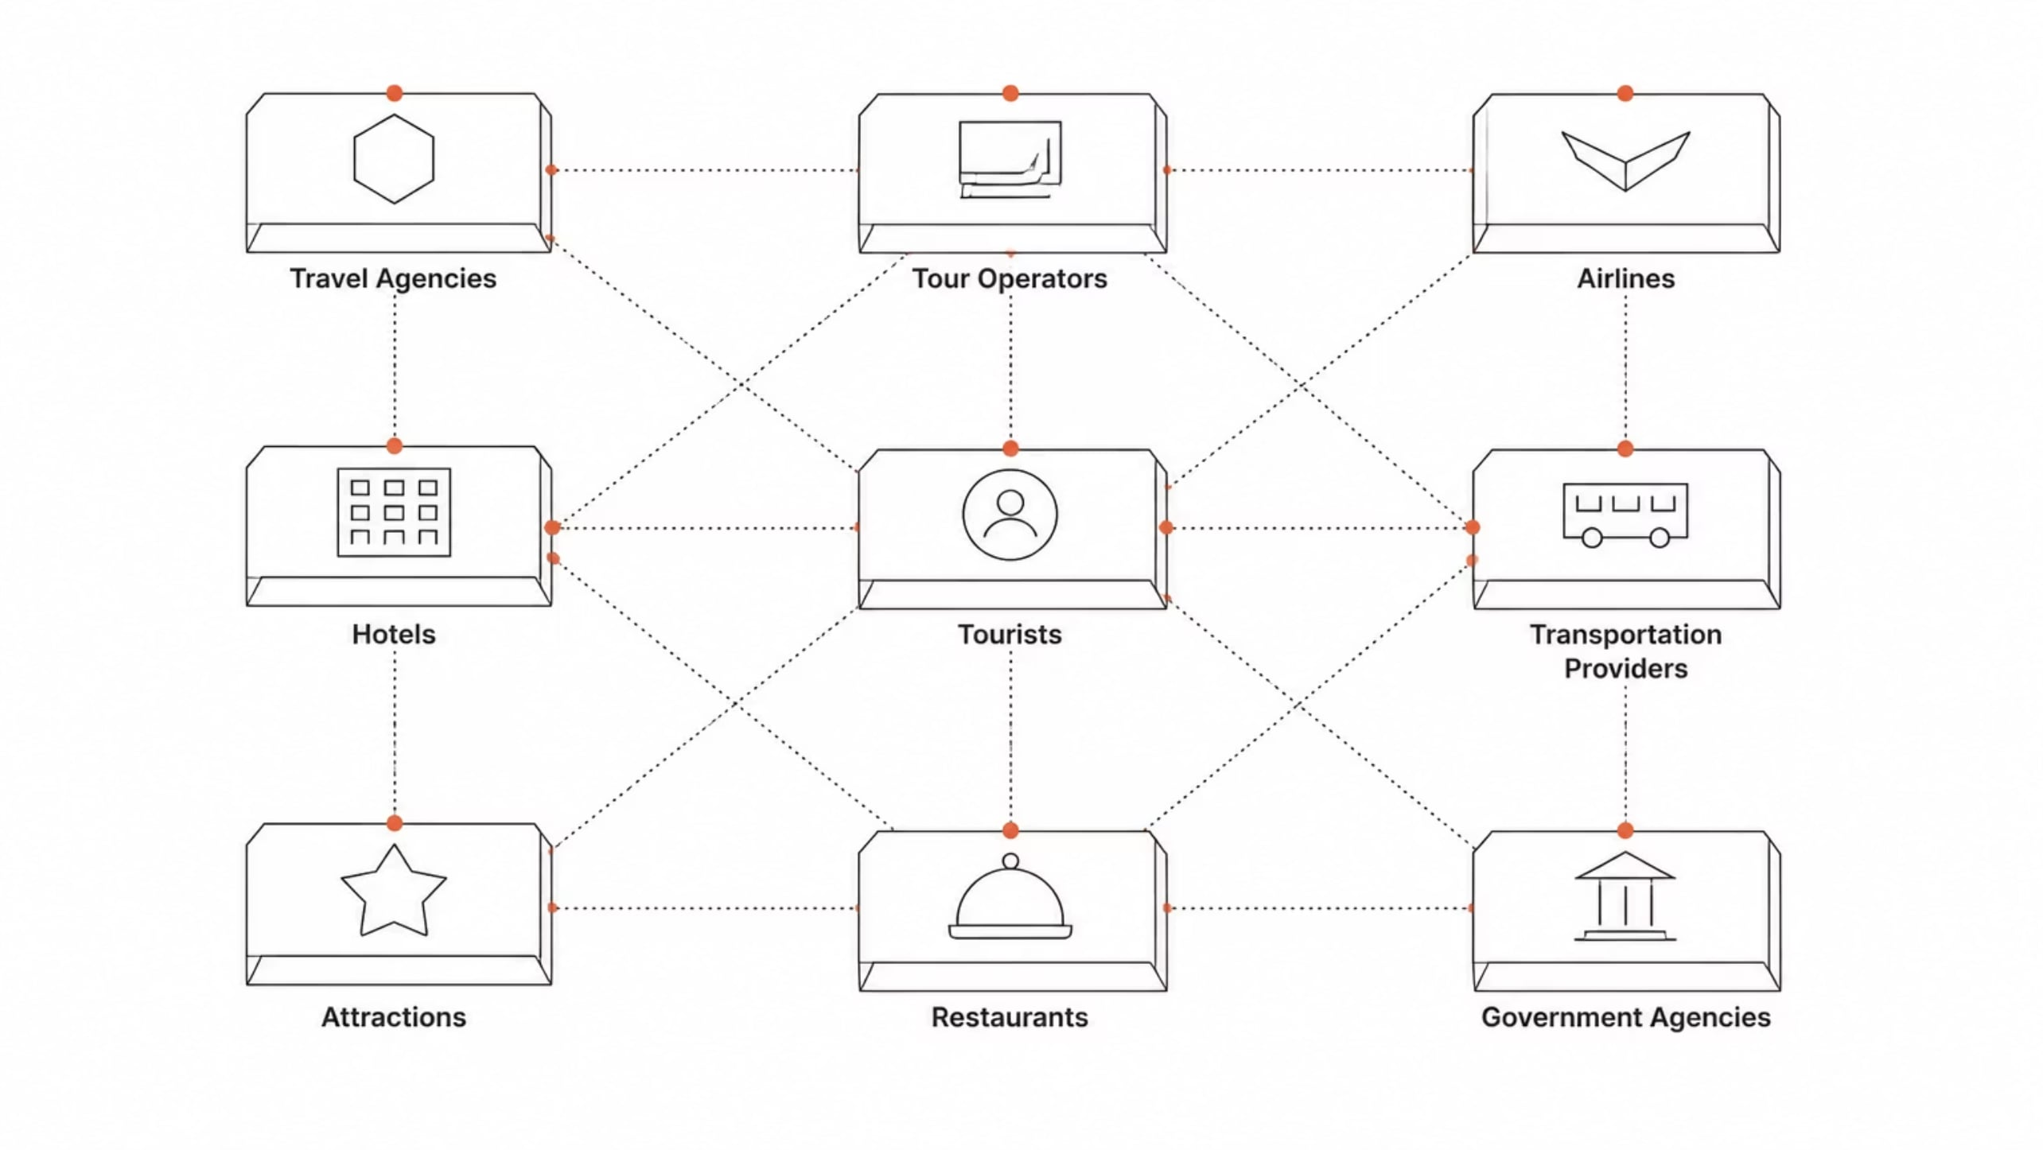
The Tourism Ecosystem
Every stakeholder plays a role — and every role requires communication.

Slide 13

Real Example: A Baguio Package Tour
One seamless trip requires many organizations communicating perfectly.
1
Travel Agency
2
Transport Company
Books and sells the package
Coordinates pickup and routes
3
Hotel
4
Attractions & Guides
Confirms room availability
Prepare for arrivals

Slide 14
STAGE 1
The Journey Starts with a Search
Before any booking happens, tourists gather information to answer one key question: "Where should I go, and how much will it cost?"
Destinations
Attractions
Travel Costs
Activities
Accommodations

Slide 15

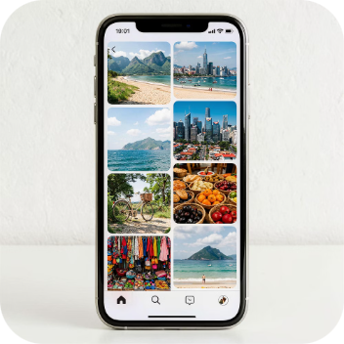


How Tourism Organizations Communicate Information
The quality of information often determines whether a tourist chooses your destination — or a competitor's.
Websites
Social Media
Brochures
Travel Fairs
24/7 accessible destination info
Visual storytelling and engagement
Print materials for on-the-spot decisions
Face-to-face promotions and deals

Slide 16

STAGE 2
Travel Planning: Communication Turns Dreams into Itineraries
Once a destination is chosen, travel professionals guide customers through every detail of their trip.
Travel options & comparisons
Suggested itineraries
Transportation arrangements
Accommodation recommendations
Activity schedules

Slide 17

STAGE 3
Booking: Where Precision Matters Most
A single miscommunication during booking can derail an entire trip. Accuracy is non-negotiable.
Passenger Details
Travel Dates & Flights
Hotel Reservations
Full name, ID, contact information — exactly as required
Departure, arrival, layovers, and seat preferences
Room type, check-in/check-out, special requests

Slide 18
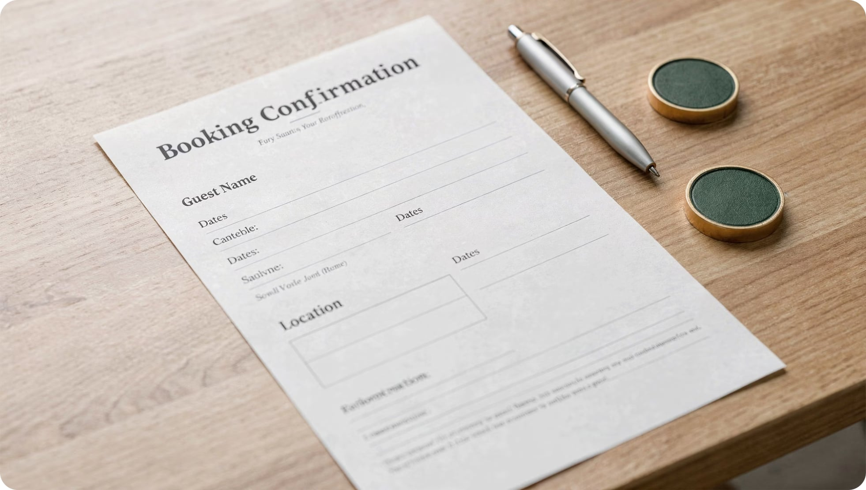


Completing the Booking
Beyond basic details, complete booking communication includes:
Tour Inclusions
What is covered in the package
Payment Procedures
Amounts, deadlines, and methods
Errors at this stage create serious operational problems that are difficult to fix later.

Slide 19




STAGE 4
Pre-Departure: Keep Travelers Informed
As the trip approaches, proactive communication reduces anxiety and builds confidence.
Booking Confirmations
Flight Schedules
Travel Reminders

Slide 20

The Final Communication Before Departure
Weather Updates
Complete pre-departure communication prepares travelers for what lies ahead — turning uncertainty into confidence.
Emergency Contacts
Packing Recommendations
Effective communication doesn't just inform travelers. It empowers them to travel with ease and peace of mind.
Travel Requirements
Communication is not just a skill — it is the backbone of every successful tourism operation.

Slide 21

Stage 5: During Travel — Communication in Action
Key Idea: Communication doesn't stop when the trip begins — it becomes continuous.
Tour Briefings
Setting expectations at the start
Activity Instructions
Guiding tourists step by step
Attraction Interpretation
Making places meaningful
Safety Reminders
Keeping everyone protected

Slide 22
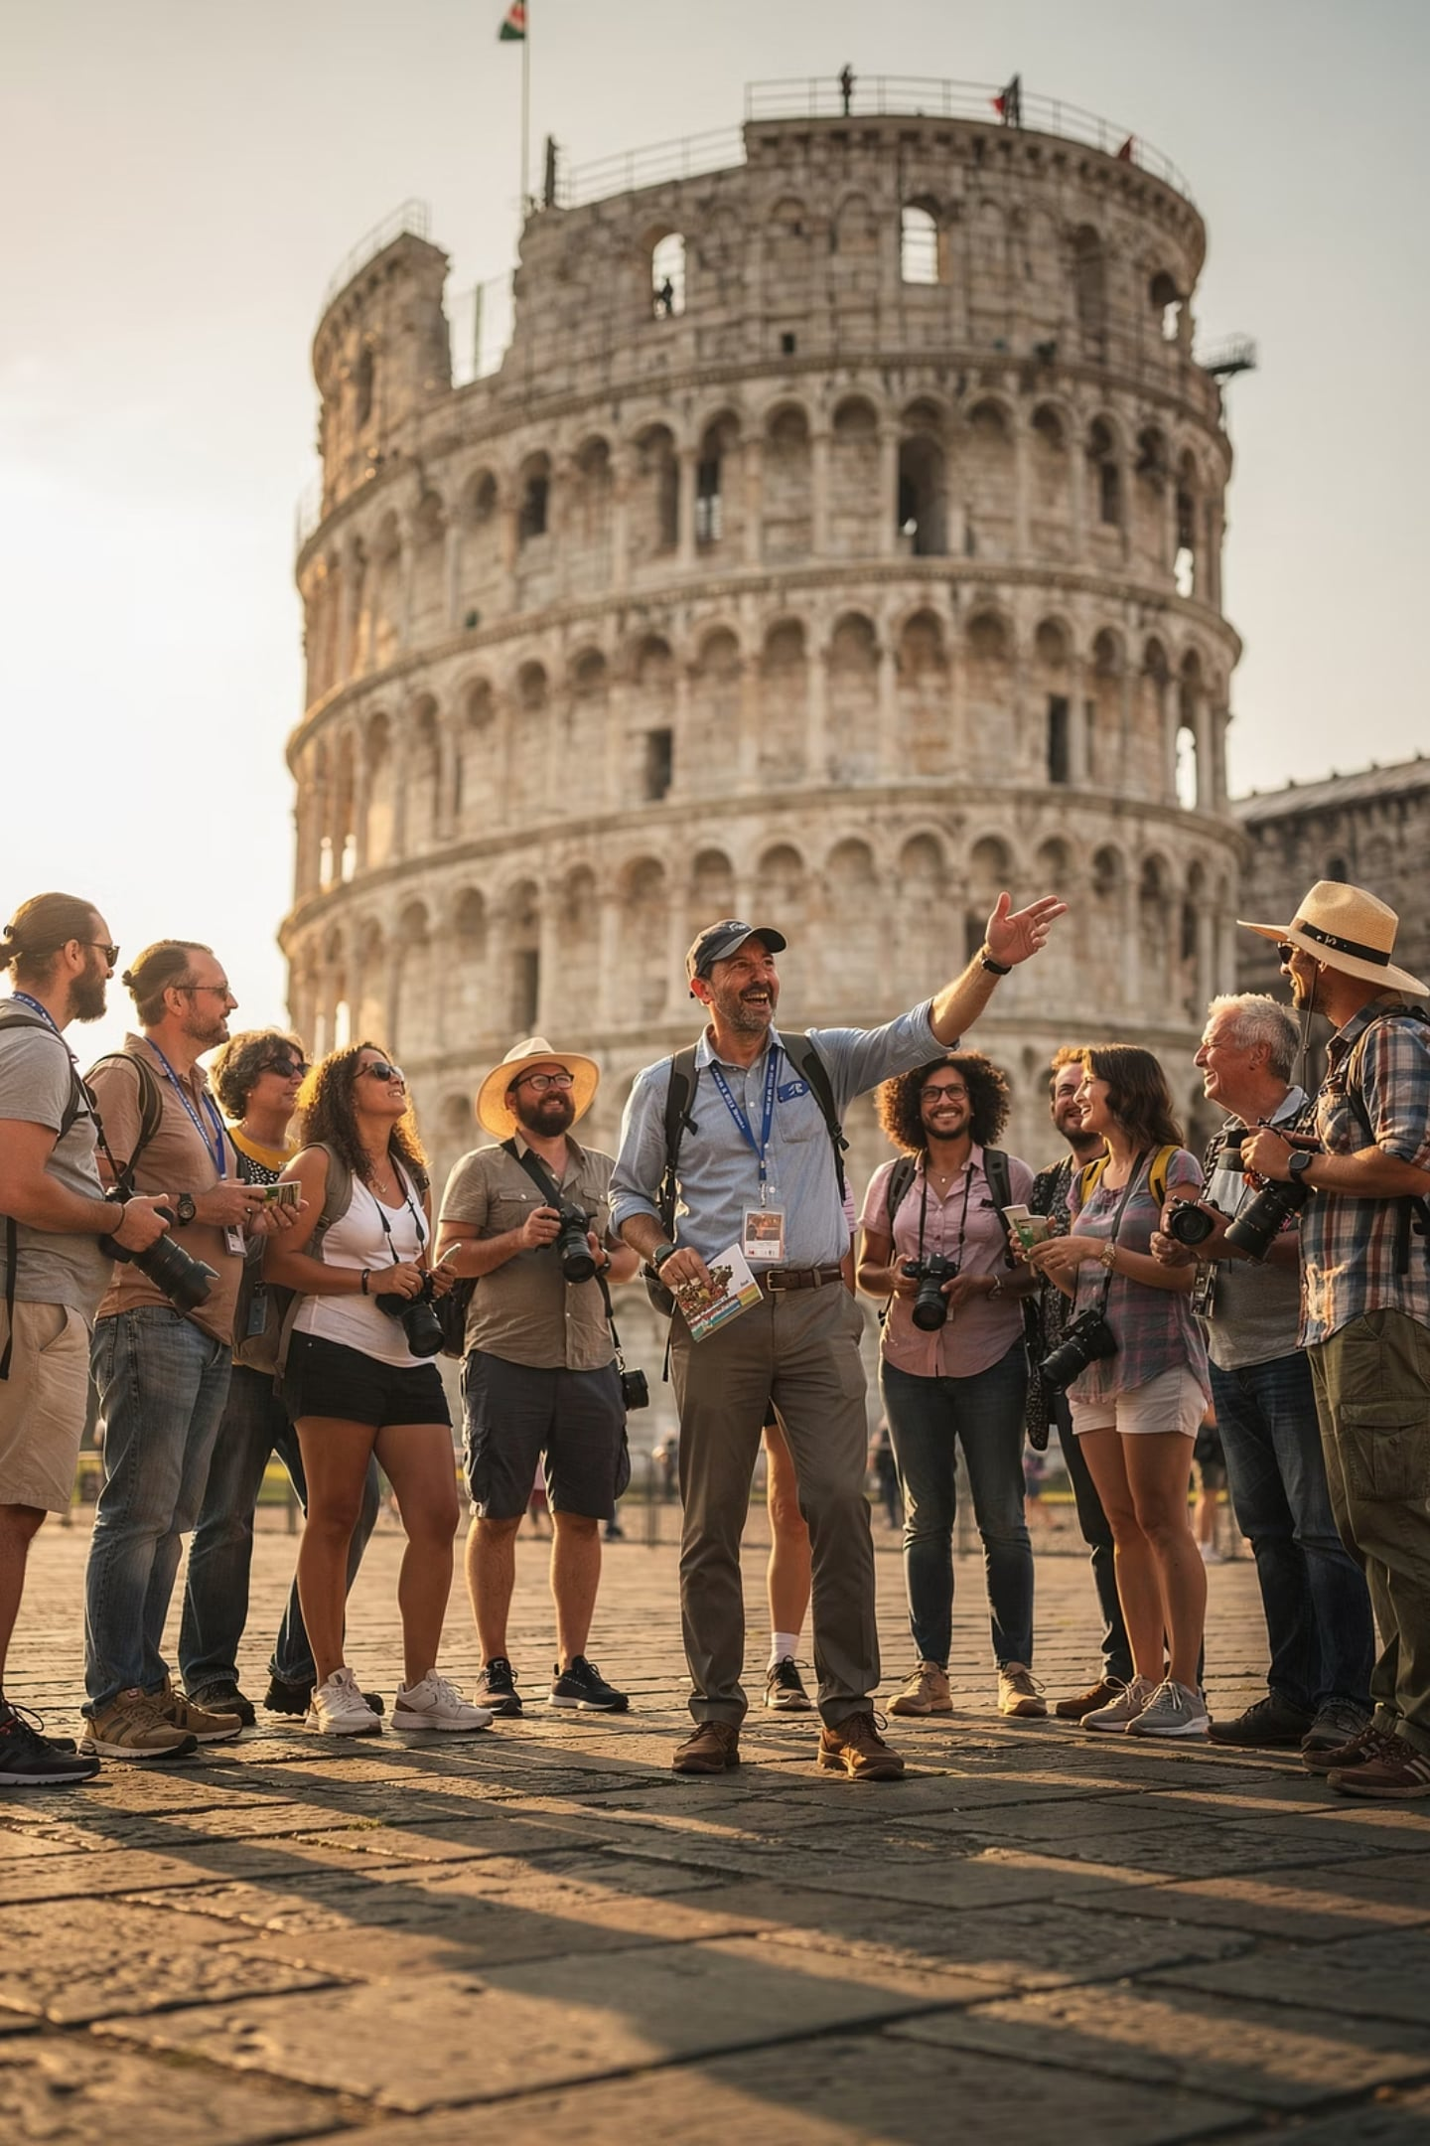

Why During-Travel Communication Matters
Key Idea: Good communication helps tourists feel informed, safe, and engaged throughout their journey.
Understand Schedules
Know where to be and when
Follow Instructions
Smooth, coordinated movement
Appreciate Destinations
Deeper understanding through context
Travel Safely
Awareness prevents accidents

Slide 23


Stage 6: Post-Travel Communication
Key Idea: The trip is over — but communication continues to gather feedback and improve future services.
Organizations Reach Out Via:
Why It Matters
Feedback helps organizations understand what worked and what needs improvement — directly from the traveler's perspective.
Customer satisfaction surveys
Feedback request emails
Online review invitations
Think of it like a restaurant asking "How was your meal?" — except for an entire trip.

Slide 24
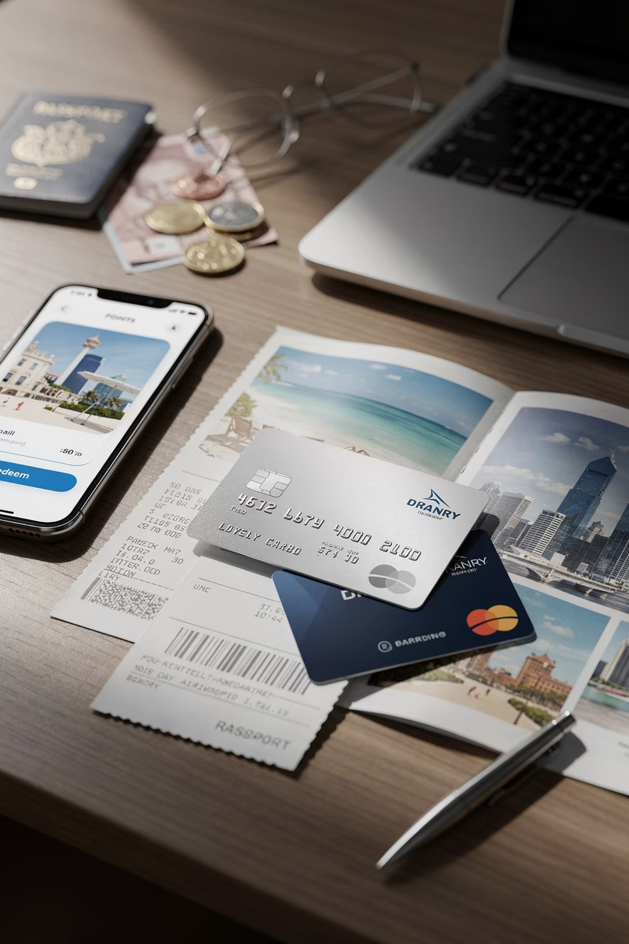

Post-Travel: Building Lasting Relationships
Key Idea: Post-travel communication turns one-time tourists into loyal, repeat customers.
Loyalty Programs
Reward returning customers with points, discounts, and exclusive offers
Future Travel Promotions
Personalized offers based on past travel preferences
Customer Retention
Staying connected after the trip keeps your brand top of mind

Slide 25

Travel Consultation Communication
Key Idea: A travel consultant is like a personal guide — helping customers find the perfect trip for their needs and budget.
The Consultant's Role
What They Do
Advisor. Problem-solver. Match-maker between traveler and destination.
Identify customer needs and preferences
Present suitable travel options
Recommend within budget constraints
Guide decisions with expert knowledge

Slide 26
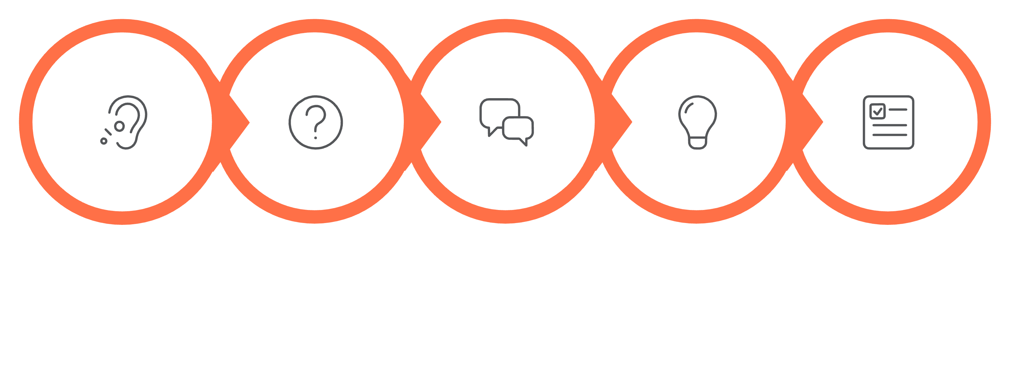
Consultation Communication Skills
Key Idea: Great consultants listen first, then advise — understanding the customer before proposing any solution.
Listen
Question
Explain
Advise
Recommend
Successful travel consultation is less about selling and more about understanding. Each step builds trust and leads to better-matched recommendations.

Slide 27






Understanding Customer Needs
Key Idea: Every traveler is different — consultants must recognize different motivations to give the right advice.
Leisure
Business
Relaxation and recreation
Meetings and conferences
Educational
Adventure
Learning and discovery
Thrills and challenges
Cultural
Religious
Heritage and local life
Pilgrimage and spiritual travel

Slide 28

Active Listening in Travel Consultation
Key Idea: Listening well is the most powerful tool a consultant has — it builds trust and surfaces what the customer truly needs.
1
Listen Attentively
Full focus on the customer — no distractions
2
Avoid Interrupting
Let them finish before responding
3
Clarify & Confirm
Restate what you heard to ensure accuracy

Slide 29

Professional Questioning Techniques
Key Idea: The right questions unlock the right recommendations — ask before you advise.
"What destinations interest you?"
Opens up the traveler's dream destinations
"What is your budget range?"
Sets realistic boundaries for options
"What accommodations do you prefer?"
Matches comfort level and style
"Any special requirements?"
Catches dietary, mobility, or personal needs

Slide 30

Making Professional Recommendations
Key Idea: A good recommendation puts the customer's needs first — not the consultant's personal preference or commission.
Accurate
Relevant
Based on verified information
Matched to customer needs
Honest
Customer-Focused
Transparent about limitations
Always about their satisfaction

Slide 31

Communication in Tour Operations Management
Key Idea: Tour operators are like orchestra conductors — they coordinate many moving parts to create one seamless travel experience.
Who Tour Operators Communicate With:
The Challenge
Every service must be coordinated precisely. A breakdown in communication anywhere in the chain can disrupt the entire customer experience.
Hotels and accommodations
Transport providers
Attraction managers
Tour guides and staff
Customers and travel agents

Slide 32
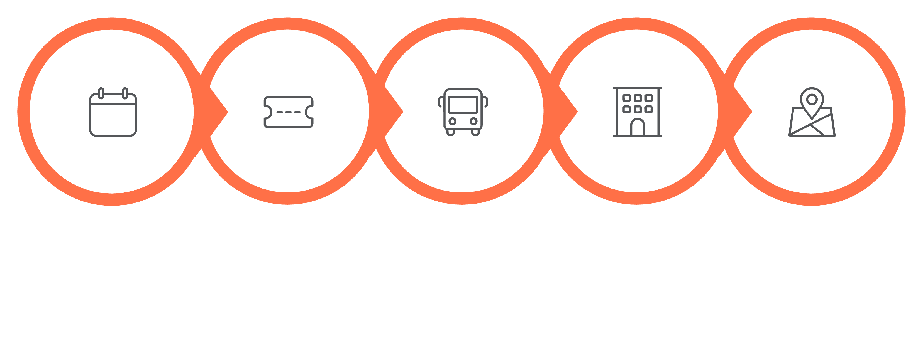
Tour Operations Communication Flow
Key Idea: Every component of a tour — from booking to transportation to activities — depends on clear, accurate communication between teams.
Scheduling
Reservations
Transportation
Accommodation
Activities
When each link in this chain communicates effectively, the result is a smooth, enjoyable experience for the traveler.

Slide 33
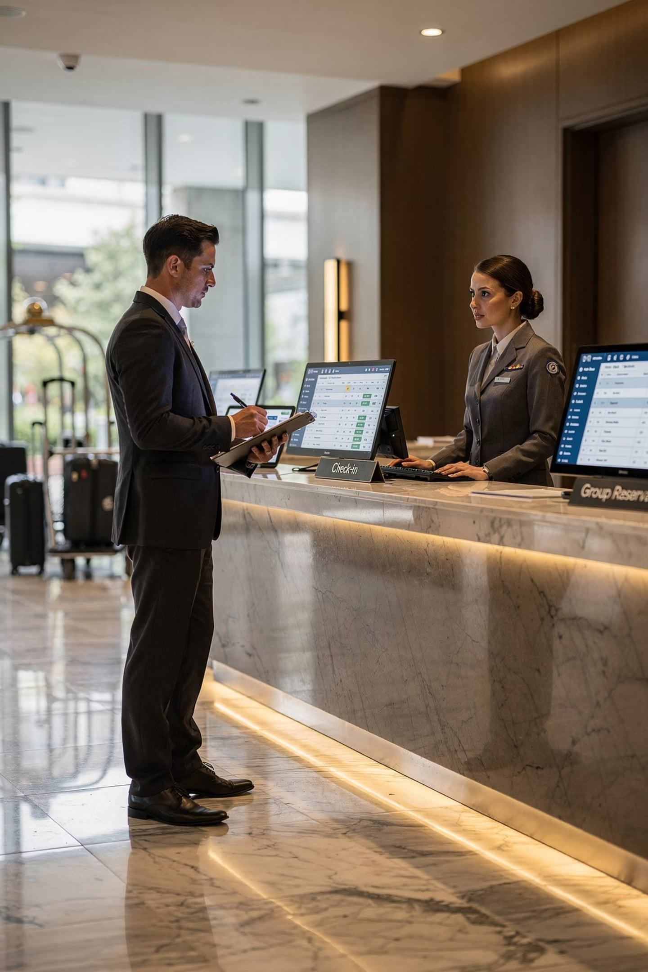





Supplier Communication: Hotels
Key Idea: Tour operators and hotels must communicate clearly and early — especially for group travel where details matter most.
Room Allocations
How many rooms, what type, and when
Group Bookings
Block reservations for entire tour groups
Check-In Schedules
Arrival times and coordination needs
Special Requests
Dietary needs, accessibility, preferences

Slide 34
Communication with Transport & Attractions
Key Idea: Smooth coordination with buses, trains, and attractions keeps the tour on schedule and tourists happy.
🚌 Transportation Providers
🏛️ Attractions & Sites
Pick-up schedules and timing
Accurate passenger lists
Route adjustments and changes
Entry times and booking slots
Capacity limits and group sizes
Special group arrangements
Accurate communication with all providers is the backbone of operational efficiency.

Slide 35
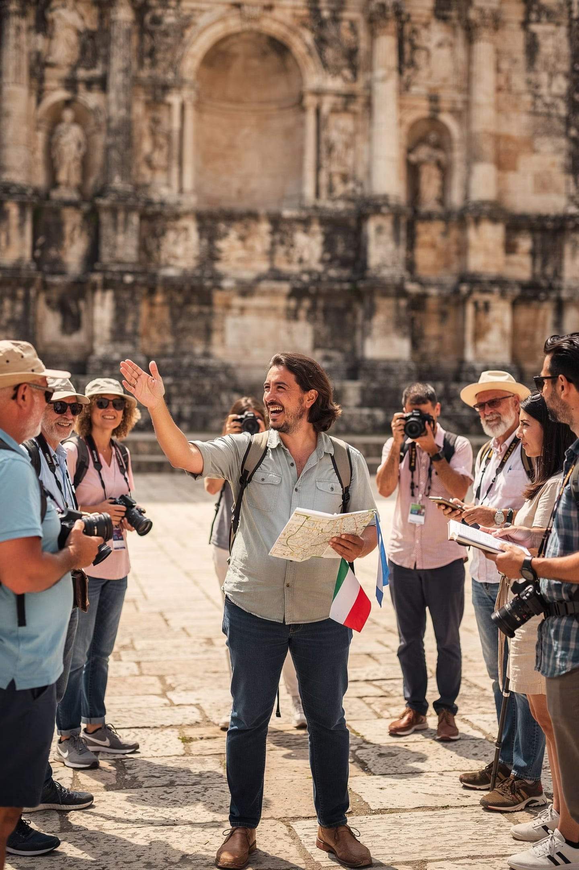
Tour Guiding Communication
Key Idea: Tour guides are the face of tourism — their words shape how visitors feel about an entire destination.
1
2
Visitor Satisfaction
Destination Image
Directly influenced by the guide's communication
Shaped by how the guide presents a place
3
Overall Experience
Elevated or diminished by quality of interaction

Slide 36










The 5 Communication Roles of Tour Guides
Key Idea: A tour guide wears many hats — they teach, translate culture, manage groups, lead, and solve problems all at once.
Interpreter
Educator
Facilitator
Problem Solver
Leader

Slide 37
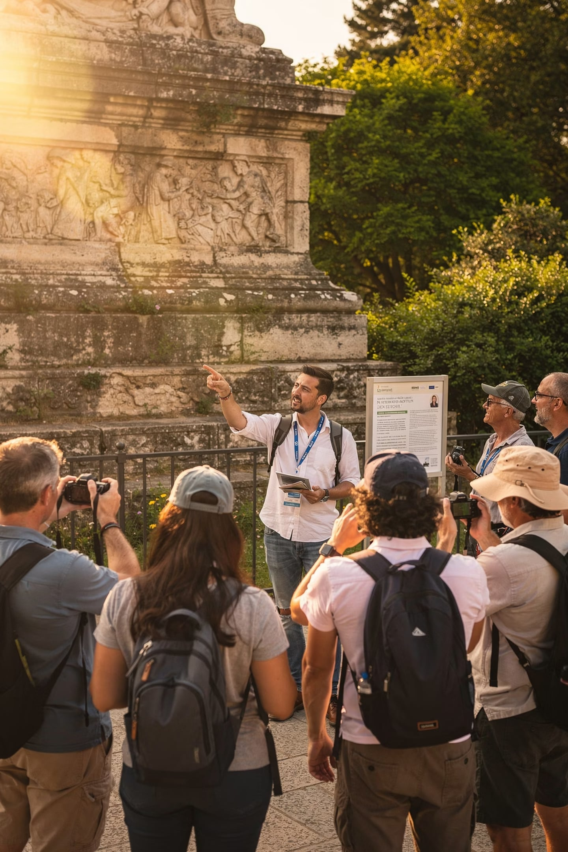
Verbal & Interpretive Communication
Key Idea: How a guide speaks — and what they explain — turns sightseeing into a meaningful, memorable learning experience.
Effective Verbal Communication
Interpretive Communication Covers
Clear speech and pronunciation
Appropriate volume for the setting
Pacing suited to the audience
Language adapted to listeners
Historical importance of sites
Cultural relevance and meaning
Environmental significance
Local community connections

Slide 38
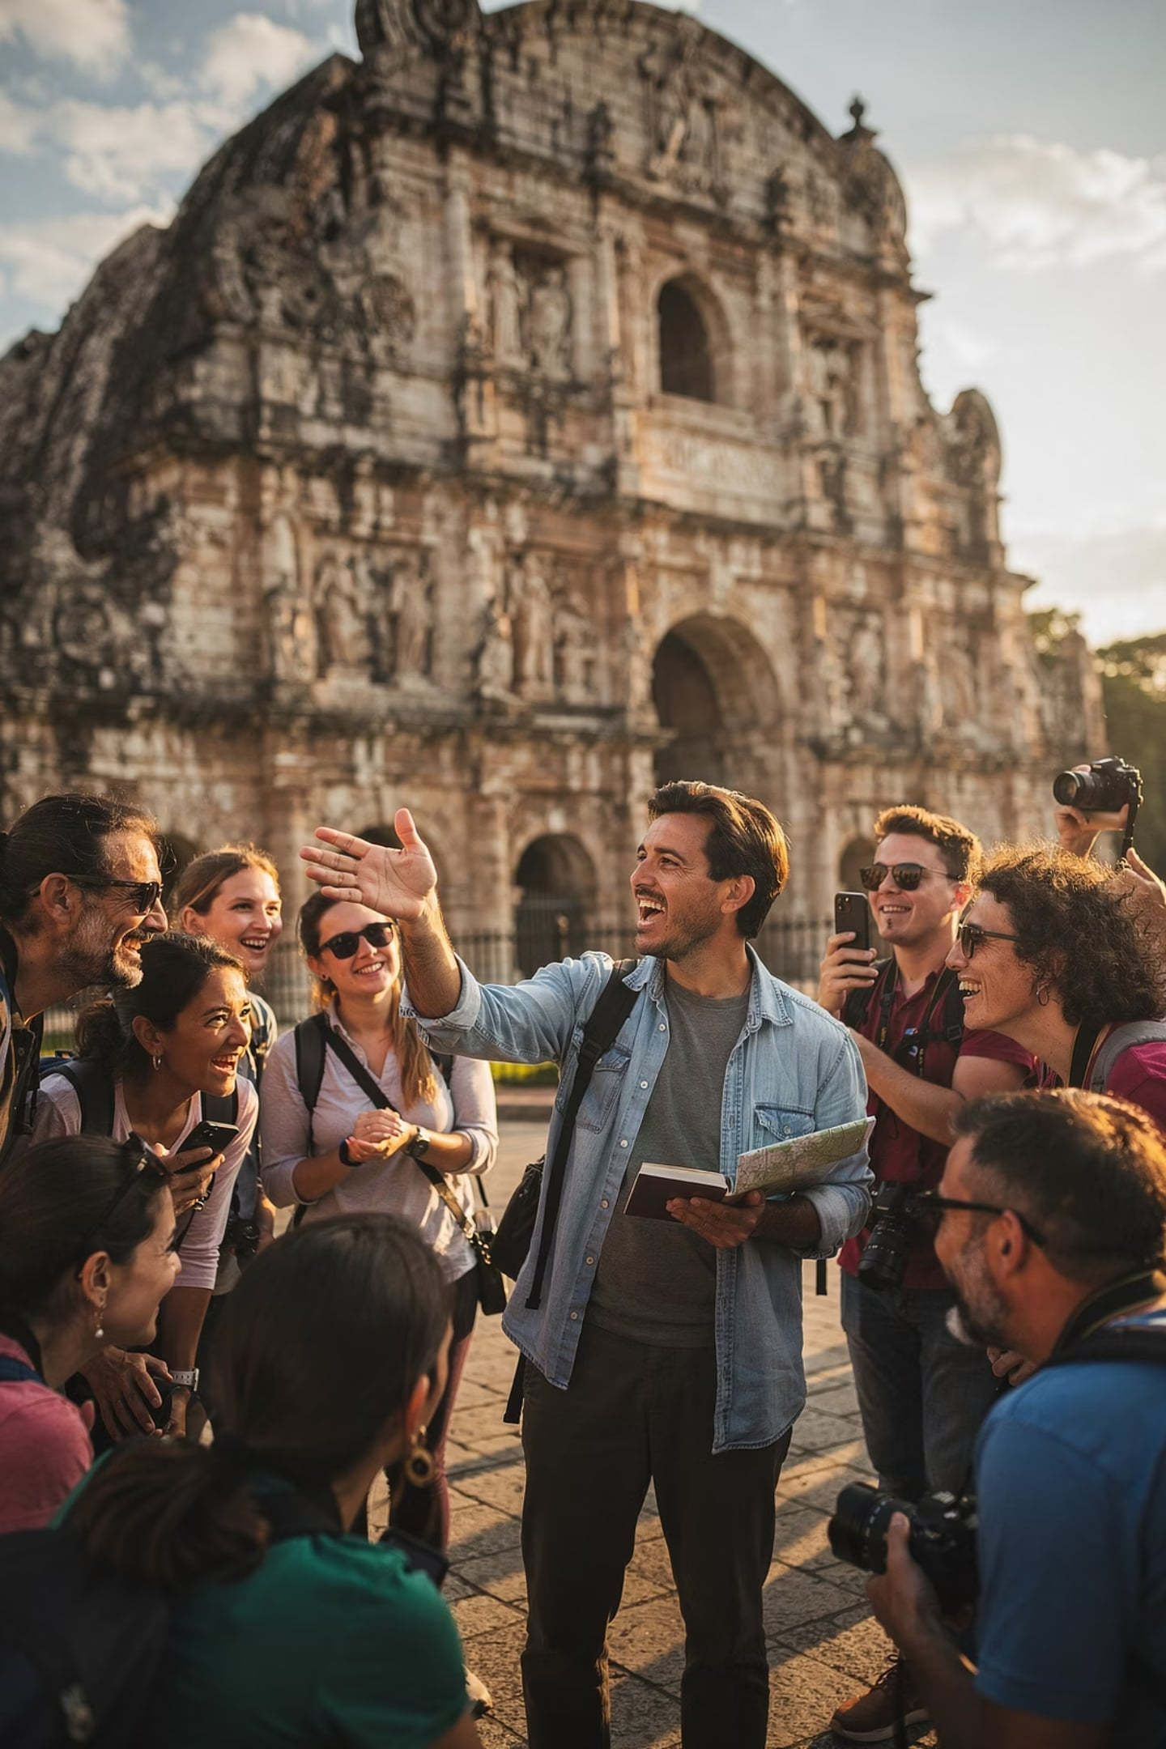
Storytelling & Group Communication
Key Idea: Stories make information stick — and managing a group well keeps the experience enjoyable for everyone.
Why Storytelling Works
Group Communication Skills
Tourists remember stories, not facts
Creates emotional connection to place
Local legends bring destinations to life
Human experiences feel relatable
Capture and hold attention
Give clear, simple instructions
Manage time and pacing
Keep everyone engaged

Slide 39
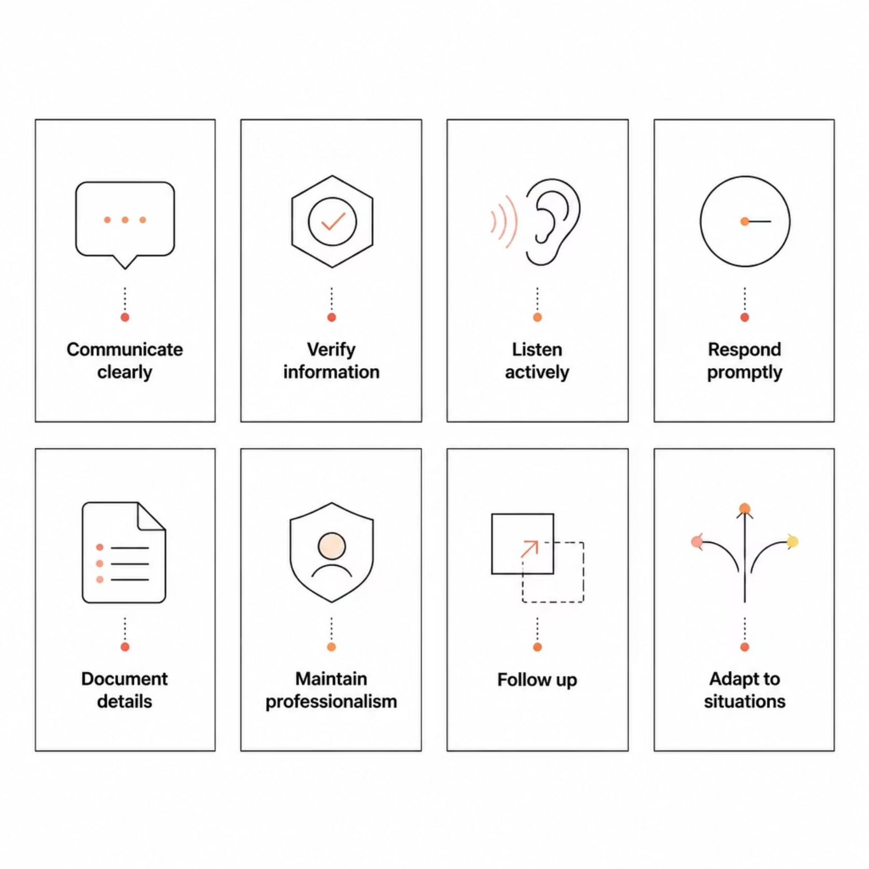
Itineraries, Technology & Best Practices
Key Idea: A well-structured itinerary and smart use of technology — combined with professional habits — are the keys to effective travel operations communication.
📋 Effective Itineraries Include:
Accuracy and completeness
Clear organization and flexibility
Schedules, transport, and accommodation details
💻 Key Communication Technologies:
Online booking and CRM systems
Mobile apps and messaging platforms
Social media channels

Slide 40










Summary: Communication Is the Foundation of Tourism
Key Idea: Every part of travel — from consultation to tour guiding to supplier coordination — depends on clear, professional communication.
Customer Satisfaction
Consultation
Service Quality
Tourism Success
Operational Efficiency
Communication is not just a support function — it is a strategic resource that drives every aspect of travel and tour operations.

