Slide 1
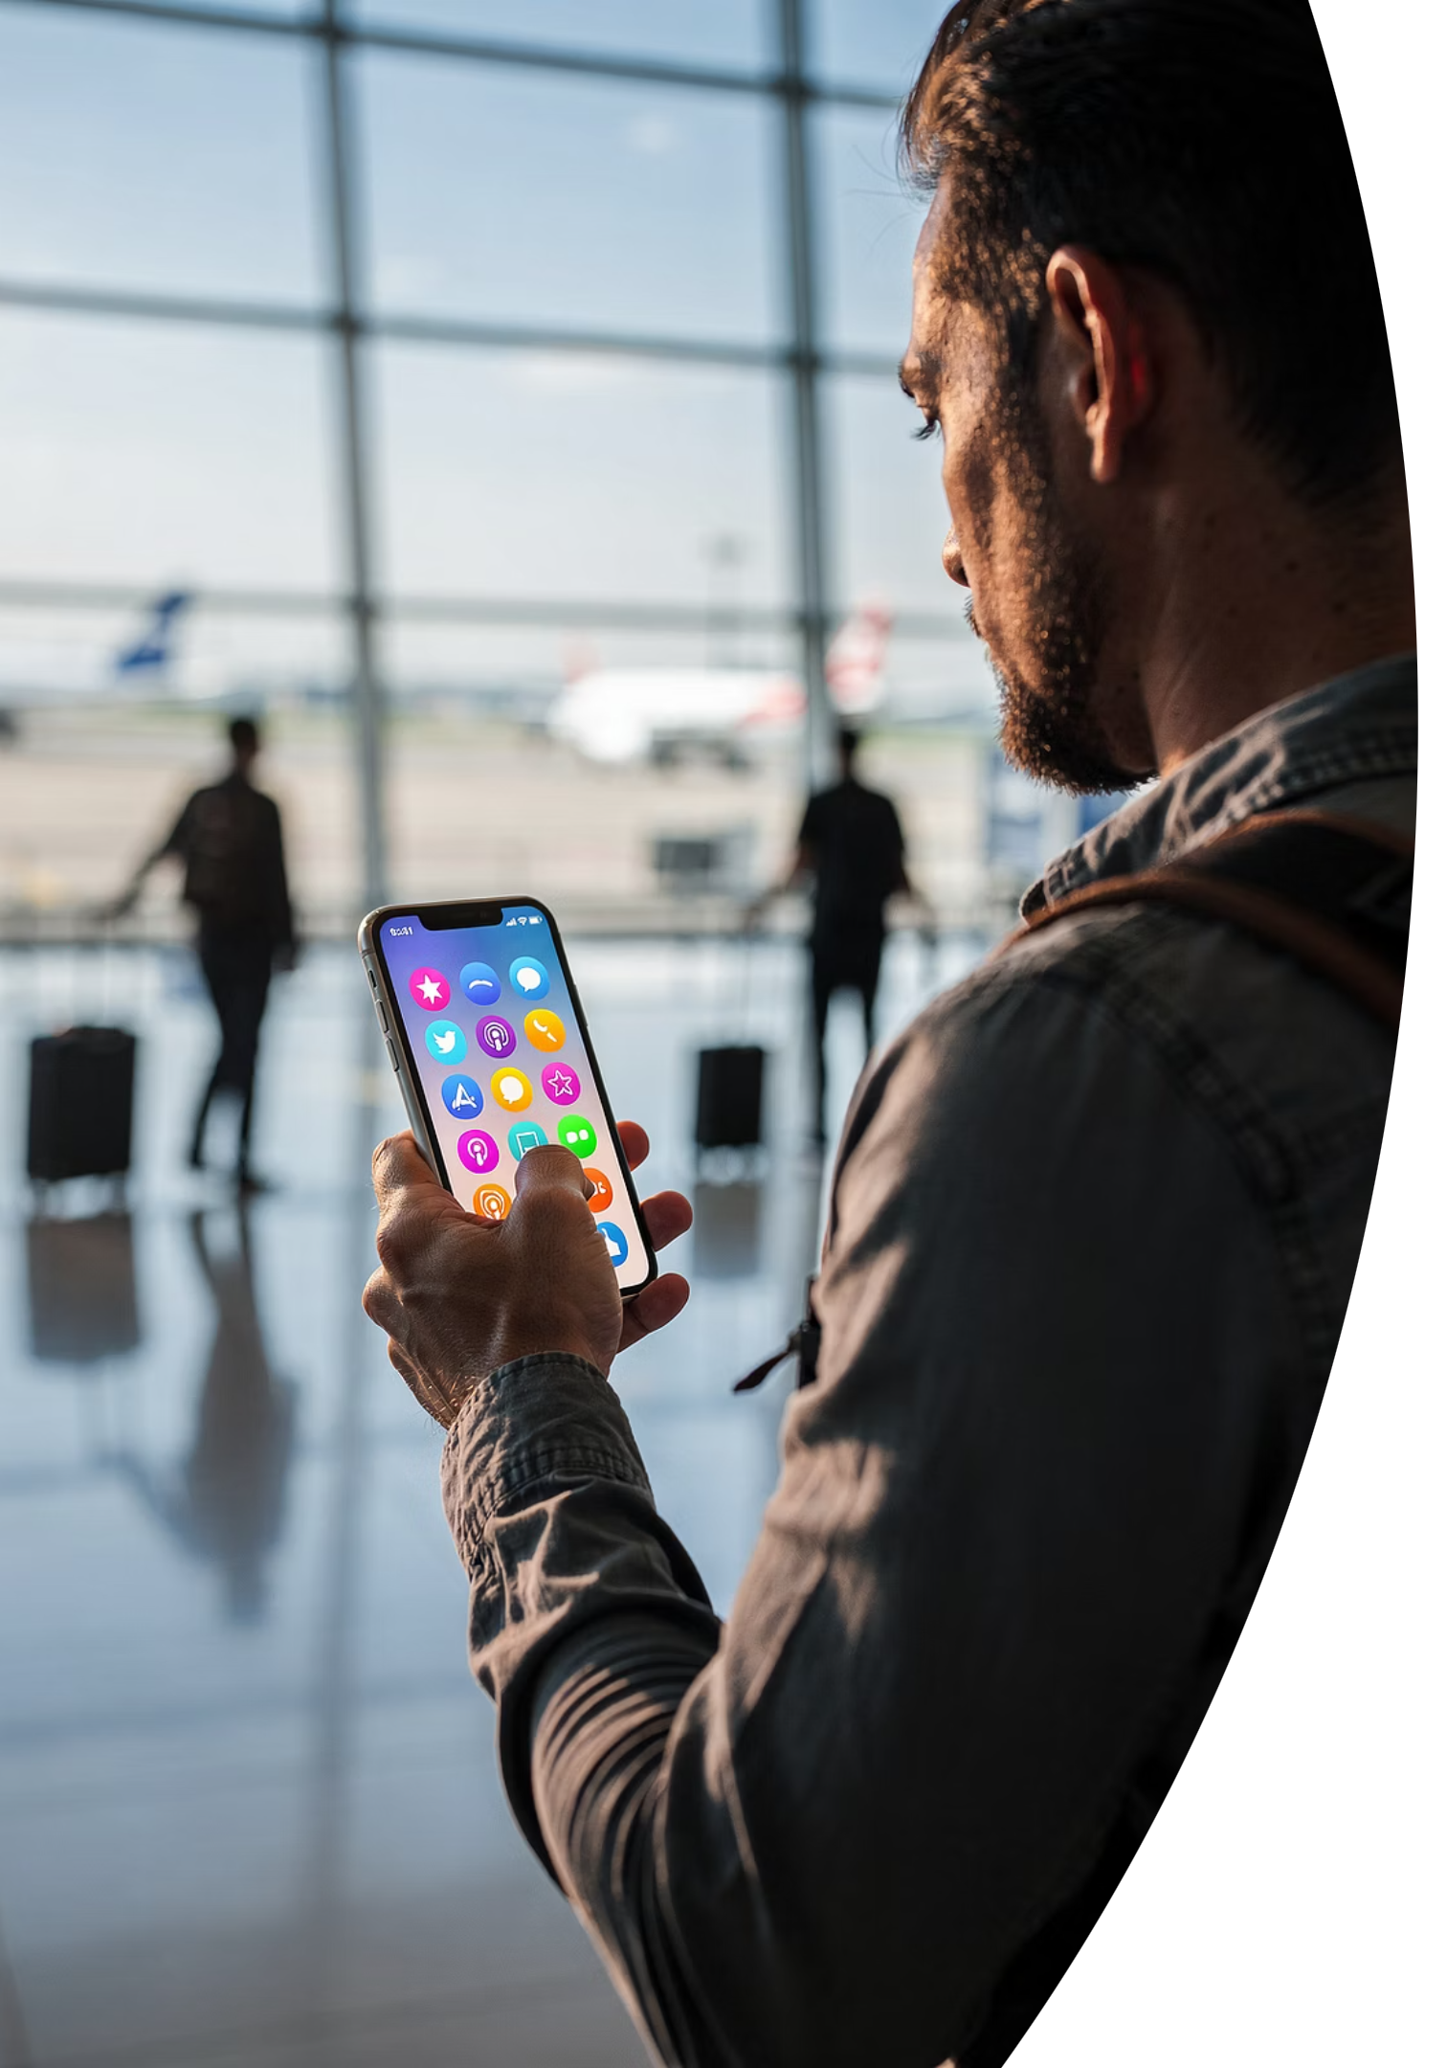
Module 11: Introduction
Digital Communication and Social Media in Tourism
Course: Hospitality and Tourism Business Communication
PROF. ALIA AMOR D. UY, MBA

Slide 2
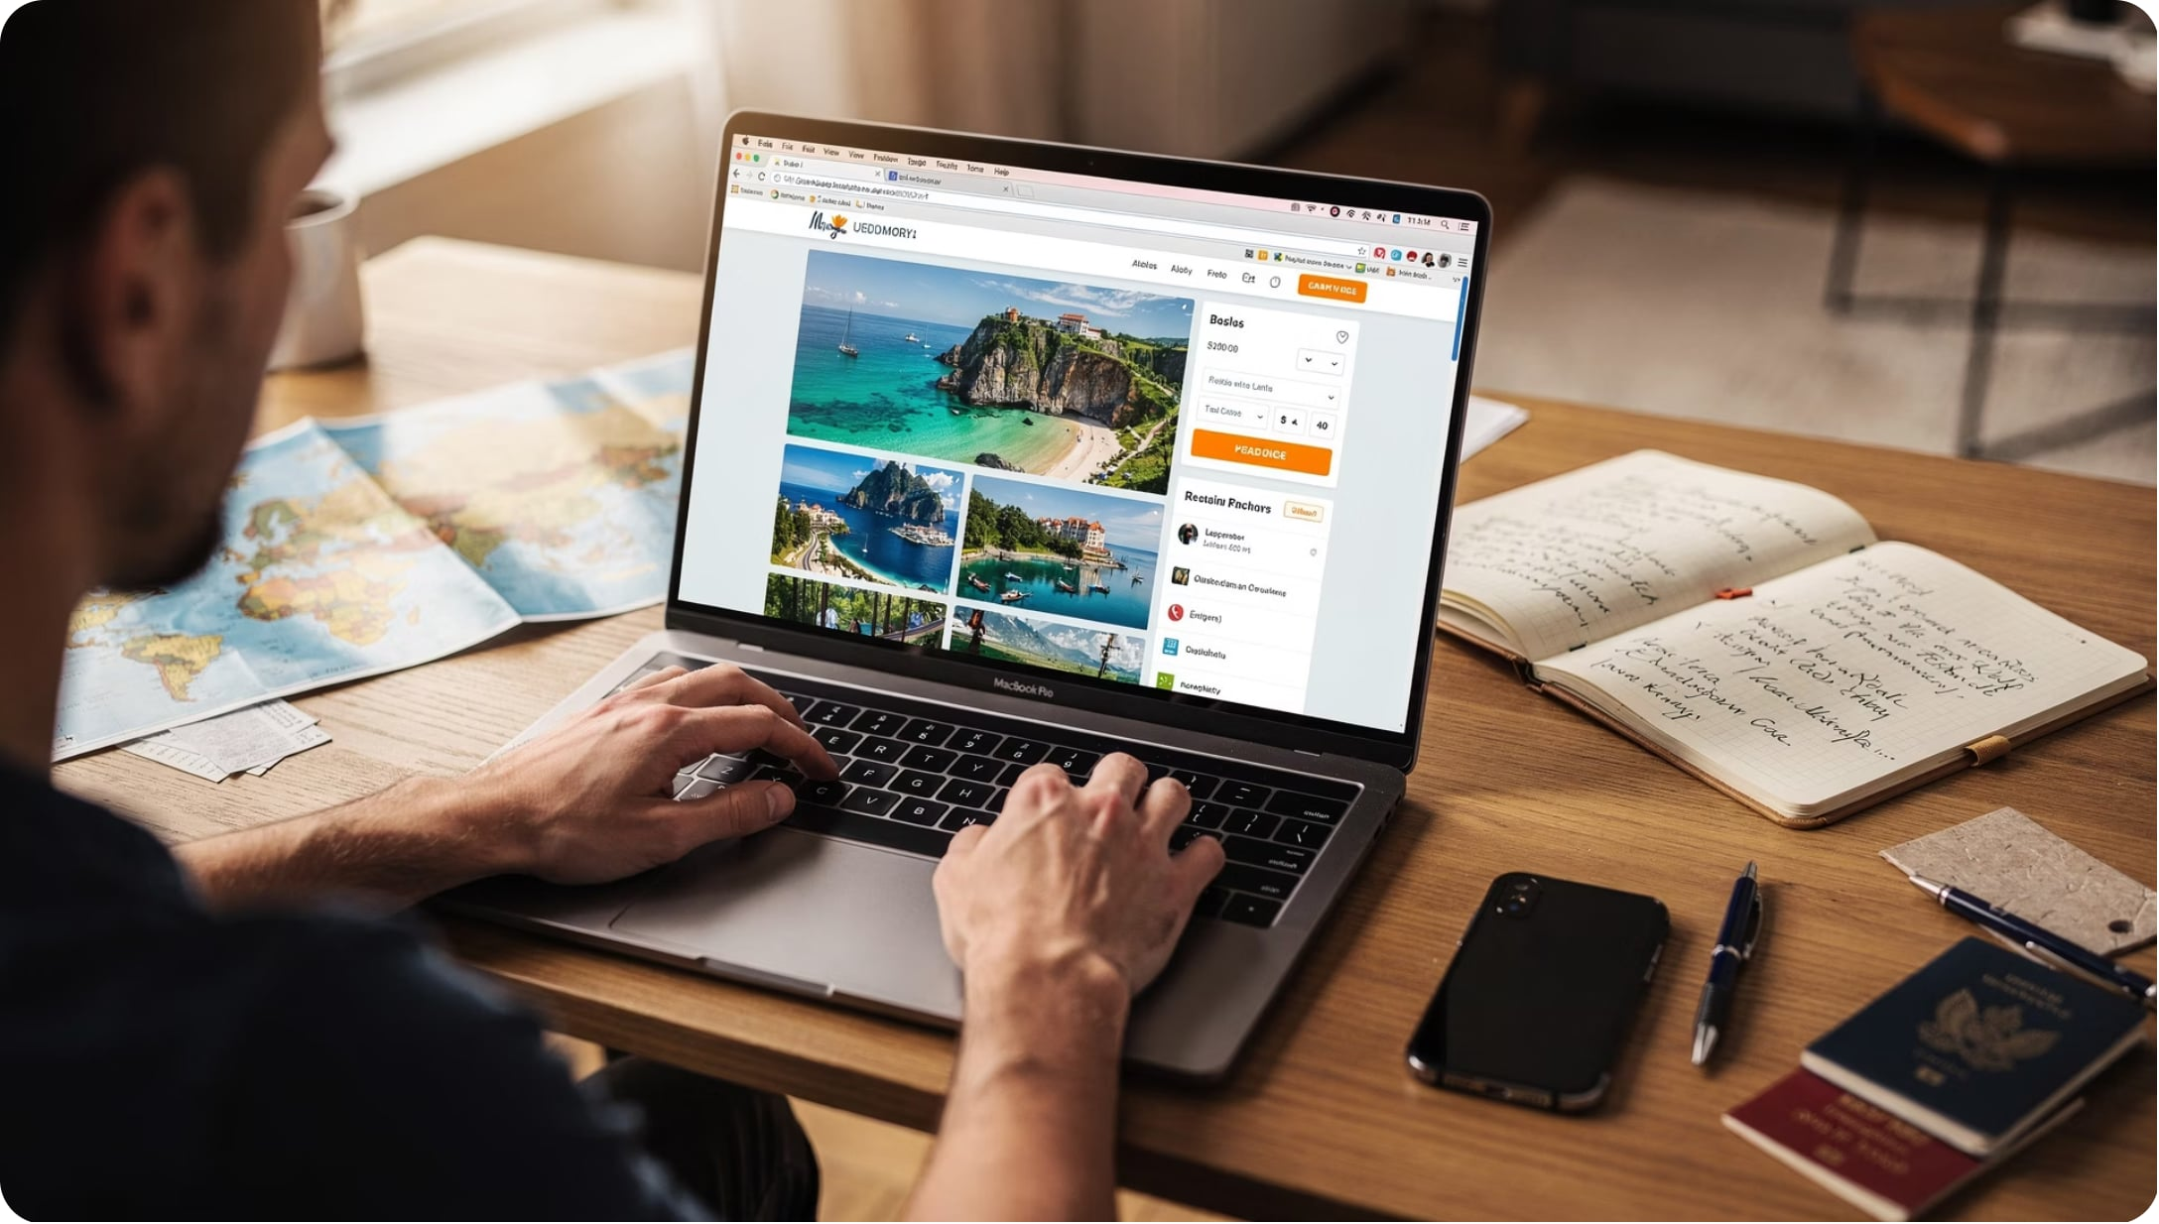

KEY IDEA
Tourism Has Gone Digital
Core Message
Travelers no longer rely on travel agents alone — they search, book, and share everything online.
Think of the last trip you planned. Did you Google it first? That's digital communication.

Slide 3
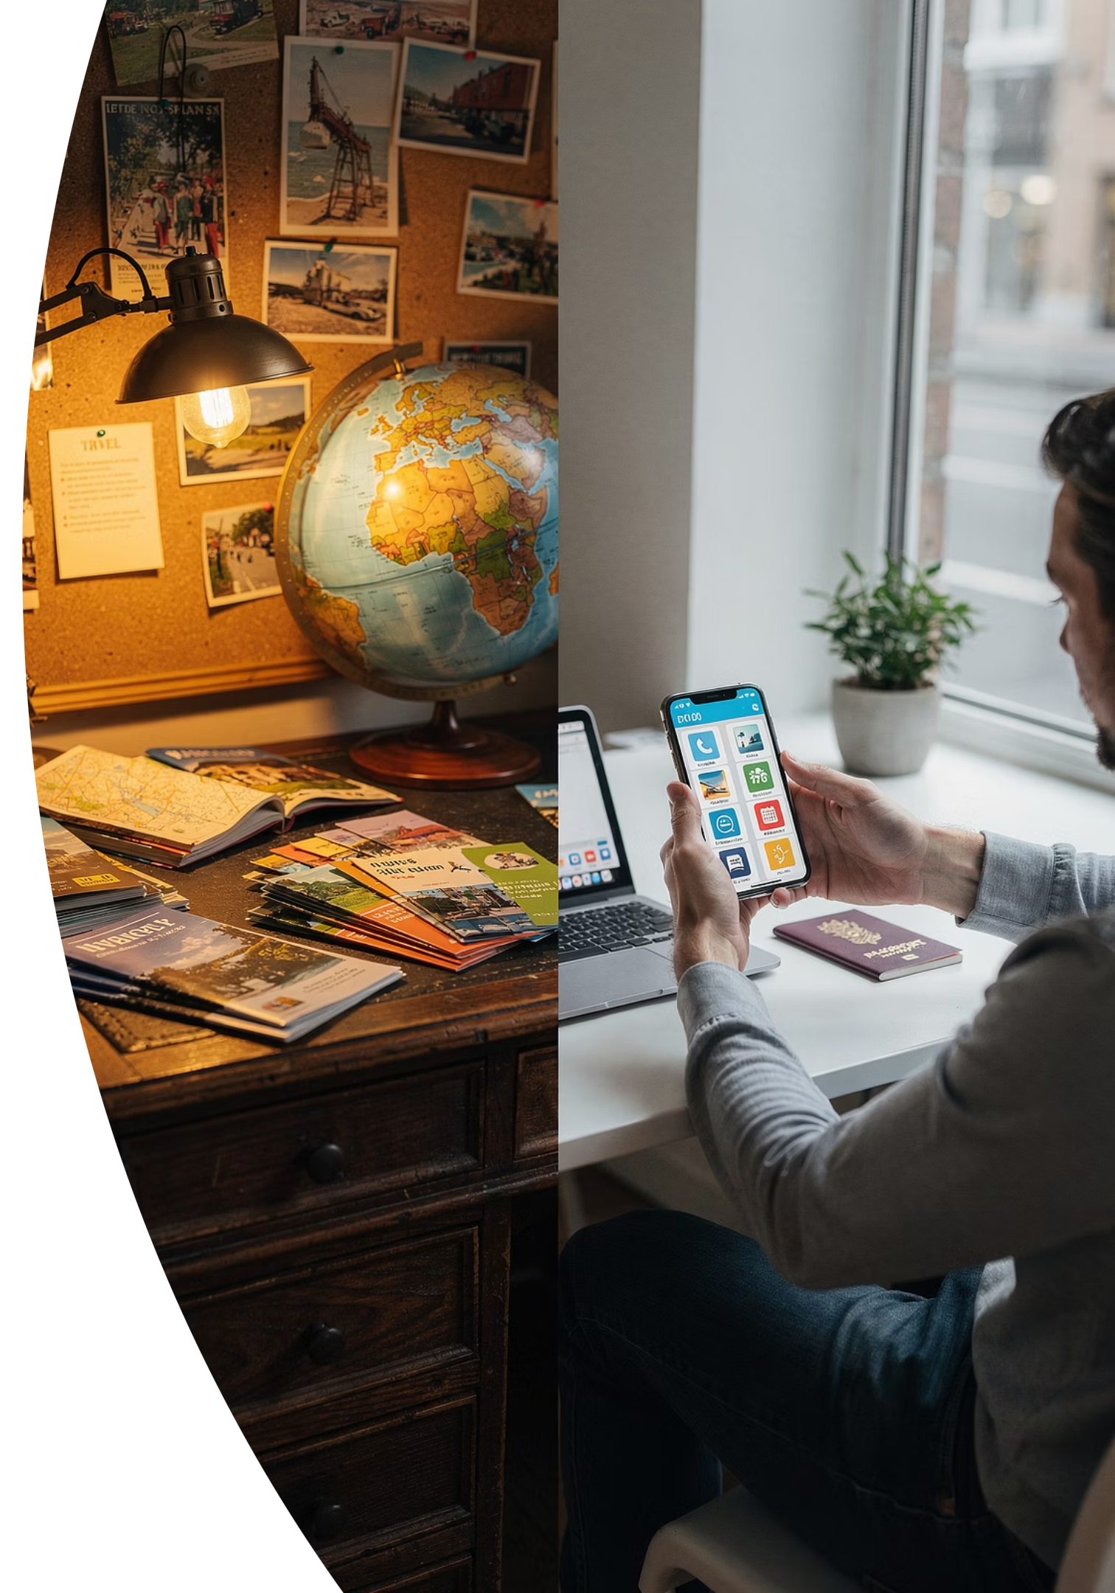
EVOLUTION
Then vs. Now
📰 Before
📱 Today
Travel agencies
Brochures & newspapers
TV ads
Word of mouth
Websites & social media
Online travel agencies
Mobile apps
Blogs & review sites
The shift happened fast — and it changed everything about how we discover and plan travel.

Slide 4
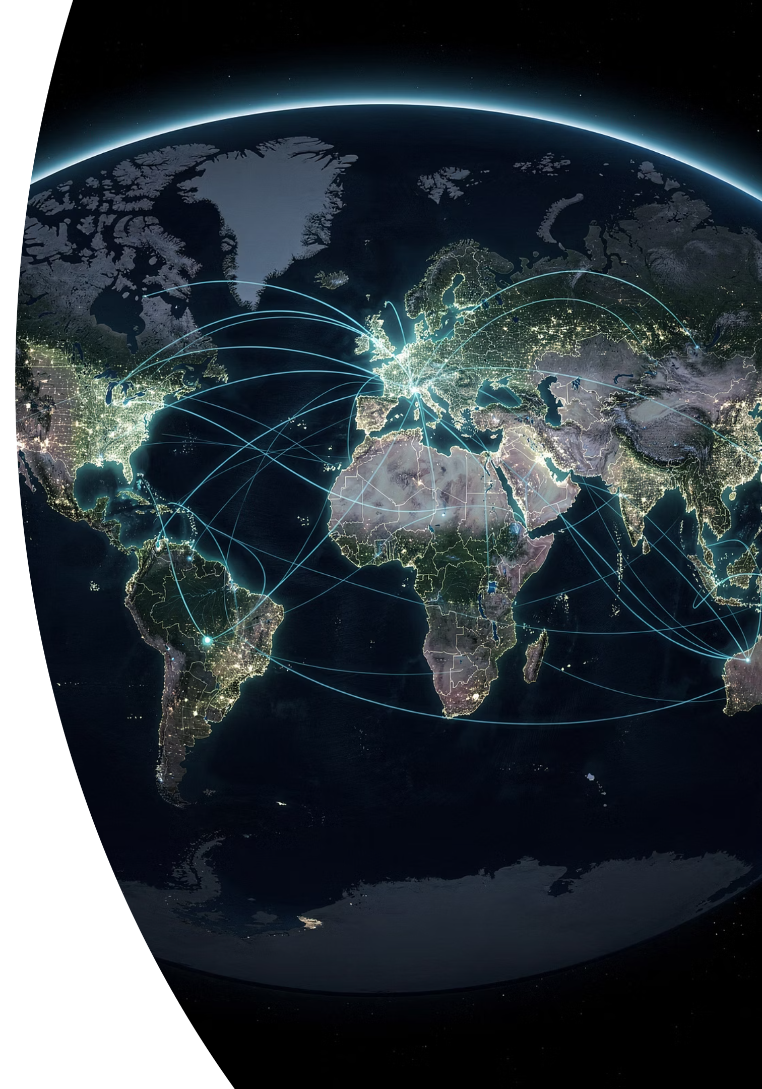
What Is Digital Communication?
Exchanging information through electronic and internet-based technologies — quickly, efficiently, and globally.
FAST
EFFICIENT
GLOBAL

Slide 5




WHO USES IT?
Tourism Organizations Are All Connected
Hotels & Resorts
Airlines
Bookings, updates, guest messaging
Schedules, check-in, promotions
Tour Operators
Attractions & DMOs
Packages, itineraries, bookings
Destination promotion, visitor info

Slide 6

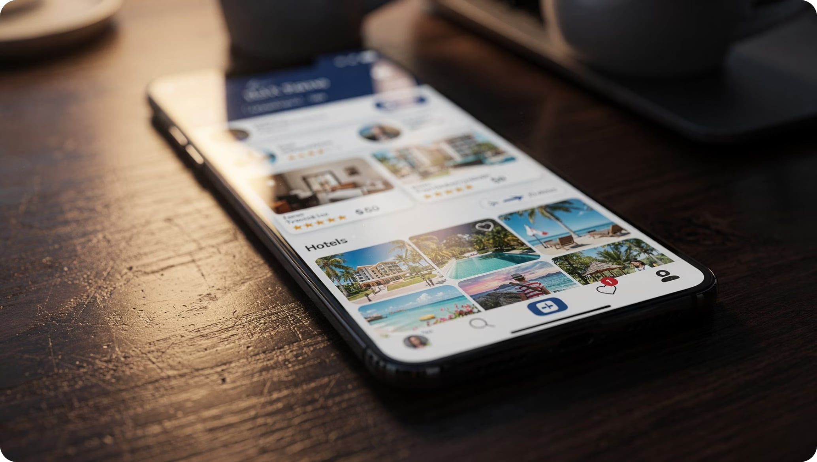
DIGITAL TRANSFORMATION
What Travelers Can Do Now
Search destinations online
Compare prices instantly
Read real customer reviews
Book flights & hotels online
Share experiences on social media

Slide 7

OPPORTUNITIES
Digital = Competitive Advantage
🌍 Wider Reach
Connect with global audiences
⚡ Better Service
Faster, smarter customer support
💰 Lower Cost
Market globally at low expense
🤝 Stronger Loyalty
Build lasting customer relationships

Slide 8
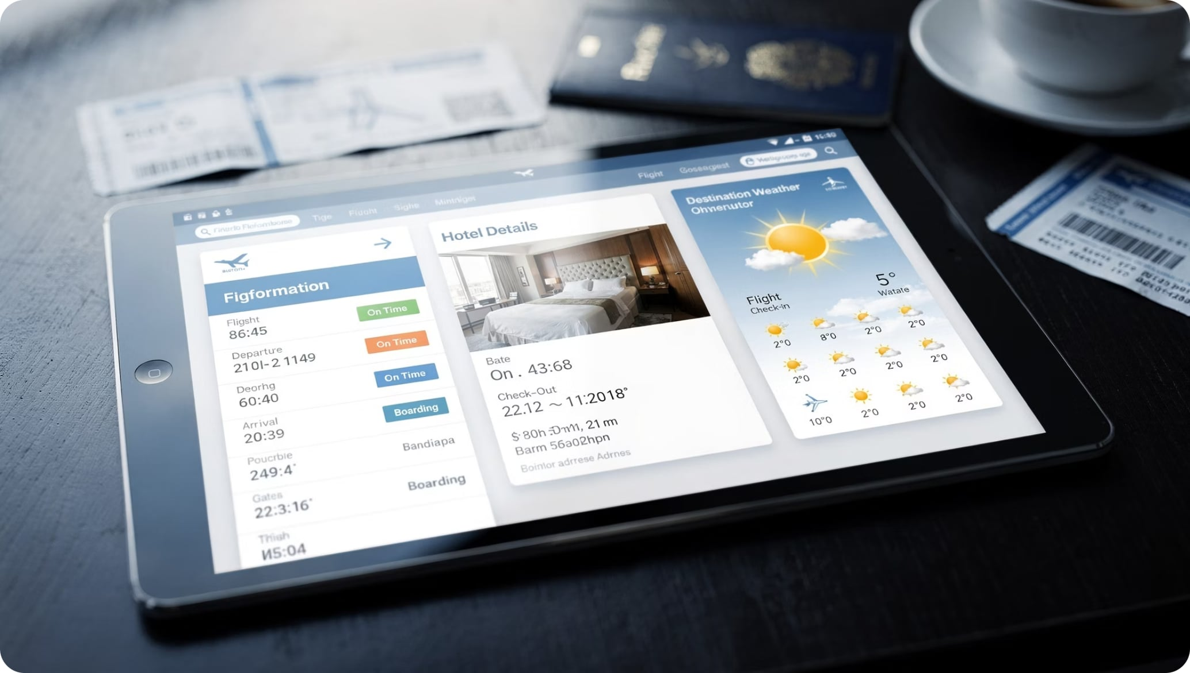

KEY FUNCTION
Providing Information That Matters
What tourists need to know:
Destination guides
Travel requirements
Accommodation details
Transport schedules
Accurate digital information helps tourists make informed decisions — before they even leave home.

Slide 9
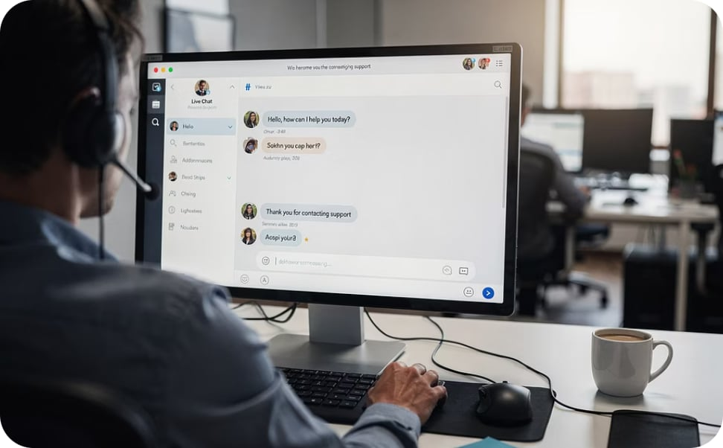
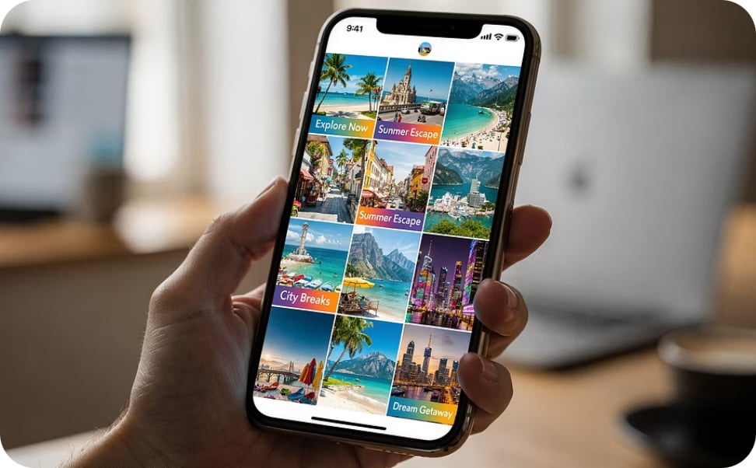
KEY FUNCTIONS
Service + Marketing in One Platform
Customer Service
Marketing & Promotions
Live chat, email, messaging apps, and social media replies — help is always one tap away.
Reach global audiences with destination campaigns, travel packages, and special offers — at low cost.

Slide 10
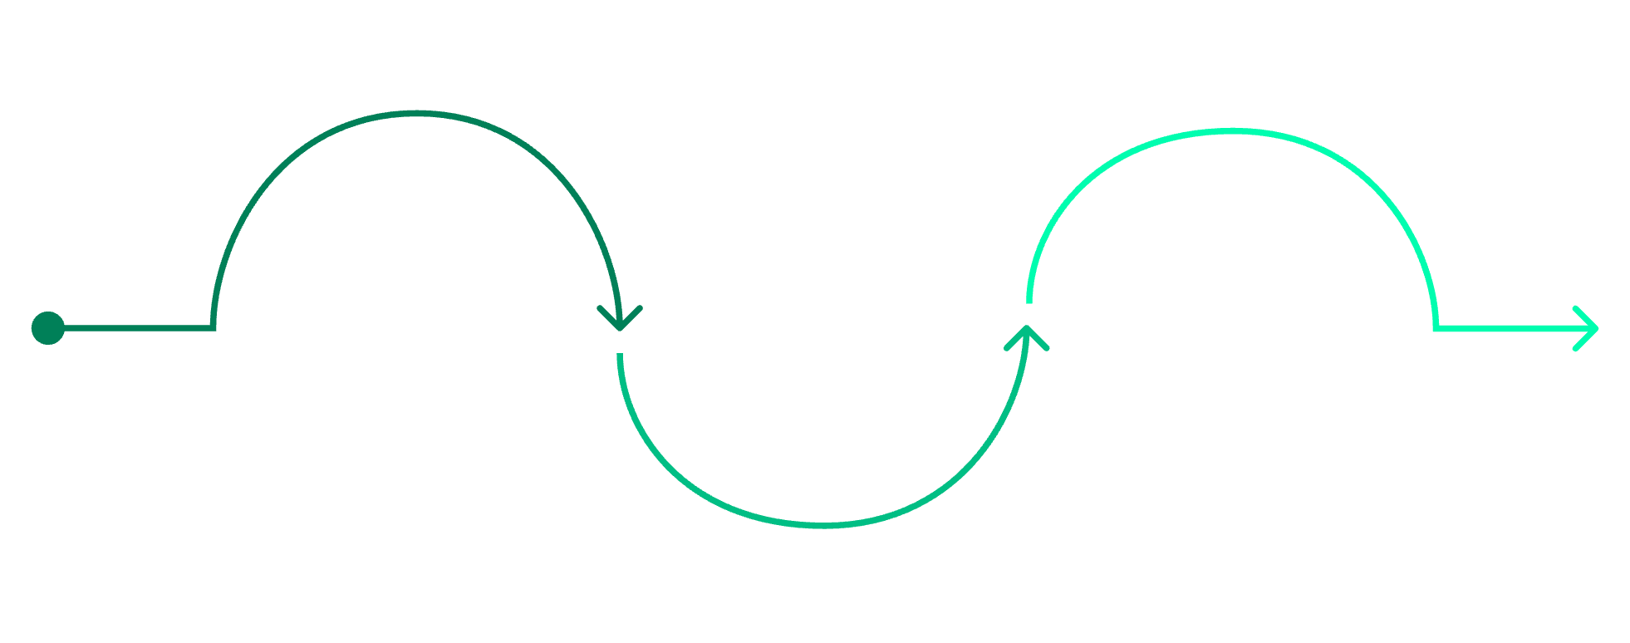

TAKEAWAY
Building Lasting Customer Relationships
Why it matters for you
As future tourism professionals, understanding digital communication shapes:
Customer behavior
Before Travel
After Travel
Organizational reputation
Email newsletters and personalized offers
During Travel
Loyalty programs and review requests
Live updates and social engagement
Service quality
Business performance
Repeat business starts with meaningful digital engagement.

