Slide 1
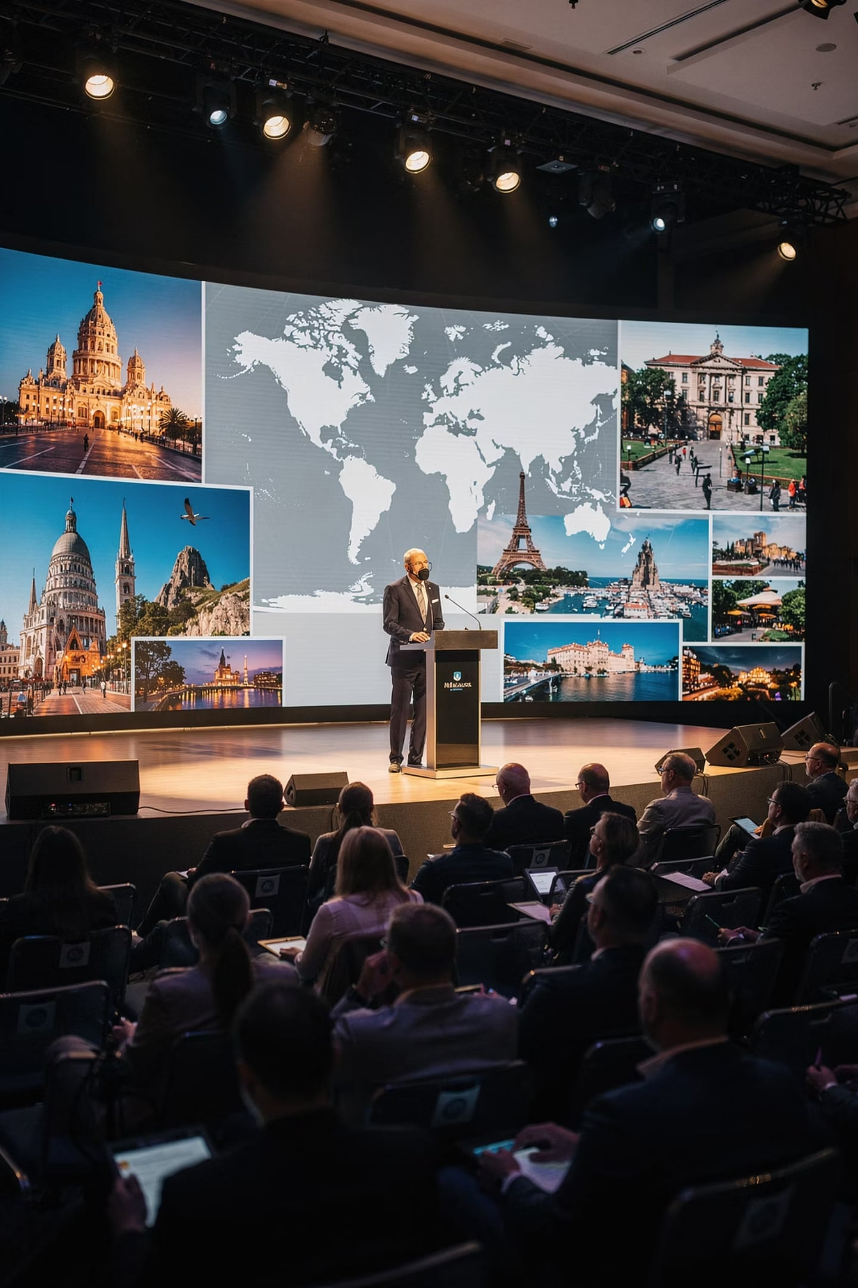
Module 12: Introduction
Professional Presentation and Public Speaking
Course: Hospitality and Tourism Business Communication
Prof. Alia Amor D. Uy, MBA

Slide 2
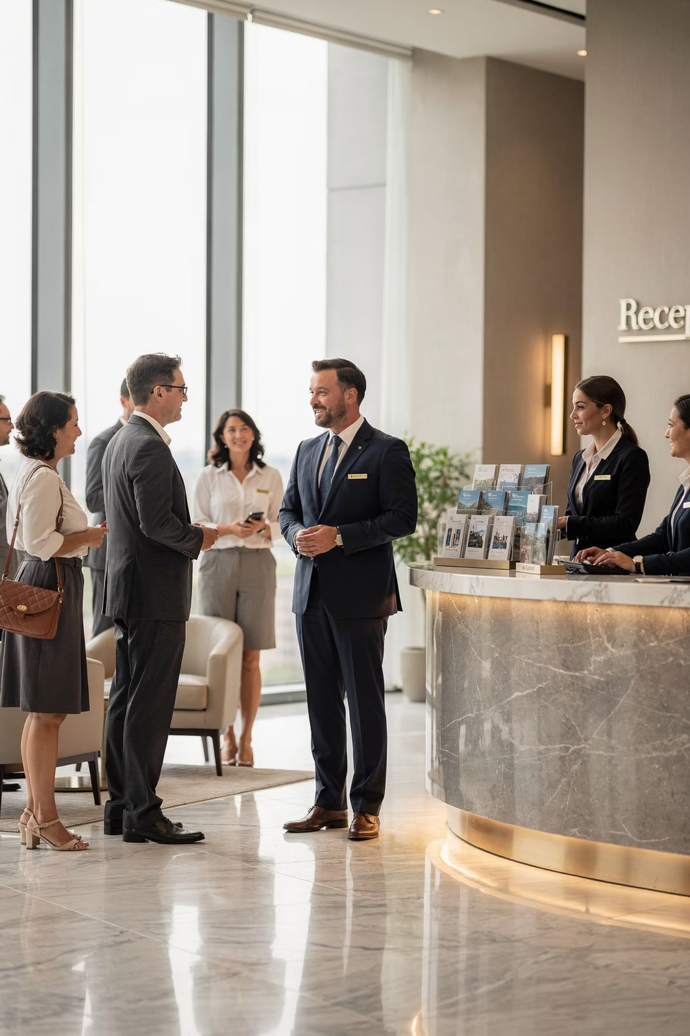


Why Communication Skills Matter
Key Idea: Communication is the most essential skill in hospitality and tourism careers.
Tourism professionals interact daily with a wide range of people:
Guests and Clients
Colleagues and Teams
Investors and Stakeholders
Government and Community
Think of it like this: a tourism professional who can't communicate clearly is like a tour bus without a driver.

Slide 3


More Than Just Conversation
Key Idea: Many professional situations require more than simple one-on-one talks.
As you grow in your career, you'll need to speak in front of groups — not just one person at a time.
Formal Presentations
Public Speaking Engagements
Structured, prepared delivery to an audience
Speaking at events, meetings, and briefings

Slide 4
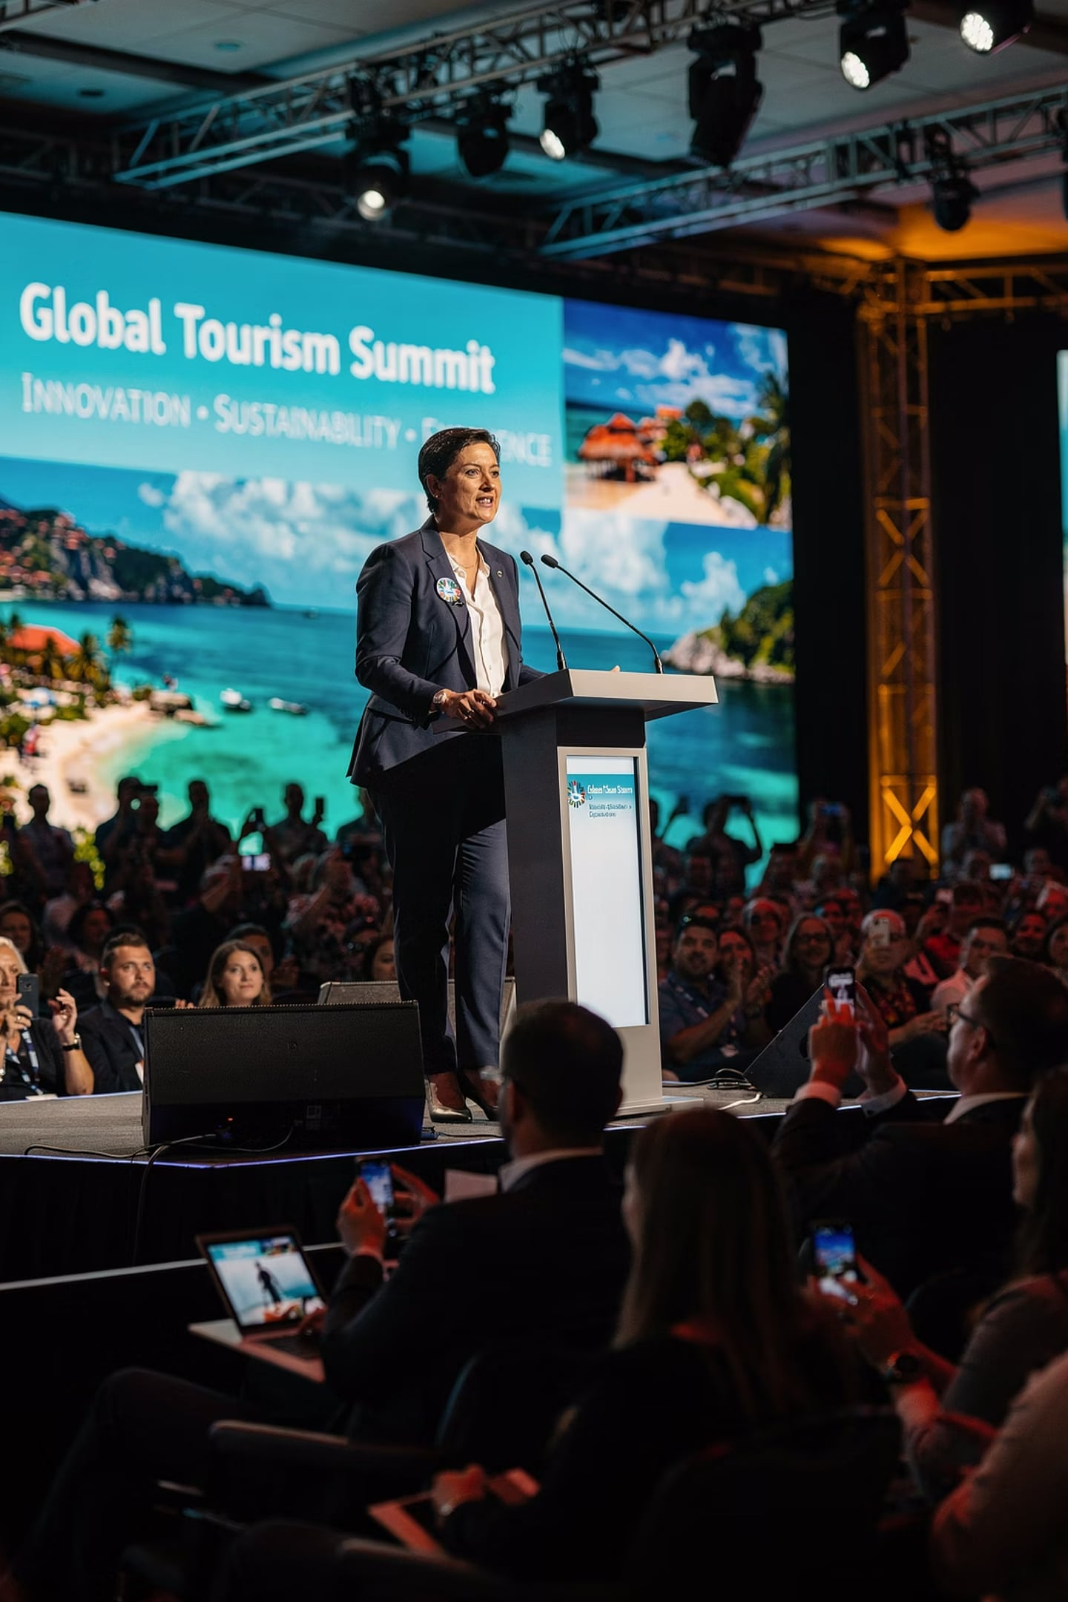
When Tourism Pros Must Speak Up
Key Idea: Real tourism jobs involve presenting — regularly and confidently.
Destination Briefing
Tourism Proposal
Sharing location details with guests or travel agents
Pitching new ideas to clients or management
Tour Itinerary
Team Meeting
Walking guests through a travel plan step by step
Leading staff discussions and coordinating operations
Industry Event
Representing your organization professionally

Slide 5

Public Speaking = Career Power
Key Idea: Speaking skills directly shape your professional success.
Career Success
Leadership
Opens doors to leadership roles
Inspires and guides teams
Reputation
Customer Confidence
Reflects on your organization
Builds trust with guests

Slide 6
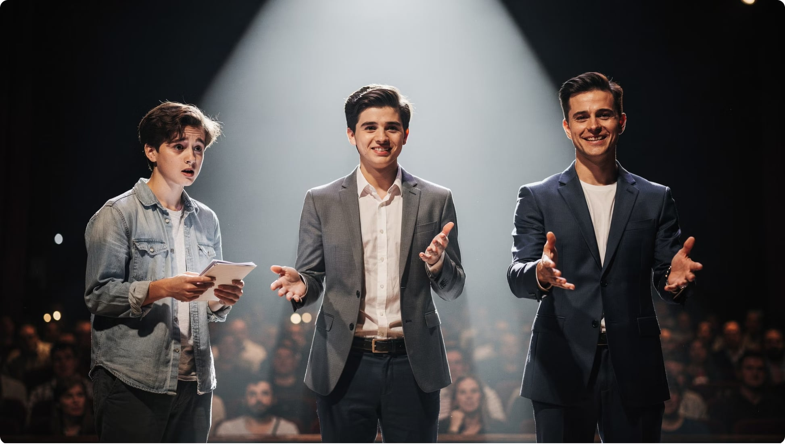

Speaking Is a Skill — Not a Talent
Key Idea: Anyone can become a great speaker with practice.
You don't have to be born with it — you just have to work at it.
Many people feel anxious speaking in front of groups. That's completely normal. But effective public speaking is not something only a few gifted people can do.
Like swimming or cooking — it can be learned, practiced, and improved over time.

Slide 7

What Makes an Effective Presenter?
Key Idea: Great presenters in tourism blend five key qualities to communicate clearly and persuasively.
Knowledge
Preparation
Confidence
Professionalism
Communication Skills
Together, these qualities help tourism professionals leave a lasting impression on any audience.

Slide 8
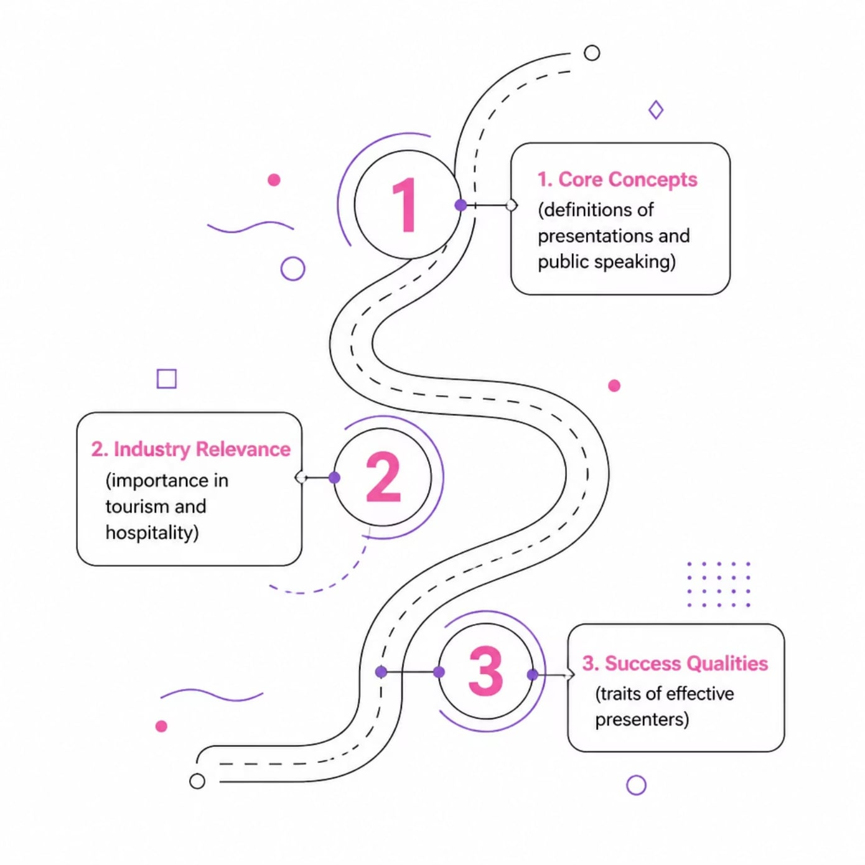

What You'll Learn
Key Idea: This lesson gives you a foundation in professional presentation skills for tourism.
Core Concepts
Industry Relevance
Success Qualities
What professional presentations and public speaking really mean
Why these skills matter specifically in tourism
Traits and habits of effective presenters

Slide 9
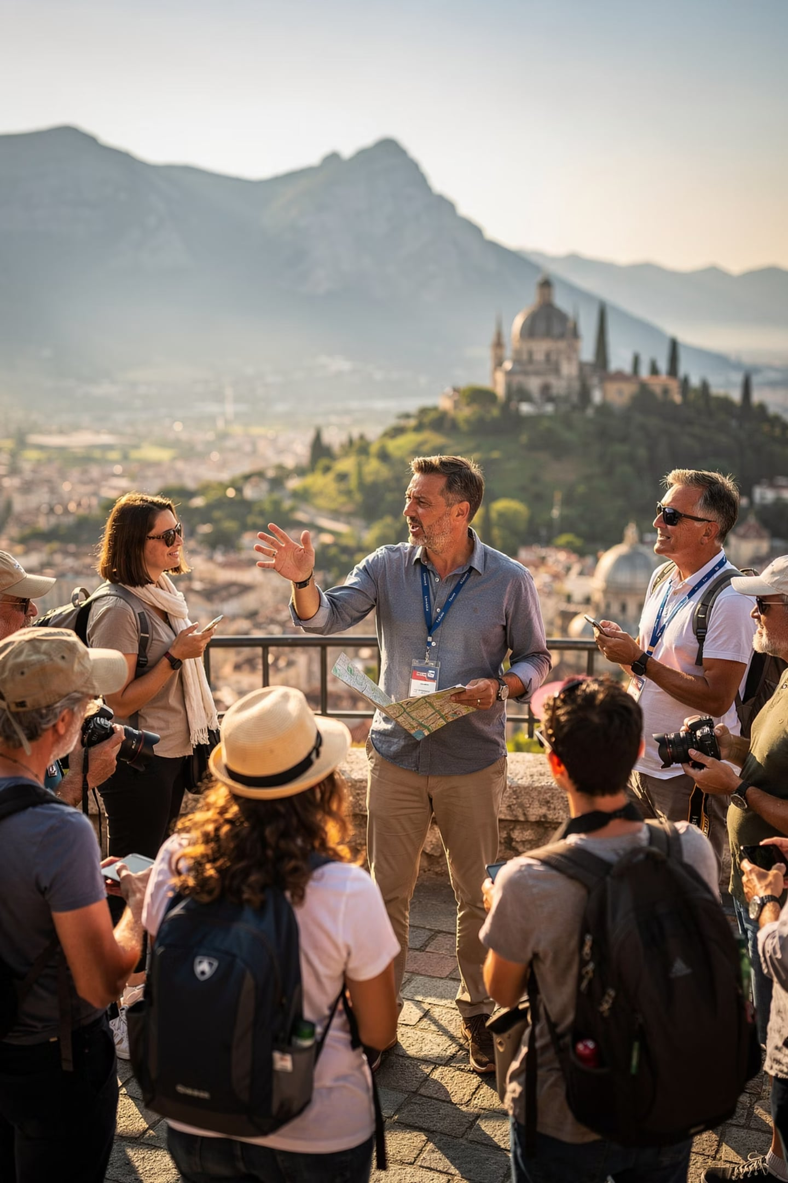
Tourism Pros Speak to Groups — Constantly
Key Idea: Unlike most jobs, hospitality and tourism professionals rarely speak to just one person at a time.
From the tour bus to the boardroom, the ability to address a group is part of the daily job.

Slide 10
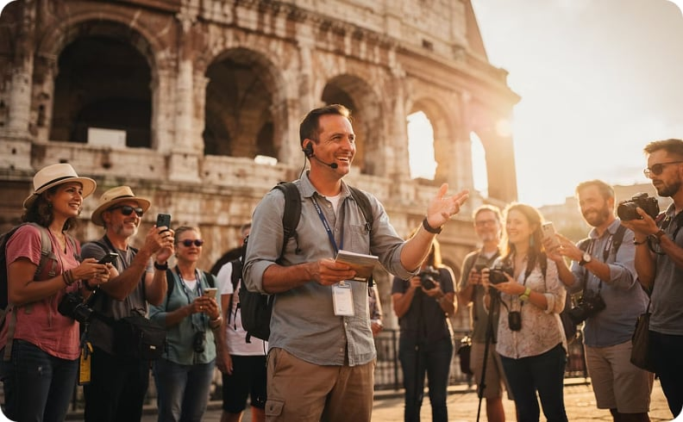
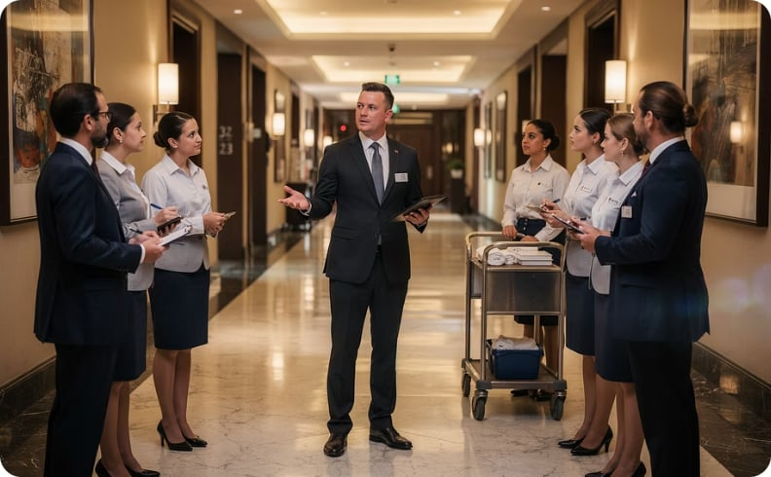
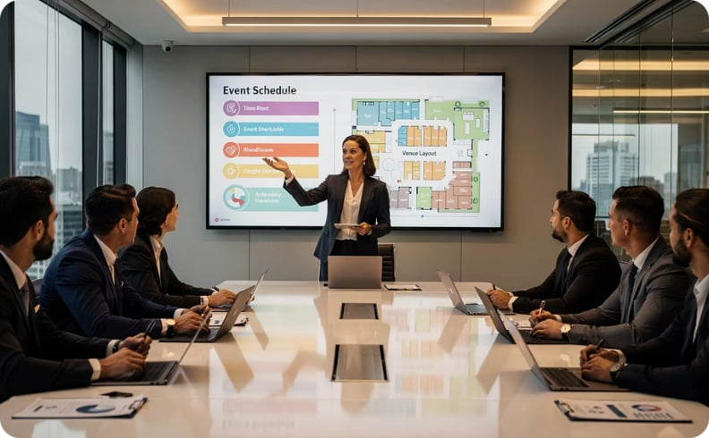
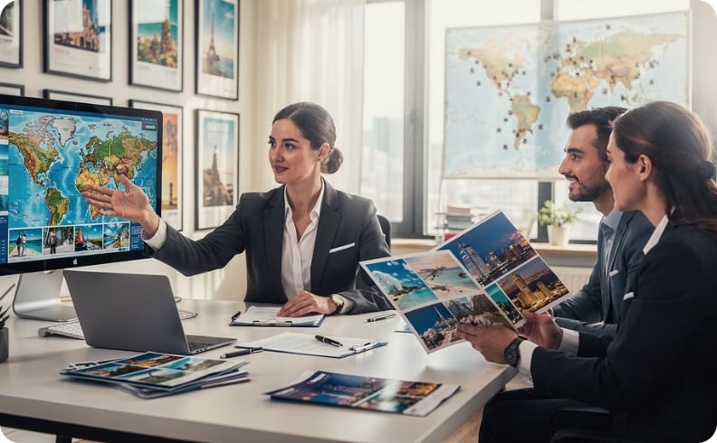
Public Speaking Across Tourism Roles
Key Idea: Every role in tourism involves some form of speaking to an audience.
Tour Guides
Hotel Managers
Event Coordinators
Travel Consultants
Presenting destination info to groups of visitors
Conducting team briefings and staff training
Pitching event plans to clients and stakeholders
Promoting packages and advising travelers

