Slide 1

Module 12
Professional Presentation and Public Speaking
Course: Hospitality and Tourism Business Communication
Prepared by: Prof. Alia Amor D. Uy, MBA

Slide 2

Why Presentations Matter in Tourism
Key Idea: Communication is essential for professional success in hospitality and tourism.
Beyond One-on-One
Diverse Audiences
Many situations require speaking to groups, not just individuals.
Teams, clients, stakeholders, and large audiences all need clear communication.
Professional Growth
Strong presentation skills set you apart in the industry.

Slide 3
What Are Presentations For?
Key Idea: Presentations help share ideas, influence decisions, and drive organizational success.
Share Information
Promote Ideas
Influence Decisions
Provide Training
Spread knowledge across teams and stakeholders.
Pitch new concepts and innovations.
Educate staff and develop capabilities.
Guide teams and leaders toward action.
Every effective presentation serves one or more of these four core purposes — radiating impact from a single, well-crafted message.

Slide 4
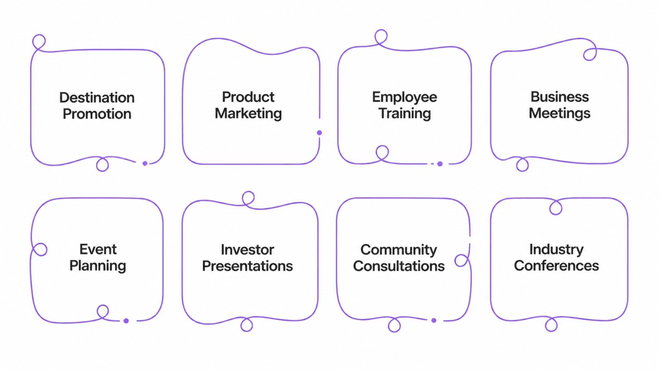
Where Do Presentations Happen in Tourism?
Key Idea: Tourism professionals present in many different real-world settings.

Slide 5




3 Pillars of a Successful Presentation
Key Idea: Every great presentation is built on planning, preparation, and delivery.
Plan
Define purpose, audience, and format.
Prepare
Develop content and rehearse thoroughly.
Deliver
Engage your audience with confidence.

Slide 6


Great Presentations Don't Happen by Accident
Key Idea: Effective presentations result from a systematic process that starts well before you speak.
Think of it like cooking — the meal depends on what you do before you enter the kitchen.

Slide 7

The 8 Stages of Presentation
Key Idea: From planning to evaluation, each stage plays a role in presentation success.
Planning
Content
Define purpose and goals
Create clear, relevant material
Audience
Organization
Analyze needs and expectations
Structure flow for clarity
Follow every stage — skipping even one can weaken your final result.

Slide 8

Every Stage Counts
Key Idea: Missing any stage reduces the quality of the entire presentation.
Skip Planning?
Skip Rehearsal?
Your message lacks direction.
Delivery becomes shaky and unpolished.
Skip Evaluation?
You miss chances to improve.

Slide 9

Start with a Solid Plan
Key Idea: Planning is the foundation — clarify your purpose, audience, and logistics before anything else.
Planning Checklist
Purpose — Why are you presenting?
Audience — Who will be listening?
Topic — What will you cover?
Time — How long do you have?
Venue — Where will you present?
Format — Slides, demo, or discussion?

Slide 10

Planning Builds Confidence
Key Idea: When you plan well, you know exactly what to say — and anxiety fades.
Organized Thinking
Reduced Anxiety
Information flows logically and clearly.
Preparation replaces nervousness with readiness.
Confident Delivery
You speak with purpose, not guesswork.

Slide 11

Define Your Objective First
Key Idea: Every presentation needs one clear goal — what should your audience know, feel, or do?
"What do I want my audience to know, feel, or do after this presentation?"
Your objective is your compass — it guides every content decision you make.

Slide 12
Presentation Objectives in Tourism
Key Idea: Objectives vary by context — but every presentation must have a clear purpose.
Explain a Tourism Concept
Train Employees
Present Research Findings
Break down industry ideas for learners or clients.
Build team skills and service standards.
Share data and insights with academic or industry audiences.
Promote a Travel Package
Encourage Investment
Persuade clients to choose your destination or product.
Inspire confidence in tourism projects or ventures.

Slide 13
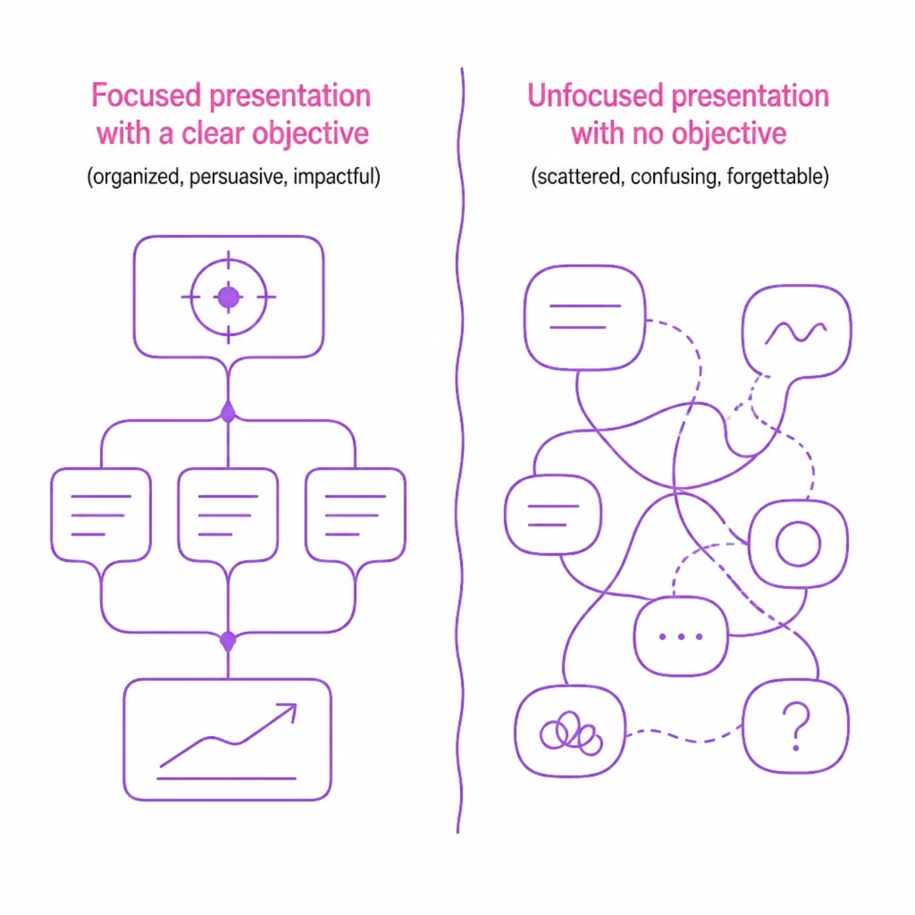
Objectives = Direction
Key Idea: Without a clear objective, your presentation becomes scattered and forgettable.
Objectives guide content choices
They keep delivery focused
They make evaluation possible
No objective = no direction. Always define your goal before you build your slides.

Slide 14

Know Your Audience
Key Idea: Audience analysis means gathering information about your listeners to communicate more effectively.
Think of it like a chef who learns a guest's dietary preferences before cooking the meal.

Slide 15












Who Is in the Room?
Key Idea: Understanding audience characteristics helps you tailor your message appropriately.
Age
Education
Professional Background
Interests
Cultural Context
Knowledge Level

Slide 16

Tailor Your Content
Key Idea: Understanding your audience lets you adapt your message so it truly connects.
Use language your audience understands
Choose examples that feel relevant
Match the depth of detail to their knowledge level

Slide 17

Be Audience-Centered, Not Speaker-Centered
It's about them,
not you.
Key Idea: Great presentations focus on what the audience needs — not on what the speaker wants to say.

Slide 18
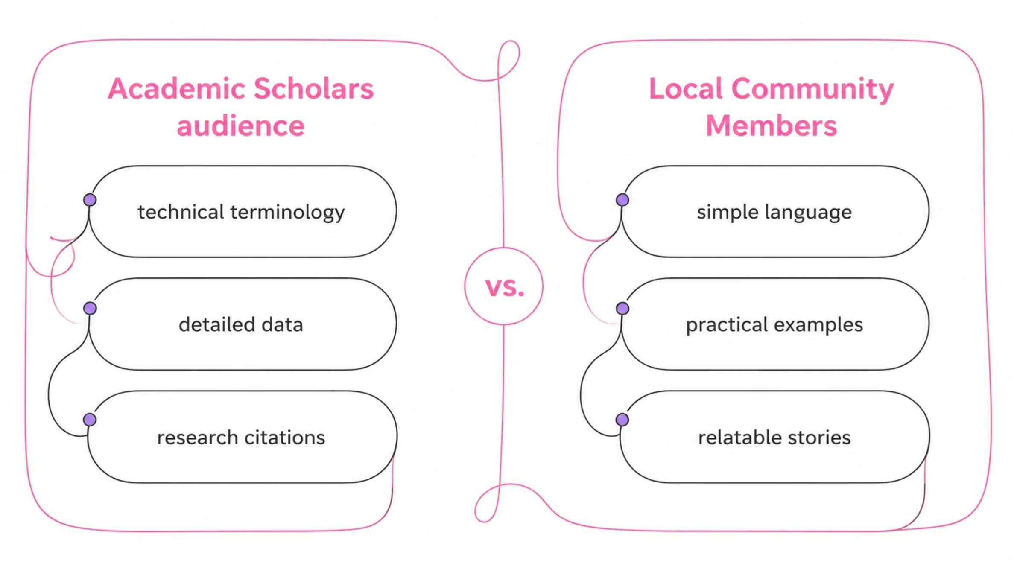
Same Topic, Different Audiences
Key Idea: The same content must be delivered differently depending on who is listening.
A tourism researcher adjusts vocabulary, examples, and depth based on whether the audience is academic or community-based.

Slide 19

What Makes Strong Content?
Key Idea: Good presentation content is relevant, accurate, organized, and audience-focused.
Relevant
Accurate
Directly serves your objective.
Based on verified facts and data.
Organized
Audience-Focused
Flows logically from start to finish.
Meaningful to your specific listeners.

Slide 20
Quality Over Quantity
Key Idea: Content should support your objective — more information is not always better.
The Golden Rule
Content Principles
Every piece of content must earn its place. If it doesn't support your objective, cut it.
Stay focused on your stated objective
Avoid information overload
Prioritize clarity over completeness
Less, but better

Slide 21

Where Does Presentation Content Come From?
Key Idea: Presenters gather information from many types of sources to build credible content.
📚 Academic Sources
🏢 Industry Sources
Books, journals, research reports
Tourism stats, government data, industry reports
💼 Personal Experience
Real-world professional insights
Think of it like writing a research paper — you use books, reliable websites, and your own experience to back up what you say.

Slide 22


Industry & Organizational Sources
Key Idea: Tourism professionals use both industry-wide data and internal company documents as source material.
🌐 Industry Sources
🏨 Organizational Sources
Tourism statistics
Government publications
Industry reports
Company documents
Operational records
Internal reports
Like checking both a textbook AND your company handbook — both give you different, useful info.

Slide 23


Your Own Experience Counts Too
Key Idea: Personal professional experience can be a powerful source — but accuracy and credibility always come first.
✅ Use It To Illustrate
Real stories make abstract ideas relatable and memorable.
⚠️ Keep It Credible
Always ensure personal examples are accurate and relevant.
Think of it like sharing a personal story in class — it works great, but it still needs to be true and on-topic.

Slide 24

How to Organize a Presentation
Key Idea: Every effective presentation follows a clear three-part structure that guides the audience from start to finish.
Introduction
Body
Conclusion
Just like a good story has a beginning, middle, and end — so does every strong presentation. This structure helps audiences follow along and remember what they heard.

Slide 25

The Introduction: Your First Impression
Key Idea: The introduction sets the tone and prepares your audience for everything that follows.
Capture Attention
Introduce the Topic
Establish Credibility
Explain Objectives
Preview the Content

Slide 26

First impressions matter.
Key Idea: Audiences form opinions about a presenter very quickly — often within the first few minutes.
The opening sets the emotional tone for the entire presentation. A strong start builds trust and attention immediately.
Like meeting someone for the first time — your opening words and energy shape how the audience sees you for the rest of the talk.

Slide 27
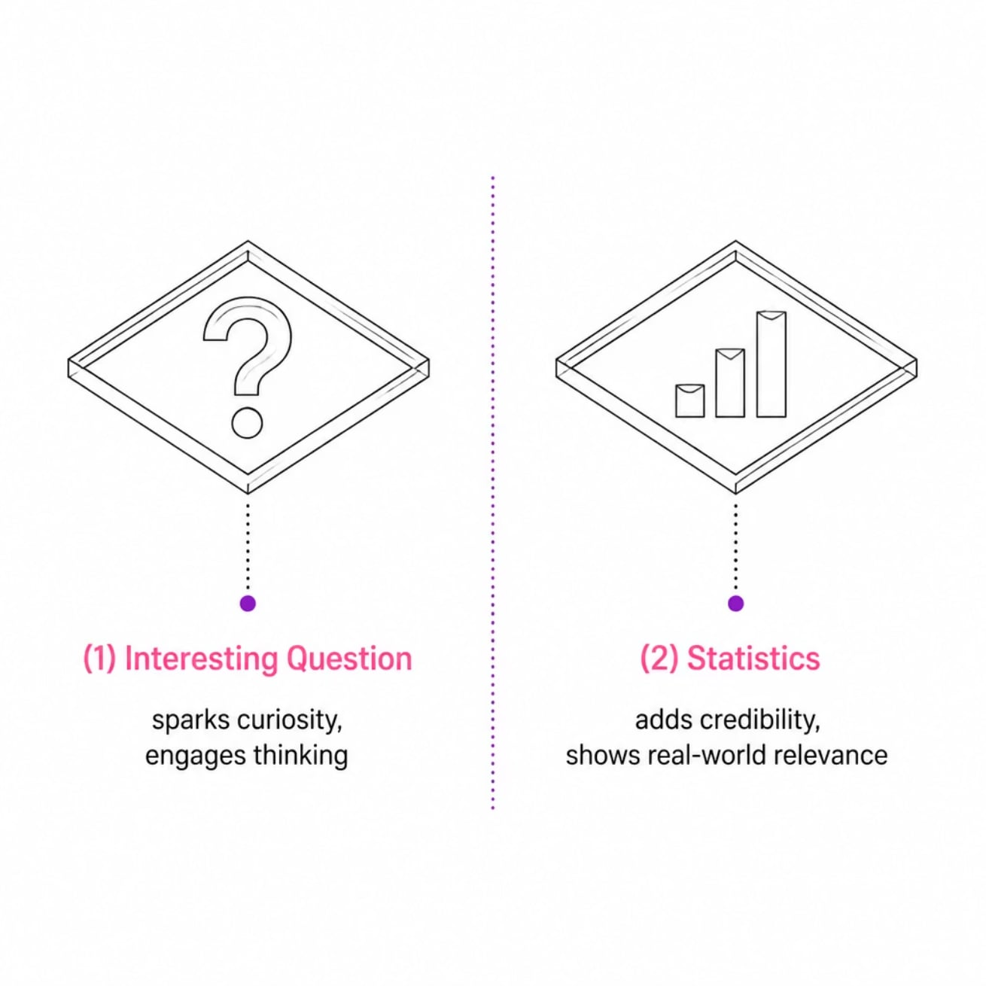
How to Open a Presentation
Key Idea: Presenters can use questions or surprising statistics to hook the audience right away.
❓ Question Example
"Have you ever wondered why some destinations attract millions of visitors every year?"
📊 Statistic Example
"International tourism continues to contribute significantly to global economic growth." — UN Tourism

Slide 28

More Ways to Open Strong
Key Idea: Short stories and meaningful quotes are powerful tools for grabbing audience attention at the start.
📖 Short Stories
A brief personal experience creates an emotional connection and makes your opening memorable.
💬 Quotations
A relevant quote from a respected source gives your presentation instant credibility and depth.
Think of these as the "hook" at the beginning of a movie — they pull you in before the main story even starts.

Slide 29



The Body: Where the Main Content Lives
Key Idea: The body of a presentation delivers the core information — and it must be organized logically for the audience to follow.
Primary Content
Logical Flow
All key ideas, evidence, and explanations belong in the body.
Information should be sequenced so each point builds naturally on the last.
Audience Clarity
A well-organized body prevents confusion and keeps attention.

Slide 30

Organizational Patterns: Part 1
Key Idea: Chronological and sequential patterns help audiences follow content that involves time or steps.
🕐 Chronological
Chronological
Modern Evolution
Tour Planning
Organize by time sequence — like telling the history of tourism development from past to present.
Arrange events by time sequence
Plan, book, prepare, execute
Recent trends and innovations
🔢 Sequential
Early History
Origins and formative developments
Sequential
Organize as step-by-step instructions — like explaining how to plan a tour from booking to departure.
Present step-by-step process

Slide 31
Organizational Patterns: Part 2
Key Idea: Cause-and-effect and problem-solution patterns are ideal for analytical or persuasive content.
⚡ Cause & Effect
🔧 Problem & Solution
Show how one thing leads to another.
Example: How tourism marketing increases visitor arrivals.
Identify an issue, then propose a fix.
Example: Managing overtourism in popular destinations.
These patterns are like a detective story — you present the clues (cause/problem) and then reveal the answer (effect/solution).

Slide 32

The Conclusion: End with Impact
Key Idea: A strong conclusion ties everything together and gives the audience a clear takeaway.
Summarize Key Points
Reinforce the Message
Briefly revisit the main ideas.
Leave no doubt about your core argument.
Encourage Action
Create a Lasting Impression
Motivate the audience to do something.
End memorably so the message sticks.

Slide 33



What Makes a Conclusion Effective?
Key Idea: A great conclusion helps the audience remember — and it never introduces new information.
✅ Do This
Reinforce what you already covered. Echo your opening. End with a memorable statement or call to action.
❌ Avoid This
Do not introduce new ideas at the end. It confuses the audience and weakens your message.
Think of the conclusion like the last scene of a film — it should feel satisfying, not like a surprise twist.

Slide 34

Visual Aids: Support What You Say
Key Idea: Visual aids enhance spoken communication — they don't replace it. They help audiences understand, stay focused, and remember.
Understand
Maintain Attention
Clarify complex ideas visually
Keep audiences engaged
Retain Information
Visual memory is stronger than spoken memory alone

Slide 35




Types of Visual Aids
Key Idea: There are many types of visual aids — choose the one that best supports your message.
Slides
Graphs & Charts
Maps
Infographics
PowerPoint or similar tools
Visualize data clearly
Show locations and routes
Combine visuals and data

Slide 36
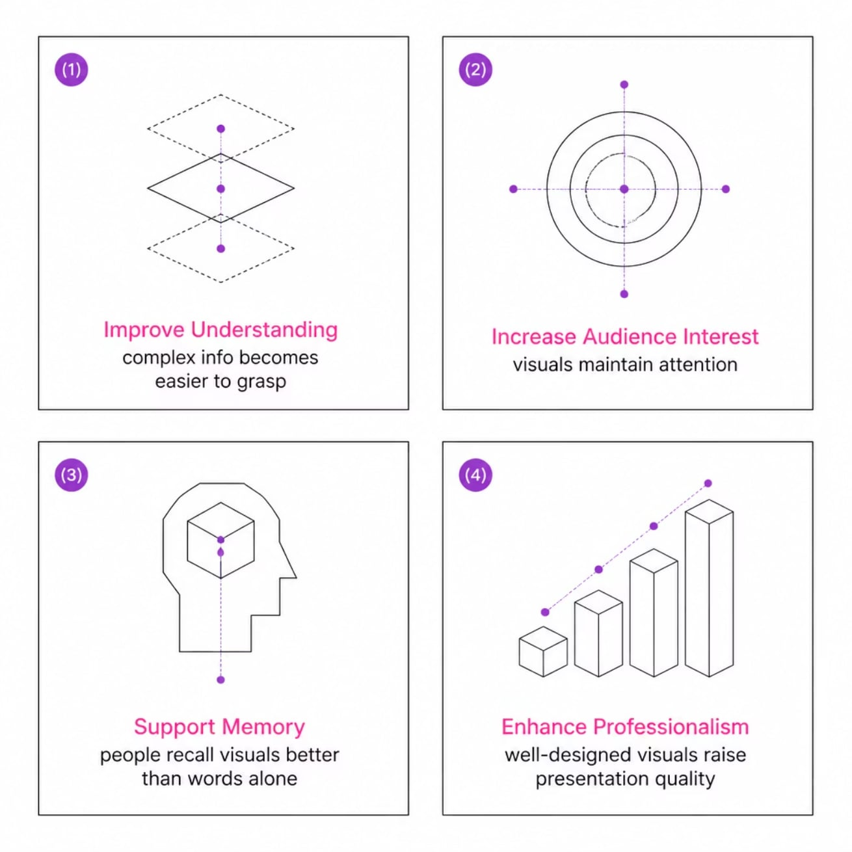

Why Visual Aids Work
Key Idea: Visual aids make presentations more effective in four key ways.
The Bottom Line
A picture really is worth a thousand words — especially in a professional presentation where time and attention are limited.
People retain 65% more information when it is paired with a relevant visual.

Slide 37


Designing Slides That Work
Key Idea: Slides should support the speaker — not replace them. Keep slides simple, readable, and relevant.
Simple
Readable
Less text = more impact
Clear fonts, appropriate sizes
Relevant
Consistent
Only include what supports your message
Uniform formatting throughout
Visually Appealing
Use images and graphics purposefully

Slide 38


Slide Design Principles in Practice
Key Idea: Each design principle directly improves how your audience experiences the presentation.
Simple
Readable
Avoid walls of text. Use bullet points and visuals instead.
Use fonts that are easy to read from the back of the room.
Relevant
Consistent
Every element on the slide should earn its place.
Same fonts, colors, and spacing across all slides.
Visually Appealing
High-quality images and clean layouts signal professionalism.

Slide 39

Slides Support — They Don't Speak for You
You are the presentation.
Key Idea: Slides are a visual aid, not a script. The presenter — not the slides — should be the focus of the room.
✅ Good Practice
Glance at slides, then speak to the audience. Use slides to reinforce your words.
❌ Common Mistake
Reading directly from slides. The audience can read — they came to hear you.

Slide 40
Presentation Skills: The Full Picture
Key Idea: Effective presentations in hospitality and tourism require careful planning, organized content, confident delivery, and smart use of visual aids.
Plan Carefully
Organize Content
Deliver Confidently
Know your audience and purpose
Intro → Body → Conclusion
Verbal and nonverbal skills matter
Use Visual Aids
Build Your Career
Support — don't replace — your message
Presentation skills drive leadership and success
Presentation competence is not just a classroom skill — it is a career-long professional asset.

