Slide 1

Digital Media, Online & Mobile Advertising, and AI
Lecture 8 · Advertising and Integrated Marketing Communications
PROF. FIDELA R. BALAJADIA

Slide 2
Learning Objectives
01
02
03
Magnitude & Growth
How It Works
Ad Formats
Describe digital media's scale, nature, and growth potential
Explain the online advertising process
SEA, display, video, mobile, programmatic, and more
04
05
AI & Privacy
Measurement
AI's role in digital ads; behavioral targeting and privacy issues
Metrics for measuring online advertising effectiveness

Slide 3


What is Digital Media?
Digital & Interactive
Always Accessible
Media Convergence
Electronic formats offering personalized, real-time engagement.
Constant, on-demand access across diverse devices.
Seamlessly integrates text, audio, video, and graphics.
Notes:
Speaker Script
[SLIDE 3 — WHAT IS DIGITAL MEDIA? | ~2 min]
Let's start with a foundational question: what exactly is digital media, and what makes it different from everything that came before it?
Digital media refers to any form of media that is encoded in a machine-readable format and delivered through electronic devices — computers, smartphones, tablets, smart TVs, and increasingly, wearables and connected home devices. But the definition alone doesn't capture what makes it revolutionary. What makes digital media transformative is a set of characteristics that no previous medium has ever combined.
First: it is interactive. Unlike a television commercial or a newspaper ad, digital media allows for two-way communication. A user can click, comment, share, like, skip, or ignore. Every one of those actions generates data that feeds back into the advertising system.
Second: it is individualized. Digital media can be — and increasingly is — tailored to the individual. The ad you see on Instagram is not the same ad your classmate sees, even if you're both on the same platform at the same time. Algorithms are constantly analyzing your behavior and serving content that matches your profile.
Third: it is always accessible. There is no 'prime time' in digital media. Ads can reach consumers at 3am just as effectively as at 8pm. This 24/7 availability fundamentally changes campaign planning.
Fourth: it is convergent. Digital media seamlessly integrates text, audio, video, graphics, and interactivity in a single experience. A single digital ad can contain a video, a clickable link, a product catalog, and a purchase button — all in one unit.
Think about the last time you used your phone. Every app, every website, every search — all of it is digital media. And all of it is an advertising opportunity. That's the world we're studying today.

Slide 4

Digital Media: The Dominant Ad Channel
$258.9B
Total Digital Ad Spend
2023 U.S. digital media advertising
76%
Share of All Ad Spend
Digital surpassed TV in 2017
45.6%
Search Engine Ads
Largest digital category (SEA)
27.9%
Social Media
Second-largest digital category

Slide 5

Digital vs. Traditional Media
Fundamental differences shaping modern advertising strategies.
Digital Media
Traditional Media
Pull Marketing
Targeted Audiences
Two-way Interaction
Dynamic & Adaptive
Push Marketing
Mass Audiences
One-way Communication
Static & Fixed

Slide 6
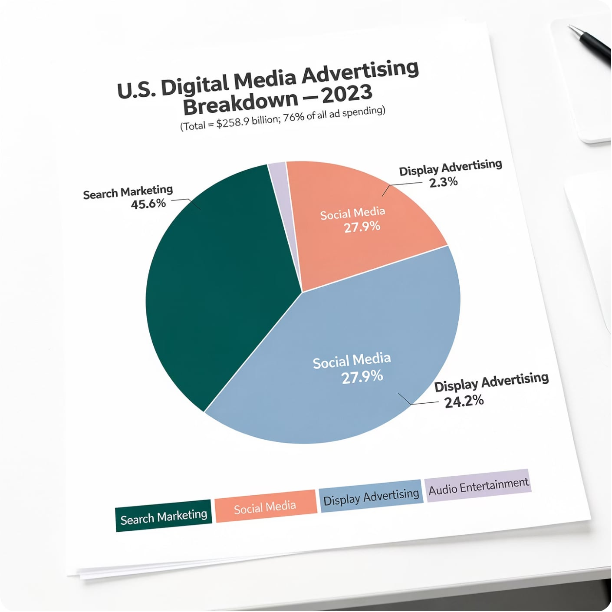

U.S. Digital Media Breakdown — 2023
Key Takeaways
Search Marketing: 45.6% — leads all categories
Social Media: 27.9%
Display Advertising: 24.2% ($62.7B)
Audio Entertainment: 2.3% ($5.9B)
IMC reminder: Digital isn't always the answer — integrate the right mix for your target market.

Slide 7


Online Advertising: Benefits & Costs
Individualization
Interactivity
Distraction
Rapid Change
User controls information flow; enables targeted ads
Two-way communication; builds brand relationships
Online users are goal-driven ("leaning forward") — ads interrupt
AI tools, mobile video evolving at breakneck speed
Cost Efficiency
Real-Time Metrics
Google CPC min $0.01; CPM min $0.25
CPA, conversions, frequency — optimize instantly
Coordination
IMC Trade-offs
International mobile ad placement is complex
Shifting budgets from traditional media requires new thinking

Slide 8






Types of Online Advertising
Search Engine Ads (SEA)
Display/Banner Ads
Targeted ads appear on search results pages.
Visual ads on websites, often rich media.
Social Media Ads
Video Ads
Promoted content across social platforms.
Short commercials before, during, or after video content.
Native Ads
Email Ads
Blended ads matching platform content and format.
Promotional messages sent directly to inboxes.

Slide 9
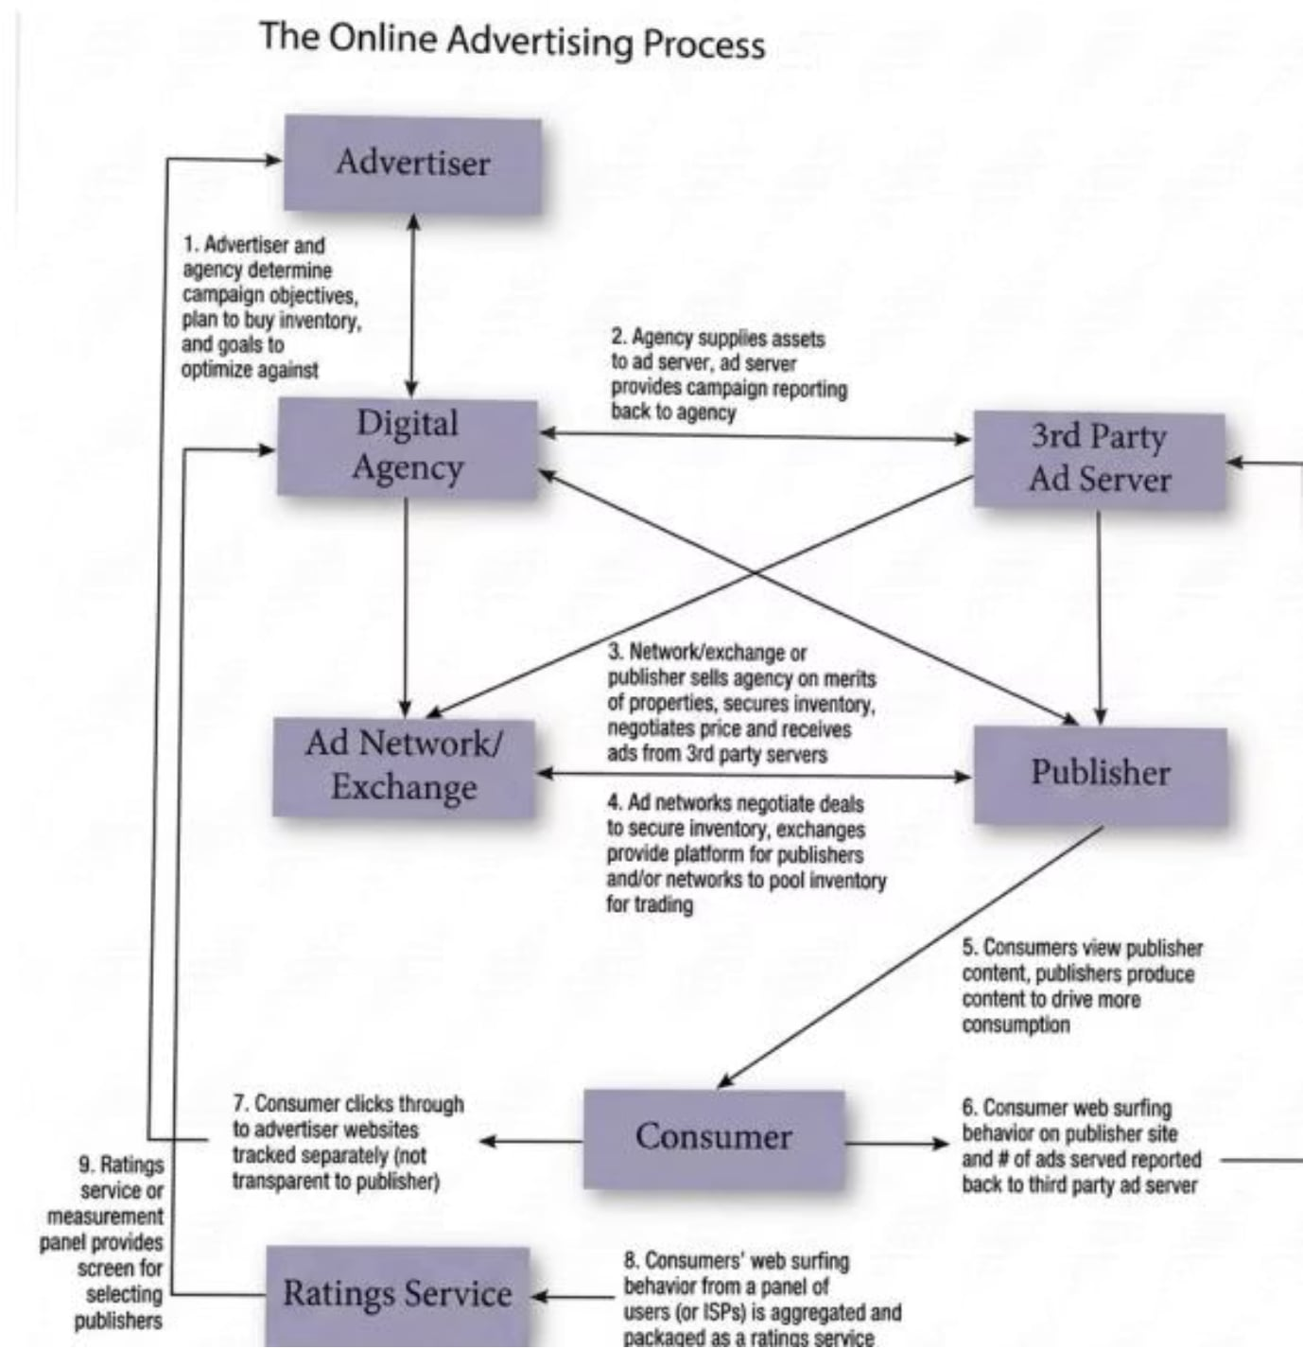
The Online Advertising Process
9-Step Flow
Advertiser + agency set objectives & buy inventory
Agency supplies assets to 3rd-party ad server
Network/exchange secures inventory, negotiates price
Ad networks pool inventory for trading
Consumers view publisher content
Surfing behavior reported to ad server
Click-throughs tracked separately
Behavior aggregated as ratings service
Ratings used to screen publishers

Slide 10

Search Engine Advertising (SEA)
$118B in 2023
Largest digital ad category at 45.6% of all online spend
Keywords
Specific words/phrases matching user search intent — e.g., "navy blue sports coat"
Paid vs. Organic
Sponsored links appear alongside organic results; SEO is unpaid
Google Dominance
61%+ of U.S. searches; Google Ads, AdSense, Ad Manager

Slide 11

Keywords & Click Fraud
Keyword Types
Understanding Click Fraud
Broad Match: Ads appear for similar phrases and variations.
Phrase Match: Ads appear for phrases including the keyword, in exact order.
Exact Match: Ads appear for exact keyword or very close variants only.
Negative Keywords: Prevents ads from showing for irrelevant searches.
Click fraud occurs when bots or malicious human activity generate fake clicks on competitor ads. This is done to exhaust their ad budgets prematurely, taking their campaigns offline and providing an unfair competitive edge. It significantly impacts advertising effectiveness.

Slide 12
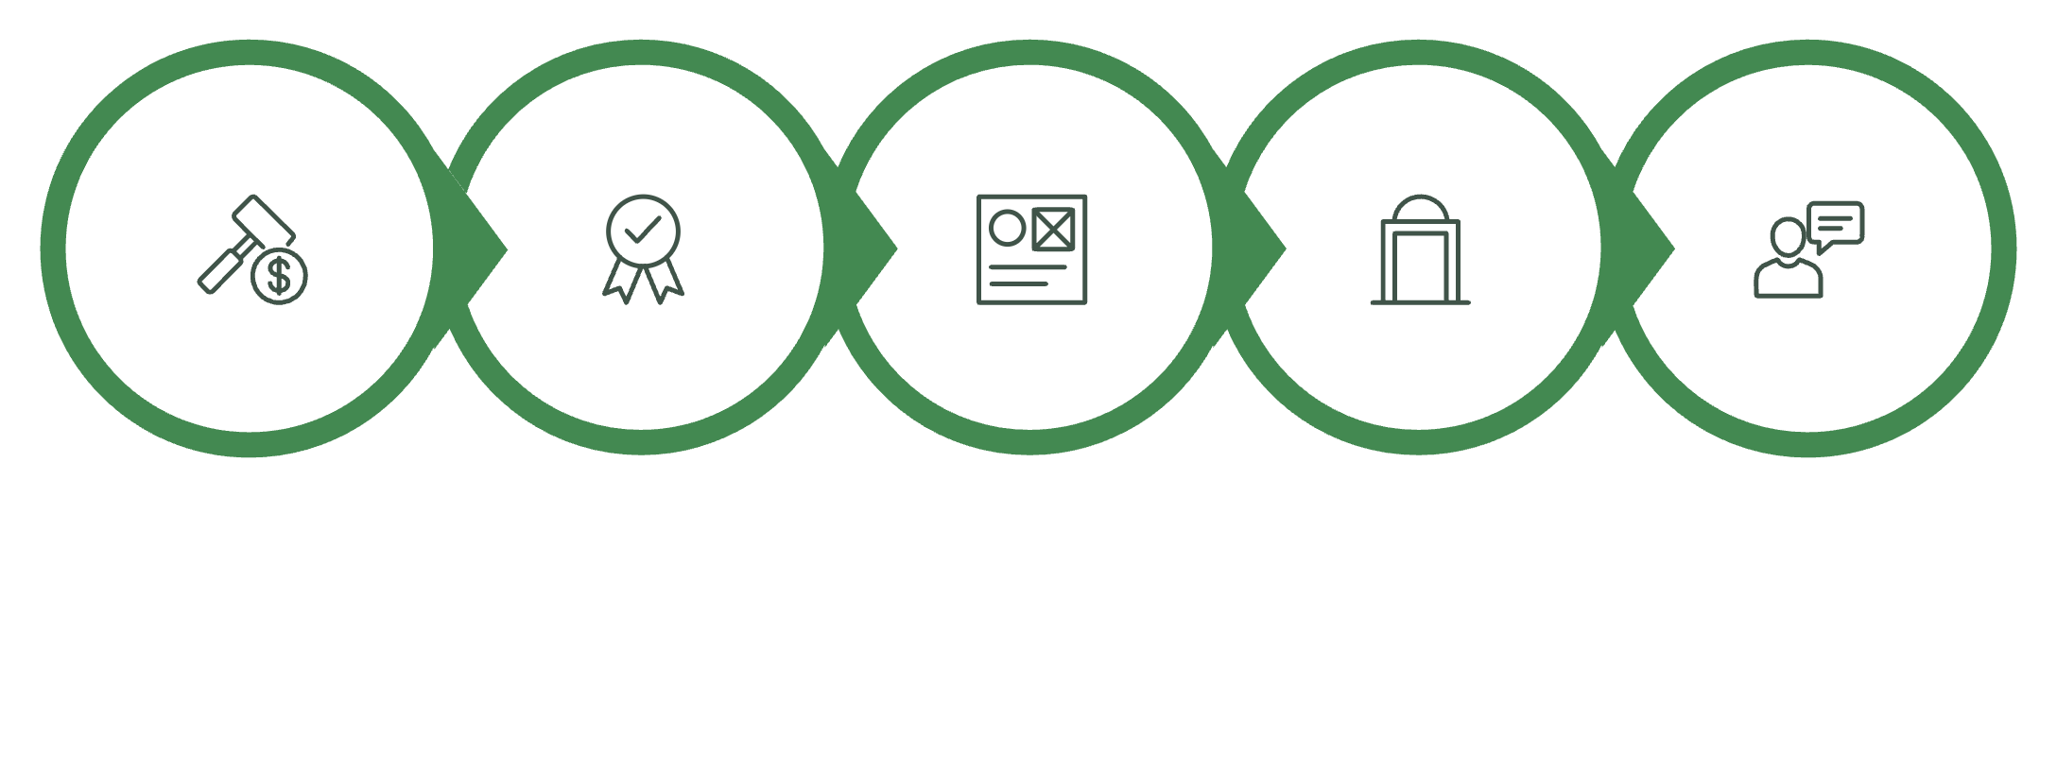
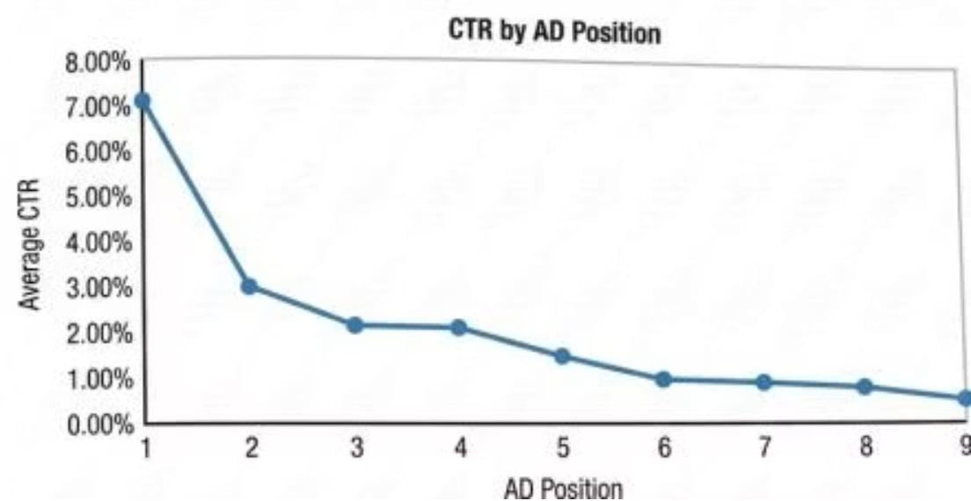
Google Ads Auction: How It Works
CTR by Ad Position
Your Bid
Quality Score
Ad Assets
Ad Rank Threshold
Content & Context
Position 1 = 7% CTR; drops to 3% at position 2. Lower positions show higher conversion rates (recency bias).
These five factors determine when and where your ad appears to potential customers.

Slide 13





Online Advertising Formats
Search Engine Ads
Display / Banner Ads
Rich Media & Video
Keyword-matching & content-targeted; 45.6% of digital spend
Static banners; avg CTR 0.35%; $67.1B by end of 2024
Pop-ups, interstitials, superstitials, online video; $54B → $62.9B (2023–24)
Mobile & Apps
E-mail & Podcasts
$194.8B in 2023; $216.4B in-app ad spend predicted for 2024
E-mail: $10.89B (3.2%); Podcasts: $2.16B, growing 2× faster than digital overall

Slide 14
Rich Media & Online Video Ads
Pop-Up
Interstitial
Superstitial
Appears in separate window; manually closed; highly intrusive (80% annoyed)
Between two pages; no exit option; runs while page loads
Short animated ad playing over a web page
Online Video
Carousel / Collection
15 sec–several min; CTV + social video; 16.5% growth 2023–24
Up to 10 images/videos per ad; drives interaction and brand storytelling

Slide 15
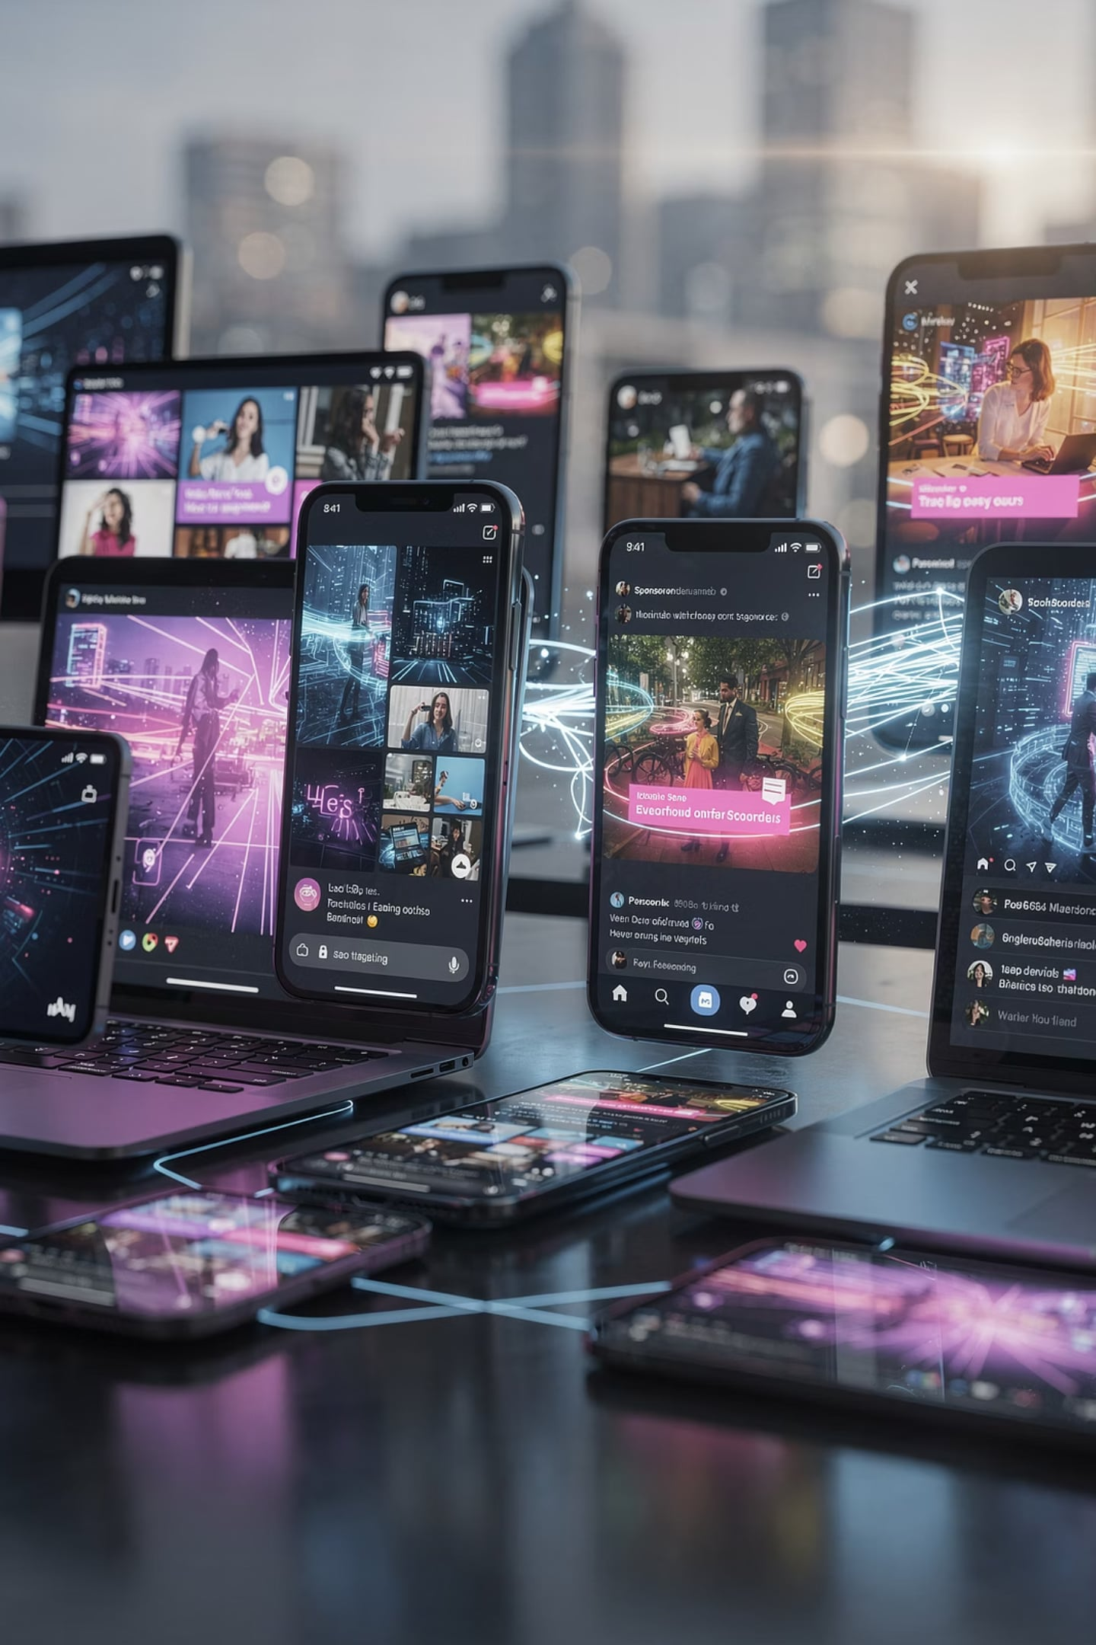




Social Media Advertising
Significant Share
Key Platforms
27.9% of digital ad spend (2nd largest category).
Meta (Facebook, Instagram), TikTok, LinkedIn, X (Twitter).
Diverse Ad Types
Precise Targeting
Sponsored posts, stories, reels, in-feed videos.
Demographics, interests, behaviors, custom audiences.

Slide 16


Mobile Advertising & Apps
Scale
7.41B mobile users worldwide in 2024 (92% of Earth)
U.S. mobile ad spend: $194.8B (2023) → $235B (2025)
In-app ad spend: $216.4B U.S. / $402B worldwide (2024)
Key Features
SMS, MMS, location-based services, QR codes
Mobile = "third screen" after TV and computers
95% of U.S. teens have smartphone access
Privacy concern: mobile phones are highly personal — unwanted ads feel invasive

Slide 17



Websites, Blogs & Podcasts
Websites
Blogs
Podcasts
Centerpiece of online advertising; users visit goal-oriented. Simple backgrounds preferred; color affects perceived download speed.
Direct brand communication; monitor via Talkwalker, Google Analytics. Top platforms: WordPress, Wix, Weebly. Ad placement via Google AdSense.
3M+ programs worldwide; 91M U.S. listeners/month. Ad spend: $2.16B in 2024. Growing 2× faster than digital overall. Top genres: sports, society, comedy.

Slide 18

E-Mail Advertising
By the Numbers
$10.89B
72%
E-mail Ad Spend
Estimated Spam
2023 — 3.2% of total digital
Share of all commercial e-mail
Opt-In vs. Spam
Opt-in: Permission-based; consumer agrees to receive messages
Spam: Unsolicited; CAN-SPAM Act fines up to $50,120 per e-mail
Phishing: Fake corporate e-mails extracting personal data
E-zines: Sponsored e-mail magazines; ads clearly labeled
Generative AI now fine-tunes subject lines, personalization, and measurement in e-mail campaigns.

Slide 19

Generative AI & Digital Advertising
Benefits
Strengthens B2B data strategies
Enhances e-mail personalization
Improves SEA via Bing AI
Aids creative brand combinations
Detects click fraud via ML
Risks
Algorithm biases (population diversity)
Celebrity chatbots & look-alikes without consent
Fake images (DALL-E, Midjourney)
IP/copyright/defamation issues
"Rogue" AI concerns
AI = computer systems using neural networks to generate text, images, voice, and video. Includes ChatGPT, Google Bard, DALL-E, Midjourney, and Sora.

Slide 20








AI Tools in Advertising
AI Copywriting
Visual Creation
LLMs generate compelling ad text and headlines.
AI crafts stunning images and video assets.
A/B Testing
Dynamic Creatives
Automated tests optimize ad performance.
Real-time ad content tailoring for users.
Chatbots
AI-powered assistants for customer engagement.

Slide 21
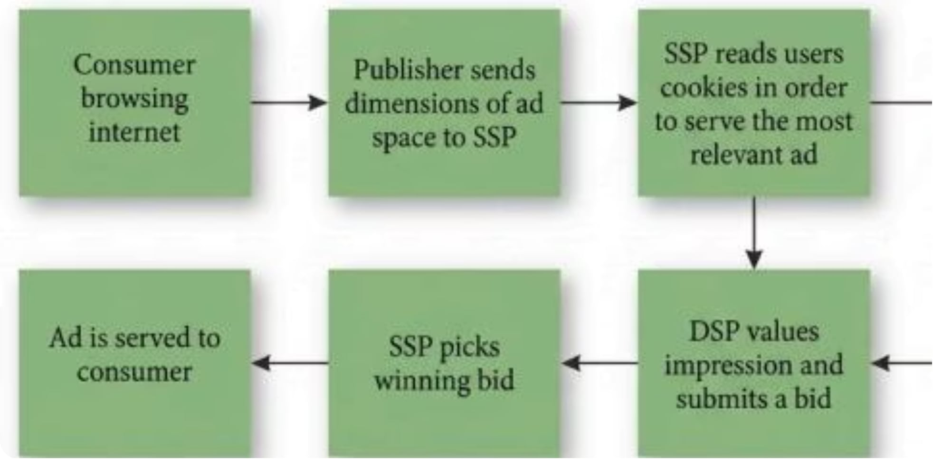

Behavioral Targeting & Programmatic Advertising
How It Works
Behavioral targeting: Ads directed only to likely buyers based on browsing history
Cookies/pixels: Track device behavior to build audience segments
DSP: Buys ad space via real-time bidding
SSP: Matches unsold publisher inventory
23% of programmatic ads land on "low quality" sites — click-bait, fake news, spam.
The entire programmatic loop — from browsing to ad served — happens in milliseconds.

Slide 22

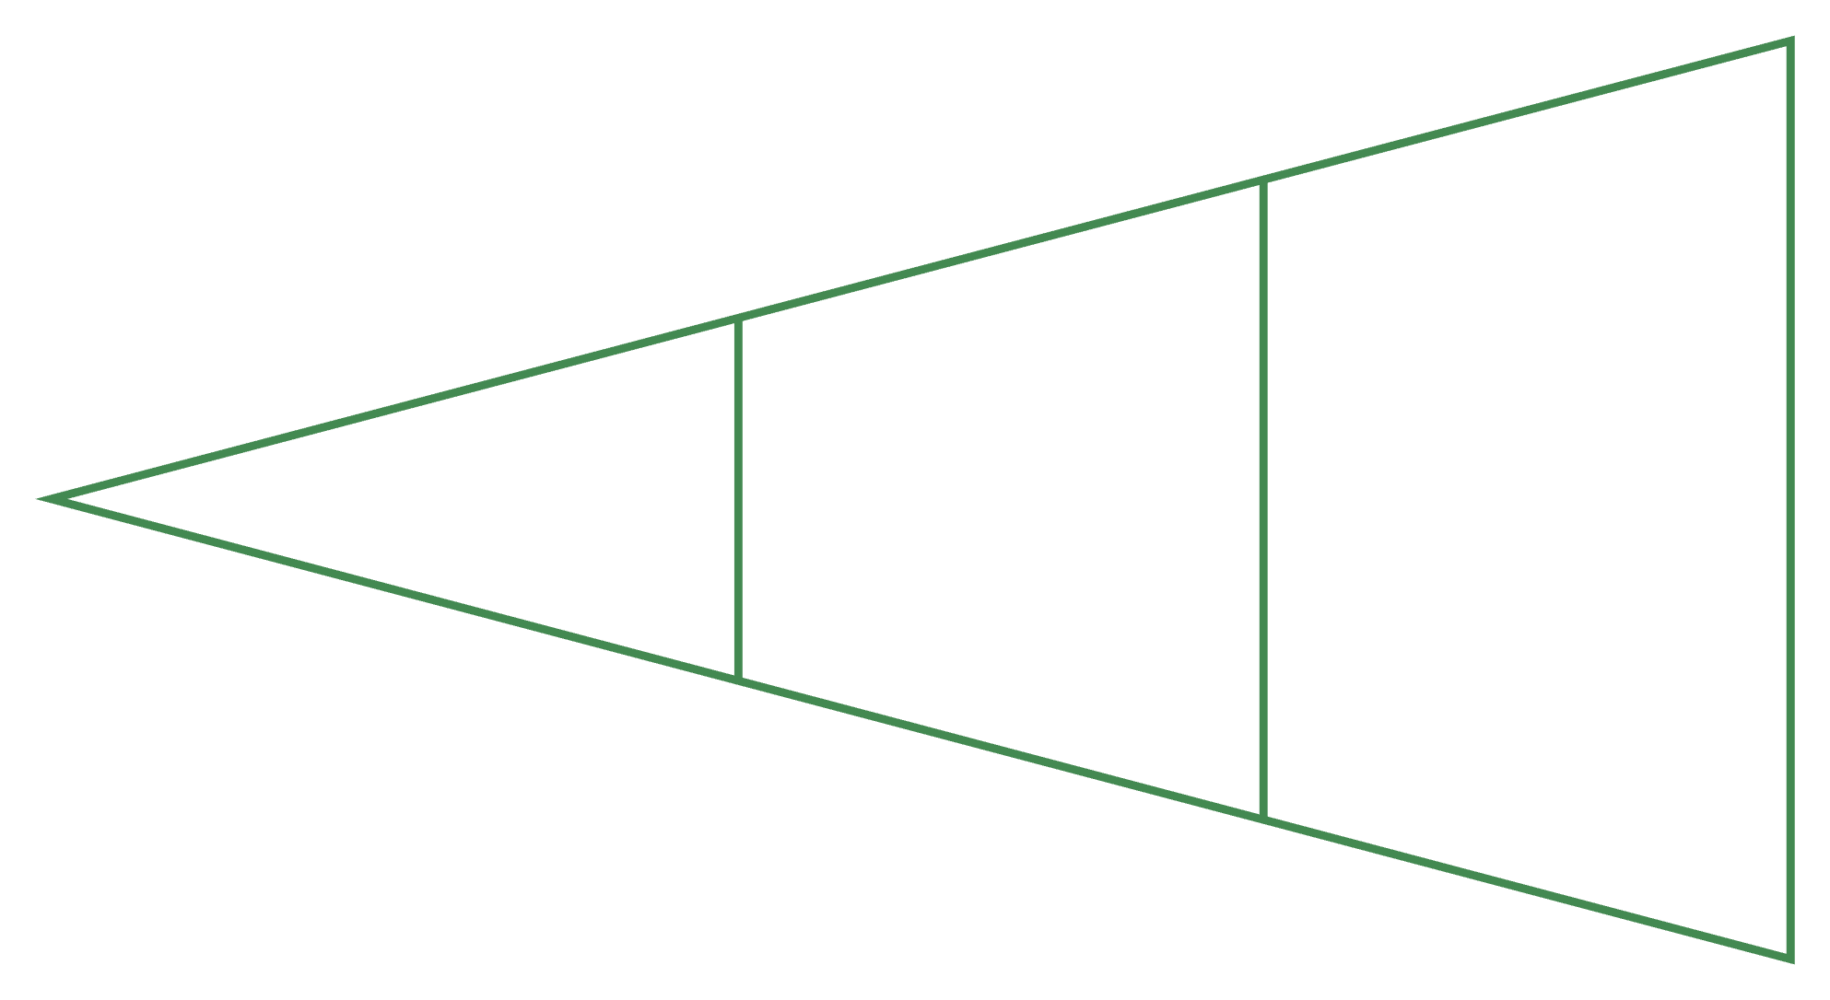
Retargeting & Cookies
User visits site
Targeted ads shown
Cookie placed
Retargeting leverages past user interactions to serve relevant ads, guiding them back to your offerings.
Third-Party Cookie Deprecation
First-Party Data Strategies
Google is phasing out third-party cookies, impacting traditional retargeting methods and necessitating new approaches to user identification.
Focus shifts to collecting and utilizing first-party data (data collected directly from your audience) for privacy-compliant and effective personalized advertising.

Slide 23

Consumer Privacy & the Sharing-Surrendering Matrix
Four Situations
Conditional Share: Active protection + shares (e.g., restricted social post)
Unconditional Share: Passive + shares (e.g., quickly accepts app privacy terms)
Conditional Surrender: Active + surrenders (e.g., Snapchat screenshot)
Unconditional Surrender: Passive + surrenders (e.g., ID scan shared with 3rd parties)
Most troubling: Unconditional Surrender — passive behavior with no control over data use.

Slide 24
Privacy Legislation & Children's Protection
COPPA
GDPR / DSA / DMA
FTC Reports
Children's Online Privacy Protection Act — under-13 data collection rules
Europe's strict data protection and digital market regulations
Dot.Com Disclosures, Mobile Privacy, IoT, Privacy & Security (2000–2021)
1
2
3
4
5
CAN-SPAM
CCPA
U.S. anti-spam law; fines up to $50,120 per e-mail violation
California Consumer Privacy Act — opt-in required under age 16
78.6 million U.S. users ran ad blockers in 2021 (27% of web users). Self-regulatory tools include the Digital Advertising Alliance's "Your Advertising Choices Icon."

Slide 25

Measuring Online Ad Effectiveness
1
2
CTR
CPM
Click-through rate = clicks ÷ impressions × 100. Avg banner CTR: 0.35%
Cost per thousand impressions — measures opportunity to see (OTS)
3
4
CPA
Auction Metrics
Cost per action/acquisition — measures actual purchases, registrations, conversions
Impression share, outranking share, top-of-page rank, overlap rate
Tools: Google Analytics (GA4), Nielsen Digital Ad Ratings, Comscore, Heap Analytics.

Slide 26

Ad Fraud & Brand Safety
Ad Fraud Types
Click fraud
Impression fraud
Domain spoofing
Brand Safety
Preventing ads from appearing next to inappropriate content.
Industry Solutions
IAS (Integral Ad Science)
DoubleVerify
ads.txt

Slide 27
Key Terms at a Glance
SEA: Ads on search engine results pages matched to keywords
Keywords: Words/phrases describing a marketer's offering
Click Fraud: Bot-driven fake clicks to deplete competitor budgets (~20% of clicks)
Programmatic Advertising: Algorithm-based automated ad buying
Attribution Model: Tracks source of behavior (installs, clicks, purchases)
Opt-in E-mail: Permission-based e-mail marketing
Phishing: Fake corporate e-mails stealing personal data
Ad Network: Intermediary between publisher and advertiser
Ad Exchange: Digital marketplace for real-time bidding
3rd-Party Ad Server: Manages, tracks, and reports online ads
Interstitial: Ad between two web pages; no exit option
Carousel Ad: Up to 10 images/videos in one packaged ad
AI: Neural network systems generating text, images, video
CPA: Cost per action — preferred metric for results-driven advertisers

Slide 28







The Future of Digital Advertising
Navigating the next wave of innovation in consumer engagement.
Cookieless Future
New privacy-centric user identification methods.
AI Personalization
Hyper-relevant content generated at scale.
Connected TV (CTV)
Growth in addressable, immersive ad experiences.
Voice Search Ads
Seamless integration into audio content and queries.
Augmented Reality (AR)
Interactive, experiential 3D advertising.
Sustainability
Eco-conscious practices and reduced carbon footprint.

Slide 29
Lecture 8 Summary
Digital Dominance
Key Formats
AI Opportunity
$258.9B in 2023; SEA leads at 45.6%
SEA, display, rich media, video, mobile, apps, e-mail, podcasts
Enhances targeting, creativity, and fraud detection — but risks remain
Privacy Matters
Measure Right
Behavioral targeting raises concerns; legislation and self-regulation evolving
CTR, CPM, CPA — choose metrics aligned to campaign objectives
"Advertising achieves its effectiveness through a chance encounter with a ready consumer."

Slide 30
Review Questions for Lecture 8
Test your understanding of digital media, online & mobile advertising, and AI's impact.
1
What is the approximate scale of the digital advertising market, and which format currently dominates in terms of spending?
2
Outline the key stages involved in the online advertising process, from ad creation to consumer interaction.
3
Explain the concept of Search Engine Advertising (SEA) and describe how the Google Ads auction system determines ad placement and cost.
4
Identify and describe at least three prominent digital ad formats, including display, rich media, video, or mobile, and their typical applications.
5
How do behavioral targeting and programmatic advertising work together to deliver personalized ads, and what are some of the components involved?
6
Discuss the implications of consumer privacy legislation, such as COPPA and GDPR, on digital advertising practices, particularly concerning data collection and usage.
7
Provide examples of how Artificial Intelligence (AI) is currently enhancing or is expected to enhance digital advertising efforts, from creation to targeting.
8
Define and differentiate between Click-Through Rate (CTR), Cost Per Mille (CPM), and Cost Per Action (CPA) as key metrics for measuring online ad effectiveness.

