Slide 1
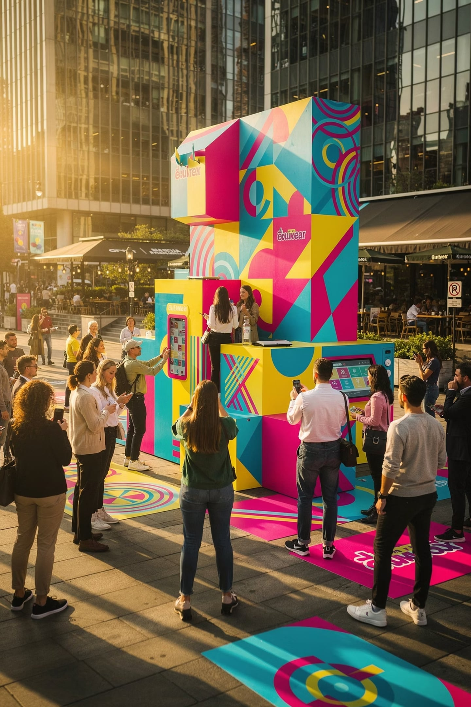
Alternative Marketing
Advertising & Integrated Marketing Communications — Lecture 10
By: Prof. Fidela R. Balajadia
Notes:
Good [morning/afternoon], everyone. Welcome. Today's session is going to be a little different from your typical marketing lecture — we're not going to talk about TV commercials or banner ads. Instead, we're going to explore the world of alternative marketing: the strategies brands use to reach you when you least expect it, and often, when you don't even realize it's happening.
By the end of this session, you'll be able to identify, analyze, and evaluate six distinct forms of alternative marketing — and you'll start seeing them everywhere you go.
Let's begin by asking a simple question: when was the last time you actually paid attention to a traditional advertisement? [Pause for responses.] Exactly. That's the problem marketers face every single day — and that's precisely why alternative marketing exists.
[Transition: Let's start by setting our learning goals for today.]

Slide 2
Learning Objectives
01
02
Define & Differentiate
Identify Types
Alternative vs. traditional marketing strategies
Buzz, Guerrilla, Lifestyle, Experiential, Product Placement, Branded Entertainment, Alternative Media
03
04
Analyze & Evaluate
Apply & Recommend
Advantages, disadvantages, and real-world effectiveness
Appropriate strategies for different products, markets, and objectives
Notes:
Before we dive in, let me walk you through what we'll accomplish today. These are your four learning objectives — think of them as your roadmap for the next hour.
First, we want to define and differentiate alternative marketing from traditional approaches. Second, we'll identify the six specific types. Third, we'll evaluate the pros and cons of each. And finally, we'll apply these concepts to real-world brand examples.
I want you to keep these objectives in mind as we go — at the end of the session, I'll ask you to reflect on which of these you feel most confident about.
[Transition: So, why does alternative marketing even exist? Let's look at the problem it's solving.]

Slide 3
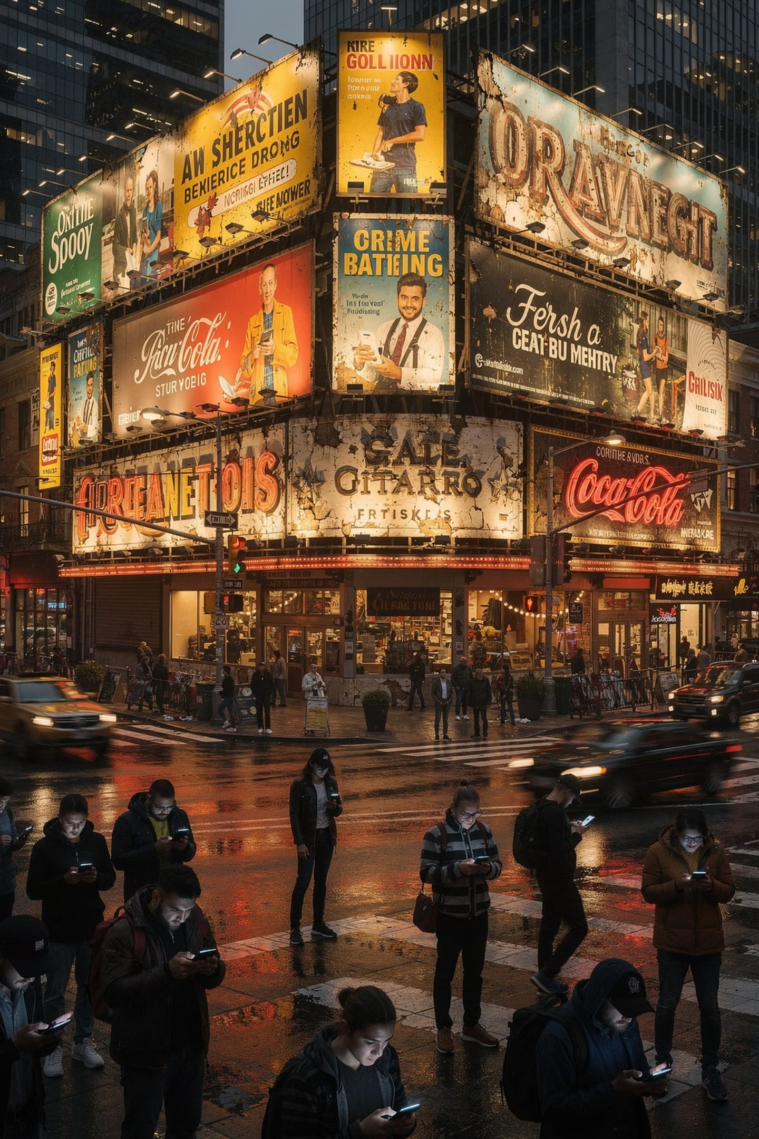
Why Alternative Marketing?
Modern consumers are increasingly resistant to conventional ads. Businesses need creative, engaging, and unconventional approaches.
Trust
Engagement
Consumers trust peers & experiences over ads
Creates memorable emotional connections
Conversation
Stimulates organic word-of-mouth spread
Notes:
Here's the reality: consumers today are bombarded with thousands of advertising messages every single day. Traditional media — TV, radio, print — is losing its grip. People skip ads, use ad blockers, and tune out anything that feels like a commercial.
So what do marketers do? They get creative. They find new ways to reach people — in places, moments, and formats that feel less like advertising and more like... life.
That's the core idea behind alternative marketing: reaching consumers through unexpected, engaging, and often highly personal channels.
[Quick discussion prompt: Can anyone think of a time a brand reached you in an unexpected way? Maybe a sticker, a pop-up, a sponsored event? — Take 1-2 responses.]
[Transition: Now let's get specific. There are six major forms of alternative marketing. Let's map them out.]

Slide 4






6 Forms of Alternative Marketing
Buzz Marketing
Guerrilla Marketing
Word-of-mouth spread
Surprise & creativity
Lifestyle Marketing
Experiential Marketing
Identity & values alignment
Direct product interaction
Product Placement
Alternative Media
Brands in media content
Nontraditional ad venues
Notes:
Here are the six forms we'll be covering today. Think of this slide as your table of contents for the rest of the lecture.
We have: Buzz Marketing, Guerrilla Marketing, Lifestyle Marketing, Experiential Marketing, Product Placement, Branded Entertainment, and Alternative Media Venues.
Each of these operates on a different principle — some rely on surprise, some on identity, some on immersion. We'll go through each one in depth, and for each, we'll look at real examples, advantages, and limitations.
[Tip: You may want to write these six down — they'll be on your review.]
[Transition: Let's start with the first one — Buzz Marketing. It's all about getting people talking.]

Slide 5




Buzz Marketing: Deep Dive
Buzz marketing thrives on creating content and experiences so compelling that people want to share them. Understanding the core triggers is key to crafting effective campaigns.
Emotion
Content that evokes strong emotions—joy, awe, anger, or humor—is highly shareable, as people use it to express their feelings or connect with others.
Surprise
The unexpected catches attention and sparks conversation. Novelty, breaking norms, or surprising facts make people stop, engage, and spread the word.
Social Currency
People share things that make them look good, smart, or in-the-know. Providing "social currency" (insider info, exclusive access, unique stories) motivates sharing.
Notes:
Buzz marketing is essentially engineered word-of-mouth. The goal is to create something so interesting, surprising, or emotionally resonant that people can't help but talk about it — online and offline.
There are three key triggers you need to remember. First: Emotion. Content that makes people feel something — joy, awe, even outrage — gets shared. Second: Surprise. When something breaks expectations, it grabs attention. Third: Social Currency. People share things that make them look good, informed, or 'in the know.'
Think about the last viral video or campaign you shared. Chances are, it hit at least one of these three triggers.
[Transition: Now, buzz marketing isn't one-size-fits-all. There are different types, and each comes with trade-offs. Let's look at those.]

Slide 6
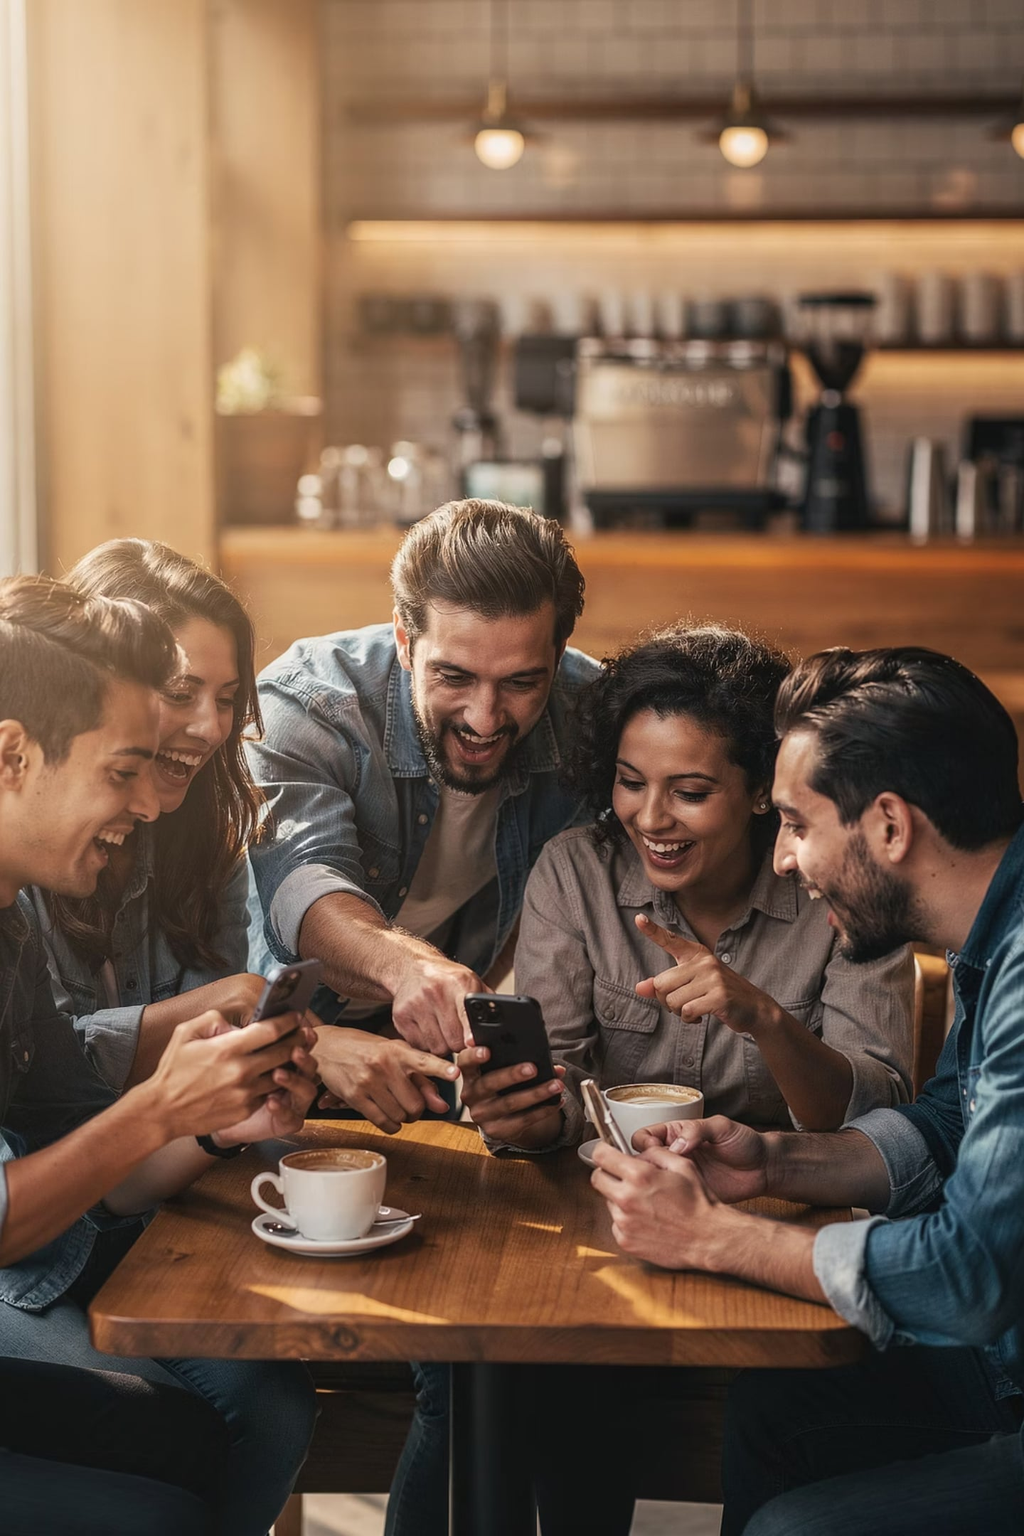



I. BUZZ MARKETING
Word-of-Mouth as Strategy
Buzz marketing encourages consumers to talk about a brand — spreading information naturally from person to person. Consumers become the messengers.
Inoculation
Introduced to influencers & early adopters
Incubation
Reviews, posts & recommendations spread
Infection
Widespread attention — consumers become promoters
Notes:
Word-of-mouth is one of the oldest and most powerful marketing tools in existence — and buzz marketing is its modern, strategic form.
The key insight here is that people trust other people far more than they trust brands. A recommendation from a friend carries more weight than any paid advertisement. So smart marketers don't just hope for word-of-mouth — they engineer it.
They do this by giving people something worth talking about: a remarkable product, a shocking stunt, an exclusive experience, or a story that resonates deeply.
[Transition: But who actually creates the buzz? And what are the risks? Let's look at the types and trade-offs.]

Slide 7

I. BUZZ MARKETING
Types & Trade-offs
Who Creates the Buzz?
Advantages vs. Disadvantages
✅ High credibility & trust
✅ Cost-effective, rapid spread
Brand Lovers
Sponsored Consumers
Genuine customers who voluntarily recommend (e.g., Apple users)
Influencers, reviewers, brand ambassadors
✅ Strong brand awareness
❌ Difficult to control
❌ Negative buzz spreads fast
❌ Unpredictable, short-term impact
Employees
Share product news — transparency is key
Notes:
"Now, buzz can be created in different ways — and not all of them are equal. On one side, you have organic buzz from genuine brand lovers: loyal customers who share because they truly believe in the product. On the other, you have paid buzz — influencers or seeded campaigns where the brand is paying for the spread.
The ethical question here is important: when a brand pays someone to talk about their product without disclosing it, is that honest? This is a real regulatory issue today — the FTC in the US, for example, requires influencers to disclose paid partnerships.
The trade-off is clear: organic buzz is more credible but harder to control. Paid buzz is more scalable but risks backlash if it feels inauthentic.
[Transition: Let's move on to our second form — Guerrilla Marketing. This one is all about shock, surprise, and creativity on a shoestring budget.]"

Slide 8
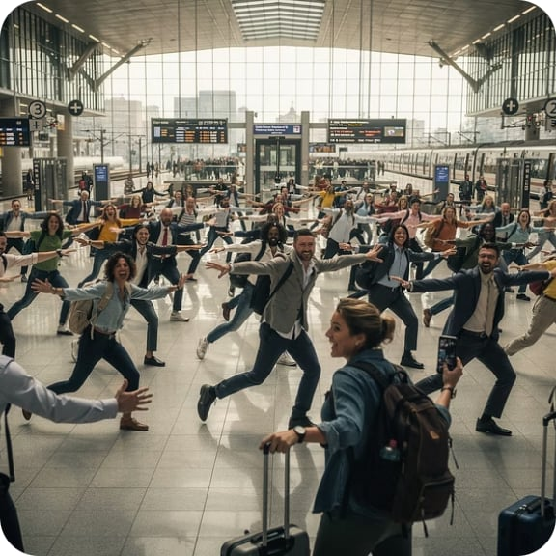
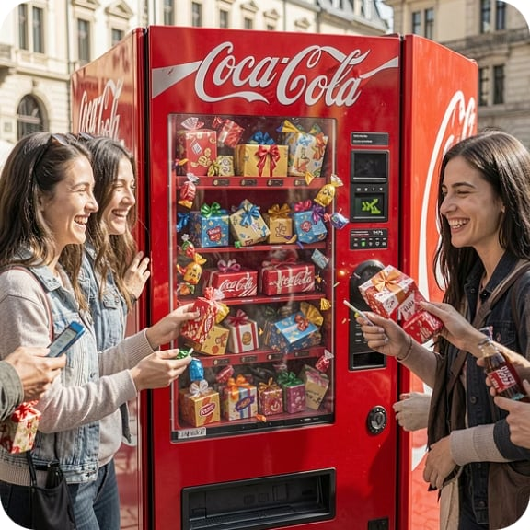

II. GUERRILLA MARKETING
Guerrilla Marketing in Action
Guerrilla marketing leverages surprise and unconventional tactics to create maximum impact with minimal resources. These campaigns are designed to be memorable and shareable.
Flash Mob: T-Mobile
Happiness Machine: Coca-Cola
Street Art: Various Brands
T-Mobile orchestrated several surprise flash mobs in public spaces, turning ordinary moments into joyous spectacles that generated significant buzz and media coverage.
Coca-Cola placed a vending machine that dispensed more than just soda, offering flowers, pizza, and extra drinks, creating viral videos and positive sentiment.
Brands utilize temporary street art, stencils, or chalk drawings in high-traffic areas to capture attention and promote products or messages in an artistic, non-intrusive way.
Notes:
Guerrilla marketing was coined by Jay Conrad Levinson in 1984. The term comes from guerrilla warfare — unconventional tactics used by smaller forces to outsmart larger ones. In marketing, it means using creativity and surprise instead of big budgets.
Look at these three examples on screen. T-Mobile's flash mobs turned ordinary train stations into joyful spectacles — people filmed it, shared it, and it went viral. Coca-Cola's Happiness Machine gave people unexpected gifts from a vending machine — again, filmed and shared. Street art campaigns create visual disruptions that people photograph and post.
Notice the common thread: all of these are designed to be shared. The campaign doesn't end when the stunt does — it lives on through social media.
[Transition: Let's look at what makes guerrilla marketing so powerful — and what makes it risky.]

Slide 9
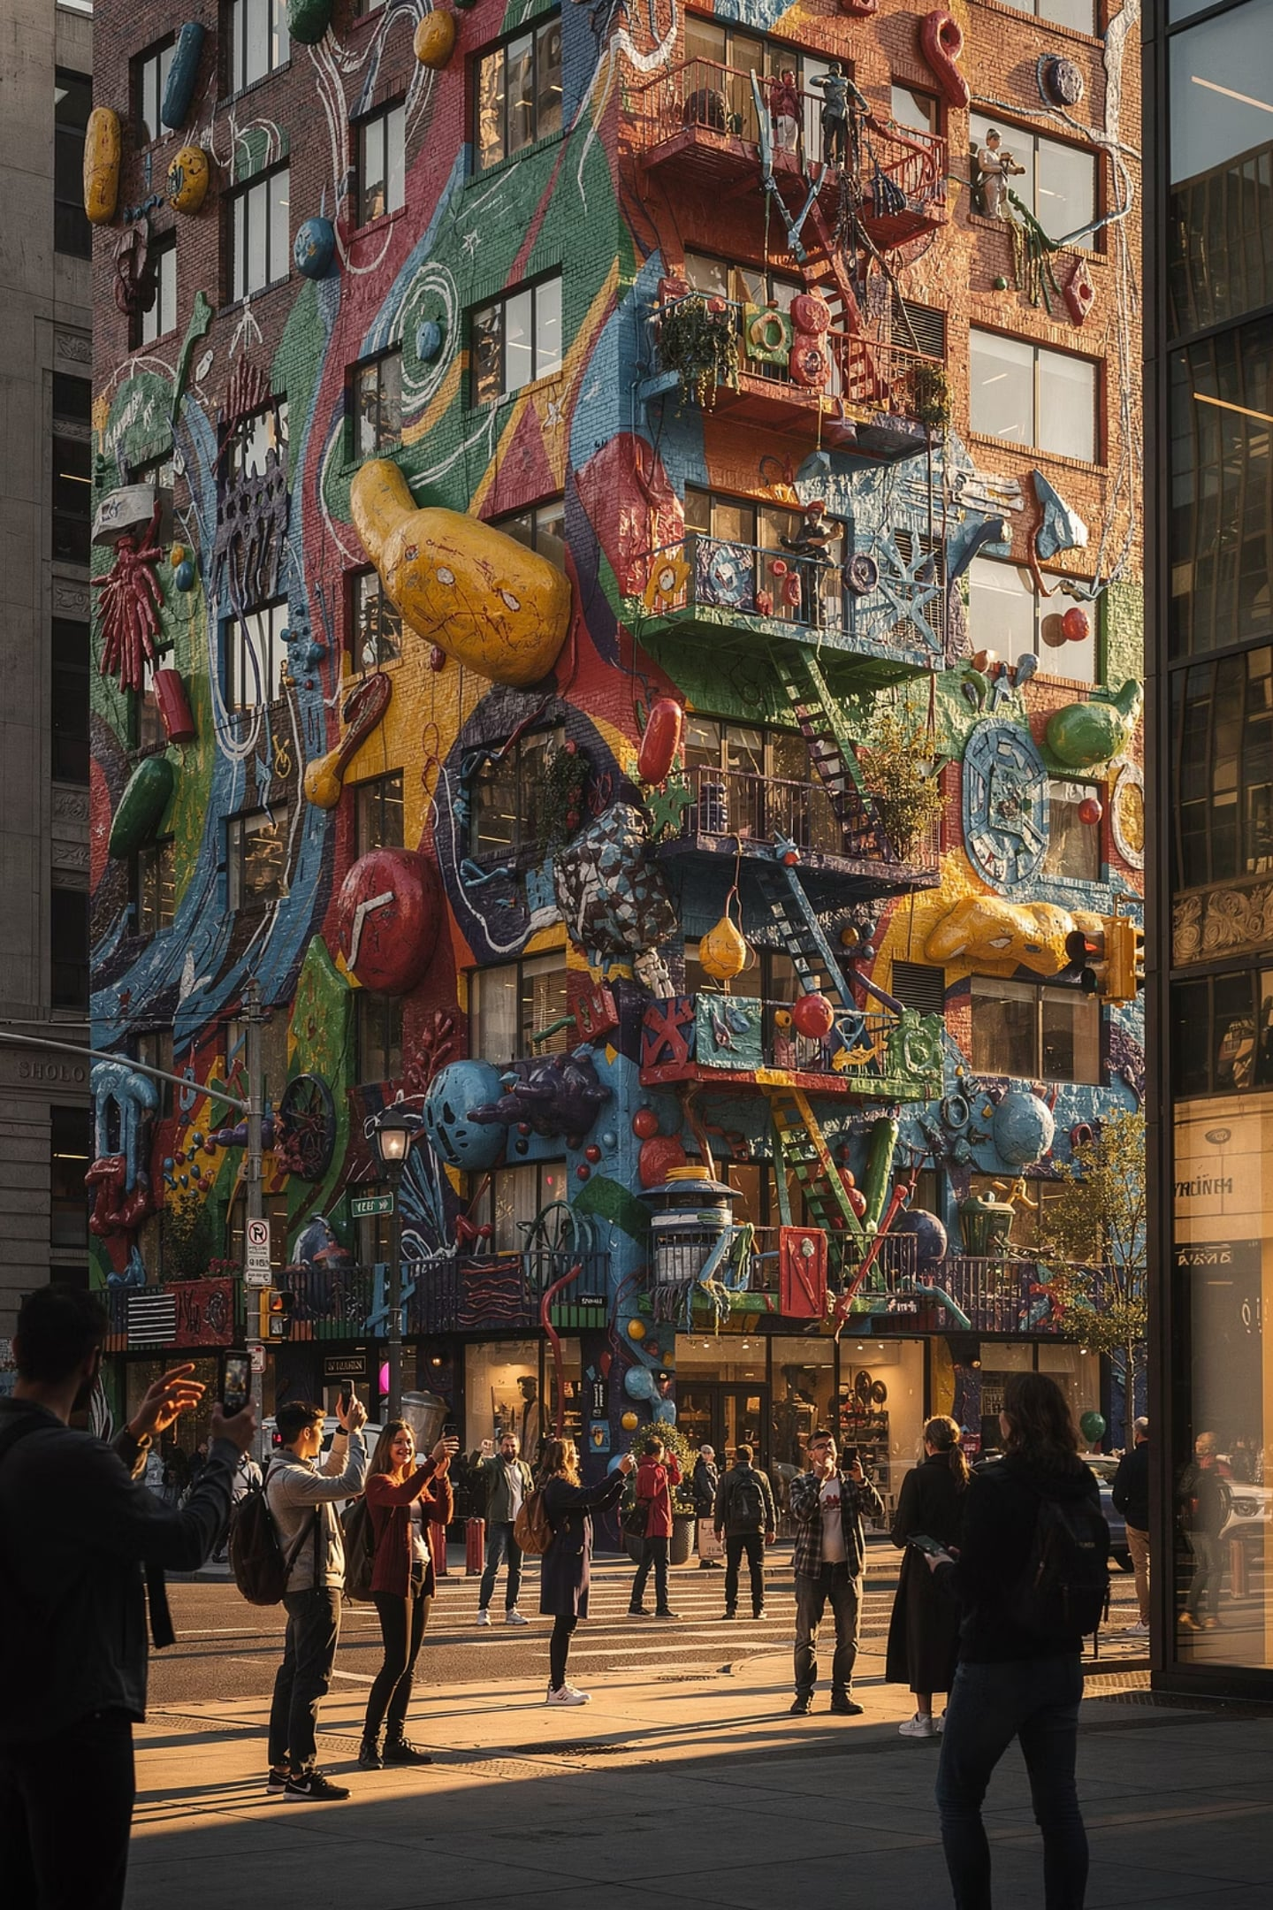
II. GUERRILLA MARKETING
Maximum Impact, Minimal Budget
Introduced by Jay Conrad Levinson (1984) — unconventional creativity to leave a lasting impression.
Creativity
Relationships
Think outside the box — originality is everything
Build positive emotional brand connections
Unconventional Methods
Locations & media people don't expect
Notes:
"The beauty of guerrilla marketing is its asymmetry — a small investment can generate enormous returns if the idea is strong enough. A can of spray paint and a clever stencil can get more attention than a million-peso billboard.
But here's the key: the idea has to be genuinely creative and relevant. A bad guerrilla campaign doesn't just fail — it can embarrass the brand or even cause public safety concerns. In 2007, Turner Broadcasting ran a guerrilla campaign for a cartoon show that placed LED devices around Boston — and the city's bomb squad was called in. That's a cautionary tale.
So the lesson is: guerrilla marketing rewards boldness, but punishes carelessness.
[Transition: Now let's look at the pros and cons more formally.]"

Slide 10
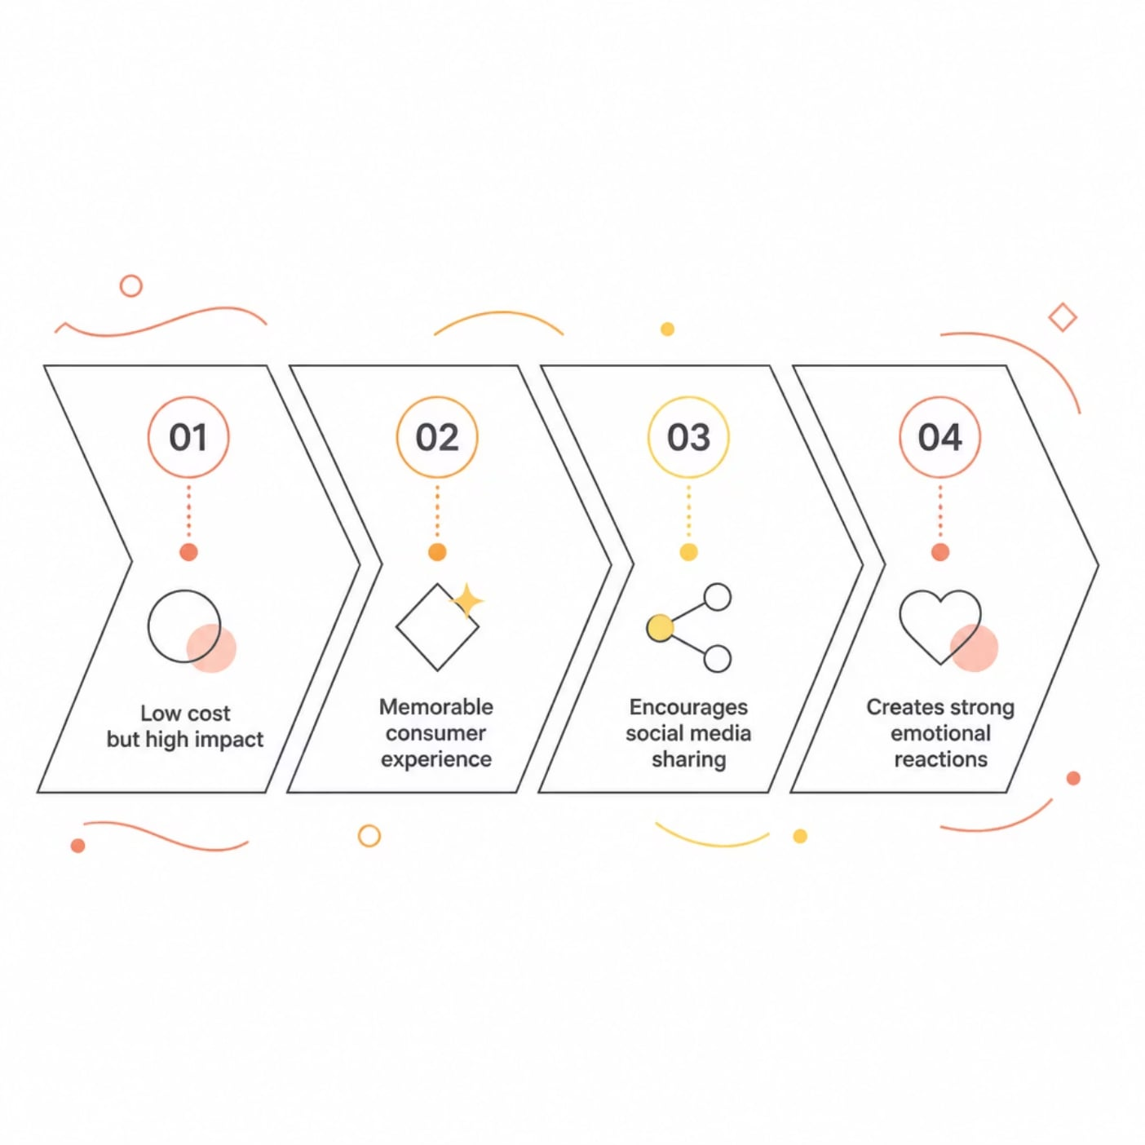

II. GUERRILLA MARKETING
Pros & Cons
Watch Out For:
Misunderstanding
Public Backlash
Message may be unclear or confusing
Risk of being seen as annoying or offensive
Legal Issues
Hard to Measure
Public installations require permits
Difficult to quantify sales impact
Notes:
Let's formalize the pros and cons. On the positive side: guerrilla marketing is low-cost, highly memorable, and generates organic PR. When it works, it really works.
On the negative side: it's unpredictable. You can't guarantee it will go viral. It can also backfire — if the stunt is misunderstood, offensive, or causes disruption, the brand takes the hit. And unlike a TV ad, you can't pull a guerrilla campaign once it's out there.
[Quick poll: Raise your hand if you think the benefits outweigh the risks. Now raise your hand if you think the risks are too high. — Briefly discuss.]
[Transition: Alright, let's shift gears. Our third form is Lifestyle Marketing — and this one is about something much deeper than a clever stunt.]

Slide 11
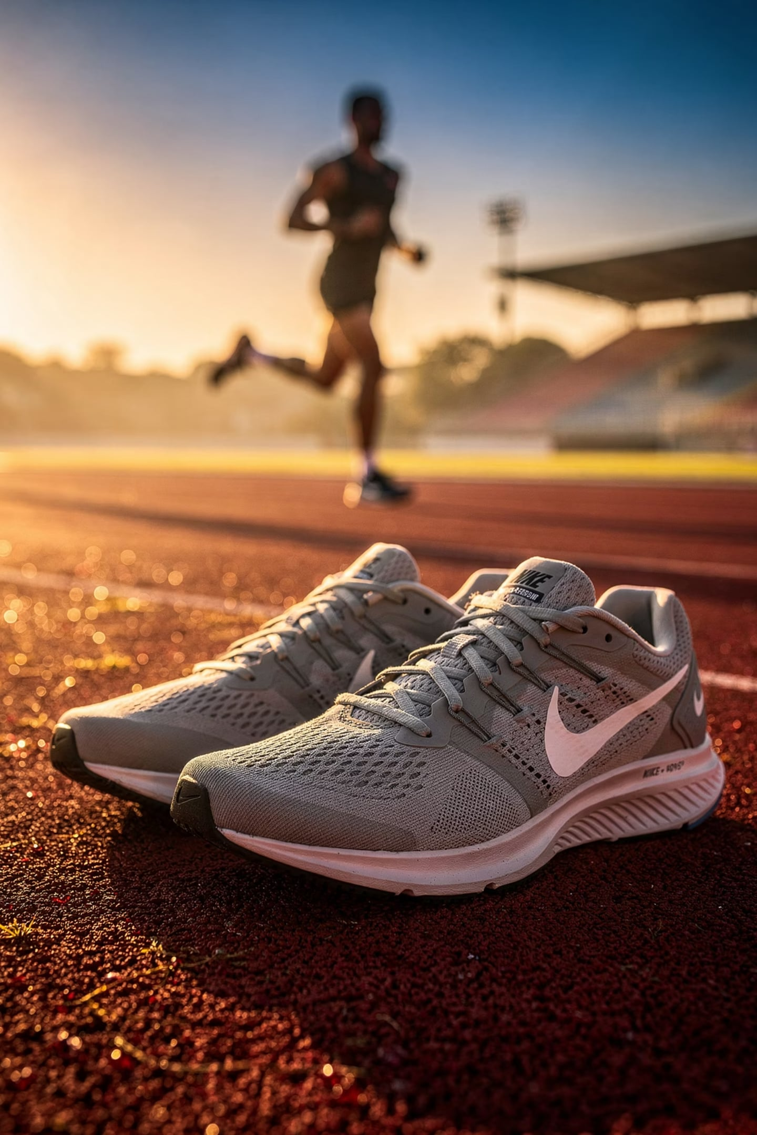


III. LIFESTYLE MARKETING
Sell an Identity, Not Just a Product
Align the brand with consumers' values, interests, and aspirations. Consumers buy identities and social meanings — not just features.
Nike doesn't sell shoes — it sells fitness, achievement, discipline, and empowerment. "Just Do It."
Harley-Davidson sells freedom. Apple sells innovation. The product is secondary to the lifestyle.
Notes:
Lifestyle marketing is built on a powerful psychological insight: people don't just buy products — they buy identities. They buy a version of themselves they want to be.
When you buy Nike, you're not just buying shoes. You're buying into the idea of being an athlete, a competitor, someone who pushes their limits. When you buy Harley-Davidson, you're buying freedom and rebellion. The product is almost secondary.
This is why lifestyle marketing is so effective — and so sticky. Once a brand becomes part of someone's identity, they become fiercely loyal. They don't just buy the product; they defend it, promote it, and recruit others.
[Transition: Let's look at three brands that have mastered this approach.]

Slide 12
III. LIFESTYLE MARKETING
Strengths & Limitations
Why It Works
Risks
Strong emotional connections
Narrow audience
Brand represents who consumers are
Limits market reach
Brand loyalty & premium pricing
Trends change
Consumers pay more for identity
Today's lifestyle may be irrelevant tomorrow
Differentiates the brand
Risk of inauthenticity
Personality over product specs
Consumers detect forced trend-chasing
Notes:
The strengths of lifestyle marketing are significant. It creates deep emotional loyalty, it's hard for competitors to copy because it's tied to culture and identity, and it generates organic advocacy.
But the limitations are real too. It takes time — you can't build a lifestyle brand overnight. It requires authenticity — if the brand's actions don't match its stated values, consumers will call it out. And it can be exclusionary — by targeting one lifestyle, you may alienate others.
[Transition: Now let's see these principles in action with three iconic brands.]

Slide 13
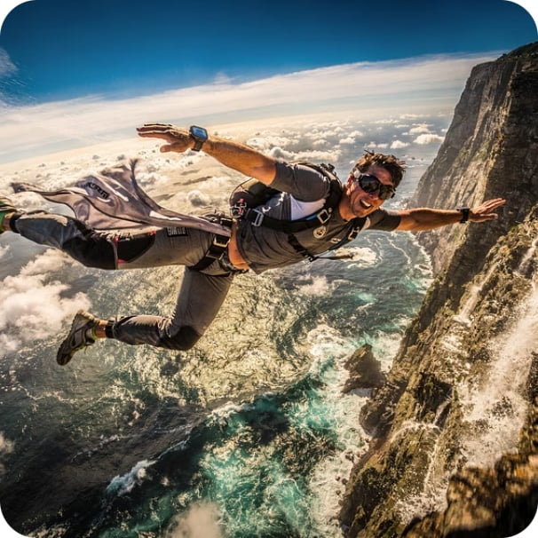


III. LIFESTYLE MARKETING
Lifestyle Marketing in Action
Leading brands don't just sell products; they cultivate a vision of life, aligning their offerings with specific values and aspirations. This creates deep emotional connections with their target audience.
Red Bull
Patagonia
Lululemon
Sells extreme sports, adventure, and overcoming limits. Its events and sponsorships embody a high-octane lifestyle, positioning the drink as fuel for extraordinary feats.
Promotes environmental activism, outdoor exploration, and sustainability. Customers buy into a commitment to nature and durable, ethically produced gear for a mindful, adventurous life.
Aligns with wellness, yoga, and mindful living. Beyond activewear, they foster a community around health, self-improvement, and premium comfort for a balanced, active lifestyle.
Notes:
Let's look at three brands that have built empires not on products, but on lifestyles.
Red Bull doesn't advertise a drink — it sponsors extreme sports, music festivals, and record-breaking stunts. Their tagline 'gives you wings' is about possibility and daring, not caffeine content.
Patagonia sells outdoor gear, but their real product is environmental activism. They've run ads telling people NOT to buy their jackets unless they really need them. That kind of radical authenticity builds cult-like loyalty.
Lululemon built a community around yoga and wellness long before athleisure was mainstream. Their stores host free yoga classes. Their staff are called 'educators.' The product is almost incidental to the community.
[Discussion: Which of these resonates most with you personally, and why? — Take 1-2 responses.]
[Transition: Now we move to our fourth form — Experiential Marketing. If lifestyle marketing sells an identity, experiential marketing sells a memory.]

Slide 14
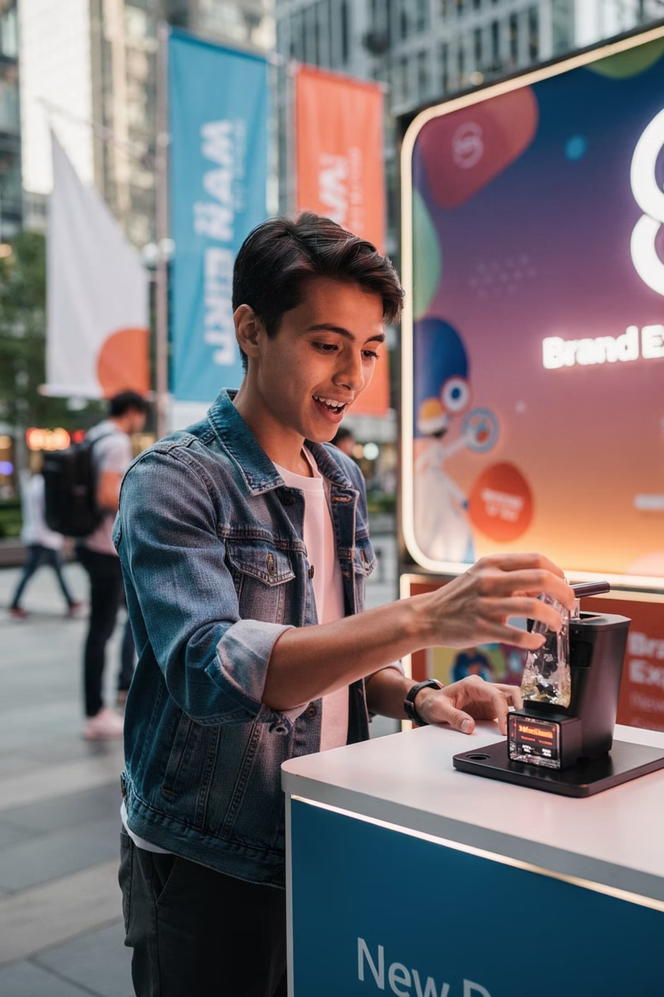
IV. EXPERIENTIAL MARKETING
Don't Tell — Let Them Experience It
Allow consumers to directly interact with a product before purchasing. Experiences create stronger memories, higher trust, and greater emotional engagement.
Wuling Air EV
Test drives let buyers evaluate comfort, handling & performance firsthand
Steam Game Demos
Free demos reduce uncertainty and encourage full-game purchases
Notes:
Experiential marketing is based on a simple but powerful idea: let people experience the product before they buy it. Don't tell them it's great — let them feel it for themselves.
Research consistently shows that direct experience is the most persuasive form of marketing. When you test drive a car, you're not just evaluating specs — you're imagining your life with that car. When you play a game demo, you're already emotionally invested before you've spent a peso.
The Wuling Air EV example here is particularly relevant for our market. Test drives allow buyers to evaluate comfort and performance firsthand — removing the uncertainty that often blocks a purchase decision.
[Transition: But experiential marketing comes with real costs and challenges. Let's look at both sides.]

Slide 15
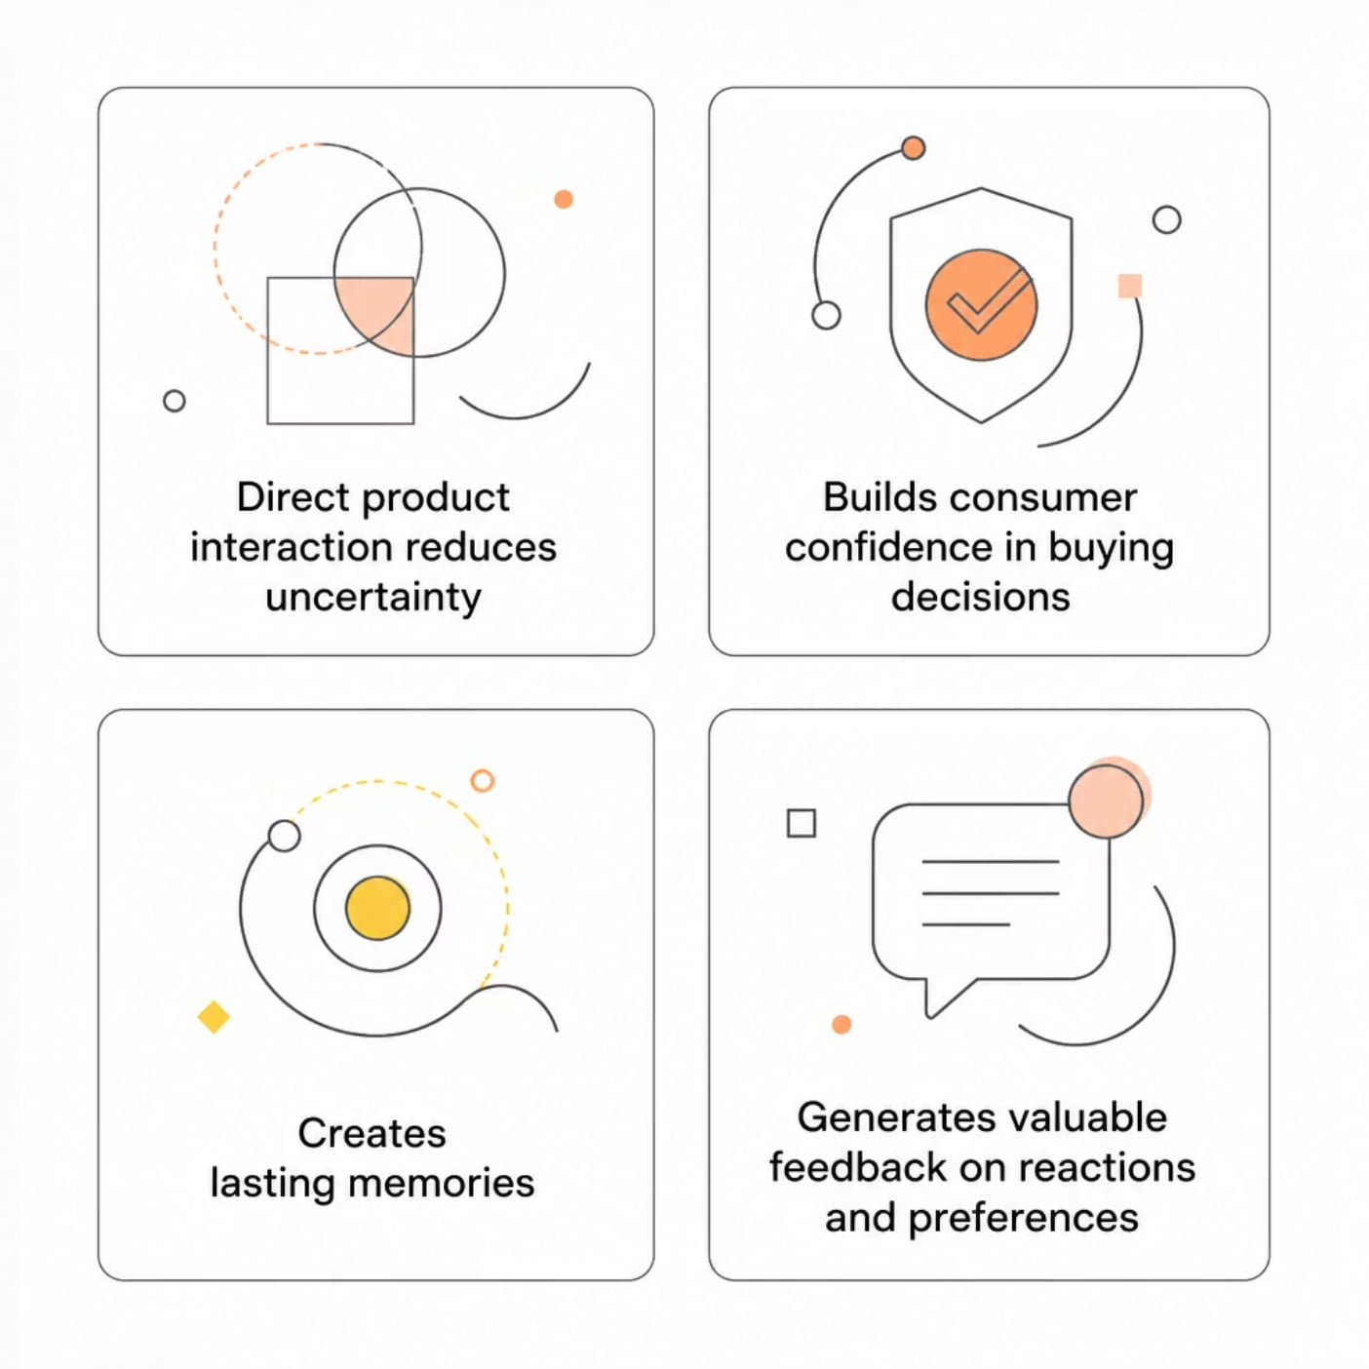

IV. EXPERIENTIAL MARKETING
Benefits & Challenges
Key Challenges
High costs
Limited reach
Staff, equipment, venues & logistics
Only those physically present
Complex planning
Hard to scale
Small mistakes can damage brand image
Personalized experiences at large volume are difficult
Notes:
"The benefits of experiential marketing are clear: it reduces purchase uncertainty, builds confidence, creates lasting memories, and generates valuable feedback. When someone has a great experience with your product, they remember it — and they tell others.
But the challenges are significant. It's expensive. You need staff, equipment, venues, and logistics. It has limited reach — only the people physically present benefit from the experience. And it's hard to scale. You can't give everyone a personalized experience at volume.
This is why experiential marketing is often used for high-involvement purchases — cars, technology, luxury goods — where the cost of the experience is justified by the value of the sale.
[Transition: Let's look at some of the most iconic experiential campaigns ever executed.]"

Slide 16

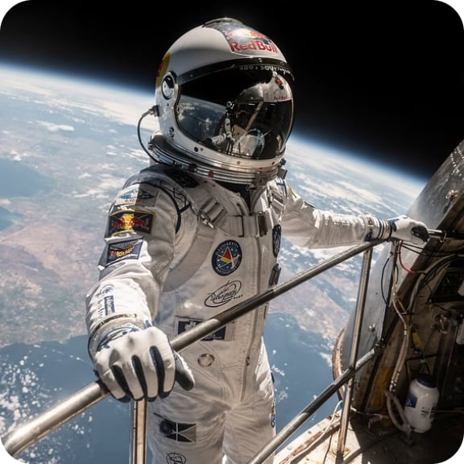

IV. EXPERIENTIAL MARKETING
Experiential Marketing in Action
Leading brands create memorable moments that deeply connect with consumers, allowing them to immerse themselves in the brand's world rather than just observe it.
IKEA Sleepovers
Red Bull Stratos
Nike Run Club
IKEA invited customers for exclusive overnight stays in their stores, offering a unique opportunity to test beds and experience home furnishings in a memorable and shareable way.
Red Bull sponsored Felix Baumgartner's record-breaking freefall from the stratosphere, an extreme event that captured global attention and perfectly embodied the brand's 'gives you wings' ethos.
Nike built a global community through its app and events, offering guided runs, training programs, and social gatherings, turning running into a lifestyle supported by their products.
Notes:
These three examples represent the gold standard of experiential marketing.
IKEA's sleepovers — imagine being invited to spend the night in a furniture store. It sounds absurd, but it's genius. Customers got to actually sleep in the beds, use the kitchens, and experience the products in the most authentic way possible. The PR value was enormous.
Red Bull Stratos — Felix Baumgartner jumping from the edge of space. Over 8 million people watched it live on YouTube. It wasn't just a stunt — it was a global event that perfectly embodied Red Bull's brand promise of pushing human limits.
Nike Run Club — rather than just selling shoes, Nike built a global running community. The app, the events, the group runs — they turned a product into a lifestyle ecosystem.
[Transition: Now we move to our fifth form — Product Placement. This is where marketing meets entertainment.]

Slide 17
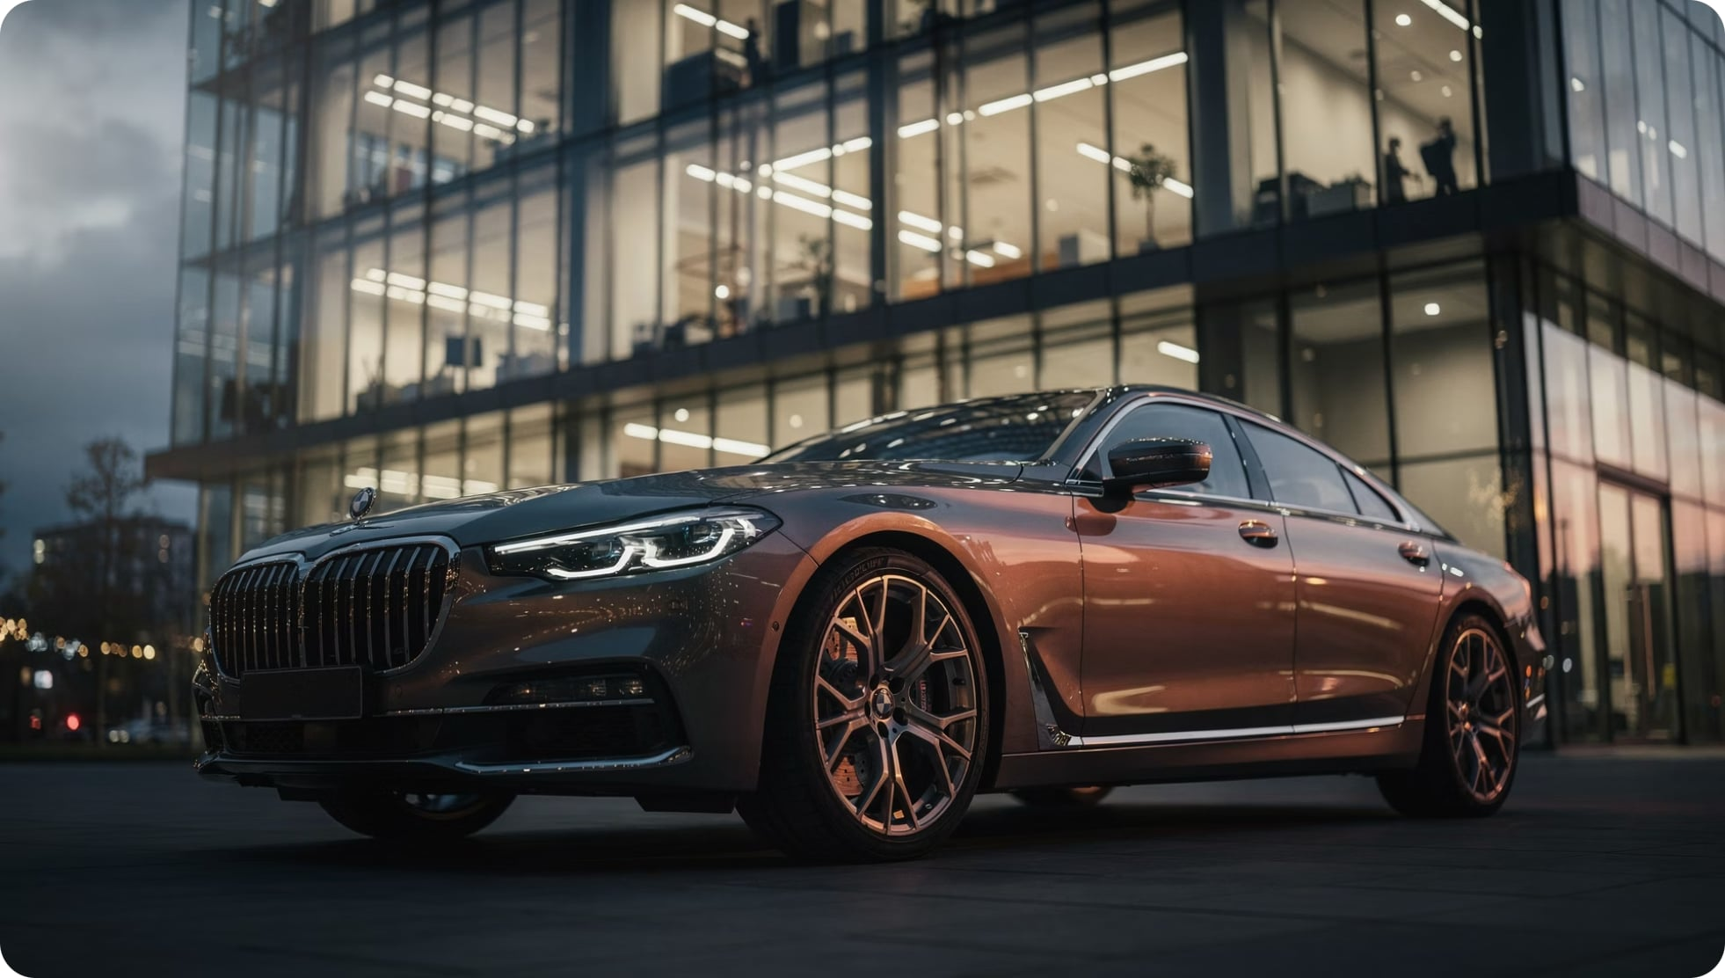

V. PRODUCT PLACEMENT
The Brand Becomes Part of the Story
What It Is
Deliberate inclusion of branded products within movies, TV, or streaming content — without interrupting the viewing experience.
Why It Works
Consumers associate brands with admired characters
Positive emotions transfer to the brand
Example: Audi in Iron Man → innovation, luxury, sophistication
Notes:
Product placement is one of the oldest forms of alternative marketing — and one of the most subtle. The idea is simple: instead of interrupting a TV show or movie with an ad, you put the brand inside the content itself.
Think about James Bond. He doesn't drive just any car — he drives an Aston Martin. He doesn't drink just any drink — he drinks Heineken. These aren't accidents. They're carefully negotiated placements worth millions of dollars.
Why does it work? Because when we see a character we admire using a product, we associate that product with those qualities. Bond is sophisticated, powerful, and cool — and so, by extension, is the Aston Martin.
The key advantage over traditional advertising: viewers don't skip it. They can't fast-forward past Bond's car.
[Transition: But product placement has evolved into something even more powerful — Branded Entertainment. Let's explore that next.]

Slide 18
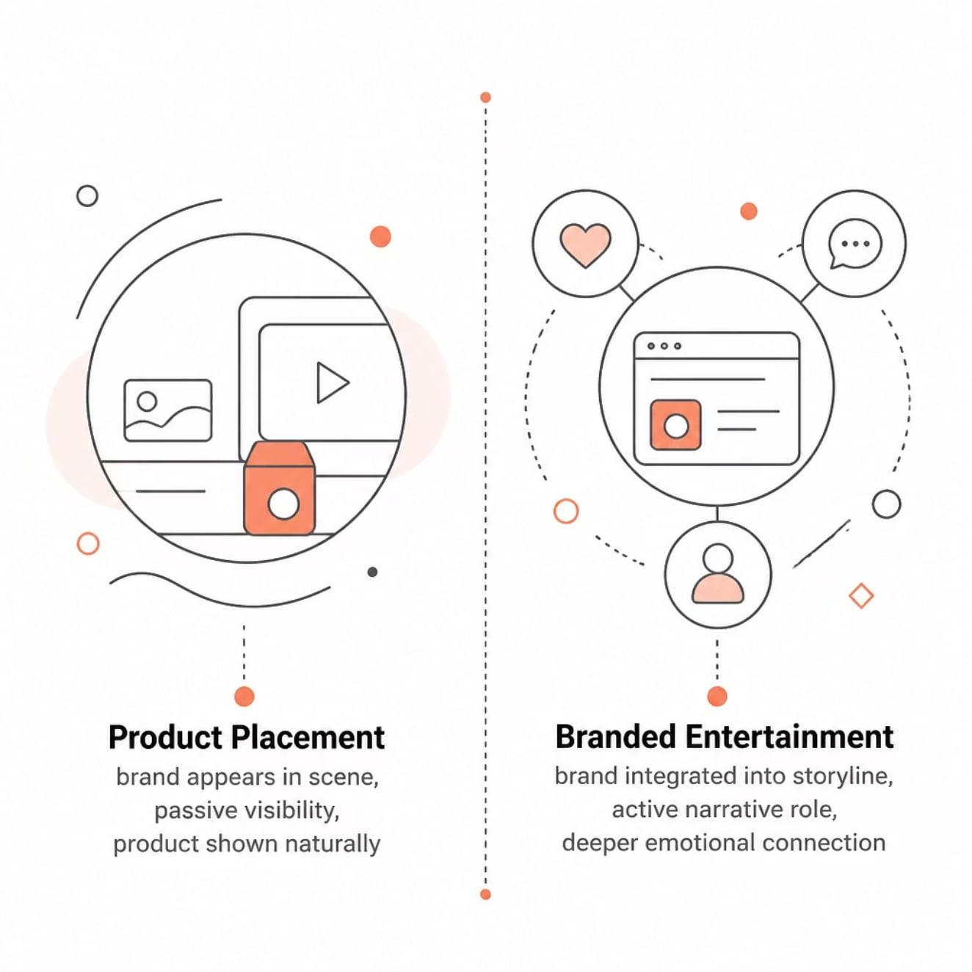
VI. BRANDED ENTERTAINMENT
Beyond Placement — Into the Narrative
Product Placement vs. Branded Entertainment
Real Example
In the Korean drama Vincenzo, Song Joong-ki consumed Kopiko candy as part of the story — not as a separate ad. The Indonesian brand gained massive international exposure.
Why Both Keep Growing
Less advertising resistance
Celebrity influence transfers to brand
Builds brand equity & consumer loyalty
Notes:
Branded entertainment takes product placement to its logical extreme. Instead of putting a brand inside someone else's story, the brand becomes the story.
The LEGO Movie is the perfect example. The entire film is essentially a two-hour advertisement for LEGO — but it's so entertaining, so well-made, that audiences paid to watch it and loved it. It grossed over $469 million worldwide. That's not just marketing — that's a business model.
This represents a fundamental shift: from interrupting entertainment to creating it. The brand doesn't just appear in the content — it IS the content.
[Transition: Let's compare these two approaches side by side to make the distinction crystal clear.]

Slide 19
VI. BRANDED ENTERTAINMENT
Product Placement vs. Branded Entertainment
While both methods embed brands into content, their approach to integration and narrative role differ significantly, leading to distinct viewer experiences and marketing outcomes.
Feature
Product Placement
Branded Entertainment
Integration Level
Subtle, often passive appearance
Brand is central to the storyline or content
Narrative Role
Usually background or incidental; minimal plot influence
Drives the plot, characters, or overall theme
Viewer Perception
Recognized as an advertisement within content
Primarily seen as entertainment; brand is part of the story
Main Goal
Brand exposure, recall, and association
Deep emotional connection, brand immersion, storytelling
Example
James Bond & Aston Martin: Bond drives the car
The LEGO Movie: The entire film is about the brand
Notes:
This table gives you a clean framework for distinguishing the two. The key differences come down to integration level, narrative role, and viewer perception.
With product placement, the brand is a guest in someone else's story. With branded entertainment, the brand is the host — it owns the story.
Both are valuable, but they serve different goals. Product placement is great for brand exposure and association. Branded entertainment is better for deep emotional connection and long-term brand building.
[Quick check: Can anyone give me another example of branded entertainment — something you've watched recently where a brand was central to the story? — Take 1-2 responses.]
[Transition: Now let's look at our final category — Alternative Media Venues. This is about finding your audience in the most unexpected places.]

Slide 20
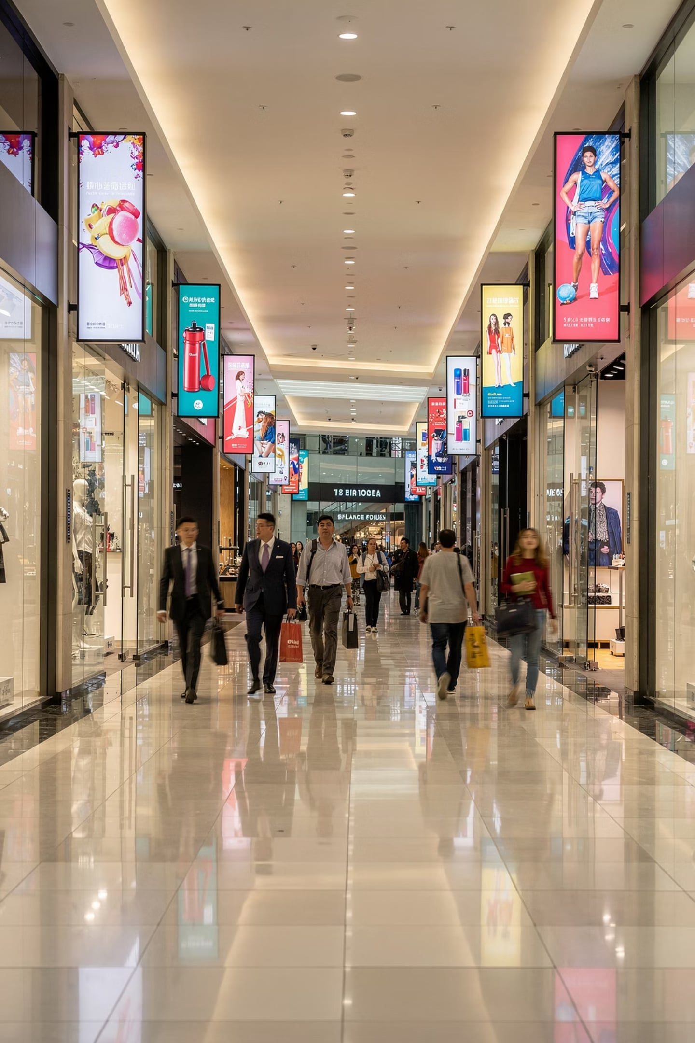




VII. ALTERNATIVE MEDIA VENUES
Ads Where You Least Expect Them
Nontraditional locations where advertising messages appear during consumers' everyday activities.
Video Games
FIFA 23: Mbappé + PlayStation branding
Cinemas
Captive, focused audience pre-screening
MRT Stations
Tokopedia × BTS campaign across Jakarta MRT
Airports & Airlines
High-dwell-time travel environments
Notes:
Alternative media venues are exactly what they sound like: advertising in places you don't normally expect to see ads. The goal is to reach consumers when their guard is down — when they're not in 'ad-watching mode.'
Think about it: when you're waiting for an elevator, you're captive. When you're in a restroom, you're captive. When you're pumping gas, you're captive. These are moments of low distraction and high dwell time — perfect for advertising.
The key insight is context. An ad for a gym placed in a restroom mirror is far more impactful than the same ad on a billboard, because the context — you looking at yourself — makes the message personally relevant.
[Transition: Let's look at the full range of alternative media venues available to marketers.]

Slide 21

Alternative Media: More Venues
Shopping Malls
Escalators & Elevators
Digital displays & promotional installations
High-traffic captive moments
Parking Areas
Clothing & Apparel
Large visuals for drivers & pedestrians
Logos as walking advertisements
The goal: reach consumers where they already are — naturally and unobtrusively.
Notes:
Here's a broader look at the venues available. Shopping malls, escalators, restrooms, parking lots, gas stations, gyms, doctor's waiting rooms — all of these are spaces where people spend time and are receptive to messaging.
What makes these venues powerful is the combination of captive audience and contextual relevance. A food brand advertising in a grocery store parking lot reaches people who are literally about to go buy food. A pharmaceutical brand advertising in a doctor's waiting room reaches people who are thinking about their health.
The challenge is measurement — it's harder to track the impact of a restroom ad than a digital ad. But the recall rates for contextually relevant alternative media are often surprisingly high.
[Transition: How do we actually measure whether these placements are working? Let's look at the metrics.]

Slide 22
VII. ALTERNATIVE MEDIA VENUES
Alternative Media: Effectiveness & Measurement
Measuring the success of unconventional placements requires tailored metrics that capture consumer engagement and impact beyond traditional advertising.
5M+
30-90s
Reach
Dwell Time
Number of unique individuals exposed to the ad message.
Average duration consumers spend engaging with the advertisement.
60%
3.5x
Recall
ROI
Percentage of consumers who remember the brand or message.
Measured through sales uplift, brand perception, or web traffic.
Notes:
One of the criticisms of alternative marketing is that it's hard to measure. So let's address that directly.
There are four key metrics. Reach tells you how many unique people were exposed to the message. Dwell time tells you how long they engaged with it — and in alternative venues, dwell time is often much higher than with traditional ads. Recall measures whether people actually remember the brand or message after exposure. And ROI ties it all together — did the campaign drive sales, improve brand perception, or increase web traffic?
The numbers on this slide are illustrative, but they reflect real industry benchmarks. A well-executed alternative media campaign can achieve recall rates of 60% or higher — significantly above the industry average for traditional advertising.
[Transition: Now that we've covered all six forms, let's zoom out and compare them. Then we'll look at how to choose the right one for a given situation.]

Slide 23

Comparing All 6 Strategies
Product Placement
Guerrilla
Buzz
Lifestyle
Experiential
Each strategy engages consumers differently — but all share one goal: feel natural, memorable, and less intrusive than traditional advertising.
Notes:
Now let's step back and look at all six strategies together. Each one occupies a different space in the marketing landscape.
Buzz marketing is about conversation. Guerrilla marketing is about surprise. Lifestyle marketing is about identity. Experiential marketing is about immersion. Product placement is about association. Branded entertainment is about storytelling. And alternative media is about context.
Notice that these aren't mutually exclusive — the best campaigns often combine multiple approaches. Red Bull, for example, uses all six simultaneously.
[Transition: Let's look at the shared advantages that make all of these strategies worth considering.]

Slide 24
Advantages Across Strategies
6
↑
Strategy Types
Brand Awareness
Each with unique engagement mechanism
All strategies build recognition beyond traditional ads
💬
$
Consumer Trust
Cost Efficiency
Peer recommendations & experiences outperform paid ads
Buzz & guerrilla achieve high impact with low spend
Notes:
Despite their differences, all six alternative marketing strategies share a set of core advantages over traditional advertising.
They all tend to generate higher brand awareness because they're more memorable. They all create stronger emotional connections because they're more personal and contextual. They all benefit from lower advertising resistance because they don't feel like ads. And they all have the potential to generate earned media — coverage and sharing that the brand didn't pay for directly.
These shared advantages explain why alternative marketing has grown so dramatically over the past two decades, and why it will continue to grow as consumers become even more resistant to traditional advertising.
[Transition: But it's not all upside. Let's look at the challenges and ethical considerations that marketers must navigate.]

Slide 25
Choosing the Right Strategy
Selecting the optimal alternative marketing strategy depends on a clear understanding of your budget, target audience, and campaign objectives. Each approach offers unique advantages and requires different resources.
Strategy
Budget
Audience
Primary Goal
Key Characteristic
Buzz Marketing
Low to Medium
Early adopters, trendsetters
Generate hype, word-of-mouth
Relies on novelty, shareable content
Guerrilla Marketing
Low
Local, specific niches
Maximize impact, generate PR
Surprise, unconventional tactics
Lifestyle Marketing
Medium to High
Specific lifestyle groups
Integrate brand into daily life
Authentic, values-driven integration
Experiential Marketing
Medium to High
Engaged, active consumers
Memorable, immersive experiences
Interactive, emotional connection
Product Placement
Medium to High
Viewers of specific content
Brand exposure, subtle association
Seamless integration into media
Branded Entertainment
High
Content consumers
Deep brand immersion, storytelling
Brand drives narrative, entertainment
Alternative Media
Low to Medium
Consumers in specific locations
Reach where consumers expect least
Unconventional, everyday locations
Notes:
Emphasize that while each strategy has a typical budget range, creativity can often reduce costs in areas like Guerrilla and Buzz marketing.
Stress the importance of understanding the brand's core values and target audience's habits before committing to a strategy.
This decision framework is one of the most practical tools you'll take away from today's session. When a client or employer asks you 'what kind of marketing should we do?', this table gives you a structured way to answer.
Walk through it with me. If you have a low budget and want to generate hype quickly — Buzz or Guerrilla. If you're targeting a specific lifestyle community and have time to build — Lifestyle Marketing. If you're selling a high-involvement product and can afford the investment — Experiential. If you're working with a media partner — Product Placement or Branded Entertainment. If you want to reach people in specific physical locations — Alternative Media.
The key is matching the strategy to the context. There's no universally 'best' approach — only the best approach for a given brand, audience, and objective.
[Transition: Now let's look at the challenges and ethical issues that apply across all these strategies.]

Slide 26


Challenges & Ethical Considerations
Control
Negative buzz spreads as fast as positive
Measurement
Guerrilla & buzz outcomes are hard to quantify
Authenticity
Forced lifestyle alignment destroys consumer trust
Legal & Ethical
Permits, transparency, and sponsored disclosure required
Notes:
This is a critical slide — and one that's often overlooked in marketing courses. Alternative marketing, by its very nature, operates in gray areas. Let's talk about the ethical dimensions.
The biggest challenge is transparency. When a brand pays an influencer to promote a product without disclosure, or plants a fake 'consumer review,' that's deceptive. Consumers have a right to know when they're being marketed to.
There's also the issue of intrusiveness. Guerrilla campaigns in public spaces, ads in restrooms, product placement in children's content — at what point does creative marketing become an invasion of personal space or a manipulation of vulnerable audiences?
And then there's measurement and accountability. If you can't measure it, how do you know it's working? How do you justify the spend?
These aren't just academic questions — they're the questions regulators, consumers, and brands are wrestling with right now.
[Transition: Let's look at where all of this is heading — the future of alternative marketing.]

Slide 27
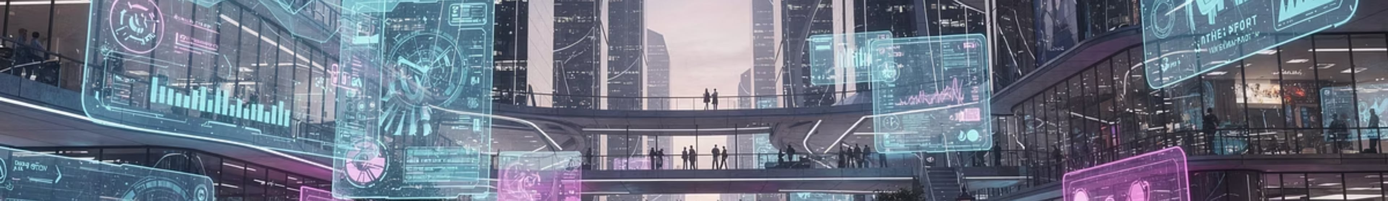




VIII. EMERGING TRENDS
The Future of Alternative Marketing
As the digital landscape evolves, so do the opportunities for innovative, non-traditional marketing. These emerging trends harness cutting-edge technology and human connection to redefine consumer engagement.
AI-Driven Personalization
AR/VR Experiences
Leveraging artificial intelligence to deliver hyper-targeted messages and adaptive experiences in real-time, making every interaction unique.
Creating immersive brand narratives and virtual product trials, allowing consumers to interact with products in augmented or virtual realities.
Niche Influencer Marketing
Community-Led Growth
Shifting focus to authentic advocacy through specialized niche creators and micro-influencers who deeply resonate with specific communities.
Fostering vibrant brand communities that drive organic expansion, loyalty, and co-creation, turning customers into advocates.
Notes:
We're living through a transformation in marketing. The strategies we've discussed today are already powerful — but they're about to become even more sophisticated.
AI-driven personalization means that alternative marketing can be tailored to individual consumers in real time. Imagine a guerrilla campaign that adapts its message based on who's walking by.
AR and VR are creating entirely new experiential marketing possibilities. Brands can now create immersive virtual experiences that reach millions of people simultaneously — solving the scale problem of traditional experiential marketing.
Niche influencer marketing is replacing celebrity endorsements. A micro-influencer with 10,000 highly engaged followers in a specific niche often delivers better ROI than a celebrity with 10 million passive followers.
And community-led growth — where the brand's own customers become its primary marketing engine — is becoming the gold standard for sustainable brand building.
[Transition: Let's see all of this in action with one brand that does it better than almost anyone else.]

Slide 28




IX. CASE STUDY
Red Bull: A Multi-Strategy Powerhouse
Red Bull epitomizes integrated alternative marketing, seamlessly blending diverse strategies to cultivate a potent brand identity centered on adventure, energy, and peak performance.
Buzz Marketing
Lifestyle Marketing
Generating global conversations with stunts like the Stratos space jump and sponsoring extreme sports events, making headlines worldwide.
Integrating the brand into action sports, music, and adventure communities, embodying a lifestyle of daring, achievement, and pushing limits.
Experiential Marketing
Branded Entertainment
Creating immersive events like the Red Bull Air Race and local competitions that offer direct, memorable experiences to target consumers.
Producing high-quality content via Red Bull TV, including documentaries, series, and music videos that entertain while subtly reinforcing brand values.
These strategies aren't standalone; they form a cohesive ecosystem where each element amplifies the others, turning Red Bull from a beverage into a global cultural phenomenon.
Notes:
Red Bull is the ultimate case study in integrated alternative marketing. They don't just use one strategy — they use all of them, and they use them in a way that feels completely coherent and authentic.
Buzz: The Stratos space jump generated global headlines and social media conversation. Guerrilla: Red Bull's street teams hand out free cans in unexpected places. Lifestyle: They sponsor extreme sports, music, and esports — embedding the brand in the cultures their audience lives in. Experiential: The Red Bull Air Race, Flugtag, and local events create direct, memorable brand encounters. Branded Entertainment: Red Bull TV produces original content — documentaries, series, music videos — that people actively seek out.
The result? Red Bull is not perceived as an energy drink company. It's perceived as a media and lifestyle company that happens to sell energy drinks. That's the power of integrated alternative marketing.
[Transition: Let's close with our key takeaway, and then we'll move into the review questions.]

Slide 29
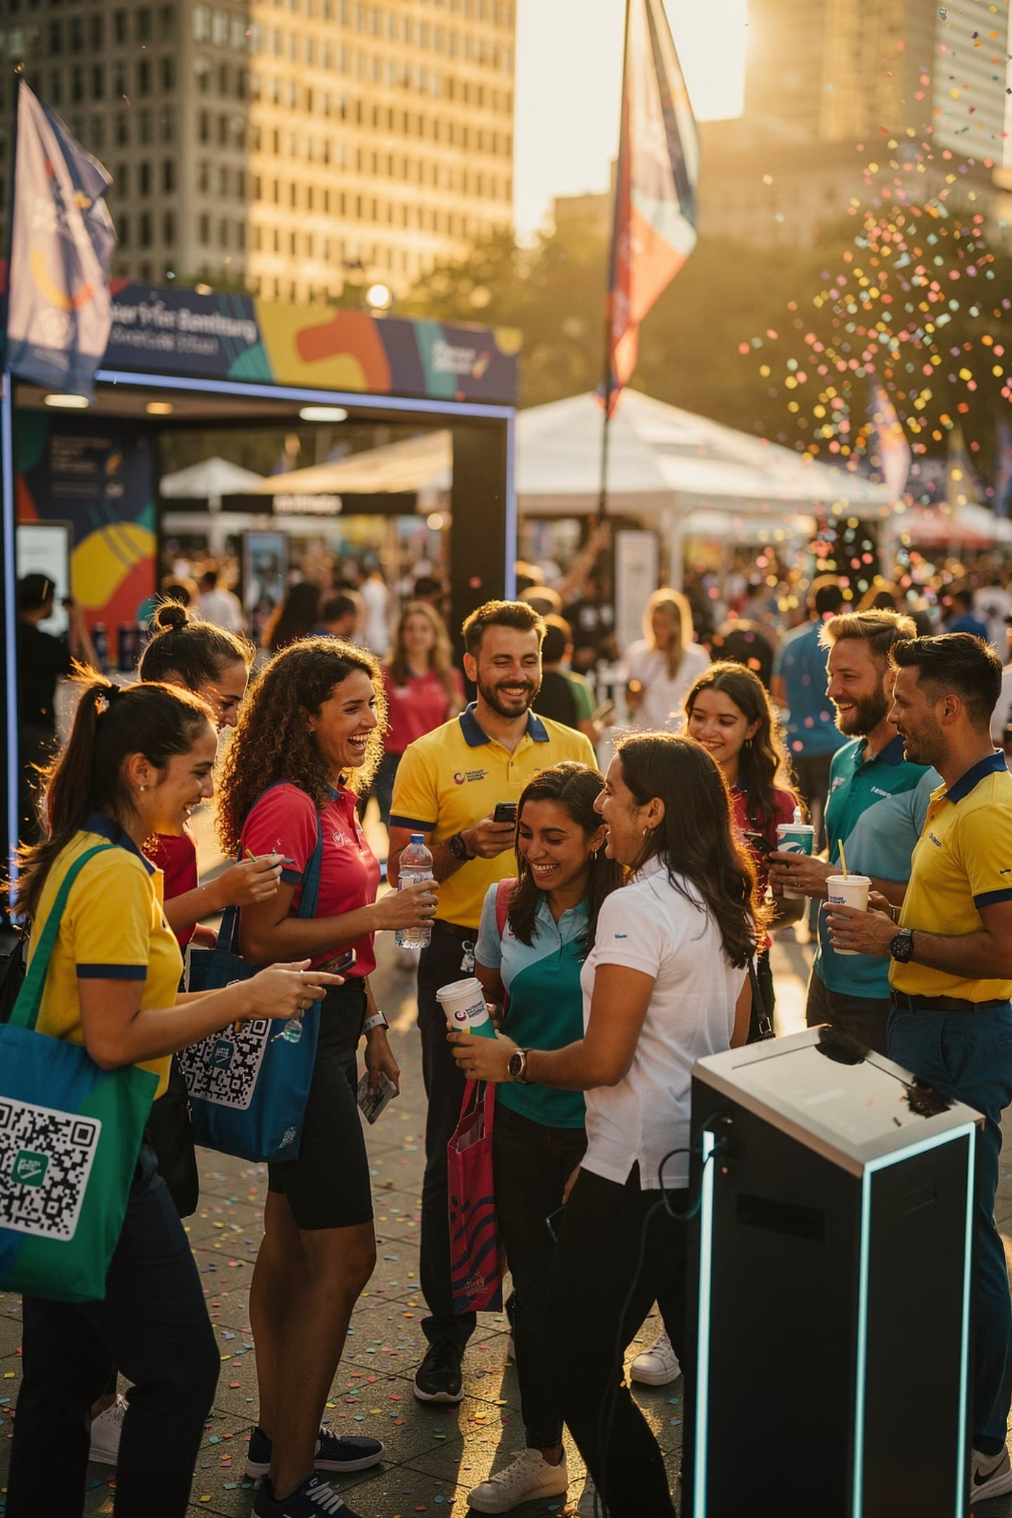
Key Takeaway
Experiences. Conversations. Connections.
Alternative marketing is not just about selling products — it is about creating experiences, building relationships, and establishing meaningful connections between brands and consumers.
References
Belch & Belch (2024) · Clow & Baack (2022) · Kotler & Keller (2022) · Armstrong & Kotler (2021) · Levinson (2011)
Notes:
And that brings us to our key takeaway for today.
Alternative marketing is not just a collection of clever tactics. It's a philosophy — a fundamental shift in how brands think about their relationship with consumers.
Traditional marketing says: 'Here is our message. Listen to it.' Alternative marketing says: 'Here is an experience, a conversation, a story. Be part of it.'
The brands that win in the modern marketplace are the ones that create genuine value for their audiences — not just through their products, but through the experiences, communities, and stories they build around those products.
As future marketing professionals, your job is not just to sell. It's to connect. To create moments that matter. To build brands that people don't just buy — but believe in.
[Pause for effect.]
Now, let's make sure you've absorbed today's material. Turn to the next slide for your review questions — I'll give you a few minutes to think through your answers before we discuss as a class.

Slide 30
Review Questions
01
02
What is alternative marketing and how does it differ from traditional advertising?
Name and briefly describe the 6 forms of alternative marketing discussed.
03
04
What are the three key triggers that make buzz marketing effective?
How does guerrilla marketing achieve high impact with a low budget? Give one real-world example.
05
06
What distinguishes lifestyle marketing from other forms? Name a brand that uses it effectively.
What is the difference between product placement and branded entertainment? Provide an example of each.
07
08
What metrics are used to measure the effectiveness of alternative media placements?
What ethical considerations should marketers keep in mind when using alternative marketing strategies?
Notes:
Alright, here are your eight review questions. I'll give you about 3 minutes to look through them and jot down your initial thoughts — then we'll go through them together.
[Allow 3 minutes of quiet reflection.]
Let's go through them:
Q1 — Alternative marketing differs from traditional advertising in that it seeks to reach consumers through non-traditional, often unexpected channels that feel less like advertising and more like genuine experiences or conversations.
Q2 — The six forms are: Buzz Marketing (word-of-mouth), Guerrilla Marketing (surprise and creativity), Lifestyle Marketing (identity alignment), Experiential Marketing (direct product interaction), Product Placement (brands in media), and Alternative Media Venues (unconventional ad locations). Note: Branded Entertainment is sometimes listed as a seventh.
Q3 — The three key triggers for buzz marketing are: Emotion, Surprise, and Social Currency.
Q4 — Guerrilla marketing achieves high impact through creativity and unconventional tactics rather than large budgets. Example: T-Mobile's flash mobs in train stations.
Q5 — Lifestyle marketing aligns the brand with consumers' values and identity, not just product features. Red Bull, Patagonia, and Lululemon are strong examples.
Q6 — Product placement embeds a brand passively in content (James Bond/Aston Martin). Branded entertainment makes the brand central to the story (The LEGO Movie).
Q7 — Key metrics include: Reach, Dwell Time, Recall, and ROI.
Q8 — Ethical considerations include: transparency and disclosure of paid relationships, avoiding deceptive practices, respecting public spaces, and being mindful of vulnerable audiences.
[Wrap up.] Excellent work today. These concepts will be increasingly relevant as you enter the marketing profession. Alternative marketing is not the future — it's the present. See you next session.

