Slide 1

Module 3: Theories on Economic Development
ECONOMICS
DEVELOPMENT STUDIES

Slide 2

Welcome, Learners!
In this module, you will explore the major theories that explain how countries develop economically and improve the quality of life of their people.
You will discover how industrialisation, investments, migration, technology, and innovation influence national development and social progress.

Slide 3
What You Will Explore
In This Module, You Will Learn About:
1
Rostow's Stages of Economic Growth
The classic model of modernisation through sequential stages.
2
Harrod-Domar Growth Model
How savings and investment drive economic expansion.
3
Lewis Model of Structural Economic Growth
Labour migration from agriculture to industry.
4
Neoclassical Growth Theory
Technology and innovation as long-term growth drivers.
5
Philippine Applications
Real-world examples and policy implications for the Philippines.
6
Strengths & Weaknesses
Critical evaluation of each development theory.

Slide 4

Why Study Development Theories?
Development theories are essential tools for understanding the world around us. They provide frameworks that help us make sense of complex economic realities.
Understand Economic Growth
Grasp how economies grow, modernise, and transition through different phases of development.
Analyse Poverty & Inequality
Examine the root causes of poverty and unequal distribution of wealth across societies.
Examine Industrialisation & Technology
Explore how industrial transformation and technological change reshape economies.
Understand Philippine Development Challenges
Apply theoretical lenses to the specific context and challenges facing the Philippines.
Evaluate Policies & Economic Strategies
Critically assess government policies and economic strategies using theoretical frameworks.

Slide 5
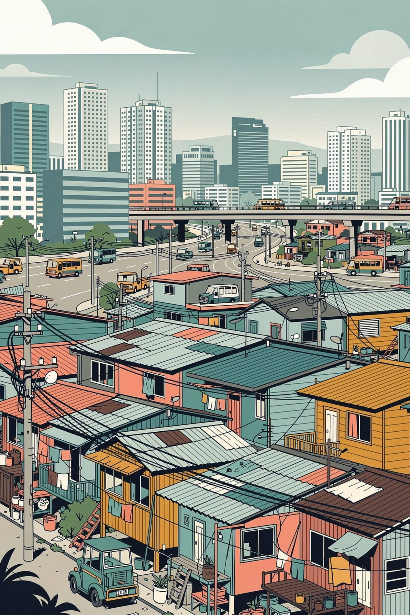

Economic Development in the Philippines
Despite decades of economic growth, the Philippines continues to face significant structural challenges that development theories help us understand and address.
Key Challenges
Key Question: Why do some countries develop faster than others?
Poverty and unemployment
Unequal regional development
Weak industrialisation
Infrastructure challenges
Climate vulnerability
Urban congestion and migration issues
This central question drives the study of development economics. The theories in this module offer different — and sometimes competing — answers that illuminate the complex pathways to national progress.
By examining the Philippine experience through these theoretical lenses, we can better understand both the progress made and the work that remains.

Slide 6

Major Development Theories
Theories Discussed in This Module
1. Rostow's Stages of Growth
2. Harrod-Domar Model
Development happens through stages of modernisation and industrialisation — from traditional society to the age of high mass consumption.
Savings and investments drive economic growth. Higher savings rates lead to greater capital accumulation and faster development.
3. Lewis Model
4. Neoclassical Growth Theory
Labour moves from agriculture to industry during development, fuelling industrial growth through surplus rural labour.
Technology and innovation are the key drivers of long-term growth, beyond just capital and labour inputs.
Neoclassical
Rostow
Harrod-Domar
Lewis Model
Emphasis on technology, innovation, and markets
Sequential stages from traditional to mass consumption
Growth driven by savings and investment rates
Labor moves from agriculture to industry

Slide 7


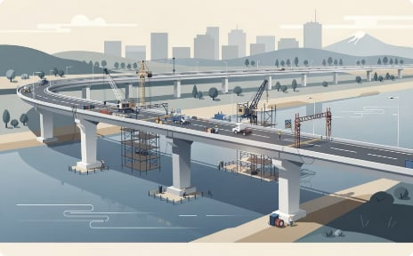

Development Theories & the Philippines
Philippine Examples of Development Theories in Action
Growth of BPO Industries
Rural-to-Urban Migration
Infrastructure Expansion
Digital Transformation
The Business Process Outsourcing sector exemplifies structural transformation, shifting labour from agriculture towards services and technology.
Consistent with the Lewis Model, surplus agricultural labour continues to migrate to urban centres in search of industrial and service employment.
Major infrastructure programmes reflect Harrod-Domar principles — investment in capital drives productivity and long-term economic growth.
Technology adoption and online services align with Neoclassical Growth Theory, where innovation becomes the primary engine of sustained development.
These examples show how development theories can be applied in real-life Philippine situations, bridging abstract economic concepts with tangible national realities.

Slide 8

Your Role as a Learner
As a Learner, You Are Encouraged To:
By the End of This Module, You Should Be Able To:
01
Explain major development theories clearly
Compare the different theories of economic development
Apply theories to the Philippine context
Analyse economic and social challenges
Evaluate how development theories influence policies and progress
Analyse Critically
Examine economic issues with a questioning and evidence-based mindset.
02
Relate to Philippine Realities
These learning goals will guide your journey through Module 3.
Connect theoretical frameworks to the lived experiences of Filipinos.
03
Participate Actively
Engage in discussions, share perspectives, and challenge assumptions.
04
Evaluate Theories
Assess the strengths and weaknesses of each development model.
05
Propose Solutions
Think creatively about possible solutions to development challenges.

Slide 9





Learning Goals
By the End of This Module, You Should Be Able To:
Explain
Compare
Apply
Articulate the major development theories clearly and accurately.
Distinguish between the different theories of economic development and their assumptions.
Connect theoretical frameworks to real Philippine development contexts and case studies.
Analyse
Evaluate
Break down complex economic and social challenges using theoretical tools.
Assess how development theories influence national policies and social progress.

Slide 10
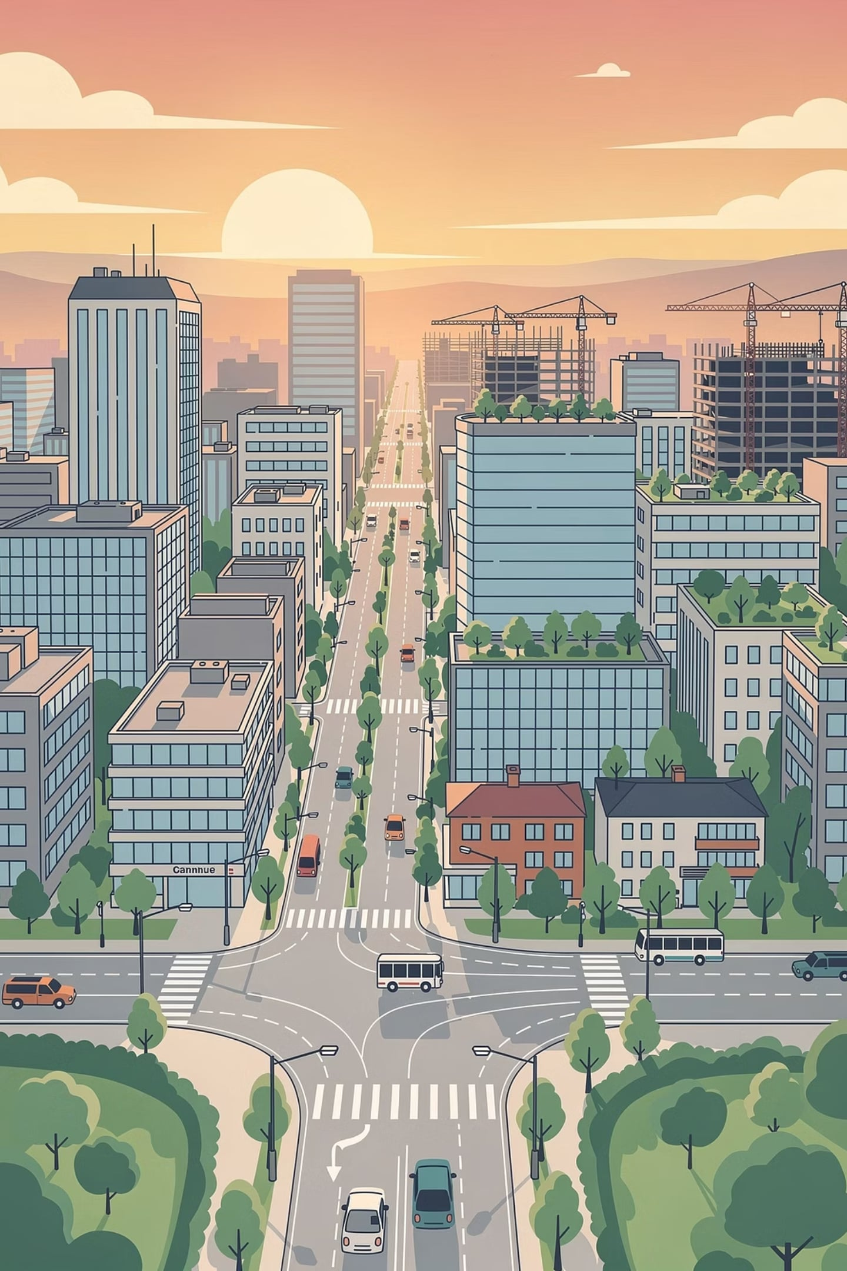
Are You Ready to Explore Economic Development Theories?
Together, let us understand how nations grow, industrialise, innovate, and transform societies through different paths of development.
Module 3 invites you on an intellectual journey through the most influential frameworks in development economics. From Rostow's stages of growth to the Neoclassical emphasis on technology, each theory offers a unique lens through which to view the Philippine experience and the broader story of human progress.
WELCOME TO MODULE 3!

