Slide 1
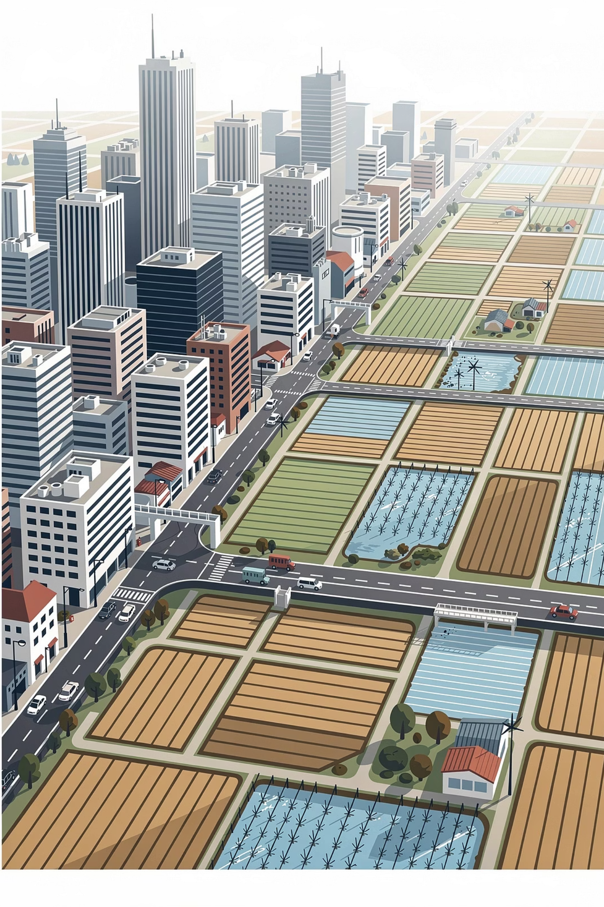
Urbanisation and Rural–Urban Migration
MODULE 5
Exploring the forces, patterns, and consequences of urbanisation in the Philippines — and what it means for national development.

Slide 2
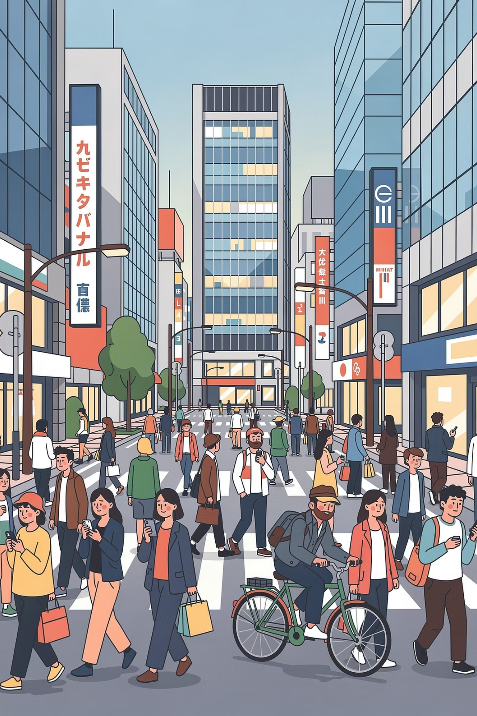
What is Urbanisation?
Definition
In the Philippine Context
Urbanisation is the process by which an increasing number of people move from rural areas to urban areas, causing cities to grow in population, land area, and economic activity.
It typically occurs alongside industrialisation and economic development, as cities offer more employment, education, healthcare, and modern lifestyles.
Urbanisation is highly visible in:
Metro Manila (Manila & Quezon City)
Cebu City
Davao City
These cities became centres of commerce, BPO, transportation, education, and government services — drawing millions of Filipinos from the provinces.

Slide 3

Urban–Rural Population Trends
The world has become increasingly urbanised, with more than half of the global population now living in urban areas. The Philippines mirrors this global trend.
>50%
#1
↑
Global Urban Population
Metro Manila's Role
Urban Density Rising
More than half of all people worldwide now live in urban areas.
The National Capital Region contributes the largest share of the country's GDP.
Population movement increases urban density while weakening rural economies.
A farmer from Nueva Ecija may leave farming to work as a construction worker in Metro Manila because urban wages are generally higher than agricultural income. Nurses from Visayas or Mindanao similarly relocate to cities offering better salaries and opportunities.

Slide 4
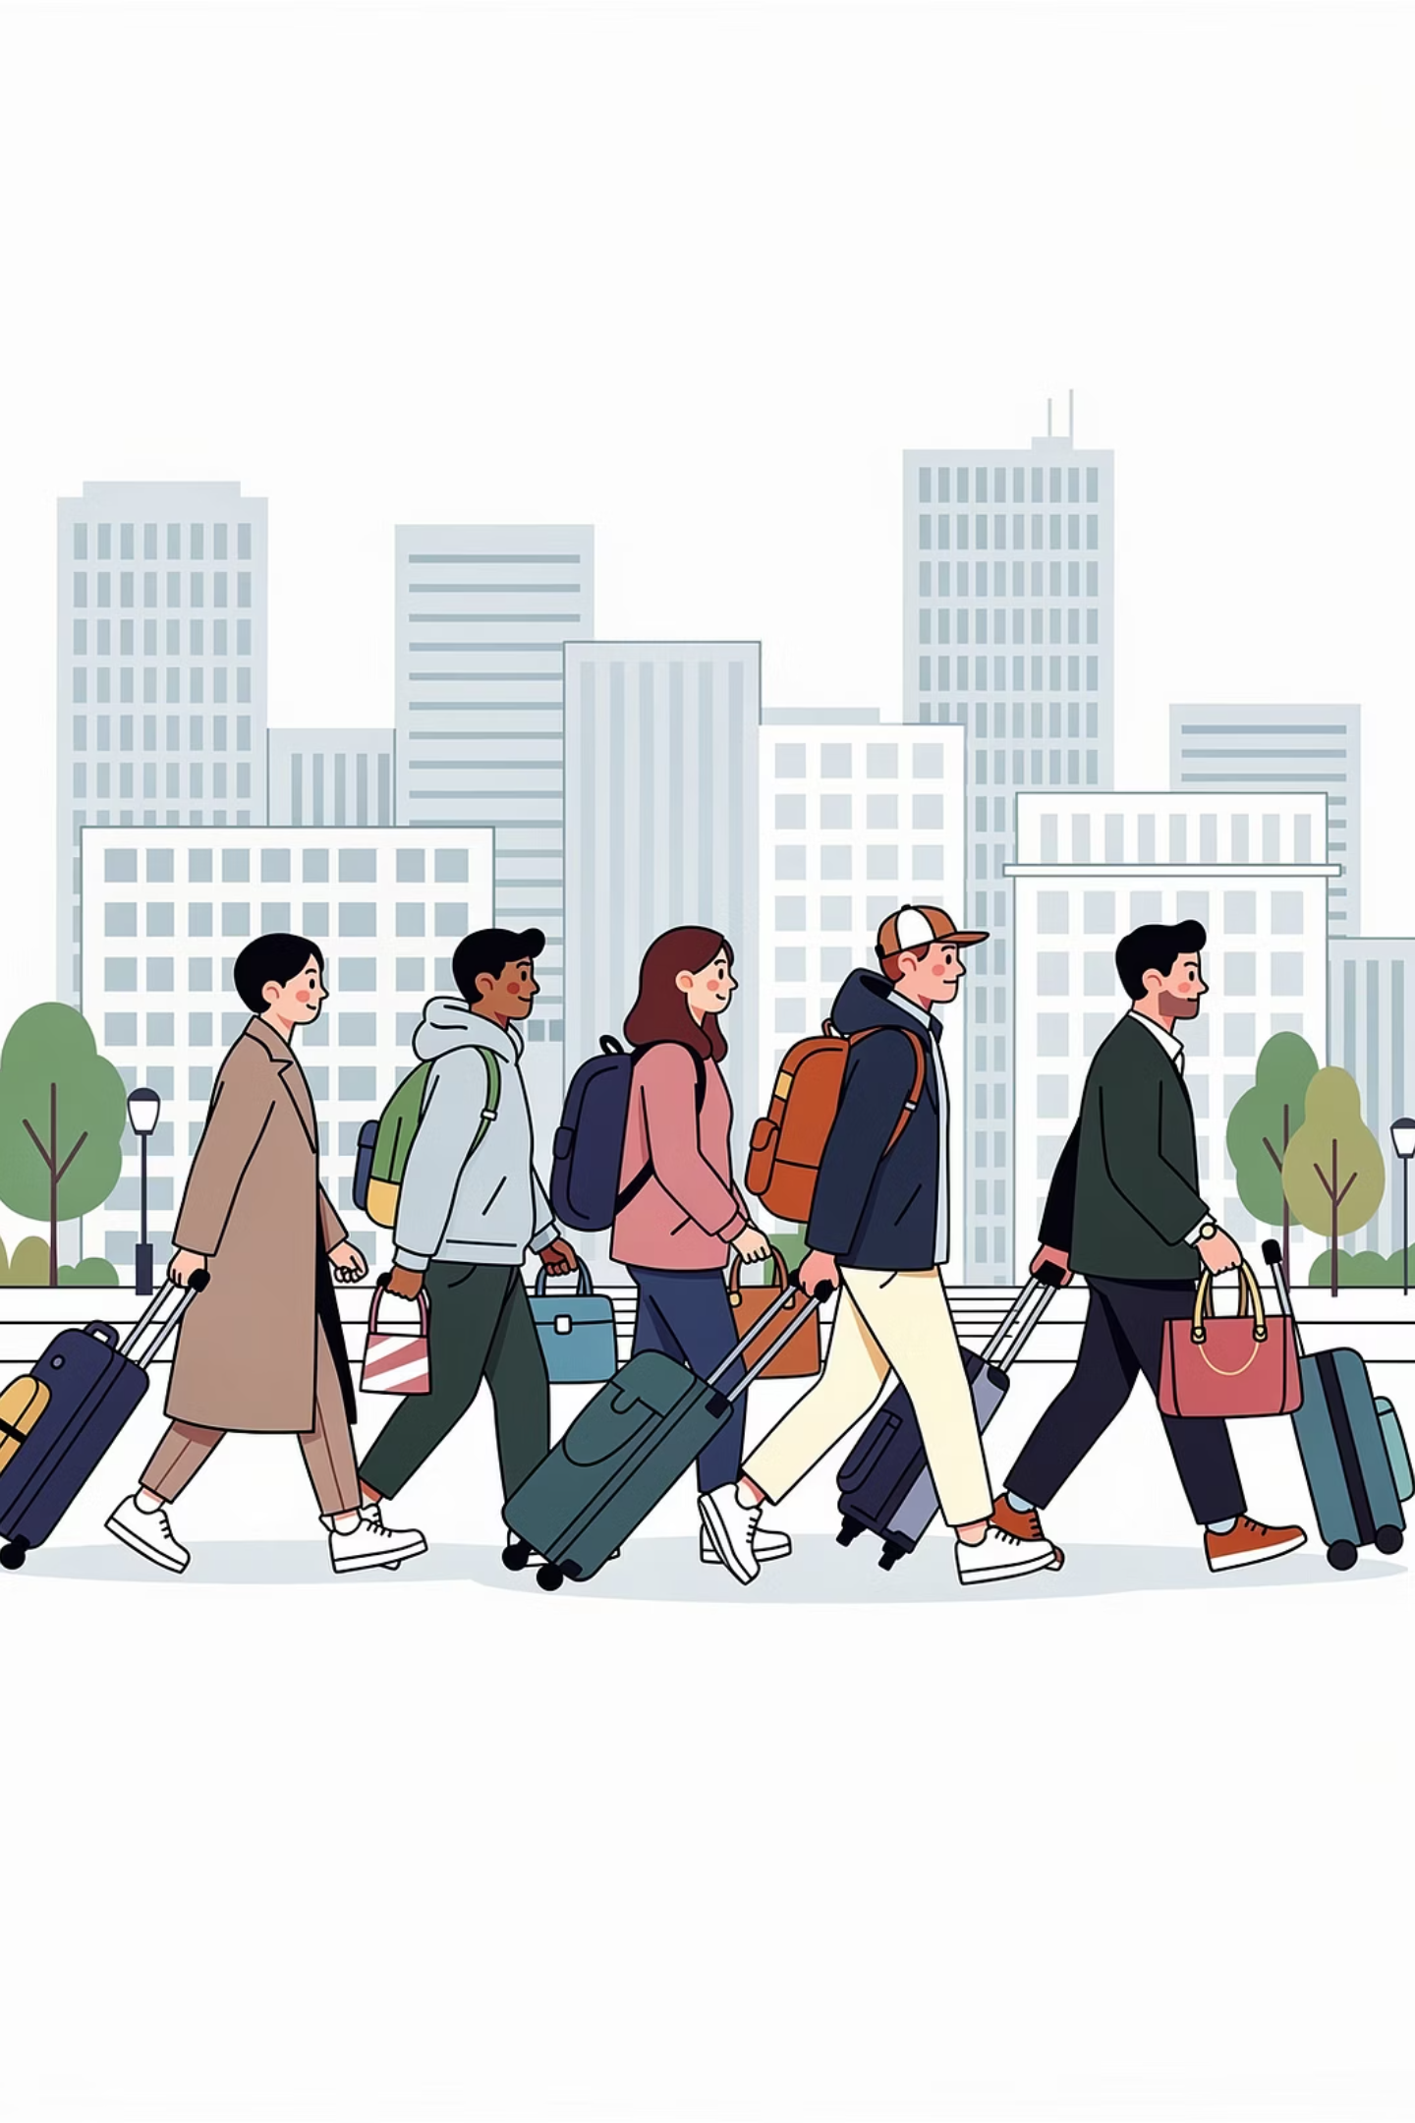




Causes of Urbanisation
Multiple forces — both push and pull — drive people from rural communities to urban centres. The module identifies five key categories.
Economic
Jobs, higher wages, industries
Educational
Universities and training institutions
Environmental
Typhoons, flooding, disasters
Social
Modernisation, entertainment, mobility

Slide 5

Economic Causes
Pull Factors — Why Cities Attract
Push Factors — Why People Leave
Economic opportunities are among the strongest pull factors attracting people to cities. Urban centres provide jobs in industries, transportation, retail, tourism, healthcare, and BPO sectors.
Meanwhile, conditions in rural areas force many Filipinos to leave their communities:
Low farm income
Unemployment and underemployment
Lack of local industries
Limited career advancement
Poor infrastructure in provinces
The rise of BPO companies in Makati, Taguig, and Quezon City has attracted thousands of workers from nearby provinces. Fresh graduates move to Metro Manila because call centres and corporate offices offer salaries far higher than rural employment.

Slide 6
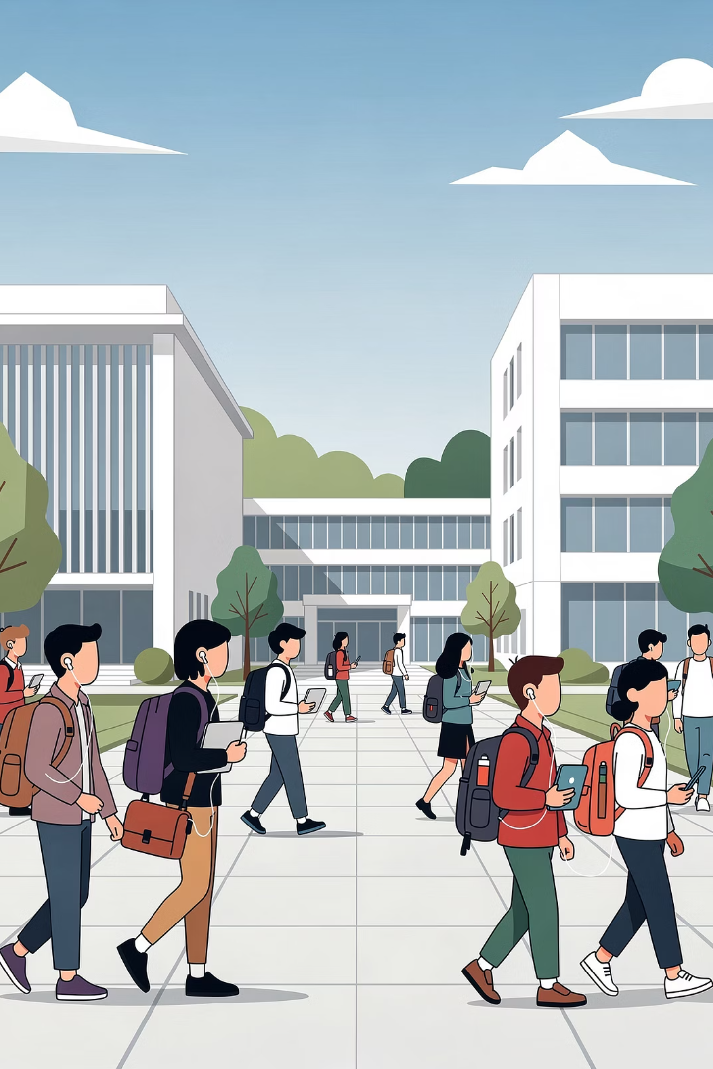
Educational Causes
Urban areas typically have far more universities, technical schools, and training institutions than rural communities — making education a powerful driver of migration.
University of the Philippines
University of Santo Tomas
Students from across the country relocate to Diliman, Quezon City for access to the country's premier state university.
One of Asia's oldest universities, attracting provincial students seeking medicine, law, and the arts.
Ateneo de Manila University
Draws students from Mindanao, Visayas, and other regions seeking wider academic programmes and career opportunities.
This educational migration contributes significantly to population growth in urban centres and often results in permanent settlement after graduation.

Slide 7
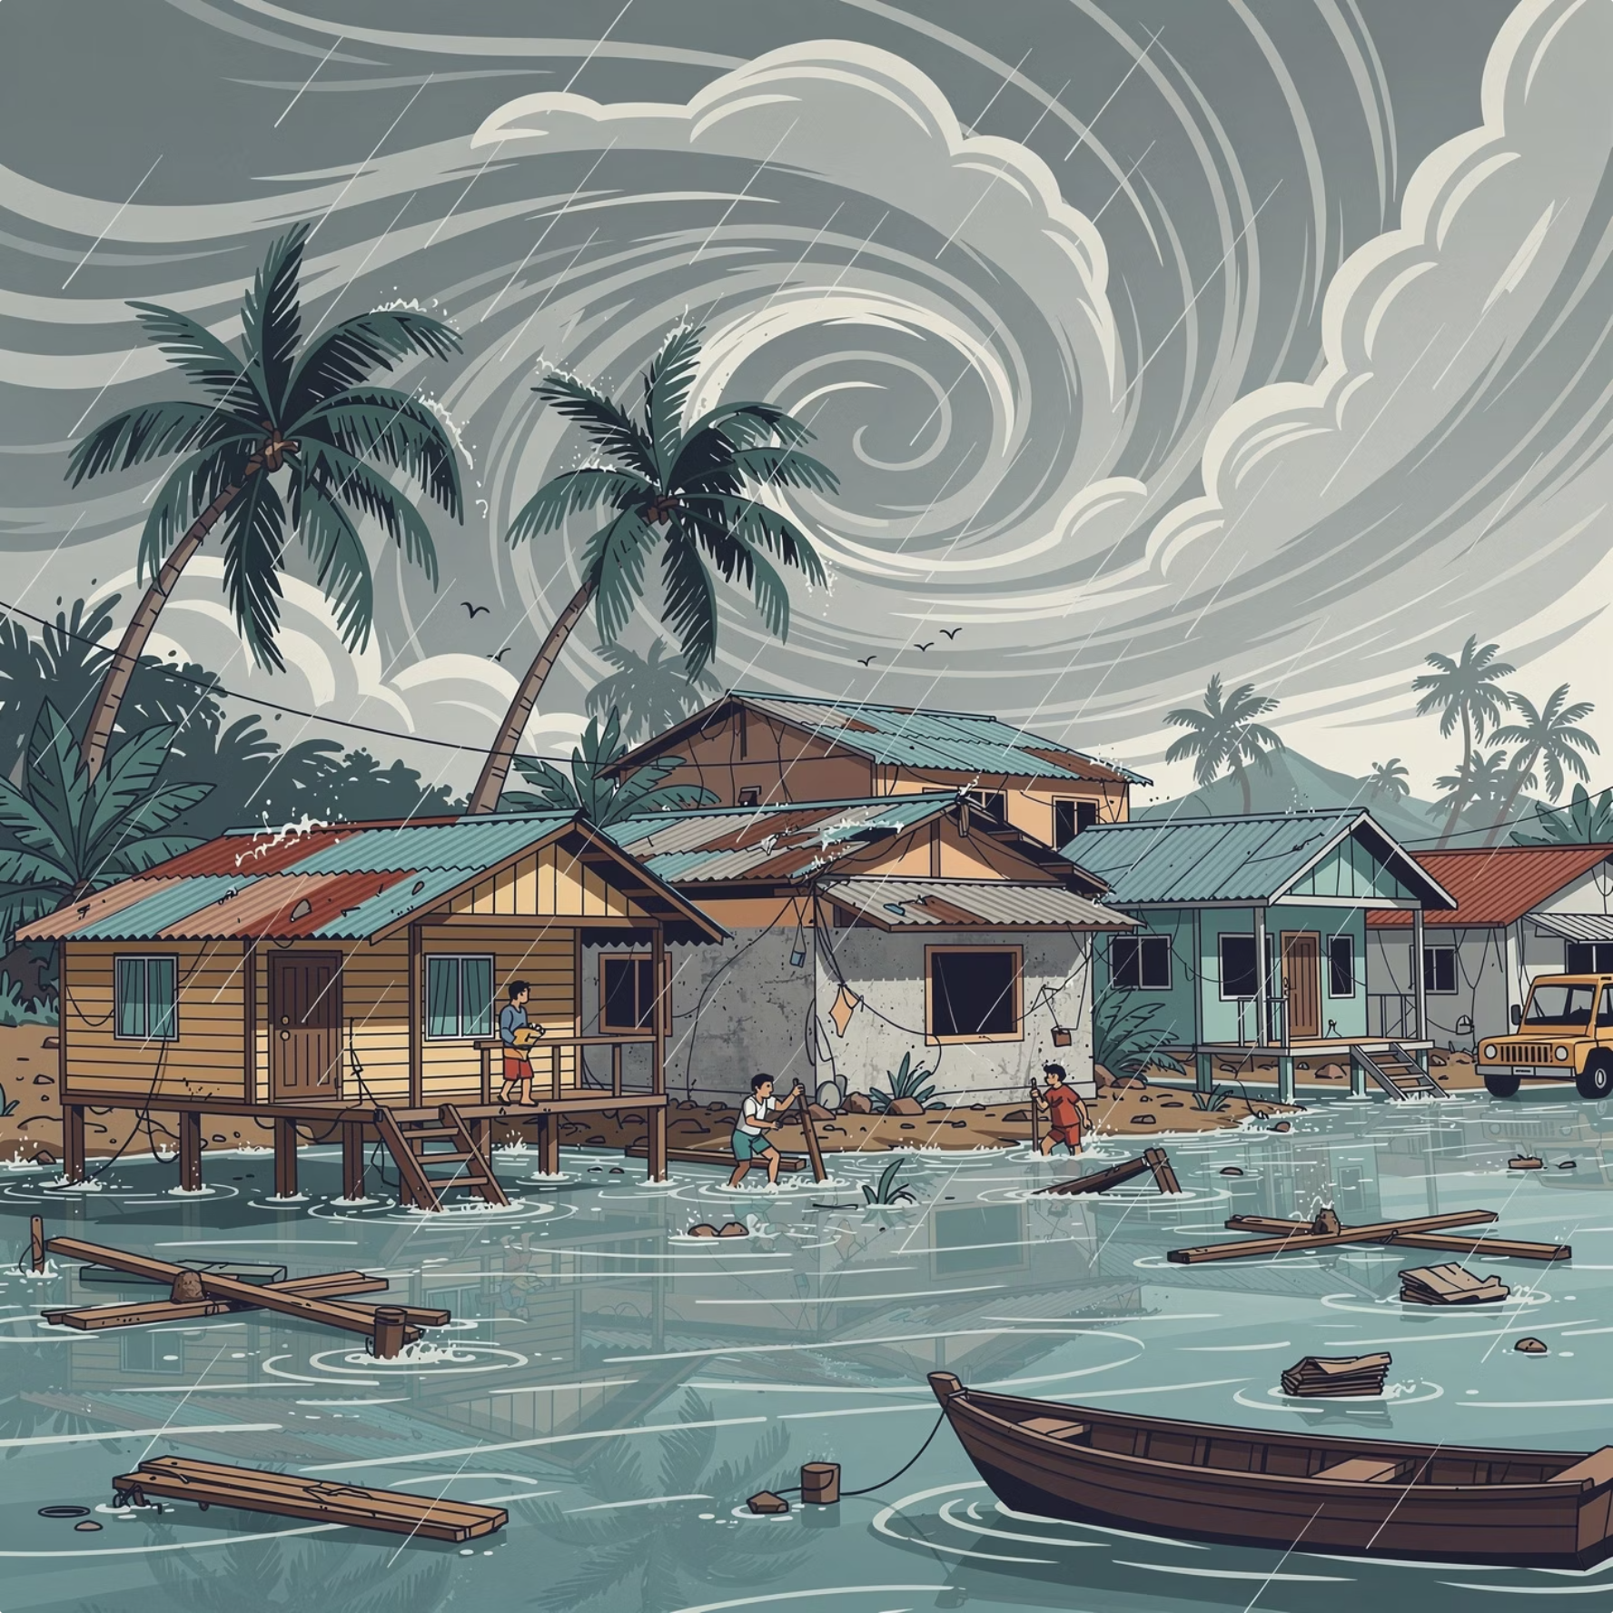
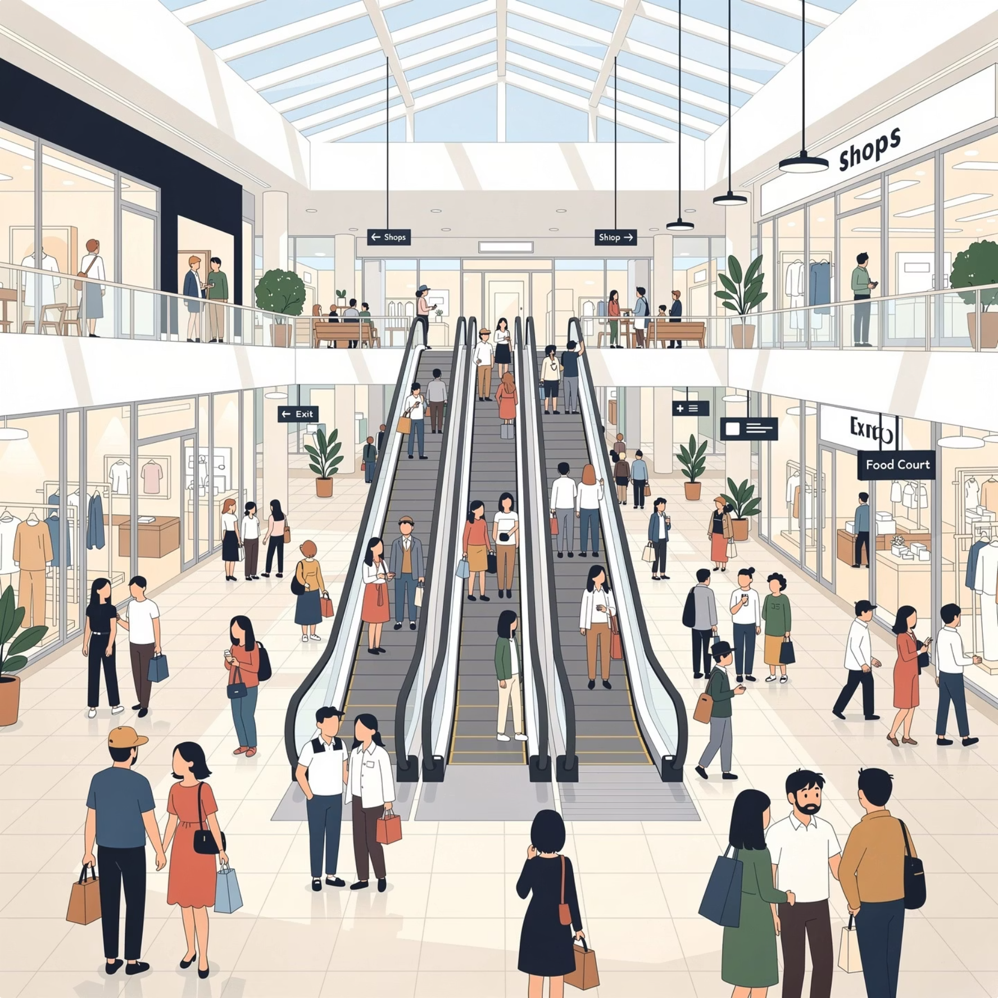
Environmental & Social Causes
Environmental Displacement
Social Attraction of Urban Life
Environmental degradation and natural disasters force communities to relocate. After Typhoon Yolanda, many families from Eastern Visayas transferred to urban centres in Cebu and Manila seeking work and stability.
Urban life is associated with modernisation, entertainment, technology, and social mobility. Young Filipinos are drawn to cities because they offer:
Typhoons and flooding
Mining-related land degradation
Volcanic eruptions
Loss of agricultural livelihoods
Malls and nightlife
Concerts and cultural events
High-speed internet connectivity
Modern conveniences
Greater social freedom

Slide 8
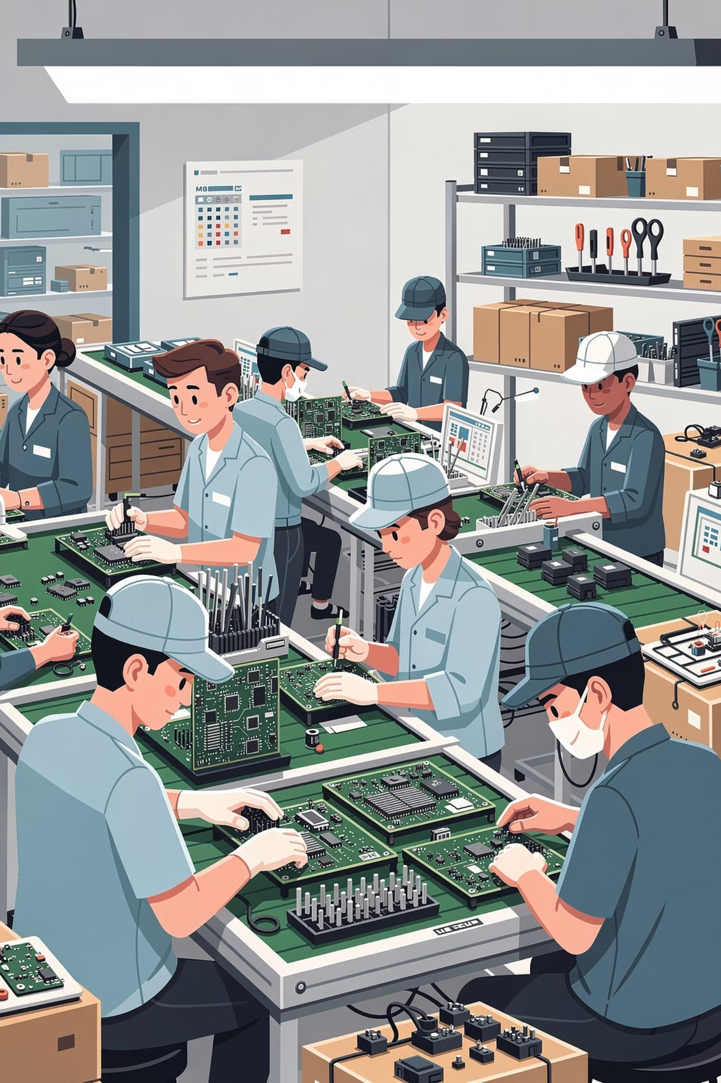
Positive Impacts: Industrialisation & Economic Growth
Urbanisation promotes industrial growth and expands the national economy. As people concentrate in cities, industries scale up and productivity increases.
Economic Zones
BPO Industry
Special economic zones in Laguna, Cavite, and Batangas provide thousands of manufacturing jobs in electronics, food processing, and automotive industries.
The Philippines is a global leader in business process outsourcing, with major hubs in Makati, Taguig, and Quezon City generating billions in revenue.
GDP Contribution
Metro Manila and surrounding urban regions contribute the largest share of national GDP, driving overall economic development.

Slide 9

Positive Impacts: Employment Opportunities
Cities provide far more diverse employment options than rural areas, improving household income for many migrant families.
BPO & Call Centres
Healthcare
Thousands of agents employed in Metro Manila's thriving outsourcing industry.
Hospitals and clinics in cities employ nurses, doctors, and medical technicians from across the country.
Government Agencies
Hotels & Tourism
National agencies concentrated in Metro Manila provide stable civil service employment.
The hospitality sector employs large numbers in urban tourist destinations.
Retail & Malls
Transportation
Large shopping centres provide entry-level and managerial roles for urban workers.
Urban transport networks create employment for drivers, operators, and logistics workers.

Slide 10
Positive Impacts: Better Access to Services
Urban residents generally enjoy significantly better access to essential services compared to their rural counterparts.
Philippine General Hospital
Services Concentrated in Cities
Patients from provinces regularly travel to Metro Manila hospitals such as the Philippine General Hospital because advanced medical equipment and specialists are concentrated there — services simply unavailable in many rural health centres.
Tertiary hospitals with specialist care
Universities and technical schools
Efficient public transportation (MRT, LRT)
High-speed internet connectivity
National government offices
Courts, banks, and financial institutions

Slide 11
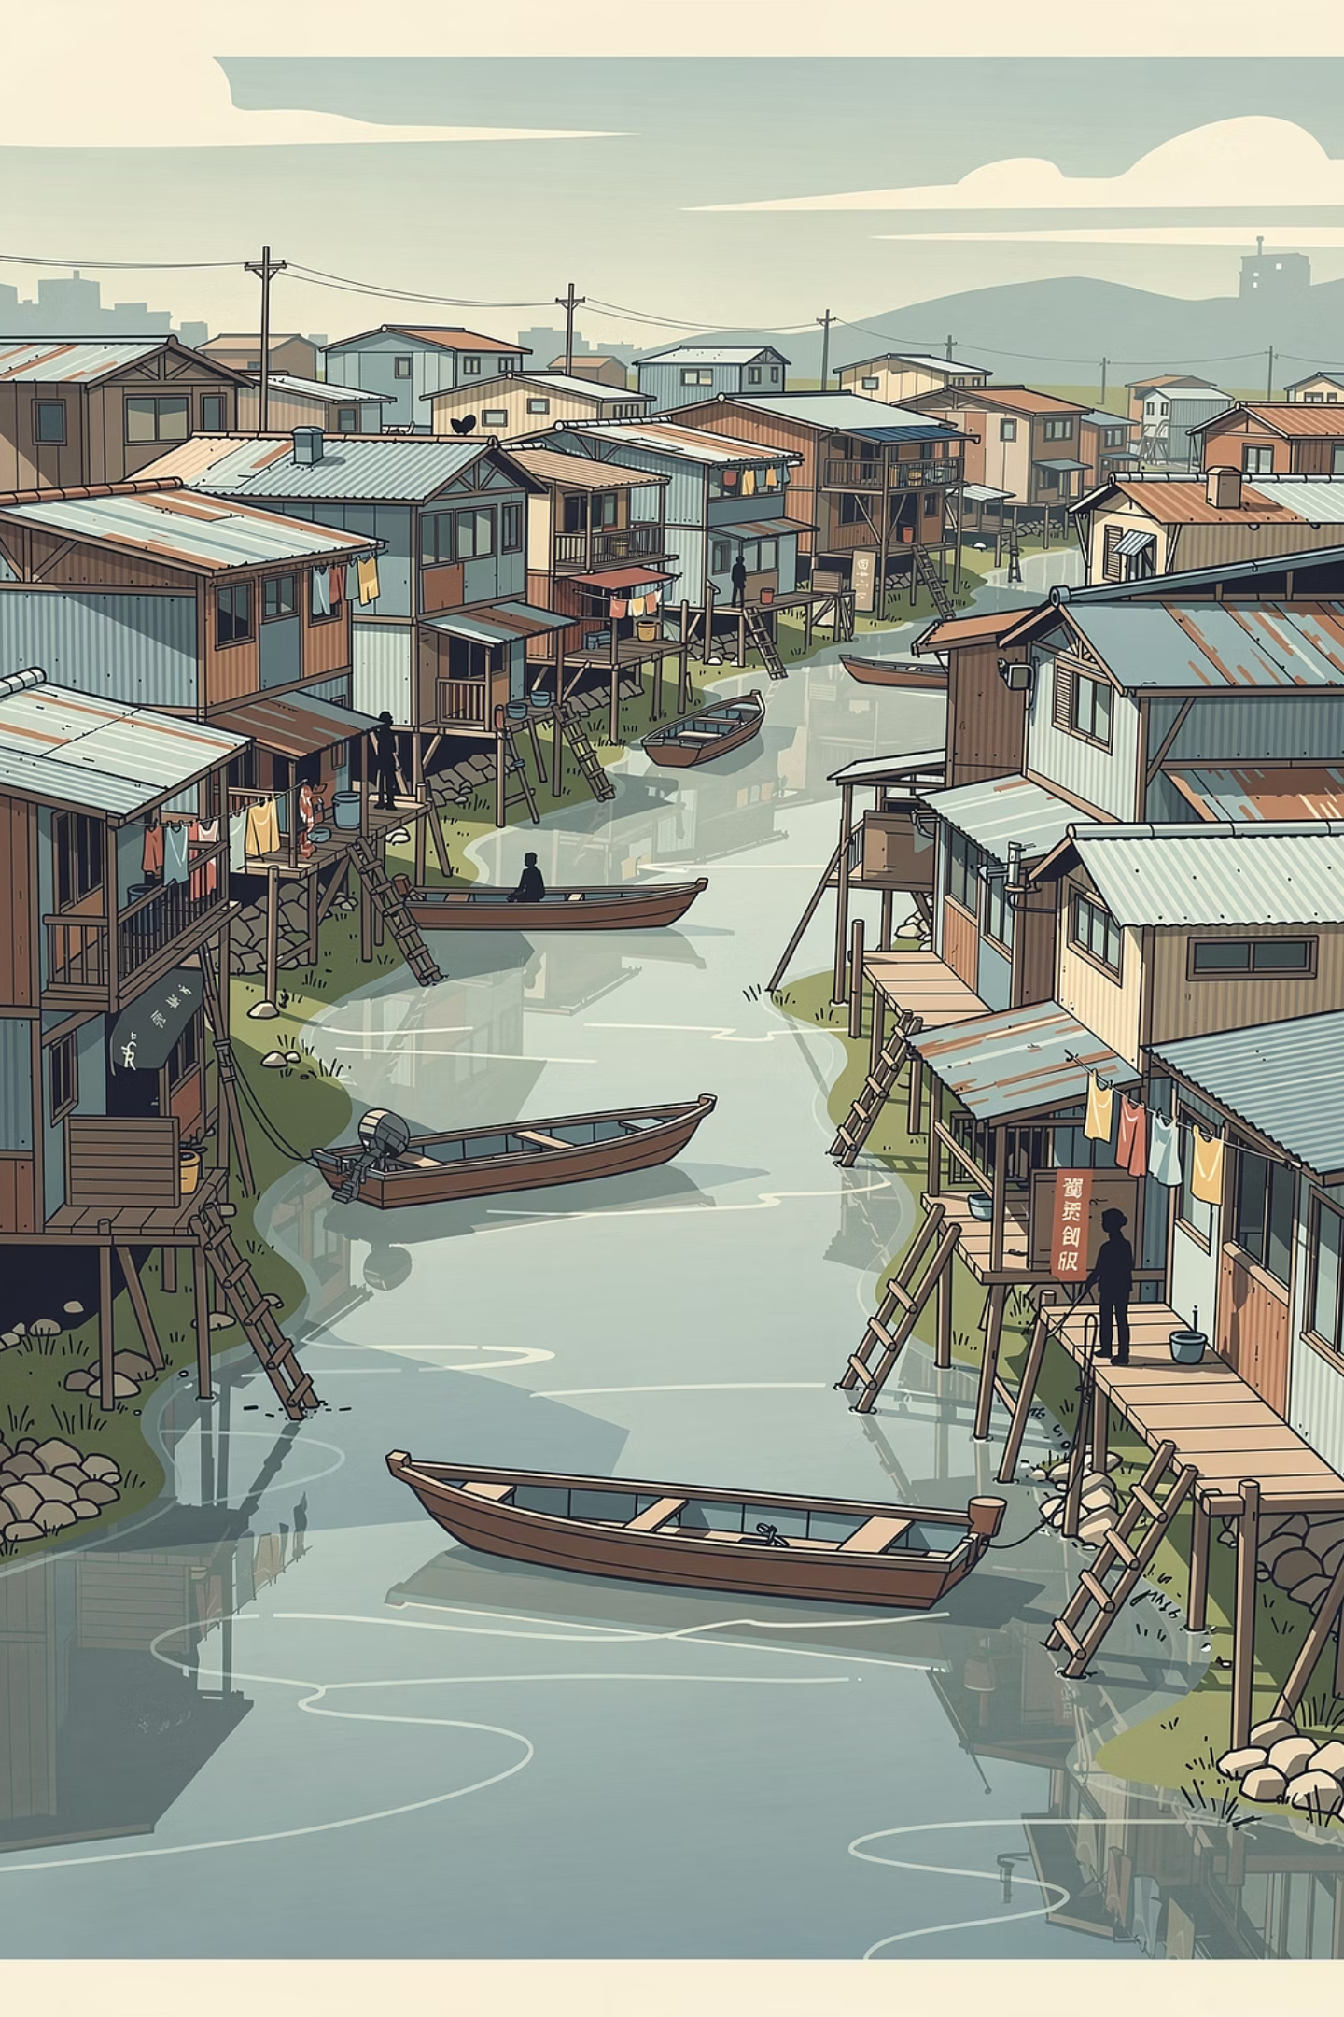
Negative Impacts: Housing & Informal Settlements
Rapid migration dramatically increases housing demand, often outpacing the supply of affordable formal housing.
Waterway Communities
Informal settlements are common along esteros (waterways) in Metro Manila. Migrants who cannot afford formal housing build makeshift homes in these flood-prone areas.
Railway Settlements
Communities along railroad tracks in Manila are densely populated and highly vulnerable to accidents, flooding, and fire hazards.
Root Cause
The gap between urban wages and housing costs forces many low-income migrants into informal settlements, creating cycles of urban poverty that are difficult to break.

Slide 12
Negative Impacts: Traffic, Unemployment & Pollution
Traffic Congestion
Unemployment & Underemployment
Pollution & Health Problems
EDSA is notorious for severe traffic, causing commuters to spend hours travelling daily. This reduces productivity, increases fuel consumption, and contributes to stress and air pollution across Metro Manila.
Air pollution from vehicles and factories contributes to respiratory illnesses such as asthma and bronchitis. Flood-prone urban communities also face serious sanitation issues during heavy rains.
Not all migrants find stable formal employment. Many become informal vendors, tricycle drivers, or contractual workers because formal opportunities are limited relative to the volume of arrivals.

Slide 13
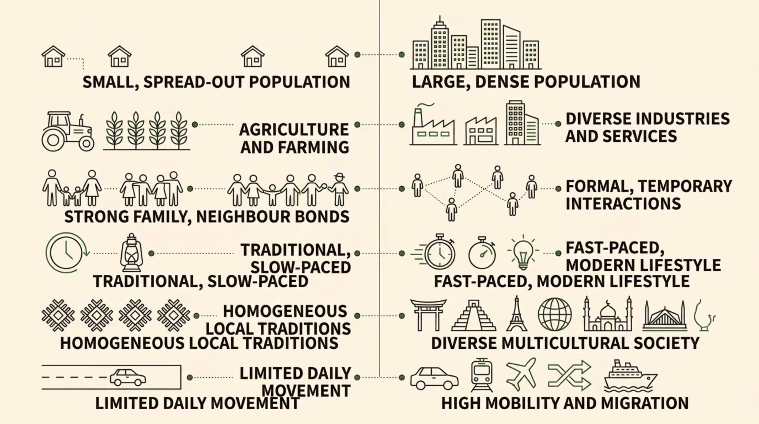

Comparing Rural and Urban Communities
Understanding these differences helps explain why migration occurs and what is gained — and lost — when people move from rural to urban settings.

Slide 14
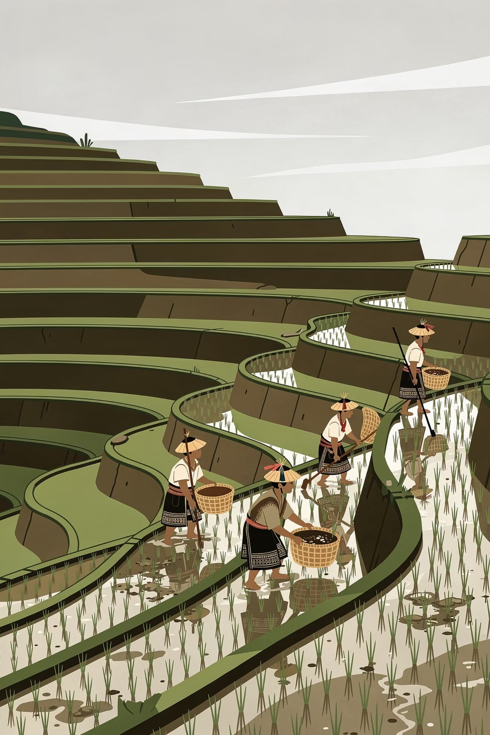
Rural Communities in the Philippines
Many barangays in provinces such as Ifugao and Bohol still maintain traditional farming lifestyles where neighbours know one another closely and community cooperation remains strong.
Smaller Populations
Agricultural Livelihoods
Rural communities are characterised by lower population density, allowing for more personal and intimate social relationships.
Farming, fishing, and forestry remain the primary sources of income in most Philippine rural communities.
Strong Community Bonds
Close family ties and bayanihan (community cooperation) remain central to rural Filipino culture and daily life.

Slide 15
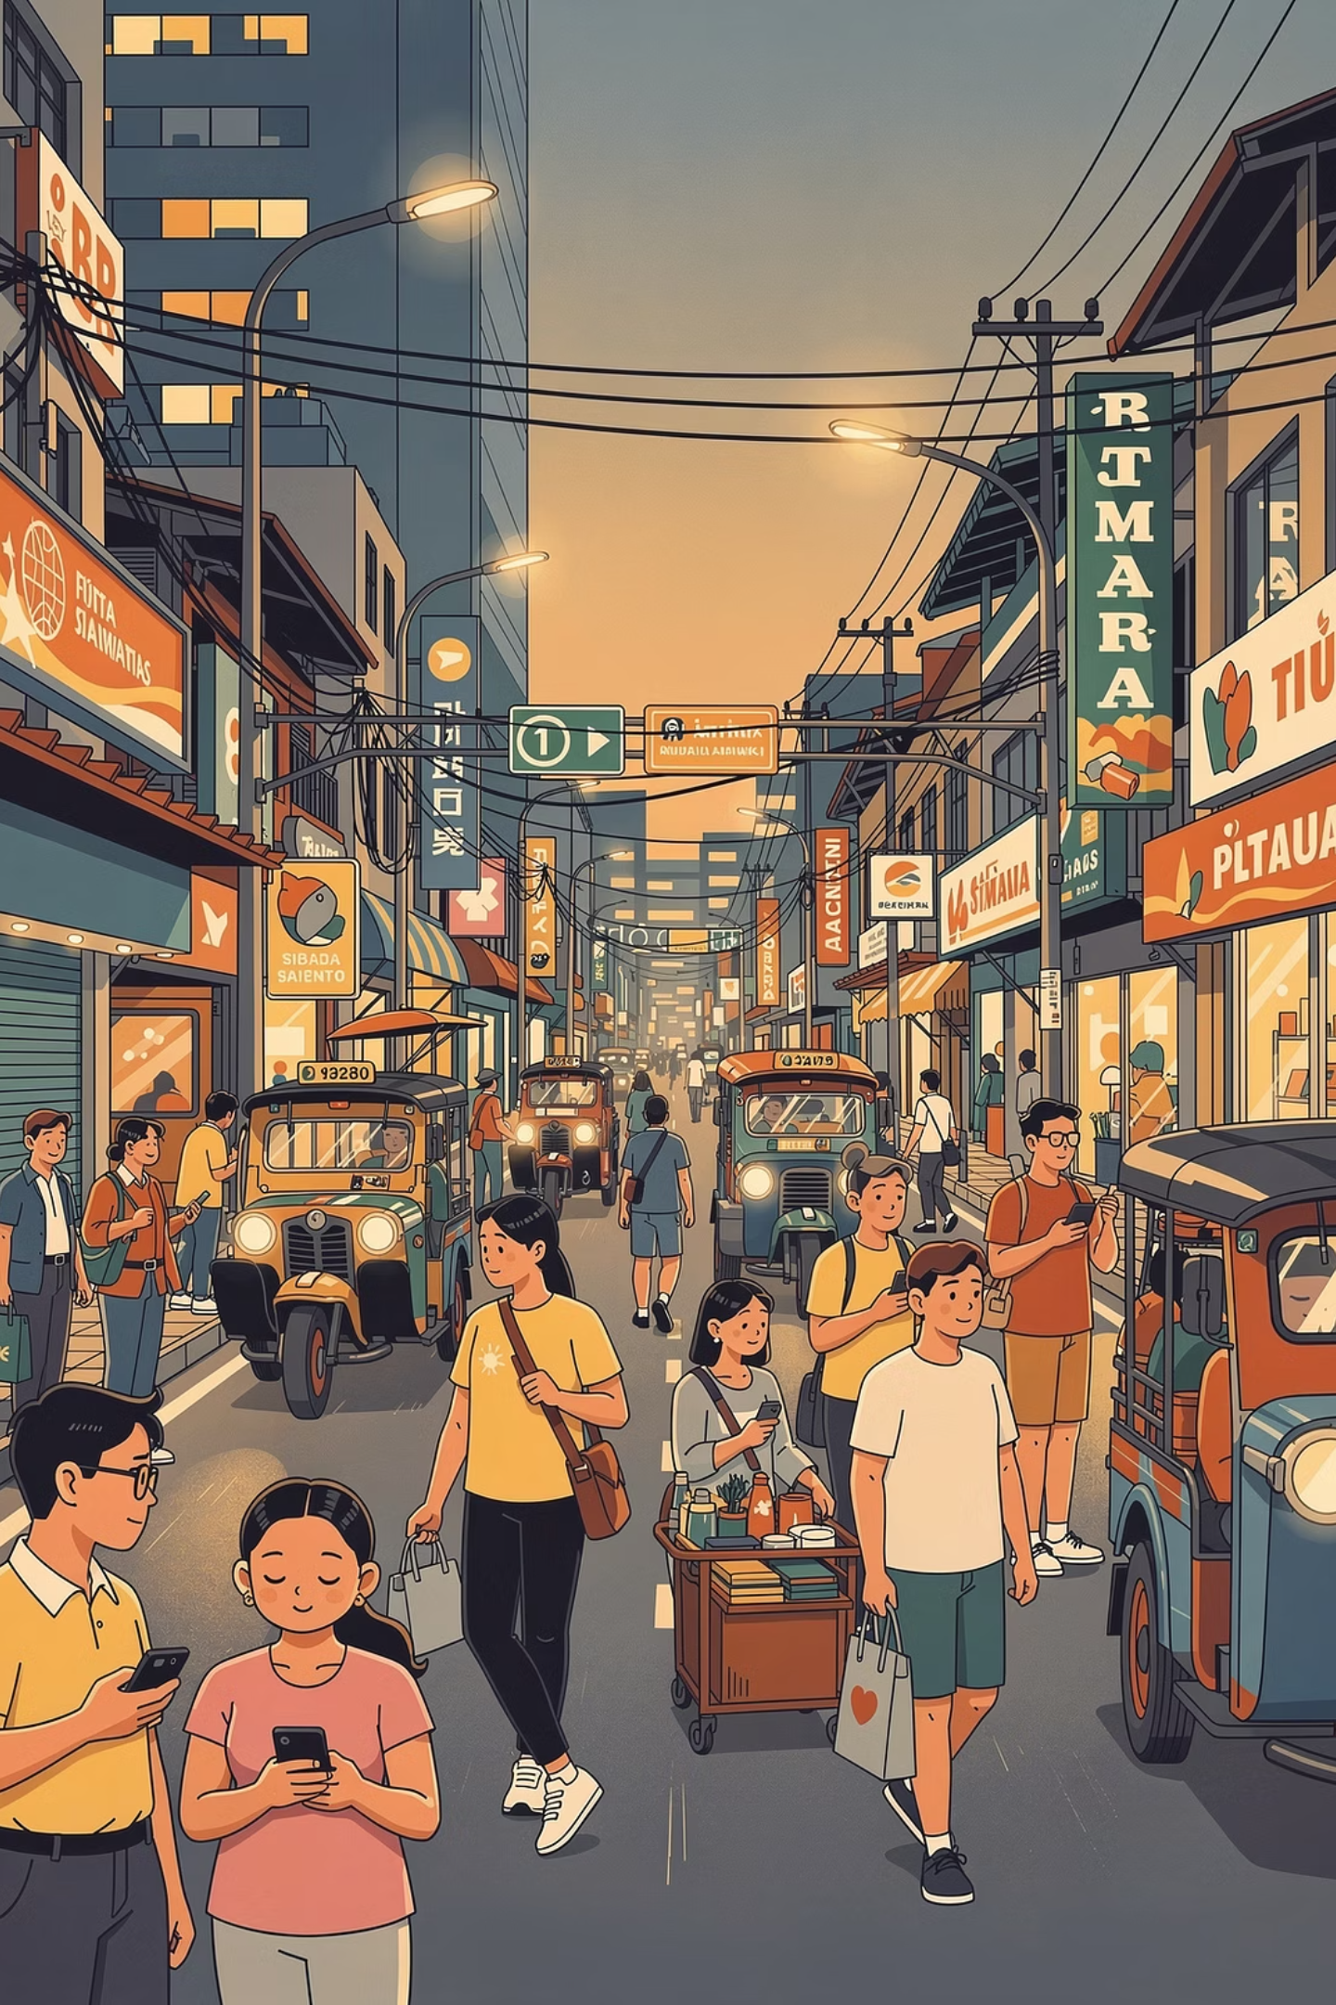
Urban Communities in the Philippines
Metro Manila contains people from different regions, religions, and socioeconomic backgrounds. Social interactions are often more formal and temporary compared to rural communities.
Large & Dense Populations
Diverse Cultures
Metro Manila is one of the most densely populated urban areas in the world, with millions living in a relatively small geographic area.
Urban centres bring together Filipinos from all regions — Ilocanos, Bisaya, Kapampangan, Maranao — creating a rich multicultural environment.
Fast-Paced Lifestyles
Urban life is characterised by greater mobility, time pressure, and exposure to global trends, technology, and consumer culture.

Slide 16

Urbanisation and Development in the Philippines
Urbanisation in the Philippines reflects both progress and inequality. Cities generate economic growth, but development is often uneven across regions.
Infrastructure Responses
The Core Challenge
The government has invested in urban infrastructure to address congestion and connectivity:
The Philippine government must balance urban and rural development simultaneously. Without deliberate policy intervention, urbanisation may worsen poverty, overcrowding, and environmental degradation rather than alleviate them.
Effective management requires coordination across housing, transport, employment, education, and environmental policy.
Metro Rail Transit (MRT)
Light Rail Transit (LRT)
Skyway and expressways
Metro Manila Subway (under construction)
Despite these investments, population growth continues to outpace infrastructure expansion — a persistent challenge for urban planners.

Slide 17

Policy Responses: Balancing Urban and Rural Development
To manage urbanisation sustainably, the Philippine government must pursue a multi-pronged strategy that addresses both urban pressures and rural underdevelopment.
Provincial Economies
Agricultural Productivity
Strengthen local industries and fiscal capacity
Boost yields, supply chains, and farmer support
Rural Health & Education
Jobs & Sustainable Cities
Expand access to clinics and quality schools
Create jobs outside Metro Manila and plan sustainably
Each of these pillars is interconnected — strengthening rural economies reduces the pressure on cities, while sustainable urban planning improves quality of life for those already living there.

Slide 18

Summary: Positive vs. Negative Impacts
✅ Positive Impacts
⚠️ Negative Impacts
Industrialisation and economic growth
Diverse employment opportunities
Better access to healthcare
Access to quality education
Improved living standards for migrants
Cultural exchange and modernisation
Housing shortages and informal settlements
Severe traffic congestion (e.g. EDSA)
Unemployment and underemployment
Air, water, and noise pollution
Weakening of rural economies
Overcrowding and urban poverty
The balance between these outcomes depends heavily on the quality of urban planning, government policy, and investment in both urban and rural communities.

Slide 19
Key Takeaways
1
Urbanisation is driven by multiple forces
2
Cities offer opportunity — but also hardship
Economic, educational, environmental, and social factors all push and pull people from rural to urban areas in the Philippines.
While urban centres provide jobs, education, and services, they also generate overcrowding, pollution, informal settlements, and traffic congestion.
3
Rural communities bear the cost of out-migration
4
Sustainable planning is essential
Urbanisation must be managed through inclusive economic policies, balanced regional development, and investment in both urban infrastructure and rural communities.
When young and skilled workers leave provinces, rural economies weaken — making it harder for those who remain to thrive.

Slide 20
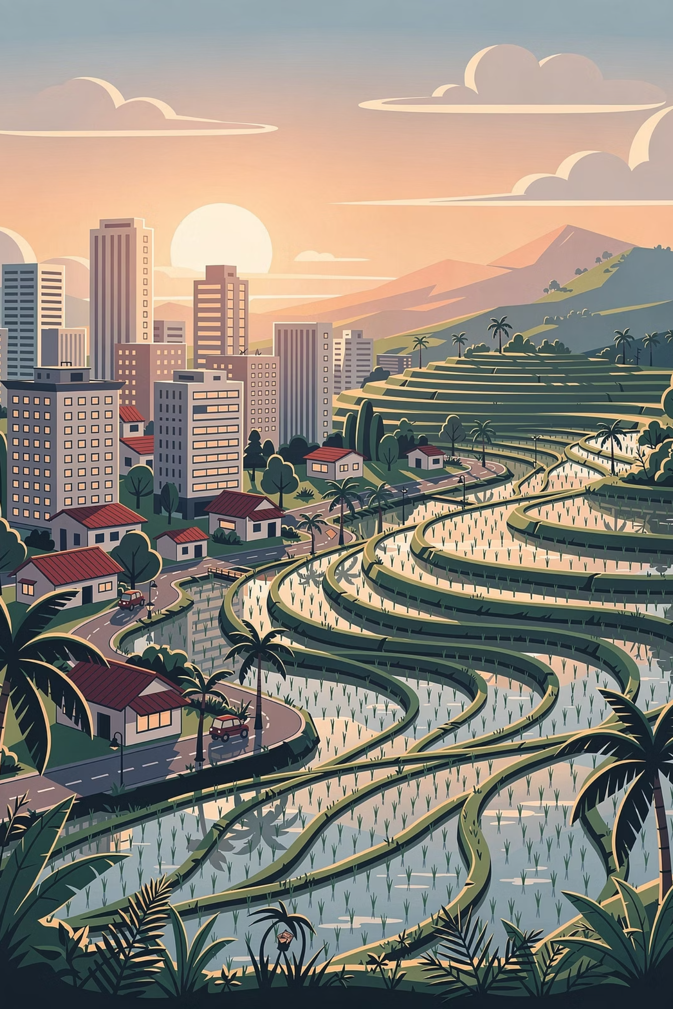
Conclusion
Urbanisation and rural–urban migration are major forces shaping Philippine society and economic development. People migrate to cities in search of employment, education, healthcare, and improved living standards.
The Philippine experience demonstrates that urbanisation must be managed through sustainable planning, inclusive economic policies, and balanced regional development — so that all Filipinos, whether in cities or provinces, can enjoy a better quality of life.
01
02
Invest in Rural Communities
Expand Jobs Beyond Metro Manila
Strengthen provincial economies, agriculture, healthcare, and education to reduce excessive migration.
Decentralise economic activity to secondary cities and growth corridors across the archipelago.
03
Plan Cities Sustainably
Invest in affordable housing, public transport, environmental management, and inclusive urban services.

