Slide 1

Development Policymaking and the Roles of Market, State, and Civil Society
MODULE 9
Exploring how governments, markets, and civil society work together to drive sustainable and inclusive economic development — with a focus on the Philippine experience.

Slide 2
Overview: The State as an Active Development Partner
Beyond Law and Order
Why Planning Matters
Today's governments do not simply maintain law and order. They actively participate in productive activities, influence investment decisions, regulate markets, and shape economic outcomes through fiscal and monetary policies.
In developing economies, planning is often viewed not merely as an option but as a necessity. Resources such as capital, infrastructure, skilled labor, and technology are limited — making careful allocation among competing priorities essential.
The Philippine Context
Government agencies such as NEDA formulate medium-term and long-term development plans guiding public investments, infrastructure projects, poverty reduction programs, and economic reforms.

Slide 3
Desired Learning Outcomes
01
02
03
Explain Planning Arguments
Compare Planning Models
Market vs. Government Failure
Articulate the major arguments supporting development planning in developing countries.
Compare and contrast the three basic planning models used in economic development.
Distinguish between market failure and government failure and their implications.
04
05
Evaluate Intervention
Analyze Philippine Development
Evaluate the advantages and disadvantages of government intervention in the economy.
Analyze the role of the state, market, and civil society in Philippine development.

Slide 4
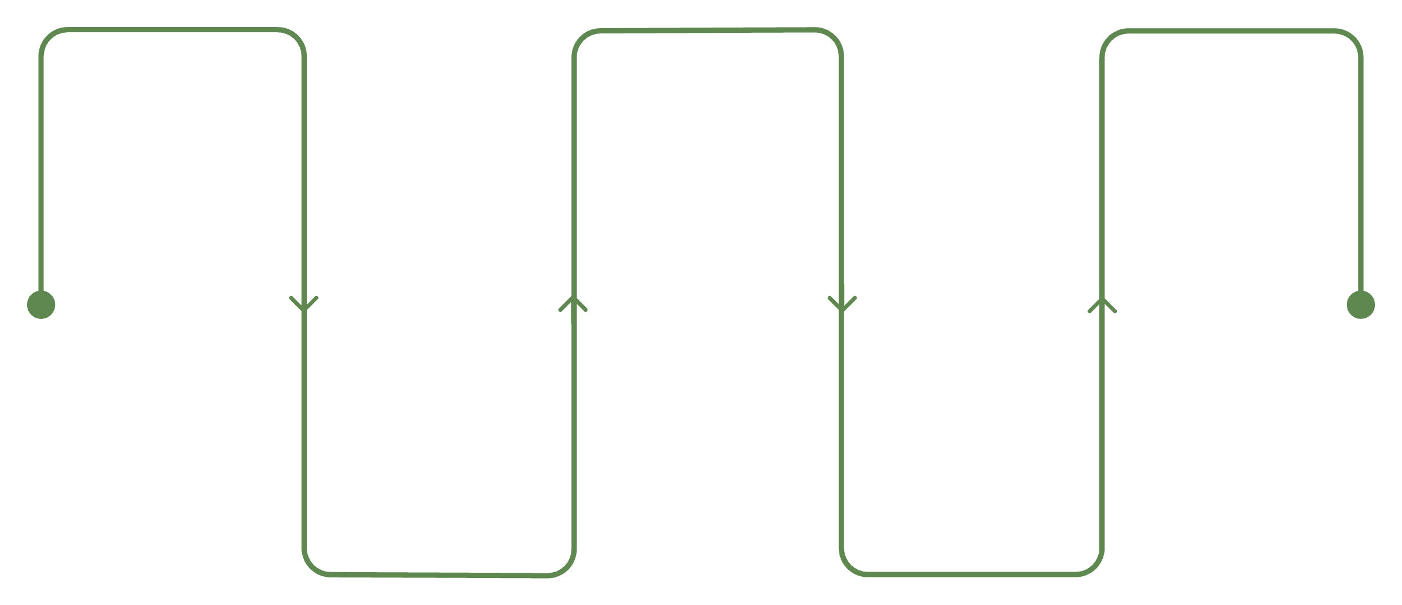
The Nature of Development Planning
Economic planning is a deliberate government effort to coordinate economic decisions over the long term and influence the growth and direction of important economic variables in order to achieve predetermined development objectives.
Comprehensive Plans
Partial Plans
Cover all major sectors of the economy — agriculture, industry, services, infrastructure, education, health, and trade — providing a holistic national development framework.
Focus on specific sectors or policy areas, allowing targeted interventions where they are most needed without overhauling the entire economic system.
Identify Goals
Allocate Resources
Monitor Progress
Define long-term development aims
Assign budgets and personnel
Track outcomes and adjust
Implement Programs
Set Targets
Translate goals into measurable targets
Execute planned initiatives
The planning process is cyclical and iterative — each phase informs the next, ensuring that national development efforts remain aligned with evolving priorities and conditions.

Slide 5
The Philippine Development Plan
The Philippine Development Plan (PDP) outlines national priorities and serves as the primary guide for government programs and investments across all sectors.
Economic Transformation
Infrastructure Development
Structural reforms to shift toward higher-value industries and improve competitiveness.
Build Better More Program connecting regions and reducing logistics costs.
Poverty Reduction
Food Security
Targeted social protection programs and inclusive growth strategies.
Agricultural modernization and farm-to-market connectivity initiatives.
Digitalization
Environmental Sustainability
Expanding digital infrastructure and e-government services nationwide.
Climate resilience, renewable energy, and natural resource protection.

Slide 6
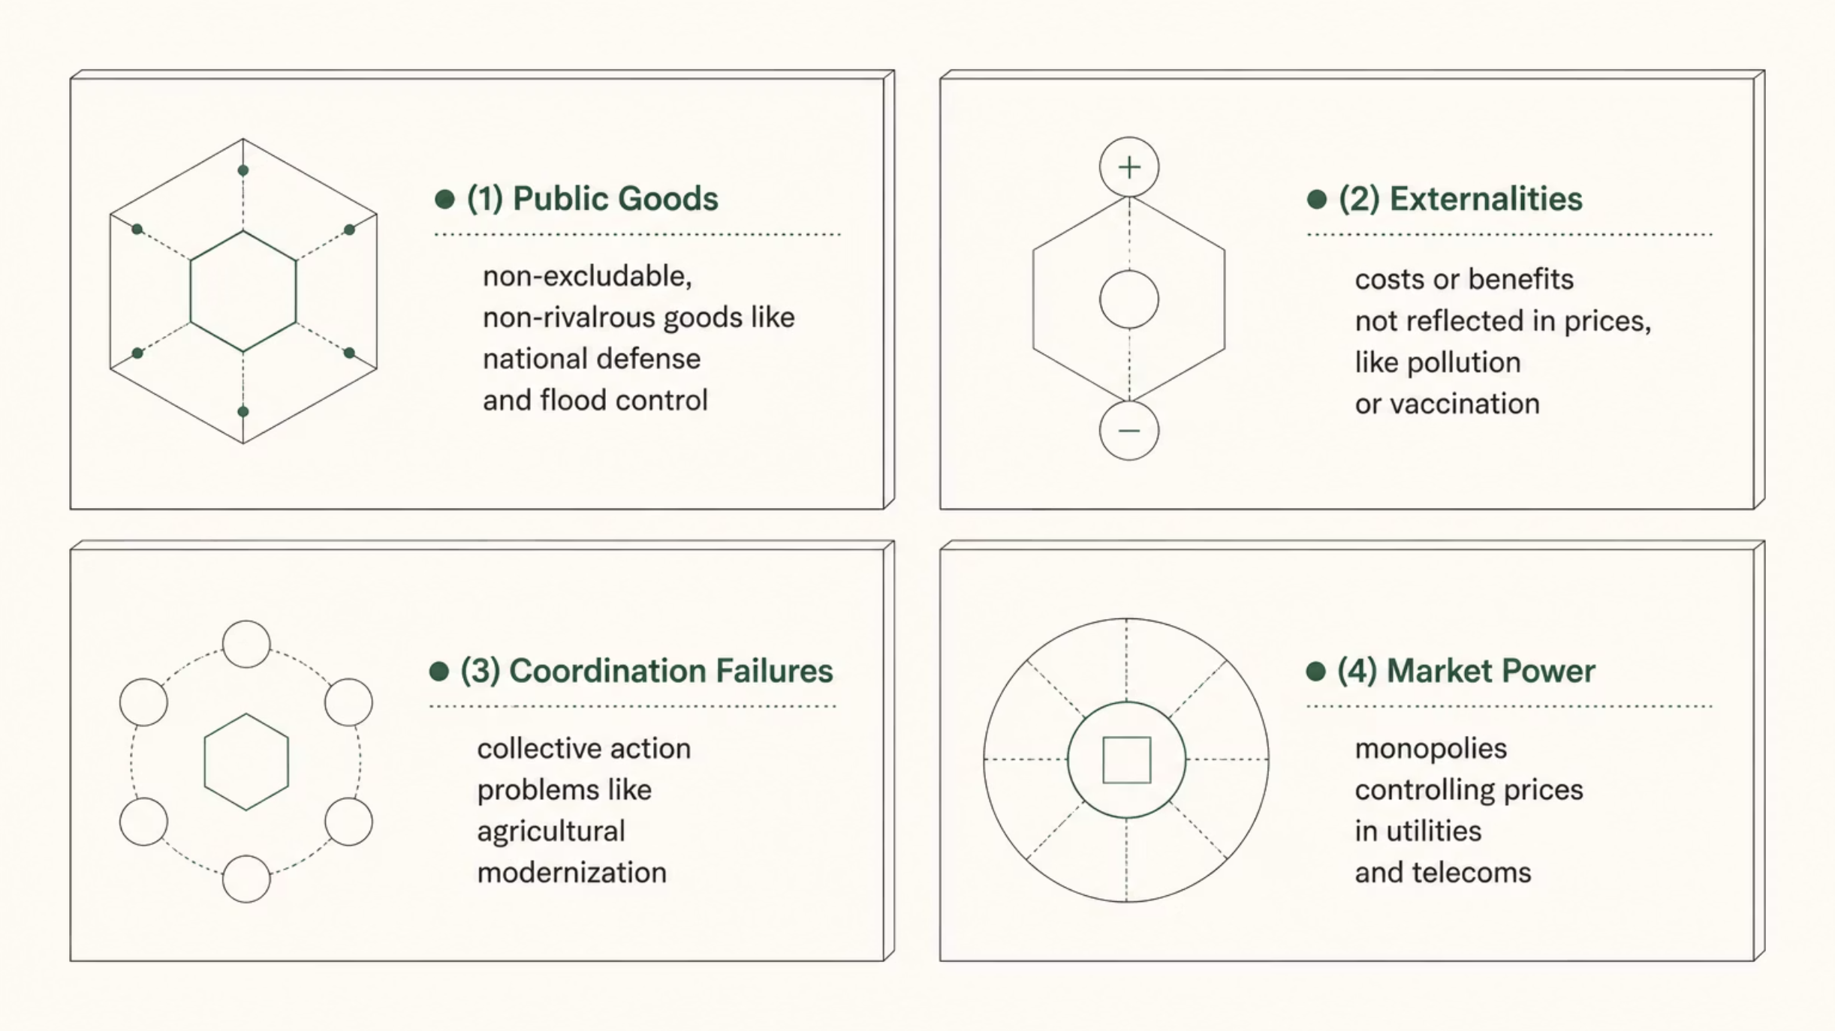
Market Failure: When Markets Fall Short
Market failure occurs when the free market fails to allocate resources efficiently or produce outcomes that maximize social welfare. It is the primary rationale for government intervention in developing economies.
Each form of market failure creates a distinct rationale for government action — from providing goods the private sector won't supply, to correcting price distortions, to enabling coordination that markets cannot achieve on their own.

Slide 7

Public Goods: What Markets Won't Provide
Defining Characteristics
Philippine Examples
Public goods are non-excludable (people cannot easily be prevented from using them) and non-rivalrous (one person's use does not reduce availability for others). Private firms have little incentive to provide these goods because consumers can benefit without directly paying.
National Defense — provided by the Armed Forces of the Philippines
Public Street Lighting — illuminating roads and communities nationwide
Flood Control Systems — protecting communities from seasonal flooding
Disaster Warning Systems — operated by PAGASA and PHIVOLCS

Slide 8
Externalities: Hidden Costs and Benefits
Externalities occur when economic activities impose costs or benefits on others that are not reflected in market prices, leading to over- or under-production of certain goods and services.
Negative Externalities
Positive Externalities
Industrial pollution affecting communities along the Pasig River
Vehicle emissions contributing to air pollution in Metro Manila
Plastic waste affecting marine ecosystems and coastal livelihoods
Vaccination programs reducing disease transmission across communities
Education increasing labor productivity and innovation capacity
Community tree-planting improving environmental quality for all
These impose social costs not borne by the producers, requiring regulation or taxation to correct.
These generate social benefits beyond what the market rewards, justifying subsidies or direct government provision.

Slide 9

Coordination Failures and Market Power
Coordination Failures
Market Power
Coordination failures occur when economic agents would benefit from collective action but fail to coordinate their decisions. Agricultural modernization, for example, requires simultaneous investments in irrigation, roads, storage facilities, financing, and technology. If only one component is provided, overall productivity gains remain limited.
The Philippine government's Farm-to-Market Roads Program directly addresses coordination failures by connecting agricultural production areas to markets and processing facilities.
Market power exists when firms possess sufficient control to influence prices and output. Monopolies or dominant firms in utilities, telecommunications, and transportation can exploit consumers and reduce economic efficiency.
Government regulation — through agencies like the Philippine Competition Commission — is often necessary to protect consumers and ensure fair competition in concentrated markets.

Slide 10

Three Basic Types of Planning Models
Aggregate Growth
Input‑Output
Project Appraisal
Each planning model operates at a different level of analysis — from the economy-wide view of aggregate growth models, to the sectoral linkages captured by input-output analysis, to the project-level scrutiny of cost-benefit appraisal. Together, they form a comprehensive toolkit for development planners.
Aggregate Growth Model
Input-Output Model
Project Appraisal
Uses macroeconomic variables — savings, investment, exports, imports — to forecast GDP growth and set broad development targets. Used by NEDA, DOF, and BSP.
Examines relationships among economic sectors. Recognizes that industries both produce outputs and consume inputs from other industries, revealing ripple effects of policy changes.
Microeconomic technique using social cost-benefit analysis to evaluate specific public investment projects before committing public resources.

Slide 11


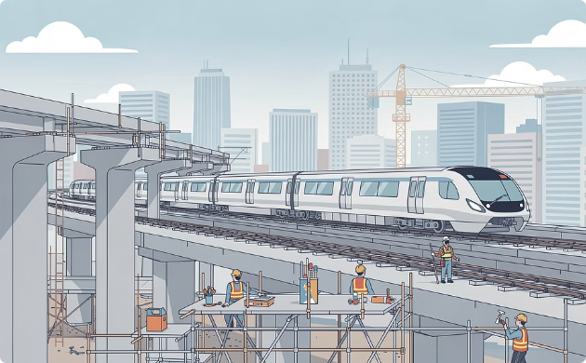
Planning Models in Philippine Practice
Aggregate Growth Forecasting
Input-Output: Tourism Ripple Effects
Project Appraisal: Metro Manila Subway
When the government projects a 6–8% economic growth target, it relies on macroeconomic planning models estimating how investment, consumption, exports, and government spending will contribute to growth. NEDA, DOF, and BSP coordinate these projections.
Growth in tourism affects transportation, hospitality, agriculture, retail trade, and construction simultaneously. Input-output analysis helps policymakers understand how changes in one sector cascade throughout the entire economy.
Before implementation, policymakers assess whether social benefits — reduced congestion, shorter travel times, lower pollution, increased productivity — exceed the billions of pesos in construction costs.

Slide 12

Government Failure: When Intervention Goes Wrong
While government intervention can correct market failures, it may also create inefficiencies known as government failures — situations where public policies fail to improve outcomes or create unintended negative consequences.
1
2
3
Distortion of the Price Mechanism
Imperfect Knowledge
Law of Unintended Consequences
Taxes, subsidies, and price controls can distort market signals. Rice price ceilings may reduce farmer incentives; fuel subsidies encourage excessive consumption; electricity subsidies raise expenditures without solving long-term energy challenges.
Governments often lack complete information for optimal decisions. Educational programs may produce graduates in fields that no longer match labor market requirements — as the rapid growth of digital industries demonstrates.
Traffic schemes may shift congestion to neighboring roads. Agricultural subsidies may encourage overproduction. Import restrictions may raise consumer prices. Policies must be continuously monitored and evaluated.

Slide 13
Pros and Cons of Government Intervention
One of the most important debates in economics concerns the appropriate role of government. Most economists agree that the ideal approach lies somewhere between minimal and extensive intervention.
Arguments FOR Intervention
Arguments AGAINST Intervention
Promoting equality through social protection programs
Providing public goods markets underprovide
Developing human capital through education
Influencing harmful consumer behaviors
Protecting the environment from market failures
Controlling monopoly power and anti-competitive practices
Leading large-scale infrastructure development
Government failure and poor policy design
Lack of competitive incentives in public agencies
Influence of political pressure groups over public interest
Reduced consumer choice and market competition
Potential restrictions on personal freedom
Resource misallocation and bureaucratic inefficiency

Slide 14





Promoting Equality and Social Protection
Markets often generate unequal outcomes. Government programs are essential tools for reducing poverty and improving opportunities for disadvantaged groups across the Philippines.
Pantawid Pamilya (4Ps)
Conditional cash transfers supporting poor households in health, nutrition, and education.
Social Pensions
Monthly stipends for indigent senior citizens ensuring basic income security.
Universal Health Care
Expanding PhilHealth coverage to ensure all Filipinos access quality health services.
Scholarship Programs
Free tuition in state universities and colleges under the Universal Access to Quality Tertiary Education Act.

Slide 15
Environmental Protection and Infrastructure
Environmental Programs
Infrastructure Development
Environmental problems require government action because markets fail to account for environmental costs. Key Philippine initiatives include:
Large-scale infrastructure often requires government leadership to overcome financing barriers and coordinate complex projects:
Manila Bay Rehabilitation Program — restoring water quality and coastal ecosystems
National Greening Program — reforestation across degraded lands
Metro Manila Subway — underground rapid transit reducing surface congestion
North-South Commuter Railway — connecting Metro Manila to Bulacan and Laguna
Renewable Energy Act — promoting solar, wind, and geothermal power
Plastic Regulation Initiatives — reducing single-use plastic waste
Cebu-Cordova Link Expressway — improving Visayas connectivity
New Clark City — decongesting Metro Manila through planned urban development

Slide 16





The Role of Civil Society in Development
Beyond markets and government, civil society organizations play an indispensable role in development — addressing social needs, promoting accountability, and strengthening citizen participation in governance.
Philippine Red Cross
Providing humanitarian assistance, disaster response, blood services, and community health programs across the archipelago.
Gawad Kalinga
Building communities and restoring dignity for poor Filipino families through housing, livelihood, and values formation programs.
Haribon Foundation
Leading biodiversity conservation efforts, protecting Philippine forests, wildlife, and ecosystems through science-based advocacy.
NGOs in Education & Health
Thousands of civil society organizations supporting education access, public health, disaster relief, and community empowerment nationwide.

Slide 17
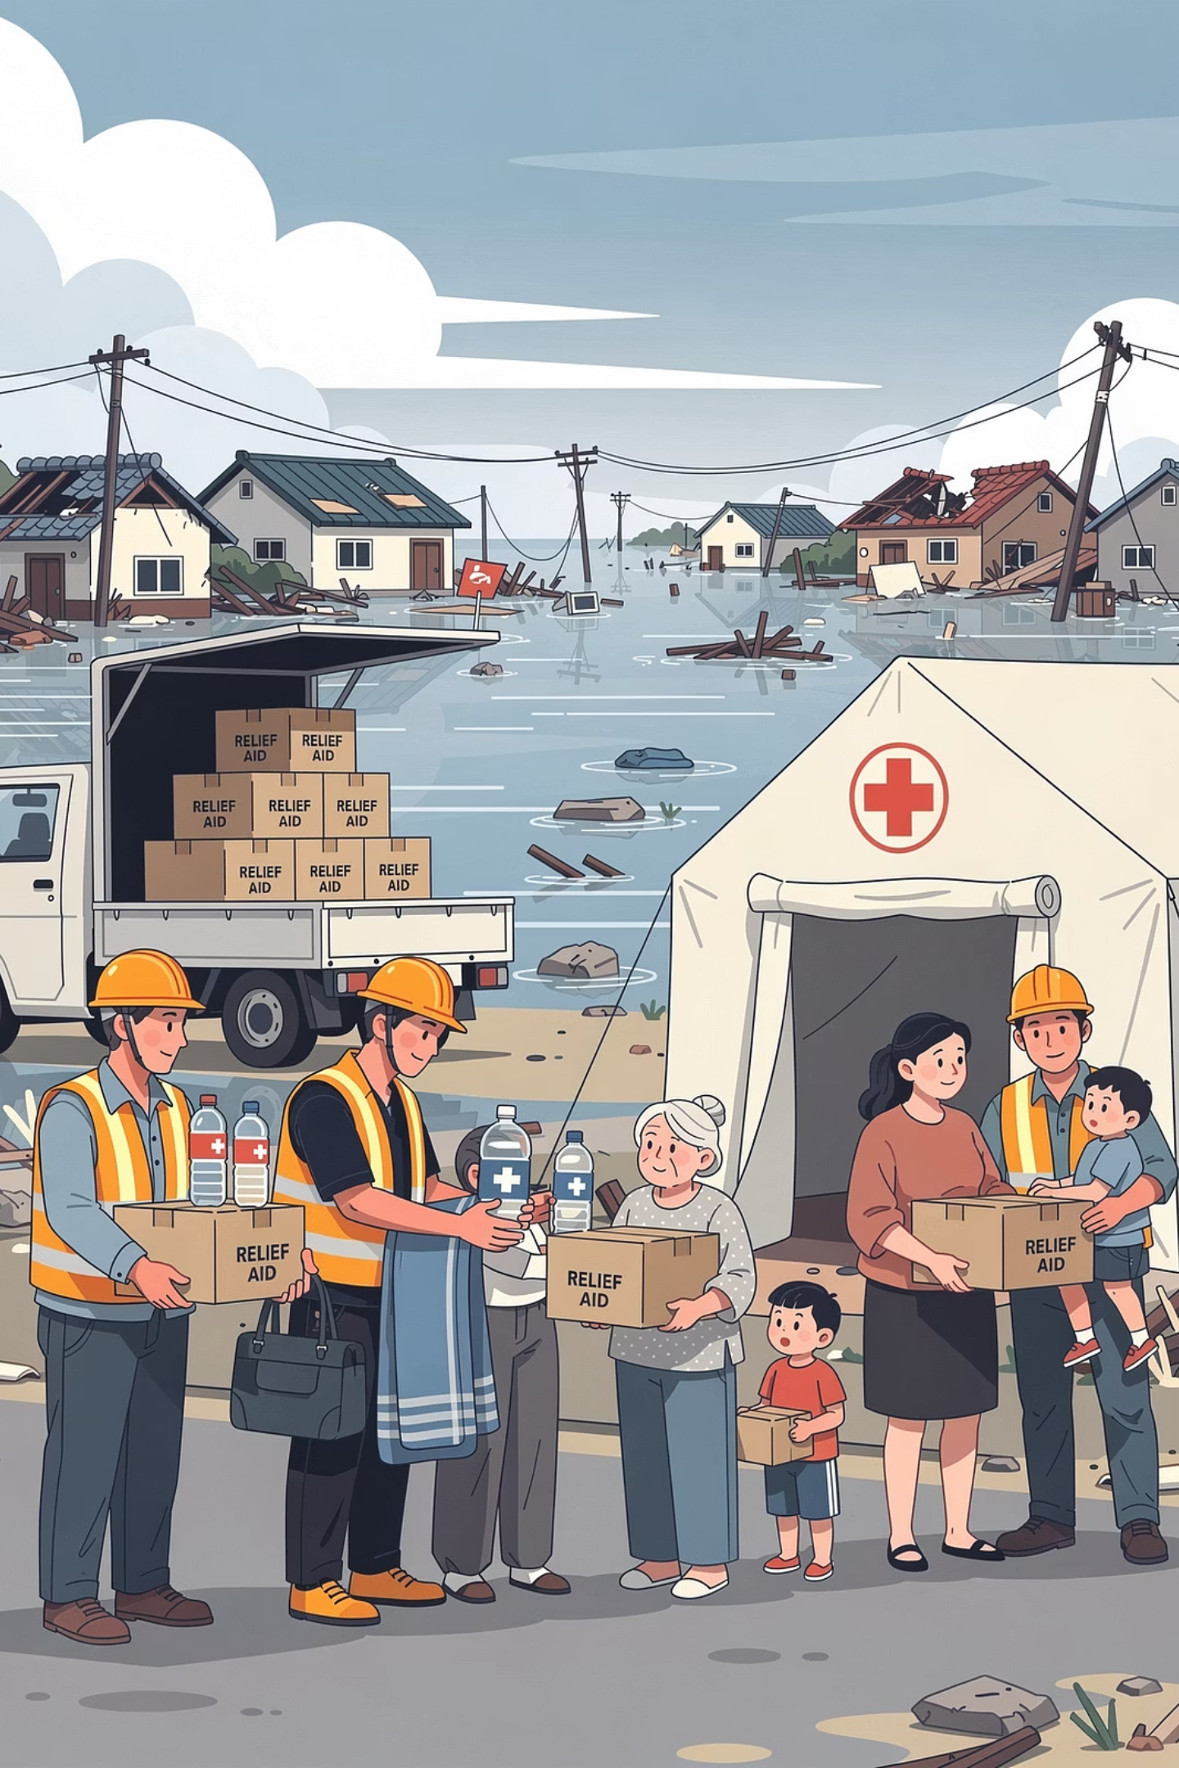
Typhoon Yolanda: A Model of Multi-Sector Collaboration
The response to Typhoon Yolanda (Hainan) — one of the strongest tropical cyclones ever recorded — demonstrated how government agencies, private organizations, international donors, and civil society groups can work together to achieve development and recovery goals.
Government
NDRRMC, DSWD, AFP, and LGUs coordinated evacuation, relief distribution, and infrastructure rehabilitation.
Private Sector
Corporations donated resources, logistics, and reconstruction support, demonstrating corporate social responsibility at scale.
Civil Society
NGOs and community organizations provided immediate relief, psychosocial support, and long-term community rebuilding.
International Community
Foreign governments, UN agencies, and international NGOs provided billions in humanitarian assistance and technical support.

Slide 18
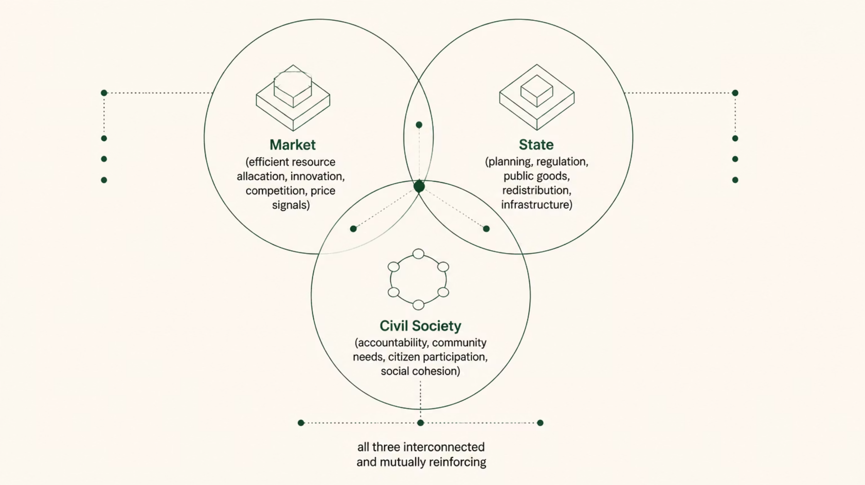
Balancing Market, State, and Civil Society
Development policymaking involves determining the appropriate balance among market forces, state intervention, and civil society participation in promoting sustainable and inclusive development.
No single actor can achieve development alone. The most successful development outcomes emerge when markets, governments, and civil society each play their appropriate roles — complementing rather than replacing one another.

Slide 19
Key Concepts Summary
Development Planning
Deliberate government coordination of economic decisions to achieve predetermined development objectives through comprehensive or partial plans.
Market Failure
Occurs when free markets fail to allocate resources efficiently — through public goods, externalities, coordination failures, or market power.
Government Failure
When public policies create inefficiencies through price distortions, imperfect knowledge, or unintended consequences that worsen outcomes.
Three Planning Models
Aggregate growth models, input-output models, and project appraisal each serve distinct analytical purposes in development planning.
Civil Society
Organizations beyond markets and government that address social needs, promote accountability, and strengthen citizen participation in governance.

Slide 20

References
Samuelson, P. A., & Nordhaus, W. D. (2009). Economics (19th ed.). McGraw-Hill Education.
Todaro, M. P., & Smith, S. C. (2015). Economic development (12th ed.). Pearson.
Buchanan, J. M. (2003). Public choice: The origins and development of a research program. George Mason University Press.
Hayek, F. A. (1945). The use of knowledge in society. American Economic Review, 35(4), 519–530.
Stiglitz, J. E. (2000). Economics of the public sector (3rd ed.). W.W. Norton.
National Economic and Development Authority. (2023). Philippine Development Plan 2023–2028. https://www.neda.gov.ph
Philippine Competition Commission. (2024). https://www.phcc.gov.ph
World Bank. (2024). World Development Report. https://www.worldbank.org
Asian Development Bank. (2024). Asian Development Outlook. https://www.adb.org

