Slide 1
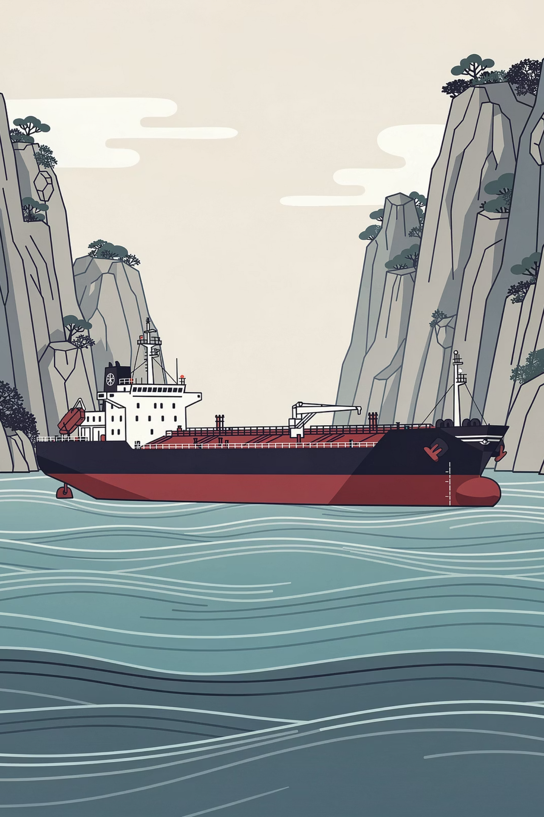
Module 12: The Effects of the US–Iran War and Oil Price Hike on Economic Development
Including the Strategic Importance of the Strait of Hormuz
ECONOMICS & GEOPOLITICS
GLOBAL ENERGY SECURITY

Slide 2
Overview
Why This Matters
The US–Iran Dimension
The relationship between war, energy security, and economic development has always been significant in the global economy. Modern economies rely heavily on petroleum for transportation, manufacturing, electricity generation, agriculture, and international trade.
Any disruption in global oil supply can trigger widespread economic consequences — affecting nations large and small.
One of the most critical geopolitical tensions in recent decades involves the United States and Iran. Whenever tensions escalate, global markets become concerned because Iran sits near the Strait of Hormuz — one of the most strategically important waterways in the world.
For developing countries such as the Philippines, rising oil prices create serious challenges: higher fuel costs, rising food prices, increased electricity rates, and pressure on businesses and households.

Slide 3
Learning Objectives
At the end of this lesson, students should be able to:
1
Explain
The causes of US–Iran tensions and conflicts
2
Describe
The importance of oil in the global economy
3
Analyze
How oil price hikes affect economic development
4
Discuss
The strategic importance of the Strait of Hormuz
5
Evaluate
The economic consequences of geopolitical conflicts
6
Identify
Possible solutions to reduce dependence on oil imports

Slide 4
Background: The US–Iran Conflict
Historical Roots
The conflict between the United States and Iran is rooted in a long history of political, ideological, and strategic disagreements. Although the two countries once maintained close relations, events during the late twentieth century dramatically altered their relationship.
Pre-1979
1
Iran governed by Shah Pahlavi with close ties to the United States and Western nations
2
1979 Revolution
Islamic government under Ayatollah Khomeini replaces the monarchy; US influence strongly opposed
Hostage Crisis
3
American diplomats held hostage in Tehran for 444 days, severely damaging diplomatic relations
4
Nuclear Disputes
Western concerns over Iran's nuclear program lead to economic sanctions and ongoing tensions
2020
5
Assassination of General Qasem Soleimani heightens fears of direct military confrontation

Slide 5
Three Pillars of US–Iran Tension
The Iranian Revolution (1979)
Nuclear Disputes
Military Tensions
The revolution replaced a pro-Western monarchy with an Islamic government that strongly opposed American influence. The Iran Hostage Crisis — 444 days of captivity for US diplomats — marked the beginning of decades of hostility and severed formal diplomatic ties.
The United States and Western allies have expressed concerns that Iran could develop nuclear weapons. Iran maintains its nuclear activities are for peaceful energy and research purposes. Economic sanctions were imposed, limiting trade and restricting financial transactions.
Naval confrontations, missile tests, cyberattacks, and regional conflicts have contributed to ongoing instability in the Persian Gulf. These tensions are especially important because of their potential impact on global energy markets and international trade.

Slide 6
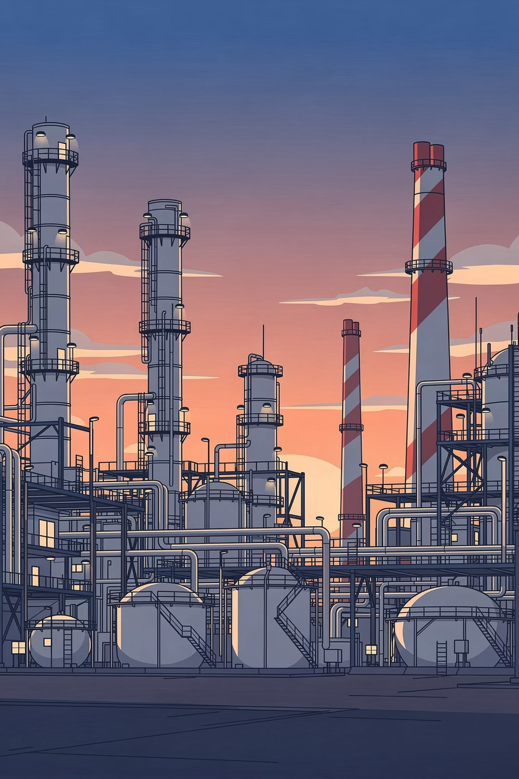
Understanding Oil and Economic Development
The Lifeblood of the Modern Economy
Oil is often described as the lifeblood of the modern economy because it powers many of the activities that support economic growth and development. Despite increasing interest in renewable energy, petroleum remains one of the world's most important energy sources.
Transportation
Vehicles, ships, and aircraft all depend on petroleum-based fuels
Manufacturing
Factories use petroleum products throughout production processes
Agriculture
Farm machinery and fertilizers depend on diesel and petroleum derivatives
Chemical & Plastics
Petroleum is a raw material for plastics, chemicals, and synthetic materials

Slide 7

Oil and the Philippine Economy
High Import Dependence
What is Economic Development?
The Philippines imports most of its petroleum requirements. Because domestic oil production is limited, the country is highly sensitive to fluctuations in global oil prices. When international oil prices rise:
Economic development encompasses more than simply increasing national income. It includes improvements in:
Living standards
Employment opportunities
Industrial growth
Infrastructure development
Education and healthcare
Poverty reduction
Transportation costs increase across all sectors
Electricity generation becomes more expensive
Businesses face higher operating expenses
Stable and affordable energy supplies are essential for achieving all of these goals.
Consumers pay more for goods and services

Slide 8
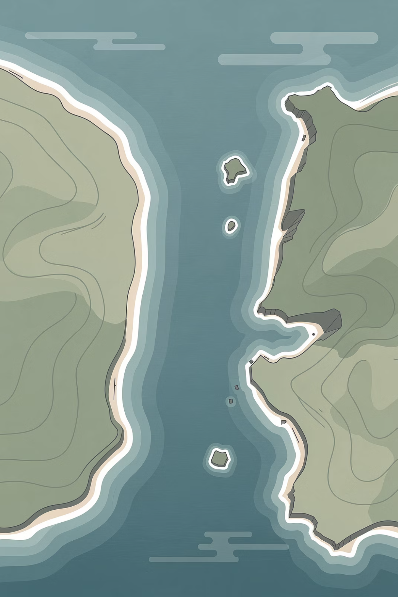

The Strait of Hormuz
STRATEGIC CHOKEPOINT
The Strait of Hormuz is a narrow waterway located between Iran and Oman. It serves as the primary maritime connection between the Persian Gulf and the Gulf of Oman, which connects to the Arabian Sea and the broader global shipping network.
Approximately one-fifth of the world's oil supply passes through the Strait of Hormuz every single day — making it one of the most critical energy chokepoints on Earth.

Slide 9




Why the Strait of Hormuz Is Critical
Major Oil Exporters Dependent on the Strait
Potential Impacts of Disruption
Reduced oil supply reaching global markets
Higher shipping costs for tankers rerouting
Saudi Arabia
World's largest oil exporter relies on the Strait for the majority of its petroleum exports
Increased fuel prices worldwide
Financial market instability and investor panic
Iraq, Kuwait & UAE
Rising inflation across importing nations
These Gulf states depend heavily on this waterway to transport oil to international markets
Iran
Iran itself exports oil through the Strait while simultaneously holding the power to threaten its closure

Slide 10

Iran's Threat to Close the Strait
During periods of heightened tension with the United States and its allies, Iran has occasionally threatened to close the Strait of Hormuz. Such threats are often viewed as responses to economic sanctions, military actions, or diplomatic disputes.
Oil Tanker Disruption
Global Supply Decline
Oil tankers would face severe difficulties transporting petroleum, forcing costly rerouting around Africa
Global oil supply would decline sharply as one-fifth of daily supply is suddenly removed from markets
Energy Price Surge
Trade Disruption
Energy prices would rise sharply worldwide, triggering inflation and economic hardship in importing nations
International trade would be broadly disrupted, affecting supply chains and manufacturing globally
Even the possibility of closure — without any actual blockade — can generate significant uncertainty and volatility in global commodity markets.

Slide 11

How War Drives Oil Prices Up
Market Speculation
Supply Disruptions
Risk Premium
Oil prices are influenced not only by actual supply and demand but also by expectations about future conditions. During times of geopolitical uncertainty, all three mechanisms can operate simultaneously — amplifying price increases far beyond what physical disruptions alone would cause.

Slide 12
Effects of Oil Price Hikes: Inflation
The Most Immediate Consequence
One of the most immediate effects of rising oil prices is inflation. Higher fuel costs increase transportation and production expenses throughout the economy. Businesses often pass these additional costs on to consumers through higher prices.
Inflation Consequences
Philippine Example
More expensive food and agricultural products
Higher electricity bills for households
Increased transportation fares
Rising prices for consumer goods
When global oil prices rise, public transportation fares in Metro Manila and other urban areas often increase. Agricultural products transported from provinces to cities also become more expensive due to higher logistics costs.
This creates a compounding effect: higher fuel prices → higher transport costs → higher food prices → reduced household purchasing power.
For households, inflation reduces purchasing power because incomes may not increase as quickly as prices rise.

Slide 13




Broader Economic Consequences of Oil Shocks
Slower Economic Growth
Businesses facing higher energy costs experience lower profits and reduced investment capacity. Firms may postpone expansion plans or reduce output, slowing industrial production and infrastructure development.
Unemployment
As operating costs increase, some businesses may reduce production or delay hiring. In severe cases, firms may lay off workers to reduce expenses, contributing to higher unemployment rates.
Poverty and Inequality
Poor households are most affected because a larger portion of their income is spent on transportation, food, and basic necessities. Oil price shocks can worsen poverty and increase income inequality.
Trade Deficits
Countries that import large quantities of oil must spend more foreign currency when prices rise, leading to trade deficits, pressure on exchange rates, and reduced foreign exchange reserves.

Slide 14

Global Economic Consequences
Impact on Developing Countries
Impact on Advanced Economies
Developing economies are highly vulnerable to oil price shocks because they depend heavily on imported energy and often have limited financial reserves. Rising fuel costs increase inflation, strain government budgets, and slow economic growth. Their limited capacity to absorb shocks makes them especially exposed.
Even advanced economies are affected. Higher oil prices increase production costs, reduce consumer spending, and contribute to stock market volatility. Countries such as the United States, Japan, China, and members of the European Union all experience economic pressure during major oil crises.
Risk of Global Recession: If oil prices remain elevated for a prolonged period, global economic growth may slow significantly. Reduced investment, weaker consumer demand, and declining trade can contribute to recessionary pressures worldwide.

Slide 15




Impact on the Philippines
The Philippines is particularly vulnerable because it imports most of its petroleum requirements. The effects of global oil price increases ripple through multiple sectors of the Philippine economy.
Fuel Price Increases
Inflation in Basic Goods
Impact on OFWs
Higher global oil prices lead to more expensive gasoline and diesel, higher transportation costs, increased logistics expenses, and rising electricity rates across the country.
As transportation and production costs increase, the prices of food, agricultural products, and consumer goods also rise, placing additional pressure on Filipino households — particularly low-income families.
The Middle East remains an important destination for Filipino workers. Regional instability creates concerns regarding worker safety, employment opportunities, remittance flows, and potential evacuation requirements.
Remittances from Overseas Filipino Workers (OFWs) contribute significantly to the Philippine economy. Disruptions affecting OFWs in the Middle East may therefore have broader macroeconomic consequences for the country.

Slide 16
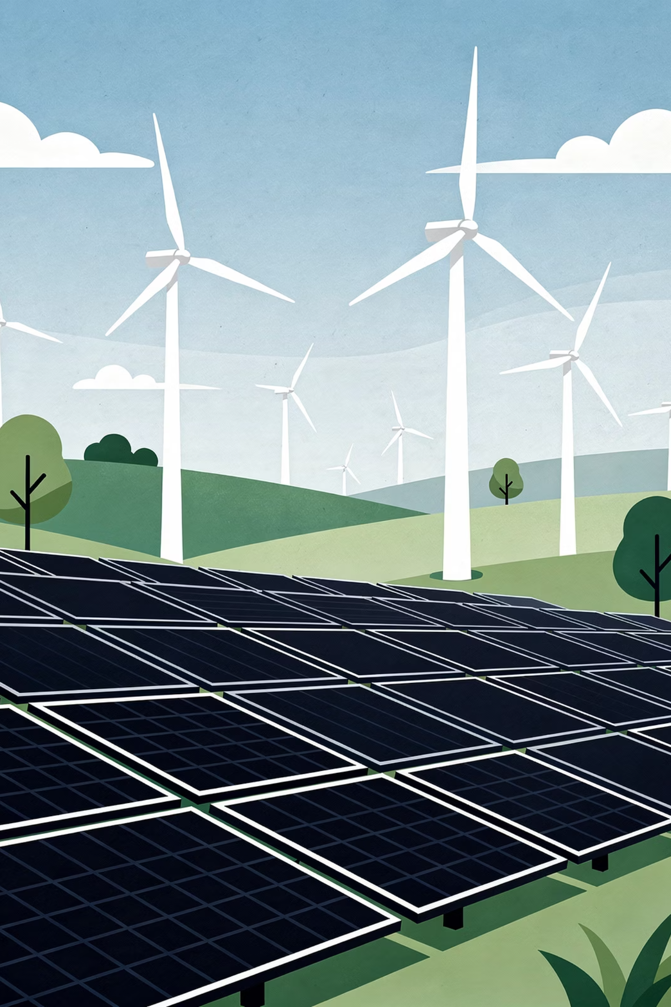




Possible Solutions: Diversifying Energy Sources
Reducing Dependence on Imported Oil
Reducing dependence on imported oil requires sustained investment in alternative energy sources. The Philippines possesses significant potential in renewable energy, particularly geothermal and solar resources.
Solar Power
Abundant sunlight across the Philippine archipelago makes solar energy a highly viable and rapidly expanding option
Wind Energy
Coastal and highland areas offer strong wind resources suitable for utility-scale wind power generation
Hydroelectric Power
Rivers and water resources can be harnessed for clean, reliable electricity generation with low operating costs
Geothermal Energy
The Philippines is already one of the world's top geothermal energy producers, with significant untapped potential remaining

Slide 17
Additional Solutions: Resilience Strategies
Strategic Oil Reserves
Energy Conservation Measures
Governments can establish emergency oil reserves to provide temporary protection during supply disruptions. Strategic reserves help stabilize domestic markets and reduce the immediate impact of global crises by ensuring a buffer supply is available.
Governments, businesses, and individuals can all contribute to reducing oil dependence through conservation:
Reduce Fuel Consumption
Diplomatic Solutions
Encourage fuel-efficient vehicles and driving habits
Peaceful diplomacy remains one of the most effective ways to reduce geopolitical risks. Negotiations and international cooperation can prevent conflicts from escalating and help maintain stability in energy markets — benefiting all nations.
Use Public Transportation
Mass transit reduces per-capita fuel consumption significantly
Improve Energy Efficiency
Buildings, appliances, and industrial processes can all be made more efficient
Promote Sustainable Technologies
Electric vehicles, smart grids, and green building standards reduce long-term dependence

Slide 18
Key Concepts Summary
Concept
Explanation
Oil Price Hike
A significant increase in global petroleum prices, often triggered by supply disruptions, geopolitical conflict, or market speculation
Economic Development
Improvement in economic conditions and quality of life, including employment, infrastructure, education, healthcare, and poverty reduction
Inflation
A continuous increase in the prices of goods and services, reducing the purchasing power of households and businesses
Strait of Hormuz
A strategic oil shipping route between Iran and Oman through which approximately one-fifth of the world's daily oil supply passes
Geopolitical Conflict
Political and military tension between nations that can disrupt trade, energy supply, and international economic stability
Supply Shock
A sudden reduction in supply causing rapid price increases, often resulting from conflict, natural disaster, or deliberate restriction

Slide 19
Conclusion
The US–Iran conflict demonstrates how geopolitical tensions can strongly influence global economic development. Because oil remains essential for transportation, manufacturing, agriculture, and trade, disruptions in supply can quickly affect economies around the world.
Global Impact
The Strait's Unique Role
The Philippine Path Forward
Rising oil prices contribute to inflation, slower economic growth, unemployment, and increased poverty — particularly in developing countries with limited financial buffers.
The Strait of Hormuz occupies a uniquely important position within the global energy system. Any military conflict, blockade, or disruption in the region can trigger significant volatility in global energy markets.
For the Philippines, dependence on imported petroleum highlights the importance of strengthening energy security through diversification, renewable energy investments, strategic planning, and international cooperation.
By reducing reliance on imported fuel and promoting sustainable development strategies, countries can better protect themselves from future oil shocks and geopolitical crises.

Slide 20

References
Council on Foreign Relations. (2024). Iran tensions and Middle East security. https://www.cfr.org
Goldman Sachs. (2024). Oil markets and geopolitical risk analysis.
Reuters. (2024). Oil prices and US–Iran negotiations. Reuters.
Reuters. (2024). Strait of Hormuz explainer. Reuters.
United Nations Conference on Trade and Development. (2024). Global trade and energy disruptions. UNCTAD.
World Bank. (2024). Commodity markets outlook. World Bank.
Al Jazeera. (2024). Strait of Hormuz and global oil markets. Al Jazeera.
MarketWatch. (2024). Global oil supply disruptions and economic consequences. MarketWatch.

