Slide 1

Strategic Business Analysis & Management Advisory Services
Module 1 · Part 2 — Profession and Application
MODULE 1
PART 2
Rosalinda E. Perez

Slide 2
Learning Outcomes
By completing this part of the module, you will be equipped with two transformative capabilities:
Define
Develop
The scope of Strategic Business Analysis and MAS within the Philippine business landscape.
The personal characteristics and technical skills required to succeed as a modern business analyst.

Slide 3

Recap: Part 1 Highlights
In Part 1, we examined the paradigm shift driven by automation and technological advancement — how accounting professionals are transitioning from compliance-driven record-keepers into active strategic business designers.
We introduced the economic value chain, showing that while routine compliance is increasingly automated, high-level strategic advisory remains a distinctly human domain reliant on insight, empathy, and deep judgment.

Slide 4
The CPA + AIS Partnership
Part 1 concluded with the powerful synergy created by the CPA and AIS partnership — where financial stewardship meets systemic data integrity to form the engine behind high-impact advisory services.
CPA
AIS
Advisory Engine
Financial stewardship, professional judgment, and regulatory compliance expertise.
Systemic data integrity, information architecture, and technology-driven reporting.
Together, they power high-impact, future-ready strategic advisory services.

Slide 5
Defining Strategic Business Analysis
Conceptual Definition
Operational Definition
The holistic process of researching an organization and its volatile environment to formulate, align, and execute long-term strategies under conditions of market uncertainty. (IIBA, 2024; University of London, 2025)
The pre-implementation execution of environmental scanning, business capability modeling, and information-processing behaviors used to measure, map, and reduce enterprise uncertainty. (IIBA, 2024; Palma & Simbillo, 2023)

Slide 6
Three Quantifiable Tasks of Strategic Business Analysis
01
02
03
Environmental & Variable Quantification
Business Capability Modeling (BCM)
Outcome-Focused Transformation Mapping
Measuring macro-environmental shifts using PESTEL Analysis and mapping internal capabilities using SWOT Matrices and Porter's Five Forces. (Palma & Simbillo, 2023)
Mapping the enterprise operating model — aligning people, processes, technology, and financial data — to score strategic maturity of organizational units. (IIBA, 2024)
Transforming qualitative executive concerns into data-backed statements of core corporate needs before programs or capital projects are funded. (IIBA, 2024)

Slide 7
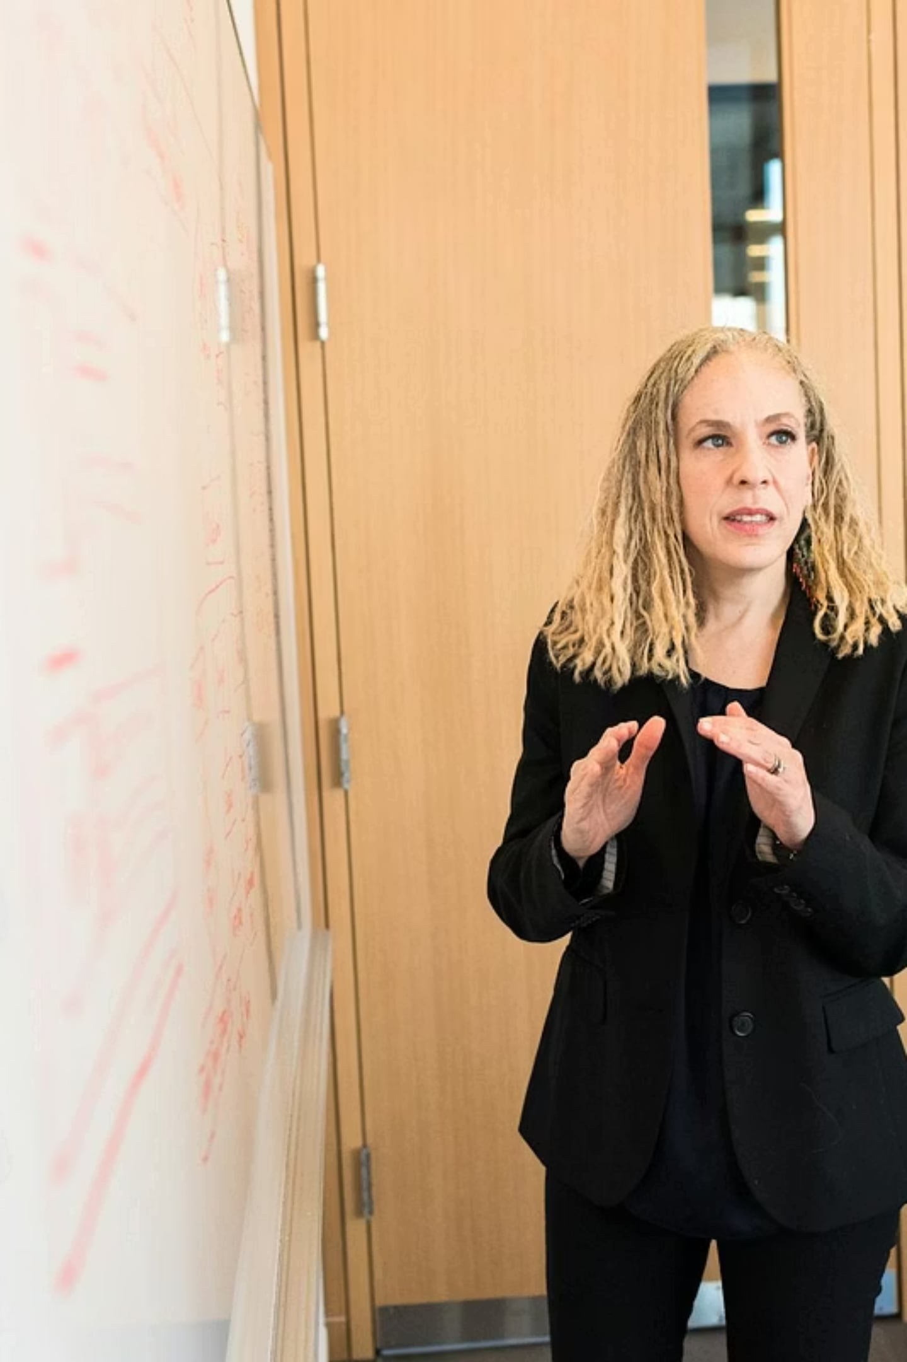
What Is Management Advisory Services (MAS)?
Management Advisory Services is the function of providing professional advisory (consulting) services. Its primary purpose is to improve the client's use of its capabilities and resources to achieve the strategic objectives of the organization. — Angeles, 2025; Cabrera, 2015
In essence, management consultants help to effect constructive change through the sound application of substantive and process skills.

Slide 8
Two Types of Professional Encounters
Consultations
Engagements
Providing advice and information within a short timeframe, typically delivered orally. May be definitive when the consultant has immediate expertise, but often qualified by stated limitations due to limited first-hand observation.
A formal MAS process applying a strict analytical methodology to a study or project — involving fact-finding, problem definition, solution evaluation, recommendations, and implementation.

Slide 9
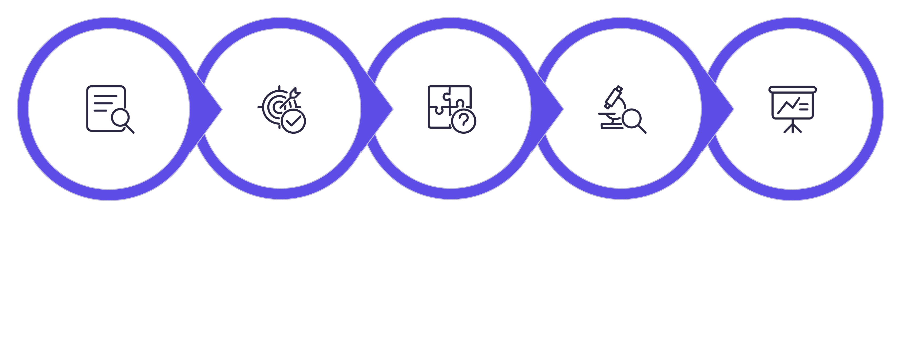
The Engagement Methodology
A formal MAS engagement follows a systematic, step-by-step analytical approach:
Present Recommen-dations
Ascertain Facts
Identify Objectives
Define Problem
Evaluate Solutions
This structured methodology ensures rigorous, objective, and actionable outcomes for every client engagement.

Slide 10
Scope of Management Advisory Services
Management consulting relates fundamentally to improving management functions — analysis, planning, organizing, and controlling — and introducing new methods and refined corporate policies.
Business Planning & Strategic Development
Information Systems Consulting
Operations Audit & Process Improvement
Feasibility studies, market research, and multi-year international market strategies.
Designing MIS, evaluating data processing methods, and establishing EDP controls.
Operational audits and Business Process Reengineering (BPR) to eliminate waste.

Slide 11

More Advisory Service Domains
Marketing & Promotional Strategy
Financial Management Advisory
Formulating promotional campaigns, planning sales force activity, and steering new product development paths.
Introducing managerial accounting controls, quantitative methods, cost accounting systems, and structures for securing financial support.
The scope of management consultancy is incredibly wide-ranging — any function that improves organizational performance falls within its domain.

Slide 12

Personal Characteristics of Top Advisors
To successfully drive structural change, top advisors must possess distinct personal and behavioral traits that complement their analytical minds.

Slide 13
Three Core Personal Traits
Keen Business Acumen
Empathy & Open Communication
Uncompromising Integrity
The vital capacity to make sound, logical judgments and rapid, effective business decisions based on fluid, evolving data sets.
Listening to client anxieties without bias, facilitating transparent cross-departmental dialogue, and ensuring human capital feels supported during technological transformations.
Anchoring all recommendations strictly in data-backed truths, remaining completely objective, and adhering to strict professional standards.

Slide 14
Required Technical Skills
The technical skill map of a modern advisor requires deep, interdisciplinary mastery across several key areas:
Advanced Managerial Accounting
Quantitative & Analytical Methods
Constructing complex cost accounting mechanisms, data processing controls, and financial models.
Mastery over mathematical, statistical, and forecasting methodologies to model business scenarios under high economic risk.
System Design & Verification
Regulatory & Framework Literacy
Auditing system processes, mapping operational duties, and ensuring reliability of management information streams.
Aligning all business advice with corporate standards, local commercial rules, and professional regulatory acts. (Angeles, 2025; de la Hostria, 2020)

Slide 15
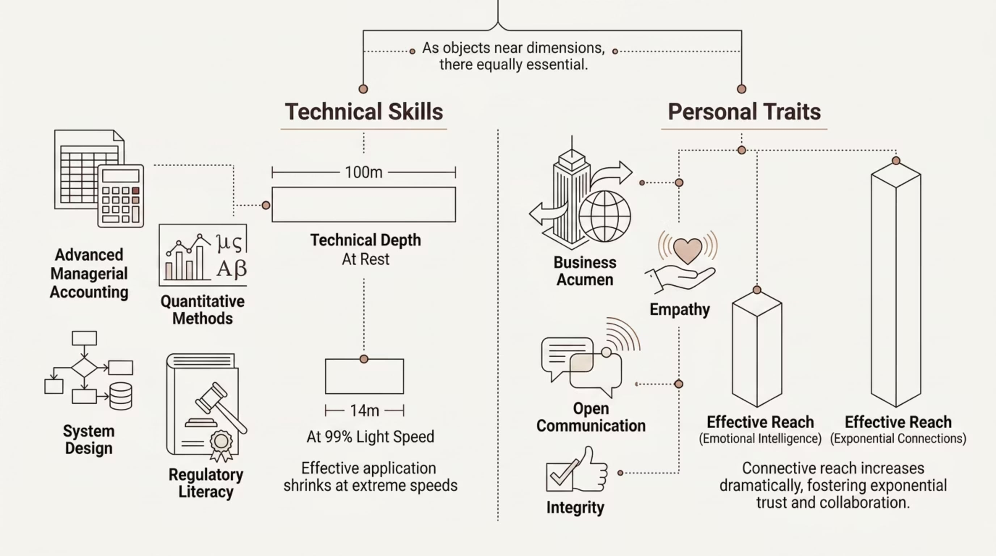
Skills vs. Traits: A Balanced Profile
World-class advisors cultivate both dimensions equally — technical mastery without personal integrity is incomplete, and empathy without analytical rigor is insufficient.

Slide 16
Skills vs. Traits: A Balanced Profile
Technical Skills
Personal Traits
Advanced Managerial Accounting
Keen Business Acumen
Quantitative & Analytical Methods
Empathy & Open Communication
System Design & Verification
Uncompromising Integrity
Regulatory & Framework Literacy
World-class advisors cultivate both dimensions equally — technical mastery without personal integrity is incomplete, and empathy without analytical rigor is insufficient.

Slide 17

PHILIPPINE SETTING
Applications in the Philippine Context

Slide 18
Case Study: Philippine Agricultural Cooperatives
Agricultural cooperatives in Isabela, Philippines face persistent funding and asset liquidity risks due to erratic weather patterns and seasonal financial strains. (Madayag, 2023)
Traditional Record-Keeper
MAS Consultant
Reports historical balance sheet deficits after a crisis has already occurred — reactive, not preventive.
Applies strategic business analysis to design and run Liquidity Risk Management systems proactively — empowering cooperative boards before crises strike. (Madayag, 2023)

Slide 19
MAS Tools Applied to Cooperatives
By executing the following tools, the MAS advisor empowers cooperative boards to manage capital proactively, ensuring smallholder Filipino farmers retain emergency funding access: (Madayag, 2023)
Financial Ratio Analysis
Structured Funding Facility Assessments
Budgeted Cash Flow Forecasting
Measuring liquidity, solvency, and operational efficiency indicators.
Evaluating access to credit lines and emergency capital sources.
Predicting seasonal cash shortfalls before they become crises.

Slide 20

Moving Up the Economic Value Chain
Historical Reporting
Proactive Capital
Document past performance and trends
Plan capital buffers and sources
Sustainable Growth
Liquidity Risk
Assess cash flow vulnerabilities
Scale cooperatives responsibly
This case demonstrates how MAS consulting successfully moves Philippine agricultural cooperatives up the economic value chain — from reactive reporting to proactive, resilient financial management. (Madayag, 2023)

Slide 21

Local Professional Benchmarks: The CPALE
The importance of mastering these competencies is reflected directly in local professional frameworks. In the CPA Licensure Examination (CPALE), regulated by the Professional Regulation Commission (PRC), Management Advisory Services stands out as a core, high-stakes subject area. (Angeles, 2025; de la Hostria, 2020)

Slide 22
What the Board of Accountancy Tests
The Board of Accountancy explicitly designs the CPALE to evaluate a candidate's grasp of management processes — specifically testing their technical capability to use information as a catalyst for strategic planning, operational control, and corporate decision-making. — Angeles, 2025
MAS is not a peripheral subject — it is a core competency that defines the modern Filipino CPA's professional readiness.

Slide 23



The Transformation: From Complier to Designer
Historical Complier
Strategic Analyst
Strategic Designer
Reactive record-keeping, compliance-driven, backward-looking reporting.
Environmental scanning, capability modeling, transformation mapping.
Future-ready advisory, proactive value creation, high-impact consulting.

Slide 24

Module Summary: The Value of MAS
The ultimate aim of management consulting and strategic business analysis is to add tangible, measurable value to the firm — by delivering specialist expertise, providing objective new perspectives, securing critical resources, and guiding personnel through difficult organizational changes.

Slide 25
Four Pillars of Consultant Value
Specialist Expertise
Objective Perspective
Delivering critical knowledge clients cannot generate internally.
Providing uncompromised, data-backed external viewpoints.
Critical Resources
Change Guidance
Securing the tools, frameworks, and capital pathways needed for growth.
Leading personnel through complex organizational transformations.

Slide 26

Reflection: On Mindset
Reviewing the paradigm shift discussed across both parts of this module — what concrete steps can you take this week to stop thinking like a traditional compliance record-keeper and start analyzing like a strategic business designer?

Slide 27

Reflection: On Application
Reflecting on the case of Philippine agricultural cooperatives — how can you use operational tools like PESTEL or financial forecasting to help a local SME in your community navigate current economic uncertainties? (Madayag, 2023)
Consider a specific business in your community. What is its most pressing uncertainty? Which analytical tool would you apply first?

Slide 28
Reflection: On Skills
Look closely at the balance between technical skills (like quantitative methods) and personal traits (like open communication). Which of these competencies do you currently need to develop most urgently — and what is your immediate plan of action?
Assess
Prioritize
Act
Identify your current skill gaps honestly.
Choose one technical and one personal trait to develop.
Commit to a specific, time-bound action this week.

Slide 29

Looking Ahead: Module 2
The foundational concepts, operational definitions, and skill maps established in Module 1 form the baseline for our next journey.
01
02
Formal MAS Practice Standards
Stages in Consultancy Engagements
The professional standards governing management advisory engagements.
A sequential deep-dive into the full lifecycle of a formal engagement.
03
Ethical Considerations
The complex ethical principles that govern the professional advisor's daily practice.

Slide 30
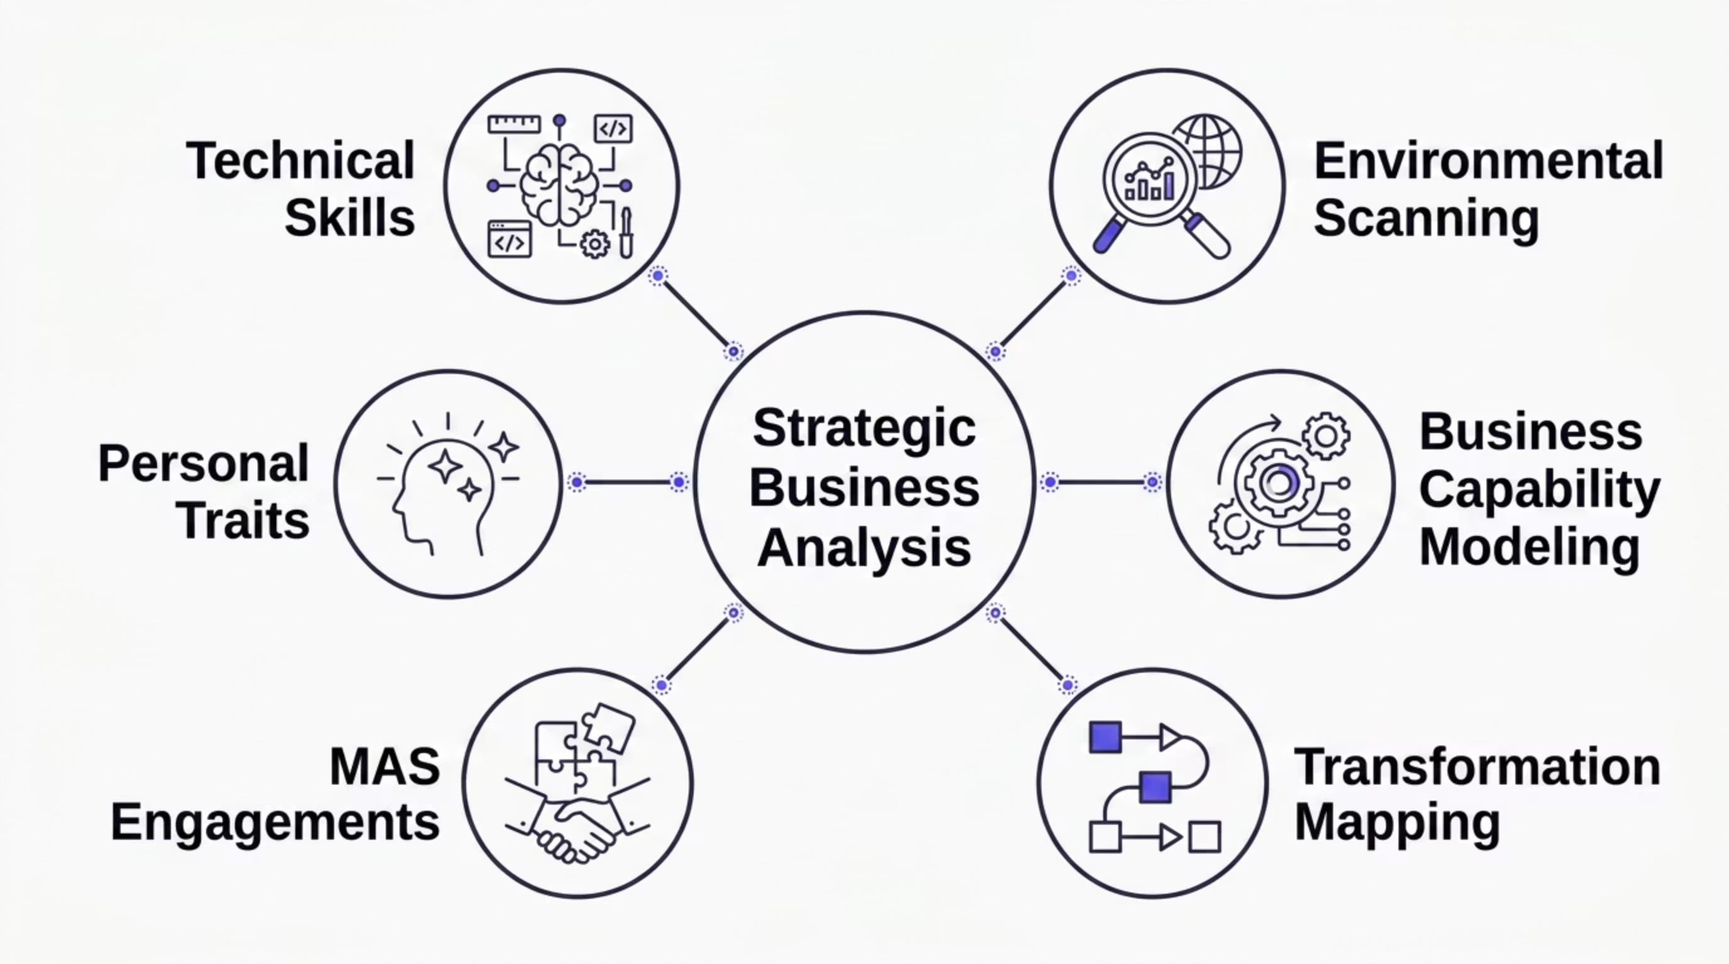
Key Concepts at a Glance

Slide 31
The Analytical Encounter: A Comparison
Dimension
Consultation
Engagement
Timeframe
Short, often single session
Extended, project-based
Delivery
Oral advice and information
Formal written methodology
Depth
May be qualified by limitations
Systematic, rigorous analysis
Outcome
Immediate guidance
Implemented recommendations
Formality
Informal to semi-formal
Strictly formal process

Slide 32
PESTEL & Strategic Tools in Practice
Environmental & Variable Quantification relies on proven analytical frameworks to measure macro-environmental shifts and internal capabilities:
PESTEL Analysis
SWOT Matrix
Porter's Five Forces
Tracks Political, Economic, Social, Technological, Environmental, and Legal metrics.
Maps internal Strengths and Weaknesses against external Opportunities and Threats.
Analyzes competitive intensity and industry attractiveness. (Palma & Simbillo, 2023)

Slide 33

Business Capability Modeling Explained
Business Capability Modeling (BCM) maps the enterprise operating model on a unified framework — aligning people, operational processes, technological architecture, and financial data streams — to score the strategic maturity and value-contribution of current organizational units. (IIBA, 2024)

Slide 34
From Theory to Practice: The Full Picture
01
02
Regulatory Literacy
System Design & Verification
Aligning advice with PRC standards and local commercial rules.
Auditing AIS processes and ensuring information reliability.
03
04
Quantitative Methods
Strategic Business Analysis
Modeling business scenarios with mathematical and statistical rigor.
Integrating all tools to deliver transformative advisory outcomes.

Slide 35
References
Angeles, E. M. (2025). Determinants of CPA licensure examination preparedness. Baliuag University Research Journal.
Cabrera, M. E. (2015). Management Consultancy. GIC Enterprises & Co.
IIBA. (2024). Strategic Business Analysis — Insight. IIBA Global Publications.
Madayag, F. L. (2023). Liquidity risk management of agricultural cooperatives in Isabela, Philippines. International Journal of Professional Business Review, 8(10).
Palma, R., & Simbillo, G. (2023). Strategic Business Analysis with Management. John B. Lacson Foundation Maritime University.
University of London. (2025). Business Analysis and Decision Making. LSE Content Repository.

Slide 36

From Compliance to Strategy — Your Journey Begins
By mastering Strategic Business Analysis and MAS, accounting and business professionals effectively shift their careers from traditional historical compliers to essential, future-ready strategic designers.
MODULE 1 COMPLETE
NEXT: MODULE 2 — MAS PRACTICE STANDARDS

