Slide 1

The Management Advisory Services (MAS) Lifecycle & Ethics
Module 2 — Part 2: 7-stage framework and ethics
C-AE24 STRATEGIC BUSINESS ANALYSIS
Rosalinda E. Perez

Slide 2


The Engagement Lifecycle & Ethical Considerations
Today’s session covers the consulting process and the ethics that keep it credible.
Track A: The 7-Stage Engagement Lifecycle
Track B: Ethical Foundations
From negotiation to follow-up.
Key principles from the Philippine Code of Ethics.

Slide 3

Agenda & Learning Map
Track A — The 7-Stage Lifecycle
Track B — Ethical Foundations
01
Integrity
Objectivity
Initial Negotiation & Proposal
02
Competence & Due Care
Confidentiality
Project Planning & Work Plans
Professional Behavior
03
Field Execution & Analysis
Philippine Code of Ethics for Professional Accountants
04
Reporting & Recommendations
05
Solution Implementation
06
Engagement Evaluation
07
Post-Engagement Follow-Up

Slide 4
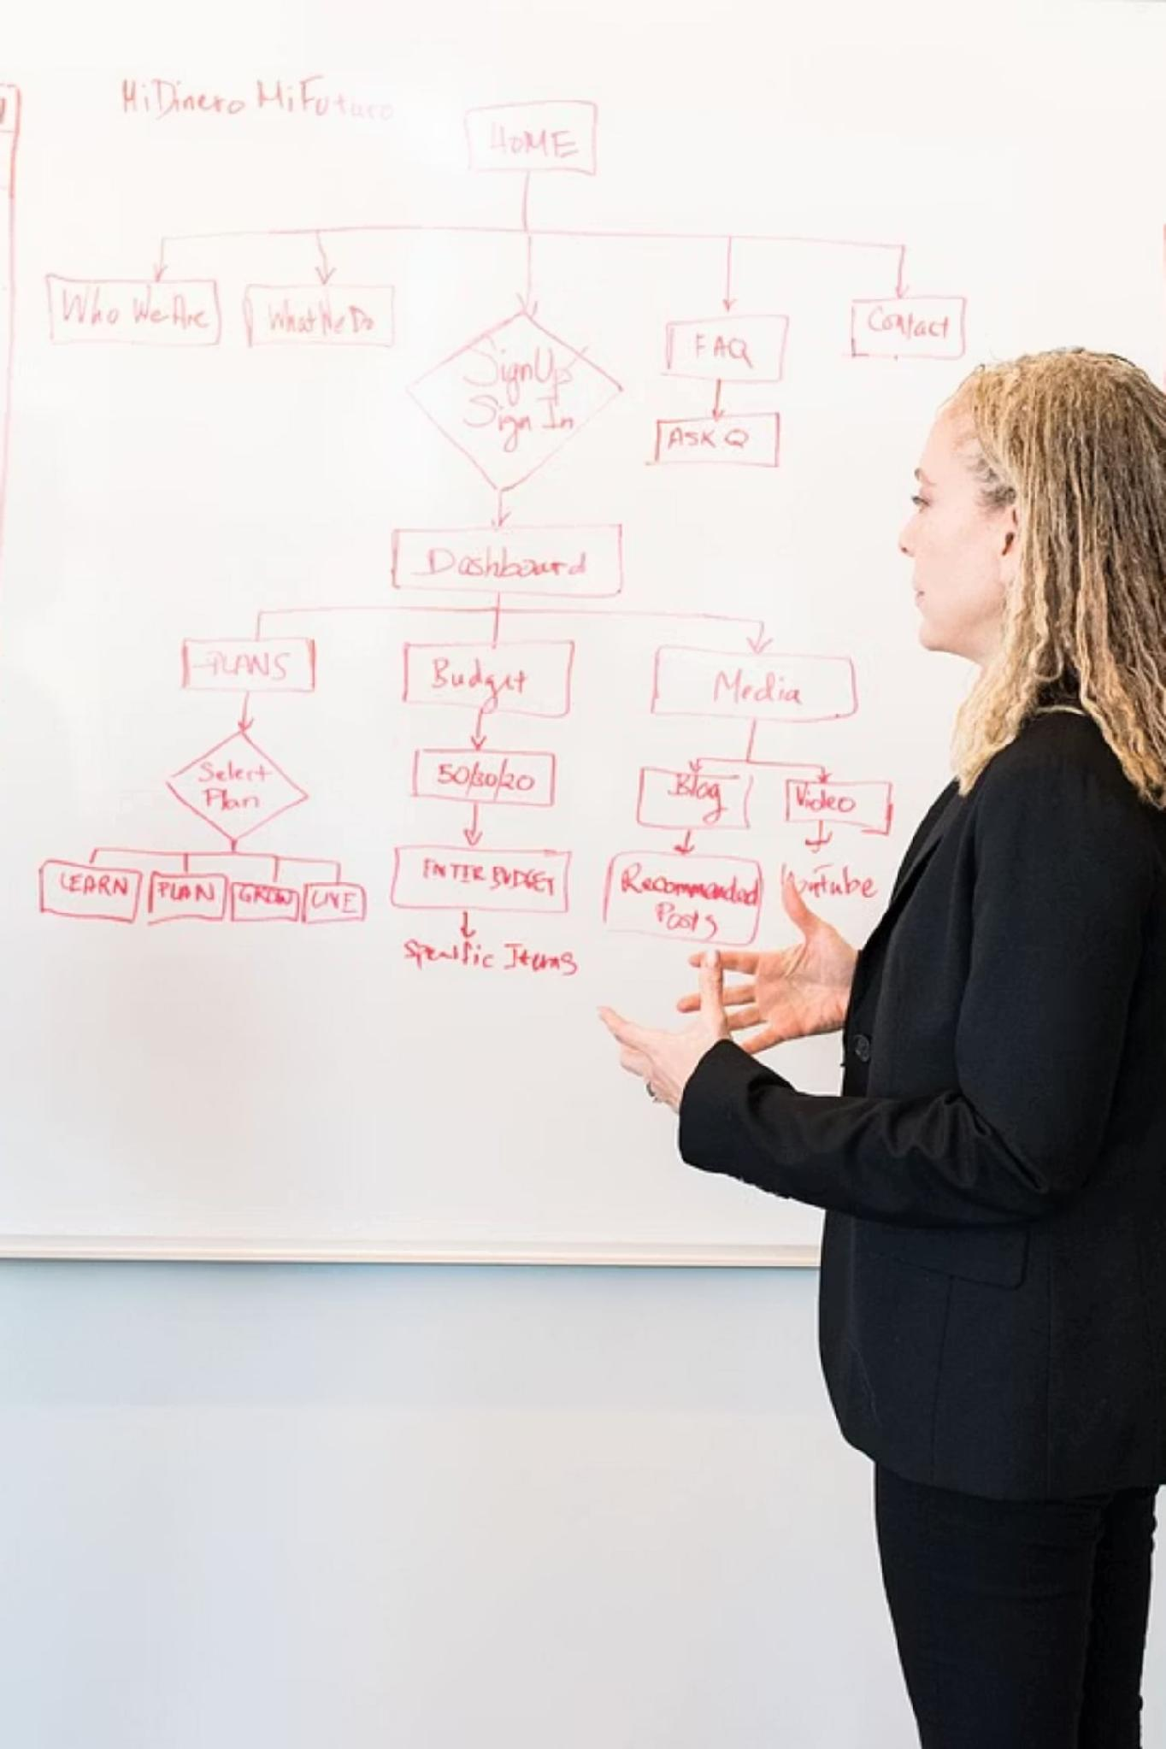
Expanding the Lifecycle
From broad phases to accountable steps — to expose execution risk.
Interdependence
Granular Control
Each stage feeds the next.
Seven steps enable tighter checks.
The Golden Goal
Reduce risk and deliver more value.

Slide 5


Stage 1 — Negotiating the Engagement
PHASE I
Objective
Define boundaries, spot the real problem, and check strategic fit before any proposal.
Core Gateways
Discovery meetings and early client conversations
Background checks for acceptance and retention
Independence review and conflict screening
Stage 1 is diagnosis, not selling.

Slide 6
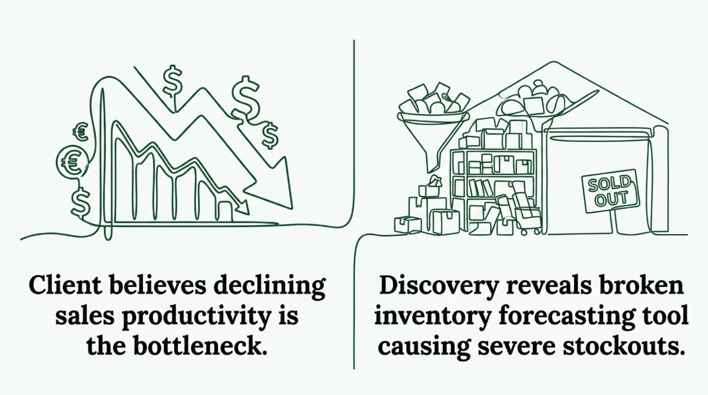

The Diagnostic Challenge: Real vs. Perceived Problems
Clients often mistake a symptom for the root problem. Pre-engagement discovery is the first safeguard.
MAS Practice Standard #5: Define the problem clearly and completely before committing to action.

Slide 7
The Mechanics of Stage 1 Execution
Stage 1 ends with legally binding documentation that turns discovery into a professional agreement.
Key Practitioner Inputs
Critical Milestone Outputs
Pre-engagement surveys
Financial health data
Organizational context
Formal Proposal Letter — broad approach and scope
Signed Engagement Contract — fee model and terms
These documents reduce ambiguity from day one.

Slide 8

Stage 2 — Preparing for and Starting the Engagement
PHASE II
The contract is signed. Now the legal agreement becomes an operational plan.
Engagement Program
Milestone Scheduling
Break tasks into a clear work plan with owners.
Set dates and budgets to keep things on track.
Staff Allocation
Assign specialists to each task.

Slide 9

Connecting Practice Standard #6 to Project Control
MAS Practice Standard #6
Planning, Supervision, and Control — the work plan is the main control document.
Supervise
Track team progress
Early scoping and task mapping cut execution risk.
— Sun, Ni, & Huang (2023)
Control
Plan
Check quality and adjust
Break down the work
A clear work breakdown helps prevent project failure.

Slide 10




Stage 3 — Conducting the Engagement
PHASE III
This is the core diagnostic phase — fieldwork, insight, and evidence.
Data Gathering
Analytical Evaluation
Collect key evidence across the business.
Spot inefficiencies and performance gaps.
Root-Cause Mapping
Trace symptoms to their real source.

Slide 11

Evidentiary Foundations in Field Execution
Field insights must never rely on guesses. MAS Practice Standard #7 requires Sufficient Relevant Data — hard numbers plus context.
Quantitative Evidence
Qualitative Evidence
Standard Alignment
Ledger history, production data, cycle times, and output metrics.
Stakeholder interviews and direct field observations.
Keep every data point relevant, sufficient, and documented.

Slide 12
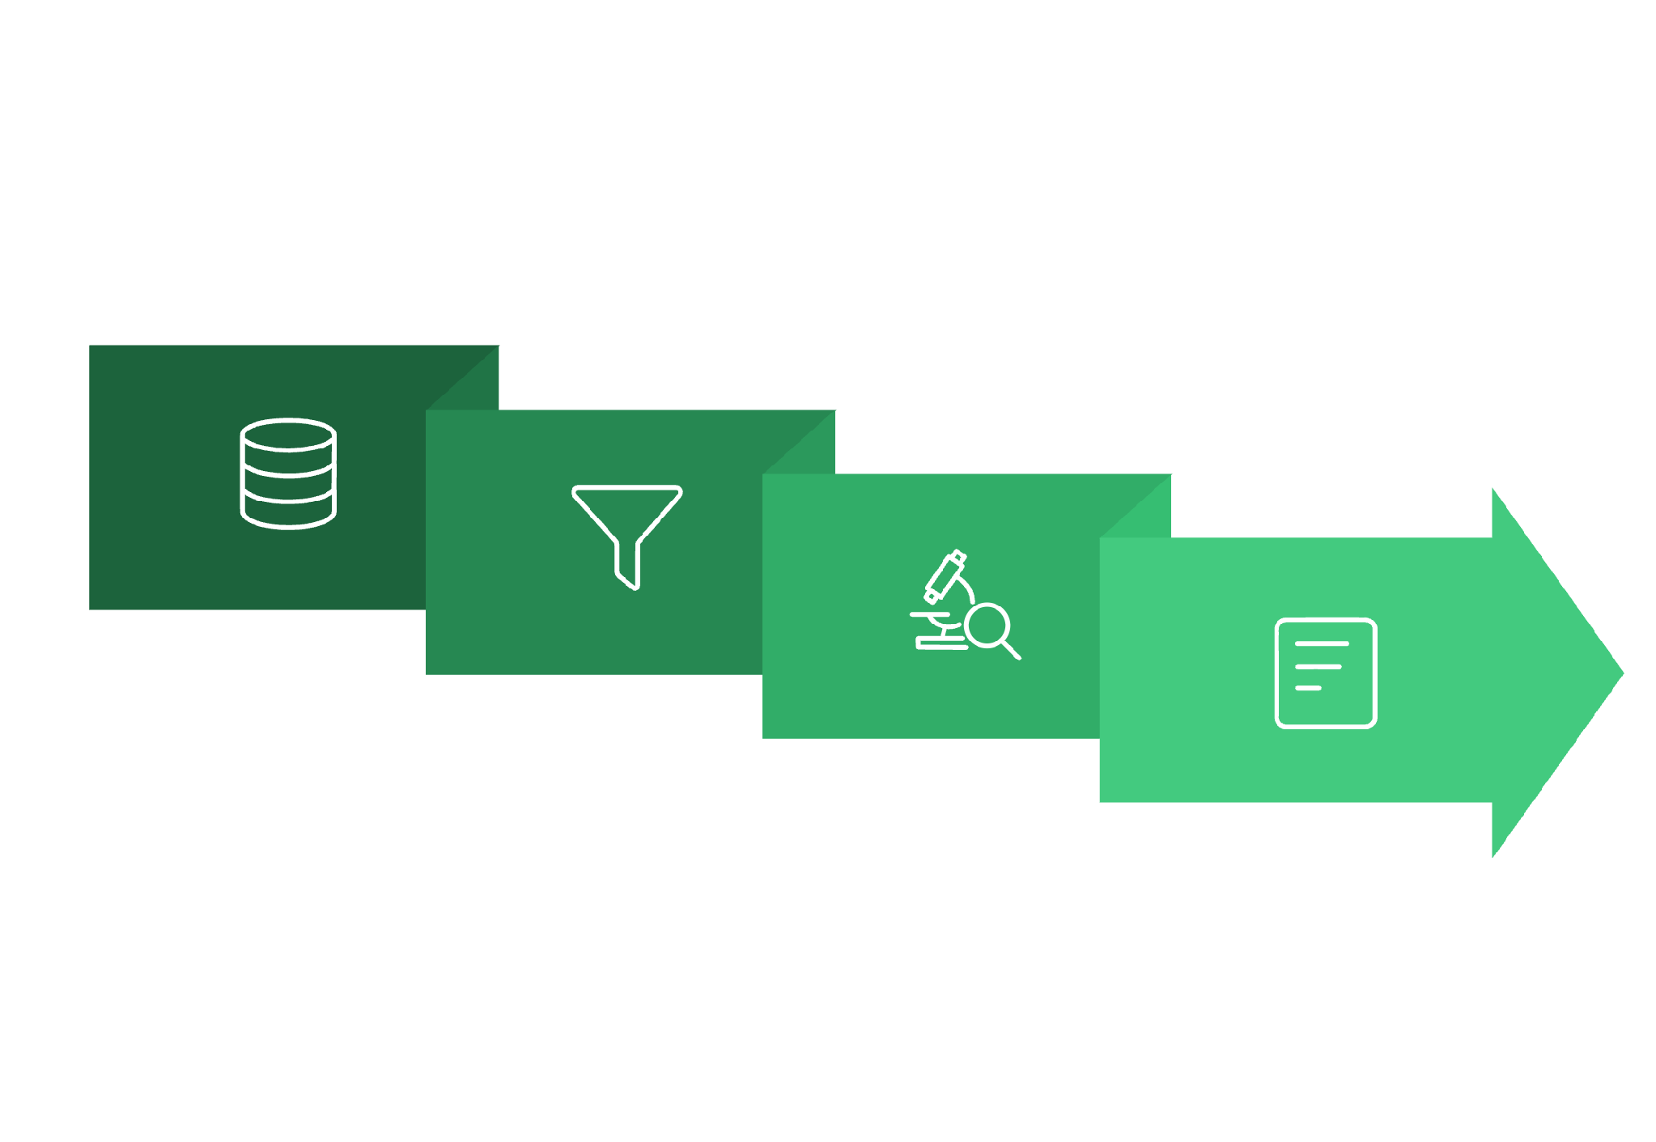

The Analytical Transformation
From Raw Data to Strategic Intelligence
Classify
Raw data needs synthesis. Stage 3 maps evidence to causes and bottlenecks.
Document
Engagement Working Papers — the record behind every conclusion and recommendation.
Raw Data
Analyze

Slide 13
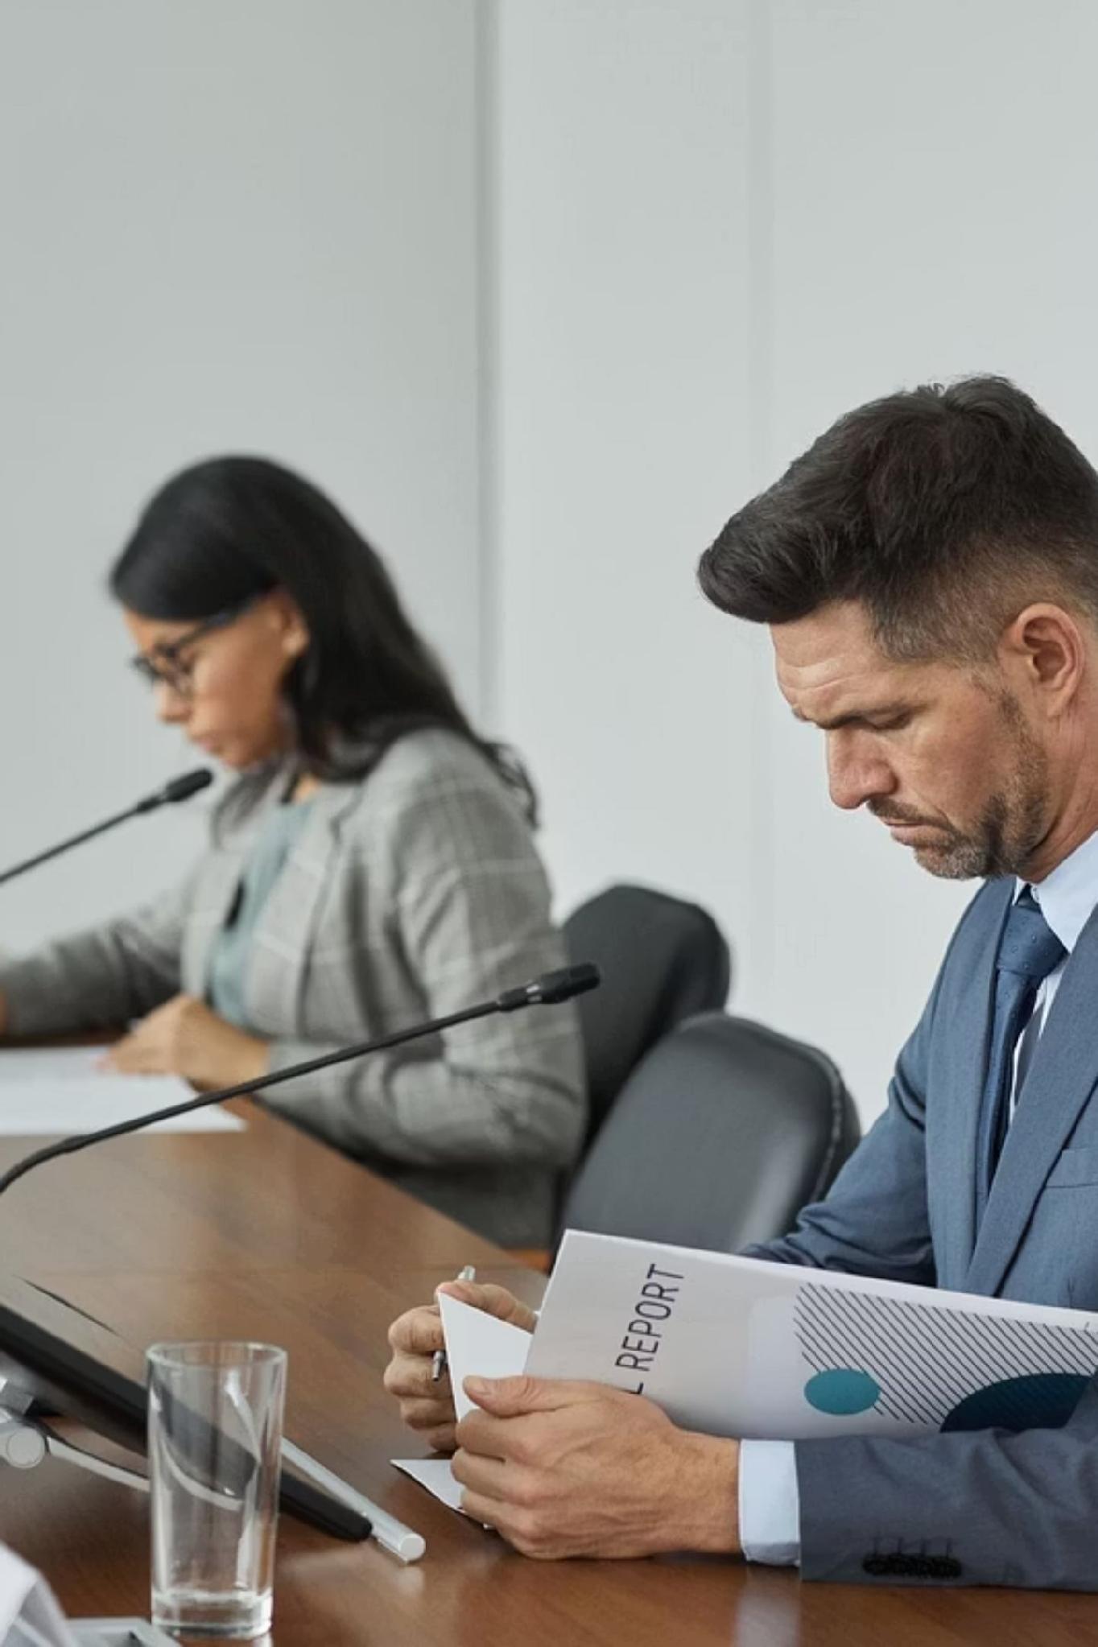
Stage 4 — Preparing and Presenting Reports & Recommendations
PHASE IV
This is the peak of the engagement — data becomes tailored strategy for client leadership.
The Core Strategy
Skip templates. Build recommendations around the client’s unique context.
The Ultimate Deliverable
The final consulting report — the record of findings, analysis, and next steps.

Slide 14
Report Engineering: Long-Form vs. Short-Form
The best format depends on scope and the client's implementation posture. Both align with MAS Practice Standard #8.
Report Dimension
Long-Form Consulting Report
Short-Form Consulting Report
Operational Scope
Full research, process maps, and appendices
Key findings and direct actions only
Primary Use-Case
Clients executing independently
Projects with ongoing interim updates
Depth of Detail
Comprehensive and self-contained
Concise executive summary
Standard Link
MAS Practice Standard #8
MAS Practice Standard #8

Slide 15

Value Co-Creation in Solution Architecture
Never Design in a Vacuum
Early client involvement builds ownership and improves fit.
Value co-creation requires close collaboration between professionals and client teams to ensure execution viability.
— Camilleri et al. (2024)
Build with the client team, not for them.

Slide 16




Stage 5 — Implementing the Recommendations
PHASE V
Theory meets reality. Execution at scale is where many advisory engagements stall.
Technology Rollouts
System cutovers, migrations, and deployments with minimal disruption.
Workforce Retraining
Structured retraining and policy updates for new operating standards.
Skill Focus
Requires strong Project Management and Interpersonal Skills.

Slide 17
Managing Knowledge Transfers in Stage 5
The Goal: Self-Sufficiency
Preventing Dependency
Leave the client independent. Train their team well enough to run the new systems without outside support.
Build internal capability so the client does not rely on vendors long-term.
Knowledge Transfer Pillars
Participative leadership and strong knowledge transfer build lasting capability and protect productivity.
— Ekowati et al. (2023)
Clear SOPs and system guides
Hands-on training sessions
Internal champions for each process

Slide 18
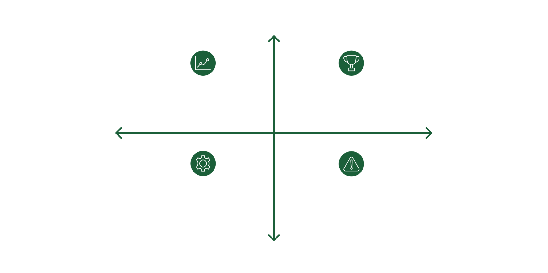

Stage 6 — Evaluating the Engagement
PHASE VI
Accountability in action. We revisit the contract and assess what was actually delivered.
Core Assessments
High Financial Performance
Financial Performance: ROI and cost savings vs. plan
Process Speed: Cycle time, errors, throughput
High Finance, Low Ops: Strong ROI, limited process gains
High Finance, High Ops: ROI plus major cycle improvements
Low Operational Performance
High Operational Performance
MAS Practice Standard #4: Measure realized client benefit, not projected benefit.
Low Finance, High Ops: Operational wins, limited cost impact
Low Finance, Low Ops: No ROI, persistent errors and delays
Low Financial Performance

Slide 19
Stage 7 — Post-Engagement Follow-Up
PHASE VII
True MAS practitioners don't disappear. We return later to protect the client's investment.
Project Exit
12-Month Audit
Handover complete.
Spot regression early.
1
2
3
4
6-Month Review
Continuous Alignment
Check if gains hold.
Apply MAS Standard #3: Due Professional Care.

Slide 20
Summary Matrix: The 7-Stage Architecture
Each stage maps to a practice standard and a skill dimension.
Stage
Core Activity
Practice Standard
Skill Dimension
I. Negotiation
Problem intake
Standard #5: Understanding
Communication
II. Planning
Task and resource planning
Standard #6: Supervision
Project management
III. Fieldwork
Data gathering
Standard #7: Sufficient Data
Diagnostics
IV. Reporting
Solution pitches
Standard #8: Communication
Synthesis
V. Execution
Rollouts and training
Standard #4: Client Benefit
Project management
VI. Evaluation
ROI and metrics
Standard #4: Client Benefit
Diagnostics
VII. Follow-Up
Long-term review
Standard #3: Due Care
Strategy

Slide 21

TRANSITION
"Ethical conduct is the foundation of trust and long-term reputation."
We now move from execution to the ethical guardrails of the profession.

Slide 22
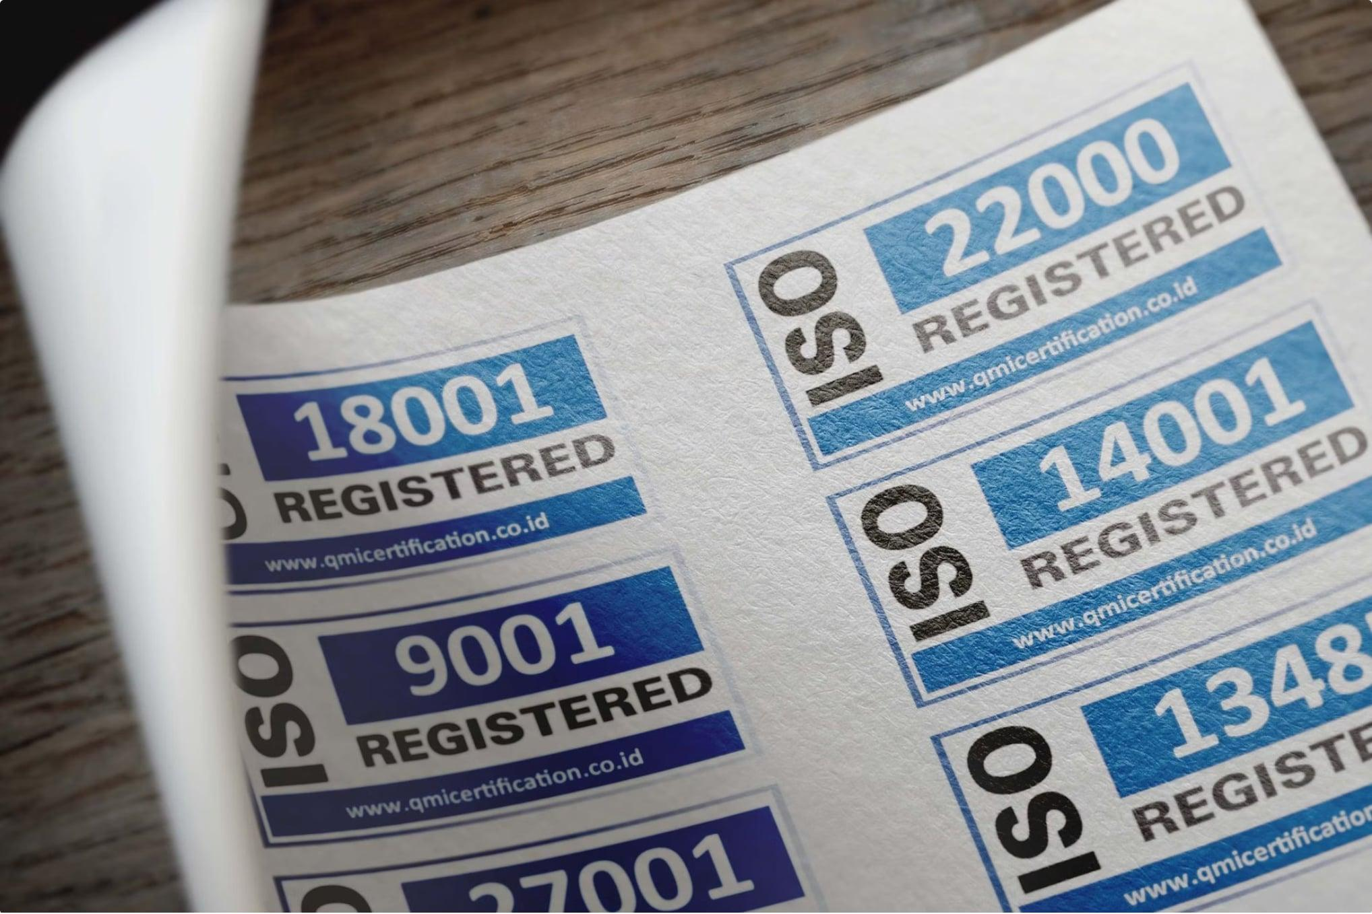

Regulatory Framework —
The Philippine Code of Ethics
The Governing Standard
Every CPA and advisor in the Philippine market must follow the Philippine Code of Ethics for Professional Accountants.
Why It Matters Now More Than Ever
Rising scrutiny makes strict ethical alignment non-negotiable for consulting firms.
Management Consulting Journal (2026): ethics compliance is a top reputational risk.

Slide 23


Principle 1 — Integrity
ETHICS PRINCIPLE 1 OF 5
Be honest, direct, and fully truthful in every professional relationship — even when it is uncomfortable.
In Practice
The Red Line
Share the facts plainly, even when they challenge assumptions or politics.
Never change findings to match a client's preferred story.
If data shows a project is losing money, say it clearly.

Slide 24


Pressures on Integrity During Field Discovery
The Reality in the Field
Consultants often face quiet pressure to trim unflattering numbers.
The Threat
The Remedy
Pressure to hide weak data
Log facts objectively. Stay independent.
Your Primary Shield
Integrity keeps reporting clear, even when politics get messy.
The Risk
One compromised report can damage your credibility.
Reports get softened to protect contracts

Slide 25

Principle 2 — Objectivity
ETHICS PRINCIPLE 2 OF 5
Definition
Keep judgments free from bias, conflicts, and undue influence.
Strict objectivity protects trust in advisory work.
— Schöpfel & Azeroual (2023)
Base findings on facts — not loyalty, politics, or money.

Slide 26
Navigating Conflicts of Interest
Objectivity requires a transparent response as soon as a conflict appears.
1
2
3
Identify
Disclose
Resolve
Spot clashes between clients, roles, or relationships.
Tell affected parties immediately.
Step aside if objectivity can’t be guaranteed.
Advising major rivals at once is a clear conflict — disclosure is required, and withdrawal may be necessary.

Slide 27
Principle 3 — Professional Competence and Due Care
ETHICS PRINCIPLE 3 OF 5
Professional Competence
Due Care
Keep the right knowledge and skills for the engagement — and stay current.
Work with diligence, precision, and full professional focus.
Get qualified before accepting the work
Stay updated on technical and regulatory changes
Pay close attention to detail
Meet professional standards at every step

Slide 28


The Technical Limits of Competence
The Golden Rule
Never take on work your firm cannot deliver to a professional standard.
Modern Tech Pressures
As client demands shift to AI, data, and cloud security, build capability fast — or stay within your limits.
Ethical firms must build capability in emerging tech.
— Camilleri et al. (2024)
Continuous learning is both an ethical duty and a competitive edge.

Slide 29
Principle 4 — Confidentiality
ETHICS PRINCIPLE 4 OF 5
In MAS engagements, practitioners handle sensitive data — margins, payroll, pipelines, and trade secrets. Protect it absolutely.
The Definition
What to Safeguard
The Exception
Never disclose client information without explicit authorization.
Financial data, product plans, pricing, and employee records.
Disclose only when legally compelled by subpoena or regulation.

Slide 30
Data Protection in the Information Age
The Modern Challenge
NDAs
Role-Based Access
Confidentiality now depends on cybersecurity. Breaches can be as damaging as leaks.
Use NDAs for everyone handling sensitive data
Limit access to those who need it
Protecting research and business data takes strong systems, not just personal judgment.
— Schöpfel & Azeroual (2023)
Secure Systems
Use encryption, secure transfer, and cloud controls
Client privacy is a technical duty, not just paperwork.

Slide 31
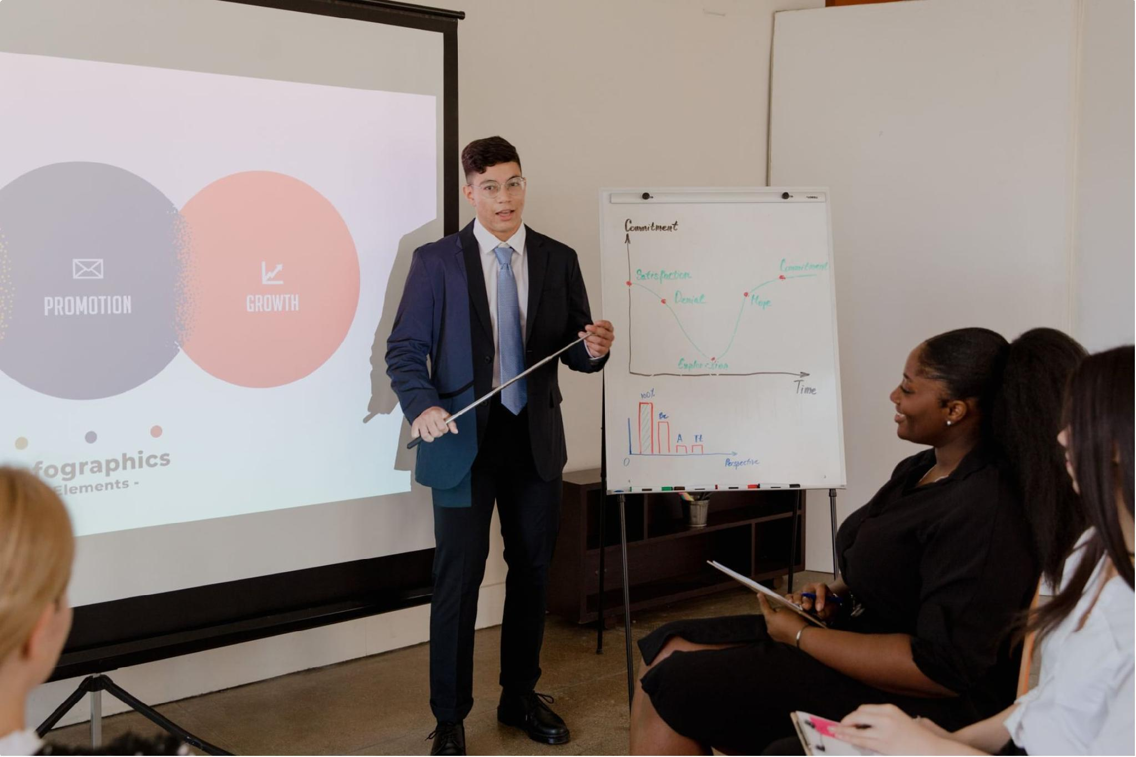
Principle 5 — Professional Behavior
ETHICS PRINCIPLE 5 OF 5
Definition
Follow all laws and regulations. Avoid anything that could damage the profession.
The Wider Responsibility
Your conduct reflects on the whole advisory community — not just your firm.
Professional behavior means leading by example, not just avoiding penalties.

Slide 32

Protecting Public Trust
The Most Valuable Asset
Public trust is a firm's most fragile asset. It takes years to build and seconds to lose.
Ethical Standards
Regulatory Compliance
Ethical decisions in uncertain markets reduce risk and protect long-term trust.
— IntechOpen (2025)
Long-Term Reputation
Public Confidence

Slide 33

Case Study — The Stage 3 Fieldwork Dilemma
APPLIED ETHICS
Principles in action: What do you do when truth threatens the contract?
The Scenario
The Threat
The Ethical Path
During a Stage 3 audit, the consultant finds a material error caused by the client’s CFO.
The CFO warns that reporting it could cost the firm its renewal.
Use Integrity and Objectivity: document it and report to the audit committee.
There’s no ethical middle ground. Silence makes you complicit.

Slide 34

Case Study — The Stage 5 Delivery Dilemma
APPLIED ETHICS
Short-term margins vs. long-term client value.
The Scenario
The Temptation
The Ethical Path
At Stage 5, the team lacks the skills to run the system safely after exit.
Close fast, protect margin, and move to the next job.
Guided by Professional Care and Client Benefit, flag the gap and recommend phased training before exit.
Success means lasting client value, not a quick handoff.

Slide 35

Common Ethical Challenges for Filipino Consultants
Real-world pressures that test professional standards in the Philippine consulting landscape.

Slide 36


Challenge 1 — "Utang na Loob" and Client Favoritism
ETHICAL CHALLENGE 1 OF 10
The Filipino cultural value of Utang na Loob (debt of gratitude) deeply influences social and professional relationships. It demands reciprocity, creating a subtle pressure that can test a consultant's objectivity.
The Cultural Pressure
The Ethical Risk
The Professional Response
A client who offered your firm its first major project might evoke a strong sense of personal obligation, making it difficult to deliver unfavorable news or critical assessments.
This can lead to compromised objectivity and integrity, causing consultants to soften findings, overlook red flags, or show preferential treatment to maintain harmony and repay perceived debts.
Maintain professional distance and uphold impartiality. Clearly differentiate personal gratitude from professional duties, ensuring all advice is evidence-based and unbiased.
Prioritizing *Utang na Loob* over professional standards risks damaging your firm's reputation for impartiality and trustworthiness.

Slide 37


Challenge 2 — "Pakikisama" and the Pressure to Conform
ETHICAL CHALLENGE 2 OF 10
The Filipino cultural value of Pakikisama (group harmony or 'going along with others') emphasizes pleasant social interaction and avoiding confrontation. While fostering camaraderie, it can exert significant pressure on consultants.
The Cultural Context
In professional settings, Pakikisama can mean feeling compelled to agree with client management, even when a consultant’s findings or recommendations differ. The desire to maintain smooth relationships and avoid discomfort can override objective judgment.
Professional Independence
Group Harmony (Pakikisama)
The Ethical Risk
Duty to provide candid guidance
Avoiding conflict to preserve relationships
This pressure directly threatens a consultant's independence and objectivity. It can lead to:
Suppressing unfavorable data or critical assessments.
Softening advice to avoid offending powerful client stakeholders.
Reluctance to challenge assumptions or established practices, even if flawed.
Objective Advice
Fear of Disapproval
Pressure to Conform
Reluctance to speak up
Social expectation to agree
The Professional Response
Consultants must navigate Pakikisama by subtly but firmly upholding their professional duties. This means presenting findings with diplomacy but without compromise, reinforcing the value of independent counsel, and framing difficult truths as beneficial for the client's long-term success.
Allowing Pakikisama to compromise professional judgment can lead to flawed advice, eroding client trust and damaging your firm's reputation for impartiality.

Slide 38


Challenge 3 — Referral-Based Engagements and Hidden Conflicts of Interest
ETHICAL CHALLENGE 3 OF 10
In the Philippines, many consulting engagements originate from personal networks, often through kakilala (acquaintances) or kumpare/kumare (close friends/godparents). While this builds rapport, it can inadvertently create undisclosed conflicts of interest.
The Scenario
The Ethical Risk
The Professional Response
A new project comes from a long-standing kumpare who expects preferential terms or diluted scrutiny due to your personal connection.
Undisclosed personal relationships can compromise a consultant’s independence and objectivity, leading to biased advice or a failure to identify critical issues. Transparency is key to maintaining trust.
Always disclose any personal relationships that could be perceived as conflicts of interest to both the client and your firm. Document these disclosures and ensure decisions are made on objective merit.
Personal ties should never overshadow professional duties. Full disclosure is mandatory to prevent hidden conflicts from eroding credibility.

Slide 39
Challenge 4 — "Hiya" (Face-Saving) and Withholding Bad News
ETHICAL CHALLENGE 4 OF 10
The Filipino concept of Hiya (shame or face-saving) deeply influences social interactions, including professional ones. While it promotes harmony, it can lead consultants to delay or soften the delivery of negative findings, risking critical feedback being lost.
The Cultural Dynamic
The Professional Response
Driven by the desire to avoid embarrassing clients or damaging relationships, consultants may instinctively sugarcoat issues or postpone bad news. This preserves "face" for all parties involved, maintaining a comfortable interaction.
Consultants must navigate Hiya by delivering difficult truths in a structured, respectful, and fact-based manner. Frame negative findings as opportunities for improvement, focusing on objective data and proposing solutions. Diplomacy and empathy are key, ensuring the message is heard without causing undue offense.
The Ethical Risk
Delaying or diluting critical feedback can have severe consequences for the client. It leads to delayed corrective actions, perpetuates underlying problems, and ultimately misleads the client about the true state of affairs, hindering effective decision-making.
Allowing "Hiya" to compromise transparency risks long-term damage to the client’s business and the consultant’s credibility. Candor, delivered respectfully, builds stronger trust.

Slide 40




Challenge 5 — Scope Creep Driven by "Bayanihan" Expectations
ETHICAL CHALLENGE 5 OF 10
The Filipino spirit of Bayanihan (communal helping and cooperation) fosters strong ties but can also lead clients to expect consultants to undertake work significantly beyond the agreed-upon scope without additional compensation, often framing it as "just helping out."
The "Just Helping Out" Expectation
Unpaid Labor & Quality Erosion
Clear Scope & Protocols
Clients, leveraging the communal spirit of Bayanihan, may subtly expect consultants to perform tasks significantly beyond the agreed scope, framing it as mutual support or a small favor.
Failing to manage these expectations leads to consultants providing unpaid labor. This can dilute the quality of core deliverables, exhaust the project team, foster resentment, and ultimately erode profitability for the consulting firm.
Combat this by establishing comprehensive engagement letters with explicit scope definitions. Implement formal change management protocols for any new requests, clearly outlining the impact on timelines and costs.
Uncontrolled scope creep, even under the guise of Bayanihan, compromises project success, firm profitability, and team morale. Clear boundaries are essential.

Slide 41


Challenge 6 — Political Interference and Government-Linked Clients
ETHICAL CHALLENGE 6 OF 10
Filipino consultants working with government agencies or politically connected firms may face immense pressure. This often means aligning findings with political agendas, approving questionable projects, or avoiding scrutiny of powerful officials.
The Scenario
Consultants are often engaged by government entities or firms with strong political ties. In these environments, there can be overt or subtle directives to produce reports that favor certain outcomes or protect specific interests, rather than presenting objective findings.
The Ethical Risk
This directly compromises a consultant's independence and objectivity, undermining the public interest. It can lead to misallocation of public funds, approval of non-viable projects, and a systemic erosion of trust in fair processes.
The Professional Response
Consultants must rigorously document all interactions and findings. Establish internal whistleblowing protocols and be prepared to escalate concerns or, if necessary, withdraw from engagements where ethical lines are irrevocably crossed. Prioritize integrity over political expediency.
Succumbing to political pressure not only damages professional credibility but can also contribute to corruption and hinder good governance. Upholding ethical standards is paramount.

Slide 42
Challenge 7 — Fee Undercutting and Lowball Competition
ETHICAL CHALLENGE 7 OF 10
In the intensely competitive Philippine consulting market, the pressure to secure contracts can lead some practitioners to drastically underprice their services. This often results in compromising quality and cutting corners to maintain profitability.
The Scenario
The Ethical Risk
The Professional Response
Driven by fierce competition, some consultants initially underbid projects. To compensate for low fees, they may subsequently reduce project scope, assign less experienced staff, or streamline deliverables to a degree that impacts quality.
This behavior directly jeopardizes due care and professional competence. Substandard work can result in flawed recommendations, project failures, financial losses for clients, and in critical sectors, even pose risks of public harm, damaging the entire profession's credibility.
Consultants must prioritize value-based pricing, articulating the long-term benefits and expertise provided. Implementing transparent fee structures and educating clients on the true cost of quality helps distinguish ethical firms and upholds professional standards.
Underpricing to win bids often forces compromises that erode quality and trust. Upholding robust pricing models reflects a commitment to ethical practice and sustainable value delivery.

Slide 43
Challenge 8 — Confidentiality Breaches in Small, Tight-Knit Markets
ETHICAL CHALLENGE 8 OF 10
The Philippines has a relatively small business community where industry players often know each other. This tight-knit nature increases the risk of consultants inadvertently (or deliberately) sharing client information across engagements, especially when serving competing firms.
The Scenario
In a small, interconnected market, consultants frequently work with competing clients. This proximity can lead to situations where sensitive information from one engagement might be unintentionally, or even deliberately, disclosed or applied in another, creating a conflict of interest.
The Ethical Risk
This behavior directly compromises client confidentiality, eroding trust and potentially leading to unfair competitive advantages or strategic disadvantages for the original client. It can also result in severe legal and reputational repercussions for the consulting firm.
The Professional Response
Consulting firms must implement strict information barriers (e.g., separate project teams, restricted data access) and conduct thorough conflict-of-interest screenings before accepting new engagements. Regular ethics training emphasizing confidentiality and reinforced non-disclosure agreements are crucial.
Breaching confidentiality, even unintentionally, can destroy a firm’s reputation and lead to legal action. Robust protocols and continuous vigilance are essential to protect client trust and professional integrity.

Slide 44


Challenge 9 — Overrepresentation of Credentials and Competence
ETHICAL CHALLENGE 9 OF 10
In a competitive market, some Filipino consultants overstate their qualifications, experience, or the capabilities of their team to win engagements — then struggle to deliver.
The Scenario
Driven by intense competition, consultants may exaggerate past project roles, claim expertise they don't possess, or present junior staff as highly experienced to secure contracts, ultimately failing to meet client expectations.
The Ethical Risk
This breaches professional competence and due care. It leads to client harm through wasted resources, project delays, or poor outcomes. It also damages the firm's reputation and erodes trust in the consulting profession as a whole.
The Professional Response
Consultants must honestly assess and represent their capabilities. If a project requires specialized expertise they lack, transparently partner with or recommend qualified specialists. Prioritize ethical subcontracting and continuous professional development over winning at any cost.
Misrepresenting qualifications is a serious breach of integrity. Honesty and transparency regarding capabilities are essential to build long-term trust and deliver genuine value to clients.

Slide 45





Challenge 10 — Gift-Giving Culture and Bribery Risk
ETHICAL CHALLENGE 10 OF 10
In Filipino culture, gift-giving (e.g., pasalubong for souvenirs, pabaon for provisions) is a deeply ingrained social practice. However, in a professional consulting context, gifts or favors from clients or vendors can inadvertently cross the line into undue influence or bribery, posing a significant ethical dilemma.
The Cultural Context
The custom of offering gifts or hospitality is a sign of goodwill and appreciation. While benign in personal relations, when extended to professional engagements, it can create expectations or perceived obligations that challenge professional boundaries and objectivity.
The Ethical Risk
Accepting gifts can compromise a consultant's independence and objectivity, leading to biased advice or decisions. It also exposes practitioners to legal risks under the Philippine Anti-Graft and Corrupt Practices Act (RA 3019), which prohibits public officials from accepting gifts in connection with their official duties, a standard often applied to private sector professionals in high-stakes engagements.
The Professional Response
Consultants must establish clear, written gift policies, defining acceptable limits and requiring disclosure of all received gifts or hospitality. Educate clients and staff on these policies. When in doubt, politely decline gifts or donate them to charity to preserve impartiality and avoid any perception of impropriety.
Navigating cultural nuances requires diligence. By upholding strict gift policies and prioritizing transparent conduct, consultants reinforce their independence and safeguard their professional integrity.

Slide 46

Next Steps & Summary
Module 2 complete. You now understand the consulting lifecycle and the ethics that guide it.
Immediate Milestone
Strategic Transition
Module 2 Assessment — Review consultant attributes, practice standards, the 7-stage lifecycle, and the five ethical principles.
Next week: Strategic Business Analysis frameworks and methods — applying these ideas to real-world analysis.
Core Values Integration
Carry forward: Integrity, Excellence, Teamwork, and Open Communication in every engagement.

Slide 47


References
Camilleri, M., Zhong, L., Rosenbaum, M. S., & Wirtz, J. (2024). Ethical considerations of service organizations in the information age. Service Industries Journal, 44(7-8), 481–502. https://doi.org/10.1080/02642069.2024.2353613
Ekowati, D., Abbas, A., Anwar, A., Suhariadi, F., & Fahlevi, M. (2023). Engagement and flexibility: An empirical discussion about consultative leadership intent for productivity from Pakistan. Cogent Business & Management, 10(1), 2196041. https://doi.org/10.1080/23311975.2023.2196041
IntechOpen. (2025). The comprehensive process of ethical decision-making in business under uncertainty. IntechOpen Chapter Elements, 114–132.
Schöpfel, J., & Azeroual, O. (2023). Ethical issues in organizing and managing research information. Communication, Technologies et Développement, 14, 4000–4015. https://doi.org/10.4000/ctd.9857
Sun, H., Ni, W., & Huang, L. (2023). Fuzzy assessment of management consulting projects: Model validation and case studies. Mathematics, 11(20), 4381–4402. https://doi.org/10.3390/math11204381

