Slide 1

Strategic Business Analysis: Bridging Data, Ethics and Enterprise Strategy
MODULE 3 · PART 1
A data-driven approach to understanding business reality.
Build the analytical and ethical judgment to advise with confidence.
Rosalinda E. Perez

Slide 2

Welcome to Module 3
STRATEGIC BUSINESS ANALYSIS
This module connects corporate strategy with rigorous, evidence-based analysis.
You will build the skills, frameworks, and ethical judgment needed to lead as a strategic advisor.
Please refer to the Module 3 Introduction.docx for context, readings, and assessment details.

Slide 3

Transitioning Focus
Module 3 shifts from corporate intent to rigorous diagnosis. We move from “what do we want?” to “what is really happening, and why?”

Slide 4

Learning Goals
By the end of Module 3, you’ll have the core skills of a trusted strategic advisor. The focus is analytical rigor, ethical judgment, and clear communication.
Analytical Toolkit
Ethical Grounding
Advisor Mindset
Use structured frameworks to assess external conditions and internal capabilities.
Apply intellectual honesty, data integrity, and stakeholder accountability.
Turn analysis into balanced recommendations that reflect real organizational constraints.

Slide 5

Career Pillars
Strategic analysis can shape high-impact business careers. This module highlights three paths: corporate strategy, management advisory services, and organizational transformation.

Slide 6


Strategic Tools
Environmental scanning works best with repeatable frameworks backed by research. These tools help advisors cut through noise and see the business environment clearly.
PESTEL Analysis
Porter's Five Forces
Scan six macro forces — Political, Economic, Social, Technological, Environmental, and Legal.
Assess industry attractiveness through rivalry, entry barriers, substitutes, and buyer-supplier power.

Slide 7
Ethical Pillars
Intellectual Honesty
Data Integrity
Report only what the data supports. Never stretch findings to fit a client narrative.
Protect data with care and transparency. Avoid weak sourcing, hidden assumptions, or selective omissions.

Slide 8




Stakeholder Focus
A recommendation is only as strong as the perspectives behind it. Durable solutions account for everyone affected, not just the client.
Fairness
Accountability
Do not let one stakeholder win at the unjust expense of another.
Stand behind your analysis and be clear about its limits.
Transparency
Stakeholder Empathy
Share sources, assumptions, and constraints openly.
Understand each party’s priorities before you decide.

Slide 9

Module Structure
Module 3 has two sequential parts: external diagnosis first, then internal assessment. This mirrors real strategic analysis.
External Analysis
Competitive Forces
PESTEL and Porter's Five Forces
Industry rivalry and supplier power
Internal Capabilities
Synthesis & Ethics
VRIO assessment of resources and strengths
SWOT/TOWS and analytical ethics
Sequence matters: diagnose outside first, then synthesize recommendations.

Slide 10
Part 1 Overview
PART 1 OF 2
Part 1 builds the core skills for the module. It covers four key areas of strategic analysis.
01
02
Career Pathways
Data Analytics Credentials
Explore three high-impact paths for analytically skilled business professionals.
See how the IT Specialist in Data Analytics certification adds career value.
03
04
PESTEL Analysis
Porter's Five Forces
Use a six-factor framework to scan the macro environment.
Assess industry attractiveness through competitive forces.

Slide 11
Part 2 Overview
PART 2 OF 2
Part 2 looks inward: assess internal strengths, compare them to the market, and turn insights into clear strategic recommendations.
01
02
03
VRIO Framework
SWOT & TOWS Matrix Synthesis
Analytical Ethics
Test resources against Value, Rarity, Imitability, and Organization.
Apply integrity, transparency, and stakeholder accountability.
Combine internal and external findings into actionable strategy.

Slide 12

Part 1: Career Trajectories and External Landscape Tools
PART 1 BEGINS
Part 1 sets your career direction and introduces two core external analysis frameworks.
These tools are directly useful in corporate planning, consulting, and transformation roles.

Slide 13



Career Pathways in Strategic Analysis
Strong strategic analysis skills open three high-impact career paths. Each turns complex data into clear strategic guidance.
Corporate Strategy
Advisory Services
Transformation
Guide market entry, competitive positioning, and long-term investment decisions.
Solve complex business problems across industries and geographies.
Redesign operations, structures, and systems to improve efficiency.

Slide 14

Corporate Strategy
Corporate strategists work in-house, advising senior leaders on the biggest decisions: market entry, portfolio choices, competitive positioning, and long-term planning.
They build deep company knowledge, which makes their recommendations highly relevant and directly tied to business outcomes.

Slide 15

Advisory Services
Management Advisory Services (MAS) firms help clients solve complex, high-stakes business problems across industries.
The work is fast-paced and varied, building strong problem-solving skills and broad exposure early in your career.

Slide 16

Transformation Roles
Transformation consultants step in when companies must change fast — driven by disruption, decline, regulation, or a strategic pivot. They redesign operations, implement new technology, and align people through major change.

Slide 17
Analytics Power: The New Currency of Strategy
The Shift Has Already Happened
What This Means for You
Intuition and industry instinct are no longer enough. Strategic recommendations must be grounded in data.
Data pipelines, predictive models, and executive dashboards are now baseline skills. Analytics is the price of entry in modern strategy.

Slide 18

IT Specialist in Data Analytics Certification
The IT Specialist in Data Analytics certification is a strong differentiator for strategy, consulting, and finance roles.
It validates three core skills employers look for: data collection, advanced modeling, and executive communication.
Data Collection
Advanced Modeling
Reliable source data.
Statistical and predictive insights.
Executive Communication
Dashboards that drive decisions.

Slide 19

Clean Data Collection
Strong analysis starts with accurate, well-structured data. Bad inputs weaken every step that follows.
Define scope and variables
Build validation checks
Document sources and assumptions
Focus on the data points that matter most.
Catch missing, inconsistent, or invalid entries early.
Keep a clear record of where data came from and how it changed.

Slide 20
Advanced Modeling
Raw data becomes strategic when models reveal patterns, relationships, and probabilities.
Statistical Analysis
Predictive Modeling
Regression to identify key business drivers
Variance and correlation to test assumptions
Segmentation to find meaningful market clusters
Forecasts for uncertain scenarios
Risk estimates for investment decisions
Trend analysis to anticipate market shifts

Slide 21

Executive Dashboards
Executive dashboards turn complex analysis into clear, high-stakes decisions. Keep one key message per view, highlight exceptions, and make the next action obvious.

Slide 22
Market Credibility Through Analytics
Analytics credentials signal rigor and evidence-based thinking. In strategy and consulting hiring, certified candidates often stand out earlier — especially for client-facing and executive communication roles.
3x
Top 4
↑ ROI
Application Advantage
Preferred Firms
Salary Premium
Certified candidates are more likely to clear initial screening in strategy and analytics roles.
Big Four firms and leading MNCs actively recruit certified analytics talent.
Certified professionals in advisory roles can command higher compensation.

Slide 23

Local Market Demand
Demand for certified data analytics professionals is especially strong in the Philippines. Local conglomerates, multinationals, and advisory firms are all hiring for strategy and analytics talent.
As more Philippine companies build in-house analytics teams, certified candidates remain rare and highly sought after.

Slide 24
The Rare Skill Set
The most sought-after strategic advisor bridges accounting and data analytics with ethical clarity.
Deep accounting expertise and advanced data analytics are a rare combination. Those who have both are prized by boards, CFOs, and strategy teams.

Slide 25

Scanning the External Landscape
With reliable data and analytical tools in hand, the strategic advisor turns to systematic environmental scanning: mapping the forces, trends, and conditions shaping the competitive landscape.
This is a disciplined, evidence-driven diagnostic — and two frameworks anchor it in Module 3.

Slide 26
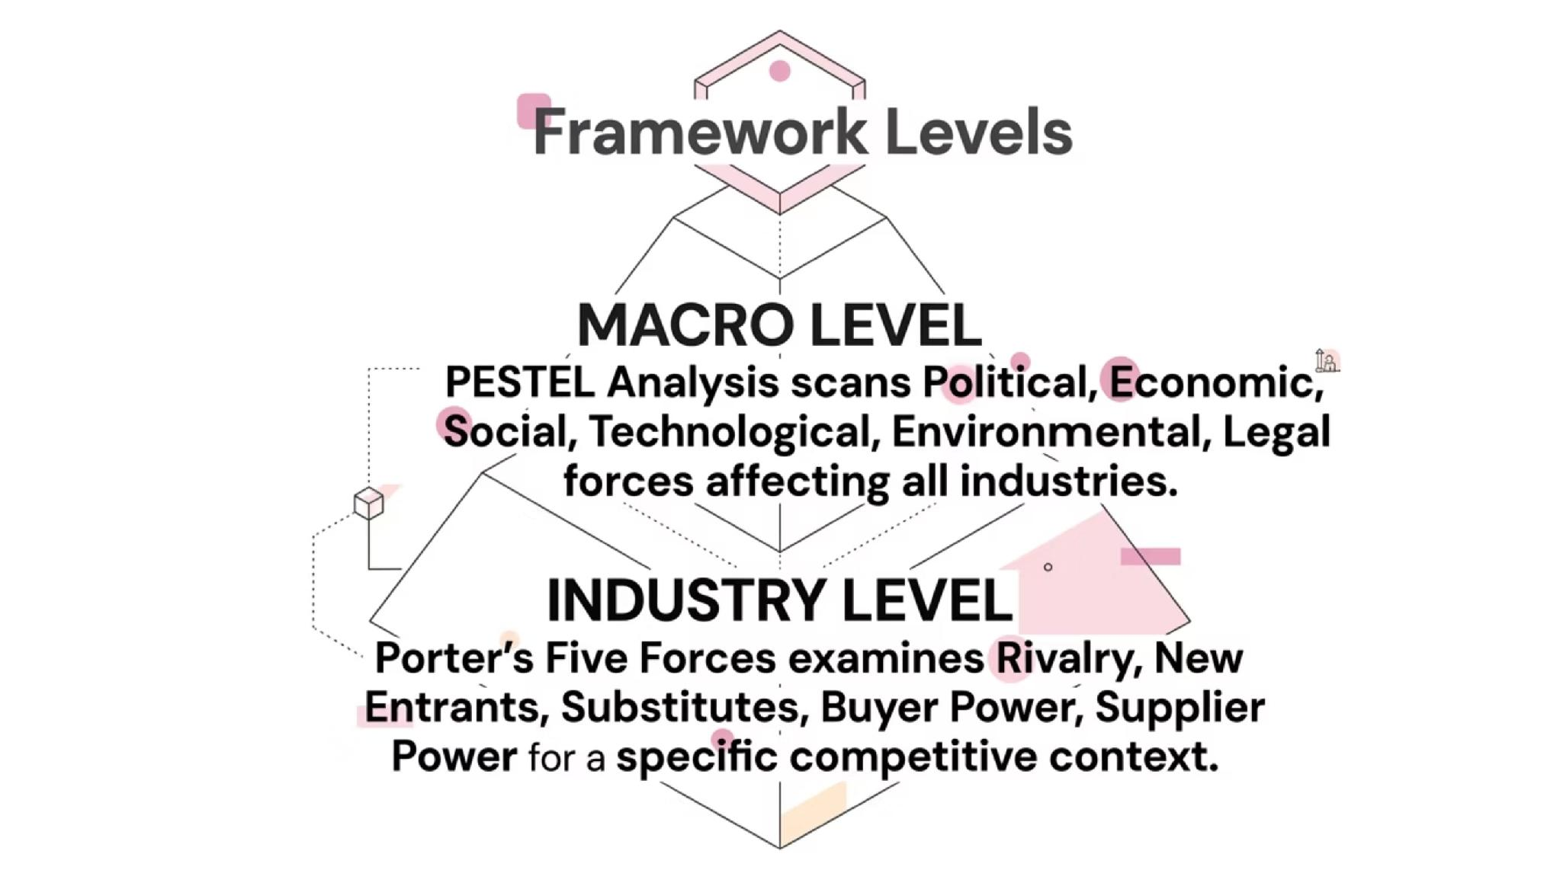
Framework Abstraction Levels
The two scanning frameworks work at different levels of abstraction. Used together, they move from the broadest context to the specific industry structure.
PESTEL defines the macro context; Five Forces reveals industry competition. Together, they give a full external diagnostic.

Slide 27
PESTEL Analysis
PESTEL scans the six external forces that shape an organization's environment. It is the starting point for external analysis.
P — Political
E — Economic
Stability, trade, regulation, geopolitics.
Growth, inflation, rates, jobs, confidence.
S — Social
T — Technological
Demographics, culture, lifestyles, behaviors.
Innovation, automation, disruption, R&D.

Slide 28
Environmental & Legal Factors
The last two PESTEL dimensions are often underweighted, yet they are critical in volatile, regulated, sustainability-focused markets.
Environmental (E)
Legal (L)
Climate risk, carbon rules, and resource scarcity can quickly become financial risks. ESG compliance is now a market expectation.
Laws on privacy, labor, IP, and licensing shape strategic options. Compliance is a core business constraint.
Privacy laws: GDPR, Philippine Data Privacy Act
Labor rules on hiring and restructuring
Sector-specific licensing requirements
Net-zero targets and deadlines
Climate disruption in supply chains
Sustainability as a competitive edge

Slide 29
Porter's Five Forces
Developed by Michael E. Porter, this framework shifts analysis from the macro environment to the structural mechanics of a specific industry.
It shows how five forces shape competitive intensity, industry attractiveness, and long-run profitability.

Slide 30
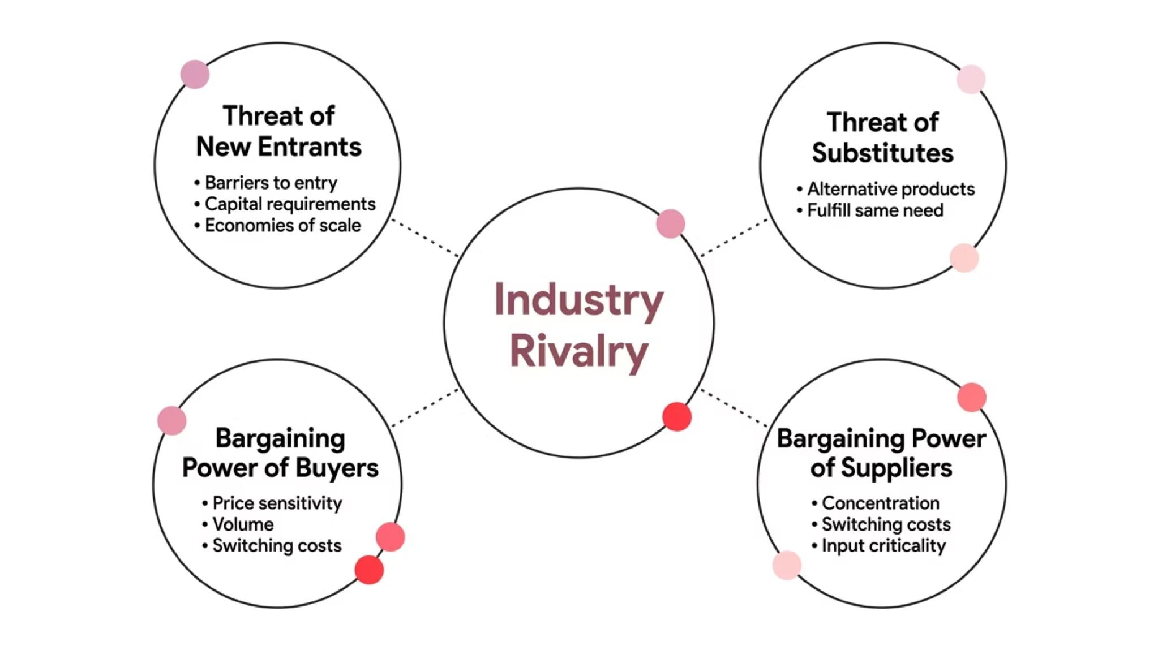
The Five Competitive Forces
Five forces shape industry profit.
Together, they set the ceiling for sustainable returns.

Slide 31

The Five Competitive Forces
PART 1 COMPLETE
PESTEL and Porter's Five Forces form the external lens for strategic analysis. They show where real advantage can be built—and where it cannot.
Part 2 shifts inward to VRIO, then brings everything together with SWOT and TOWS.
PESTEL
Five Forces
Next: Part 2
Macro-environment scanned
Industry structure mapped
VRIO, SWOT & Ethics

