Slide 1

Module 4 - Part 1
External Scanning Mastery: Navigating PESTEL Forces
A strategic framework for anticipating macro-environmental forces, building organizational resilience, and turning market volatility into competitive advantage.
C-AE24 STRATEGIC BUSINESS ANALYSIS
Rosalinda E. Perez

Slide 2

Setting the Stage
In volatile business landscapes, the difference between market leaders and those who fall behind rarely comes down to internal execution alone — it comes down to foresight.
Our Focus Today
Our Commitment
Navigate the macro-environmental forces shaping your industry using a time-tested, powerful framework.
PESTEL as a dynamic, living business tool — not an academic checklist — designed to protect revenue and identify untapped opportunities.
Your Role
Reflect on your specific business units and daily operational challenges as we move through each concept together.

Slide 3

Training Objectives
Three interconnected pillars designed to move your leadership team from understanding to execution.
1
2
3
Foundational Knowledge
Practical Execution
Strategic Application
Align on what PESTEL is, why macro-environmental scanning is vital, and how these forces dictate market trends.
Deconstruct all six dimensions with real-world corporate examples — beyond definitions, into manifestations.
Translate raw environmental data into actionable strategy, embedded into your annual planning and risk management cycles.

Slide 4


The Big Picture: Where Does PESTEL Operate?
Three Distinct Layers
Internal: Operations, talent, culture — fully within your control.
Micro-environment: Competitors, suppliers, customers — influenced but not controlled.
Macro-environment: Global forces you cannot alter or prevent. Your only path to success is absolute adaptability.
Macro-Environment
PESTEL — political, economic, social, tech
The Industry
Micro — competitors, suppliers, customers
The Enterprise
Internal — operations, talent, culture
PESTEL gives you the visibility to adapt before the wave hits — ensuring you are never caught off guard.

Slide 5
What is PESTEL?
A structured, systematic framework used to identify, analyze, monitor, and evaluate external macro-environmental factors impacting business operations, profitability, and competitive advantage.
P
E
Political
Economic
S
T
Social
Technological
E
L
Environmental
Legal
PESTEL is your corporate early-warning radar — forcing leadership to look through the windshield at weather patterns forming miles ahead, not just the rearview mirror.

Slide 6




PART 1: DECONSTRUCTING THE FRAMEWORK
P — Political Factors
Assesses how government policies, institutional stability, and political dynamics shape your operating environment.
Tax & Trade Policy
Tariffs, trade agreements, and subsidies can overnight reshape profit margins and open — or close — entire markets.
Political Stability
Regime stability in core markets determines the safety of long-term capital investments and supply chain continuity.
Government Priorities
Infrastructure spending, privatization stance, and foreign investment policies define the sector landscape for years.

Slide 7


PART 1: DECONSTRUCTING THE FRAMEWORK
E — Economic Factors
Economic factors have a direct, quantifiable impact on financial performance, operational costs, and customer purchasing behavior.
GDP & Inflation
Consumer Spending
Currency Volatility
Rising inflation squeezes margins; central bank rate hikes increase cost of borrowing capital.
High interest rates reduce disposable income, delaying major purchases and softening demand.
A strengthening local currency makes exports more expensive, eroding international competitiveness.

Slide 8

PART 1: DECONSTRUCTING THE FRAMEWORK
S — Social Factors
Socio-cultural dynamics dictate market demand and shape human capital expectations. Ignore them at your peril.
Aging Populations
Evolving Workforce Values
Shrinks youth-centric markets while creating multi-billion-dollar opportunities in healthcare and wealth management.
Remote work expectations and demand for corporate purpose are now critical talent acquisition and retention levers.
Consumer Ethics
Shifting values around sustainability and transparency are actively rewiring purchasing behavior and brand loyalty.

Slide 9





PART 1: DECONSTRUCTING THE FRAMEWORK
T — Technological Factors
The Fastest-Moving Dimension
Technology is an incredible enabler — and an existential threat. Disruptive innovations can render highly successful business models obsolete within months.
AI & Automation
Cloud Infrastructure
Digital streaming dismantled video rental chains. Cloud computing disrupted on-premise software. The next wave is already forming.
Cybersecurity
Data Analytics
Your critical questions: What emerging technologies could disrupt our value proposition? How are competitors leveraging automation to reduce operating costs?

Slide 10

PART 1: DECONSTRUCTING THE FRAMEWORK
E — Environmental Factors
Once a CSR checkbox, environmental factors are now a core strategic driver directly affecting corporate valuations, investor relations, and supply chain viability.
Physical Climate Risk
ESG & Investor Pressure
Droughts and extreme weather can shut down manufacturing and disrupt international shipping lanes with catastrophic financial consequences.
Institutional capital is increasingly allocated based on strict environmental, social, and governance metrics. Non-compliance is costly.
Carbon Regulation
Tightening carbon neutrality legislation will significantly increase production costs for unprepared organizations.

Slide 11


PART 1: DECONSTRUCTING THE FRAMEWORK
L — Legal Factors
Distinct from Political Factors
Political factors address government ideology and policy direction. Legal factors address the specific, codified laws and compliance frameworks your organization must operate within.
Data Privacy (GDPR)
Labor & Employment Law
Intellectual Property
Breaches can trigger fines of millions and catastrophic loss of brand trust.
Minimum wage and contractor classification shifts alter operating cost structures.
IP protection underpins your competitive moat and R&D investment returns.

Slide 12

PART 2: PESTEL IN ACTION
Case Study: A Turning Point
The automotive sector's transformation from combustion engines to Electric Vehicles is a textbook example of all six PESTEL forces aligning simultaneously — creating a perfect storm that forced a global industry to reinvent itself.
Early Movers Won
Companies that monitored PESTEL signals early achieved staggering market valuations and category leadership.
Late Movers Scrambled
Organizations that dismissed the signals played an expensive, high-stakes game of catch-up — at great cost.

Slide 13

PART 2: PESTEL IN ACTION
Case Study: The EV Transformation Mapped
No single force drove this change in isolation. Forces compounded — feeding and reinforcing each other — to reshape an entire global industry.
Political
Governments set net-zero targets and offered billions in EV tax credits and subsidies to consumers and manufacturers.
Economic
Battery cost-per-kWh fell dramatically; rising fuel prices made electricity a cheaper alternative for drivers.
Social
Zero-emission driving became a cultural status symbol aligned with personal environmental values.
Technological
Breakthroughs in battery chemistry, fast-charging, and autonomous software transformed cars into digital platforms.
Environmental
Urban air pollution and climate crisis created urgent global narrative demanding corporate accountability.
Legal
Nations passed laws banning new diesel and gasoline car sales by specified future deadlines.
This is PESTEL in action: political subsidies fed economic viability, which accelerated technology, demanded by social shifts, codified by legal mandates.

Slide 14


PART 2: PESTEL IN ACTION
Common Pitfalls in PESTEL Analysis
⚠ The "Shopping List" Effect
Listing 50 factors without analyzing impact, likelihood, or strategic relevance is a hollow exercise that creates zero business value.
⚠ Static Thinking
Treating PESTEL as a one-off annual document is a failure mode. It must be an ongoing, living monitoring system.
⚠ Analyzing Factors in Isolation
Macro forces are deeply interconnected. A political decision impacts economics, which triggers social shifts, which demands technological solutions.
⚠ Confirmation Bias
Do not only seek trends that validate your current model. Use this tool honestly to surface uncomfortable threats and challenge assumptions.

Slide 15
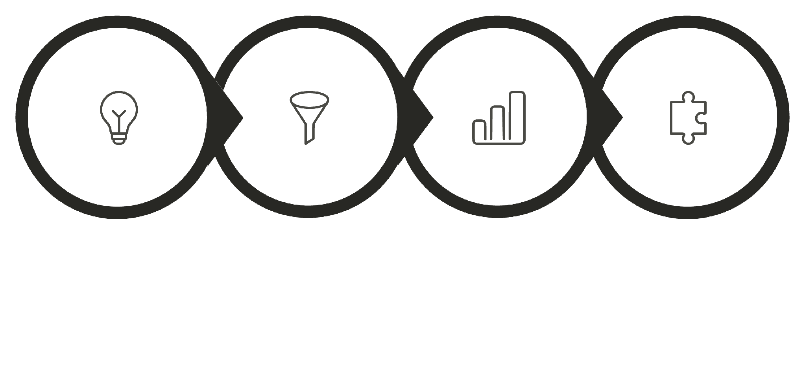
PART 3: FROM ANALYSIS TO ACTION
Step-by-Step: How to Conduct the Analysis
Brainstorm
Filter
Analyze
Integrate
This structured process ensures PESTEL shifts from an abstract brainstorming session into a concrete, disciplined strategic tool that drives executive decision-making and capital allocation.

Slide 16
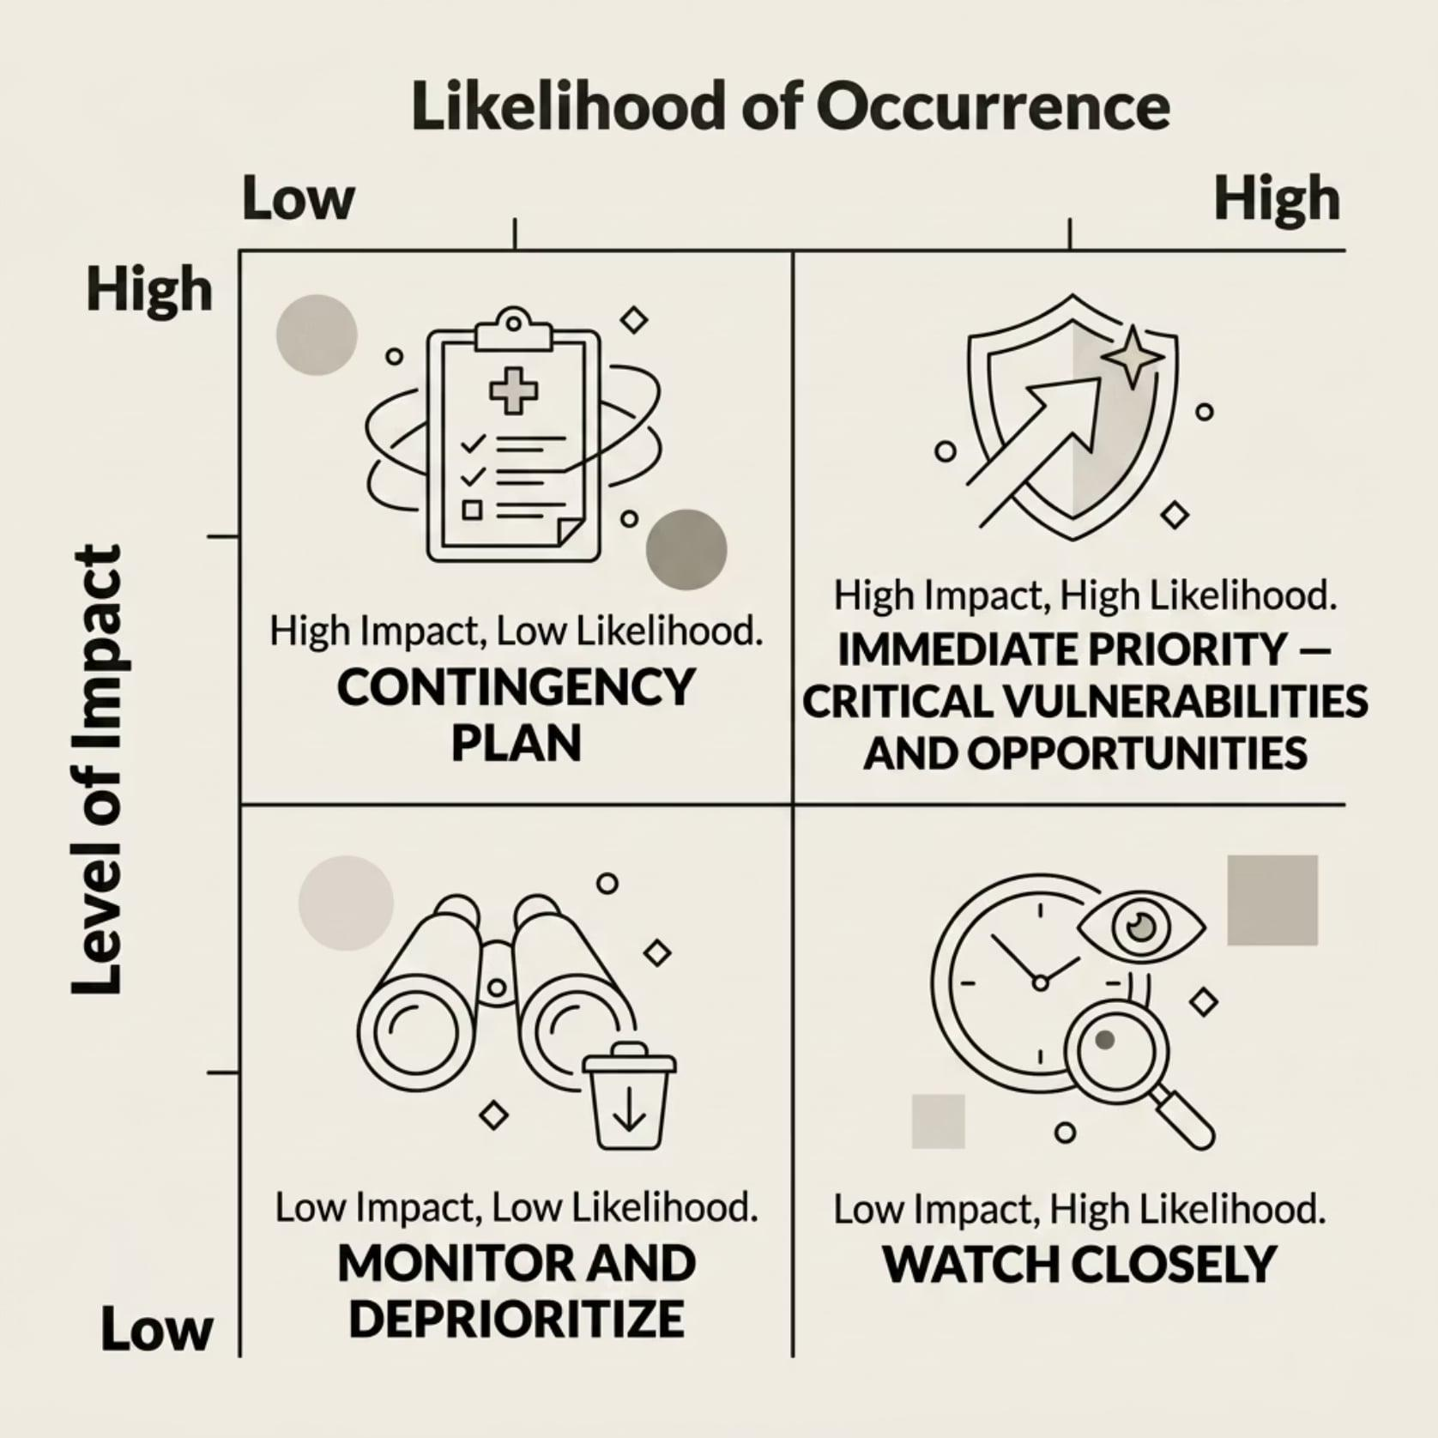
PART 3: FROM ANALYSIS TO ACTION
Prioritizing the Factors: Impact vs. Likelihood
How to Use This Matrix
Plot each identified PESTEL factor based on two criteria:
Likelihood of Occurrence — Remote possibility or near-certain within your planning window?
Level of Impact — Minor nuisance or potentially catastrophic to financial health?
Top-right quadrant factors require immediate executive ownership, dedicated capital allocation, and mitigation or market-capture strategies.

Slide 17
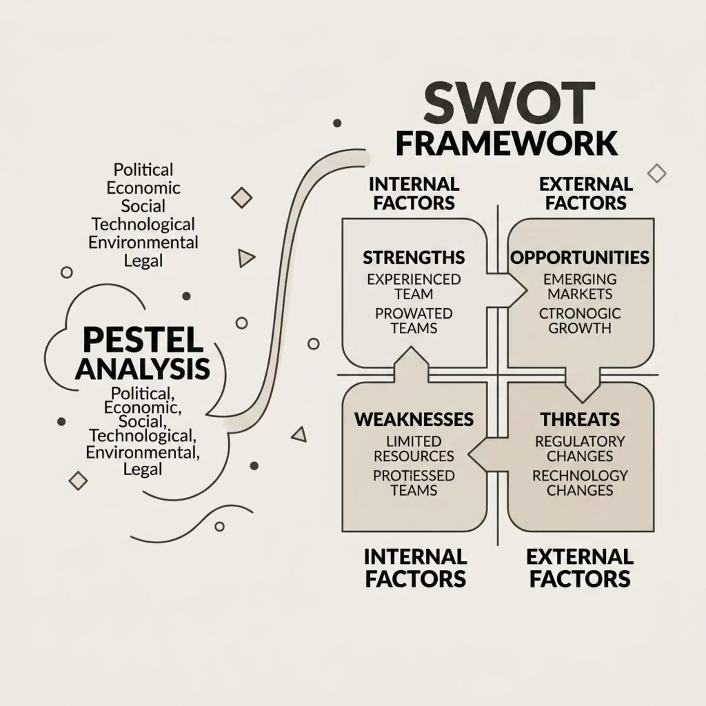
PART 3: FROM ANALYSIS TO ACTION
Connecting PESTEL to SWOT Analysis
Complementary, Not Competing
PESTEL is the dedicated deep-dive into the external world. SWOT blends both internal and external views.
PESTEL outputs directly populate the Opportunities and Threats quadrants of your SWOT, ensuring they are grounded in objective macroeconomic reality — not internal guesswork.
A new automation technology → Opportunity (if adopted early)
A strict new data regulation → Threat (if compliance is unready)

Slide 18




Key Takeaways for Leadership
Early-Warning System
Growth Engine
Build institutional risk mitigation plans before a crisis hits — move from reactive firefighting to controlled strategic posture.
Systematic macro scanning surfaces untapped market opportunities and emerging digital spaces before competitors notice them.
Agile Culture
Department heads trained in PESTEL thinking stop operating in silos — they build flexibility and foresight into their operations.
Mastering PESTEL transforms market volatility from a terrifying threat into a distinct, highly profitable competitive advantage.

Slide 19

PART 4: NEXT STEPS & Q&A
Next Steps & Implementation Roadmap
Week 2
Advisory workshop to review and stress-test findings
Week 1
Week 3+
Form working groups and run PESTEL sessions
Integrate validated insights into roadmap and budgets
Our advisory team is fully committed to partnering with you through every step — from template distribution to validated strategic integration into your annual planning cycle.

Slide 20


Questions & Discussion
We have covered significant strategic ground today — from environmental layers and the six PESTEL pillars, to the EV case study and prioritization methodology.
To kick-start our discussion: Which of the six PESTEL dimensions is currently exerting the most intense pressure on your organization's growth and operational efficiency? Are there macro trends that keep you up at night — or areas where competitors may be reacting faster than you are?
The floor is open for questions on the framework, the upcoming implementation steps, or applying these concepts to your specific challenges.

Slide 21

Thank You
By equipping your management team with the PESTEL framework today, you have taken a major step toward securing your organization's long-term market leadership.
What's Coming Next
Customized digital execution templates, prioritization matrices, and this presentation deck — in your inbox within the hour.
We're Here to Support
Our advisory team is available to assist, clarify, and provide data support as you begin your cross-functional brainstorming sessions next week.
Strategic planning is a continuous journey. We look forward to collaborating with you at our review workshop in two weeks.

