Slide 1

Porter's Five Forces: Analyzing Industry Competition
Module 4 External Scanning Part 2
C-AE24 Strategic Business Analysis
A Strategic Framework for Understanding Competitive Dynamics
Rosalinda E. Perez

Slide 2

Who Is Michael Porter?
The Mind Behind the Framework
Michael Porter is a professor at Harvard Business School and one of the most influential thinkers in the field of business strategy. In 1979, he introduced the Five Forces Framework in a Harvard Business Review article. His goal was to give businesses a structured way to understand the competitive forces shaping their industry and use that understanding to build a stronger strategic position.

Slide 3
What Is Porter's Five Forces?
The Core Idea
Porter's Five Forces is a framework used to analyze the competitive intensity and attractiveness of an industry. It argues that the profitability of any industry is shaped by five fundamental forces.
Understanding these forces helps businesses identify where power lies, where threats come from, and where strategic opportunities exist.
The Framework Answers:
Where does power lie in this industry?
Where do the real threats come from?
Where do strategic opportunities exist?

Slide 4
Why Industry Analysis Matters
Why Look at the Whole Industry?
Too Narrow a View
Competition Comes from Multiple Directions
A Complete Strategic Picture
Many businesses focus only on their direct competitors. Porter argued this is too narrow a perspective for effective strategy.
True competition comes from suppliers, buyers, new entrants, substitutes, and rivals — not just the company across the street.
A complete strategic picture requires looking at all five forces simultaneously to understand the full competitive landscape.

Slide 5
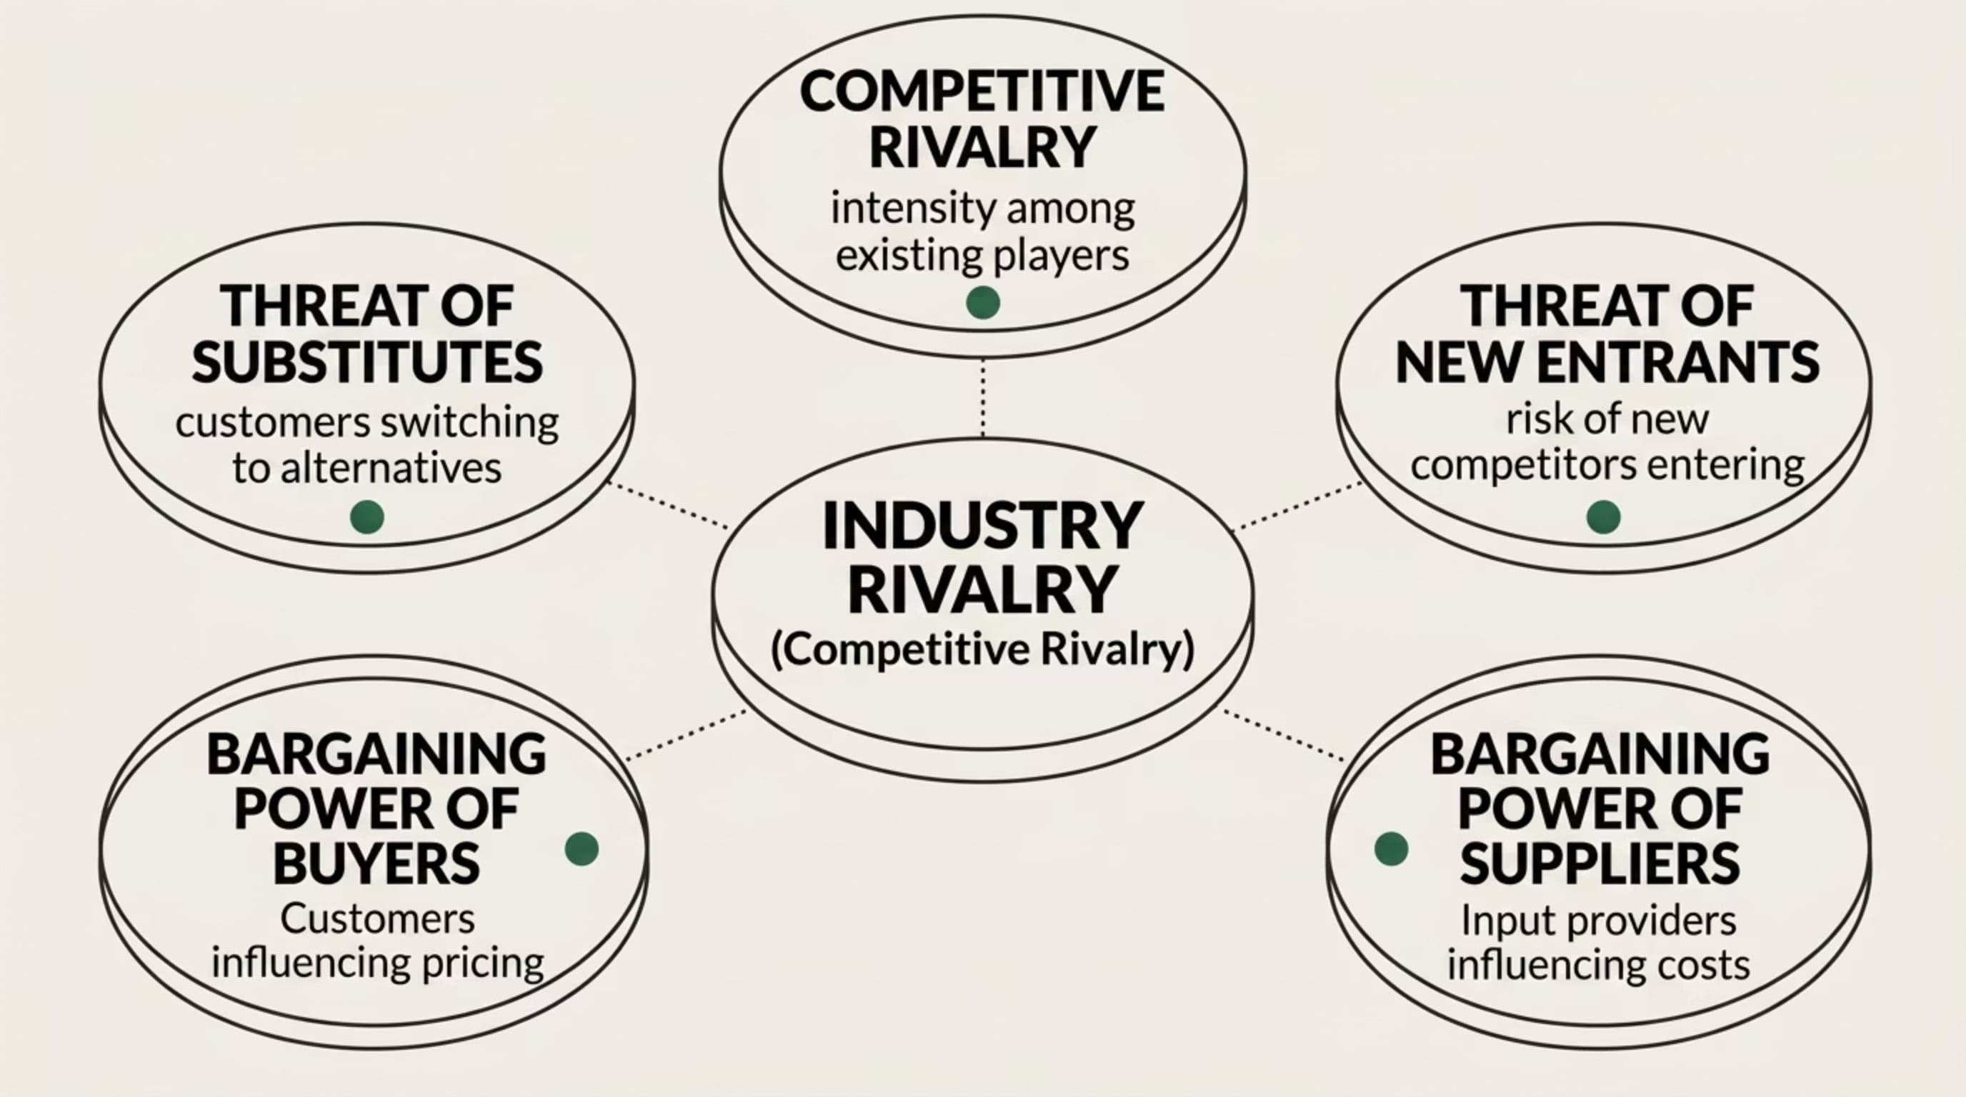
The Five Forces Overview
The Five Forces at a Glance
Together, these five forces determine the competitive intensity and long-run profitability of any industry. No single force operates in isolation — they interact and reinforce one another.

Slide 6



How Businesses Apply Porter's Five Forces
How to Use This Framework
Evaluate Industry Attractiveness
1
Assess an industry before entering it to understand whether it offers sustainable profit potential.
Understand Profitability Differences
2
Identify why some industries are consistently more profitable than others over the long term.
Locate Competitive Pressure
3
Pinpoint where competitive pressure is strongest so resources can be allocated strategically.
Complement Other Tools
4
Use alongside PESTEL and SWOT analysis for a comprehensive strategic assessment.

Slide 7

FORCE 1
Force 1 — Competitive Rivalry
The intensity of competition among existing players in the industry
What Is Competitive Rivalry?
Why It Matters
When rivalry is low, businesses have more pricing power and can sustain higher margins over time. The level of rivalry is one of the most visible and immediate forces shaping day-to-day business decisions.
Competitive rivalry refers to the intensity of competition between existing companies within an industry. When rivalry is high, businesses compete aggressively on price, quality, marketing, and innovation — driving down profitability for everyone.

Slide 8


Factors That Influence Competitive Rivalry
What Makes Rivalry High or Low?
Rivalry tends to be HIGH when:
Rivalry tends to be LOW when:
Many competitors of similar size and capability
Slow industry growth, forcing companies to fight for the same customers
Products are similar and hard to differentiate
High exit costs, keeping struggling companies in the market
Few dominant players control the market
Rapidly growing industry with room for all
Highly differentiated products reduce direct comparison
High switching costs for customers reduce churn

Slide 9

FORCE 2
Force 2 — Threat of New Entrants
The risk that new competitors will enter the industry and increase competition

Slide 10
What Is the Threat of New Entrants?
Threat of New Entrants Defined
The threat of new entrants refers to how easily new competitors can enter an industry and begin competing with existing players. When this threat is high, existing businesses must constantly defend their position and invest in maintaining competitive advantages.
When the threat is low, established companies enjoy more stability and pricing power. The key concept here is barriers to entry: the obstacles that make it difficult for new players to break in.
Key Question
How hard is it for a new competitor to set up shop and start taking your customers?

Slide 11






What Keeps New Competitors Out?
Common Barriers to Entry
Capital Requirements
Brand Loyalty
High startup costs and capital requirements deter underfunded entrants.
Strong brand loyalty among existing customers makes switching unlikely.
Economies of Scale
Regulations & Licensing
Established players produce at lower cost per unit, undercutting new entrants.
Government regulations and licensing requirements create legal barriers.
Proprietary Technology
Distribution Access
Patents, trade secrets, and proprietary tech protect incumbents' advantages.
Exclusive access to distribution channels or raw materials blocks new players.

Slide 12

FORCE 3
Force 3 — Threat of Substitutes
The risk that customers will switch to a different product or service that serves the same need

Slide 13


What Is the Threat of Substitutes?
Threat of Substitutes Defined
A substitute is a product or service from a different industry that fulfills the same need. The threat is high when customers can find alternatives at lower cost or with greater convenience.
Substitutes do not have to be identical products. They just need to satisfy the same customer need — and in doing so, they place a ceiling on what businesses can charge.
Classic Example: Streaming services are a substitute for cinema. They are not the same product, but they fulfill the same need — entertainment at home — and limit how much cinemas can charge.
Key Risk: When substitutes are plentiful and affordable, businesses lose pricing power entirely.

Slide 14

FORCE 4
Force 4 — Bargaining Power of Buyers
The ability of customers to influence pricing and terms in their favor

Slide 15
What Is Buyer Power?
Bargaining Power of Buyers Defined
Buyer power refers to the ability of customers to push prices down, demand higher quality, or require better service. When buyers are powerful, they erode profit margins. When they have little power, businesses maintain control over pricing and terms.
High Buyer Power
Low Buyer Power
Strategic Response
Buyers are few and large, products are undifferentiated, switching costs are low, and buyers can credibly threaten to produce the product themselves.
Many fragmented buyers, highly differentiated products, high switching costs, and buyers depend heavily on the seller's product for their own operations.
Understanding buyer power helps a business decide how much flexibility it can afford and where it needs to defend its value proposition most aggressively.

Slide 16
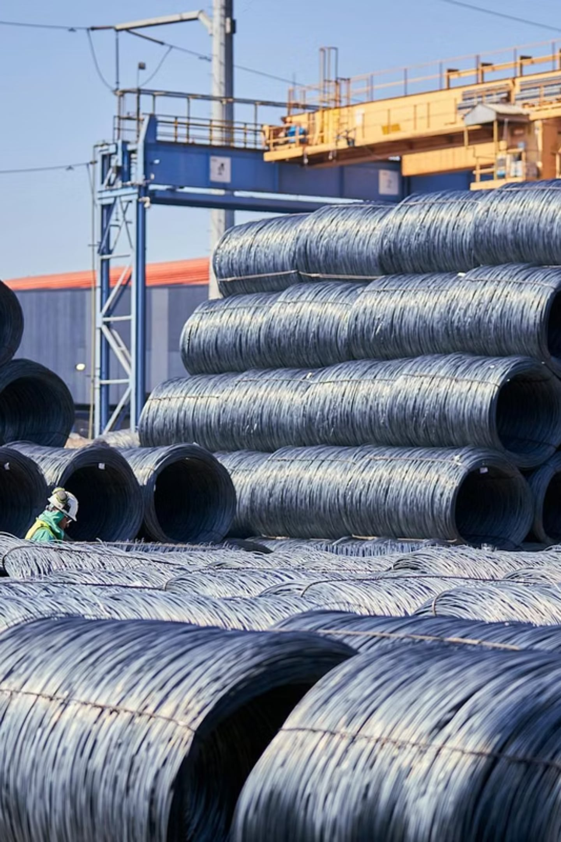
FORCE 5
Force 5 — Bargaining Power of Suppliers
The ability of suppliers to influence costs and availability of inputs

Slide 17
What Is Supplier Power?
Bargaining Power of Suppliers Defined
Supplier power refers to the ability of input providers to influence the prices, quality, or availability of what they supply. When supplier power is high, businesses face higher costs and less operational flexibility. When it is low, businesses can negotiate better deals and maintain predictable cost structures.
Suppliers are often overlooked in competitive analysis, but they can significantly shape a company's competitive position — especially in industries that depend on scarce or specialized inputs.
Supplier Power Is High When:
Few suppliers dominate the market
No viable substitute inputs exist
Switching suppliers is costly or disruptive
Suppliers can credibly threaten to integrate forward

Slide 18
Conducting a Five Forces Analysis
Putting It All Together
01
02
03
Define the Industry
Assess Each Force
Identify Greatest Threats
Define the industry clearly and specifically — scope matters enormously in determining which forces apply.
Rate each of the five forces as high, medium, or low based on evidence from the industry context.
Identify which forces pose the greatest threat to profitability and require the most urgent strategic attention.
04
05
Develop Strategic Recommendations
Revisit Regularly
Translate findings into strategic positioning recommendations that address the most powerful forces.
Revisit the analysis regularly as industries evolve — forces shift over time and strategy must adapt accordingly.

Slide 19
Competition Is Bigger
Than Your Closest Rival
Closing
Porter's Five Forces reminds us that competition comes from more than just the business next door. It comes from suppliers, buyers, new entrants, substitutes, and existing rivals. The businesses that thrive are those that understand all five forces, position themselves wisely, and stay alert as those forces shift over time.
"Strategy is about making choices, trade-offs. It's about deliberately choosing to be different." — Michael Porter

Slide 20
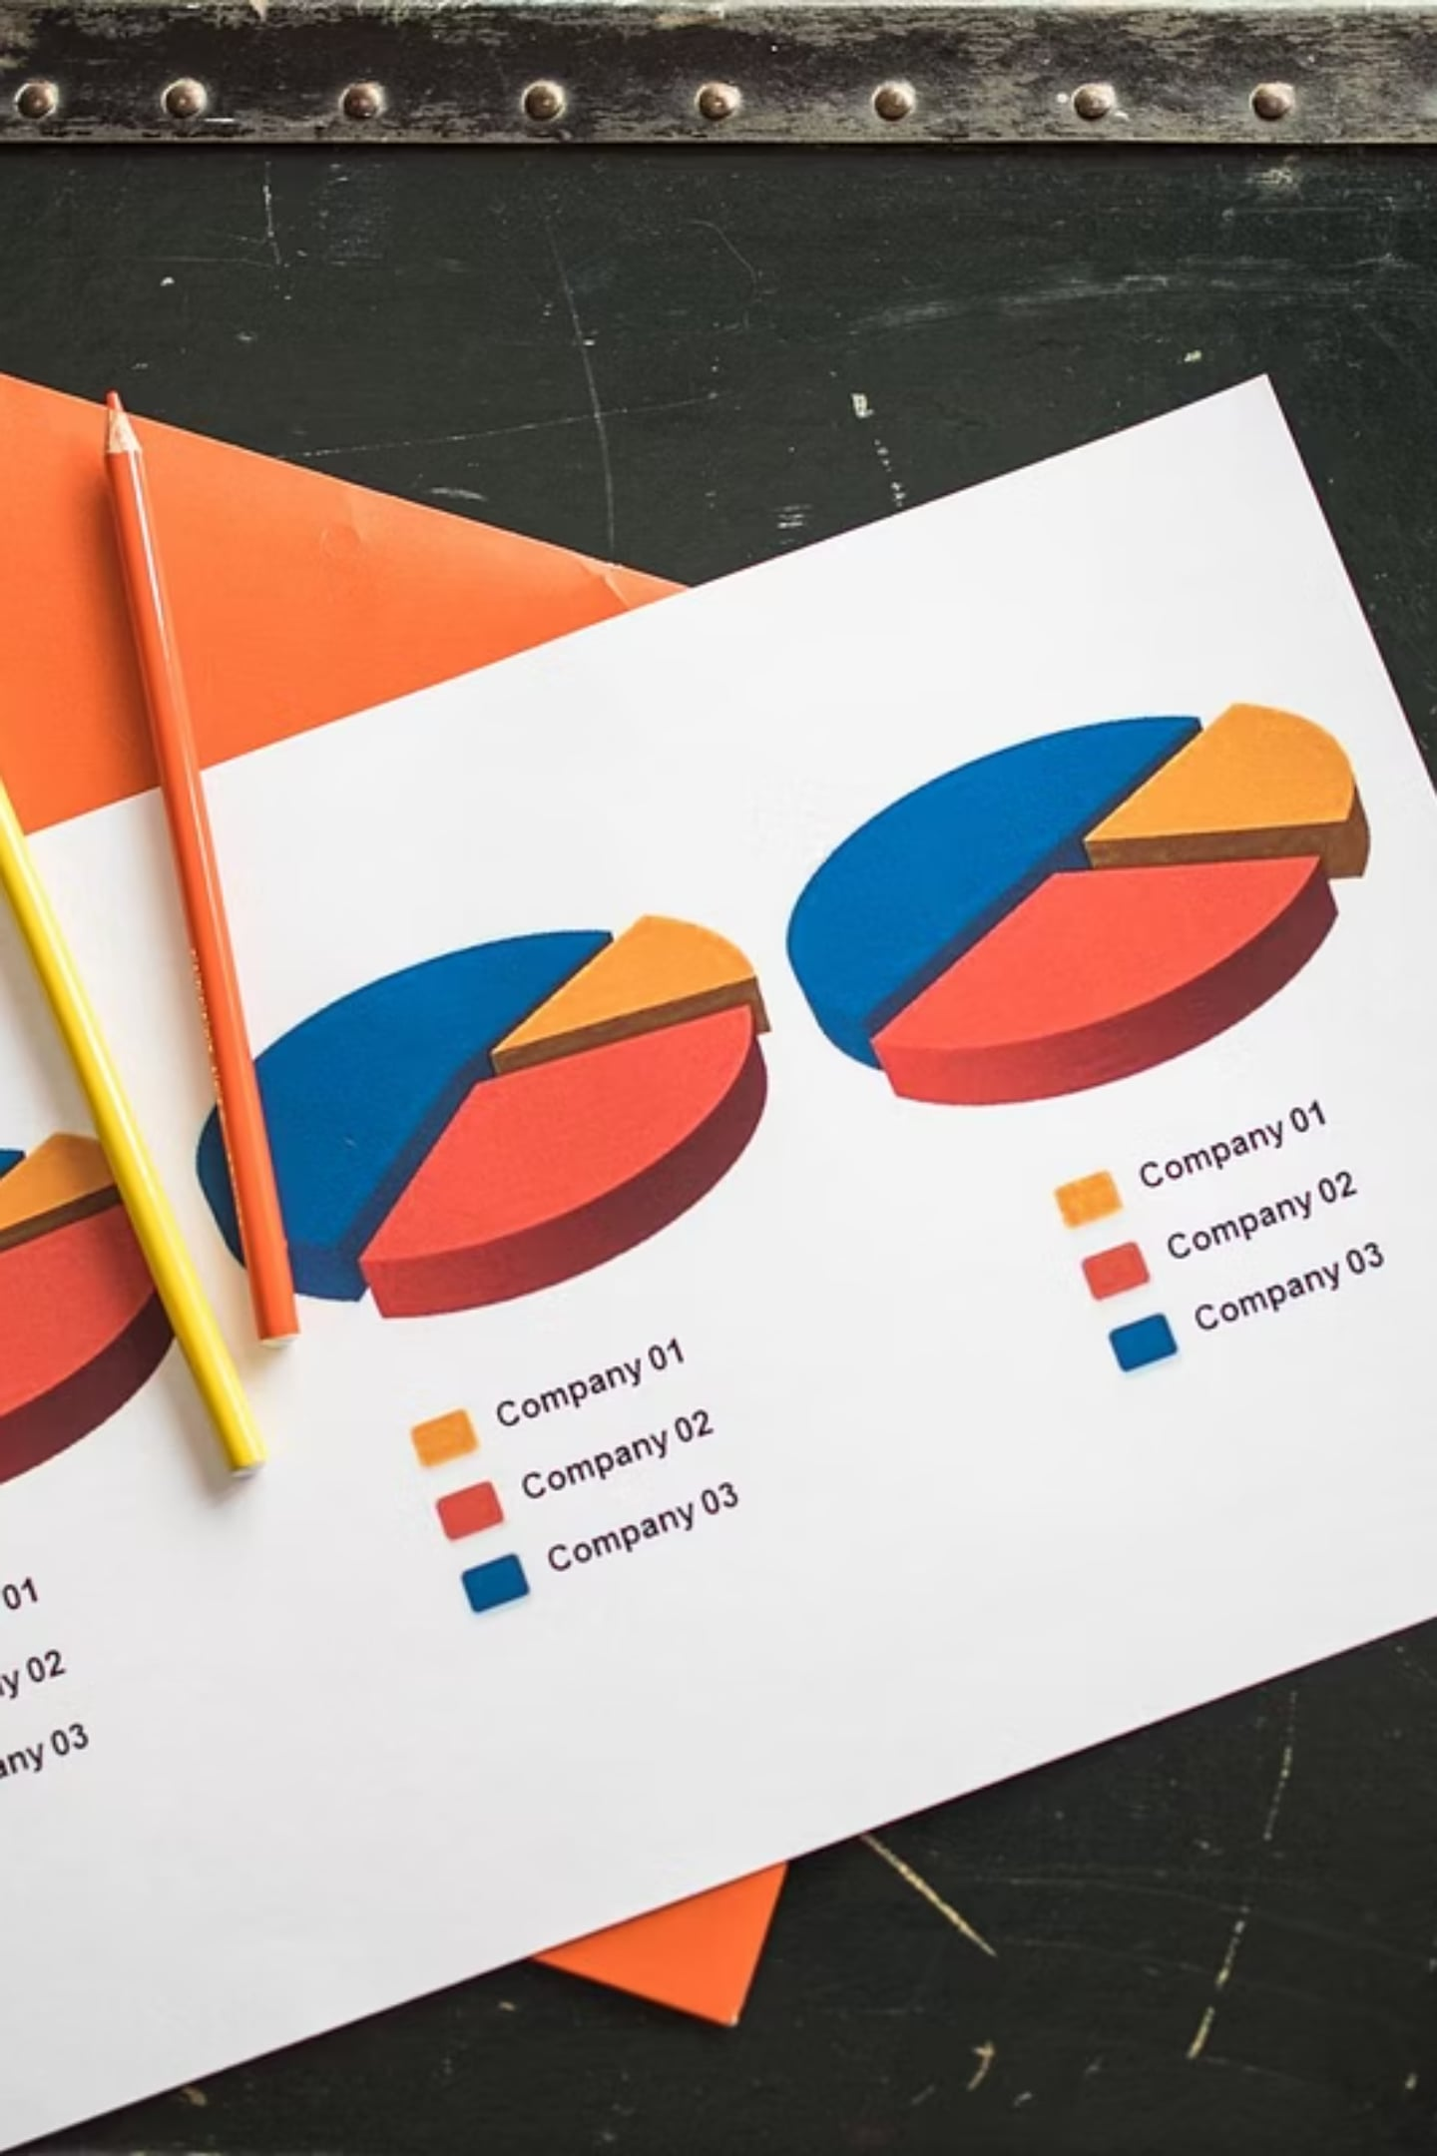
NEXT MODULE
What's Next? Internal Scanning
While Porter's Five Forces provides a crucial external view of industry competition, a complete strategic analysis also demands a rigorous look inward.
In our upcoming module, we'll shift focus to Internal Scanning, diving deep into understanding an organization's unique strengths, weaknesses, core capabilities, and valuable resources to forge a sustainable competitive advantage.

