Slide 1
Theory and Practice of Supporting Learning (1) Course
Session 2
MODELS OF LEARNING

Slide 2
After completing this session you will be able to:
Discuss the central goal of education – learning to learn
Learn about 4 models of learning – Learning to think inductively, learning to explore concepts, learning to think metaphorically with synectics, learning how to learn through cooperative inquiry
Learn about principles underpinning these models of learning
Identify advantages and disadvantages of these models
Reflect and analyze which models of learning are adopted by your students

Slide 3
Do it yourself
Read through the following statements and see if you can comment on them referring to your personal learning or teaching experience
Students tend to adopt and employ a specific way of learning regardless of the teachers instructions
A specific way of students learning depend on the profile of the students and many other factors
It is vital to learn about the way students learn as this can inform our teaching practice
Students learn in different ways, however in formal teaching context of a school or an institution teachers should follow one specific way of teaching
Teachers have little influence on the way their students learn

Slide 4
Let’s look at some examples

Slide 5
Selected examples
Students tend to adopt and employ a specific way of learning regardless of the teachers instructions
A specific way of students learning depend on the profile of the students and many other factors
5. Teachers have little influence on the way their students learn

Slide 6
‘The best curriculums are devoted to learning how to learn and the best schools make learning to learn central’
(Joyce, 2009, p3)
A quote about playing doubles in tennis
‘It is your partner who will make you successful’
Teachers’ partners are students!

Slide 7

Learning inductively

Slide 8
Learning about plants
At the X school a group of students are engaged in the study of a botany unit that focuses on the structure of plant life.
Students are presented with a large number of UNLABELLED plants to be categorized. Students are asked to create their own categories. Students work in pairs and build classifications of plants based on the observable structural characteristics of their roots, stems and leave. Then the teacher interrupts the process and introduces scientific names to students’ categories.
Later the teacher supplies students with some new specimens and ask them to see if they can define to which category the plant belongs.
Finally the teacher takes students out in the school garden and asks the students to collect new specimens to fit them to the categories they have developed and see how comprehensive the categories are. Students discover that most of the new plants will fit into existing categories but some new categories have to be developed to hold some of them.

Slide 9
Phases of the inductive model
Phase 1 Identify the domain – define the focus, set the inquiry
Phase 2 Collect, present and enumerate data – assemble and present the initial data set (teacher or students)
Phase 3 Examine data – study the items in data sets and identify characteristics, attributes, similarities, etc
Phase 4 Form the concept by classifying – classify the items in the data set, add more data to the set, reclassify if necessary
Phase 5 Generate and test hypotheses – see correlations and classify the categories
Phase 6 Consolidate and transfer – search for additional data, apply and test again

Slide 10
Inductive model of learning
COGNITIVE effects | AFFECTIVE effects
Information processing | Spirit of inquiry
Concepts building | Awareness of the nature of knowledge
Observation skills development | Logical thinking
Working with hypothesis | Reasoning and rationalizing
 | Interest and motivation
 | Learner autonomy development

Slide 11
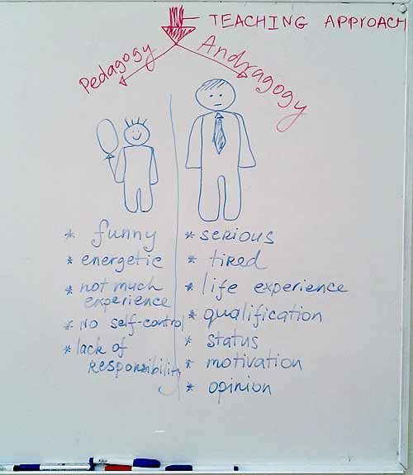
Exploring concepts
Learning about pedagogy and andragogy

Slide 12
Learning about pedagogy and andragogy
A group of teachers-students from the university is having a training to learn about pedagogy and andragogy. A trainer first draws two pictures on the board – one of a child and another of an adult. A group is asked to construct two list of attributes for the pictures. A trainer then draws just one ‘arrow’ pointing at the two pictures and says that it represents the teaching approach. A trainer makes a pause and allows students to observe the picture closely and comment. They suggest that having one teaching approach for two teaching objects (child and adult) seems not logical and they suggest to have two separate ‘arrows’. A trainer now draws an additional ‘arrow’ and write the terms pedagogy and andragogy where appropriate. The concept is introduced and a group continues to develop principles of the two from the lists of attributes created earlier.

Slide 13
Learning to explore concepts
Phase 1 Present data to learners. Each unit of data is an example or a nonexample of data. Data units are presented in pairs. The data maybe event, people , objects, stories. They must be differentiated. Learners are informed about the differences. Finally students are asked to name the concept or its attributes.
Phase 2 Students test their understanding of the concept bringing more examples of their own.
Phase 3 Students apply the concepts to further develop strategies. Strategies can be designed and redesigned again and again to see their effectiveness.

Slide 14
Learning to explore concepts
COGNITIVE effects | AFFECTIVE effects
Nature of concepts | Flexibility and openness
Concepts application | Reasoning
 | Tolerance of ambiguity

Slide 15
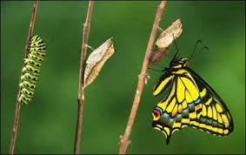
Learning to think metaphorically

Slide 16
Learning to think metaphorically
Teachers-students studied about lesson planning and learned that there were many important ingredients that should be considered.
A trainer suggested to discuss time and pace.
Before the discussion stared, students were given a story that from the first sight had nothing to do with teaching.
After the story was told, students were given time to discuss it in small groups and then they presented their ideas to each other.

Slide 17
A story
A man found a cocoon of a butterfly. One day a small opening appeared. He sat and watched the butterfly for several hours as it struggled to force its body through that little hole.
Then it seemed to stop making any progress. It appeared as if it had gotten as far as it had and it could go no further.
Then the man decided to help the butterfly, so he put a cocoon under an electric lamp as he knew that warmth can push the butterfly to come out quicker. The butterfly tried but her wings got overheated and she refused to continue.
A man got impatient and he took a pair of scissors and snipped off the remaining bit of the cocoon.
The butterfly then emerged easily. But it had a swollen body and small, shriveled wings.
The man continued to watch the butterfly because he expected that, at any moment, the wings would enlarge and expand to be able to support the body, which would contract in time.
Neither happened! In fact, the butterfly spent some time crawling around with a swollen body and shriveled wings. It never was able to fly and then soon it died.

Slide 18
Phases of learning to think metaphorically
Phase 1 Description of a present condition
Phase 2 Direct analogy
Phase 3 Personal analogy
Phase 4 Concept building
Phase 5 Revisiting and re-examination of a concept or an original task

Slide 19
Learning to think metaphorically
Cognitive effects | Affective effects
Problem solving | Adventurous learning
Thinking outside the box | Motivation and interest
Ability to link information | Creativity development

Slide 20

Learning through cooperative enquiry

Slide 21
Learning through cooperative enquiry
Project description - Planning and delivering a learning episode
With a partner produce a plan for a learning episode that will FIT into the teaching calendar of one of you. This may be a learning episode of any nature such as a lesson, a debate, a field trip, a round table discussion, a project, etc.
A learning episode may have been planned already and thus you will only need to review it to ensure that students achieve its learning outcomes effectively. Design all necessary learning materials.
Deliver/facilitate the learning episode together, ensuring that the responsibilities are properly divided among you.
Get a personal tutor to observe your learning episode.

Slide 22
Phases of the learning though cooperative inquiry
Phase 1 Students encounter a puzzling situation
Phase 2 Students formulate a task and organize themselves for study
Phase 3 Independent and group study
Phase 4 Students present their results for comments
Phase 5 Students analyze progress and plan for further action if needed

Slide 23
Learning through cooperative enquiry
Cognitive effects | Affective effects
Effective group process and governance | Independence and autonomy
Constructive view of knowledge | Respect for others
 | Social inquiry
 | Working with others

Slide 24
Watching video
Now it is time for you to turn to the video.
See if you can complete the notes (print them before playing a video) while watching.
Good luck!

