Slide 1
Theory and Practice of Supporting Learning (1) Course
Session 3
MODELS OF LEARNING TOOLS FOR TEACHING
An example of a class based on metaphorical thinking

Slide 2
After completing this session you will be able to:
Learn how a model of learning metaphorically can be applied for teaching
Reflect on the principles underpinning this model of learning
Identify advantages and disadvantages of the model
Reflect how the model can be adopted to your teaching context

Slide 3
Let’s recall
The story about a butterfly

Slide 4
Models of learning should inform and determine tools for teaching

Slide 5
Exploring teaching philosophies through a metaphor
Learning outcomes
Students will be able to:
Share their “Teaching Metaphors” with other colleagues
Explore personal philosophies of teaching and learning
Reflect on their understanding of “teaching and learning” through categorizations
Build a concept of effective teaching

Slide 6
Initial phases of learning
Students were introduced to the word philosophy of teaching and learning through discussion
Students were asked to think about their personal philosophy beyond the classroom. Thinking questions were suggested and students were given a week.
Students were instructed to create a metaphorical picture/image of their philosophy. They had to draw/produce a collage.

Slide 7
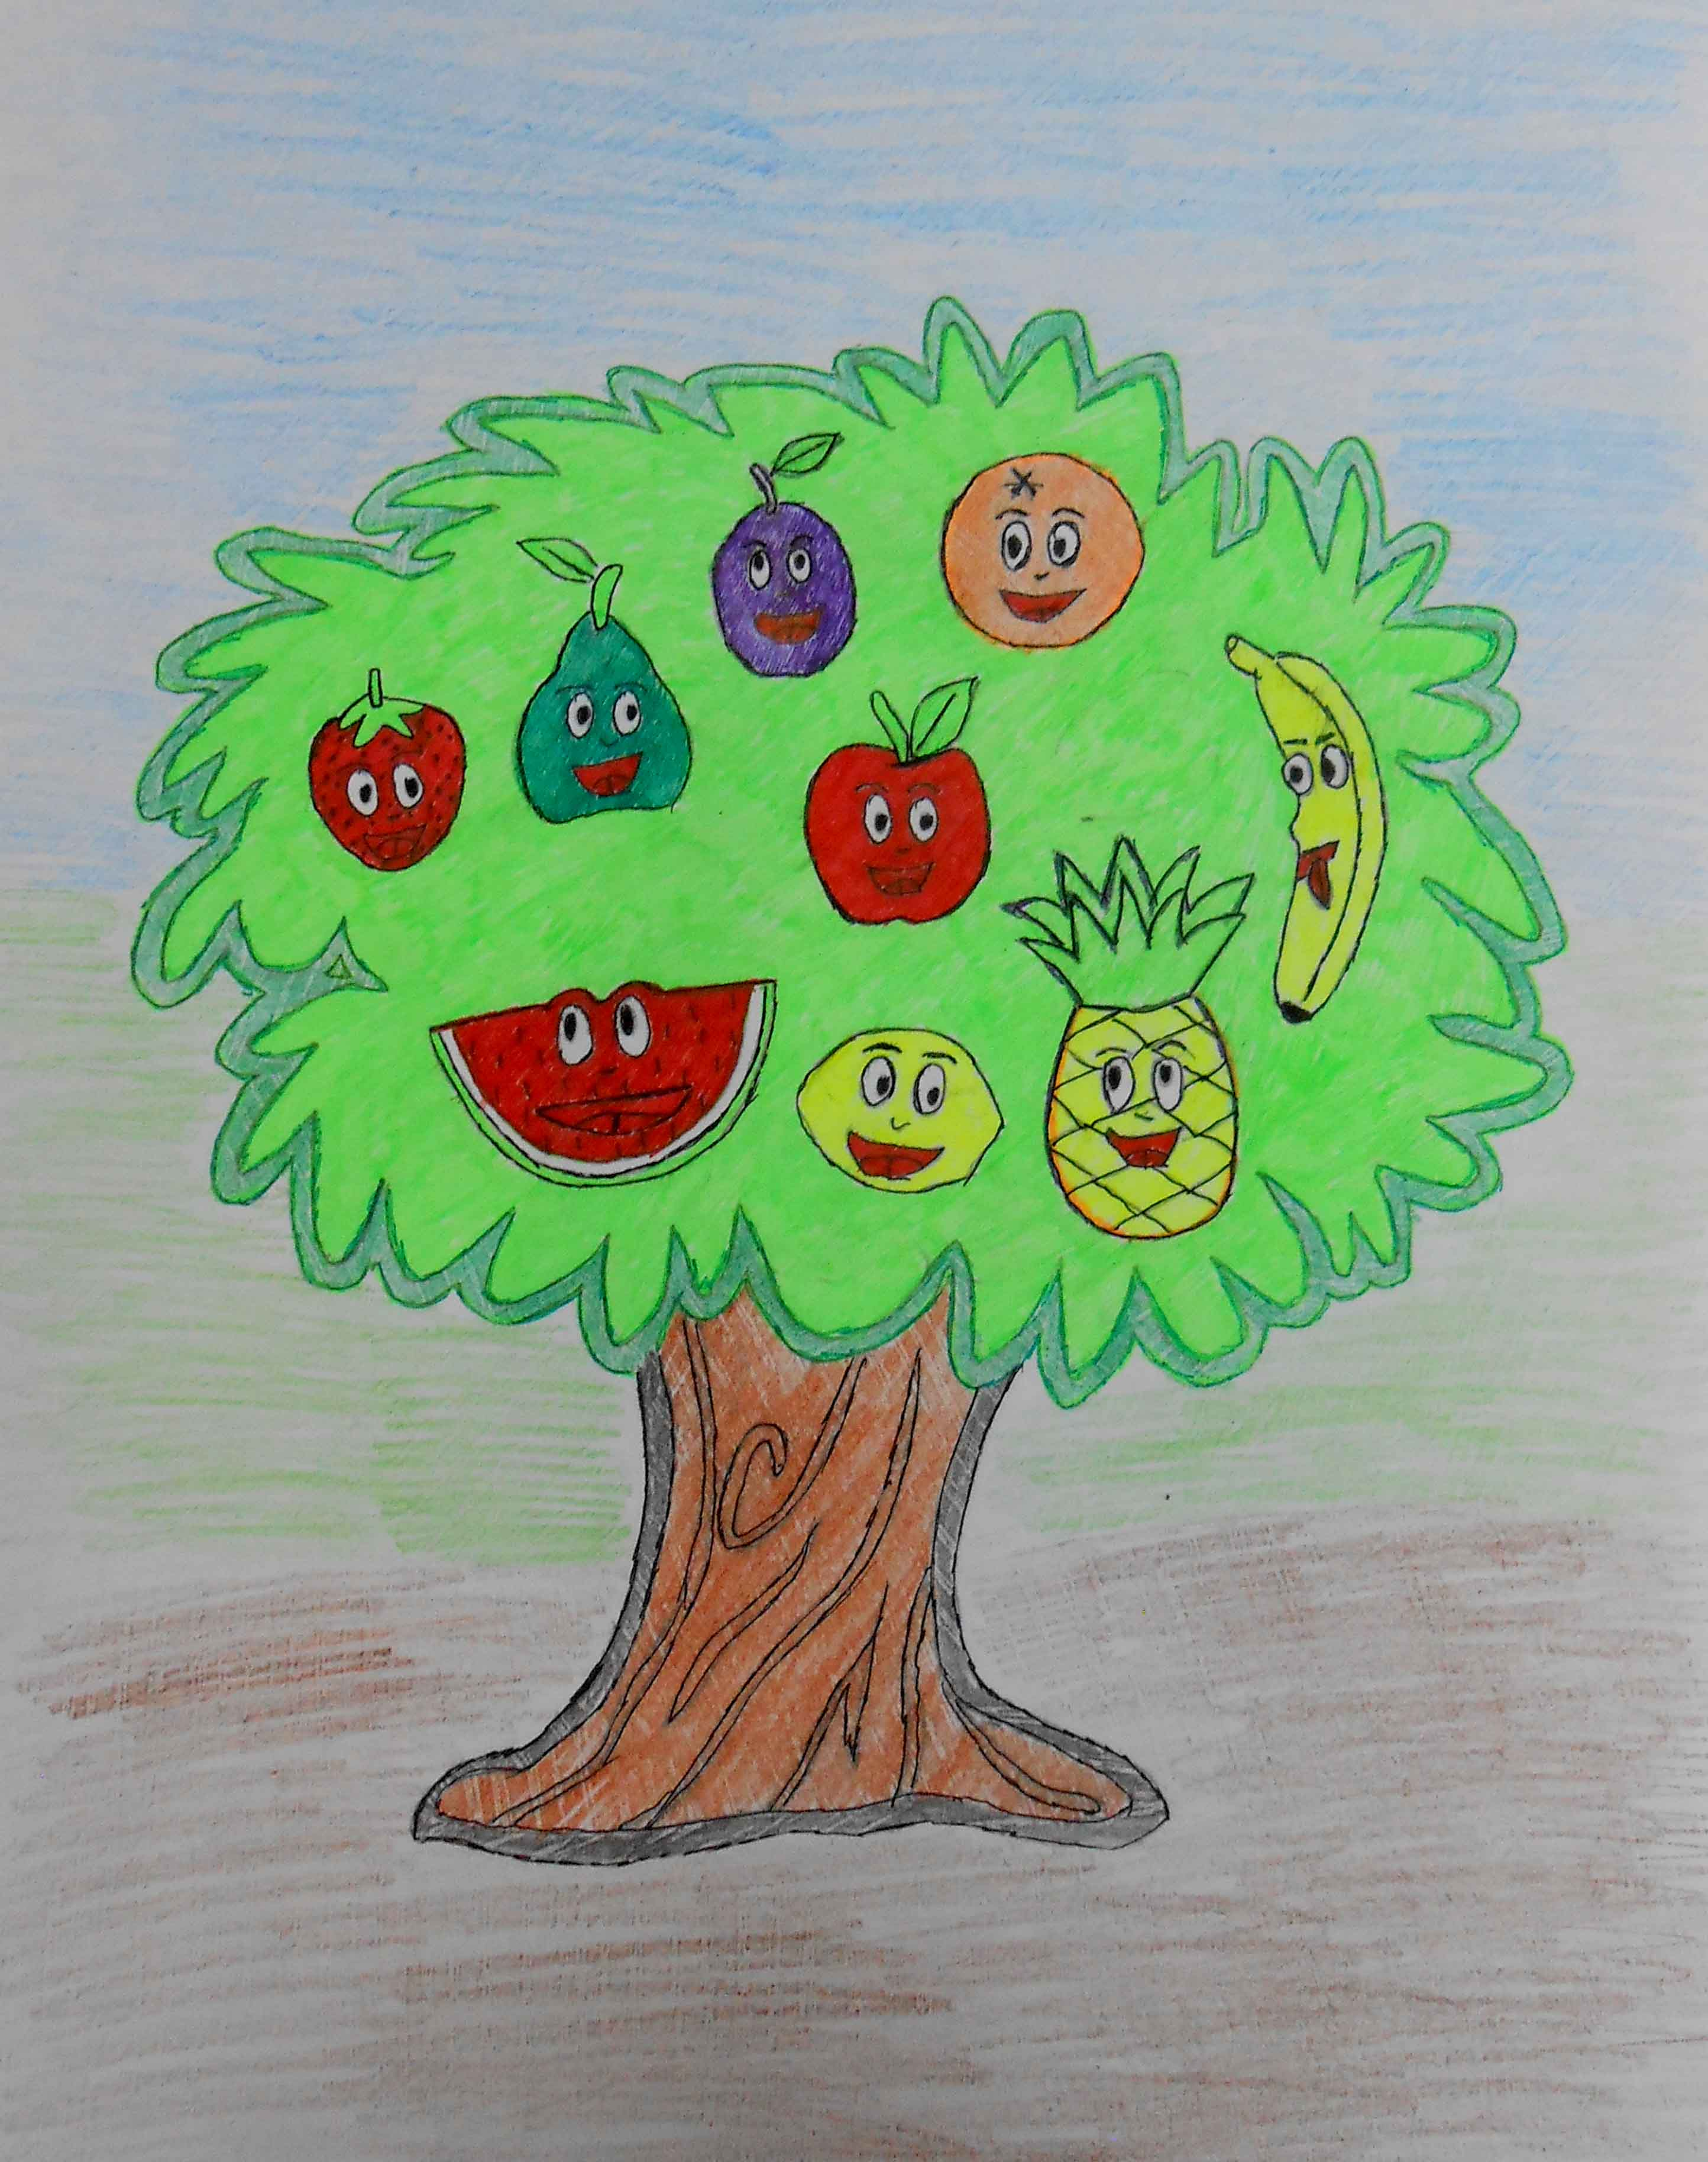
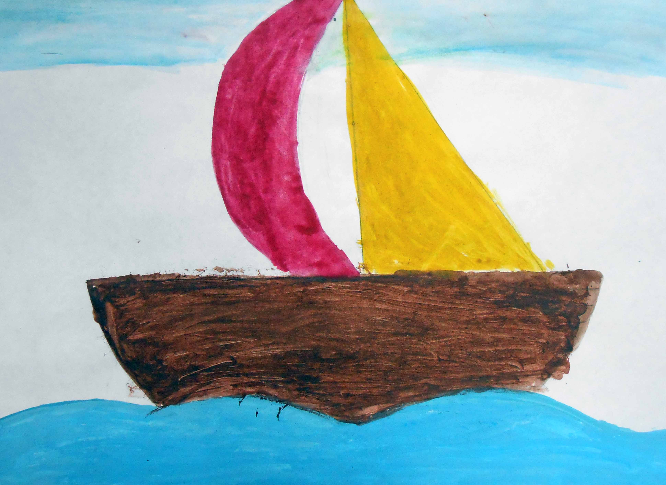
Teaching for me is like…..

Slide 8
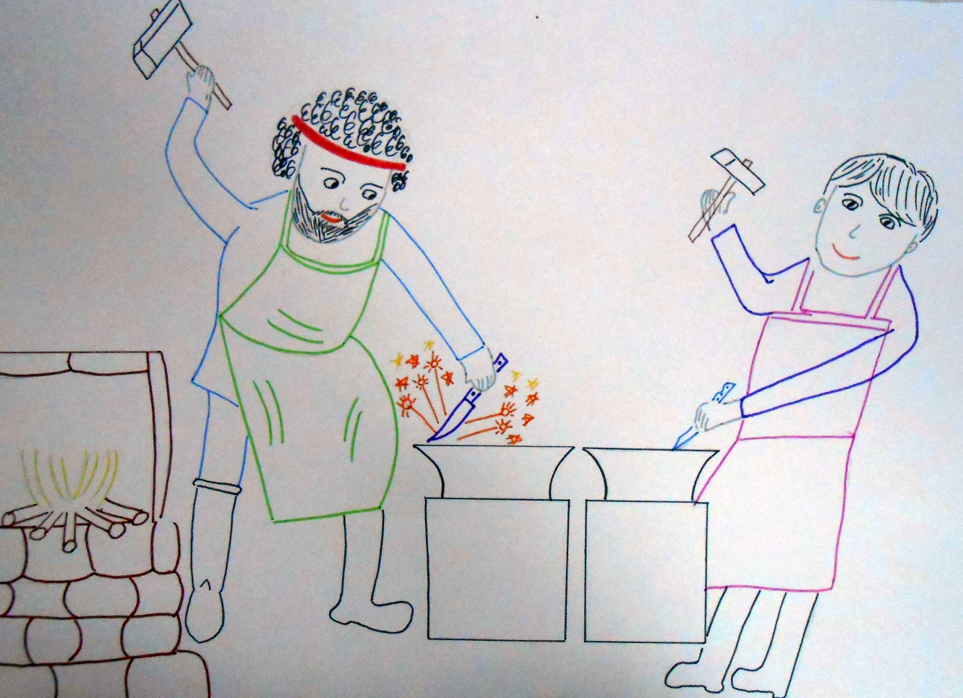

Teaching for me is like…..

Slide 9
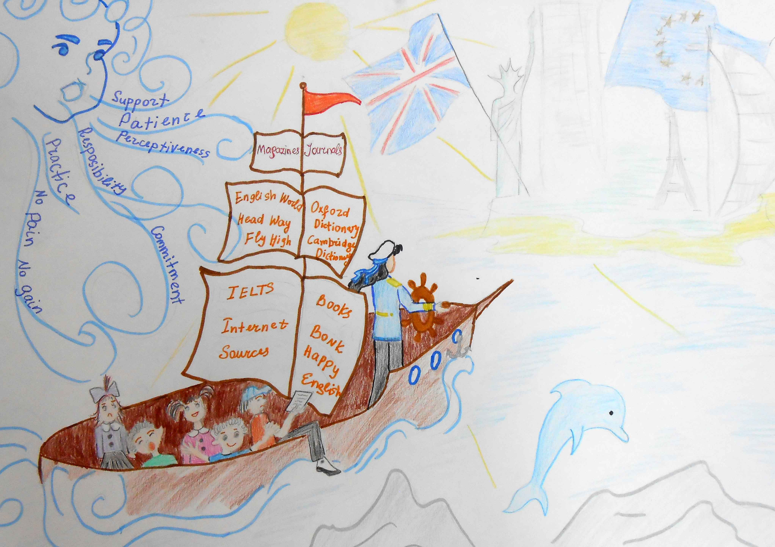
Teaching for me is like…..

Slide 10
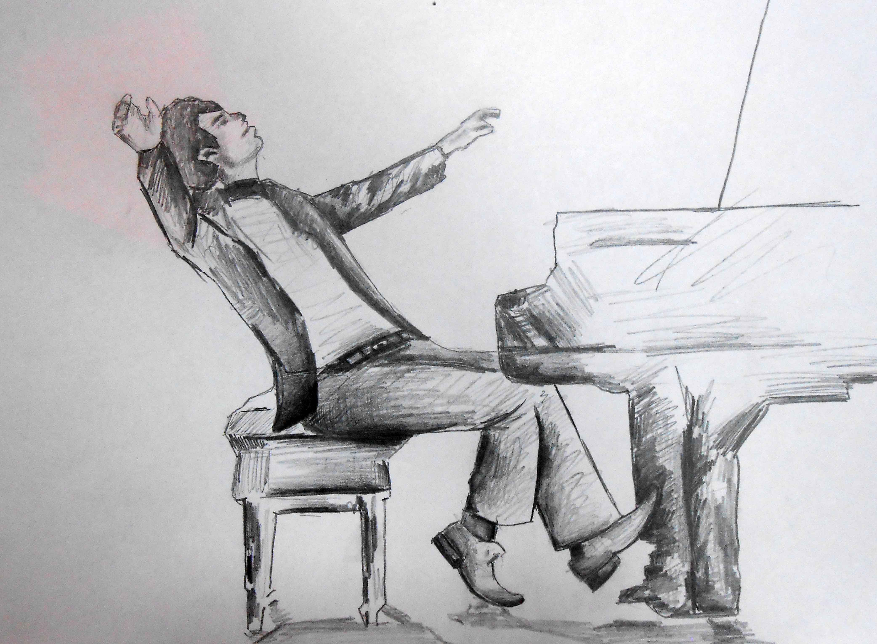
Teaching for me is like…..

Slide 11
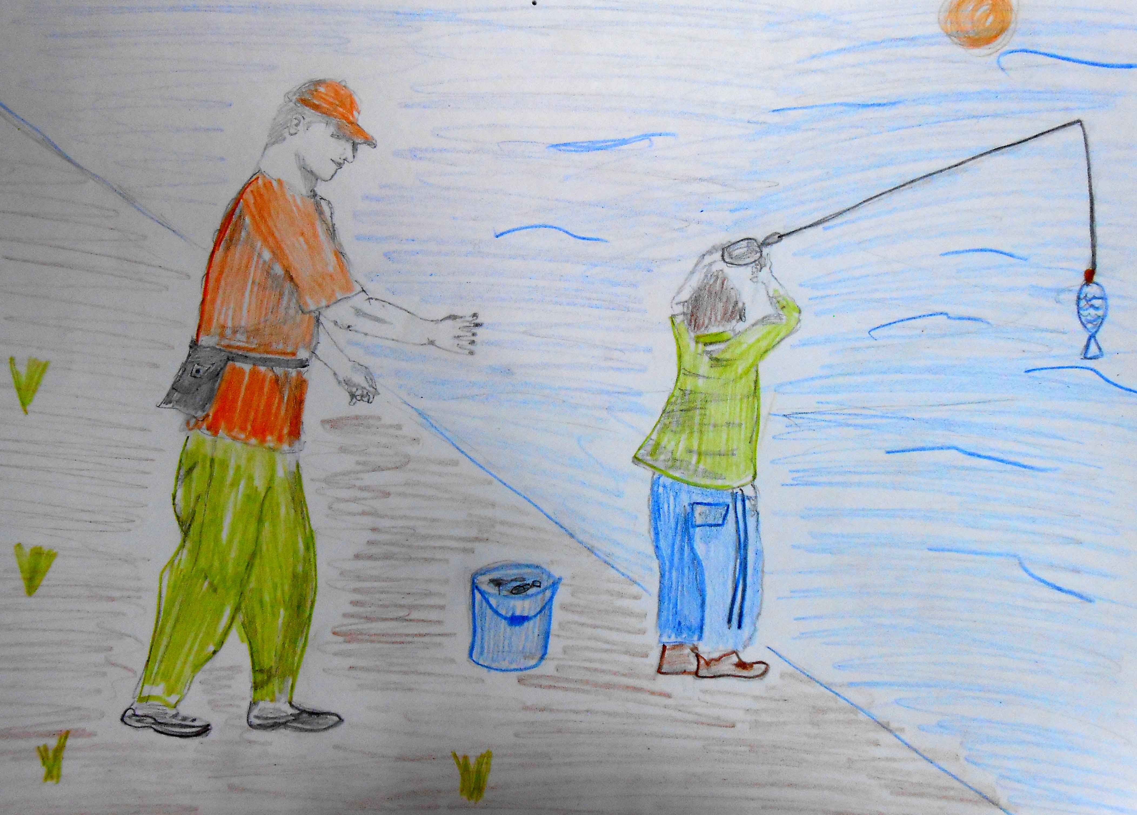

Slide 12
Next phases of learning
Students were invited to present their metaphors individually
The audience was encouraged to ask clarifying or any other questions
Once all presentations were done, students were instructed to catergorise the images and to rationalize their categorisations.
Students were given thinking questions that you can see on the following slide. Immediate reaction was sought.
In the end of the academic year students were prompted to re-examine their metaphors again.

Slide 13
Thinking questions to make reflection more appealing
Can you clearly see the teacher in your picture?
Is it a human being? Is it an object?
Is it possible to understand what role the teacher is adopting?
What is the teacher doing?
Can you clearly see students in your picture?
If there is a teacher/students, how big or small are their?
Can you see a classroom? What is the size of the class?
Where does teaching take place? What is the environment? (Indoor, outdoor, in the nature, etc.)
Is your picture colorful? What colors are used?
Does your picture show a process or a product?
Can you see any /read any emotions from the picture?
Is there the only way to learn?
Where is the teacher in the picture? (in the middle, at the back, up, down, etc.) Is he/she facing the students?
Is your picture dynamic? Does it depict the process?
How many times have you used the word “learning” when you described your picture?

Slide 14
What is the use of questions?
Making invisible visible
Making implicit more explicit

Slide 15
Advantages of using a metaphor to explore personal ideas about teaching – teacher’s view
Serves as a diagnostic tool to learn about students
Less threatening physiologically to express personal ideas
More fun
Wider pool of shared knowledge and ideas
Developing thinking outside the box
Developing noticing skills
Thinking is creative
Evaluation, synthesis and creation are being encouraged
Follows the experiential learning cycle
Allows reflection
Students centered and inclusive way of teaching

Slide 16
Advantages of using a metaphor to explore personal ideas about teaching – students’ views
Allows for creativity and more philosophical approach in explaining your vision and ideas
Brief
Visual
Helps to express the notion in a very concise way
While applying a metaphor a student gets an opportunity to analyze deeper
Motivating
It provokes a professional dialogue between a teacher and teacher trainer
Unconscious reflection
Metaphors make the classroom process closer to the life.
Helps to see the psychology and a character of students

Slide 17
Disadvantages of using a metaphor to explore personal ideas about teaching – teacher’s view
Not relevant to all learners types
Time consuming
Requires creativity
Maybe confusing
Requires a lot of individual attention to all students

Slide 18
Disadvantages of using a metaphor to explore personal ideas about teaching – students’ views
Disadvantages: if the expectations are not clearly stated, it can be a little confusing
The metaphors may be understood very differently by the rest of the students depending on their past experience, cultural background etc.
Someone who is very bad at crafts may feel disadvantageous
The task realization (how to implement all the ideas and how the metaphor is going to look at the end) may mislead the teacher from the initial idea
May be very time-consuming
It is not always possible to describe everything with a metaphor.
Students can produce very confusing metaphors

Slide 19
A quote from a student
‘At the very beginning of the course we were asked to come up with our own metaphor that described teaching and learning, and to share it with the group. The image of a wheel came to my mind in an instance. Wheel is a moving force and normally signifies progress, as well as being associated with knowledge and wisdom in many cultures.
I strongly believe in the inquiry-based learning and that knowledge can be gained from multiple sources and in various ways. Inquiry means allowing our natural curiosity to lead our learning process, and it is often the learner’s genuine interest to learn something. My metaphor suited my educational philosophy, because the wheel is round and it can be steered in different directions, making things move and work. It can symbolize the opportunity for exploring and experimenting.
However, when we reflected on our metaphors by using the questions provided by our tutor, it made us think deeper about ourselves as teachers. I answered each question on the list and I was surprised by my responses. I could not clearly see the teacher and learner on my metaphor, as well as who was in control and where was the teaching was happening.’

Slide 20
A quote from a student
At the end of the course, I easily made amendments, which were the result of my transformation and the new perspectives that I gained about teaching and learning. When I reflected on the improved metaphor, my answers to the same set of questions were changed noticeably. I had a clearer picture of my role as a facilitator and my students’ role as autonomous learners.
I added the teacher and the learner on either side of the wheel. They look as if they are rolling the wheel together, which can symbolize sharing knowledge and learning from each other. The size of the teacher and the learner is exactly the same. This shows that I do not consider myself to be more important than any of my students and I disapprove the notion of a teacher as an authority. Both the teacher and the learner are smiling, which shows that their interests are aroused. Another change that I made was adding all the important key concepts that we covered over the course that I find valuable in successful teaching and learning process. Interestingly, on the improved metaphor, the learner’s hands are pointing to the Experiential Learning Cycle, while the teacher's hands are on the word 'facilitator'.
Two words stand out in the new version of my metaphor: schemata and lifelong learners.

Slide 21
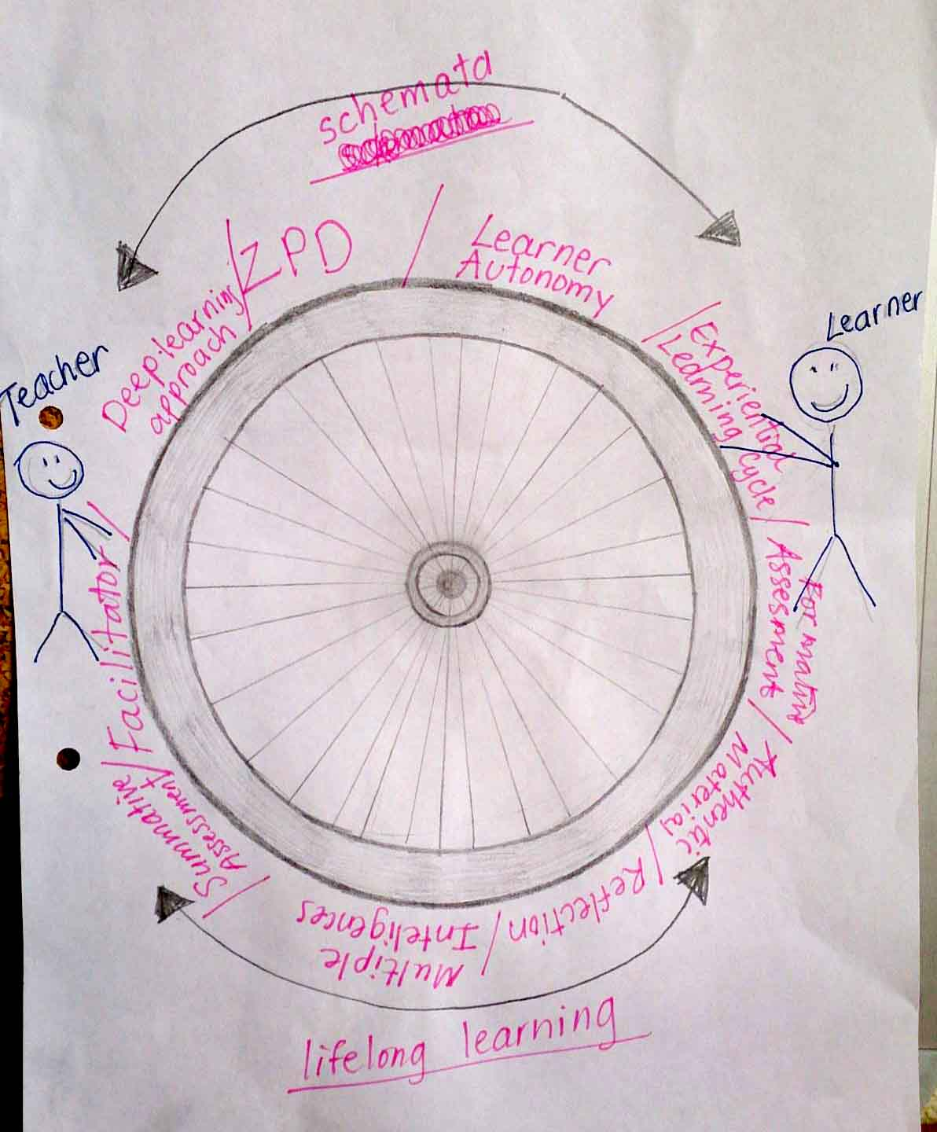
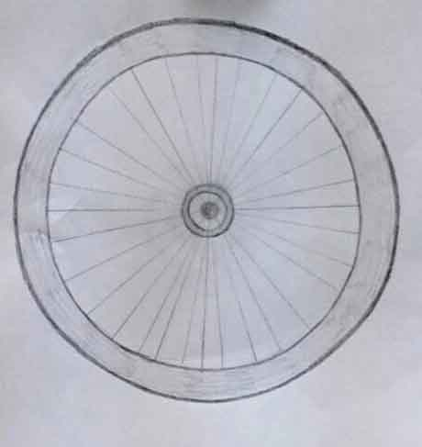

Slide 22
What could be different
Students were introduced to the word philosophy of teaching and learning through discussion
Students were asked to think about their personal philosophy beyond the classroom. Thinking questions were suggested and students were given a week.
Students were instructed to create a metaphorical picture/image of their philosophy. They had to draw/produce a collage.
Students are introduced to the word philosophy of teaching and learning through a LECTURE
Students are given examples of other colleagues’ ideas
Students are given a task to write about their philosophy.

Slide 23
Initial phases of learning
Students were invited to present their metaphors individually
The audience was encouraged to ask clarifying or any other questions
Once all presentations were done, students were instructed to catergorise the images and to rationalize their categorisations.
Students were given thinking questions that you can see on the following slide. Immediate reaction was sought.
In the end of the academic year students were prompted to re-examine their metaphors again.
Students submits their ideas in written form
There is no opportunity for interaction
Students may share their ideas in an informal way outside the class
Students are given thinking questions as a feedback
In the end of the academic year students may be prompted to re-examine their metaphors again.

