Slide 1
Theory and Practice of Supporting Learning (1) Course
Session 4
BEHAIVIORISM and
LEARNING

Slide 2
After completing this session you will be able to:
Explore and reflect on the extract from the teaching material
Get familiarized with the background of Behaviorism
Define its principles
Identify advantages and disadvantages of the learning theory
Reflect how the theory can explain some of the teachers and students actions

Slide 3
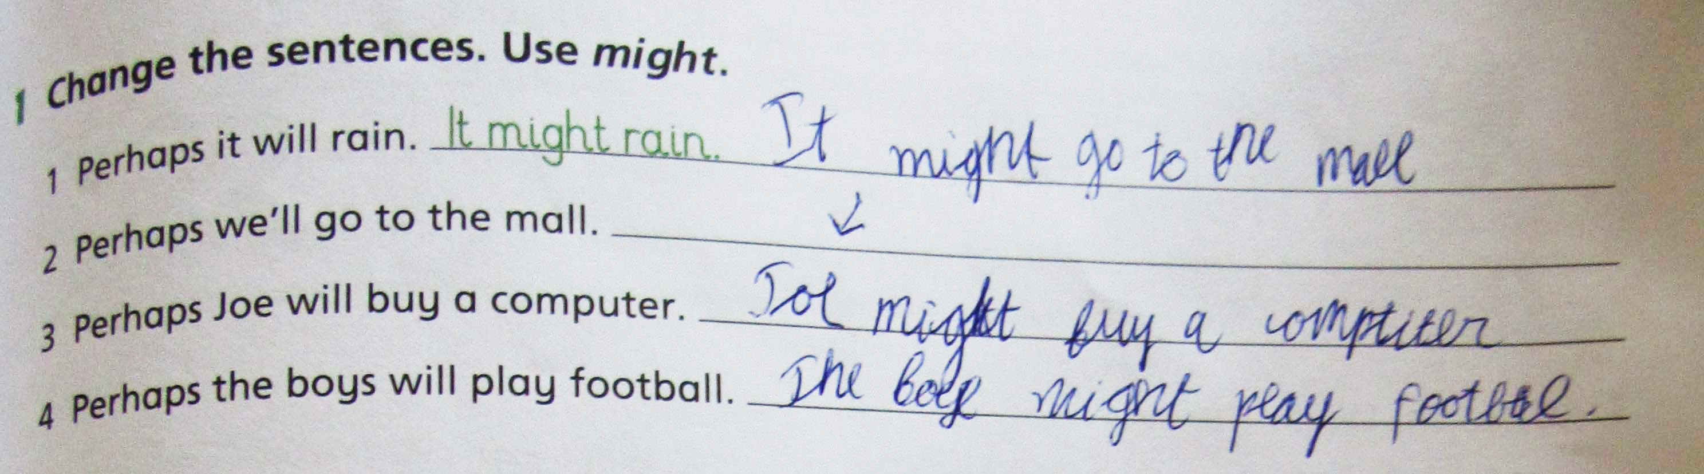
Examine the example form the student’s book

Slide 4
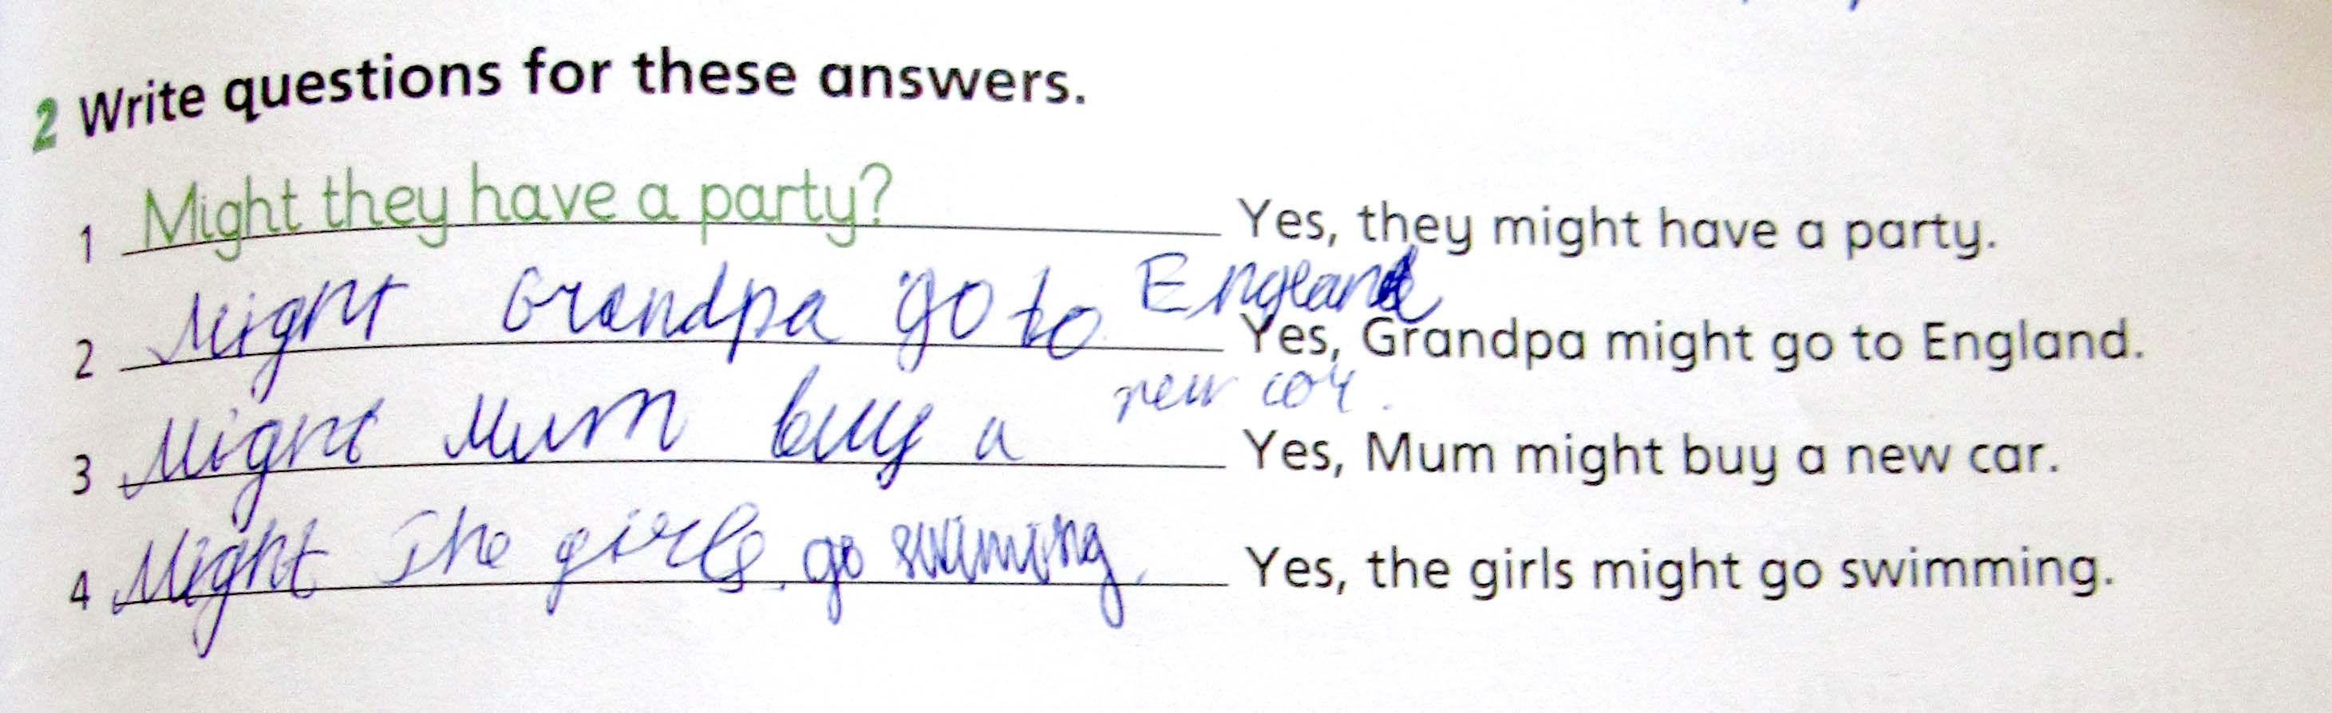

Slide 5
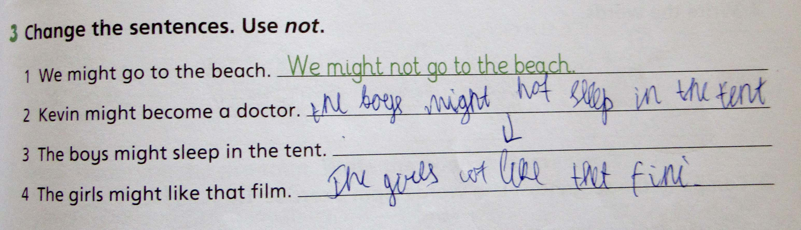

Slide 6
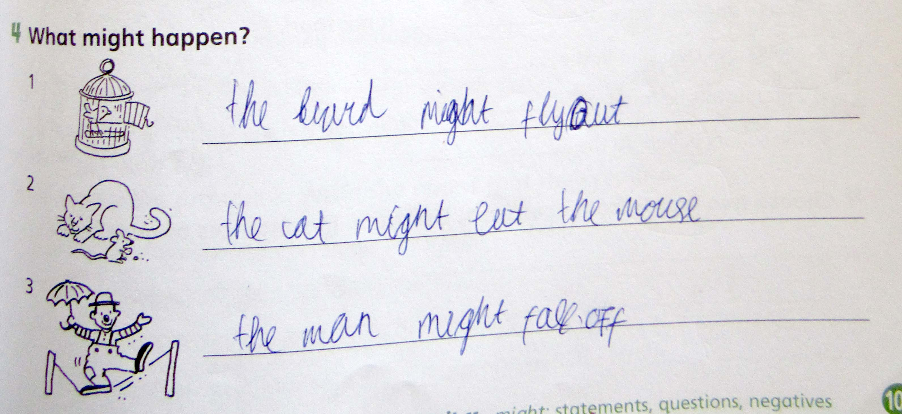

Slide 7
Can you see any specific order in these exercises?

Slide 8
The 3 of them provide an example that needs to be followed
The 4th one gives pictures that serve as stimuli

Slide 9
Behaviorism and learning
Learning is measured by new behaviors
Learning has biological basis
Learning is context-independent
Learning happens through reflexes, feedback and reinforcement
Learning is seen as linear process
Learner is passively adapting to environment

Slide 10
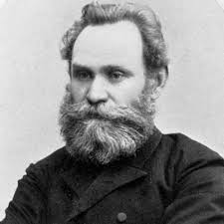
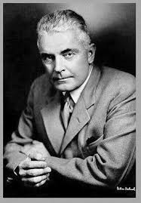
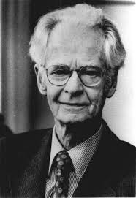
Pavlov (1849–1936)
Watson (1878-1958)
Skinner (1904-1990)

Slide 11
"Give me a dozen healthy infants, well informed, and my own specified world to bring them up in and I'll guarantee to take anyone at random and train him to become any type of specialist I might select--doctor, lawyer, artist, merchant-chief; and yes, even beggar-man and thief, regardless of his talents, penchants, tendencies, abilities, vocations, and race of his ancestors." John Watson

Slide 12

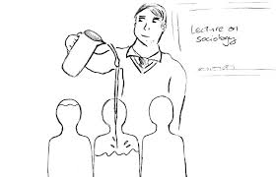
Mind of a human is a Tabula Rasa
A human is an empty vessel

Slide 13
History of Behaviorism
Dominant theory (Psychology and Learning) in the first part of the 20th century
Observation and experimentation
The "Salivation Experiment" by Ivan Pavlov
The "Skinner Box" experiment with pigeons by B.F. Skinner

Slide 14
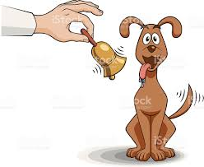
Classical conditioning (no choice on the side of the object)

Slide 15
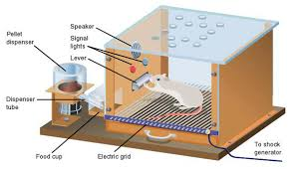
Operant conditioning – reinforcement and punishment

Slide 16
How behaviorism can be used in the class classroom
Direct instructions – making sure there is stimulus and response.
The information gets where it needs to get.
Straightforward lecturing.
Presentation-practice-production sequence.
“I do, we do, and you do” model.
Strictly controlled practice.
Goals and objectives articulated clearly.
Assessment as a stimuli.
Classroom management – rules and procedures extremely important.

Slide 17
Teachers actions
Differentiated reinforcement
Intentional ignoring
Signaling
Touch control
Rewards
Punishments

Slide 18
Avoid turning reinforcement into nagging
Remember that all f the above are short term effect

Slide 19
Punishment
Extra class or home work
Not allowing the break time
Not allowing to have a break outside the classroom
Physical punishment
Psychological punishment
Suspending the student from classroom, school

Slide 20
Behaviorism pluses and minuses
Observable behavior
Learner is actively involved and responding to stimuli
Can be very effective
Observable behavior only
Does not focus on intrinsic motivation
Does not encourage thinking

Slide 21
What behaviorism is all about
It is a study of external behavior
Behavior of a human is observable
What goes on in human’s mind can never really be known or measured
The mind is a “black box”
Behavior is the response of an organism to stimuli
Behaviourism is derived from the belief that free will is an illusion.
Human beings are shaped entirely by their external environment

Slide 22
Now it is time to watch a video and get to some reading!
Good Luck!

