Slide 1
Theory and Practice of Supporting Learning (1) Course
Session 5
COGNITIVISM and
LEARNING

Slide 2
After completing this session you will be able to:
Get familiarized with the background of cognitivism
Define its principles
Reflect how the theory can explain some of the teachers’ and students’ actions

Slide 3
Cognitivism and Learning
The “black box” of the mind should be opened and understood.
The learner is viewed as an information processor (like a computer).
Learning is measured by the processes happening in the mind
Learning has biological basis
Learning is contextualized
Learning is not always indicated by behavior

Slide 4
Learning happens through exploration
Learning is seen as a non - linear process
Learner is active
Learning is a conflict between known and unknown

Slide 5
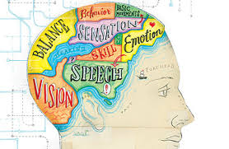
Learning is a result of internal mental activity but not from an external stimulus

Slide 6
The learner is not am empty vessel and it comes to learning situations with knowledge, skills and experiences
The role of the learner is active participation in the learning process using various strategies to process and construct their personal understandings of the content to which they are exposed

Slide 7
Learning takes a form of
Observation
Categorisation
Forming generalisations

Slide 8
Schema/Shemata

Slide 9
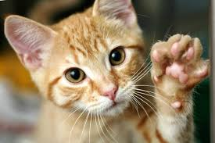
Look at the picture and jot down some notes on what you know about this animal.

Slide 10
Produce myauuu sounds
They have 4 legs
They have fur
Can be wild and domestic
Can be big or small
Can usually have 5 kittens when reproduce
Can be or different breeds and colors
They eat meat
They give allergy
They can see well

Slide 11
Relationship between humans and cats started 9.500 years ago
Outdoor cats tend to be farsighted, while most indoor cats are nearsighted.
Cats cannot recognize the sweet taste
The DNA samples from cats all over the words are collected for different purposes

Slide 12
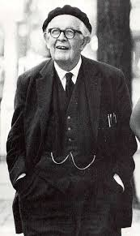
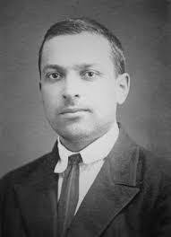
Piaget (1896–1980)
Vygotsky (1896-1934)
Bloom (1913-1999)

Slide 13


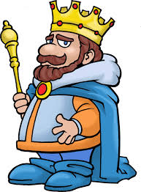
Benjamin Bloom and his taxonomy

Slide 14
Knowledge
Comprehension
Application
Analysis
Synthesis
Evaluation
King
Charles
Always
Analyses
Solar
Eclipse

Slide 15
New information is most easily acquired when people can associate it with the things they have already learned
People control their own learning
The more meaningful the information is, the easier it is learned and remembered

Slide 16
Cognitive Neuroscience
Perception
Attention
Memory
Representation of Knowledge
Imagery
Developmental Psychology
Language
Thinking and concept formation
Human intelligence
Artificial Intelligence
Pattern Recognition

Slide 17
How cognitivism can be used in the class classroom
The new knowledge and the learning process have both to be meaningful.
The information must be anchored to what is already known.
New material has to be integrated into the already studied.
Before introducing new material, a teacher must explore what students already know about it.
The tasks should be appropriate to the level of students.
Goals and objectives articulated clearly.

Slide 18
Teachers actions
Lecturing should be decreased
Students should be involved into the process
Students learning styles have to be taken into consideration
Teachers must know where the starting point of learning is
Teachers must consider the cognitive challenge that is given to students
Teachers must allow enough time for processing
Teachers must provide scaffolding
Teachers should employ teaching techniques that promote learning (mind maps, metaphors)

Slide 19
Cognitivism BUTs
Requires specific knowledge on the side of the teacher
Planning for learning take more time
Difficult to employ cognitivist techniques in a big classroom as conginitivism prompts to appeal to individual learners

Slide 20
Final thoughts
People can have control over what they are learning and thus students should be given opportunities to decide for themselves. They do not need stimuli.
People organize what they learn
Technology can assist learning
Students who do not do good have not developed personal strategies
Students’ schemata should be activated for learning to happen

Slide 21
Now it is time to watch a video and get to some reading!
Good Luck!

