Slide 1
Theory and Practice of Supporting Learning (1) Course
Session 7
Multiple Intelligences -
Empowering different learners

Slide 2
After completing this session you will be able to:
Get to know about Howard Gardner
Get familiarized with the background of Multiple Intelligences
Define 8 Intelligences
Reflect how the theory can be helpful for teachers and students
Learn about Howard Gardner's personal reflection on th etheory and its implementation

Slide 3
"I am 100% convinced that if I were to come back to Earth in 50 years, people would laugh at the idea of uniform education.” -Howard Gardner

Slide 4
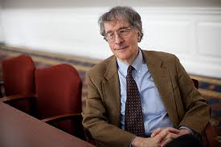
The biggest mistake of past centuries in teaching has been to treat all students as if they were variants of the same individuals and to feel justified in teaching them all in the same subjects in the same way.

Slide 5
Howard Earl Gardner (born July 11, 1943) is an American psychologist and Professor of Cognition and Education at the Harvard Graduate School of Education
Senior director of Harvard Project Zero
Co-director of the Good Project
Author of hundreds of research articles and thirty books

Slide 6
Reasoning Behind Gardner’s Theory
“Individuals should be encouraged to use their preferred intelligences in learning.”
“Instructional activities should appeal to different forms of intelligence.”
“Assessment of learning should measure multiple forms of intelligence.”

Slide 7
What is an intelligence?
Special talent?
Ability?
Capacity?
Domain?
Learning style?
The way you process information?

Slide 8
We are all smart
We are smart in different ways
One way is not better than the other

Slide 9
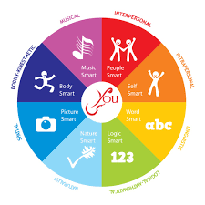

Slide 10
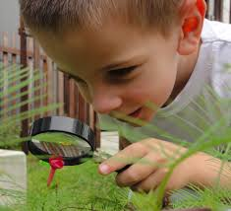
Naturalist Learners (the new intelligence)
Sensitive to patterns in and connecting to nature
Especially like animals and natural phenomena
Suggestions for Teachers: Be aware to changes in even minute details of the classroom environment, bring the outdoors in

Slide 11
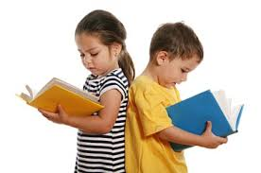
Verbal-Linguistic Learners
Sensitive to meanings, sounds and rhythms of words
Especially like storytelling and creative writing
Suggestions for Teachers: activities such as dialogue writing, books on tape, word processing, newspaper activities, etc.

Slide 12
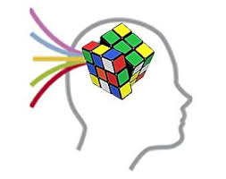
Logical-Mathematical Learners
Sensitive to order and sequence
Especially like problem solving, noting and creating patterns and experiments
Suggestions for Teachers: use of graphic organizers, showing relationships, computer instruction, syllogism, etc.

Slide 13
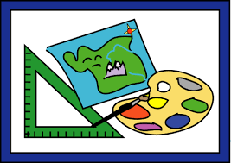
Visual-Spatial Learners
Sensitive to visual cues and images
Especially like day-dreaming and art
Suggestions for Teachers: using color, mind-mapping, manipulatives, etc.

Slide 14

Body-Kinesthetic Learners
Sensitive to activity, athletics and physical gestures while talking
Especially like role-playing, touching and feeling
Suggestions for Teachers: hands-on activities, manipulatives, use of textures, etc.

Slide 15

Musical-Rhythmic Learners
Sensitive to singing, playing instruments, drumming
Especially like the human voice, sounds from nature, instrumental music
Suggestions for Teachers: vary voice pitch during instruction, play music in the classroom, watch surrounding sounds for possible interference

Slide 16

Interpersonal Learners
Sensitive to leadership opportunities, others’ feelings; “street smart”
Especially like helping others, peer tutoring, working cooperatively
Suggestions for teachers: group work, discussions, skits, etc.

Slide 17

Intrapersonal Learners
Sensitive to their own feelings, personal motivation
Especially like day-dreaming, working alone; “march to the beat of a different drummer”
Suggestions for Teachers: designate quiet areas, independent practice, journals, etc.

Slide 18
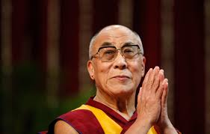
Interesting combinations

Slide 19
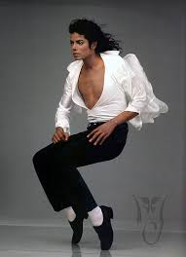

Slide 20
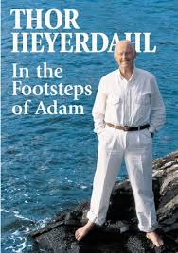

Slide 21
Why the Attraction for Educators
Helps to create more personalized lessons
Helps “explain and promote understanding” (Owen)
Helps promote self-motivation in students because learning is based on innate talents
Validates teacher insights into their students
        (Gardner)

Slide 22
“Successful education does not require covering everything ‘from Plato to NATO.’ In fact, the greatest enemy of understanding is coverage. If we try to cover everything, by the end of the day people will have learned very little and will have understood nothing. As a teacher, ask yourself, ‘If I had one hour (per semester) to teach students, what would I teach them?’”

Slide 23
Now it is time to watch a video and get to some reading!
Good Luck!

