Slide 1
Theory and Practice of Supporting Learning (1) Course
Session 8
Deep and surface approaches to learning and
Bloom’s Taxonomy

Slide 2
After completing this session you will be able to:
Get familiarized with the background of Deep and Surface approaches to learning
Define the characteristics and principles of Deep and Surface Approaches to Learning
Get familiarized with the background of Bloom’s Taxonomy and identify how the taxonomy can help in differentiating between deep and surface approaches
Identify advantages of adopting a deeper approach to learning (for a learner)
Identify some teaching strategies to encourage deeper approach to learning

Slide 3

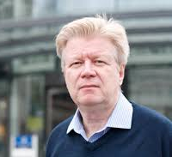
Ference Marton and Roger Saljo

Slide 4
Deep and Surface approaches to learning 1976
Experiments with volunteer students who read academic texts in artificial settings
Levels of processing adopted
On qualitative differences in learning: Outcome and process – sited in 3764 publications and a major contribution to understanding students learning in higher education

Slide 5
Text as a collection of discrete untints of information that should be memorized
________________________________
Text as something that contains a structure of meaning with underlying concerns, implications, meaning to themselves.

Slide 6
Students who are adopting deep approaches tend to have higher quality learning outcomes

Slide 7
What is the major difference?
Deep approach is about knowledge transforming
  An intention to understand material to oneself
  Vigorous and critical interaction with knowledge content
  Relating ideas to one’s previous knowledge and experience
  Discovering and using organizing principle to integrate ideas
  Relating evidence to conclusions
  Examining the logic of arguments
Surface approach is about information reproducing
  An intention to reproduce the parts of the content
  Ideas and information is accepted passively
  Concentrating only on what is required by the assessment
  Not reflecting on purpose and strategies
  Memorirsing facts and procedures routinely
  Failing to distinguish guiding principles or patterns

Slide 8
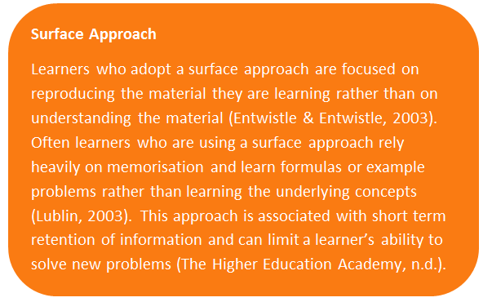

Slide 9
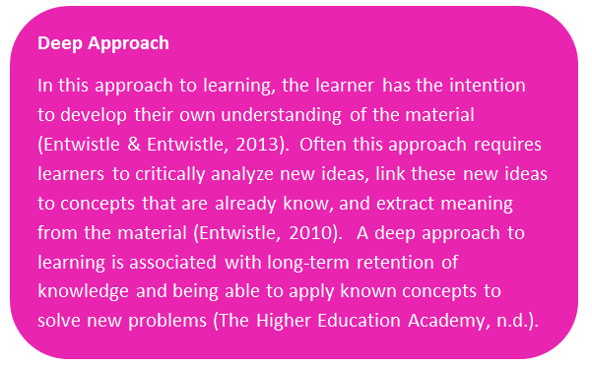

Slide 10
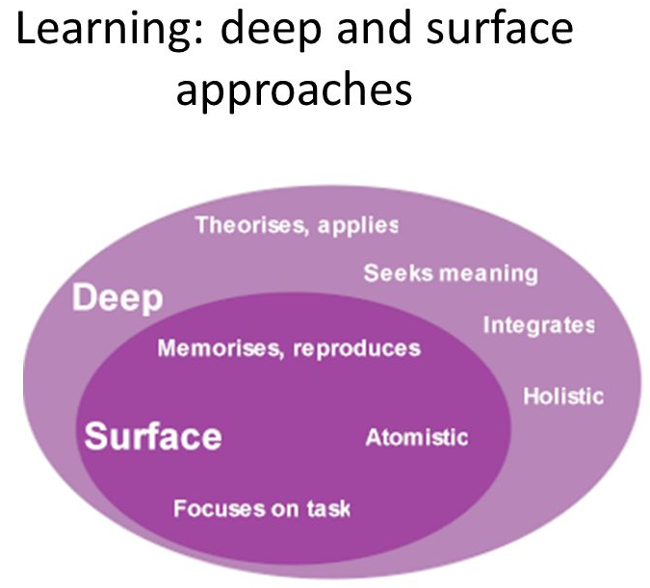

Slide 11
Students’ study activity is not resulting from them being highly motivated or lazy
Students’ study activity is the outcome of interaction between the students and his environment

Slide 12
Three points about deep and surface approach to learning
Number 1
Deep or surface approach are not personal traits or fixed learning style
Students adopt an approach related to the perception of the task

Slide 13
Three points about deep and surface approach to learning
Number 2
Memorisation can be a feature of both surface and deep approaches to learning but it plays completely different role in each

Slide 14
Three points about deep and surface approach to learning
Number 3
The surface approach and the deep approach are the manifestation that the student possesses.

Slide 15
How Bloom’s Taxonomy can be helpful

Slide 16
What is taxonomy?
Taxonomy of Cognitive Objectives
1950s- developed by Benjamin Bloom
Means of expressing qualitatively different kinds of thinking
Adapted for classroom use as a planning tool
Continues to be one of the most universally applied models
Provides a way to organise thinking skills into six levels, from the most basic to the higher order levels of thinking

Slide 17
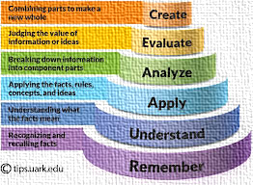

Slide 18
Evaluation
Synthesis
Analysis
Application
Comprehension
Knowledge
Creating
Evaluating
Analysing
Applying
Understanding
Remembering

Slide 19
Summary of changes
From noun to verb
Taxonomy reflects different forms of thinking (active process verbs)
Knowledge as a product of thinking was replaced with remembering instead.
Comprehension became understanding
Synthesis was renamed creating

Slide 20
Remembering
Recognising
Listing
Describing
Identifying
Retrieving
Naming
Locating
Finding
Listing
Memorising
Relating
Showing
Giving examples
Reproducing
Quoting
Repeating
Labeling
Recalling
Knowing
Grouping
Reading
Writing
Outlining
Locating

Slide 21
Classroom Roles for Remembering
Teacher roles
Directs
Tells
Shows
Examines
Questions
Evaluates
Student roles
Responds
Absorbs
Remembers
Recognises
Memorises
Defines
Describes
Retells
Passive recipient

Slide 22
Remembering: Potential Activities and Products
Listing the main events/facts of a story/text
Making a time line of activities
Making a concept map of the topic
Listing keywords about….

Slide 23
Understanding
  Interpreting
  Exemplifying
  Summarising
  Inferring
  Paraphrasing
  Classifying
  Comparing
  Explaining

Slide 24
Classroom Roles for Understanding
Teacher roles
Demonstrates
Listens
Questions
Compares
Contrasts
Examines
Student roles
Explains
Describes
Outlines
Restates
Translates
Demonstrates
Interprets
Active participant

Slide 25
Understanding: Potential Activities and Products
Write/summarise in your own words…
Illustrate a particular event in the story
Report to the class…
Write a brief outline to explain this story/text to someone else
Explain how the characters solved the problem in the particular way
Write a summary report of the event

Slide 26
Applying
  Implementing
  Carrying out
  Using
  Executing

Slide 27
Classroom Roles for Applying
Teacher roles
Shows
Facilitates
Observes
Evaluates
Organises
Questions
Student roles
Solves problems
Demonstrates use of knowledge
Calculates
Compiles
Completes
Illustrates
Constructs
Active participant

Slide 28
Applying: Potential Activities and Products
Construct a model to demonstrate how it looks or works
Explain why certain things are done in certain manner
Correct the mistakes
Write a case of your own
Solve a problem

Slide 29
Analysing
  Comparing
  Organising
  Deconstructing
  Attributing
  Outlining
  Finding
  Structuring
  Integrating

Slide 30
Classroom Roles for Analysing
Teacher roles
Probes
Guides
Observes
Evaluates
Acts as a resource
Questions
Organises
Dissects
Student roles
Discusses
Uncovers
Argues
Debates
Thinks deeply
Tests
Examines
Questions
Calculates
Investigates
Inquires
Active participant

Slide 31
Analysing: Potential Activities and Products
Use a Venn Diagram to show how two topics are the same and different
Survey classmates to find out what they think about a particular topic. Analyse the results.
Make a flow chart to show the critical stages.
Classify
Construct a graph to illustrate selected information.
Devise a roleplay about the study area.
Prepare a report about the area of study.
Conduct an investigation to produce information to support a view.
Review a work of art in terms of form, colour and texture.
Complete a Decision Making Matrix/SWOT analysis/etc

Slide 32
Evaluating
  Checking
  Hypothesising
  Critiquing
  Experimenting
  Judging
  Testing
  Detecting
  Monitoring

Slide 33
Classroom Roles for Evaluating
Teacher roles
Clarifies
Accepts
Guides
Student roles
Judges
Disputes
Compares
Critiques
Questions
Argues
Assesses
Decides
Selects
Justifies
Active participant

Slide 34
Evaluating: Potential Activities and Products
Write a letter to the editor
Prepare and conduct a debate
Prepare a list of criteria to judge…
Write a persuasive speech arguing for/against…
Make a booklet about five rules you see as important. Convince others.
Form a panel to discuss viewpoints on….
Write a letter to. ..advising on changes needed.
Prepare a case to present your view about...
Evaluate the character’s actions in the story

Slide 35
Creating
  Designing
  Constructing
  Planning
  Producing
  Inventing
  Devising
  Making

Slide 36
Classroom Roles for Creating
Teacher roles
Facilitates
Extends
Reflects
Analyses
Evaluates
Student roles
Designs
Formulates
Plans
Takes risks
Modifies
Creates
Proposes
Active participant

Slide 37
Creating: Potential Activities and Products
Create a new product. Give it a name and plan a marketing campaign.
Write about your feelings in relation to...
Write a TV show play, puppet show, role play, song or pantomime about..
Design a new monetary system
Develop a menu for a new restaurant using a variety of healthy foods
Design a record, book or magazine cover for...
Sell an idea
Devise a way to...
Make up a new language and use it in an example
Write a jingle to advertise a new product.

Slide 38
Now it is time to watch a video and get to some reading!
Good Luck!

