Slide 1
Theory and Practice of Supporting Learning (1) Course
Session 12
Teaching skills – questioning

Slide 2
After completing this session you will be able to:
Recall the Bloom’s Taxonomy
Get to know some questions that can be used to encourage students thinking process
Discuss an example

Slide 3
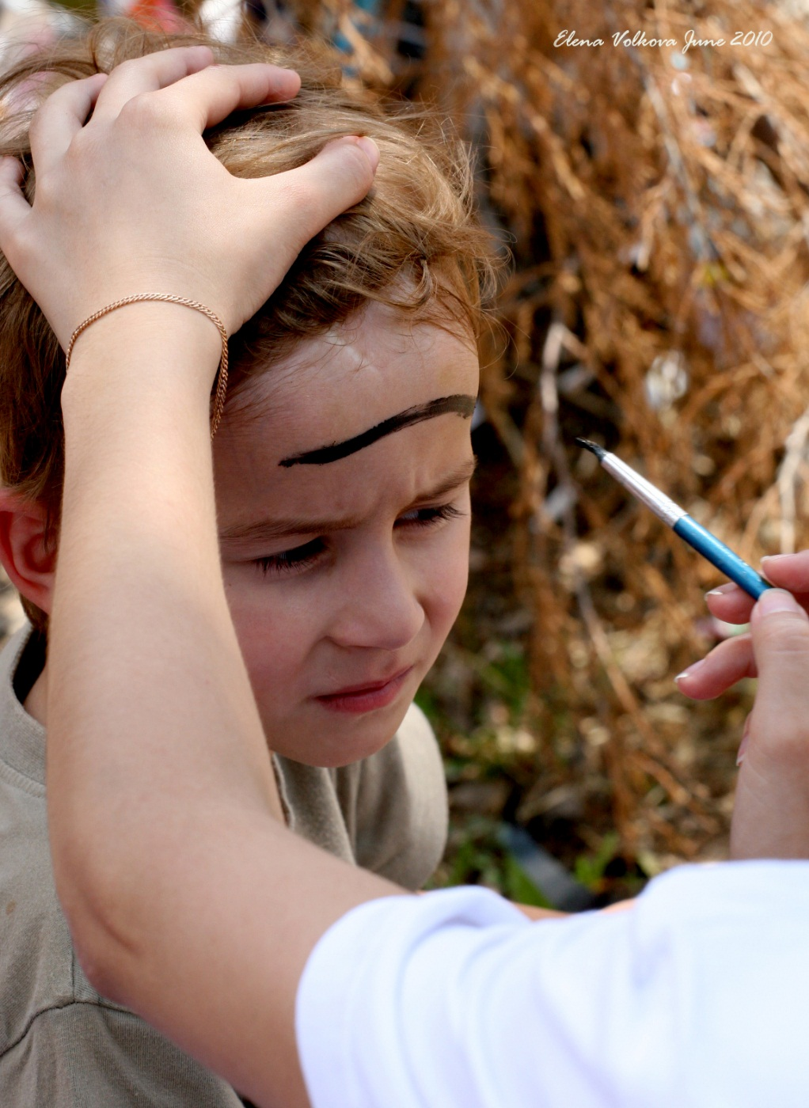
Task
In your copy book, formulate 10 questions about this picture

Slide 4

First set of questions
How many people can you see in the picture?
What is a person doing to a boy?
Where is this happening?
What color is the line of paint on the boy’s face?
What is the boy wearing?
Can you see other people in the picture?
What season is it?
Is the boy happy?
What can you see on the background?
What color is the brush?

Slide 5
Second set of questions
What do you see in the picture?
Why do you think somebody is painting the boy’s face?
Have you ever had similar experience? On what occasion?
What do you think the boy is thinking about?
How does he feel?
What do you think he will look like when the painter finishes?
How long do you think it will take to finish the painting?
How long do you think the paint will last?
How much do you think it costs to get your face painted?
Would you like to get your face painted? Why yes? Why no?

Slide 6
Difference between first and second set
Requiring:
More thinking time
More analytical ability
Reference to previous experience
Evaluating existing knowledge
Extrapolating
Synthesizing
Making predictions

Slide 7
A good teacher makes you think even when you don’t want to.

Slide 8
Questions and their role in the learning process
Before you start introducing anything new to your students, ask no less than two questions
      What they know already
      What else they want to learn
Ask questions elegantly
Make students ask each other
Make students Ask themselves
Vary the level of questions
Usually, move from simple to more complex

Slide 9
Remember
Understand
Apply
Analyse
Evaluate
Create
Simple
Lower order thinking skills
LOTS
Complex
Higher order thinking skills
HOTS

Slide 10
Simple questions
Remembering, understanding and lower level application levels of the taxonomy.
Usually questions at the lower levels are appropriate for:
    Evaluating students’ preparation and comprehension
    Diagnosing students’ strengths and weaknesses
    Reviewing and/or summarising content

Slide 11
Complex questions
Complex application, analysis, evaluation or creation skills
Questions at higher levels of the taxonomy are usually most appropriate for:
    Encouraging students to think more deeply and critically
    Problem solving
    Encouraging discussions
    Stimulating students to seek information on their own

Slide 12
Remembering
What happened after...?
How many...?
What is...?
Who was it that...?
Can you name ...?
Find the definition of…
Describe what happened after…
Who spoke to...?
Which is true or false...?

Slide 13
Questions for Understanding
Can you explain why…?
Can you write in your own words?
How would you explain…?
Can you write a brief outline...?
What do you think could have happened next...?
Who do you think...?
What was the main idea...?
Can you clarify…?
Can you illustrate…?
Does everyone act in the way that …….. does?

Slide 14
Questions for Applying
Do you know of another instance where…?
Can you group by characteristics such as…?
Which factors would you change if…?
What questions would you ask of…?
From the information given, can you develop a set of instructions about…?

Slide 15
Question for Analysing
Which events could not have happened?
If. ..happened, what might the ending have been?
How is...similar to...?
What do you see as other possible outcomes?
Why did...changes occur?
Can you explain what must have happened when...?
What are some or the problems of...?
Can you distinguish between...?
What were some of the motives behind..?
What was the turning point?
What was the problem with...?

Slide 16
Questions for Evaluating
Is there a better solution to...?
Judge the value of... What do you think about...?
Can you defend your position about...?
Do you think...is a good or bad thing?
How would you have handled...?
What changes to.. would you recommend?
Do you believe...? How would you feel if. ..?
How effective are. ..?
What are the consequences..?
What influence will....have on our lives?
What are the pros and cons of....?
Why is ....of value?
What are the alternatives?
Who will gain & who will loose?

Slide 17
Questions for Creating
Can you design a...to...?
Can you see a possible solution to...?
If you had access to all resources, how would you deal with...?
Why don't you devise your own way to...?
What would happen if ...?
How many ways can you...?
Can you create new and unusual uses for...?
Can you develop a proposal which would...?

Slide 18
Now it is time to watch a video and get to some reading!
Good Luck!

